Slide 1
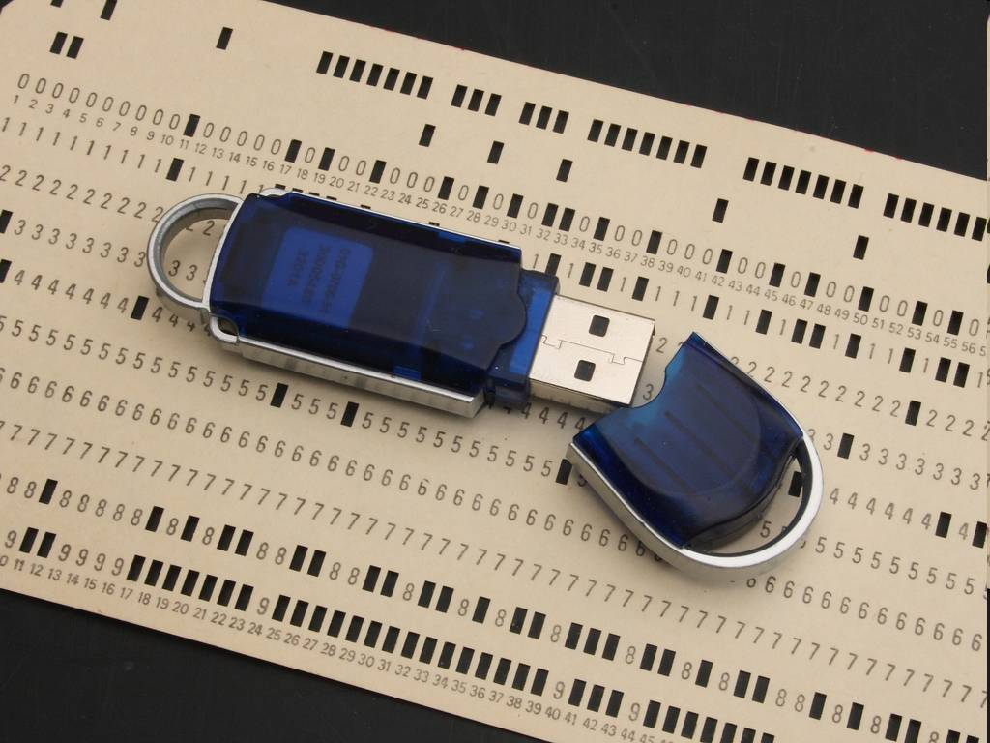
“Data, Data, Data… Watson, I need Data!”
CS180: Intro to Computer Vision & Comp. Photography
Efros & Ng, UC Berkeley, Fall 2026

Slide 2
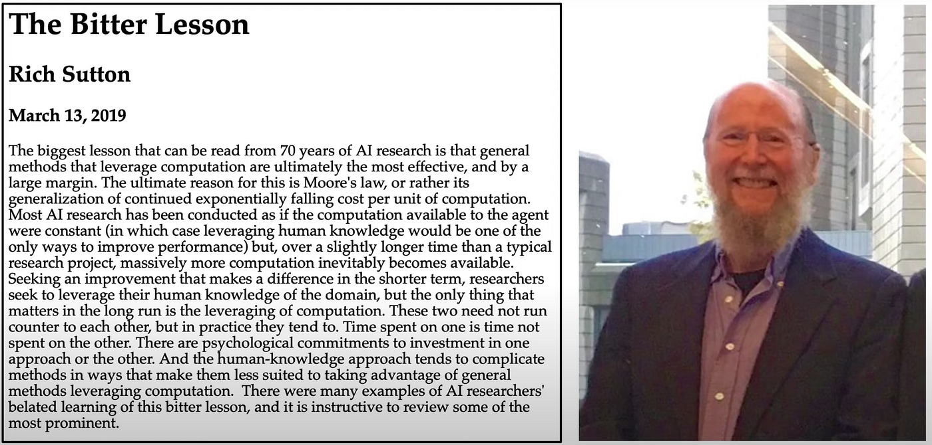
My issues with “The Bitter Lesson”?
Is it actually bitter?
Is it even the right lesson?

Slide 3
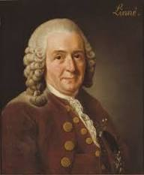
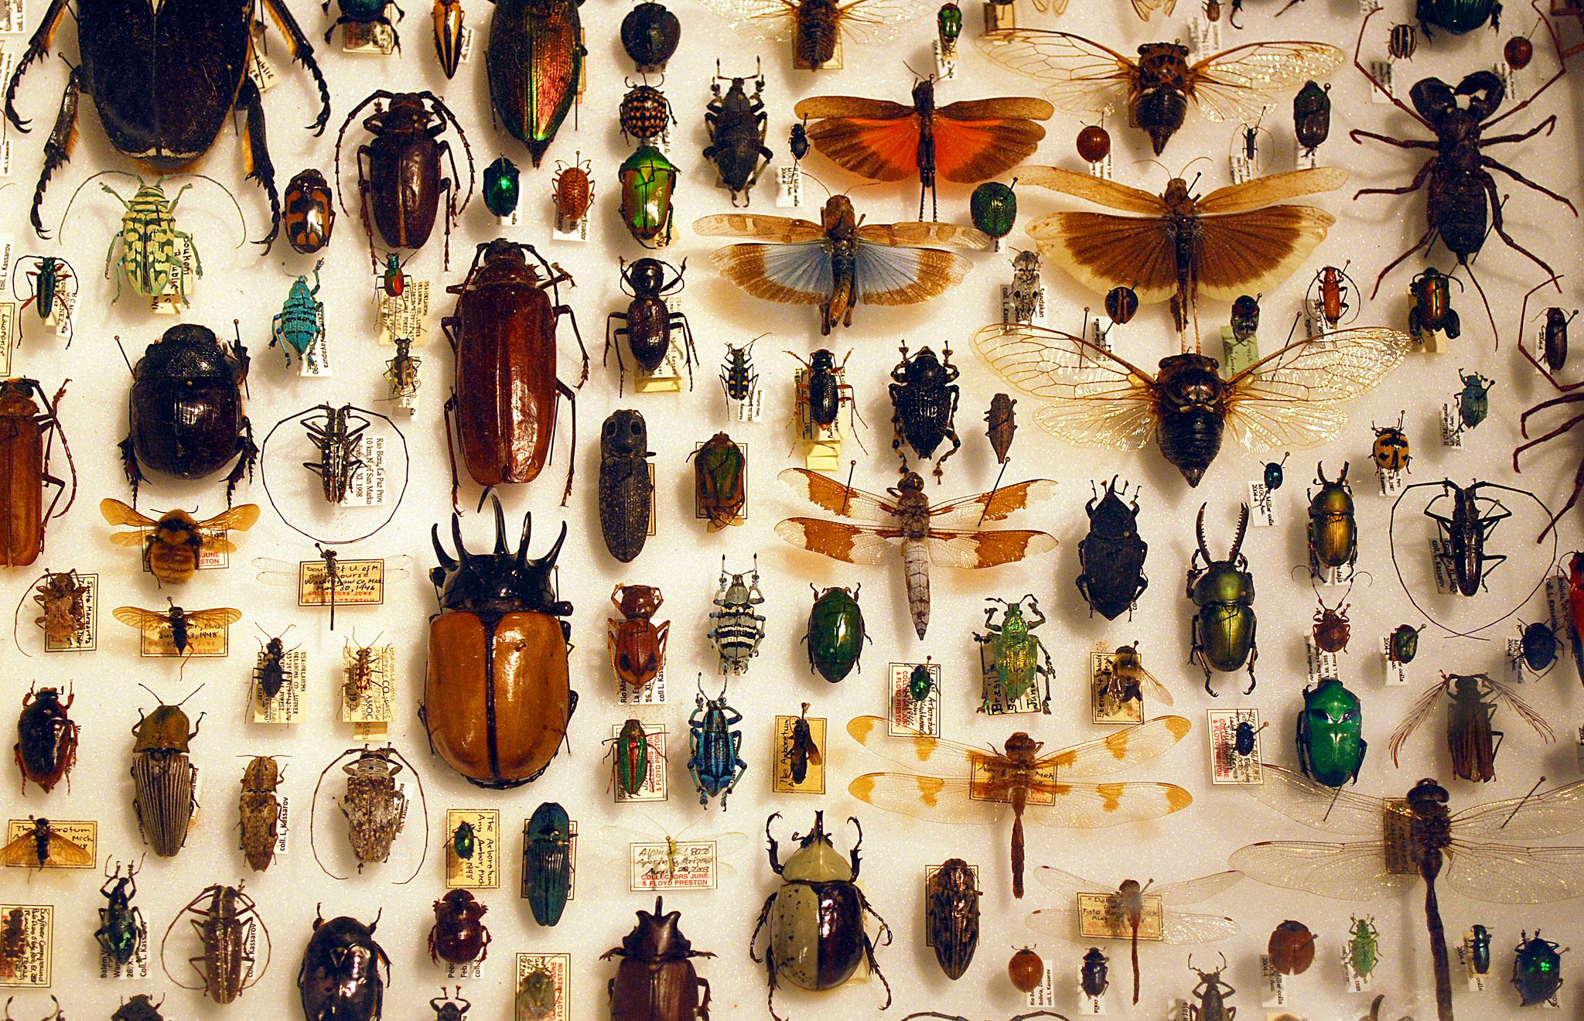
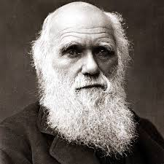
Biology’s Bitter Lesson?
Infinite complexity
Everything is simple,
once you go meta!

Slide 4
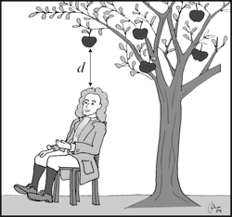
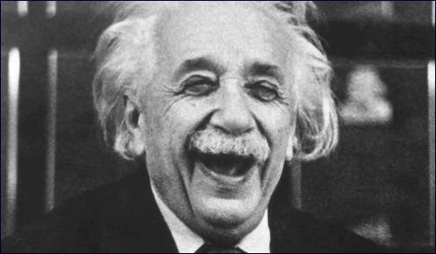
Physics’ Bitter Lesson?
Physics before Newton is ‘miscellaneous early efforts’
  Don Geman, circa 2007
But was Einstein embittered?

Slide 5
Is it even the right lesson?
“the actual contents of minds are tremendously, irredeemably complex; we should stop trying to find simple ways to think about the contents of minds”

Slide 6
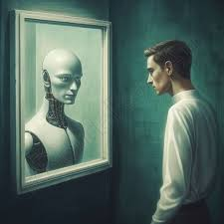
A Humbling Lesson for Humans
Humans turned out to be far simpler than we thought!
99% of the time, we are just nearest neighbor machines:
  walking cliches
  pastiches from high school reading lists
We are in the next Copernican Revolution. Hold on tight…

Slide 7
Is it even the right lesson?
“computation” is mentioned 21 times
“data” is mentioned once, in passing

Slide 8
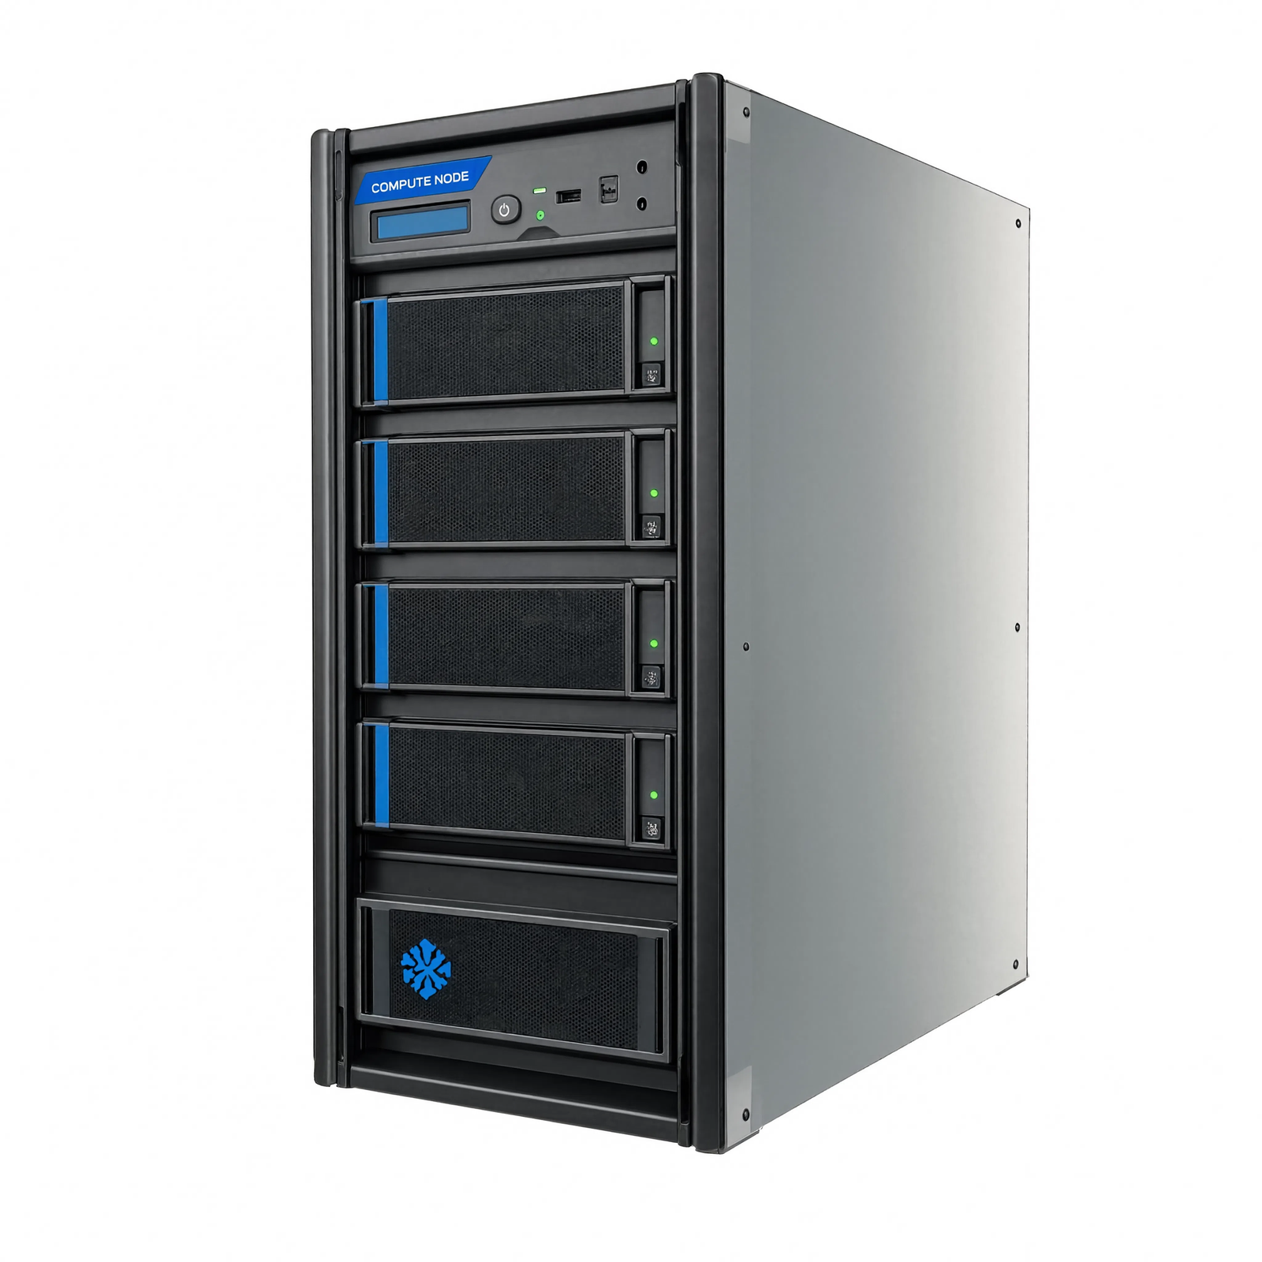


Data / Compute trade-off?
Data
Compute

Slide 9
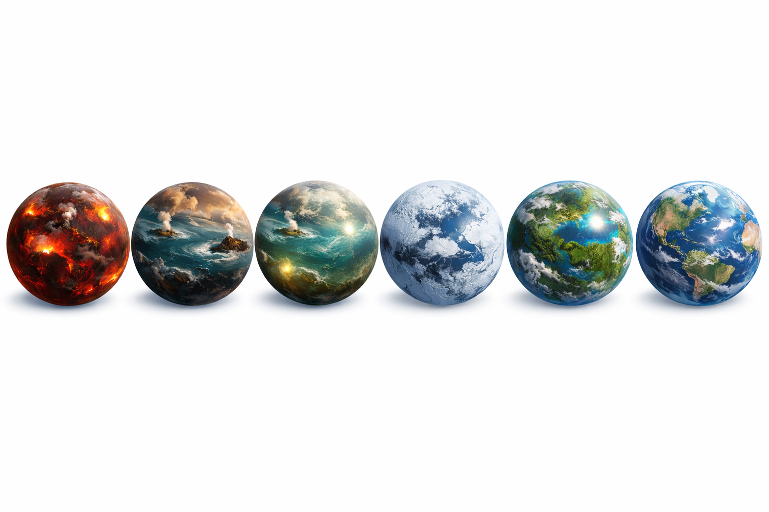
Data / Compute trade-off?
Simulation
Data

Slide 10

What if we want to simulate our world?

Slide 11
(much of) The Magic is in the Data

Slide 12
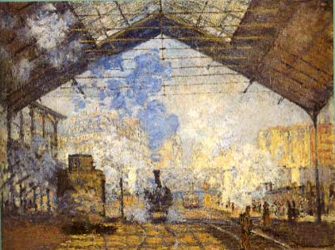
Importance of Past Experience
Claude Monet
Gare St.Lazare
Paris, 1877

Slide 13
There is almost nothing inside!

Slide 14

Seeing more than meets the eye
Video by Antonio Torralba (starring Rob Fergus)

Slide 15
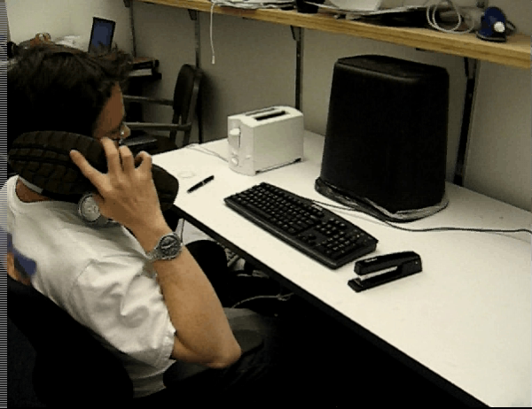
But actually…
Video by Antonio Torralba (starring Rob Fergus)

Slide 16
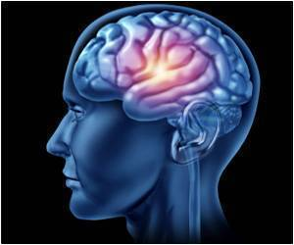
“Our perception relies
on memory as much as it does on incoming information, which blurs the border between perception and cognition.”
-- Moshe Bar
“Mind" is largely an emergent property of "data."
-- Lance Williams

Slide 17
“Our perception relies
on memory as much as it does on incoming information, which blurs the border between perception and cognition.”
-- Moshe Bar
“Mind" is largely an emergent property of "data."
-- Lance Williams

Slide 18
Still, data itself got no respect
Data
Features
Learning Algorithm

Slide 19
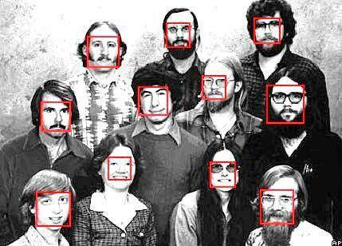
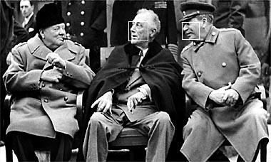
Face Detection: Early Success Story
  Rowley, Baluja, and Kanade, 1998
    features: pixels, classifier: neural network
  Schniderman & Kanade, 1999
    features: pairs of wavelet coeff., classifier: naïve Bayes
  Viola & Jones, 2001
    features: haar, classifier: boosted cascade

Slide 20
Our Scientific Narcissism
All things being equal, we prefer to credit our own cleverness

Slide 21
“Unreasonable Effectiveness of Data”
[Halevy, Norvig, Pereira 2009]
Parts of our world can be explained by elegant mathematics:
  physics, chemistry, astronomy, etc.
But some cannot:
  psychology, genetics, economics, AI, etc.
Enter: The Magic of Data
Decade before “The Bitter Lesson”

Slide 22
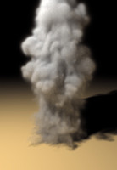
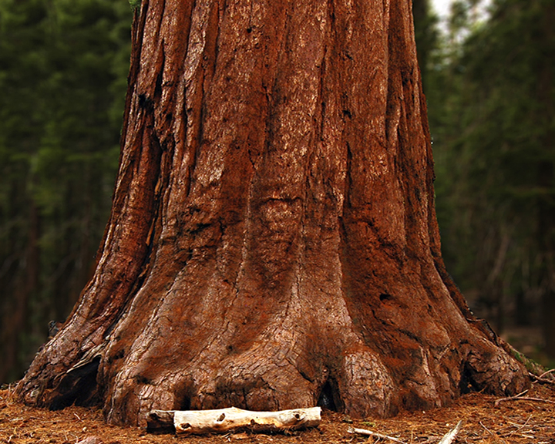
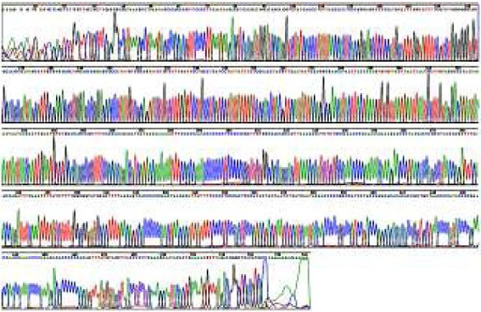
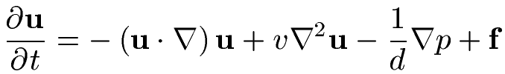
Some things are just messy
Navier-Stokes Equation
+ weather
+ location
+ …

Slide 23
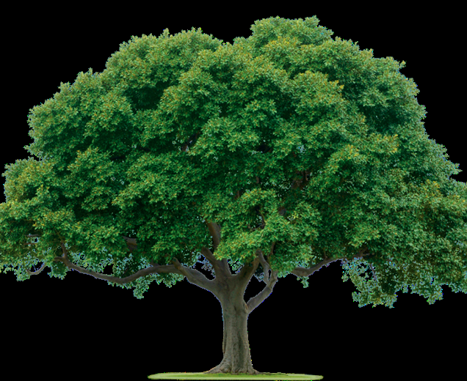
Let’s Define a Tree
Brown trunk moving upward and branching with leaves

Slide 24
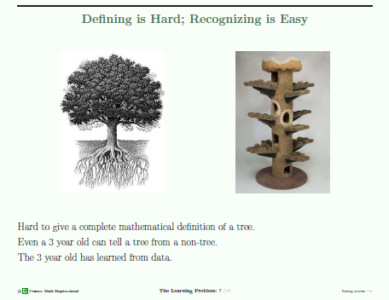
Are these trees?
Hard to give a good definition of tree
But any 3-year-old can tell a tree from a non-tree
The 3-year-old has learned from data!
Slide from Makdon Ismail

Slide 25

Notes:
WE know about the data deluge, but arguably, the biggest big data out there is visual.

Slide 26
With enough data, brain-dead lookup (aka Nearest Neighbor) works surprisingly well

Slide 27
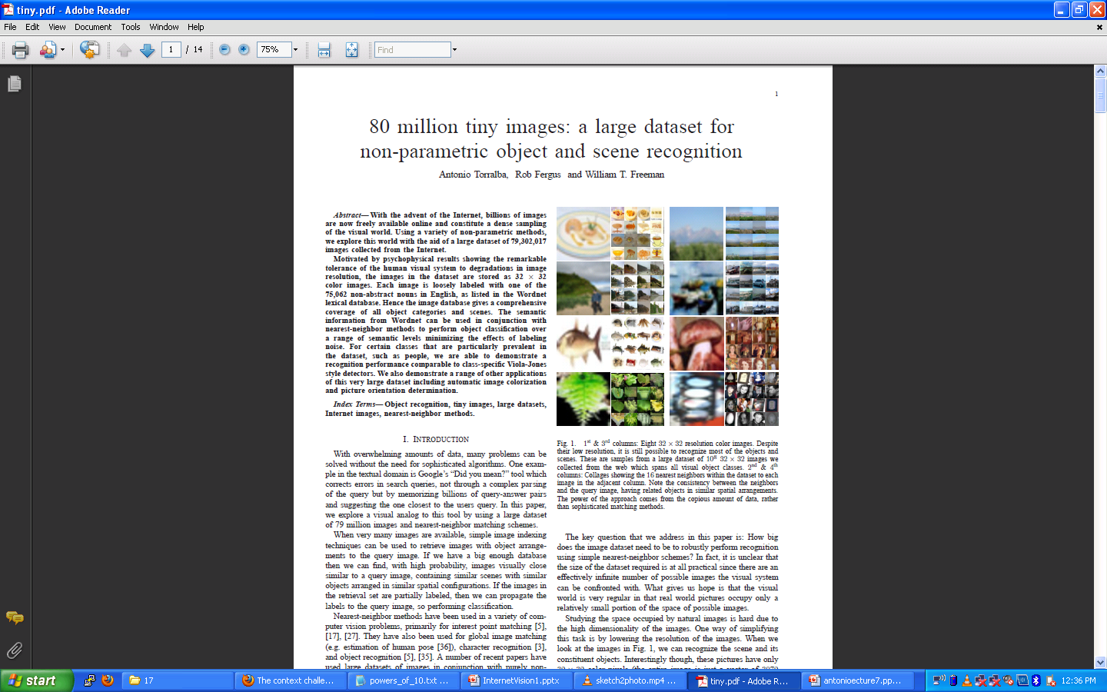
How many images does a 5-year-old see?
Where CIFAR-10/100 came from!
“80 million tiny images: a large dataset for non-parametric object and scene recognition”, Antonio Torralba, Rob Fergus and William T. Freeman. PAMI 2008.

Slide 28
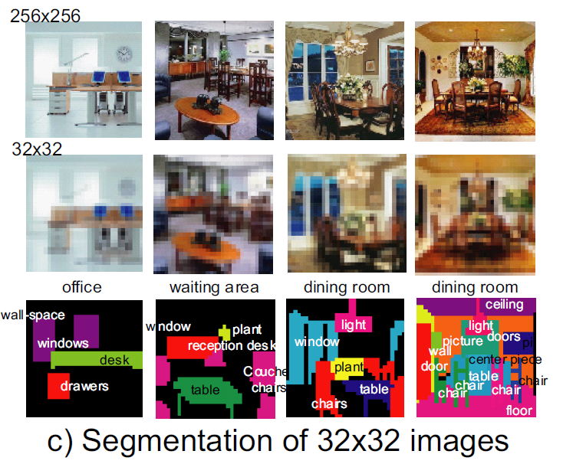
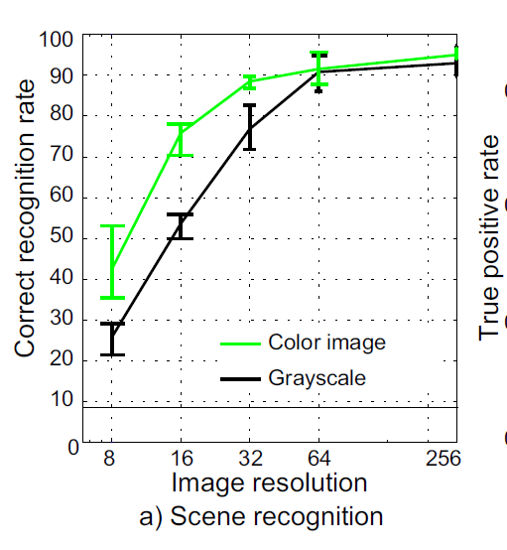
32x32 turns out to be enough!

Slide 29
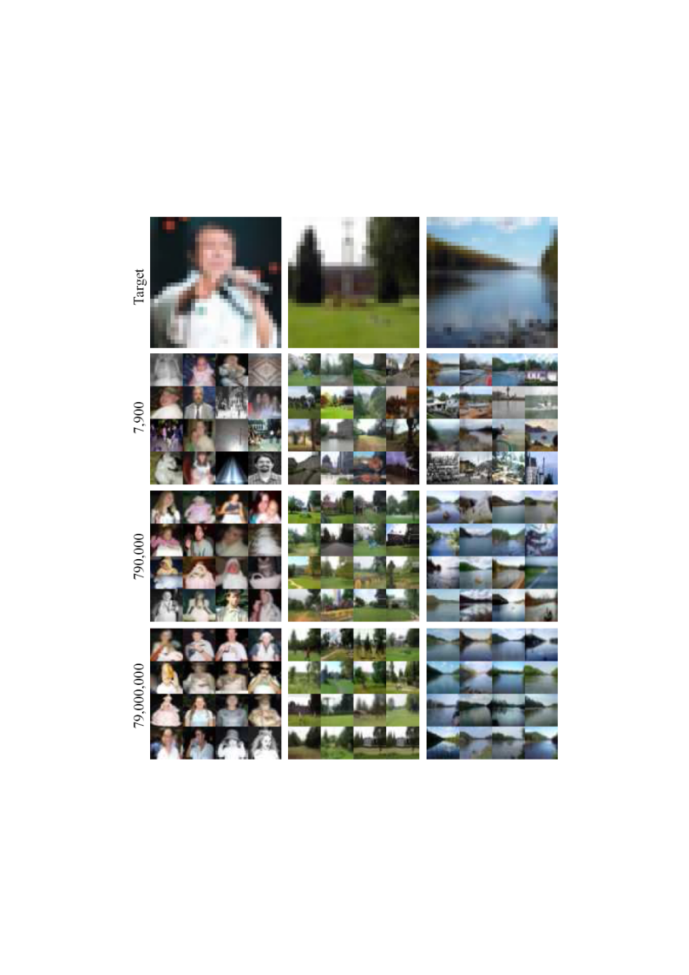
Lots
Of
Images
A. Torralba, R. Fergus, W.T.Freeman. PAMI 2008

Slide 30
Lots
Of
Images
A. Torralba, R. Fergus, W.T.Freeman. PAMI 2008

Slide 31
Lots
Of
Images

Slide 32
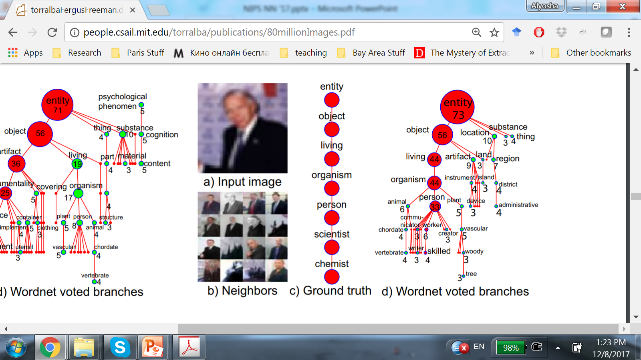

Slide 33
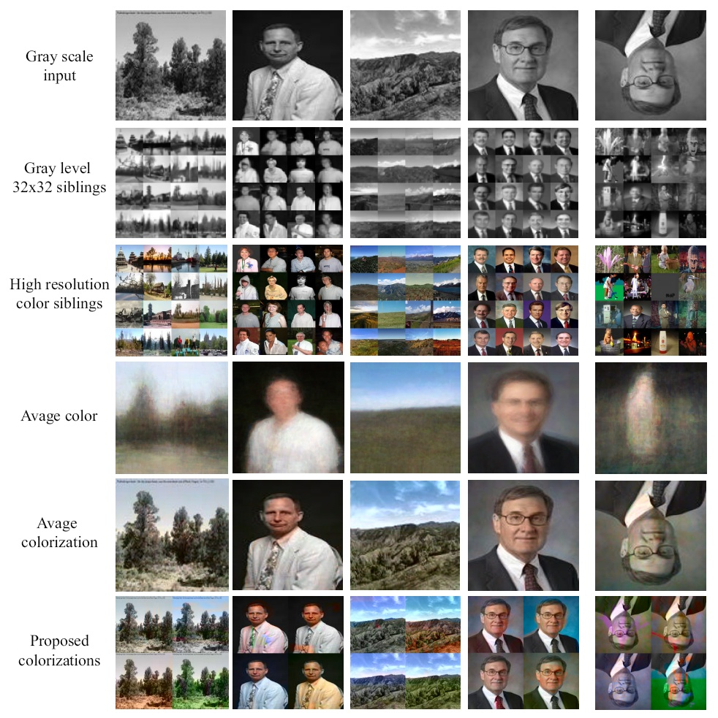
Automatic Colorization
Grayscale input High resolution
Colorization of input using average
A. Torralba, R. Fergus, W.T.Freeman. 2008

Slide 34
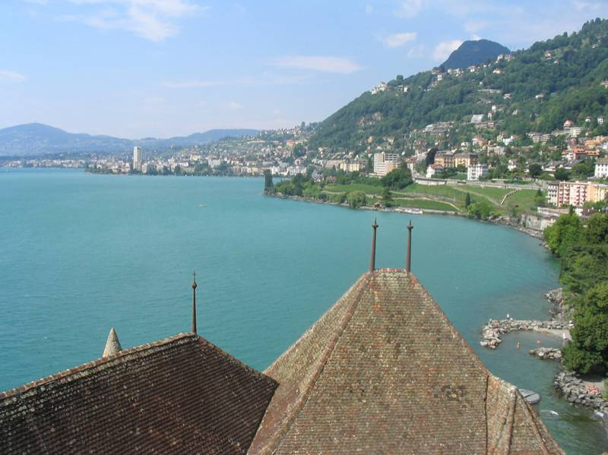
[Hays & Efros, SIGGRAPH’07]

Slide 35
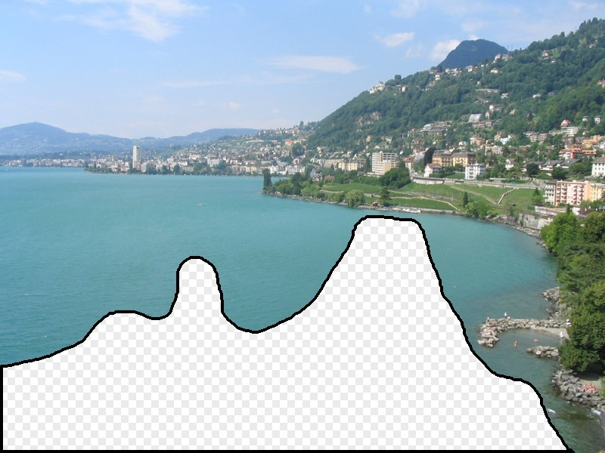

Slide 36
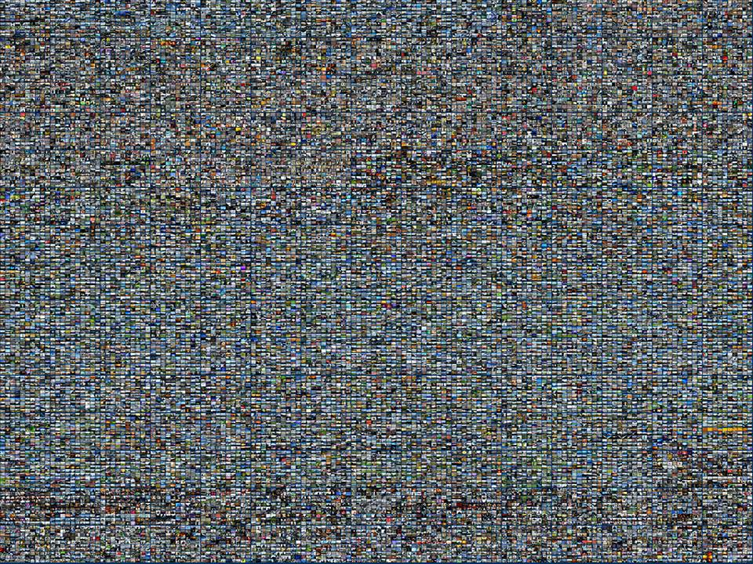
2 Million Flickr Images

Slide 37
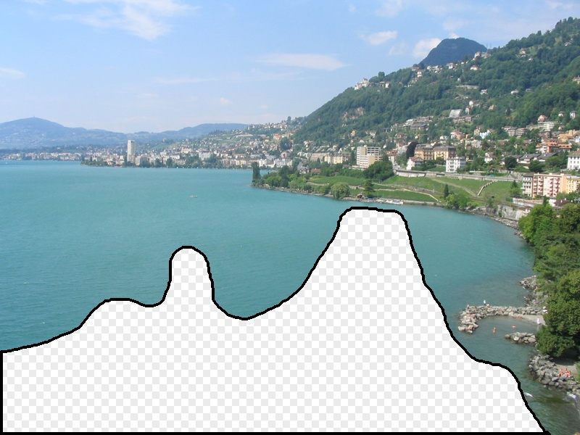


Slide 38
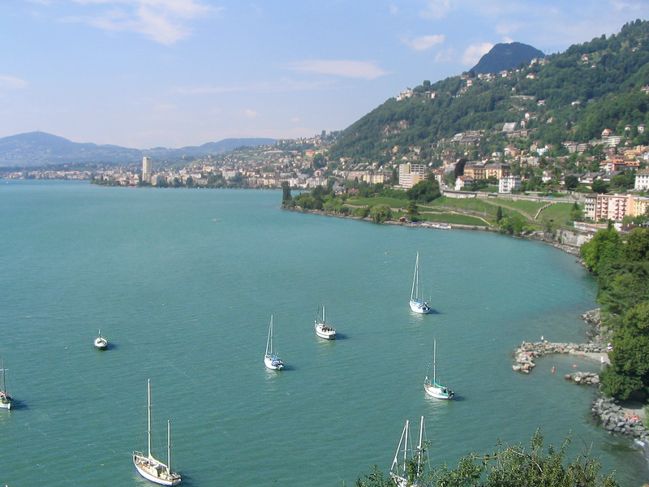

Slide 39
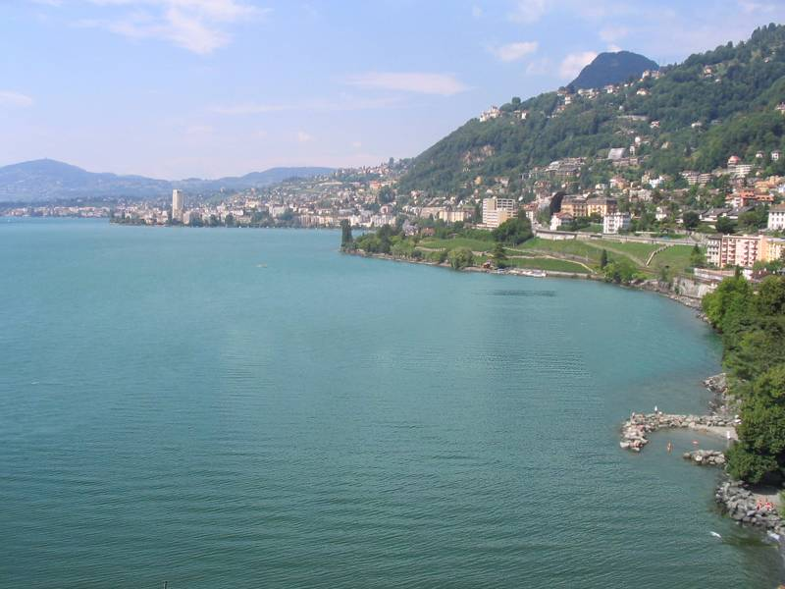

Slide 40
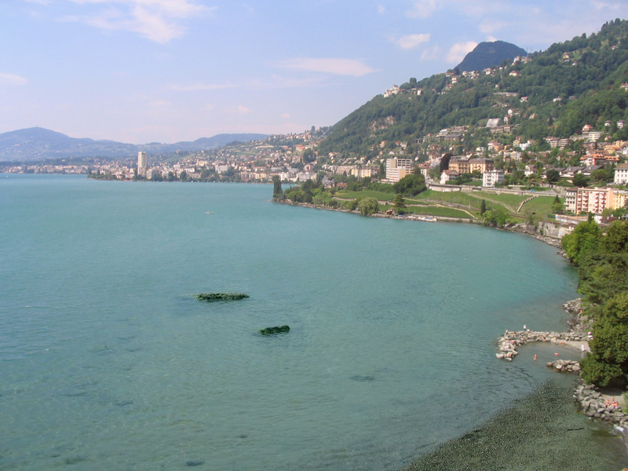

Slide 41
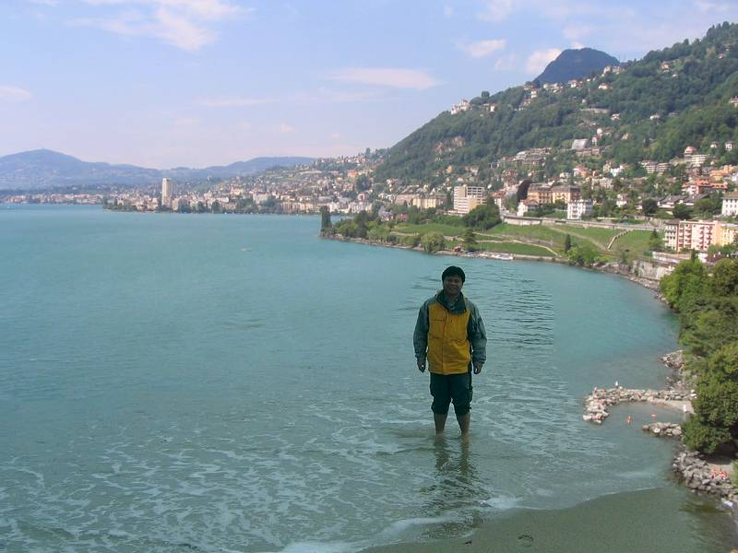

Slide 42
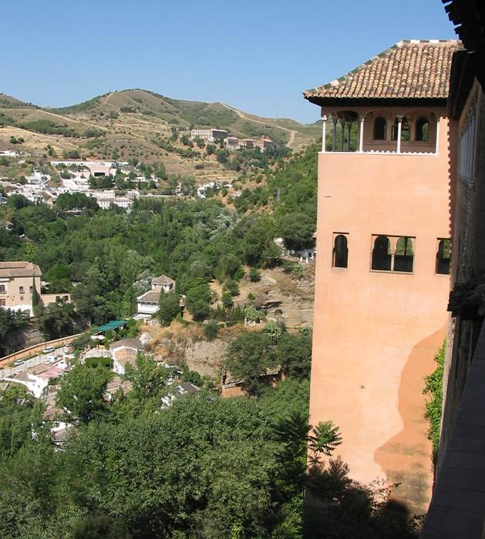

Slide 43
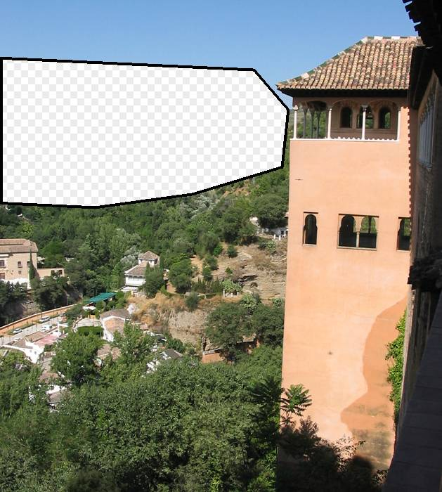

Slide 44
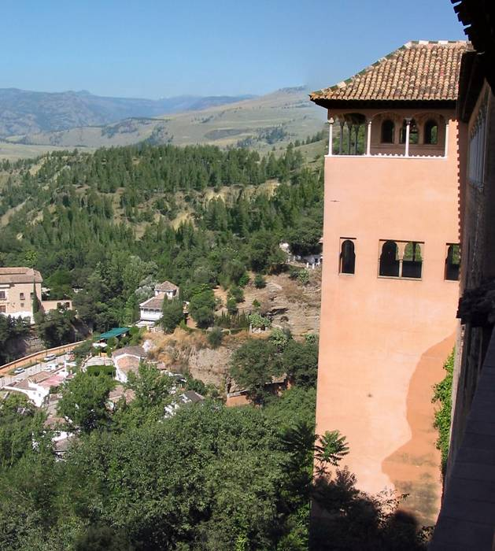

Slide 45
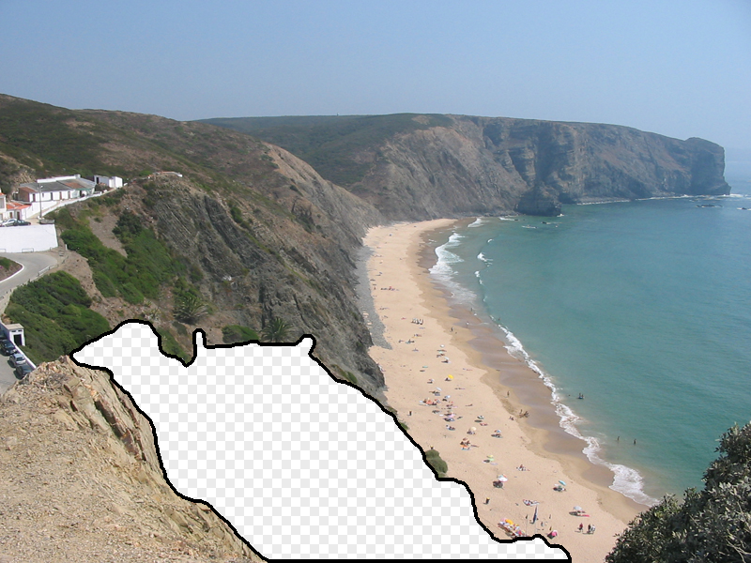
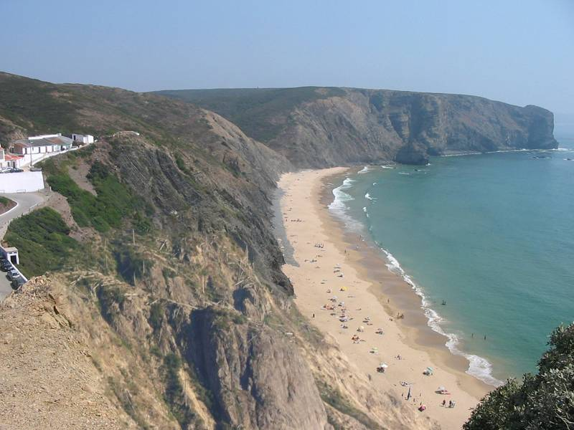
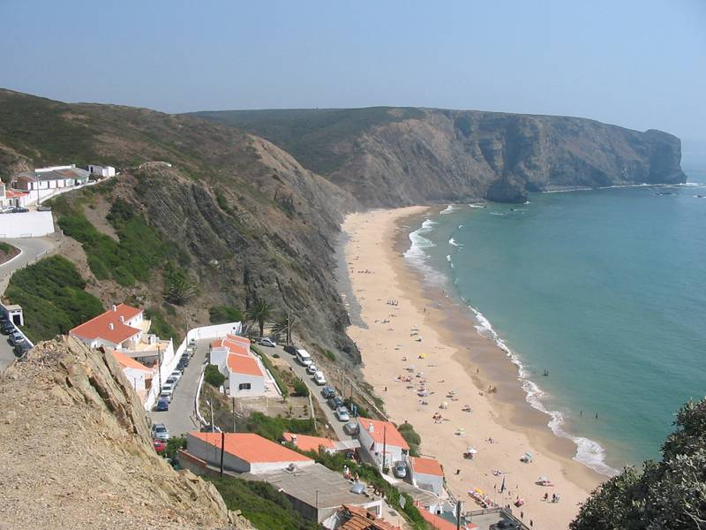

Slide 46
Why does it work?

Slide 47
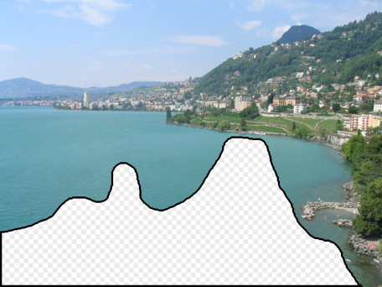
Notes:
47
10 nearest neighbors, 20,000 image database

Slide 48
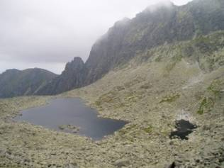
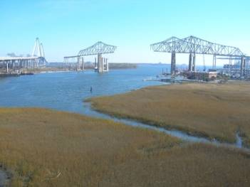
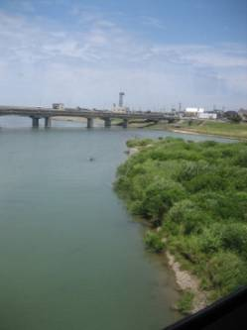
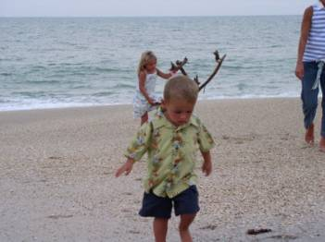
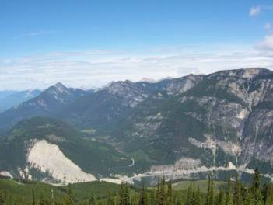
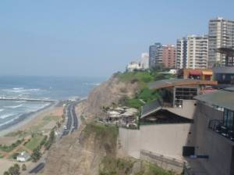
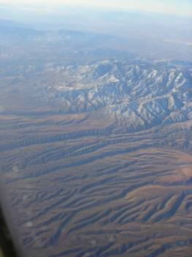
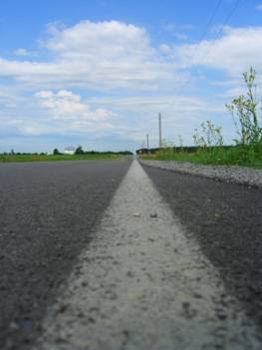


Nearest neighbors from a
collection of 20 thousand images
Notes:
48
10 nearest neighbors, 20,000 image database
20000 images is still 5 times larger than the PASCAL training set

Slide 49










Nearest neighbors from a
collection of 2 million images
Notes:
49
10 nearest neighbors, 2.3 million image database
This is one of the key results from my research – I’ve discovered that it’s possible to sample the space of scenes densely enough to permit photorealistic image manipulations, short circuiting the typical graphics pipelines. Say that this is surprising
DATA is the key

Slide 50

im2GPS
(using 6 million GPS-tagged Flickr images)
Im2gps [Hays & Efros, CVPR’08]

Slide 51
6 Million Flickr Images

Slide 52
im2GPS
(using 6 million GPS-tagged Flickr images)
Im2gps [Hays & Efros, CVPR’08]

Slide 53
15 years later…

Slide 54


Algorithm vs. Data
im2gps, 2008
PlaNet, 2016
Nearest Neighbors
6 million images
Deep Net
91 million images

Slide 55

Algorithm vs. Data
Weyand et al, PlaNet, ECCV 2016

Slide 56
But can humans ever remember so much?
[Halevy, Norvig, Pereira 2009]

Slide 57


What’s the Capacity of Visual Long Term Memory?
Aude Oliva, MIT
http://olivalab.mit.edu/MM/

Slide 58



What’s the Capacity of Visual Long Term Memory?
What was known…
What was not known…
… what people are remembering for each item?
Standing (1973)
10,000 images
83% Recognition
According to Standing
“Basically, my recollection is that we just separated the pictures into distinct thematic categories: e.g. cars, animals, single-person, 2-people, plants, etc.) Only a few slides were selected which fell into each category, and they were visually distinct.”
… people can remember thousands of images
Dogs
Playing Cards
“Gist” Only
Sparse Details
Highly Detailed
Slide by Aude Oliva

Slide 59






Massive Memory Experiment I
A stream of objects will be presented on the screen for
~ 3 second each.
Your primary task:
Remember them ALL!
afterwards you will be tested with…
Completely
different objects...
Different exemplars
of the same kind of object...
Different states of
the same object...
Notes:
So we run a first study to look at the fidelity of visual representations in long term memory, using objects.
…
Afterwards we’ll test your memory with
Completely different objects
So you’ll see two objects from different categories and have to report which one you’ve seen
Different exemplars of the same kind of object,
Like these two bell peppers
Or different states of the same object,
So here these are the same item but in a different pose or configuration

Slide 60



Massive Memory Experiment I
Detect exact repeats anywhere in the stream
Your other task:
Notes:
scene demo

Slide 61
Ready?
(Seriously, get ready to clap. The images go by fast…)

Slide 62


Slide 65
<clap!>

Slide 66


Slide 68


Slide 70


Slide 72


Slide 74


Slide 77
<clap!>

Slide 78


Slide 80


Slide 82


Slide 83
10 Minutes Later...

Slide 84


Slide 86


Slide 88


Slide 91
<clap!>

Slide 92


Slide 95
<clap!>

Slide 96


Slide 98


Slide 99
30 Minutes Later...

Slide 100


Slide 102


Slide 104


Slide 106


Slide 108


Slide 110


Slide 111
1 Hour Later...

Slide 112


Slide 114


Slide 116


Slide 118


Slide 121
<clap!>

Slide 122


Slide 124


Slide 125
2 Hours Later...

Slide 126


Slide 129
<clap!>

Slide 130


Slide 132


Slide 134


Slide 136


Slide 138


Slide 139
4 Hours Later...

Slide 140


Slide 142


Slide 144


Slide 146


Slide 149
<clap!>

Slide 150


Slide 152


Slide 153
5:30 Hours Later...

Slide 154


Slide 155
Which one did you see?
(go ahead and shout out your answer)

Slide 156

-A-
-B-

Slide 157

-A-
-B-

Slide 158

-A-
-B-

Slide 159

Recognition Memory Results
92%
Replication of Standing (1973)
Visual Cognition
Expert Predictions

Slide 160
Recognition Memory Results
92%
88%
87%
Brady, et al. (2008), PNAS

Slide 161
So, do humans have
“photographic memory”?

Slide 162












“No meaning” textures matching 1st & 2nd order statistics of real scenes
(by Portila & Simmonceli)
Isola & Oliva,
unpublished

Slide 163

Clap your hands when
you see an image repeat
Ready?

Slide 164


Slide 167
<clap!>

Slide 168


Slide 174


Slide 176
Notes:
Assembly hall

Slide 179
<clap!>

Slide 180


Slide 182

Notes:
Anechoic chamber

Slide 184
Notes:
Assembly hall

Slide 185
<clap!>

Slide 186


Slide 193
<clap!>

Slide 196


Slide 203
<clap!>

Slide 209
<clap!>

Slide 212
Notes:
Anechoic chamber

Slide 213
<clap!>

Slide 216

Humans do more than just memorize
4
3
2
1
0
d
‘
chance
Scene/object
texture
Isola & Oliva,
unpublished

Slide 217

Memorable
Hit rate: 67/70
False alarm rate: 4/80
Average
Hit rate: 59/81
False alarm rate: 7/92
Forgettable
Hit rate: 21/68
False alarm rate: 3/82
Memorability (Isola et al)
Notes:
For simplicity, I’m going to ignore the false alarms for the rest of the talk. The key is that false alarms are infrequent enough that lucky guesses could only account for a small proportion of our hits. More specifically, false alarms are uncorrelated with hits. They are not rank correlated with hit rate, and thus, they do not bias our memorability rankings.

Slide 218
The Good News
Really stupid algorithms + Lots of Data
= “Unreasonable Effectiveness”
[Halevy, Norvig, Pereira 2009]

Slide 219

The Bad News: Raw Memorization
(nearest-neighbor methods) have trouble with rare events:
Modern generative models are able to interpolate and compose data from different sources:
  e.g. DALL-E, Stable Diffusion, Imagen, Parti, Sora, etc.
Long Tail…

Slide 220

Impressive compositionality:
DALL-E 2

Slide 221





Impressive compositionality:
DALL-E + Danielle Baskin

Slide 222
Here we go again?
Barely Mentioned Data
Fancy Language Features
Amazing Algorithm!

Slide 223



Prompt: “squirrel reaching for a nut”
DALL-E 2 Parti GigaGAN

Slide 224

data capacity vs. image quality
Slide by Taesung Park

Slide 225

Generated Image
Prompt:
“a green creature made of leaves and vines bursting out of the ground ready to attack; detailed, best on artstation, raymond swanland, magic the gathering, epic, stunning, masterpiece”

Slide 226






“influences” from the training data
generated image
Wang et al, Evaluating Data Attribution for Text-to-Image Models, ICCV 2023

Slide 227
Interpolation in sufficiently high-dimensional space is indistinguishable from magic
to paraphrase Arthur C. Clarke:

Slide 228









But perhaps visual space isn’t even so huge?
E.g. since 1990s we know that any novel face can be represented as a linear combination of a ~200 training faces
$$α_{1}$$
$$α_{2}$$
$$α_{3}$$
$$α_{4}$$
Interpreting Face Images using Active Appearance Models, Edwards, Taylor, Cootes, 1998
A Morphable Model for the Synthesis of 3D Faces, Blanz and Vetter, 1999

Slide 229

But perhaps visual space isn’t even so huge?
E.g. since 1990s we know that any novel face can be represented as a linear combination of a ~200 training faces
$$α_{1}$$
$$α_{2}$$
$$α_{3}$$
$$α_{4}$$
Interpreting Face Images using Active Appearance Models, Edwards, Taylor, Cootes, 1998
A Morphable Model for the Synthesis of 3D Faces, Blanz and Vetter, 1999

Slide 230

But perhaps visual space isn’t even so huge?
E.g. since 1990s we know that any novel face can be represented as a linear combination of a ~200 training faces
$$α_{1}$$
$$α_{2}$$
$$α_{3}$$
$$α_{4}$$
There are more people on Earth than faces!
Interpreting Face Images using Active Appearance Models, Edwards, Taylor, Cootes, 1998
A Morphable Model for the Synthesis of 3D Faces, Blanz and Vetter, 1999

Slide 231








Amil Dravid*
Yossi Gandelsman*
Kuan-Chieh Wang
Rameen Abdal
Gordon Wetzstein
Alyosha Efros
Kfir Aberman
UC Berkeley, Snap UC Berkeley Snap Stanford Stanford UC Berkeley Snap
Neurips 2024

Slide 232










Linear Latent Spaces
Dataset of Images
Dataset of Latent Vectors
Dataset of Model Weights
Notes:
We aim to abstract this even further from, images, to latents, now model weights. Can we create a linear latent space over model weights? And why do we think this is possible?

Slide 233
















Interpolation in Weight Space
$$α_{1}$$
$$α_{2}$$
$$α_{3}$$
$$α_{4}$$

Slide 234




Interpolation in Weight Space
New Model

Slide 235




Creating a Dataset of Models
“[V] person”
Notes:
, such as visual identities. This suggests that the weight space could perhaps serve as an interpretable latent space.
To this end we create a dataset of model weights, where each model encodes a different identity through dreambooth finetuning

Slide 236

Creating a Dataset of Models
Model Weight Space
Notes:
To this end we create a dataset of model weights, where each model encodes a different identity through dreambooth finetuning
Creating a dataset of model weights
60000 diffusion models

Slide 237






Creating a Dataset of Models
Model Weight Space
60,000+ Diffusion Models!
Notes:
We repeat this for over 60000 identities to populate the model weight space.
Creating a dataset of model weights

Slide 238

weights2weights (w2w) Space
Model Weight Space
Notes:
These datapoints lie on a manifold of identity-encoding model weights, Inspired by findings that high-level concepts can be encoded as linear subspaces of representations~\cite{word2vec, ravfogel2020null, radford2015unsupervised}, we model this subset as a linear subspace $\mathbb{R}^m$ where $m<d$,
that is compressed into a set of principal components. We term the resulting space weights2weights, in which operations transform one set of valid identity-encoding weights into another.

Slide 239
weights2weights (w2w) Space
Notes:
These datapoints lie on a manifold of identity-encoding model weights, which we model as a subspace that is compressed into a set of principal components. We term the resulting space weights2weights, in which operations transform one set of valid identity-encoding weights into another.

Slide 240
weights2weights (w2w) Space
PCA Basis: w ={w₁,…w_{m}}
“Meta”-Latent Space
Notes:
These datapoints lie on a manifold of identity-encoding model weights, which we model as a subspace that is compressed into a set of principal components. We term the resulting space weights2weights, in which operations transform one set of valid identity-encoding weights into another.

Slide 241
How Do We Get These Models?

Slide 242
Fine-Tune for each Task
Task = Generate particular visual concept (e.g., identity)
Pretrained Diffusion Model
Notes:
Recent methods such as Dreambooth have been developed to adapt modern diffusion models to user-defined concepts, going beyond single domains like the old days. Rather than finding an input latent code, these personalization approaches finetune diffusion model weights to insert novel subjects, such as visual identities. This suggests that the weight space could perhaps serve as an interpretable latent space.
To this end we create a dataset of model weights.
Talk about this after the creating a dataset of model weights
What are these models. How do we get these models?
Wouldn’t work for random models, start with base models and finetuning
For this experiment, the task is personalization
Talk about LoRAs

Slide 243




























































Repeat over 60,000 Times
Fine-Tune for each Task
Small Set of Training Images
Fine-Tune Diffusion Model
Pretrained Diffusion Model
Synthetic dataset of identities based on CelebA Dataset:
Deep Learning Face Attributes in the Wild, Liu et al., 2015
Notes:
Recent methods such as Dreambooth have been developed to adapt modern diffusion models to user-defined concepts, going beyond single domains like the old days. Rather than finding an input latent code, these personalization approaches finetune diffusion model weights to insert novel subjects, such as visual identities. This suggests that the weight space could perhaps serve as an interpretable latent space.
To this end we create a dataset of model weights.
Talk about this after the creating a dataset of model weights
What are these models. How do we get these models?
Wouldn’t work for random models, start with base models and finetuning
For this experiment, the task is personalization
Talk about LoRAs

Slide 244






Generate Identity
weights2weights Space
PCA Basis: w ={w₁,…w_{m}}
Diffusion Unet
Sample weights
Notes:
weights2weights space enables applications analogous to those of a traditional generative latent space, but producing model weights rather than images. We can sample new models from this space that encode novel identities. These are essentially interpolating and extrapolating between the models used to define the subspace.

Slide 245


Generate Identity
weights2weights Space
PCA Basis: w ={w₁,…w_{m}}
“Beard"
Hyperplane
Diffusion Unet
“No Beard"
Notes:
We train linear classifiers on the the weights encoding different identities. These are paired with labels for binary attributes present for each identity. Traversing orthogonal in weight space edits the identity encoded in the model.

Slide 246
Generate Identity
weights2weights Space
PCA Basis: w ={w₁,…w_{m}}
“Beard"
Hyperplane
Diffusion Unet
“No Beard"
Notes:
We train linear classifiers on the the weights encoding different identities. These are paired with labels for binary attributes present for each identity. Traversing orthogonal in weight space edits the identity encoded in the model.

Slide 247

Inversion into w2w Space
weights2weights Space
PCA Basis: w ={w₁,…w_{m}}
Generate Identity
Input
Diffusion Unet
Invert into weights
Notes:
Finally, we show that we can invert the identity from a single image into a model without overfitting. This is done by constraining the weights to live in weights2weights space. In practice, we optimize coefficients for the principal component basis. This amounts to an interpolation between models spanning w2w space.
Show real person, then next slide show math and stuff

Slide 248
Inversion into w2w Space
weights2weights Space
PCA Basis: w ={w₁,…w_{m}}
Input
Standard diffusion denoising objective with a subspace constraint
Enforce constraint by operating directly on principal component basis
Invert into weights
Notes:
Finally, we show that we can invert the identity from a single image into a model without overfitting. This is done by constraining the weights to live in weights2weights space. In practice, we optimize coefficients for the principal component basis. This amounts to an interpolation between models spanning w2w space.
Show real person, then next slide show math and stuff

Slide 249


Notes:
we show that we can invert the identity from a single image into a model without overfitting. This is done by constraining the weights to live in weights2weights space. We can further edit the model weights to edit the identity encoded in the model

Slide 250


Out-of-Distribution Inversion
Notes:
As seen here, weightsweights inversion can distill a realistic identity even from out-of-distribution images.
Turn dog example into its own slide with real examples of dogs that look like owner

Slide 251

Out-of-Distribution Inversion
Notes:
As seen here, weightsweights inversion can distill a realistic identity even from out-of-distribution images.
Turn dog example into its own slide with real examples of dogs that look like owner

Slide 252

Extending to Other Tasks
Linear subspaces exist for other visual concepts
Train using cars from: 3D Object Representations for Fine-Grained Categorization (Stanford Cars Dataset), Krause et al., 2013
Notes:
Dataset of model weights encoding dog breeds
Extending to other tasks

Slide 253
Datasets and their discontents

Slide 254
Are datasets measuring the right thing?
In Machine Learning:
Dataset is The World
In Recognition
Dataset is a representation of The World
Do datasets provide a good representation?

Slide 255
Visual Data is Inherently Biased
Internet is a tremendous repository of visual data (Flickr, YouTube, Picassa, etc)
But it’s not random samples of visual world
  And is “random” the right thing anyway?

Slide 256







Flickr Paris

Slide 257








Google
StreetView Paris
Knopp, Sivic, Pajdla, ECCV 2010

Slide 258












“Uniformly Sampled” Paris

Slide 259

Most “collection bias” is subcontious

Slide 260

Sampling Bias
People like to take pictures on vacation

Slide 261

Photographer Bias
People want their pictures to be recognizable and/or interesting
vs.

Slide 262

Social Bias
“100 Special Moments” by Jason Salavon

Slide 263

Social Bias
Mildred and Lisa
Source: U.S. Social Security Administration
Gallagher et al CVPR 2008

Slide 264
How much does this bias affect standard recognition datasets?

Slide 265

Poor Cross-Dataset Generalization
SUN
LabelMe
PASCAL
ImageNet
Caltech101
MSRC
Classifier trained on MSRC cars
[Torralba & Efros, 2011]

Slide 266

ImageNet vs. ImageNetV2
ImageNet
ImageNetV2

Slide 267
Chapter 4:
Epilogue

Slide 268
Data is best predictor for success:
Text Data:
Image Data:
Video Data:
Robotics Data:
Available Data

Slide 269

Moravec's Paradox lives on!
“In AI, the hard things are easy while the easy things are hard”

Slide 270
Data availability going forward:
Text Data:
Image Data:
Video Data:
Robotics Data:
Available Data

Slide 271


Gopnik’s Parable of Stone Soup AI
Tech execs come to village:
  “We will make amazing AI with just a few magical algorithms (e.g. gradient descent, transformers, next token prediction)”
  …but would be so much better with more data
  …even more magical with human feedback
  …even better if humans would learn to ask questions in the right way
Villagers: wow, what magical AI just from a few algorithms!
https://simons.berkeley.edu/news/stone-soup-ai

Slide 272
Take Aways
Is it all just data, with no place for algorithms?
  No! Large-scale data is clearly necessary, but it is not sufficient
Need to learn to be humble and give data the credit it is due

