Slide 1
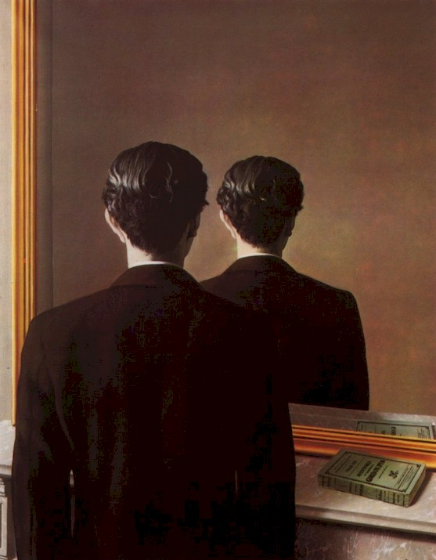
3D Modeling for a Single View
René MAGRITTE
Portrait d'Edward James
CS180: Intro to Comp. Vision and Comp. Photo
Efros & Ng, UC Berkeley, Fall 2026
…with a lot of slides stolen from
Steve Seitz and David Brogan,

Slide 2
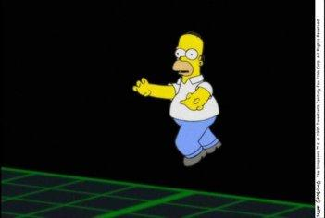
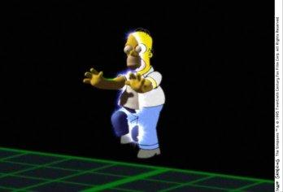
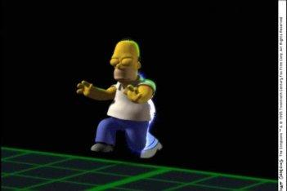
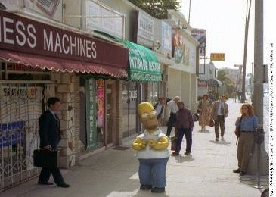
Breaking out of 2D
…now we are ready to break out of 2D
And enter the real world!

Slide 3
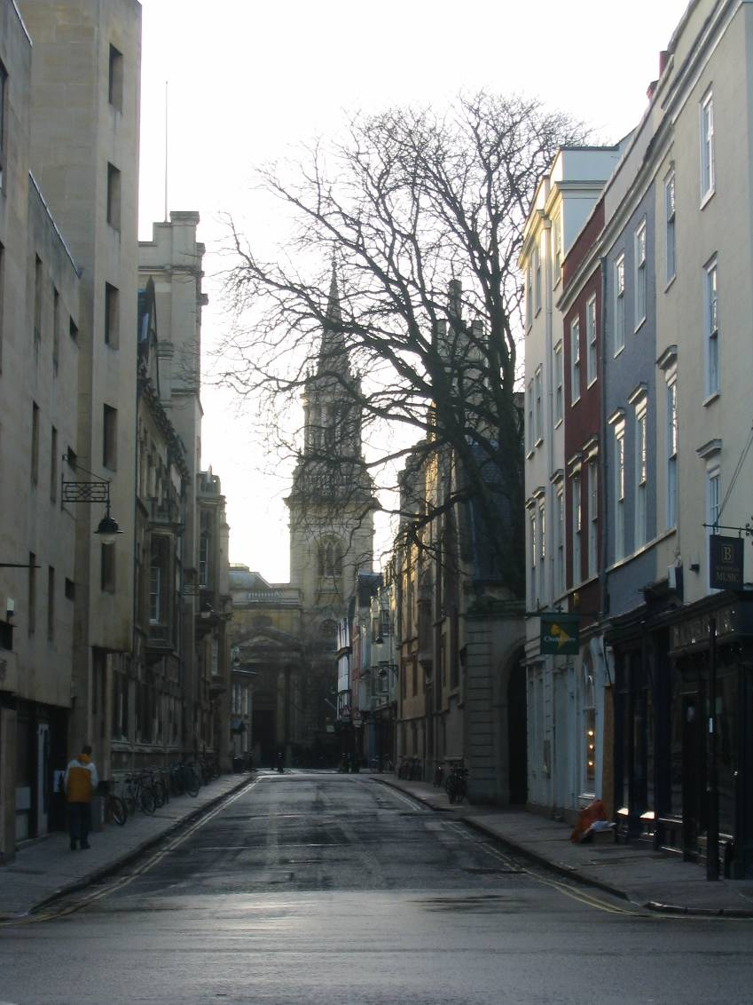
on to 3D…
  Enough of images!
  We want more of the plenoptic function
  We want real 3D scene
  walk-throughs:
    Camera rotation
    Camera translation
  Can we do it from a single photograph?

Slide 4
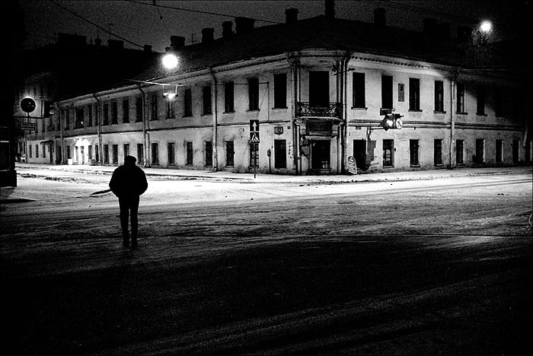
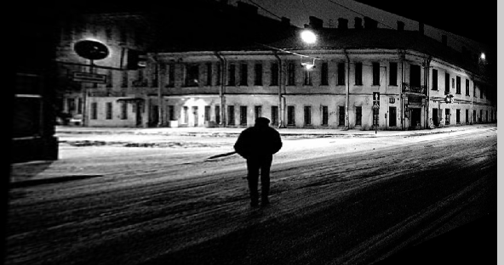
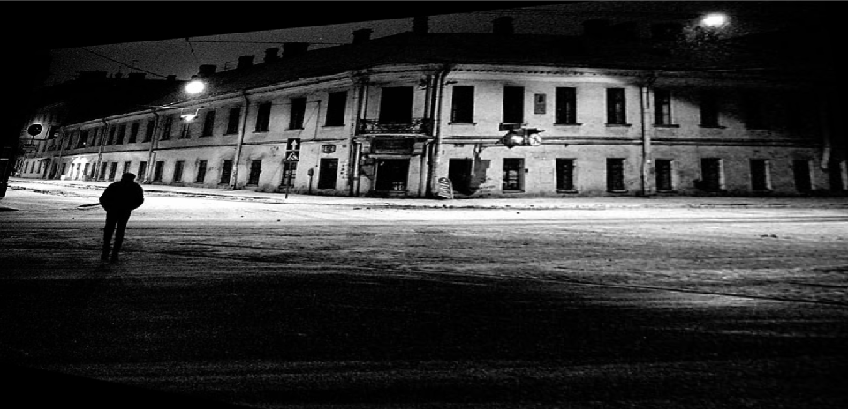
Camera rotations with homographies
Original image
St.Petersburg
photo by A. Tikhonov
Virtual camera rotations

Slide 5
Camera translation
Does it work?
synthetic PP
PP1
PP2

Slide 6
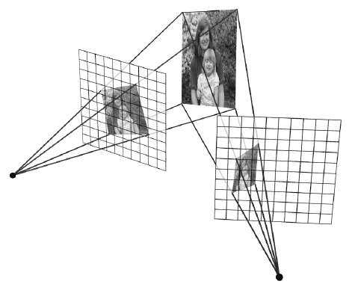
Yes, with planar scene (or far away)
PP3
PP1
PP2
PP3 is a projection plane of both centers of projection, so we are OK!

Slide 7
So, what can we do here?
Model the scene as a set of planes!
Now, just need to find the orientations of these planes.

Slide 8

Automatic Photo Pop-up
Notes:
Possibly end with this

Slide 9
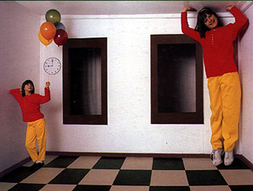
Some preliminaries: projective geometry
Ames Room

Slide 10

Silly Euclid!
Parallel lines???

Slide 11
The projective plane
Why do we need homogeneous coordinates?
  represent points at infinity, homographies, perspective projection, multi-view relationships
What is the geometric intuition?

Slide 12
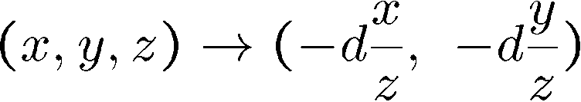
The projective plane
Why do we need homogeneous coordinates?
  represent points at infinity, homographies, perspective projection, multi-view relationships
What is the geometric intuition?
  a point in the image is a ray in projective space
y
(sx,sy,s)
(x,y,1)
(0,0,0)
z
x
image plane
  Each point (x,y) on the plane is represented by a ray (sx,sy,s)
    all points on the ray are equivalent: (x, y, 1) ≅ (sx, sy, s)
Remember projection eq:

Slide 13
Projective lines
What does a line in the image correspond to in projective space?
  A line is a plane of rays through origin
    all rays (x,y,z) satisfying: ax + by + cz = 0
l
p
  A line is also represented as a homogeneous 3-vector l

Slide 14
Point and line duality
  A line l is a homogeneous 3-vector
  It is ⊥ to every point (ray) p on the line: l p=0
p₁
p₂
l₁
p
l
l₂
  What is the line l spanned by rays p₁ and p₂ ?
    l is ⊥ to p₁ and p₂ ⇒ l = p₁ × p₂
    l is the plane normal
  What is the intersection of two lines l₁ and l₂ ?
    p is ⊥ to l₁ and l₂ ⇒ p = l₁ × l₂
  Points and lines are dual in projective space
    given any formula, can switch the meanings of points and lines to get another formula

Slide 15
Ideal points and lines
y
(sx,sy,0)
z
image plane
x
Ideal point (“point at infinity”)
  p ≅ (x, y, 0) – parallel to image plane
  It has infinite image coordinates
Ideal line
  l ≅ (0, 0, 1) – parallel to image plane

Slide 16
Vanishing points
image plane
vanishing point
camera
center
ground plane
Vanishing point
  projection of a point at infinity

Slide 17
Vanishing points (2D)
image plane
vanishing point
camera
center
line on ground plane

Slide 18
Computing vanishing points
V
P₀
D
Properties
  P∞ is a point at infinity, v is its projection
  They depend only on line direction
  Parallel lines P₀ + tD, P₁ + tD intersect at P∞

Slide 19
Vanishing points
image plane
vanishing point V
camera
center
C
line on ground plane
line on ground plane
Properties
  Any two parallel lines have the same vanishing point v
  The ray from C through v is parallel to the lines
  An image may have more than one vanishing point

Slide 20
Vanishing lines
v₁
v₂
Multiple Vanishing Points
  Any set of parallel lines on the plane define a vanishing point
  The union of all of these vanishing points is the vanishing line
    Including one special vanishing line call Horizon

Slide 21
Vanishing lines
Multiple Vanishing Points
  Note that different planes define different vanishing lines

Slide 22
Computing vanishing lines
C
l
ground plane
Properties
  l is intersection of horizontal plane through C with image plane
  Compute l from two sets of parallel lines on ground plane
  All points at same height as C project to l
    points higher than C project above l
  Provides way of comparing height of objects in the scene

Slide 23

Notes:
Is this parachuter higher or lower than the person taking this picture?
Lower—he is below the horizon

Slide 24
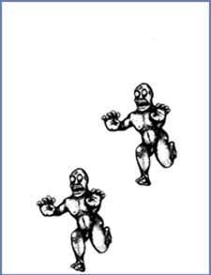
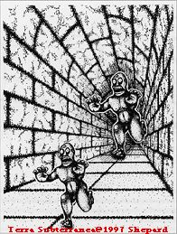
Fun with vanishing points

Slide 25
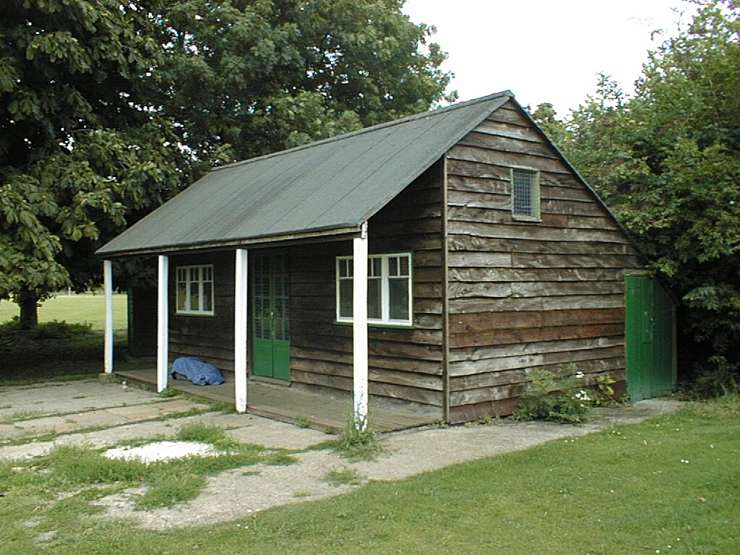
3D from single image
Find world coordinates (X,Y,Z) for a few points
Connect the points with planes to model geometry
  Texture map the planes

Slide 26
Finding world coordinates (X,Y,Z)
Define the ground plane (Z=0)
Compute points (X,Y,0) on that plane
Compute the heights Z of all other points

Slide 27
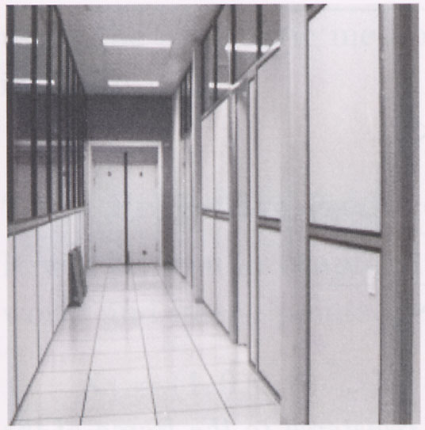
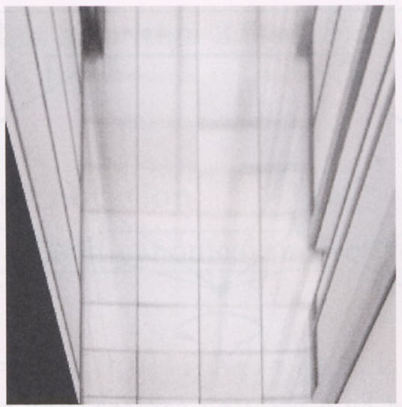
Measurements on planes
4
3
2
1
1
2
3
4
Approach: unwarp, then measure
What kind of warp is this?
Notes:
homography!

Slide 28
Unwarp ground plane
x
p’
p
Our old friend – the homography
Need 4 reference points with world coordinates
  p = (x,y)
  p’ = (X,Y,0)

Slide 29
Finding world coordinates (X,Y,Z)
Define the ground plane (Z=0)
Compute points (X,Y,0) on that plane
Compute the heights Z of all other points

Slide 30
Comparing heights

Slide 31
Perspective cues

Slide 32
Perspective cues

Slide 33
Criminisi ’99
Vertical vanishing
point
(at infinity)
Vanishing
line
Vanishing
point
Vanishing
point

Slide 34
Comparing heights
Vanishing
Point

Slide 35
Measuring height
5.4
5
Camera height
4
3.3
3
2.8
2
1

Slide 36



Measuring height
v_{z}
r
vanishing line (horizon)
t₀
t
v_{x}
v
v_{y}
H
R
H
b₀
b

Slide 37
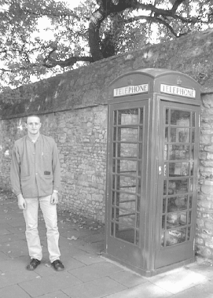
Measuring heights of people
Here we go !
185.3 cm
reference

Slide 38
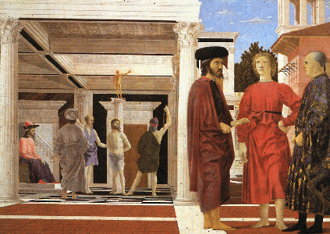
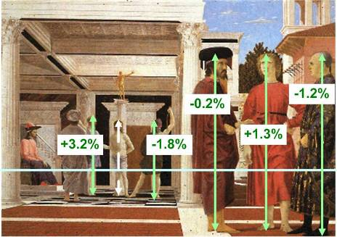
Assessing geometric accuracy
Are the heights of the 2 groups of people
consistent with each other?
Flagellation,
Piero della Francesca
Estimated relative heights

Slide 39
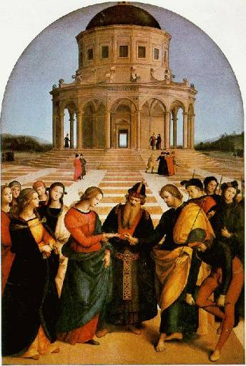
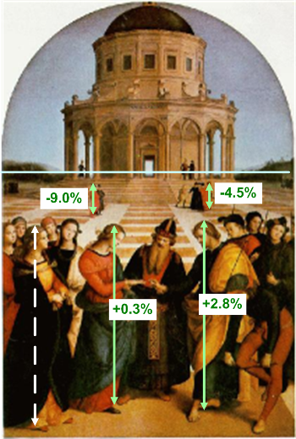
Assessing geometric accuracy
The Marriage of the Virgin, Raphael
Estimated relative heights

Slide 40
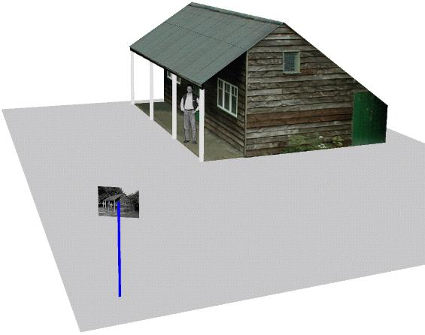
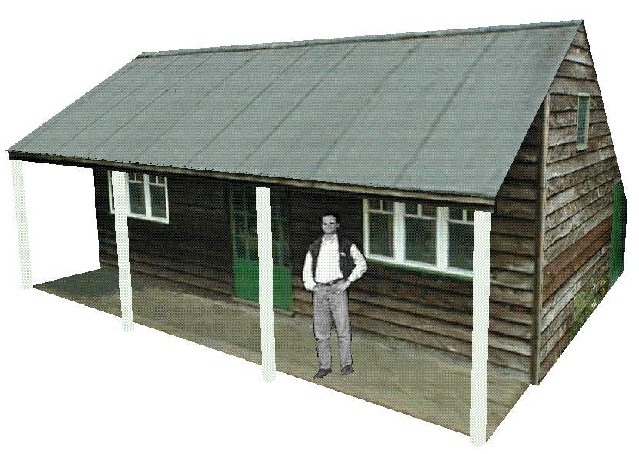
Complete 3D reconstruction
Single
View
algorithms
Planar measurements
Height measurements
Automatic vanishing point/line computation
Interactive segmentation
Occlusion filling
Object placement in 3D model
Single
image
3D
model

Slide 41
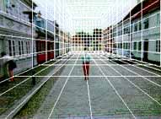
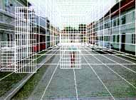

“Tour into the Picture” (SIGGRAPH ’97)
Create a 3D “theatre stage” of five billboards
Specify foreground objects through bounding polygons
Use camera transformations to navigate through the scene

Slide 42
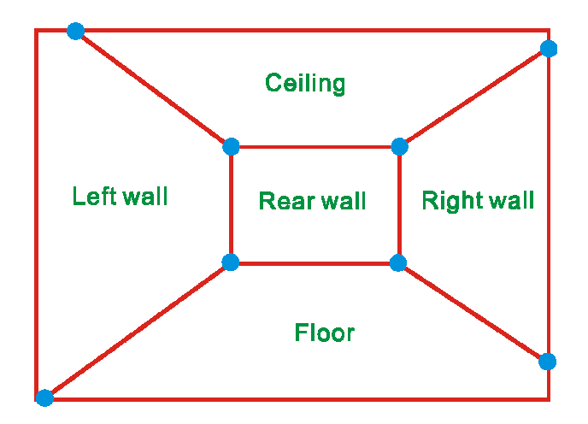
The idea
Many scenes (especially paintings), can be represented as an axis-aligned box volume (i.e. a stage)
Key assumptions:
  All walls of volume are orthogonal
  Camera view plane is parallel to back of volume
  Camera up is normal to volume bottom
How many vanishing points does the box have?
  Three, but two at infinity
  Single-point perspective
Can use the vanishing point
to fit the box to the particular
Scene!

Slide 43
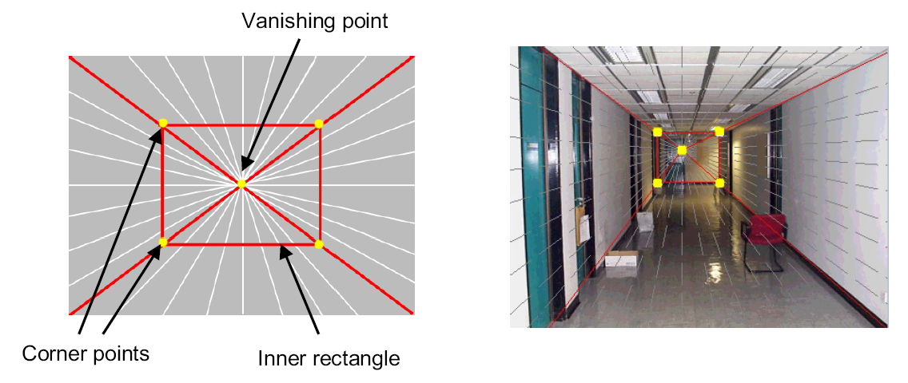
Fitting the box volume
User controls the inner box and the vanishing point placement (# of DOF???)
Q: What’s the significance of the vanishing point location?
A: It’s at eye level: ray from COP to VP is perpendicular to image plane.

Slide 44
Example of user input: vanishing point and back face of view volume are defined
High
Camera

Slide 45
Example of user input: vanishing point and back face of view volume are defined
High
Camera

Slide 46
Example of user input: vanishing point and back face of view volume are defined
Low
Camera

Slide 47
Example of user input: vanishing point and back face of view volume are defined
Low
Camera

Slide 48
Comparison of how image is subdivided based on two different camera positions. You should see how moving the box corresponds to moving the eyepoint in the 3D world.
High Camera
Low Camera

Slide 49
Another example of user input: vanishing point and back face of view volume are defined
Left
Camera

Slide 50
Another example of user input: vanishing point and back face of view volume are defined
Left
Camera

Slide 51
Another example of user input: vanishing point and back face of view volume are defined
Right
Camera

Slide 52
Another example of user input: vanishing point and back face of view volume are defined
Right
Camera

Slide 53
Comparison of two camera placements – left and right. Corresponding subdivisions match view you would see if you looked down a hallway.
Left Camera
Right Camera

Slide 54
2D to 3D conversion
First, we can get ratios
left
right
top
vanishing
point
bottom
back
plane

Slide 55
2D to 3D conversion
Size of user-defined back plane must equal size of camera plane (orthogonal sides)
Use top versus side ratio
to determine relative
height and width
dimensions of box
Left/right and top/bot
ratios determine part of
3D camera placement
left
right
top
camera
pos
bottom

Slide 56
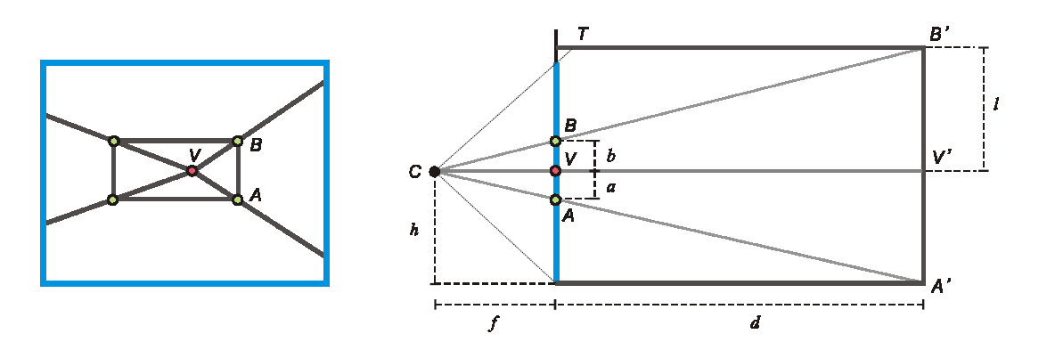
Depth of the box
Can compute by similar triangles (CVA vs. CV’A’)
Need to know focal length f (or FOV)
Note: can compute position on any object on the ground
  Simple unprojection
  What about things off the ground?

Slide 57
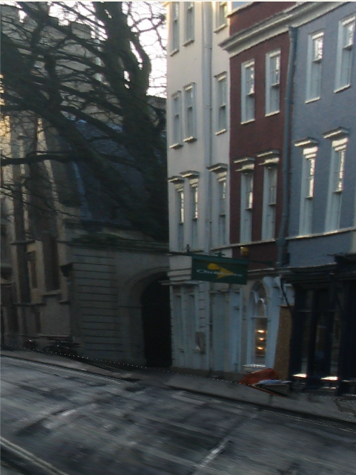
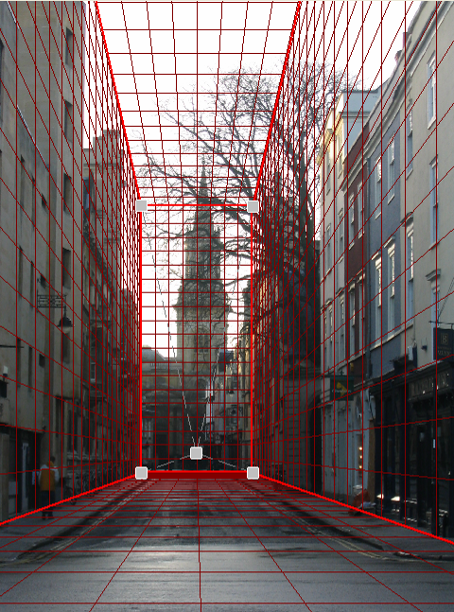
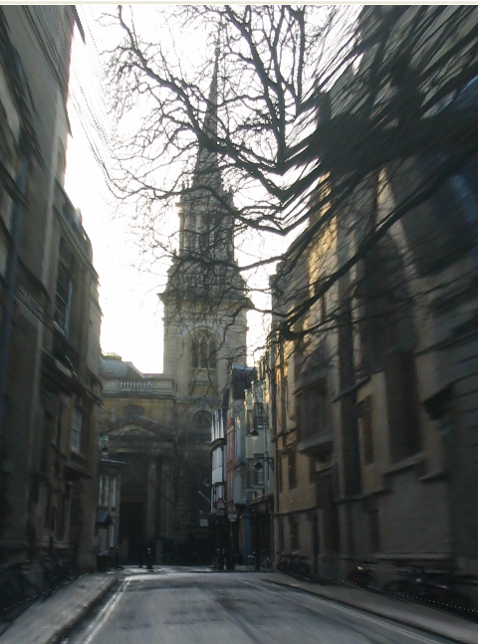
DEMO
Now, we know the 3D geometry of the box
We can texture-map the box walls with texture from the image

Slide 58


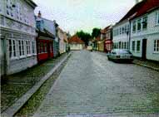
Foreground Objects
Use separate billboard for each
For this to work, three separate images used:
  Original image.
  Mask to isolate desired foreground images.
  Background with objects removed

Slide 59
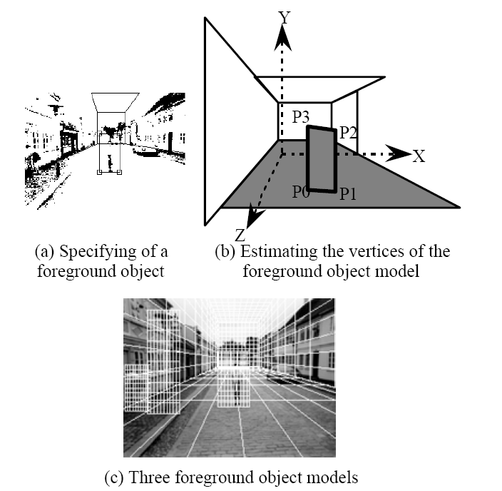
Foreground Objects
Add vertical rectangles for each foreground object
Can compute 3D coordinates P0, P1 since they are on known plane.
P2, P3 can be computed as before (similar triangles)

Slide 60
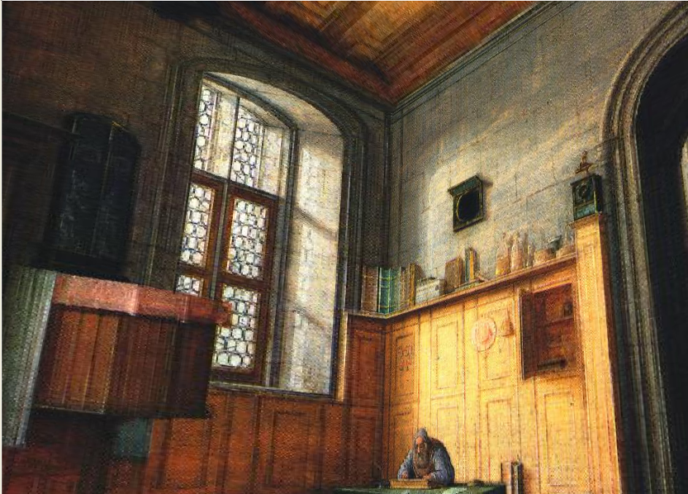
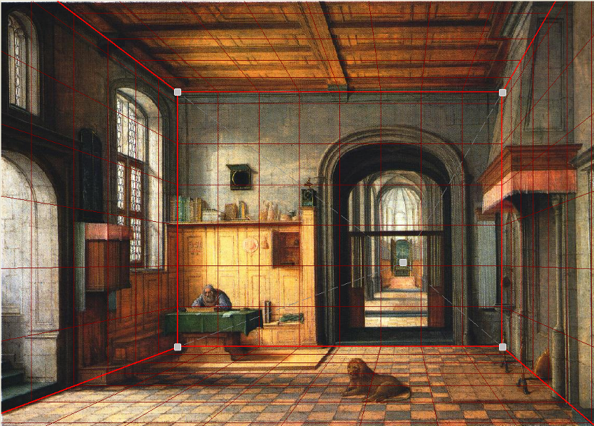
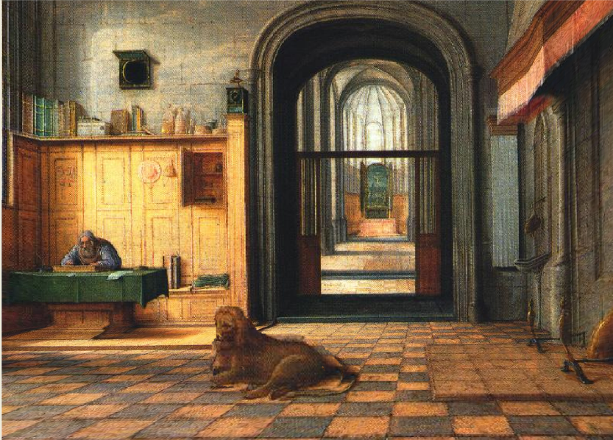
Foreground DEMO

