Slide 1
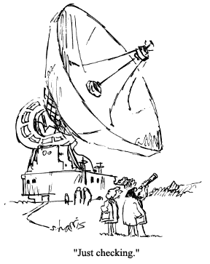
Stereopsis and Epipolar Geometry
CS180: : Intro to Comp. Vision and Comp. Photo
Efros & Ng, UC Berkeley, Fall 2026

Slide 2
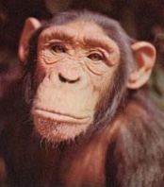
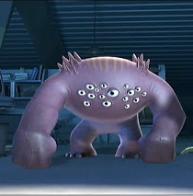

Vision systems
Two cameras
N cameras
One camera

Slide 3
Let’s consider two eyes
Two cameras
N cameras
One camera

Slide 4
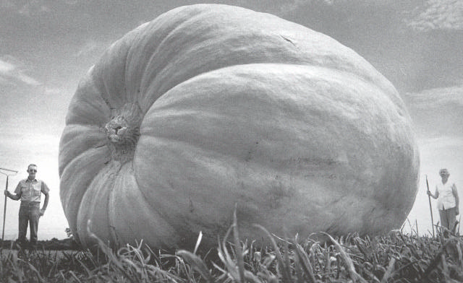
Why multiple views?
Structure (geometry) and depth are inherently ambiguous from single views.
Images from Lana Lazebnik

Slide 5
Why multiple views?
Structure (geometry) and depth are inherently ambiguous from single views.
P1
P2
P1’=P2’
Optical center

Slide 6
Stereo images

Slide 7
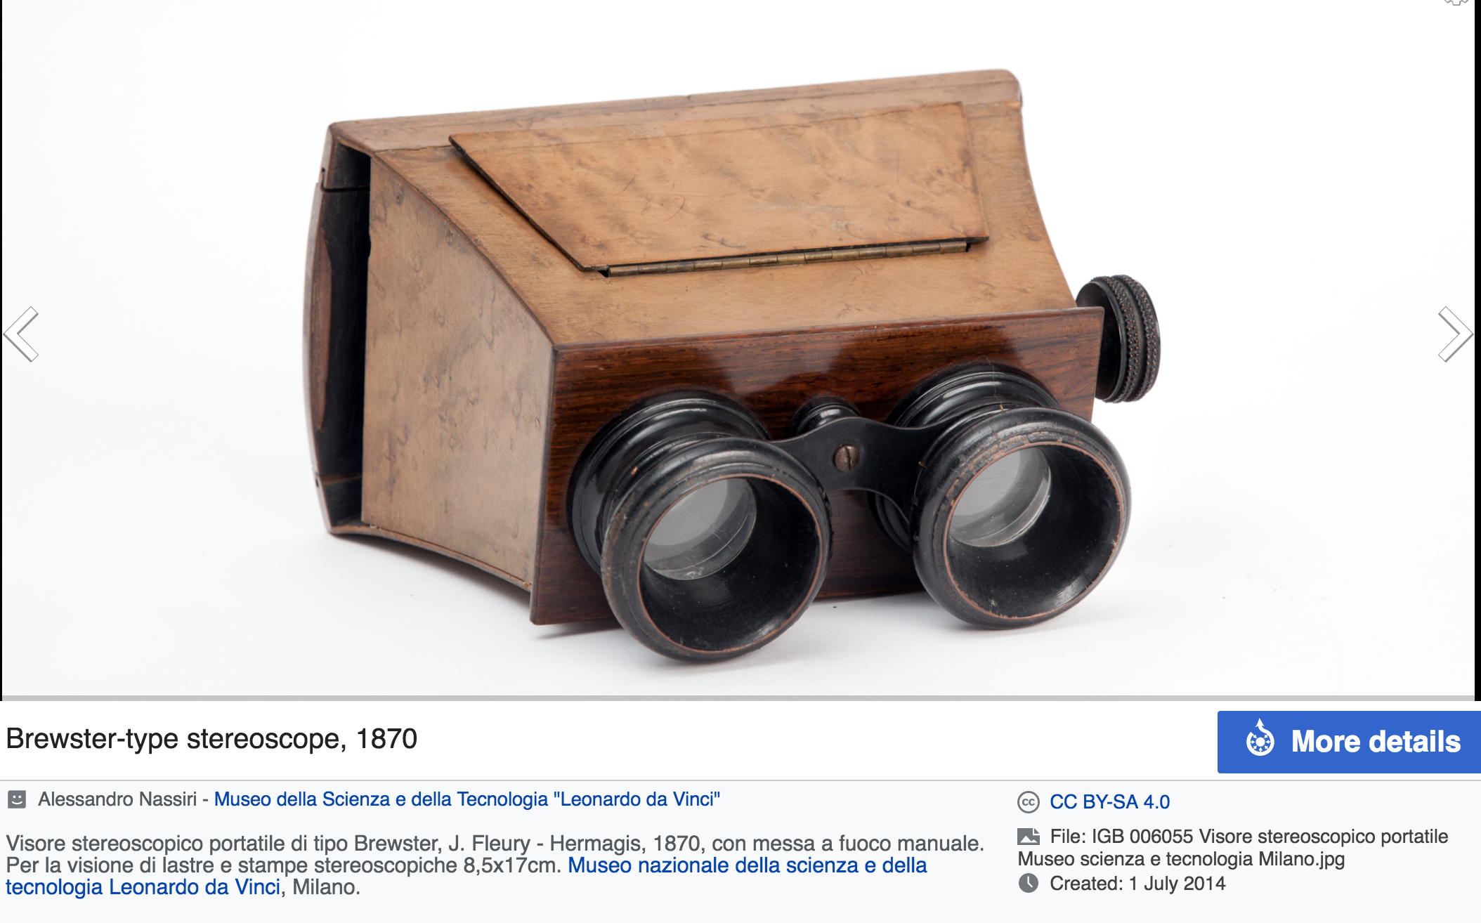
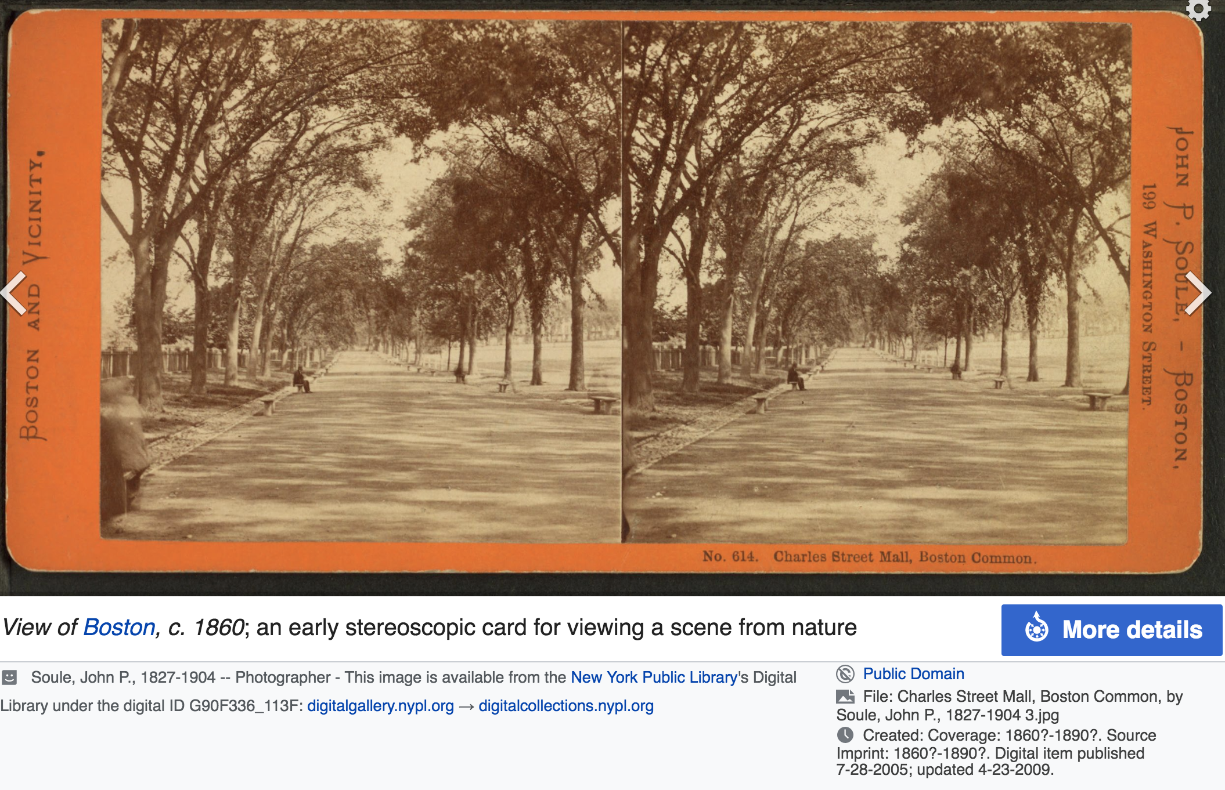
Stereoscope

Slide 8
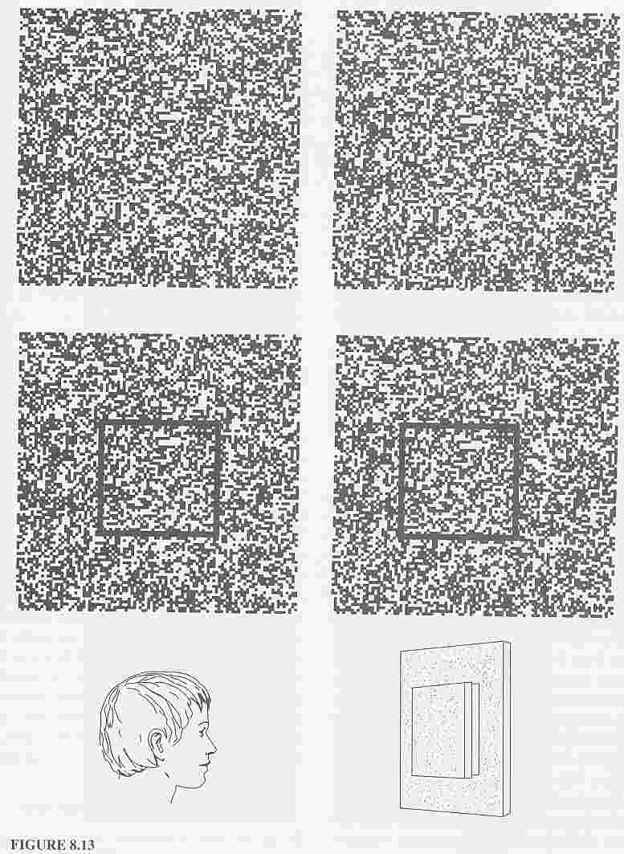
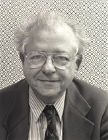
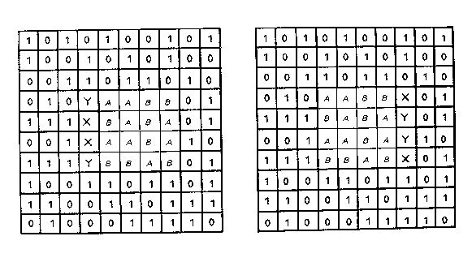
Depth without objects
Random dot stereograms (Bela Julesz)
Julesz, 1971

Slide 9
disparity
Left image
Right image
Antonio took one picture, then he moved ~1m to the right and took a second picture.

Slide 10
disparity
Left image
Right image

Slide 11
disparity
Left image
Right image

Slide 12
Disparity map
I(x,y)
I’(x,y)
I’(x,y) = I(x+D(x,y), y)
D(x,y)
a
Z(x,y) =
D(x,y)

Slide 13

Rotation vs. Translation

Slide 14
Rotation vs. Translation
Notes:
Try again by making the fingers overlap for a single eye, then look in the other eye
Bottom line, you need more than 1 view is important!!

Slide 15
Parallax
parallax!
Parallax = from ancient Greek parállaxis
= Para (side by side) + allássō, (to alter)
= Change in position from different view point
Two eyes give you parallax, you can also move to see more parallax = “Motion Parallax”
Notes:
para = side by side
allassein (vary / change)

Slide 16
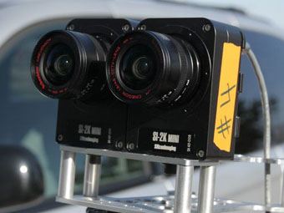
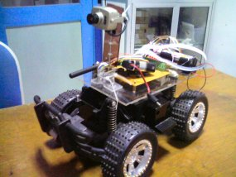
Stereo vision
Two cameras, simultaneous views
Single moving camera and static scene

Slide 17
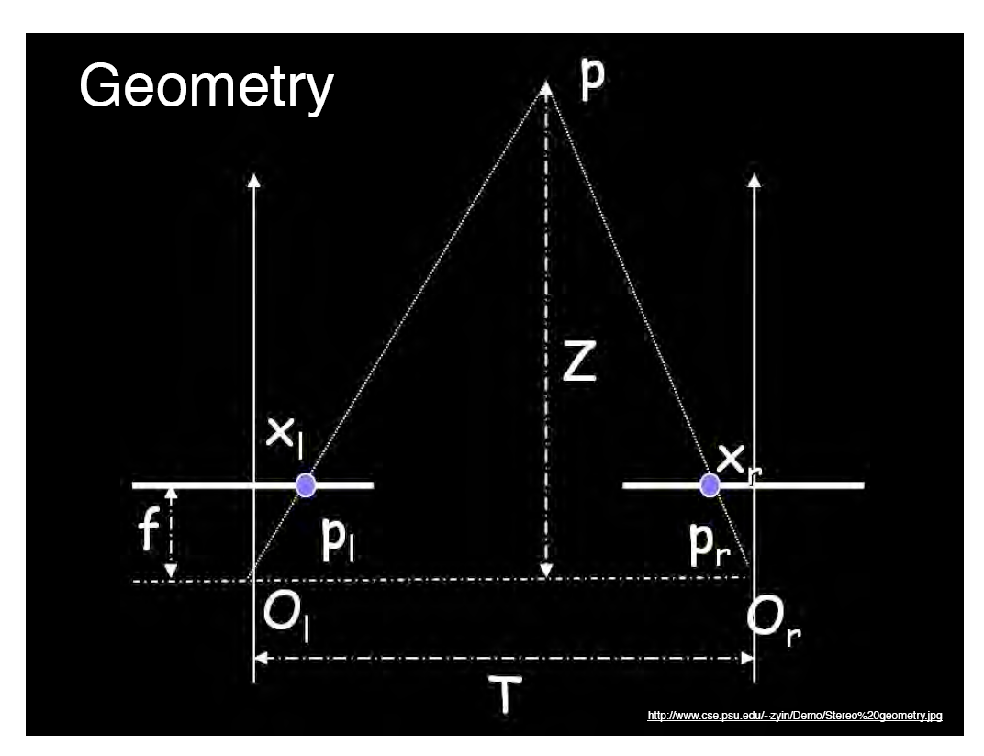
Geometry for a simple stereo system
Assume parallel optical axes, known camera parameters (i.e., calibrated cameras).
Use similar triangles (p_{l}, P, p_{r}) and (O_{l}, P, O_{r}):
want Z
disparity
Grauman
Notes:
17

Slide 18
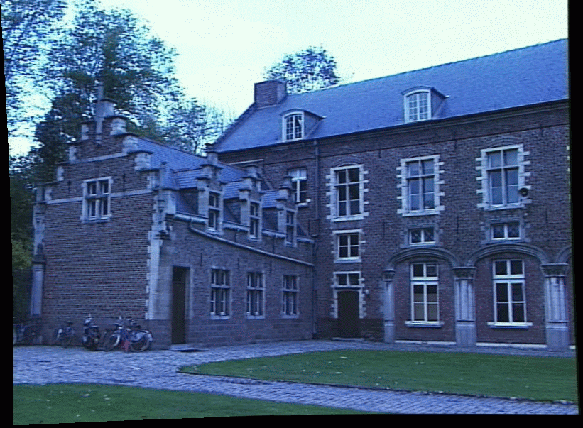
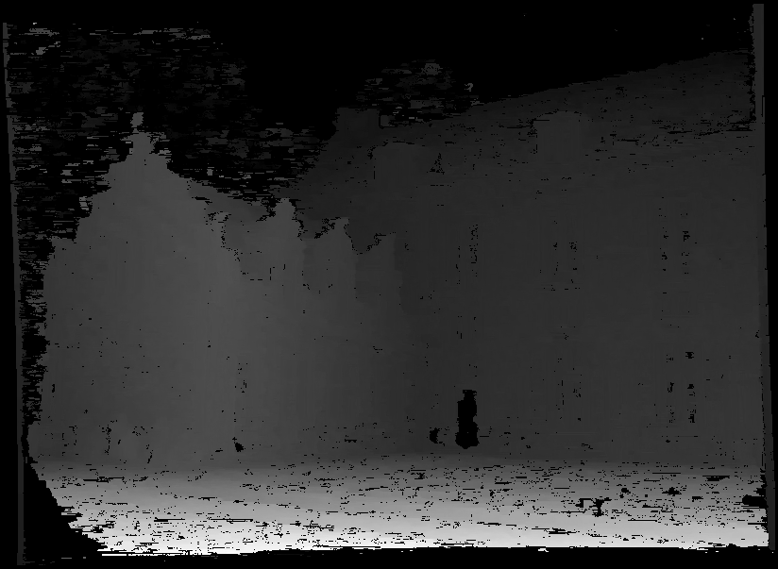
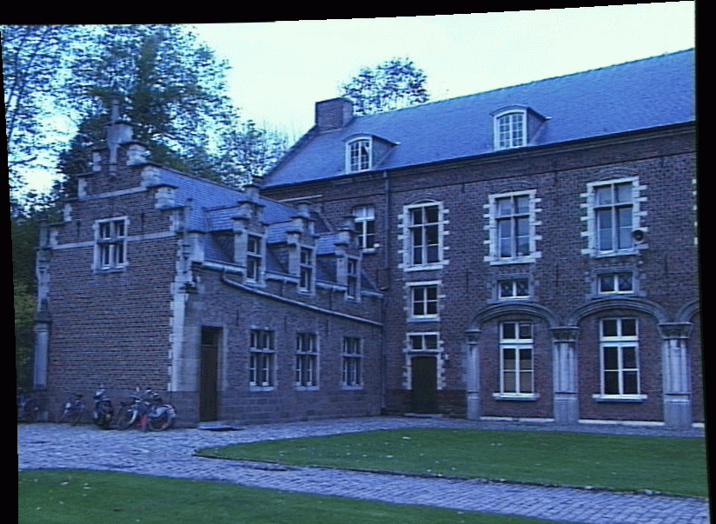
Non-parametric transformation!
image I(x,y)
Disparity map D(x,y)
image I´(x´,y´)
(x´,y´)=(x+D(x,y), y)
Grauman

Slide 19
Triangulation for Ship Navigation

Slide 20
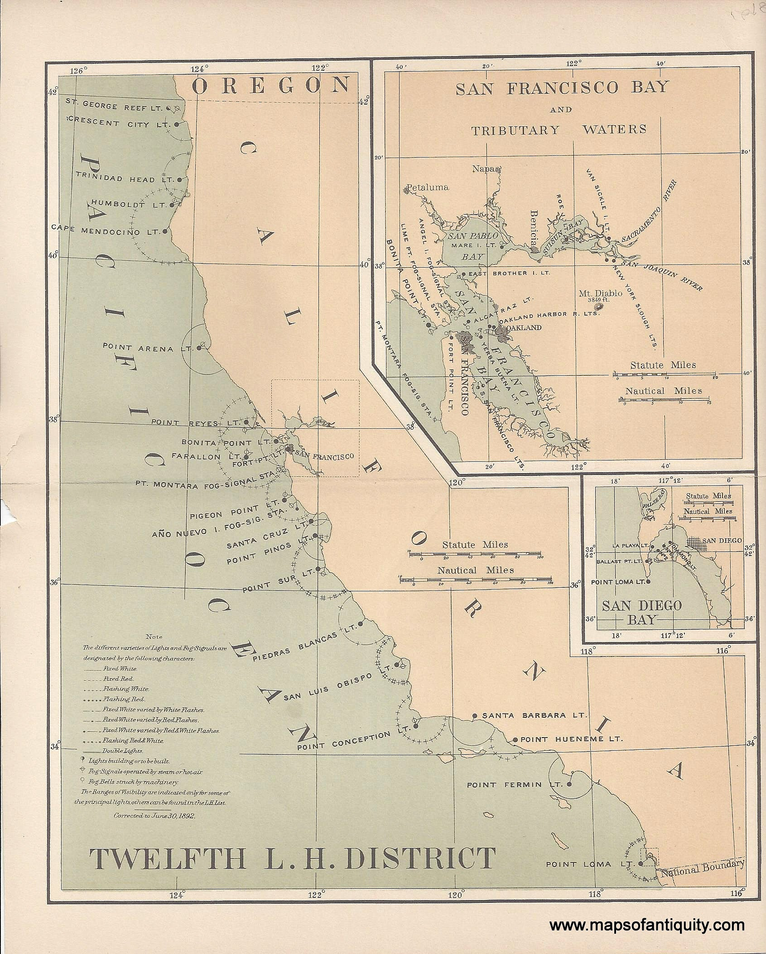
Triangulation

Slide 21
Geometry for a simple stereo system
Assume parallel optical axes, known camera parameters (i.e., calibrated cameras).
Use similar triangles (p_{l}, P, p_{r}) and (O_{l}, P, O_{r}):
want Z
disparity
Grauman
Notes:
21

Slide 22
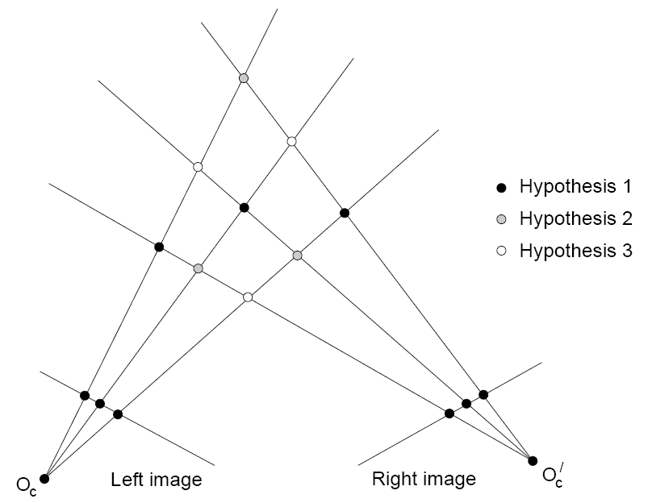
Correspondence problem
Figure from Gee & Cipolla 1999
Grauman

Slide 23
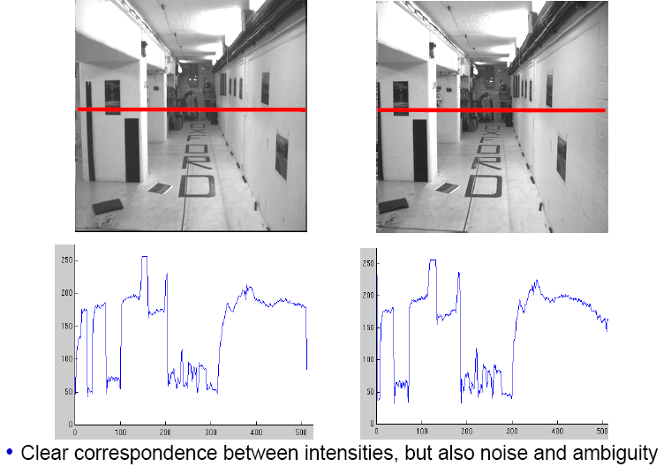
Intensity profiles
Source: Andrew Zisserman

Slide 24
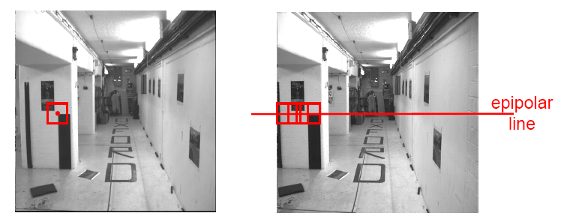
Correspondence problem
Neighborhood of corresponding points are similar in intensity patterns.
Source: Andrew Zisserman

Slide 25
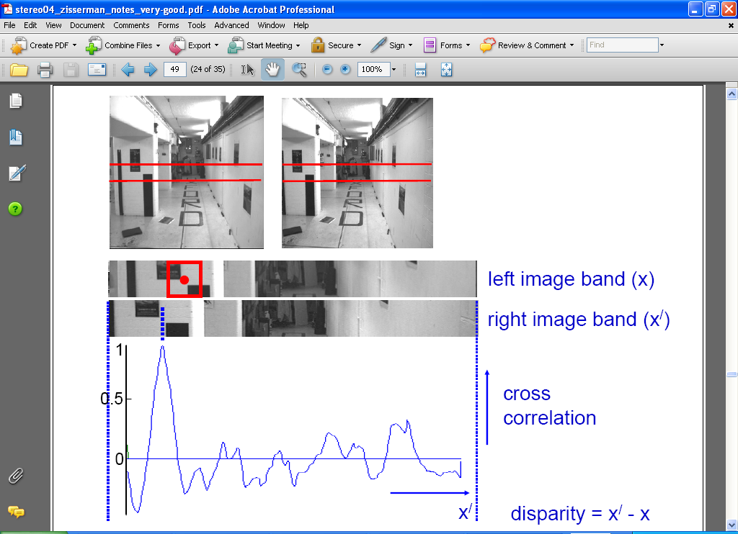
Correlation-based window matching
Source: Andrew Zisserman

Slide 26
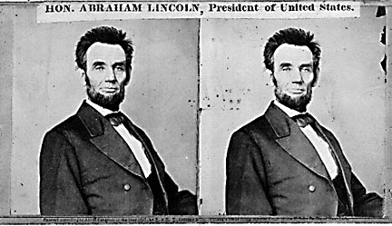
Dense correspondence search
For each epipolar line
For each pixel / window in the left image
    compare with every pixel / window on same epipolar line in right image
    pick position with minimum match cost (e.g., SSD, correlation)
Adapted from Li Zhang
Grauman
Notes:
26

Slide 27
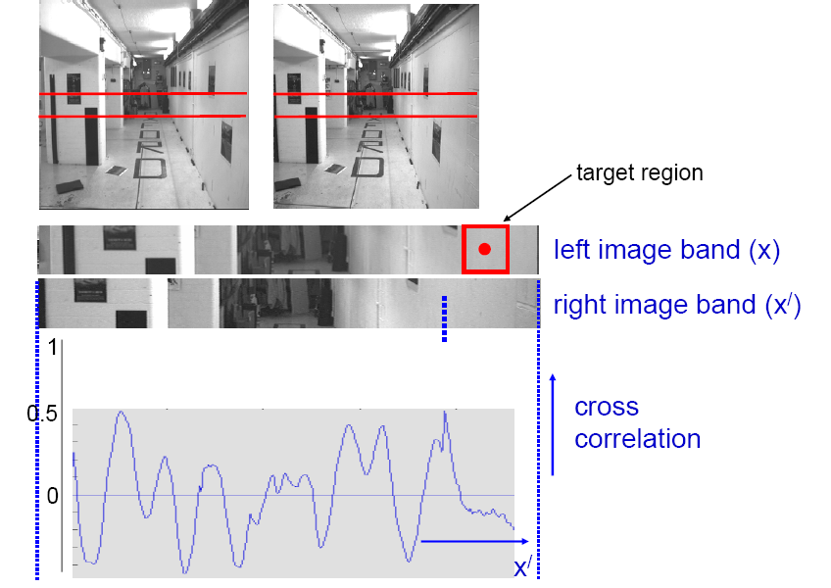
Textureless regions
Textureless regions are non-distinct; high ambiguity for matches.
Source: Andrew Zisserman
Grauman

Slide 28
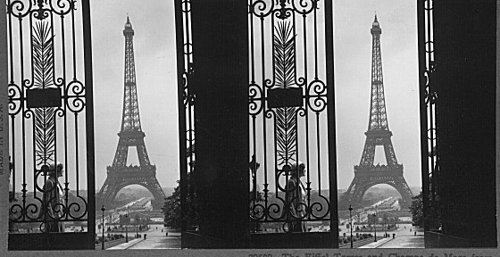
Failures of Correspondence Search
Repeated Patterns. Why?
?
?
Image credit: S. Lazebnik

Slide 29
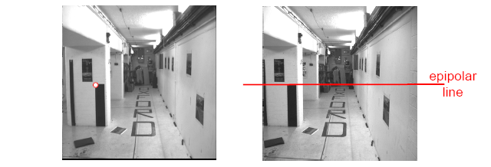
Effect of window size
Source: Andrew Zisserman
Grauman

Slide 30
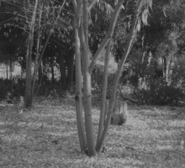
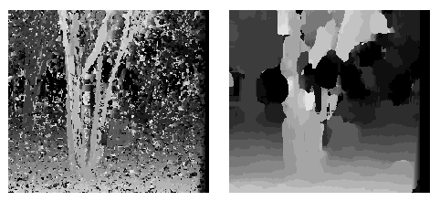
Effect of window size
W = 3
W = 20
Want window large enough to have sufficient intensity variation, yet small enough to contain only pixels with about the same disparity.
Figures from Li Zhang
Grauman

Slide 31
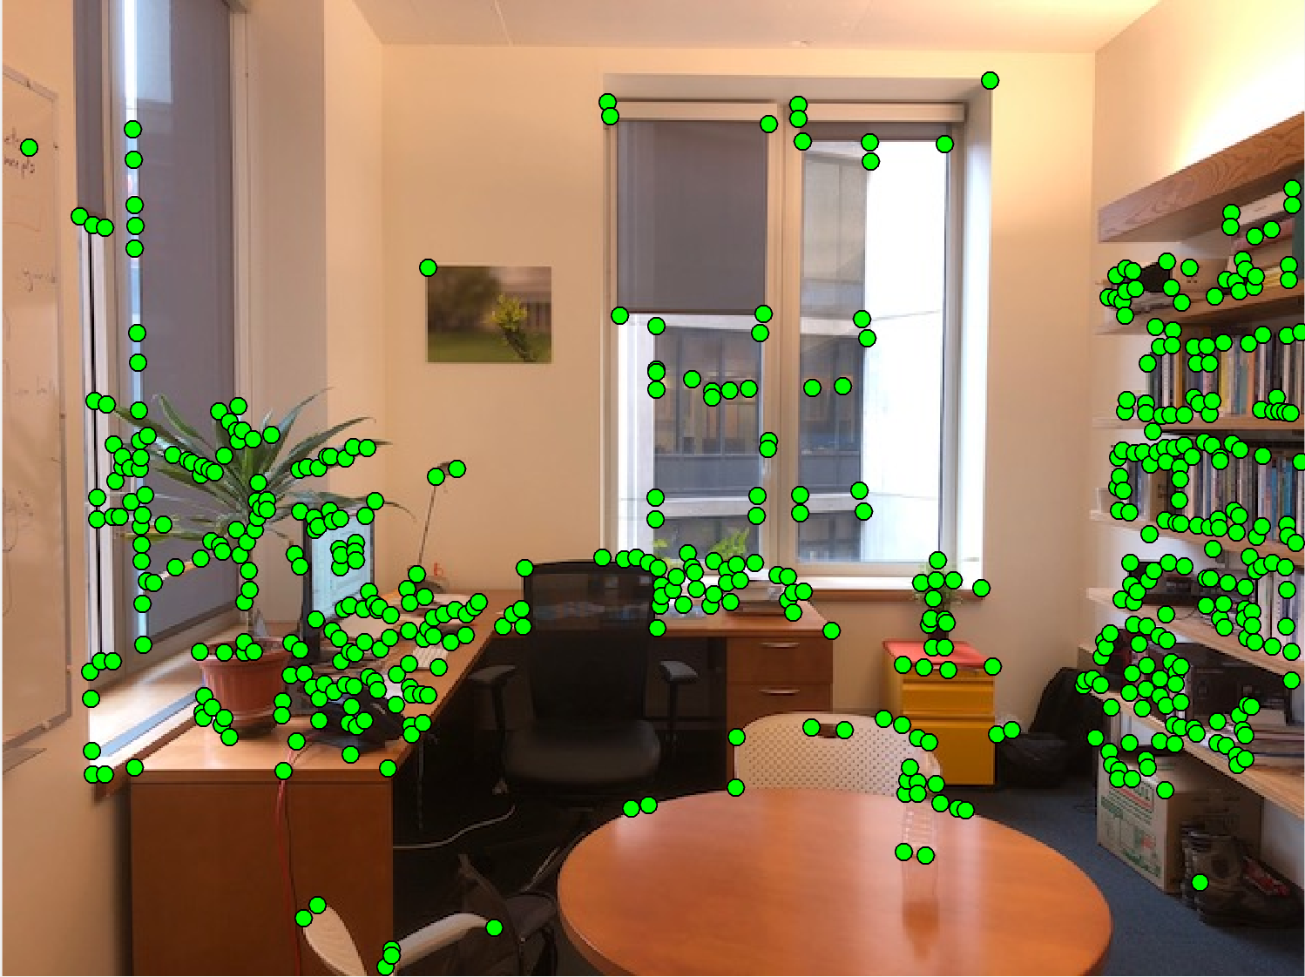
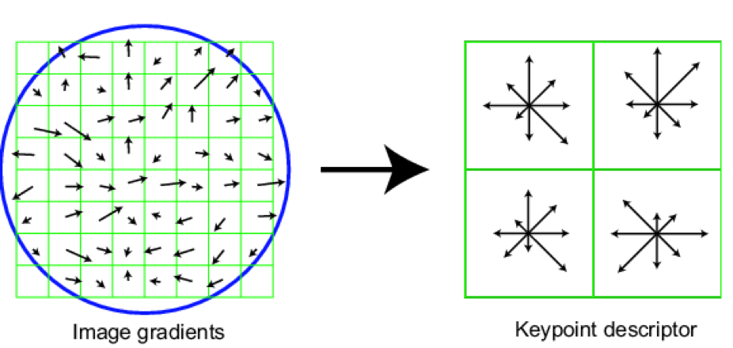
Feature correspondences
1) detect keypoints
2) extract SIFT
at each keypoint
points = detectHarrisFeatures(img);

Slide 32
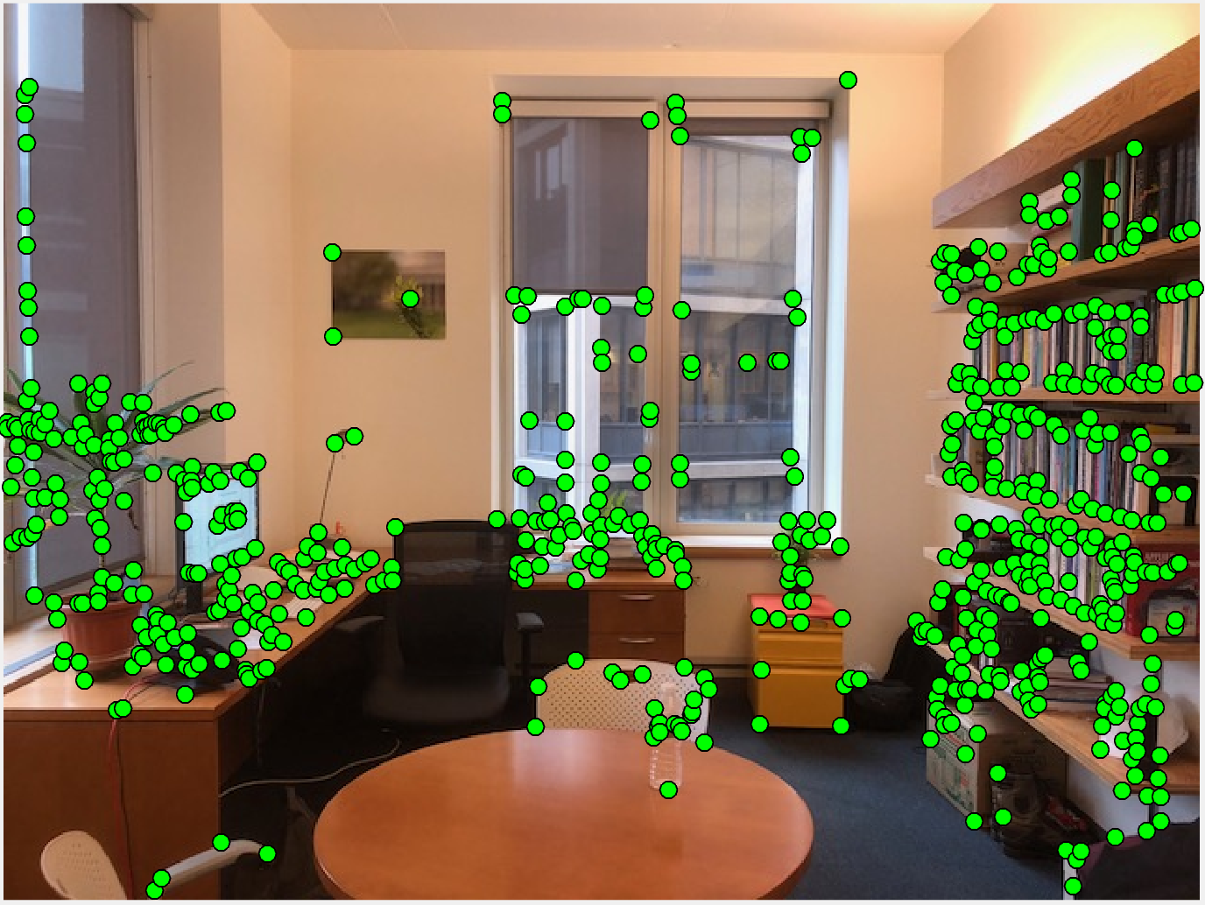
Finding correspondences (SIFT)

Slide 33
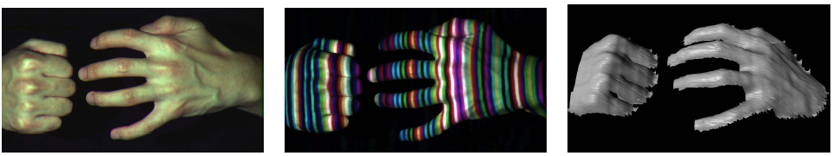
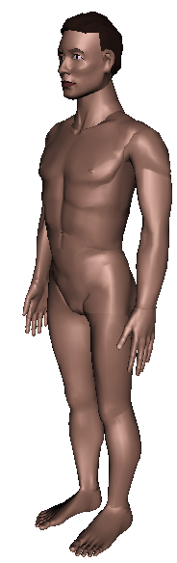
Active stereo with structured light
Li Zhang’s one-shot stereo
camera 1
camera 1
projector
projector
camera 2
Project “structured” light patterns onto the object
  simplifies the correspondence problem

Slide 34
CNN-based Stereo Matching

Slide 35
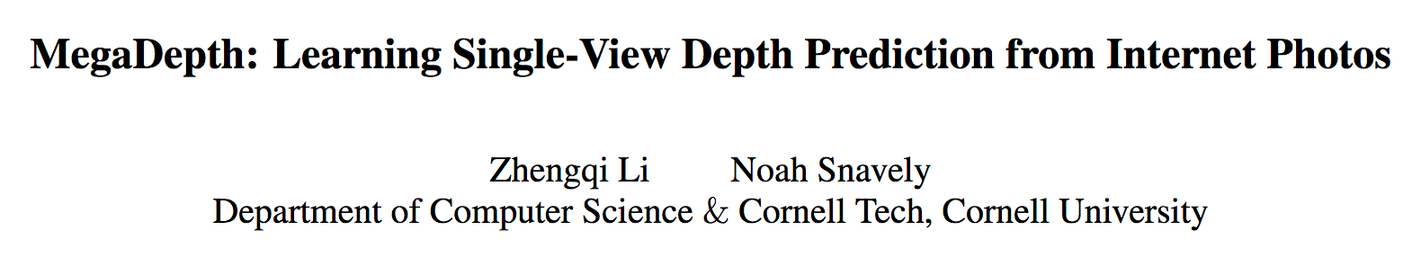
Can also learn depth from a single image
Source: Torralba, Isola, Freeman
Notes:
And of course there are others ways we could have estimated depth. For example, using a neural network to recognize depth at each pixel.
Humans rely a lot on this.

Slide 36
Geometry for a simple stereo system
Assume parallel optical axes, known camera parameters (i.e., calibrated cameras).
Use similar triangles (p_{l}, P, p_{r}) and (O_{l}, P, O_{r}):
want Z
disparity
Grauman
Notes:
36

Slide 37


General case
The two cameras need not have parallel optical axes.
Source: Torralba, Isola, Freeman

Slide 38

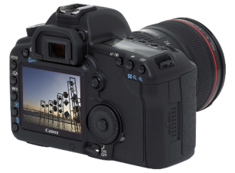
Situating Camera in the world
There is a world coordinate frame and camera looking at the world
How can we model the geometry of a camera?
Camera
w
y
(x, y, z)
COP
u
v
Three important coordinate systems:
World coordinates
Camera coordinates
Image coordinates
o
x
z
“The World”
Slide credit: Noah Snavely

Slide 39
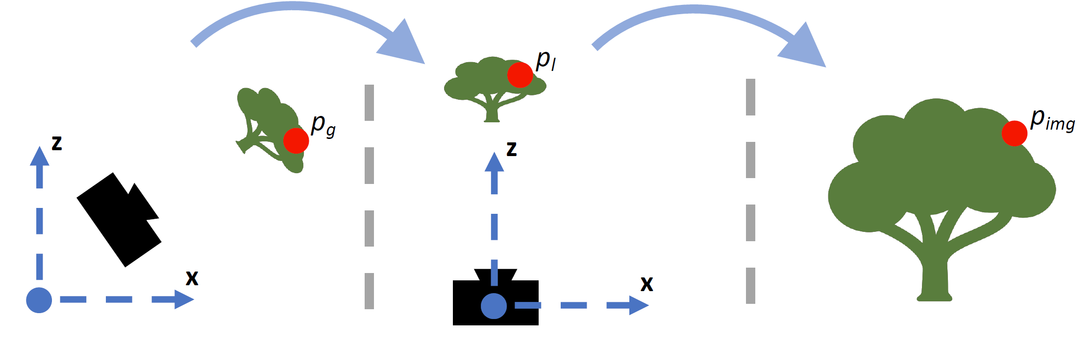
Coordinate frames + Transforms
Orientation + Location of the camera in the World
How the camera maps a point in 3D to image
Extrinsics (R, T)
Intrinsics (K)
World coordinates
Camera coordinates
Image coordinates
Figure credit: Peter Hedman

Slide 40
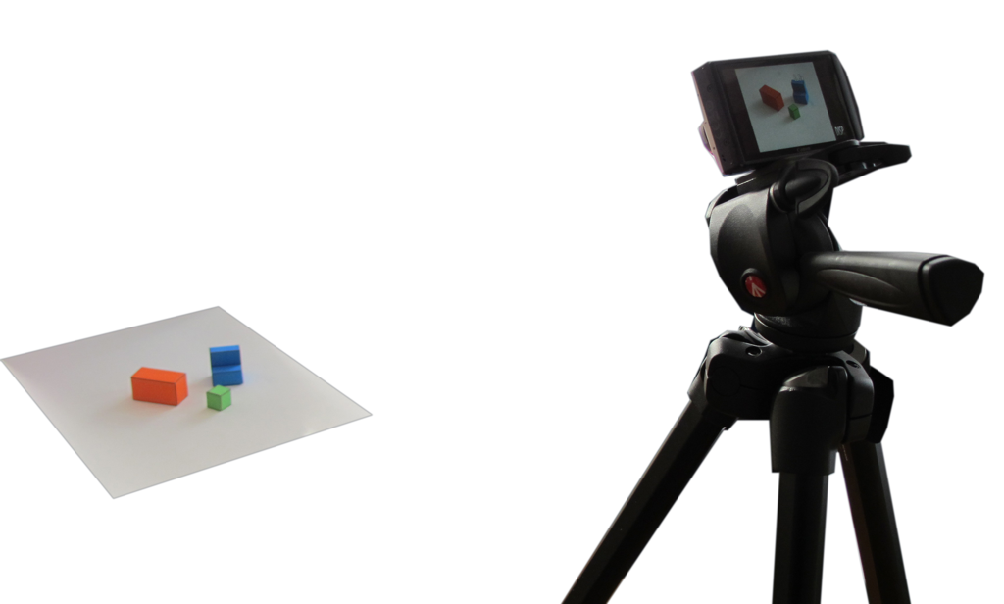
Review: Camera parameters
(x, y)
2D image
?
3D world
(X, Y, Z)
x
y
w
? | ? | ? | ?
? | ? | ? | ?
? | ? | ? | ?
X
Y
Z
1
=
.
Pixels
World coordinates

Slide 41
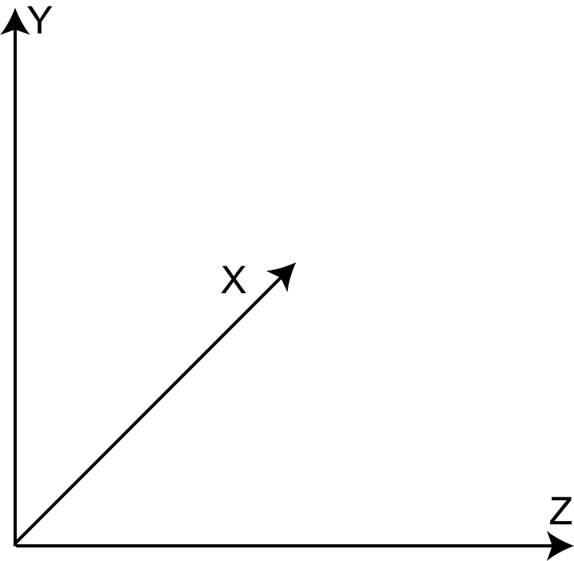
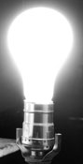
Camera parameters
Sensor
if pixels are rectangular
x
y
w
a | 0 | 0 | 0
0 | b | 0 | 0
0 | 0 | 1 | 0
X
Y
Z
1
aX
bY
Z
=
.
=
(a X/Z, b Y/Z)

Slide 42
Camera parameters
Y_{W}
World coordinates
What if the camera origin is not at the world coordinates origin?
X_{W}
Y_{C}
Z_{W}
X_{C}
T
Z_{C}
Camera coordinates

Slide 43
Camera parameters
Y_{W}
P_{W}
World coordinates
X_{W}
P_{C}
Y_{C}
Z_{W}
X_{C}
T
Z_{C}
Camera coordinates
In heterogeneous coordinates:
P_{C} = P_{W} - T

Slide 44
Camera parameters
Y_{W}
P_{W}
World coordinates
X_{W}
P_{C}
Y_{C}
R
Z_{W}
X_{C}
T
Z_{C}
Camera coordinates
In heterogeneous coordinates:
P_{C} = R(P_{W} - T)

Slide 45
Camera parameters
Y_{W}
P_{W}
World coordinates
X_{W}
P_{C}
Y_{C}
R
Z_{W}
X_{C}
T
Z_{C}
In homogeneous coordinates:
Camera coordinates
[3x3]
[3x1]
X_{c}
Y_{c}
Z_{c}
1
R | -RT
0 | 1
X_{w}
Y_{w}
Z_{w}
1
=
.
[1x3]
[1x1]

Slide 46
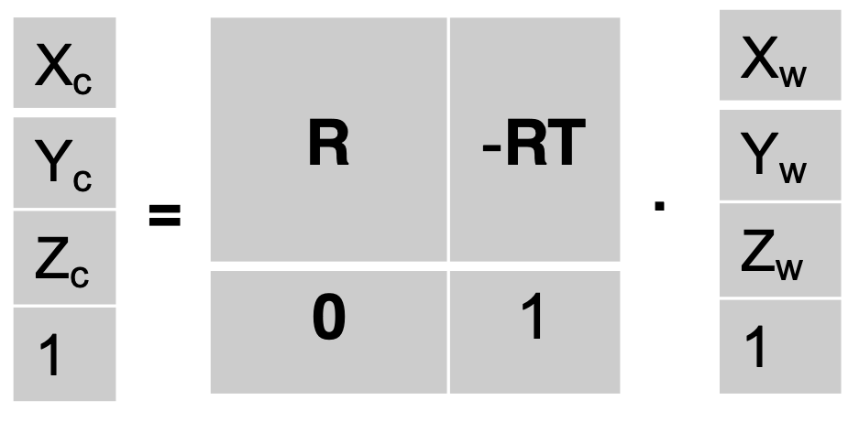
Camera parameters
Y_{W}
World coordinates
X_{W}
Y_{C}
R
Z_{W}
X_{C}
T
Z_{C}
1. World coordinates to camera coordinates
2. Camera coordinates to image coordinates (square pixels)
x
y
w
a | 0 | 0 | 0
0 | a | 0 | 0
0 | 0 | 1 | 0
X_{c}
Y_{c}
Z_{c}
1
=
.

Slide 47
Camera parameters
Y_{W}
X_{W}
Y_{C}
R
Z_{W}
X_{C}
T
Z_{C}
x
y
w
? | ? | ? | ?
? | ? | ? | ?
? | ? | ? | ?
X_{w}
Y_{w}
Z_{w}
1
=

Slide 48
Camera parameters
Y_{W}
X_{W}
Y_{C}
R
Z_{W}
X_{C}
T
Z_{C}
[3x4]
[4x4]
x
y
w
a | 0 | 0 | 0
0 | a | 0 | 0
0 | 0 | 1 | 0
R | -RT
0 | 1
X_{w}
Y_{w}
Z_{w}
1
=
.
.

Slide 49
Camera parameters
Y_{W}
X_{W}
Y_{C}
R
Z_{W}
X_{C}
T
Z_{C}
[3x3]
[3x4]
x
y
w
a | 0 | 0
0 | a | 0
0 | 0 | 1
R | -RT
X_{w}
Y_{w}
Z_{w}
1
=
.
.

Slide 50
Camera parameters
Y_{W}
X_{W}
Y_{C}
R
Z_{W}
X_{C}
T
Z_{C}
[3x3]
[3x3]
[3x4]
x
y
w
a | 0 | 0
0 | a | 0
0 | 0 | 1
R
I | -T
X_{w}
Y_{w}
Z_{w}
1
=
.
.
.
.
Intrinsic parameters
Extrinsic parameters

Slide 51
Camera Projection Model
5
6
Notes:
How many known points are needed to estimate this?

Slide 52
How to calibrate the camera?

Slide 53
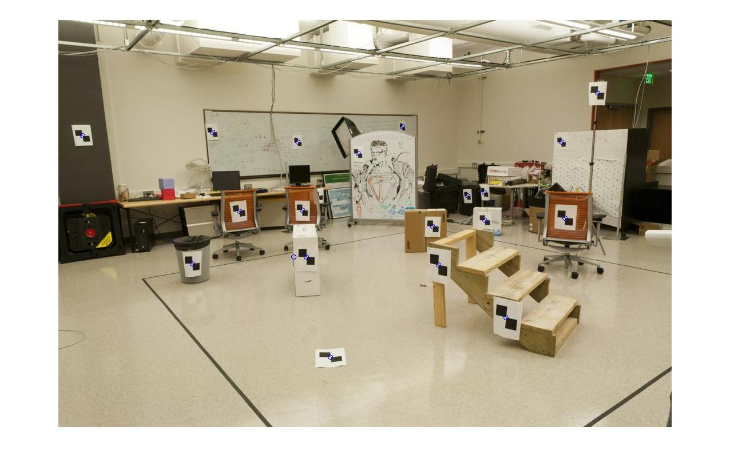
How do we calibrate a camera? Learning problem!
880 214
43 203
270 197
886 347
745 302
943 128
476 590
419 214
317 335
783 521
235 427
665 429
655 362
427 333
412 415
746 351
434 415
525 234
716 308
602 187
312.747 309.140 30.086
305.796 311.649 30.356
307.694 312.358 30.418
310.149 307.186 29.298
311.937 310.105 29.216
311.202 307.572 30.682
307.106 306.876 28.660
309.317 312.490 30.230
307.435 310.151 29.318
308.253 306.300 28.881
306.650 309.301 28.905
308.069 306.831 29.189
309.671 308.834 29.029
308.255 309.955 29.267
307.546 308.613 28.963
311.036 309.206 28.913
307.518 308.175 29.069
309.950 311.262 29.990
312.160 310.772 29.080
311.988 312.709 30.514

Slide 54
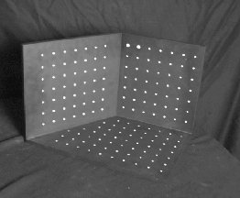
Calibration using a reference object
Place a known object in the scene
  identify correspondence between image and scene
  compute mapping from scene to image
Issues
  must know geometry very accurately
  must know 3D -> 2D correspondence

Slide 55
Method: Setup a linear system
Solve for m’s entries using linear least squares
Ax=0 form
Just like how you solved for homography!

Slide 56
Can we factorize M back to K [R | T]?
Yes.
Why? because K and R have a very special form:
RQ decomposition
Practically, use camera calibration packages (there is a good one in OpenCV)
Notes:
R is orthonormal & K is upper triangular → QR factorization
T can be recovered as K^{-1} [m14; m24; m34]
There’s lens parameters.. we’re ignoring distortions

Slide 57
General case
The two cameras need not have parallel optical axes.
Source: Torralba, Isola, Freeman

Slide 58
Source: Torralba, Isola, Freeman

Slide 59
Can we search for matches only along horizontal lines?
Source: Torralba, Isola, Freeman

Slide 60
Can we search for matches only along horizontal lines?
Source: Torralba, Isola, Freeman

Slide 61
Can we search for matches only along horizontal lines?
It looks like we might need to search everywhere... are there any constraints
that can guide the search?
Source: Torralba, Isola, Freeman
Notes:
At first, this might seem really hopeless. It looks at first glance like we might have to search everywhere.
Are there extra constraints we could take advantage of?

Slide 62
Stereo correspondence constraints
Camera 1
Camera 2
p’ ?
p
O
O’
If we see a point in camera 1, are there any constraints on where we
will find it on camera 2?
Source: Torralba, Isola, Freeman
Notes:
Let’s think about this. If we see at a point p in the image. Let’s think of lal the possible places it could appear in the second view

Slide 63
Stereo correspondence constraints
p’ ?
p
O
O’
Source: Torralba, Isola, Freeman
Notes:
The only thing that’s unknown is the depth. So the true point has to lie along this ray. It has to be one of these point.
Let’s look at where those end up in the other image. They’re all along a line!
If we could just find this line,

Slide 64
Stereo correspondence constraints
p’ ?
p
O
O’
Source: Torralba, Isola, Freeman
Notes:
The only thing that’s unknown is the depth. So the true point has to lie along this ray. It has to be one of these point.
Let’s look at where those end up in the other image. They’re all along a line!
If we could just find this line,

Slide 65
Epipolar constraint
p’ ?
p
O
O’
Source: Torralba, Isola, Freeman

Slide 66
Some terminology
p’ ?
p
O
O’
Source: Torralba, Isola, Freeman

Slide 67
Some terminology
p’ ?
p
Baseline
O
O’
Baseline: the line connecting the two camera centers
Epipole: point of intersection of baseline with the image plane
Source: Torralba, Isola, Freeman

Slide 68
Some terminology
p’ ?
p
epipole
Baseline
epipole
O
O’
Baseline: the line connecting the two camera centers
Epipole: point of intersection of baseline with the image plane
Source: Torralba, Isola, Freeman

Slide 69
Some terminology
epipolar plane
p’ ?
p
O
O’
Baseline: the line connecting the two camera centers
Epipole: point of intersection of baseline with the image plane
Epipolar plane: the plane that contains the two camera centers and a 3D point in the world
Source: Torralba, Isola, Freeman
Notes:
Consider this plane that connects the episode and contains the point.
That’s going to dictate where the epipolar line is.

Slide 70
Some terminology
epipolar line
epipolar line
p’ ?
p
O
O’
Baseline: the line connecting the two camera centers
Epipole: point of intersection of baseline with the image plane
Epipolar plane: the plane that contains the two camera centers and a 3D point in the world
Epipolar line: intersection of the epipolar plane with each image plane
Source: Torralba, Isola, Freeman

Slide 71
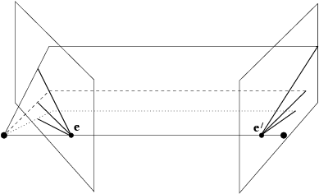
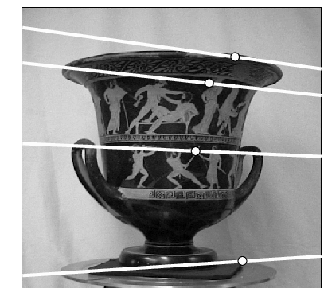
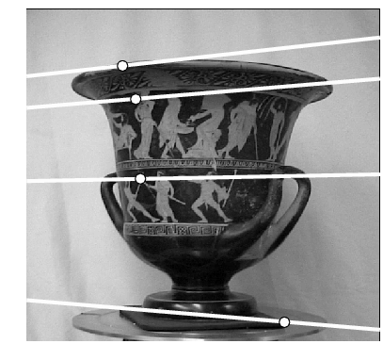
Example: converging cameras
As position of 3d point varies, epipolar lines “rotate” about the baseline
Figure from Hartley & Zisserman
Notes:
71

Slide 72
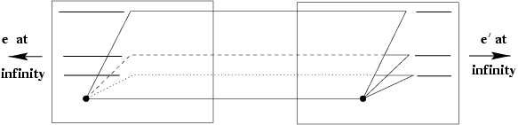
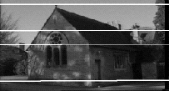
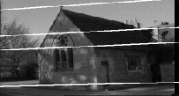
Example: motion parallel with image plane
Figure from Hartley & Zisserman
Notes:
72

Slide 73
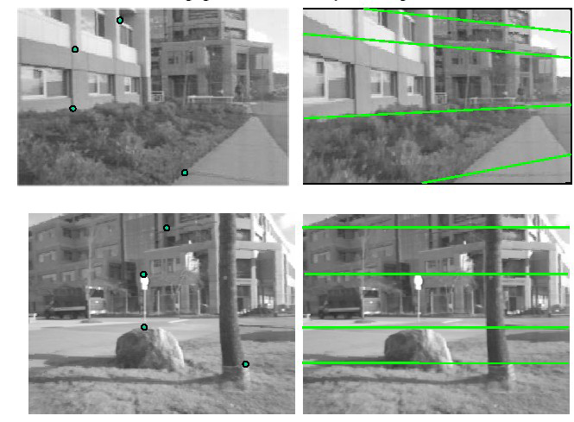
Example

Slide 74
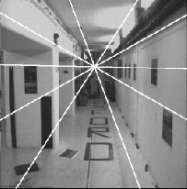
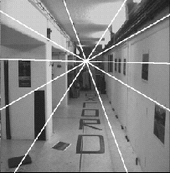
Example: forward motion
e’
e
Epipole has same coordinates in both images.
Points move along lines radiating from e: “Focus of expansion”
Figure from Hartley & Zisserman
Notes:
74

Slide 75
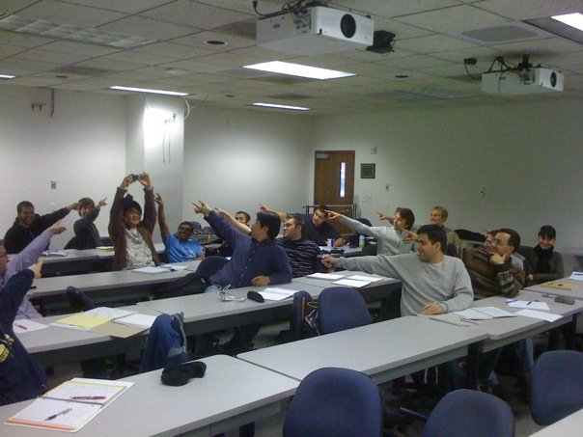
The Epipole
Photo by Frank Dellaert
Notes:
Where the students are pointing is the epipole!!! (there’s the other camera)

Slide 76
Stereo image rectification
In practice, it is convenient if image scanlines are the epipolar lines.
reproject image planes onto a common
plane parallel to the line between optical centers
pixel motion is horizontal after this transformation
two homographies (3x3 transforms), one for each input image reprojection
Adapted from Li Zhang
C. Loop and Z. Zhang. Computing Rectifying Homographies for Stereo Vision. CVPR 1999.
Notes:
76

Slide 77
Stereo image rectification: example

Slide 78
For a given stereo rig, how do we express the epipolar constraints algebraically?
For calibrated cameras, with Essential Matrix
For uncalibrated cameras, with Fundamental Matrix

Slide 79

Stereo geometry, with calibrated cameras
Deriving the Essential Matrix:
If the rig is calibrated, we know :
  how to rotate and translate camera reference frame 1 to get to camera reference frame 2.
    Rotation: 3 x 3 matrix; translation: 3 vector.
Grauman
Notes:
79

Slide 80

3d rigid transformation
Deriving the Essential Matrix:
‘
‘
‘
Grauman

Slide 81

Stereo geometry, with calibrated cameras
Deriving the Essential Matrix:
Camera-centered coordinate systems are related by known rotation R and translation T:
Grauman
Notes:
81

Slide 82

Review: Cross product
Deriving the Essential Matrix:
Vector cross product takes two vectors and returns a third vector that’s perpendicular to both inputs.
So here, c is perpendicular to both a and b, which means the dot product = 0.
Grauman
Notes:
82

Slide 83
From geometry to algebra
Deriving the Essential Matrix:
Normal to the plane
Grauman
Notes:
83

Slide 84
From geometry to algebra
Deriving the Essential Matrix:
Normal to the plane
Grauman
Notes:
84

Slide 85
Matrix form of cross product
Deriving the Essential Matrix:
Can be expressed as a matrix multiplication.
Grauman
Notes:
85

Slide 86

Essential matrix
Let
This holds for the rays p and p’ that are parallel to the camera-centered position vectors X and X’, so we have:
E is called the essential matrix, which relates corresponding image points [Longuet-Higgins 1981]
Grauman
Notes:
86

Slide 87

Essential matrix and epipolar lines
Epipolar constraint: if we observe point p in one image, then its position p’ in second image must satisfy this equation.
is the coordinate vector representing the epipolar line associated with point p
is the coordinate vector representing the epipolar line associated with point p’
Grauman

Slide 88
Essential matrix: properties
E x’ is the epipolar line associated with x’ (l = E x’)
E^{T}x is the epipolar line associated with x (l’ = E^{T}x)
E e’ = 0 and E^{T}e = 0
E is singular (rank two)
E has five degrees of freedom
  (3 for R, 2 for t because it’s up to a scale)
Grauman
Relates image of corresponding points in both cameras, given rotation and translation
Assuming intrinsic parameters are known

Slide 89


Essential matrix example: parallel cameras
0 0 0
0 0 d
0 –d 0
For the parallel cameras, image of any point must lie on same horizontal line in each image plane.
Grauman
Notes:
89

Slide 90

Essential matrix can be decomposed
E = T_{x}R
If we know E, we can recover t and R

Slide 91
Weak calibration
So far, we have assumed calibrated cameras and were able to perform dense stereo estimation
What if we want to estimate world geometry without requiring calibrated cameras?
  Archival videos
  Photos from multiple unrelated users
  Dynamic camera system
Grauman

Slide 92
Uncalibrated cameras
For an uncalibrated stereo rig, can we we express the epipolar constraints algebraically via the Essential Matrix?
No, we do not know T or R
However we can use the Fundamental Matrix
  Estimate epipolar geometry from a (redundant) set of point correspondences between two uncalibrated cameras

Slide 93
Uncalibrated case
For a given camera:
Camera coordinates
So, for two cameras (left and right):
Camera coordinates
Image pixel coordinates
Internal calibration matrices, one per camera
Grauman

Slide 94
Uncalibrated case: Fundamental matrix
c
From before, the essential matrix E.
Fundamental matrix
Grauman

Slide 95
Fundamental matrix
Relates pixel coordinates in the two views
More general form than essential matrix: we remove need to know intrinsic parameters
If we estimate fundamental matrix from correspondences in pixel coordinates, can reconstruct epipolar geometry without intrinsic or extrinsic parameters
Grauman

Slide 96
Computing F from correspondences
Cameras are uncalibrated: we don’t know E or left or right M_{int} matrices
Estimate F from 8+ point correspondences.
Grauman

Slide 97


Computing F from correspondences
Each point correspondence generates one constraint on F
Collect n of these constraints
Solve for f , vector of parameters.
Grauman

Slide 98

Rank constraint
Solve homogeneous linear system using eight or more matches
Enforce rank-2 constraint (take SVD
of F and throw out the smallest singular value)

Slide 99

The Bible by Hartley & Zisserman

Slide 100

The Fundamental Matrix Song
http://danielwedge.com/fmatrix/
https://www.youtube.com/watch?time_continue=8&v=DgGV3l82NTk&feature=emb_title

