Slide 1
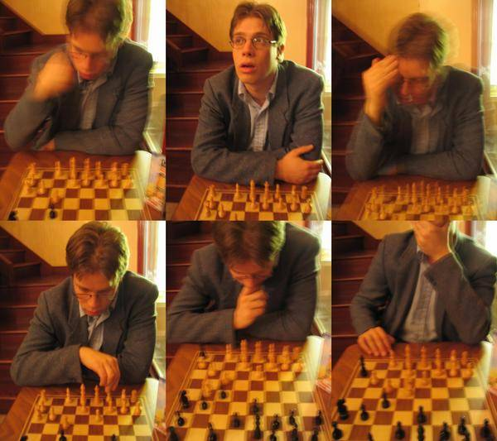
Sequence Models for words and pixels
© A.A. Efros
Many slides from Steve Seitz’s
wonderful 5 min Lectures
CS180: Intro to Computer Vision & Comp. Photography
Efros & Ng, UC Berkeley, Fall 2026

Slide 2
Michel Gondry train video
http://www.youtube.com/watch?v=0S43IwBF0uM

Slide 3
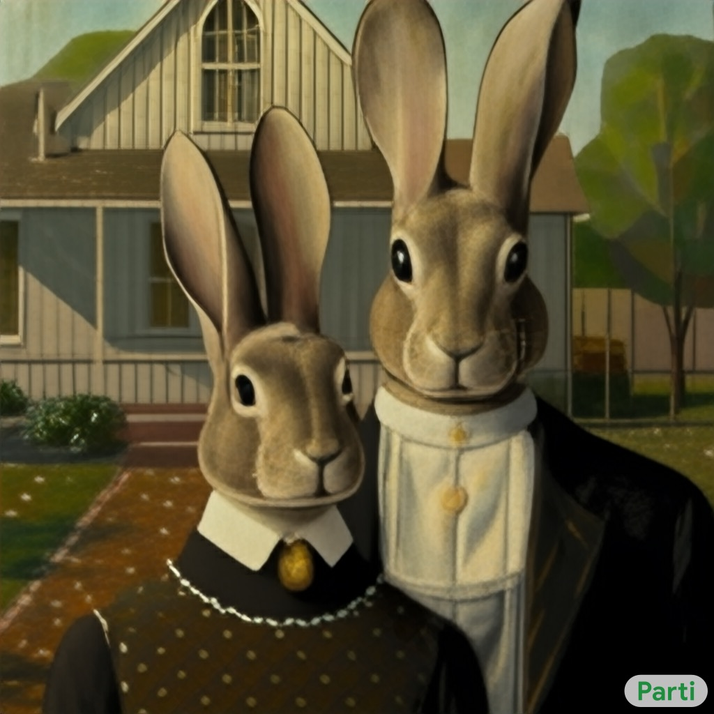

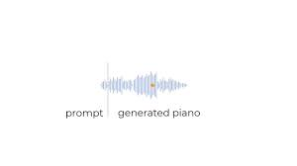
Generative AI
Generative models trained on lots of data have revolutionized computer science and beyond!
Text Pixels Audio

Slide 4
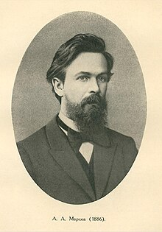
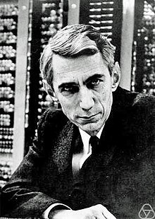
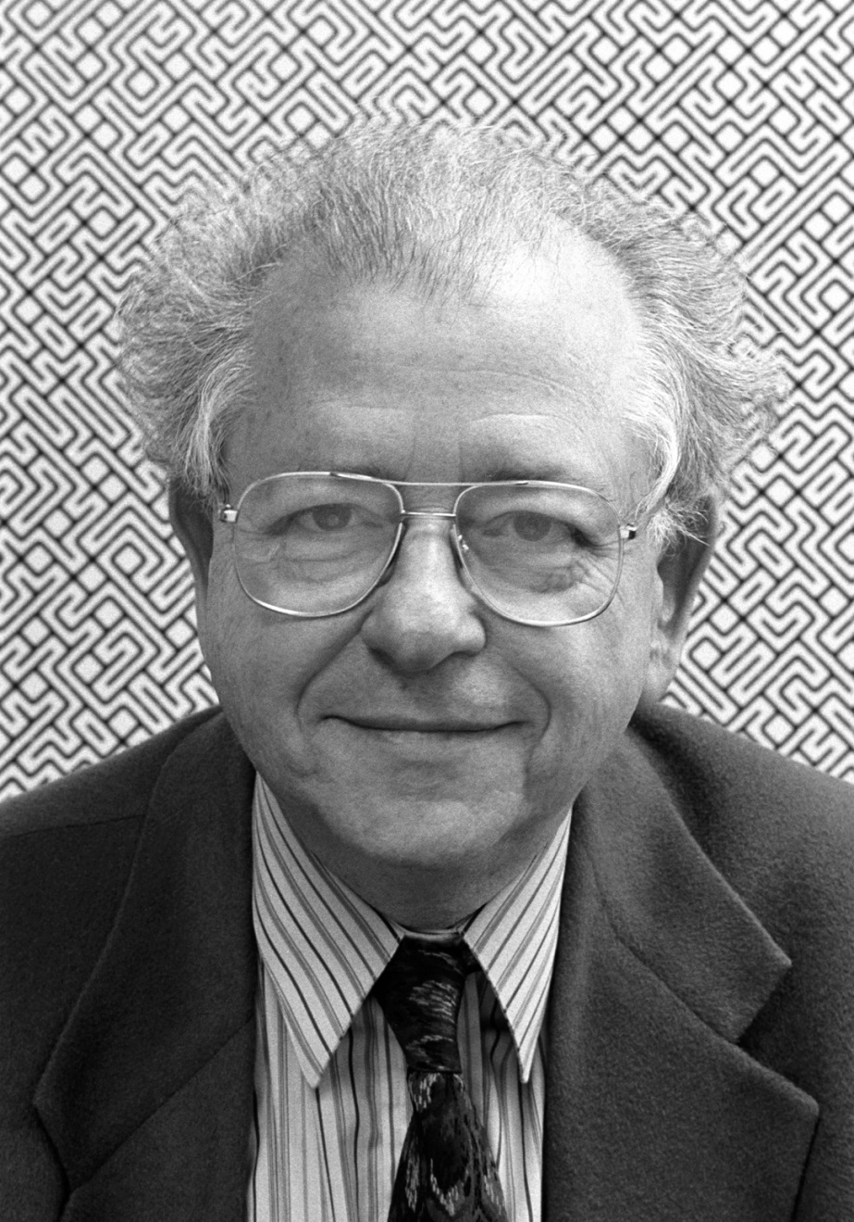
Ideas going back over a hundred years…
Andrey Markov
(1856-1922)
Claude Shannon
(1916-2001)
Bela Julesz
(1928-2003)

Slide 5
Weather Forecasting for Dummies™
Let’s predict weather:
  Given today’s weather only, we want to know tomorrow’s
  Suppose weather can only be {Sunny, Cloudy, Raining}
The “Weather Channel” algorithm:
  Over a long period of time, record:
    How often S followed by R
    How often S followed by S
    Etc.
  Compute percentages for each state:
    P(R|S), P(S|S), etc.
  Predict the state with highest probability!
  It’s a Markov Chain

Slide 6
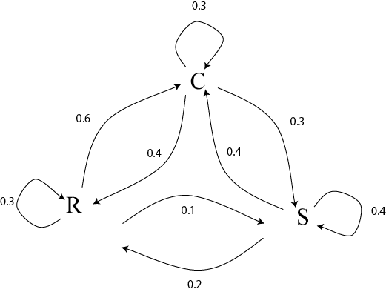
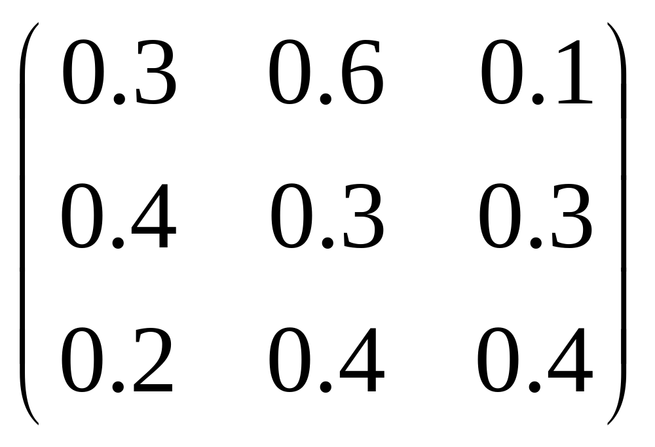
Markov Chain
What if we know today and yestarday’s weather?

Slide 7
Early
one
morning
the
sun
was
shining
I
was
laying
in
bed
Wondering
if
she
had
changed
at
all
if
her
hair
was
still
red
Bob Dylan, Tangled up in Blue
slide from Steve Seitz’s video
Notes:
Here’s an example from a Nobel Prize winning poet
Let’s try to build a language model that can write like Bob Dylan.
We’ll start by thinking of this text as a time series.
where each word depends on the previous one
Notice that the word “was” appears three times
Let’s merge all three instances into one
This gives us a new graph

Slide 8
Early
one
morning
the
sun
was
shining
I
was
laying
in
bed
Wondering
if
she
had
changed
at
all
if
her
hair
was
still
red
slide from Steve Seitz’s video
Notes:
Here’s an example from a Nobel Prize winning poet
Let’s try to build a language model that can write like Bob Dylan.
We’ll start by thinking of this text as a time series.
where each word depends on the previous one
Notice that the word “was” appears three times
Let’s merge all three instances into one
This gives us a new graph

Slide 9
Early
one
morning
the
sun
was
shining
I
was
laying
in
bed
Wondering
if
she
had
changed
at
all
if
her
hair
was
still
red
slide from Steve Seitz’s video
Notes:
Here’s an example from a Nobel Prize winning poet
Let’s try to build a language model that can write like Bob Dylan.
We’ll start by thinking of this text as a time series.
where each word depends on the previous one
Notice that the word “was” appears three times
Let’s merge all three instances into one
This gives us a new graph

Slide 10
laying
in
bed
Early
one
morning
the
sun
was
was
was
was
shining
I
her
hair
still
red
Wondering
if
she
had
changed
at
all
if
slide from Steve Seitz’s video
Notes:
Let’s merge all three instances into one
This turns our series into a graph
The other word that repeats is “if”
and let’s merge these two as well

Slide 11
laying
in
bed
Early
one
morning
the
sun
was
shining
I
her
hair
still
red
Wondering
if
she
had
changed
at
all
if
slide from Steve Seitz’s video
Notes:
Let’s merge all three instances into one
This turns our series into a graph
The other word that repeats is “if”
and let’s merge these two as well

Slide 12
laying
in
bed
Early
one
morning
the
sun
was
shining
I
her
hair
still
red
Wondering
if
if
if
she
had
changed
at
all
slide from Steve Seitz’s video
Notes:
Let’s merge all three instances into one
This turns our series into a graph
The other word that repeats is “if”
and let’s merge these two as well

Slide 13
laying
in
bed
.33
Early
one
morning
the
sun
was
shining
I
.33
.33
her
hair
still
red
.5
Wondering
if
.5
she
had
changed
at
all
Language Model
slide from Steve Seitz’s video
Notes:
If we add probabilities to these edges, it becomes a
Language Model

Slide 14
laying
in
bed
.33
Early
one
morning
the
sun
was
shining
I
.33
.33
her
hair
still
red
.5
Wondering
if
.5
she
had
changed
at
all
Language Model
slide from Steve Seitz’s video
Notes:
the sun was still red
her hair was shining
<not bad!>
the sun was laying in bed
I was shining I was shining I was red

Slide 15
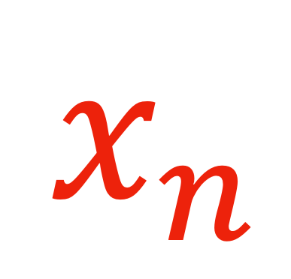
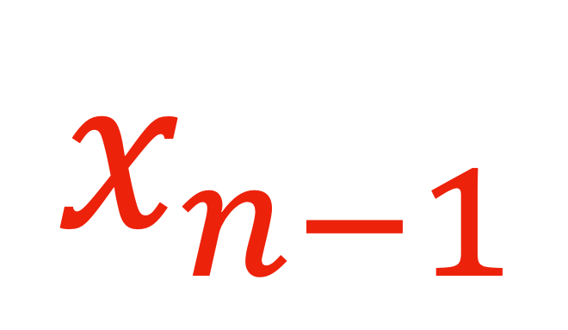

$$x_{n}$$
$$x_{n−1}$$
$$P\left( \right| )$$
laying
in
bed
Early
one
morning
the
sun
was
shining
I
her
hair
still
red
Wondering
if
she
had
changed
at
all
slide from Steve Seitz’s video
Notes:
The real problem here is that our model is too simplistic –
it assumes that each word depends only on the previous word.
We can write this as a conditional probability
It’s the probability of the current word Xn
conditioned on the previous word Xn-1

Slide 16
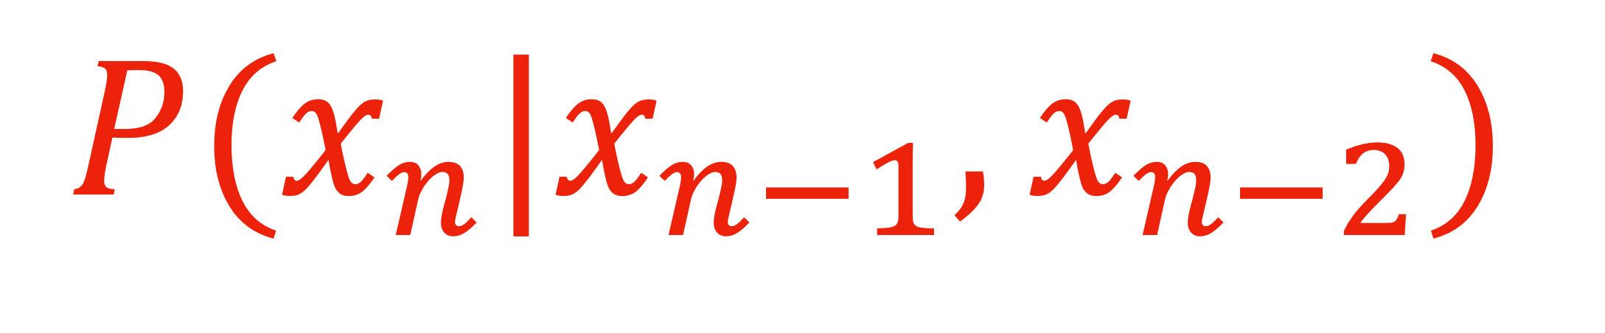
$$P(x_{n}|x_{n−1},x_{n−2})$$
Early
one
morning
one
morning
the
morning
the
sun
the
sun
was
sun
was
shining
was
shining
I
shining
I
was
I
was
laying
…
Notes:
You can use these trigrams to define next word probabilities
based on the two previous words

Slide 17
Autoregressive Text Generation via Markov Chains
[Shannon, 1948] proposed a way to generate English-looking text using N-grams:
  Assume a generalized Markov model of language
  Use a large text to compute prob. distributions of each letter given N-1 previous letters
  Starting from a seed repeatedly sample this Markov chain to generate new letters
  Also works for whole words
  E.g.:
WE NEED
TO
EAT
CAKE

Slide 18
Mark V. Shaney (Bell Labs)
Results (using alt.singles corpus):
  “As I've commented before, really relating to someone involves standing next to impossible.”
  “One morning I shot an elephant in my arms and kissed him.”
  “I spent an interesting evening recently with a grain of salt”

Slide 19
“Amateur” by Lasse Gjertsen
http://www.youtube.com/watch?v=JzqumbhfxRo

Slide 20
Video Textures
Arno Schödl
Richard Szeliski
David Salesin
Irfan Essa
Microsoft Research, Georgia Tech
SIGGRAPH 2000
Notes:
Hi, video textures is a work that I started last year at Microsoft Research with Richard and David and continued at Georgia Tech with Richard, David and Irfan, my advisor.

Slide 21
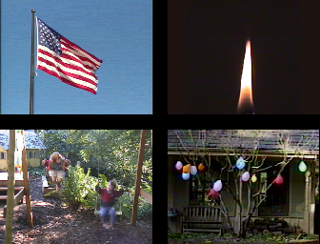
Still photos
Notes:
Everybody knows that a picture is worth a thousand words. Pictures are great, because they are timeless, we can look at them whenever and for as long as we want. But for highly dynamic scenes a single still picture can only hint at the movement involved.

Slide 22
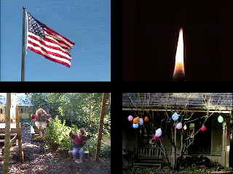
Video clips
Notes:
Videos are better, because they actually show the motion. Unfortunately, video clips have a finite duration, after which they stop, or maybe start over. As you can see here, this causes an ugly discontinuity, which we would like to avoid.

Slide 23

Video textures
Notes:
In this paper, we want to analyze regular video clips and turn them into video textures that play continuously for as long as you like. They combine the timeless quality of a photograph with the motion of a video. We call them video textures because video textures capture a pattern in time, as regular texture capture a pattern in space. They could be used on web pages, for movie backgrounds, training videos or computer games.

Slide 24
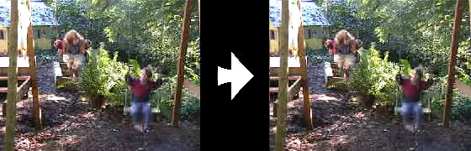
Problem statement
video clip
video texture
Notes:
As a reminder, here is our problem again: We want to turn a video clip of finite duration, that stops and starts over, into an infinitely playing video texture.

Slide 25
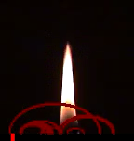
The approach: Markov Chain on frames
How do we find good transitions?
Notes:
How do we solve this problem? Here is an example of a video texture. Instead of playing the video from the beginning to end, we jump around in the sequence and continuously play pieces of the original video. The red bar shows which frames are currently being played. The arcs show the transitions that we are using to jump from one part of the sequence to another. The arc lights up when we are actually taking the transition.
Of course, we cannot just jump around randomly. This would look as jerky as the original video clip when it starts over. So the question is, how do we find transitions that are not noticeable for the viewer?

Slide 26
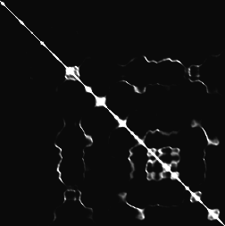
Finding good transitions
Compute L₂ distance D_{i, j} between all frames
vs.
frame i
frame j
Similar frames make good transitions
Notes:
When two frames are very similar, we can jump from one to the other without anybody noticing. So let’s compute the similarity between all pairs of frames in our sequence. We chose to use the L2 intensity difference as a metric because it is simple and worked well.
This matrix shows the difference of every frame against every other frame. The bright diagonal indicates that frames are similar to themselves and also to their neighbors in the sequence. But we also notice that sometimes frames quite far apart in the sequence are also similar to each other. These frame pairs are good candidates for transitions.

Slide 27

Markov chain representation
Similar frames make good transitions
Notes:
We now want to turn this matrix into a Markov chain, whose states are frames, and whose transitions are jumps from one frame to another. We want to make transitions more likely if they connect similar frames. We represent these by fatter arrows in the diagram on the right.

Slide 28
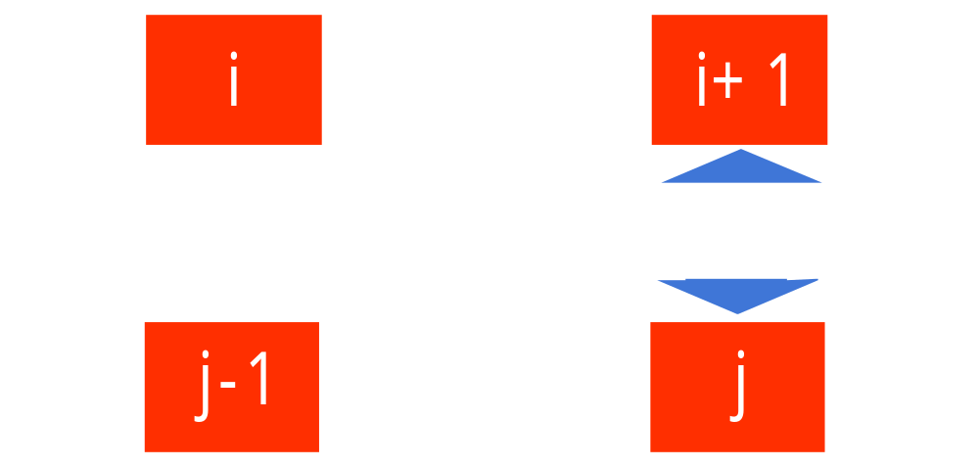
Transition costs
Transition from i to j if successor of i is similar to j
Cost function: C_{i→j} = D_{i+1, j}
Notes:
More specifically, suppose we have just shown frame i, and now want to transition to frame j. We are in fact replacing the successor of frame i with frame j. So the successor of frame i, frame i+1, should be similar to frame j. We define the cost of the transition from i to j as the difference between those two frames.

Slide 29
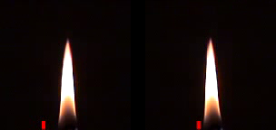
Transition probabilities
Probability for transition P_{i→j} inversely related to cost:
P_{i→j} ~ exp ( – C_{i→j} / σ² )
high σ
low σ
Notes:
To build the Markov chain, all that is left is turning the cost function into a probability. Low cost should mean high probability and vice versa. We map the cost through an exponential to do that, but any other monotonically decreasing function good be used instead.
At the bottom you can see the effect of the parameter sigma on the generated video. High sigmas produce a more randomly ordered video, low sigmas use only the best transitions, but run the risk of being too repetitive.

Slide 30
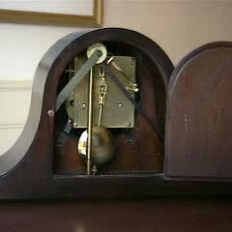
Preserving dynamics
Notes:
Let’s look at this example that we generated using the same technique. Something is not working here. The pendulum erratically changes directions. Why is this?

Slide 31
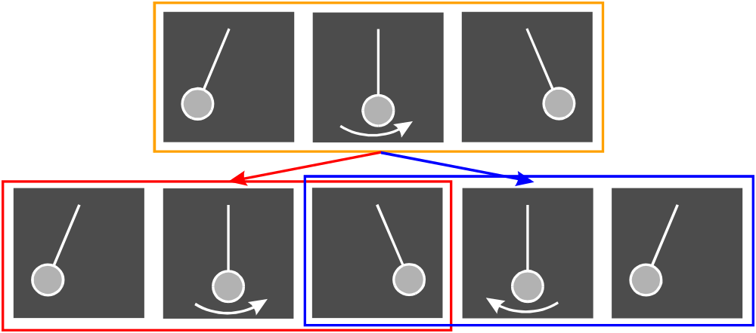
Preserving dynamics
Notes:
Look at the sequence on the top. The pendulum is swinging from left to right. But the center frame matches to both frames on the bottom. While the red sequence shows the same left to right motion as the orange sequence, the blue sequence shows a pendulum swing from right to left, so the transition suddenly reverses the motion! To prevent that, we could explicitly estimate the motion in the image, but there is a much simpler solution. Instead of single frames we compare small subsequences of frames, because then the orange sequence will be similar to the red, but not to the blue sequence.

Slide 32
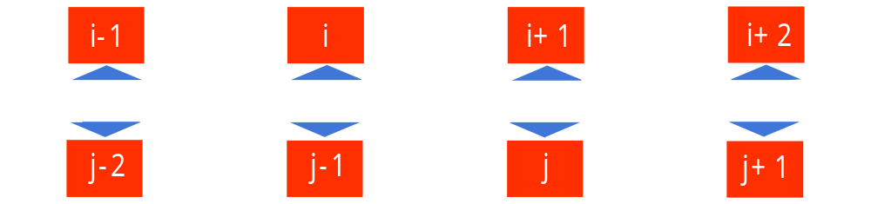
Preserving dynamics
Cost for transition i→j
C_{i→j} = w_{k} D_{i+k+1, j+k}
Notes:
So let’s make the transition cost a weighted sum over a small window of frames. The window is taken symmetrically around the position of the transition.

Slide 33
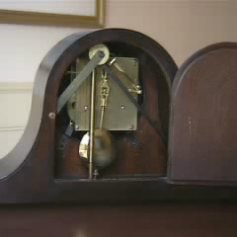
Preserving dynamics – effect
Cost for transition i→j
C_{i→j} = w_{k} D_{i+k+1, j+k}
Notes:
If we use this new cost function, our pendulum swings correctly.

Slide 34
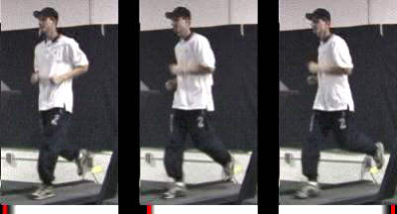
User-controlled video textures
User selects target frame range
slow
variable
fast
Notes:
So far the only criterion for selecting transitions was the smoothness of the transition. By augmenting our error function with external constraints, the user can select which part of the video to play by moving the dark band. <play>
These videotextures are generated from a video of a runner, who starts slowly and gradually speeds up. In the left video we prefer frames early in the sequence, so the runner is running slowly. In the right video we prefer late frames, so the runner is running fast. In the middle we change between slow and fast pace. Notice that the motion now matches the slow runner on the left, and now the fast runner on the right.

Slide 35
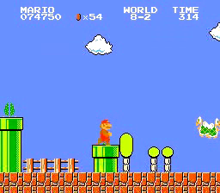
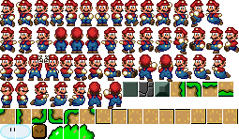
Video-based animation
Like sprites
computer games
Extract sprites
from real video
Interactively control desired motion
©1985 Nintendo of America Inc.
Notes:
I now want to talk about video-based animation. In computer games, before the advent of inexpensive 3D graphics cards, sprites were the most popular way to generate character animations. A 2D sprite is moved around the screen, and the appearance of the sprite is changed according to its current action, as you can see here with Mario.
We want to extract those sprite appearances from video, automatically select the right appearance over time to generate a good animation, and do all that while the sprite is under interactive control.

Slide 36
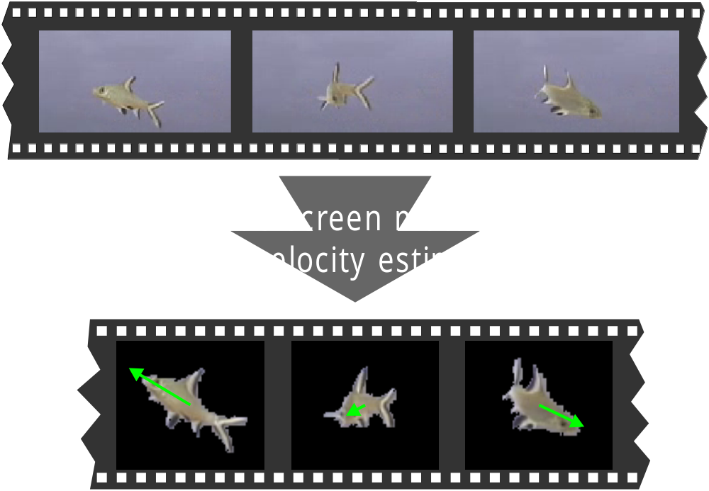
Video sprite extraction
Notes:
To try it out, we let a fish swim around in front of a blue screen and extracted the fish sprite and also the velocity of the sprite in every frame.

Slide 37
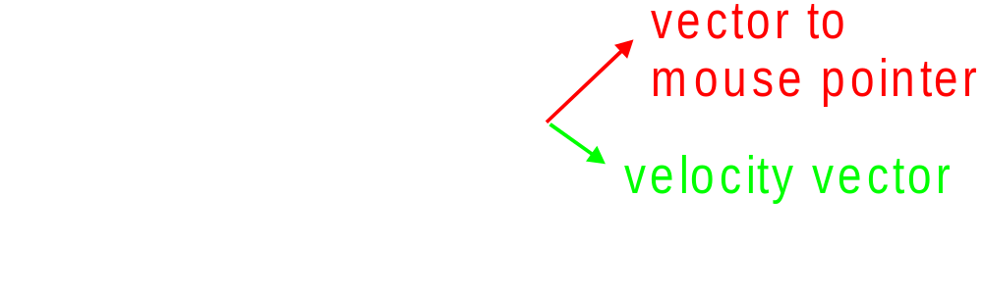
Video sprite control
Augmented transition cost:
Notes:
We then augmented the cost function. The similarity term penalizes visual discontinuities, just like for the other video textures. Here, it not only involves the image intensity difference, but also takes into account the difference in alpha channel and velocity.
The control term makes the sprite move in the desired direction. We simply penalize the angle between the current sprite velocity and the direction to the goal. We specify the goal interactively by pointing with the mouse.

Slide 38
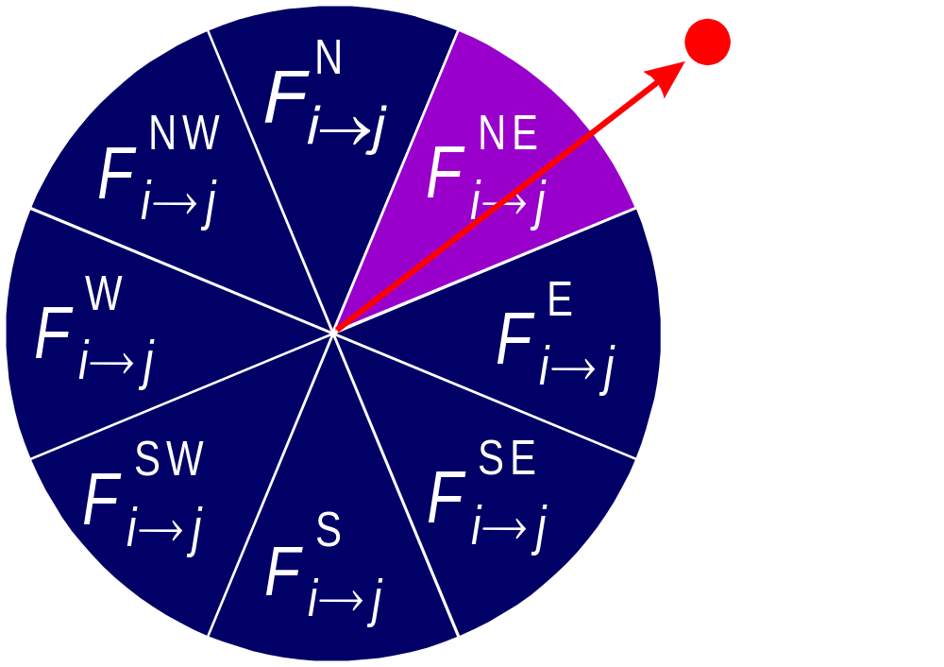

Video sprite control
Need future cost computation
Precompute future costs for a few angles.
Switch between precomputed angles according to user input
[GIT-GVU-00-11]
Notes:
We encountered a problem very similar to the dead-end problem I talked about earlier. Sometimes the fish in the original video changes direction, and the system needs to jump to maintain the prescribed direction. What if there is no good transition available at his point? We have a situation similar to the dead-end.
As before, we avoid this by computing future cost. Since our error function is different for every swimming direction, we precompute a bunch of future costs for different swimming angles. For interactive control, we then switch between these computed future cost functions, according to the direction that we want the fish to go.
To really get this to work, there are more details than I have time to discuss here. You can find them in an upcoming paper.

Slide 39
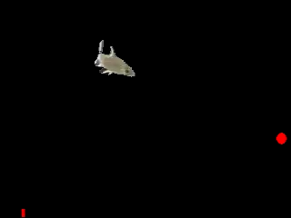
Interactive fish
Notes:
This is the result that we get. We processed 8 minutes of fish video to generate the fish animation. The current goal is marked with the red dot, and the bar shows the current frame.

Slide 40
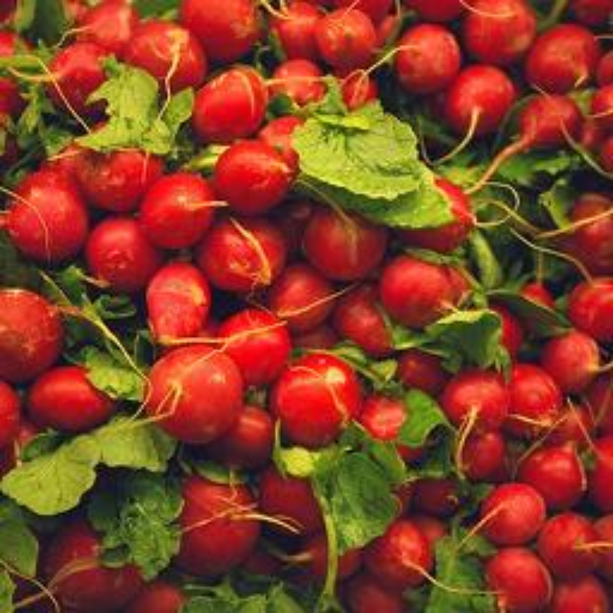
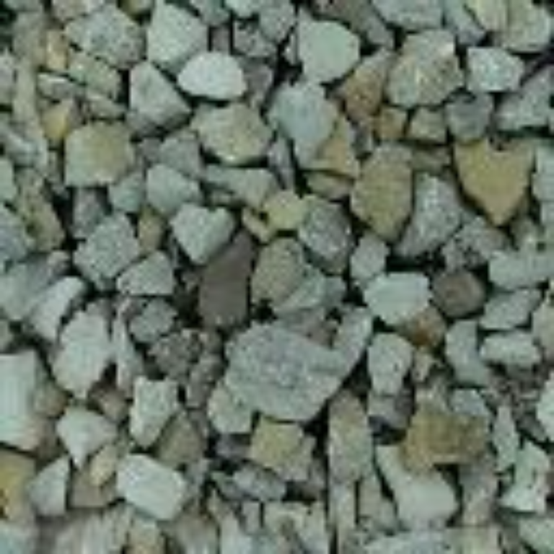
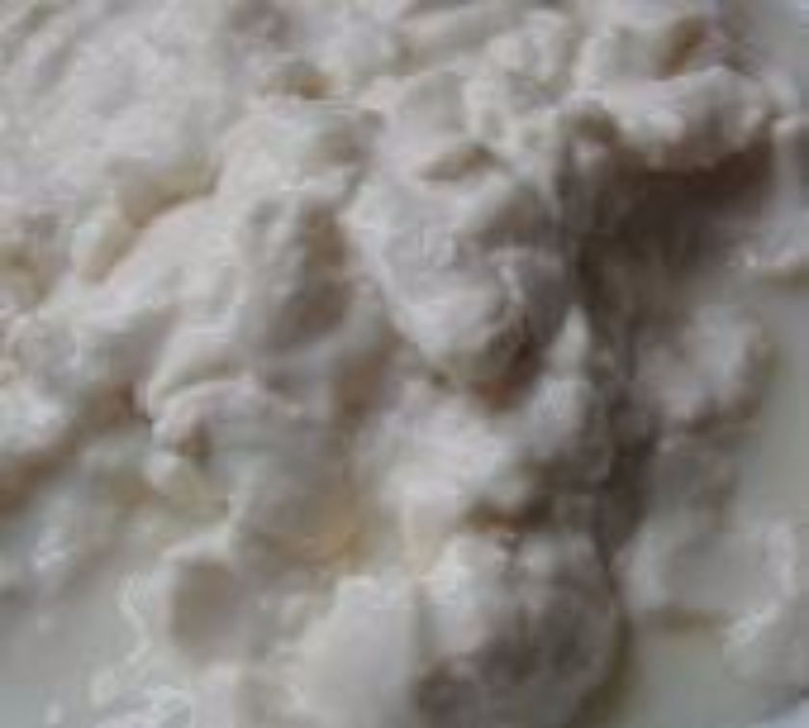
Texture
Texture depicts spatially repeating patterns
Many natural phenomena are textures
radishes
rocks
yogurt

Slide 41
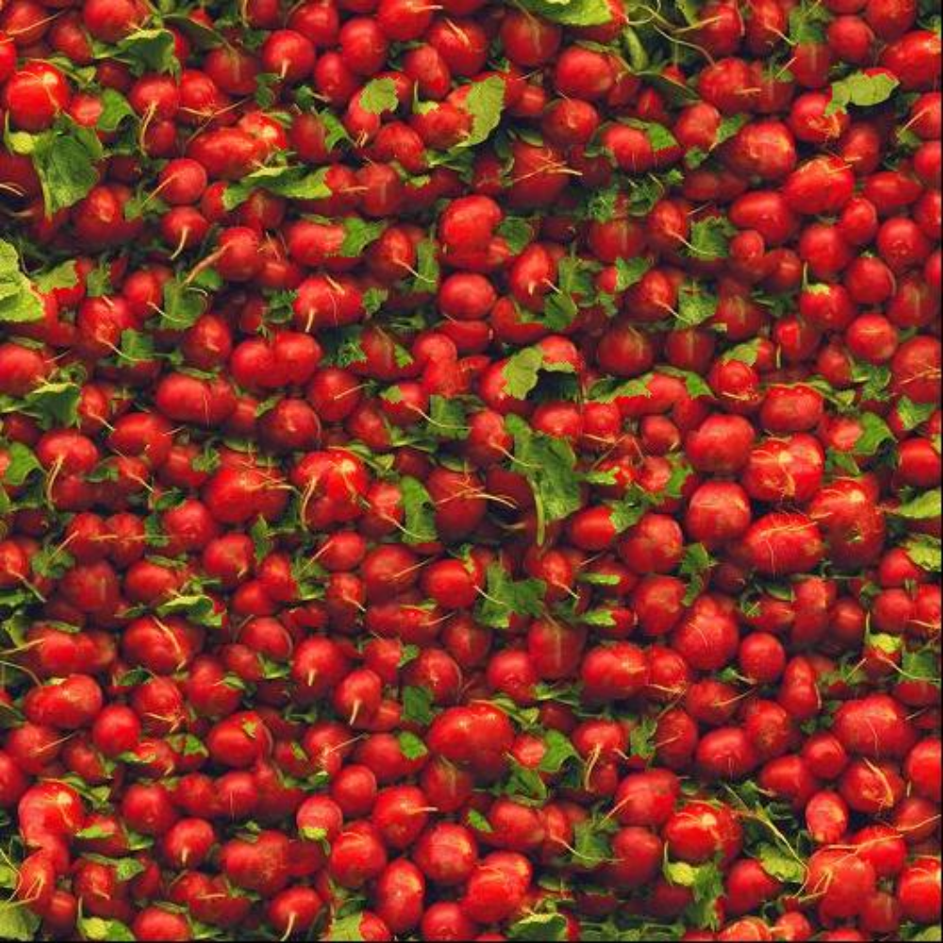
Texture Synthesis
Goal of Texture Synthesis: create new samples of a given texture
Many applications: virtual environments, hole-filling, texturing surfaces

Slide 42

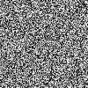

The Challenge
Need to model the whole spectrum: from repeated to stochastic texture
repeated
stochastic
Both?

Slide 43

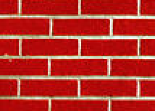
Efros & Leung Algorithm (ICCV 1999)
non-parametric
sampling
p
Input image
Synthesizing a pixel
Assuming Markov property, compute P(p|N(p))
  Building explicit probability tables infeasible
  Instead, we search the input image for all similar neighborhoods — that’s our pdf for p
  To sample from this pdf, just pick one match at random

Slide 44
Some Details
Growing is in “onion skin” order
  Within each “layer”, pixels with most neighbors are synthesized first
  If no close match can be found, the pixel is not synthesized until the end
Using Gaussian-weighted SSD is very important
  to make sure the new pixel agrees with its closest neighbors
  Approximates reduction to a smaller neighborhood window if data is too sparse

Slide 45

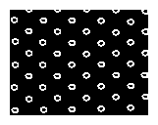
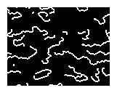
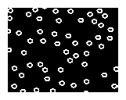
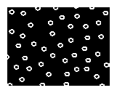
Neighborhood Window
input

Slide 46

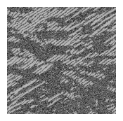
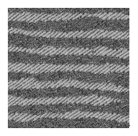
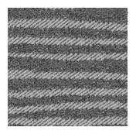
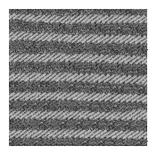

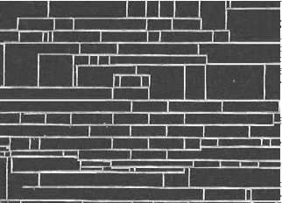
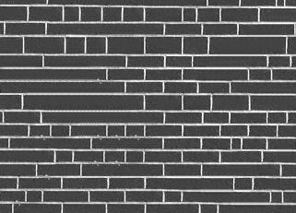
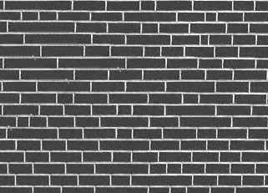
Varying Window Size
Increasing window size

Slide 47


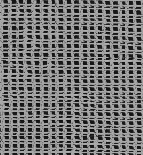
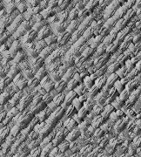
Synthesis Results
french canvas
rafia weave

Slide 48
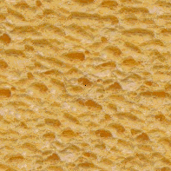
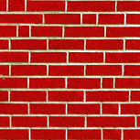
More Results
white bread
brick wall

Slide 49



Homage to Shannon

Slide 50






Hole Filling

Slide 51




Extrapolation

Slide 52
Image Analogies
Aaron Hertzmann^{1,2}
Chuck Jacobs²
Nuria Oliver²
Brian Curless³
David Salesin^{2,3}
¹New York University
²Microsoft Research
³University of Washington
SIGGRAPH 2001

Slide 53




Image Analogies
A
A’
B
B’

Slide 55



Image Analogies
Goal: Process an image by example
?
:
::
:
A
A’
B
B’
Hertzmann et al. SIGGRAPH 2001

Slide 56


Non-parametric sampling
?
:
::
:
A
A’
B
B’

Slide 57

:
::
A
A’
:
B
B’

Slide 58
:
::
A
A’
:
B
B’

Slide 59

Blur Filter

Slide 60

Edge Filter

Slide 61




Artistic Filters
A
A’
B
B’

Slide 62

Colorization

Slide 63




Texture-by-numbers
A
A’
B
B’

Slide 64


Visual Prompting via Image Inpainting
Amir Bar*, Yossi Gandelsman*,
Trevor Darrell, Amir Globerson, Alexei A Efros
NeurIPS 2022
?
:
::
:
* Equal contribution
Notes:
Hi everyone and thank you for joining our talk about Visual Prompting via Image Inpainting.

Slide 65
Visual Prompting
Task examples
Query
Result
:
::
:
?
Task examples
Query
Result
?
:
::
:
A
A’
B
B’
Hertzmann, Aaron, et al. "Image analogies." SIGGRAPH 2001.
Notes:
In this work we propose Visual Prompting. Like in NLP, we want to prompt a vision model with an input-output example, and a new input query. It’s goal is then to complete the output result. This can be viewed as completing an analogy.

Slide 66


Visual Prompting
Task examples
Query
Result
:
::
:
?
?
?
Notes:
Ideally, we want this to work in any settings that can be defined as analogies.

Slide 67
Inpainting models to the rescue!
?
InpaintingModel
Visual prompt image
Notes:
How do we go about solving this problem?,we find that by simply placing the input-output example and query in a grid like-image and inpainting the missing part, works surprisingly well.

Slide 68



Wide range of tasks
?
?
?
Colorization
Segmentation
Font Style Transfer
?
?
?
Inpainting
Edge Detection
Style Transfer
Notes:
Here are few inpainting results for a variety of different visual prompts.

Slide 69
Early
one
morning
the
sun
was
shining
I
was
laying
in
bed
Wondering
if
she
had
changed
at
all
if
her
hair
was
still
red
slide from Steve Seitz’s video
Notes:
The text generation results are slightly better, but still not great
The problem is that words can have pretty long range dependencies.
For example, the word “red”, relates to “hair”
which is three words back
but it also rhymes with “bed”,
which is 13 words back
If you ignored those rhymes, the song wouldn’t work at all!

Slide 70

$$P(x_{n}|x_{n−1},x_{n−2},x_{n−3},x_{n−4},x_{n−5},x_{n−6},x_{n−7},x_{n−8},x_{n−9},x_{n−10},x_{n−11},x_{n−12},x_{n−13})$$
$${10}^{70}$$
combinations
slide from Steve Seitz’s video
Notes:
So we need to model functions like this — or even longer — to accurately represent language
And these functions are exceedingly complex
There’s no way we can model this exactly.
But we can try to approximate it

Slide 71

















Function Approximation
Fourier Series:
$$f(x)=$$
$$+$$
$$+$$
$$+$$
$$+$$
$$...$$
Taylor Series:
$$f(x)=$$
$$+$$
$$+$$
$$+$$
$$+$$
$$...$$
Neural Network:
$$f(x)$$
$$x$$
slide from Steve Seitz’s video
Notes:
There are a number of ways to approximate a function
You may have heard of Fourier series
which approximates a function using sines and cosines
or Taylor Series,
which is a sum of polynomials
These are both universal approximators – they can approximate almost any function.
Another example of a universal approximator is neural networks.
An advantage of neural networks is that you don’t need to know anything about the function you’re trying to approximate. Just input and output pairs.

Slide 72


$$sin(x)−\frac{x^{2}}{10}$$
slide from Steve Seitz’s video
Notes:
Let’s try an example
This function is kind of interesting
Let’s approximate it with a neural network

Slide 73

slide from Steve Seitz’s video
Notes:
This is our error
you can see it’s pretty big
that’s because I generated the weights randomly.
<pause>
So, this is just one data point.
We can send many x values through our network
to generate this red curve
And let’s define an error function
that adds up all of these differences between red and blue curve values
We’ll use these errors to update the weights
This is called “training” the network.
And if we repeat these update steps
thousands of times, <…>
we get a pretty good fit.

Slide 74

slide from Steve Seitz’s video
Notes:
This is our error
you can see it’s pretty big
that’s because I generated the weights randomly.
<pause>
So, this is just one data point.
We can send many x values through our network
to generate this red curve
And let’s define an error function
that adds up all of these differences between red and blue curve values
We’ll use these errors to update the weights
This is called “training” the network.
And if we repeat these update steps
thousands of times, <…>
we get a pretty good fit.

Slide 75
$$P(x_{n}|x_{n−1},x_{n−2},x_{n−3},x_{n−4},x_{n−5},x_{n−6},x_{n−7},…)$$
slide from Steve Seitz’s video
Notes:
Welcome back!
Last time we introduced neural networks
and showed how you could use them to approximate any function
Now we’ll apply them to model Language
which involves fitting this type of function

Slide 76
Early
one
morning
the
sun
was
shining
I
was
laying
in
bed
Wondering
if
she
had
changed
at
all
if
her
hair
was
still
red
slide from Steve Seitz’s video
Notes:
Given some text like this
We’d like to predict
the last word
we’ll use some kind of neural network
We first need to turn our words into numbers, so the neural network can understand them

Slide 77
red
Early
one
morning
the
sun
was
shining
I
was
laying
in
bed
Wondering
if
she
had
changed
at
all
if
her
hair
was
still
slide from Steve Seitz’s video
Notes:
Given some text like this
We’d like to predict
the last word
we’ll use some kind of neural network
We first need to turn our words into numbers, so the neural network can understand them

Slide 78
red
neural network
Early
one
morning
the
sun
was
shining
I
was
laying
in
bed
wondering
if
she
had
changed
at
all
if
her
hair
was
still
slide from Steve Seitz’s video
Notes:
Given some text like this
We’d like to predict
the last word
we’ll use some kind of neural network
We first need to turn our words into numbers, so the neural network can understand them

Slide 79
0
1
2
a
able
about
92,487
zygote
slide from Steve Seitz’s video
Notes:
You could just number every word alphabetically
But then synonyms like apex and zygote
would have very different numbers.
It words better to use word embeddings that map semantically similar words to similar numbers

Slide 80
0
1
2
a
able
about
39
apex
56,356
zenith
92,487
zygote
slide from Steve Seitz’s video
Notes:
You could just number every word alphabetically
But then synonyms like apex and zenith
would have very different numbers.
It’s better to map semantically similar words like this
to numbers, or vectors in this case, that are similar
Methods that do this are called
word embeddings

Slide 81
0
1
2
56,356
a
able
about
39
apex
zenith
92,487
zygote
slide from Steve Seitz’s video
Notes:
We first need to turn our words into numbers, so the neural network can understand them
You could just number every word alphabetically
But then synonyms like apex and zygote
would have very different numbers.
It words better to use word embeddings that map semantically similar words to similar numbers

Slide 82

word2vec
[Collobert & Weston 2008; Mikolov et al. 2013]
Deep
Net
Notes:
- there’s already evidence that context can serve as a pretext task in the text domain
- However, doing this with pixels is hard because each pixel has so little semantic information.

Slide 83
a
about
able
apex
zenith
zygote
Word Embedding (e.g., word2Vec, GloVe)
slide from Steve Seitz’s video
Notes:
You could just number every word alphabetically
But then synonyms like apex and zenith
would have very different numbers.
It’s better to map semantically similar words like this
to numbers, or vectors in this case, that are similar
Methods that do this are called
word embeddings. And they’re readily available online

Slide 84
red
neural network
Early
one
morning
the
sun
was
shining
I
was
laying
in
bed
wondering
if
she
had
changed
at
all
if
her
hair
was
still
slide from Steve Seitz’s video
Notes:
Okay, now we’re ready to design our big language neural network!

Slide 85
red
Early
one
morning
the
sun
was
shining
I
was
laying
in
bed
wondering
if
she
had
changed
at
all
if
her
hair
was
still
slide from Steve Seitz’s video
Notes:
perhaps something like this
And you can add even more layers, neurons, and weights to increase capacity
But it’s still not going to work very well.
The problem is just too hard.
We need to give the network a bit more help

Slide 86
Early
one
morning
the
sun
was
shining
I
was
laying
in
bed
Wondering
if
she
had
changed
at
all
if
her
hair
was
still
?
red
slide from Steve Seitz’s video
Notes:
Let’s go back to our favorite example
Suppose I left out the last word
Could you guess it?
I bet you could.

Slide 87
Early
one
morning
the
sun
was
shining
I
was
laying
in
bed
Wondering
if
she
had
changed
at
all
if
her
hair
was
still
?
red
slide from Steve Seitz’s video
Notes:
You can tell it’s going to be an adjective,
associated with the verb “was”

Slide 88
Early
one
morning
the
sun
was
shining
I
was
laying
in
bed
Wondering
if
she
had
changed
at
all
if
her
hair
was
still
?
red
slide from Steve Seitz’s video
Notes:
And it has something to do with hair — that’s the noun

Slide 89
Early
one
morning
the
sun
was
shining
I
was
laying
in
bed
Wondering
if
she
had
changed
at
all
if
her
hair
was
still
?
red
slide from Steve Seitz’s video
Notes:
And it rhymes with bed
What’s kind of hair that rhymes with bed?

Slide 90
bed
hair
was
still
red
slide from Steve Seitz’s video
Notes:
In fact, I bet you could do it with only these four words
A kind of hair that rhymes with bed?
This is a key insight — you just need to pay attention to a subset of the words
What if we could train a neural network to solve this attention problem

Slide 91
0
1
0
0
0
0
0
0
0
0
0
1
1
1
attention
in
bed
Wondering
if
she
had
changed
at
all
if
her
hair
was
still
slide from Steve Seitz’s video
Notes:
We’ll do this with an attention network that takes the input words,
And outputs attention weights between 0 and 1.
We’ll multiply these weights by the words themselves
and feed the results into the next word predictor network

Slide 92
red
next word prediction
0
bed
0
0
0
0
0
0
0
0
0
hair
was
still
attention
in
bed
Wondering
if
she
had
changed
at
all
if
her
hair
was
still
slide from Steve Seitz’s video
Notes:
We’ll do this with an attention network that takes the input words,
And outputs attention weights between 0 and 1.
We’ll multiply these weights by the words themselves
and feed the results into the next word predictor network

Slide 93
0
bed
0
0
0
0
0
0
0
0
0
hair
was
still
Train
attention
in
bed
Wondering
if
she
had
changed
at
all
if
her
hair
was
still
slide from Steve Seitz’s video
Notes:
So how do you train the attention network?

Slide 94
Two roads diverted in a yellow wood
And sorry I could not travel both
And be one traveler, long I stood
And looked down as far as I could
To where it bent in the undergrowth;
Robert Frost, Road Not Taken
slide from Steve Seitz’s video
Notes:
Well, you could hire people to annotate rhymes and other word
associations in lots and lots of text,
and use this as training data
But that sounds like a pain.
And it turns out there’s a much better way.

Slide 95
Train
red
next word prediction
0
bed
0
0
0
0
0
0
0
0
0
hair
was
still
attention
in
bed
Wondering
if
she
had
changed
at
all
if
her
hair
was
still
slide from Steve Seitz’s video
Notes:
Let’s train both of these networks together!
Here, the prediction network is telling the attention network
what it needs to learn so it can predict next words better.
For example, say the network predicts “brown” instead of red
brown doesn’t rhyme with bed.
So the backpropagation algorithm might try to increase the attention on “bed”
And decrease weights that led to the selection of brown
This works really well.
and this combined network is called a transformer.

Slide 96
Train
brown
next word prediction
0
bed
0
0
0
0
0
0
0
0
0
hair
was
still
attention
in
bed
Wondering
if
she
had
changed
at
all
if
her
hair
was
still
slide from Steve Seitz’s video
Notes:
Let’s train both of these networks together!
Here, the prediction network is telling the attention network
what it needs to learn so it can predict next words better.
For example, say the network predicts “brown” instead of red
brown doesn’t rhyme with bed.
So the backpropagation algorithm might try to increase the attention on “bed”
And decrease weights that led to the selection of brown
This works really well.
and this combined network is called a transformer.

Slide 97
Train
brown
next word prediction
0
bed
0
0
0
0
0
0
0
0
0
hair
was
still
attention
in
bed
Wondering
if
she
had
changed
at
all
if
her
hair
was
still
slide from Steve Seitz’s video
Notes:
Let’s train both of these networks together!
Here, the prediction network is telling the attention network
what it needs to learn so it can predict next words better.
For example, say the network predicts “brown” instead of red
brown doesn’t rhyme with bed.
So the backpropagation algorithm might try to increase the attention on “bed”
And decrease weights that led to the selection of brown
This works really well.
and this combined network is called a transformer.

Slide 98
red
Transformer
in
bed
Wondering
if
she
had
changed
at
all
if
her
hair
was
still
slide from Steve Seitz’s video
Notes:
And while the full architecture is pretty complex,
I’ll take you through the basics

Slide 99
prediction
attention
96 (GPT-3)
118 (Palm)
prediction
attention
prediction
attention
slide from Steve Seitz’s video
Notes:
We can do this by stacking many of these prediction-attention layers
How many?
Well GPT-3 has 96 of these —
GPT-3 is a popular model from OpenAI
And the Palm model
from Google has a similar number
These models have hundreds of billions of parameters
That’s enough capacity to do some pretty impressive things

Slide 100









$$w_{2}$$
$$w_{6}$$
$$x$$
$$+$$
$$y$$
$$x$$
$$x$$
$$x$$
$$w_{7}$$
$$w_{3}$$
100,000,000
slide from Steve Seitz’s video
Notes:
Remember how increasing the capacity of this little network
Allowed it to do a better job approximating the blue function?
Just think what it could do if it had a hundred of billion weights!

Slide 101
prediction
attention
prediction
attention
prediction
attention
slide from Steve Seitz’s video
Notes:
Stacking these attention models also allows for higher level reasoning
Whereas the lower layers
focus on word relationships and syntax
The higher layers can encode more complex relationships that encode semantics

Slide 102
prediction
attention
prediction
attention
prediction
attention
Syntax
slide from Steve Seitz’s video
Notes:
Stacking these attention models also allows for higher level reasoning
Whereas the lower layers
focus on word relationships and syntax
The higher layers can encode more complex relationships that encode semantics

Slide 103
Semantics
prediction
attention
prediction
attention
prediction
attention
slide from Steve Seitz’s video
Notes:
Stacking these attention models also allows for higher level reasoning
Whereas the lower layers
focus on word relationships and syntax
The higher layers can encode more complex relationships that encode semantics

Slide 104
prediction
attention
prediction
attention
prediction
attention
slide from Steve Seitz’s video
Notes:
Alright, we’re ready to train our network!
We’ll need some text to train on. How much?
Well,
basically all of it
Today’s large language models have read
most of the Internet and publicly available books.
You’re probably guessing that it takes a long time to train
networks with billions of parameters

Slide 105
How much data
to train?
Notes:
Alright, we’re ready to train our network!
We’ll need some text to train on. How much?
Well,
basically all of it
Today’s large language models have read
most of the Internet and publicly available books.
That’s half a trillion words.
<pause>
You’re probably guessing that it takes a long time to train large language models

Slide 106
All of it…
Notes:
Alright, we’re ready to train our network!
We’ll need some text to train on. How much?
Well,
basically all of it
Today’s large language models have read
most of the Internet and publicly available books.
That’s half a trillion words.
<pause>
You’re probably guessing that it takes a long time to train large language models

Slide 107
355 years
Notes:
That’s true — training GPT-3 would take 355 years on a single GPU or computer.
But transformers are designed to be highly parallelizable,
so you can do it in about a month
with a few thousand GPUs.

Slide 108
a month
Notes:
That’s true — training GPT-3 would take 355 years on a single GPU or computer.
But transformers are designed to be highly parallelizable,
so you can do it in about a month
with a few thousand GPUs.

Slide 109
The 16th President was
The capital of Zimbabwe is
Frank Zappa’s middle name is
Napoleon was born on this date
The prime factorization of 19456721434 is
Queen Victoria’s maiden name was
US per-capita income in 1957 was
The lat long coordinates of Rome are
slide from Steve Seitz’s video
Notes:
Let’s start with Q&A
In each case I specified the blue text as input
it got most of these facts right.
It had a hard time factorizing this extremely large number
And the per-capita income figure was a bit off

Slide 110
The 16th President was Abraham Lincoln
The capital of Zimbabwe is Harare
Frank Zappa’s middle name is Vincent
Napoleon was born on this date 1769
The prime factorization of 19456721434 is 2×3×3×17
The prime factorization of 19456721434 is
Queen Victoria’s maiden name was Alexandrina Victoria
US per-capita income in 1957 was $2,974
US per-capita income in 1957 was
The lat long coordinates of Rome are 41.894722, 12.48
slide from Steve Seitz’s video
Notes:
Let’s start with Q&A
In each case I specified the blue text as input
it got most of these facts right.
It had a hard time factorizing this extremely large number
And the per-capita income figure was a bit off

Slide 111
a pattern of characters that looks like a star
. o .
o o o
. o .
slide from Steve Seitz’s video
Notes:
But can they draw pictures?
Let’s give it a try:
We’ll give this as input to GPT-3 – a Large Language Model from OpenAI.
And let’s provide the first row of the picture,
telling it to make it out of dots and os.
Hey, that worked – it’s a star!

Slide 112
a pattern of characters that looks like a vertical line
. o .
. o .
. o .
. o .
. o .
slide from Steve Seitz’s video
Notes:
Let’s try another shape:
“a pattern of characters that looks like a vertical line “
Or a triangle:
“a pattern of characters that looks like a triangle”

Slide 113
a pattern of characters that looks like a triangle
. o .
. o o .
. o o o .
. o o o o .
. o o o o o .
slide from Steve Seitz’s video
Notes:
Let’s try another shape:
“a pattern of characters that looks like a vertical line “
Or a triangle:
“a pattern of characters that looks like a triangle”
This is cool – the language model knows how to draw basic shapes.
But how about more complex images?

Slide 114


slide from Steve Seitz’s video
Notes:
You can’t represent an image like this with just dots and os
So let’s add pixels to the language model’s vocabulary.
We’ll start with a lower-res version
so you can see the pixels
And let’s replace each pixel with the name of its color
Now it looks more like language
You could even imagine
this printed on a page of a book!
The language model will read these words from left-to-right,
And top-to-bottom.
And if the words “red, green, brown, white” aren’t expressive enough,
we can represent any color as a word
that specifies its RGB value.

Slide 115


slide from Steve Seitz’s video
Notes:
You can’t represent an image like this with just dots and os
So let’s add pixels to the language model’s vocabulary.
We’ll start with a lower-res version
so you can see the pixels
And let’s replace each pixel with the name of its color
Now it looks more like language
You could even imagine
this printed on a page of a book!
The language model will read these words from left-to-right,
And top-to-bottom.
And if the words “red, green, brown, white” aren’t expressive enough,
we can represent any color as a word
that specifies its RGB value.

Slide 116
white
white
white
white
white
white
white
white
white
green
white
white
white
white
white
white
white
white
white
white
white
white
white
green
green
green
white
red
red
white
white
white
white
white
red
red
red
red
green
green
brown
red
red
red
red
white
white
white
red
red
red
red
red
brown
green
red
red
red
red
red
white
green
brown
red
red
red
red
red
red
red
red
red
red
red
red
green
green
brown
red
red
red
red
red
red
red
red
red
red
red
red
white
green
green
brown
red
red
red
red
red
red
red
red
red
red
white
white
white
white
white
red
red
red
black
red
red
red
red
red
white
white
white
white
white
white
white
white
white
white
red
red
red
red
white
white
white
white
white
white
white
white
white
white
white
white
red
red
white
white
white
white
slide from Steve Seitz’s video
Notes:
You can’t represent an image like this with just dots and os
So let’s add pixels to the language model’s vocabulary.
We’ll start with a lower-res version
so you can see the pixels
And let’s replace each pixel with the name of its color
Now it looks more like language
You could even imagine
this printed on a page of a book!
The language model will read these words from left-to-right,
And top-to-bottom.
And if the words “red, green, brown, white” aren’t expressive enough,
we can represent any color as a word
that specifies its RGB value.

Slide 117

white
white
white
white
white
white
white
white
white
green
white
white
white
white
white
white
white
white
white
white
white
white
white
green
green
green
white
red
red
white
white
white
white
white
red
red
red
red
green
green
brown
red
red
red
red
white
white
white
red
red
red
red
red
brown
green
red
red
red
red
red
white
green
brown
red
red
red
red
red
red
red
red
red
red
red
red
green
green
brown
red
red
red
red
red
red
red
red
red
red
red
red
white
green
green
brown
red
red
red
red
red
red
red
red
red
red
white
white
white
white
white
red
red
red
black
red
red
red
red
red
white
white
white
white
white
white
white
white
white
white
red
red
red
red
white
white
white
white
white
white
white
white
white
white
white
white
red
red
white
white
white
white
(255,0,0)
slide from Steve Seitz’s video
Notes:
You can’t represent an image like this with just dots and os
So let’s add pixels to the language model’s vocabulary.
We’ll start with a lower-res version
so you can see the pixels
And let’s replace each pixel with the name of its color
Now it looks more like language
You could even imagine
this printed on a page of a book!
The language model will read these words from left-to-right,
And top-to-bottom.
And if the words “red, green, brown, white” aren’t expressive enough,
we can represent any color as a word
that specifies its RGB value.

Slide 118
red
slide from Steve Seitz’s video
Notes:
And if the words “red, green, brown, white” aren’t expressive enough,
we can represent any color as a word that specifies its RGB value.

Slide 119
(255,0,0)
slide from Steve Seitz’s video
Notes:
And if the words “red, green, brown, white” aren’t expressive enough,
we can represent any color as a word that specifies its RGB value.

Slide 120
white
white
white
white
white
white
white
white
white
green
white
white
white
white
white
white
white
white
white
white
white
white
white
green
green
green
white
red
red
white
white
white
white
white
red
red
red
red
green
green
brown
red
red
red
red
white
white
white
red
red
red
red
red
brown
green
red
red
red
red
red
white
green
brown
red
red
red
red
red
red
red
red
red
red
red
red
green
green
brown
red
red
red
red
red
red
red
red
red
red
red
red
white
green
green
brown
red
red
red
red
red
red
red
red
red
red
white
white
white
white
white
red
red
red
black
red
red
red
red
red
white
white
white
white
white
white
white
white
white
white
red
red
red
red
white
white
white
white
white
white
white
white
white
white
white
white
red
red
white
white
white
white
slide from Steve Seitz’s video
Notes:
Okay, now we can represent an image in a language model.
But the model doesn’t really understand the image, or how it relates to English words and phrases.
We can teach this knowledge by providing some training data.
For example,
lots of raspberry images
sunsets
pancakes
and just about everything else
We’ll train it on millions of captioned images on the Internet

Slide 121

















1 Billion
raspberries
pancakes
sunsets
slide from Steve Seitz’s video
Notes:
Okay, now we can represent an image in a language model.
But the model doesn’t really understand the image, or how it relates to English words and phrases.
We can teach this knowledge by providing some training data.
For example,
lots of raspberry images
sunsets
pancakes
and just about everything else
We’ll train it on a billion captioned images from the Internet

Slide 122
white
Large Language Model
A
image
raspberry
slide from Steve Seitz’s video
Notes:
We can now use a Large Language Model to generate images!
We just give it a prompt like this “a raspberry image”
And it will generate the pixels one at a time

Slide 123
white
Large Language Model
A
image
white
raspberry
slide from Steve Seitz’s video
Notes:
We can now use a Large Language Model to generate images!
We just give it a prompt like this “a raspberry image”
And it will generate the pixels one at a time

Slide 124
red
Large Language Model
A
image
white
white
raspberry
slide from Steve Seitz’s video
Notes:
We can now use a Large Language Model to generate images!
We just give it a prompt like this “a raspberry image”
And it will generate the pixels one at a time

Slide 125
Large Language Model
A
image
white
white
red
red
red
white
white
green
green
green
white
raspberry
slide from Steve Seitz’s video
Notes:
We can now use a Large Language Model to generate images!
We just give it a prompt like this “a raspberry image”
And it will generate the pixels one at a time

Slide 126


1,000s of words
1,000,000s of pixels
slide from Steve Seitz’s video
Notes:
But there’s a problem with this approach
Images have millions of pixels
But today’s large language models can handle only a few thousand words
at a time.
That means we’ll have to be a bit more clever to make these images fit.

Slide 127
32
32
slide from Steve Seitz’s video
Notes:
So instead of representing every pixel with a word
Let’s break the image into a 32 x 32 grid of square patches
And we’ll give each patch a number, according to the pattern of pixels in that patch
Very similar patches get the same number.
For example all the white patches get the number 0 in this example.
Let’s call these numbers,
visual words.
This is the approach used in Parti – a leading text-to-image approach from Google.
<pause>
They say an image is worth a thousand words.
Well Parti literally represents an image with a thousand words —
1024 to be exact!
Each word on this page ranges form 0 to 9, to make it easier to visualize.
In reality Parti uses about 8000 different values for each word.

Slide 128
0
0
0
0
0
0
0
0
0
0
0
0
0
0
0
0
0
0
0
0
0
0
0
0
0
0
0
0
0
0
0
0
0
0
0
0
0
0
0
0
0
0
0
0
0
0
0
0
0
0
0
0
0
0
0
0
0
0
0
0
0
0
0
0
0
0
0
0
0
0
0
0
0
0
0
0
0
0
0
0
0
0
0
0
0
0
0
0
0
0
0
0
0
0
0
0
0
0
0
0
0
0
0
0
0
0
0
0
0
0
0
0
0
0
0
0
0
0
0
0
0
0
0
0
0
0
0
0
0
0
0
0
0
0
0
0
0
0
0
0
0
0
0
0
0
1
1
0
0
0
0
0
0
0
0
0
0
0
0
0
0
0
0
0
0
0
0
0
0
0
0
0
0
0
0
0
1
1
1
0
0
0
0
0
0
0
0
0
0
0
0
0
0
0
0
0
0
0
0
0
0
0
0
0
0
0
0
1
1
1
1
1
0
0
0
0
0
0
0
0
0
0
0
0
0
0
0
0
0
0
0
0
0
0
0
0
0
0
1
1
1
1
1
1
0
0
0
0
0
0
0
0
0
0
0
0
0
0
0
0
0
0
0
0
0
0
0
0
0
0
1
1
1
1
1
1
0
0
0
2
5
5
2
2
0
0
0
0
0
0
0
0
0
0
2
2
2
2
2
2
0
0
1
1
1
1
1
0
0
0
2
5
2
2
5
5
2
0
0
0
0
0
0
0
2
2
2
2
2
2
2
2
2
0
1
1
1
1
1
1
1
2
5
5
5
5
2
2
5
2
2
0
0
0
2
2
2
2
2
2
2
2
5
2
2
2
1
1
1
1
1
2
2
5
5
5
5
2
5
2
5
2
2
0
0
2
2
2
2
2
2
2
2
2
5
5
2
2
1
1
1
1
1
2
2
5
5
5
2
5
2
2
2
2
2
2
0
2
2
2
2
5
2
2
5
2
5
5
2
2
2
1
1
1
2
2
2
6
32
8
2
2
2
5
5
5
5
5
3
3
5
5
2
2
2
5
2
2
2
6
8
2
2
2
2
2
2
2
3
3
3
2
5
2
2
2
2
2
2
2
6
8
2
2
2
2
2
2
2
3
3
3
3
2
2
2
5
2
2
5
2
6
8
2
2
2
2
2
2
2
2
3
3
3
2
2
2
2
2
2
2
2
6
8
2
2
2
2
2
2
2
2
3
2
2
3
2
5
2
2
2
2
2
0
7
2
2
2
2
2
2
2
2
2
2
2
3
2
2
2
2
3
3
0
0
7
2
2
2
2
2
2
2
2
2
2
2
3
2
2
2
2
3
0
0
0
7
7
2
2
2
2
2
2
2
2
2
3
3
2
2
2
2
0
0
0
0
0
0
0
2
2
2
2
5
5
2
2
2
9
2
5
2
2
0
0
0
0
0
0
0
0
0
2
2
2
2
2
9
9
9
9
5
5
5
0
0
0
0
0
0
0
0
0
0
0
0
0
9
9
9
9
0
2
2
5
0
0
0
0
0
0
0
0
0
0
0
0
0
0
0
0
0
0
2
2
2
0
0
0
0
0
0
0
0
0
0
0
0
0
0
0
0
0
0
0
2
5
2
5
5
5
2
2
0
0
0
0
0
0
0
0
0
0
0
0
0
0
0
0
0
0
0
0
0
0
0
0
0
2
2
2
2
2
0
0
0
0
0
0
0
0
0
0
0
0
0
0
0
0
0
0
0
0
0
0
0
0
0
0
0
0
2
2
2
0
0
0
0
0
0
0
0
0
0
0
0
0
0
0
0
0
0
0
0
0
0
0
0
0
0
0
0
0
0
0
0
0
0
0
0
0
0
0
0
0
0
0
0
0
0
0
0
0
0
0
0
0
0
0
0
0
0
0
0
0
0
0
0
0
0
0
0
0
0
0
0
0
0
0
0
0
0
0
0
0
0
0
0
0
0
0
0
0
0
0
0
0
0
0
0
0
0
0
0
0
0
0
0
0
0
0
0
32
Notes:
So instead of representing every pixel with a word
Let’s break the image into a 32 x 32 grid of square patches
And we’ll give each patch a number, according to the pattern of pixels in that patch
Very similar patches get the same number.
For example all the white patches get the number 0 in this example.
Let’s call these numbers,
visual words.
This is the approach used in Parti – a leading text-to-image approach from Google.
<pause>
They say an image is worth a thousand words.
Well Parti literally represents an image with a thousand words —
1024 to be exact!
Each word on this page ranges form 0 to 9, to make it easier to visualize.
In reality Parti uses about 8000 different values for each word.

Slide 129


0
0
0
0
0
0
0
0
0
0
0
0
0
0
0
0
0
0
0
0
0
0
0
0
0
0
0
0
0
0
0
0
0
0
0
0
0
0
0
0
0
0
0
0
0
0
0
0
0
0
0
0
0
0
0
0
0
0
0
0
0
0
0
0
0
0
0
0
0
0
0
0
0
0
0
0
0
0
0
0
0
0
0
0
0
0
0
0
0
0
0
0
0
0
0
0
0
0
0
0
0
0
0
0
0
0
0
0
0
0
0
0
0
0
0
0
0
0
0
0
0
0
0
0
0
0
0
0
0
0
0
0
0
0
0
0
0
0
0
0
0
0
0
0
0
1
1
0
0
0
0
0
0
0
0
0
0
0
0
0
0
0
0
0
0
0
0
0
0
0
0
0
0
0
0
0
1
1
1
0
0
0
0
0
0
0
0
0
0
0
0
0
0
0
0
0
0
0
0
0
0
0
0
0
0
0
0
1
1
1
1
1
0
0
0
0
0
0
0
0
0
0
0
0
0
0
0
0
0
0
0
0
0
0
0
0
0
0
1
1
1
1
1
1
0
0
0
0
0
0
0
0
0
0
0
0
0
0
0
0
0
0
0
0
0
0
0
0
0
0
1
1
1
1
1
1
0
0
0
2
5
5
2
2
0
0
0
0
0
0
0
0
0
0
2
2
2
2
2
2
0
0
1
1
1
1
1
0
0
0
2
5
2
2
5
5
2
0
0
0
0
0
0
0
2
2
2
2
2
2
2
2
2
0
1
1
1
1
1
1
1
2
5
5
5
5
2
2
5
2
2
0
0
0
2
2
2
2
2
2
2
2
5
2
2
2
1
1
1
1
1
2
2
5
5
5
5
2
5
2
5
2
2
0
0
2
2
2
2
2
2
2
2
2
5
5
2
2
1
1
1
1
1
2
2
5
5
5
2
5
2
2
2
2
2
2
32
32
0
2
2
2
2
5
2
2
5
2
5
5
2
2
2
1
1
1
2
2
2
5
5
3
3
2
2
2
2
2
2
6
Visual
words
$$×$$
8
2
2
2
5
5
5
5
5
3
3
5
5
2
2
2
5
5
2
2
5
5
2
3
3
3
5
5
2
2
2
6
8
2
2
2
2
2
2
2
3
3
3
2
5
2
2
2
2
2
2
2
5
5
2
2
3
3
2
2
2
2
2
6
8
2
2
2
2
2
2
2
3
3
3
3
2
2
2
5
2
2
2
5
2
2
5
5
5
5
2
2
2
5
2
6
$$=1024$$
8
2
2
2
2
2
2
2
2
3
3
3
2
2
2
2
2
2
2
2
2
2
2
2
2
2
5
2
2
2
2
6
8
2
2
2
2
2
2
2
2
3
2
2
3
2
5
2
2
2
5
2
2
2
2
2
2
2
2
2
2
2
2
0
7
2
2
2
2
2
2
2
2
2
2
2
3
2
2
2
2
2
2
2
2
2
2
5
5
2
5
3
3
3
0
0
7
2
2
2
2
2
2
2
2
2
2
2
3
2
2
2
2
5
5
5
2
5
2
2
5
2
2
5
3
0
0
0
7
7
2
2
2
2
2
2
2
2
2
3
3
2
2
2
2
2
2
2
2
2
2
5
5
2
2
2
0
0
0
0
0
0
0
2
2
2
2
5
5
2
2
2
9
2
5
2
2
5
2
2
2
2
2
5
2
2
2
0
0
0
0
0
0
0
0
0
0
2
2
2
2
2
9
9
9
9
5
5
5
2
2
2
5
2
2
5
2
2
0
0
0
0
0
0
0
0
0
0
0
0
0
0
0
9
9
9
9
0
2
2
5
5
2
2
2
2
2
5
2
0
0
0
0
0
0
0
0
0
0
0
0
0
0
0
0
0
0
0
0
0
2
2
2
2
5
2
2
5
5
2
0
0
0
0
0
0
0
0
0
0
0
0
0
0
0
0
0
0
0
0
0
0
0
2
5
2
5
5
5
2
2
0
0
0
0
0
0
0
0
0
0
0
0
0
0
0
0
0
0
0
0
0
0
0
0
0
2
2
2
2
2
0
0
0
0
0
0
0
0
0
0
0
0
0
0
0
0
0
0
0
0
0
0
0
0
0
0
0
0
2
2
2
0
0
0
0
0
0
0
0
0
0
0
0
0
0
0
0
0
0
0
0
0
0
0
0
0
0
0
0
0
0
0
0
0
0
0
0
0
0
0
0
0
0
0
0
0
0
0
0
0
0
0
0
0
0
0
0
0
0
0
0
0
0
0
0
0
0
0
0
0
0
0
0
0
0
0
0
0
0
0
0
0
0
0
0
0
0
0
0
0
0
0
0
0
0
0
0
0
0
0
0
0
0
0
0
0
0
0
0
slide from Steve Seitz’s video
Notes:
So instead of representing every pixel with a word
Let’s break the image into a 32 x 32 grid of square patches
And we’ll give each patch a number, according to the pattern of pixels in that patch
Very similar patches get the same number.
For example all the white patches get the number 0 in this example.
Let’s call these numbers,
visual words.
This is the approach used in Parti – a leading text-to-image system from Google.
<pause>
They say an image is worth a thousand words.
Well Parti literally represents an image with a thousand words —
1024 to be exact!
Each word on this page ranges form 0 to 9, to make it easier to visualize.
In reality Parti uses about 8000 different values for each word.

Slide 130
squirrel reaching for a nut
1
1
1
1
1
1
1
1
1
1
1
1
1
1
1
1
6
6
6
1
1
6
6
4
4
4
9
9
9
9
9
9
1
1
1
1
1
7
7
1
1
1
1
1
1
1
1
1
slide from Steve Seitz’s video
Notes:
Okay, now let’s generate some new images!
We’ll start with this prompt:
“squirrel reaching for a nut”
This is what we give the language model as input.
It will then start outputting visual words
one a time
from left to right
and top to bottom.
Each visual word depends on the previous ones.
Let’s take this one for example
If we looked only at the most recent words,
we’d predict 1
But if you expand the window
to include the previous row
you’d notice that it’s changing to 6s in that position
And the language model will consider all of the previous visual words
along with our text prompt in blue.
If we keep going, we’ll get a 32 x 32 grid of visual words.

Slide 131
squirrel reaching for a nut
1
1
1
1
1
1
1
1
1
1
1
1
1
1
1
1
6
6
6
1
1
6
6
4
4
4
9
9
9
9
9
9
1
1
1
1
1
7
7
1
1
1
1
1
1
1
1
1
slide from Steve Seitz’s video
Notes:
Okay, now let’s generate some new images!
We’ll start with this prompt:
“squirrel reaching for a nut”
This is what we give the language model as input.
It will then start outputting visual words
one a time
from left to right
and top to bottom.
Each visual word depends on the previous ones.
Let’s take this one for example
If we looked only at the most recent words,
we’d predict 1
But if you expand the window
to include the previous row
you’d notice that it’s changing to 6s in that position
And the language model will consider all of the previous visual words
along with our text prompt in blue.
If we keep going, we’ll get a 32 x 32 grid of visual words.

Slide 132
squirrel reaching for a nut
1
1
1
1
1
1
1
1
1
1
1
1
1
1
1
1
6
6
6
1
1
6
6
4
4
4
9
9
9
9
9
9
1
1
1
1
1
7
7
1
1
1
1
1
1
1
1
1
slide from Steve Seitz’s video
Notes:
Okay, now let’s generate some new images!
We’ll start with this prompt:
“squirrel reaching for a nut”
This is what we give the language model as input.
It will then start outputting visual words
one a time
from left to right
and top to bottom.
Each visual word depends on the previous ones.
Let’s take this one for example
If we looked only at the most recent words,
we’d predict 1
But if you expand the window
to include the previous row
you’d notice that it’s changing to 6s in that position
And the language model will consider all of the previous visual words
along with our text prompt in blue.
If we keep going, we’ll get a 32 x 32 grid of visual words.

Slide 133
squirrel reaching for a nut
1
1
1
1
1
1
1
1
1
1
1
1
1
1
1
1
6
6
6
1
1
6
6
4
4
4
9
9
9
9
9
9
1
1
1
1
1
7
7
1
1
1
1
1
1
1
1
1
1
slide from Steve Seitz’s video
Notes:
Okay, now let’s generate some new images!
We’ll start with this prompt:
“squirrel reaching for a nut”
This is what we give the language model as input.
It will then start outputting visual words
one a time
from left to right
and top to bottom.
Each visual word depends on the previous ones.
Let’s take this one for example
If we looked only at the most recent words,
we’d predict 1
But if you expand the window
to include the previous row
you’d notice that it’s changing to 6s in that position
And the language model will consider all of the previous visual words
along with our text prompt in blue.
If we keep going, we’ll get a 32 x 32 grid of visual words.

Slide 134
squirrel reaching for a nut
1
1
1
1
1
1
1
1
1
1
1
1
1
1
1
1
6
6
6
1
1
6
6
4
4
4
9
9
9
9
9
9
1
1
1
1
1
7
7
1
1
1
1
1
1
1
1
1
6
slide from Steve Seitz’s video
Notes:
Okay, now let’s generate some new images!
We’ll start with this prompt:
“squirrel reaching for a nut”
This is what we give the language model as input.
It will then start outputting visual words
one a time
from left to right
and top to bottom.
Each visual word depends on the previous ones.
Let’s take this one for example
If we looked only at the most recent words,
we’d predict 1
But if you expand the window
to include the previous row
you’d notice that it’s changing to 6s in that position
And the language model will consider all of the previous visual words
along with our text prompt in blue.
If we keep going, we’ll get a 32 x 32 grid of visual words.

Slide 135
squirrel reaching for a nut
1
1
1
1
1
1
1
1
1
1
1
1
1
1
1
1
6
6
6
1
1
6
6
4
4
4
9
9
9
9
9
9
1
1
1
1
1
7
7
1
1
1
1
1
1
1
1
1
6
slide from Steve Seitz’s video
Notes:
Okay, now let’s generate some new images!
We’ll start with this prompt:
“squirrel reaching for a nut”
This is what we give the language model as input.
It will then start outputting visual words
one a time
from left to right
and top to bottom.
Each visual word depends on the previous ones.
Let’s take this one for example
If we looked only at the most recent words,
we’d predict 1
But if you expand the window
to include the previous row
you’d notice that it’s changing to 6s in that position
And the language model will consider all of the previous visual words
along with our text prompt in blue.
If we keep going, we’ll get a 32 x 32 grid of visual words.

Slide 136
squirrel reaching for a nut
1
1
1
1
1
1
1
1
1
1
1
1
1
1
1
1
6
6
6
1
1
6
6
4
4
4
9
9
9
9
9
9
1
1
1
1
1
7
7
1
1
1
1
1
1
1
1
1
6
slide from Steve Seitz’s video
Notes:
Okay, now let’s generate some new images!
We’ll start with this prompt:
“squirrel reaching for a nut”
This is what we give the language model as input.
It will then start outputting visual words
one a time
from left to right
and top to bottom.
Each visual word depends on the previous ones.
Let’s take this one for example
If we looked only at the most recent words,
we’d predict 1
But if you expand the window
to include the previous row
you’d notice that it’s changing to 6s in that position
And the language model will consider all of the previous visual words
along with our text prompt in blue.
If we keep going, we’ll get a 32 x 32 grid of visual words.

Slide 137
squirrel reaching for a nut
1
1
1
1
1
1
1
1
1
1
1
1
1
1
1
1
6
6
6
1
1
6
6
4
4
4
9
9
9
9
9
9
1
1
1
1
1
7
7
1
1
1
1
1
1
1
1
1
6
slide from Steve Seitz’s video
Notes:
Okay, now let’s generate some new images!
We’ll start with this prompt:
“squirrel reaching for a nut”
This is what we give the language model as input.
It will then start outputting visual words
one a time
from left to right
and top to bottom.
Each visual word depends on the previous ones.
Let’s take this one for example
If we looked only at the most recent words,
we’d predict 1
But if you expand the window
to include the previous row
you’d notice that it’s changing to 6s in that position
And the language model will consider all of the previous visual words
along with our text prompt in blue.
If we keep going, we’ll get a 32 x 32 grid of visual words.

Slide 138
squirrel reaching for a nut
1
1
1
1
1
1
1
1
1
1
1
1
1
1
1
1
6
6
6
1
1
6
6
4
4
4
9
9
9
9
9
9
1
1
1
1
1
7
7
1
1
1
1
1
1
1
1
1
6
6
6
6
6
6
6
4
1
4
9
9
9
9
9
9
1
1
7
1
1
1
7
1
1
1
1
1
1
1
1
6
6
6
6
6
6
6
6
4
1
4
9
9
9
9
9
9
1
1
7
1
1
1
1
1
1
1
1
1
1
1
2
6
2
6
6
2
2
6
2
9
9
9
9
9
9
9
9
9
1
1
1
7
7
1
1
1
1
1
1
1
1
1
6
6
6
6
2
5
2
2
4
9
9
9
9
9
9
9
9
9
1
1
1
7
1
1
1
1
1
1
1
1
1
1
2
6
6
6
2
5
2
2
0
9
9
9
9
9
9
9
9
9
1
1
1
1
1
1
2
2
2
2
2
2
1
2
6
6
6
2
6
2
6
2
0
9
9
9
9
9
9
9
9
9
2
1
1
1
1
2
2
1
2
2
2
2
1
2
6
6
6
6
6
2
6
4
9
9
9
9
9
9
9
8
8
8
2
2
1
1
1
1
1
1
1
1
1
1
1
1
6
6
2
6
6
6
4
4
9
9
9
9
9
9
9
9
8
8
1
1
1
1
1
1
1
1
1
1
1
1
1
1
1
6
6
0
0
0
0
0
4
9
9
9
9
9
9
9
9
8
1
1
1
1
1
1
1
1
1
7
1
5
2
2
2
0
0
0
0
0
0
4
9
9
9
9
9
9
9
9
9
8
1
1
1
1
1
1
1
1
1
1
5
2
2
2
2
0
0
0
0
4
4
6
9
9
9
9
9
9
9
9
9
9
1
1
1
1
1
1
1
1
1
1
2
2
2
2
2
5
2
0
5
4
6
9
9
9
9
9
9
9
9
9
9
9
1
1
1
1
7
1
1
1
1
1
2
2
6
6
5
5
2
9
9
9
9
9
9
9
9
9
9
9
9
9
9
9
1
1
1
1
7
2
2
2
1
1
2
2
6
5
5
0
2
9
9
9
9
9
9
9
9
9
9
9
9
9
9
9
1
1
1
7
2
2
2
2
1
1
2
6
6
5
5
0
0
4
4
4
9
9
0
0
0
0
9
9
9
9
9
9
1
1
0
1
2
1
2
1
1
1
1
1
1
1
0
0
0
0
4
0
0
0
4
0
0
0
0
9
9
9
9
8
1
1
1
1
1
1
1
1
1
1
1
7
1
1
0
0
0
0
0
0
0
0
0
0
0
0
0
9
9
9
9
8
1
1
1
1
1
1
1
1
1
7
1
1
1
1
0
0
0
0
0
0
0
0
0
0
0
0
0
9
9
9
8
8
1
1
1
1
1
1
1
1
1
1
1
1
1
1
0
0
0
0
0
0
0
0
0
0
0
4
4
9
9
9
8
9
1
1
1
1
1
7
7
1
1
1
1
1
1
1
0
0
0
0
0
0
0
0
0
0
0
4
4
9
9
5
5
9
1
1
1
1
1
7
7
7
1
1
1
1
1
1
0
0
0
0
0
0
0
0
0
0
0
4
4
9
9
5
4
3
1
1
1
1
1
1
7
7
3
3
3
3
3
3
3
4
0
4
0
0
4
0
0
0
0
4
4
9
9
5
4
4
3
3
3
3
3
3
3
3
3
3
3
3
3
3
3
4
5
0
0
0
0
0
0
0
0
4
9
9
9
4
3
3
3
3
3
3
3
3
3
3
3
3
4
4
4
3
3
3
5
3
0
4
4
4
4
4
4
4
9
9
9
4
3
8
3
3
3
3
3
3
3
3
3
3
3
3
3
3
3
3
3
3
3
8
3
4
4
4
4
4
9
3
9
4
8
8
3
3
8
3
3
3
3
3
3
3
3
3
3
8
3
8
8
3
3
8
3
8
4
4
8
4
8
3
8
3
3
3
8
8
3
8
8
3
8
3
3
3
8
3
8
3
3
3
3
3
3
8
3
8
4
8
8
8
3
3
3
3
3
3
3
3
8
3
3
3
3
3
3
3
8
8
8
8
3
3
8
8
3
3
8
8
8
8
8
8
8
8
3
8
3
8
3
3
8
8
3
3
3
3
8
3
3
3
3
3
3
3
8
8
3
3
8
3
3
3
8
3
8
8
8
8
3
8
3
3
8
8
3
3
3
8
8
3
8
3
3
3
3
3
3
3
3
3
3
3
3
3
8
3
8
8
8
8
8
8
3
3
8
3
3
3
3
3
8
3
8
8
3
3
3
3
3
3
3
3
3
3
3
3
3
3
8
8
8
8
8
8
slide from Steve Seitz’s video
Notes:
Okay, now let’s generate some new images!
We’ll start with this prompt:
“squirrel reaching for a nut”
This is what we give the language model as input.
It will then start outputting visual words
one a time
from left to right
and top to bottom.
Each visual word depends on the previous ones.
Let’s take this one for example
If we looked only at the most recent words,
we’d predict 1
But if you expand the window
to include the previous row
you’d notice that it’s changing to 6s in that position
And the language model will consider all of the previous visual words
along with our text prompt in blue.
If we keep going, we’ll get a 32 x 32 grid of visual words.

Slide 139
squirrel reaching for a nut
1
1
1
1
1
1
1
1
1
1
1
1
1
1
1
1
6
6
6
1
1
6
6
4
4
4
9
9
9
9
9
9
1
1
1
1
1
7
7
1
1
1
1
1
1
1
1
1
6
6
6
6
6
6
6
4
1
4
9
9
9
9
9
9
1
1
7
1
1
1
7
1
1
1
1
1
1
1
1
6
6
6
6
6
6
6
6
4
1
4
9
9
9
9
9
9
1
1
7
1
1
1
1
1
1
1
1
1
1
1
2
6
2
6
6
2
2
6
2
9
9
9
9
9
9
9
9
9
1
1
1
7
7
1
1
1
1
1
1
1
1
1
6
6
6
6
2
5
2
2
4
9
9
9
9
9
9
9
9
9
1
1
1
7
1
1
1
1
1
1
1
1
1
1
2
6
6
6
2
5
2
2
0
9
9
9
9
9
9
9
9
9
1
1
1
1
1
1
2
2
2
2
2
2
1
2
6
6
6
2
6
2
6
2
0
9
9
9
9
9
9
9
9
9
2
1
1
1
1
2
2
1
2
2
2
2
1
2
6
6
6
6
6
2
6
4
9
9
9
9
9
9
9
8
8
8
2
2
1
1
1
1
1
1
1
1
1
1
1
1
6
6
2
6
6
6
4
4
9
9
9
9
9
9
9
9
8
8
1
1
1
1
1
1
1
1
1
1
1
1
1
1
1
6
6
0
0
0
0
0
4
9
9
9
9
9
9
9
9
8
1
1
1
1
1
1
1
1
1
7
1
5
2
2
2
0
0
0
0
0
0
4
9
9
9
9
9
9
9
9
9
8
1
1
1
1
1
1
1
1
1
1
5
2
2
2
2
0
0
0
0
4
4
6
9
9
9
9
9
9
9
9
9
9
1
1
1
1
1
1
1
1
1
1
2
2
2
2
2
5
2
0
5
4
6
9
9
9
9
9
9
9
9
9
9
9
1
1
1
1
7
1
1
1
1
1
2
2
6
6
5
5
2
9
9
9
9
9
9
9
9
9
9
9
9
9
9
9
1
1
1
1
7
2
2
2
1
1
2
2
6
5
5
0
2
9
9
9
9
9
9
9
9
9
9
9
9
9
9
9
1
1
1
7
2
2
2
2
1
1
2
6
6
5
5
0
0
4
4
4
9
9
0
0
0
0
9
9
9
9
9
9
1
1
0
1
2
1
2
1
1
1
1
1
1
1
0
0
0
0
4
0
0
0
4
0
0
0
0
9
9
9
9
8
1
1
1
1
1
1
1
1
1
1
1
7
1
1
0
0
0
0
0
0
0
0
0
0
0
0
0
9
9
9
9
8
1
1
1
1
1
1
1
1
1
7
1
1
1
1
0
0
0
0
0
0
0
0
0
0
0
0
0
9
9
9
8
8
1
1
1
1
1
1
1
1
1
1
1
1
1
1
0
0
0
0
0
0
0
0
0
0
0
4
4
9
9
9
8
9
1
1
1
1
1
7
7
1
1
1
1
1
1
1
0
0
0
0
0
0
0
0
0
0
0
4
4
9
9
5
5
9
1
1
1
1
1
7
7
7
1
1
1
1
1
1
0
0
0
0
0
0
0
0
0
0
0
4
4
9
9
5
4
3
1
1
1
1
1
1
7
7
3
3
3
3
3
3
3
4
0
4
0
0
4
0
0
0
0
4
4
9
9
5
4
4
3
3
3
3
3
3
3
3
3
3
3
3
3
3
3
4
5
0
0
0
0
0
0
0
0
4
9
9
9
4
3
3
3
3
3
3
3
3
3
3
3
3
4
4
4
3
3
3
5
3
0
4
4
4
4
4
4
4
9
9
9
4
3
8
3
3
3
3
3
3
3
3
3
3
3
3
3
3
3
3
3
3
3
8
3
4
4
4
4
4
9
3
9
4
8
8
3
3
8
3
3
3
3
3
3
3
3
3
3
8
3
8
8
3
3
8
3
8
4
4
8
4
8
3
8
3
3
3
8
8
3
8
8
3
8
3
3
3
8
3
8
3
3
3
3
3
3
8
3
8
4
8
8
8
3
3
3
3
3
3
3
3
8
3
3
3
3
3
3
3
8
8
8
8
3
3
8
8
3
3
8
8
8
8
8
8
8
8
3
8
3
8
3
3
8
8
3
3
3
3
8
3
3
3
3
3
3
3
8
8
3
3
8
3
3
3
8
3
8
8
8
8
3
8
3
3
8
8
3
3
3
8
8
3
8
3
3
3
3
3
3
3
3
3
3
3
3
3
8
3
8
8
8
8
8
8
3
3
8
3
3
3
3
3
8
3
8
8
3
3
3
3
3
3
3
3
3
3
3
3
3
3
8
8
8
8
8
8
slide from Steve Seitz’s video
Notes:
Next, Parti decodes these visual words into 8x8 image patches.
And if you connect them together,
you can see a squirrel reaching for a nut! Pretty Cool!
It’s pretty low-res, so Parti, adds an upsampler
to convert to a higher res image.

Slide 140
squirrel reaching for a nut
slide from Steve Seitz’s video
Notes:
Next, Parti decodes these visual words into 8x8 image patches.
And if you connect them together,
you can see a squirrel reaching for a nut! Pretty Cool!
It’s pretty low-res, so Parti, adds an upsampler
to convert to a higher res image.

Slide 141
squirrel reaching for a nut
slide from Steve Seitz’s video
Notes:
Next, Parti decodes these visual words into 8x8 image patches.
And if you connect them together,
you can see a squirrel reaching for a nut! Pretty Cool!
It’s pretty low-res, so Parti, adds an upsampler
to convert to a higher res image.

Slide 142

Up-sampled
4x
squirrel reaching for a nut
slide from Steve Seitz’s video
Notes:
Next, Parti decodes these visual words into 8x8 image patches.
And if you connect them together,
you can see a squirrel reaching for a nut! Pretty Cool!
It’s pretty low-res, so Parti, adds an upsampler
to convert to a higher res image.

Slide 143

squirrel reaching for a nut
Parti, https://parti.research.google/
Notes:
A nice feature of language models is that you can get different results if you run it multiple times with the same input.
Here are a few more examples!

Slide 144


squirrel reaching for a nut underwater
slide from Steve Seitz’s video
Notes:
Now let’s try some more interesting prompts.
Can squirrels swim? Let’s ask Parti!
I guess they can!

Slide 145


fossil of a squirrel reaching for a nut
slide from Steve Seitz’s video
Notes:
Did pre-historic squirrels like nuts?
Of course they did!

Slide 146


squirrel made of toothpicks wearing sunglasses reaching for a nut
slide from Steve Seitz’s video
Notes:
This is pretty fun to play with

Slide 147


DLSR photograph of a whimsical fantasy house shaped like a squirrel
with windows and a door, in the forest
slide from Steve Seitz’s video
Notes:
Parti can even make squirrel-shaped houses

Slide 148


Squirrel reaching for a nut. by Leonardo da Vinci
slide from Steve Seitz’s video
Notes:
Here is the squirrel rendered by Leonardo da Vinci

Slide 149


Squirrel reaching for a nut. Van Gogh painting
slide from Steve Seitz’s video
Notes:
or painted by Van Gogh

Slide 150

Intricately carved cathedral door of a squirrel reaching for a nut
slide from Steve Seitz’s video
Notes:
And an intricate wood carving of our squirrel on a cathedral door. I think these are quite beautiful, and very creative!
Parti can learn almost any form of art.

Slide 151


Squirrel reaching for a nut. Picasso cubist painting
slide from Steve Seitz’s video
Notes:
And Picasso, in his Cubist phase.

Slide 152


Squirrel reaching for a nut. Woodcut tessellation pattern by M.C. Escher
slide from Steve Seitz’s video
Notes:
It can even generate squirrel nut tilings in the style of M.C. Escher — wow!

Slide 153


Squirrel reaching for a nut. Latte art
slide from Steve Seitz’s video
Notes:
Including latte art!
I like how the latte art squirrel on the left is reaching for a real nut just outside the cup.

Slide 154


Prompt: “squirrel reaching for a nut”
Algorithm vs. Data
Diffusion-based Auto-regressive GAN-based

Slide 155

data capacity vs. image quality
Graph by Taesung Park

Slide 156

Generative Magic
Prompt: “a green creature made of leaves and vines bursting out of the ground ready to attack; detailed, best on artstation, raymond swanland, magic the gathering, epic, stunning, masterpiece”

Slide 157






“influences” from the training data
generated image
Wang et al, Evaluating Data Attribution for Text-to-Image Models, ICCV 2023

Slide 158
Interpolation in sufficiently high-dimensional space is indistinguishable from magic
to paraphrase Arthur C. Clarke:

