Slide 1
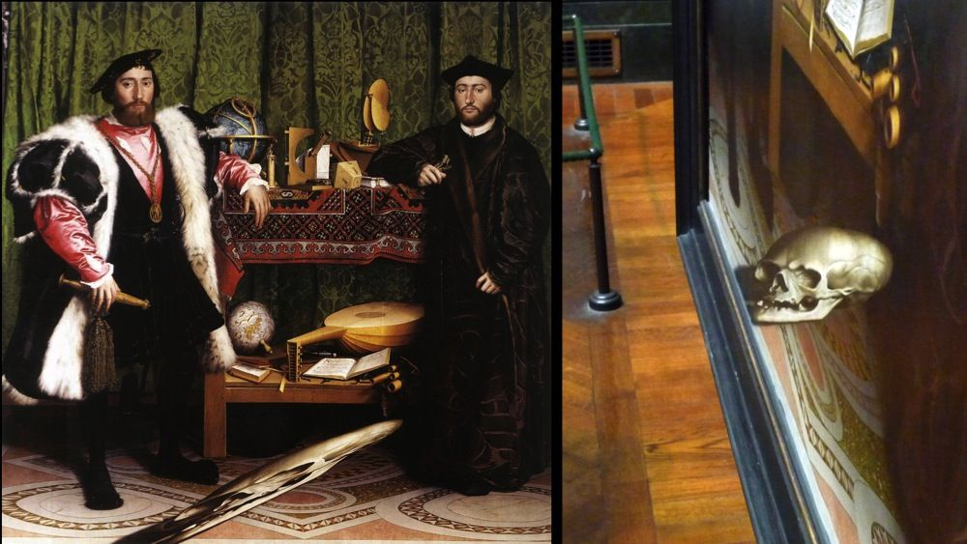
Image Transformations
The Ambassadors (Holbein), 1533
CS180: Intro to Computer Vision and Comp. Photo
Alexei Efros & Anjoo Kanazawa, UC Berkeley, Fall 2023
Some slides from Steve Seitz

Slide 2
Image Transformations
image filtering: change range of image
g(x) = T(f(x))
f
f
T
x
x
image warping: change domain of image
g(x) = f(T(x))
f
f
T
x
x

Slide 3
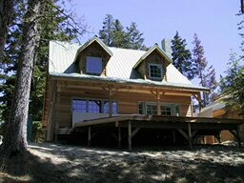
Image Transformations
image filtering: change range of image
g(x) = T(f(x))
f
g
T
image warping: change domain of image
g(x) = f(T(x))
f
g
T

Slide 4
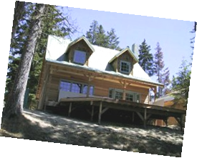
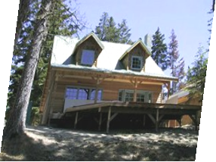
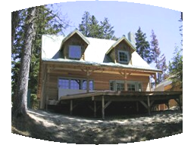
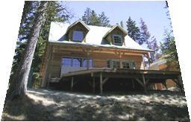
Parametric (global) warping
Examples of parametric warps:
translation
rotation
aspect
perspective
affine
cylindrical

Slide 5
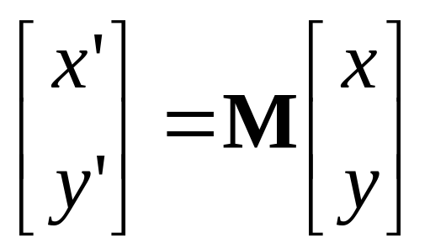
Parametric (global) warping
T
p = (x,y)
p’ = (x’,y’)
Transformation T is a coordinate-changing machine:
p’ = T(p)
What does it mean that T is global?
  Is the same for any point p
  can be described by just a few numbers (parameters)
Let’s represent a linear T as a matrix:
p’ = Mp

Slide 6
Scaling
Scaling a coordinate means multiplying each of its components by a scalar
Uniform scaling means this scalar is the same for all components:
× 2

Slide 7
Scaling
Non-uniform scaling: different scalars per component:
X × 2,
Y × 0.5

Slide 8
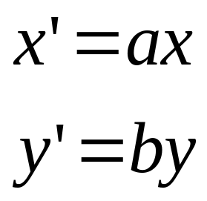
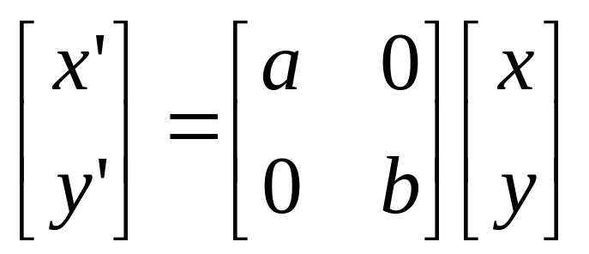
Scaling
Scaling operation:
Or, in matrix form:
scaling matrix S
What’s inverse of S?

Slide 9
2-D Rotation
(x’, y’)
(x, y)
x’ = x cos(θ) - y sin(θ)
y’ = x sin(θ) + y cos(θ)
θ

Slide 10
2-D Rotation
x = r cos (φ)
y = r sin (φ)
x’ = r cos (φ + θ)
y’ = r sin (φ + θ)
(x’, y’)
(x, y)
θ
φ

Slide 11
2-D Rotation
x = r cos (φ)
y = r sin (φ)
x’ = r cos (φ + θ)
y’ = r sin (φ + θ)
Trig Identity…
x’ = r cos(φ) cos(θ) – r sin(φ) sin(θ)
y’ = r sin(φ) cos(θ) + r cos(φ) sin(θ)
(x’, y’)
(x, y)
θ
φ

Slide 12
2-D Rotation
x = r cos (φ)
y = r sin (φ)
x’ = r cos (φ + θ)
y’ = r sin (φ + θ)
Trig Identity…
x’ = r cos(φ) cos(θ) – r sin(φ) sin(θ)
y’ = r sin(φ) cos(θ) + r cos(φ) sin(θ)
Substitute…
x’ = x cos(θ) - y sin(θ)
y’ = x sin(θ) + y cos(θ)
(x’, y’)
(x, y)
θ
φ

Slide 13
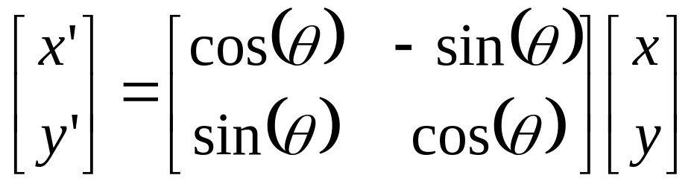

2-D Rotation
This is easy to capture in matrix form:
Is this a linear transformation?
Even though sin(θ) and cos(θ) are nonlinear functions of θ,
  x’ is a linear combination of x and y
  y’ is a linear combination of x and y
What is the inverse transformation?
  Rotation by –θ
  For rotation matrices
R

Slide 14
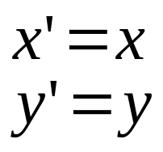
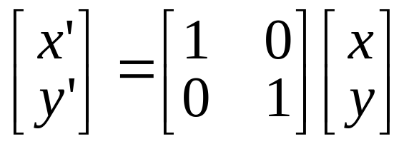
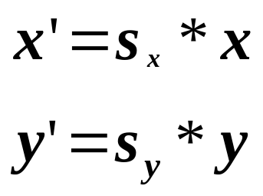
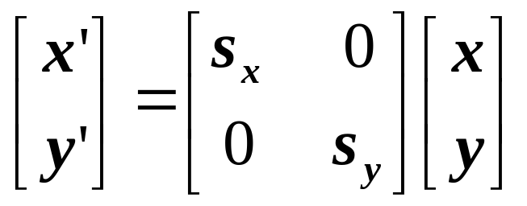
2x2 Matrices
What types of transformations can be
represented with a 2x2 matrix?
2D Identity?
2D Scale around (0,0)?

Slide 15
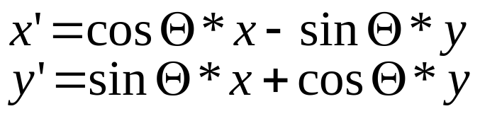
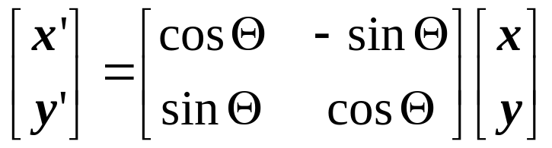
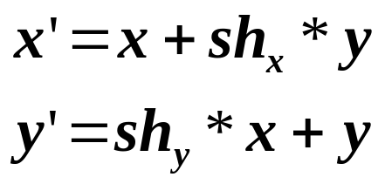
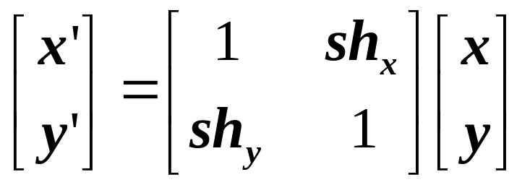
2x2 Matrices
What types of transformations can be
represented with a 2x2 matrix?
2D Rotate around (0,0)?
2D Shear?

Slide 16
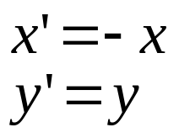
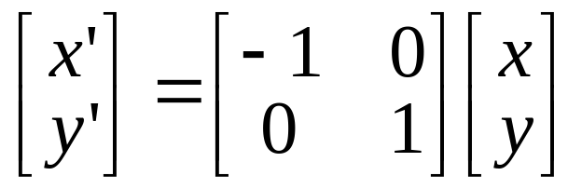
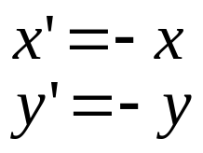
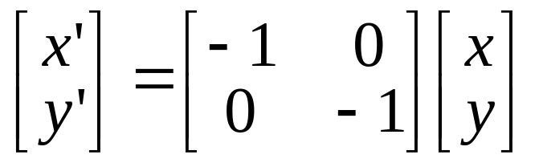
2x2 Matrices
What types of transformations can be
represented with a 2x2 matrix?
2D Mirror about Y axis?
2D Mirror over (0,0)?

Slide 17
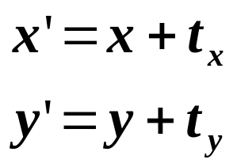
2x2 Matrices
What types of transformations can be
represented with a 2x2 matrix?
2D Translation?
NO!
Only linear 2D transformations
can be represented with a 2x2 matrix

Slide 18
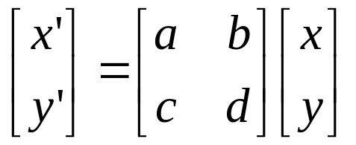
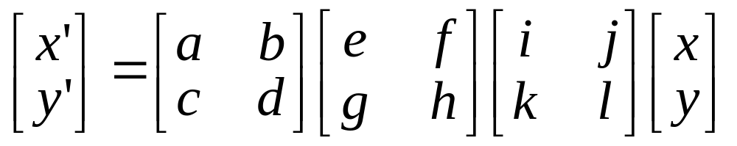
All 2D Linear Transformations
Linear transformations are combinations of …
  Scale,
  Rotation,
  Shear, and
  Mirror
Properties of linear transformations:
  Origin maps to origin
  Lines map to lines
  Parallel lines remain parallel
  Ratios are preserved
  Closed under composition

Slide 19
Consider a different Basis
j =(0,1)
v =(v_{x},v_{y})
p
q
u=(u_{x},u_{y})
i =(1,0)
q=4i+3j = (4,3)
p=4u+3v

Slide 20
Linear Transformations as Change of Basis
v =(v_{x},v_{y})
j =(0,1)
p^{uv}
p^{ij}
u=(u_{x},u_{y})
i =(1,0)
p^{uv} = (4,3)
p^{ij} = 4u+3v
p_{x}=4u_{x}+3v_{x}
p_{y}=4u_{y}+3v_{y}
⎡
u
v
⎤
⎡
4
⎤
⎡
u
v
⎤
p^{ij}
=
⎢
x
x
⎥
=
⎢
x
x
⎥
p^{uv}
⎢
⎥
⎣
u
v
⎦
⎣
3
⎦
⎣
u
v
⎦
y
y
y
y
Any linear transformation is a basis!!!

Slide 21
What’s the inverse transform?
j =(0,1)
v =(v_{x},v_{y})
p^{ij}
p^{uv}
u=(u_{x},u_{y})
i =(1,0)
p^{ij} = (5,4)
= p_{x}u + p_{y}v
p^{uv} = (p_{x},p_{y}) = ?
-1
-1
⎡
u
v
⎤
⎡
5
⎤
⎡
u
v
⎤
p^{uv}
=
⎢
x
x
⎥
=
⎢
x
x
⎥
p^{ij}
⎢
⎥
⎣
u
v
⎦
⎣
4
⎦
⎣
u
v
⎦
y
y
y
y
How can we change from any basis to any basis?
What if the basis are orthogonal?

Slide 22
Projection onto orthogonal basis
j =(0,1)
v =(v_{x},v_{y})
p^{ij}
p^{uv}
u=(u_{x},u_{y})
i =(1,0)
p^{ij} = (5,4)
p^{uv} = (u·p^{ij}, v·p^{ij})
⎡
u
u
⎤
⎡
5
⎤
⎡
u
u
⎤
p^{uv}
=
⎢
x
x
⎥
=
⎢
x
y
⎥
p^{ij}
⎢
⎥
⎣
v
v
⎦
⎣
4
⎦
⎣
v
v
⎦
y
y
x
y

Slide 23
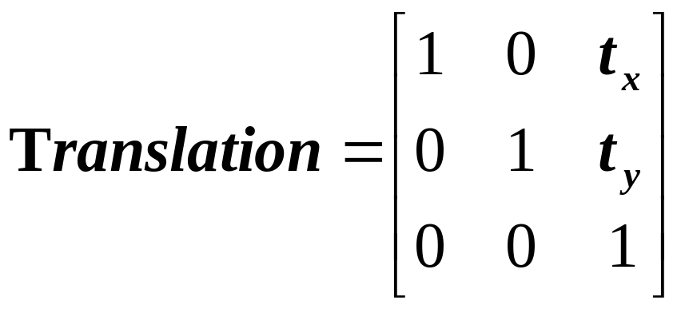
Homogeneous Coordinates
Q: How can we represent translation as a 3x3 matrix?
A: Using the rightmost column:

Slide 24
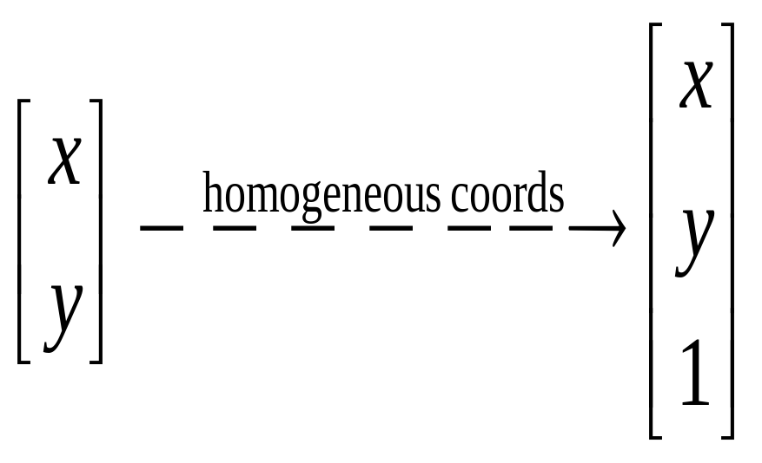
Homogeneous Coordinates
Homogeneous coordinates
  represent coordinates in 2 dimensions with a 3-vector

Slide 25
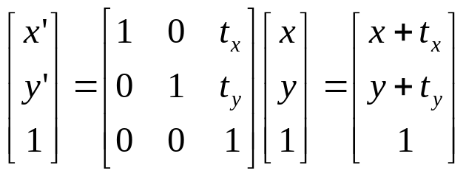
Translation
Example of translation
Homogeneous Coordinates
t_{x} = 2
t_{y} = 1

Slide 26
Homogeneous Coordinates
Add a 3rd coordinate to every 2D point
  (x, y, w) represents a point at location (x/w, y/w)
  (x, y, 0) represents a point at infinity
  (0, 0, 0) is not allowed
y
2
(2,1,1)
or (4,2,2)
or (6,3,3)
1
Convenient coordinate system to
represent many useful transformations
x
1
2

Slide 27
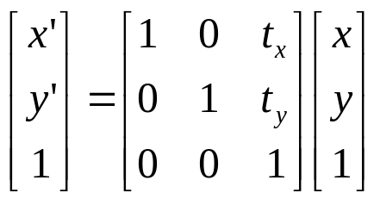
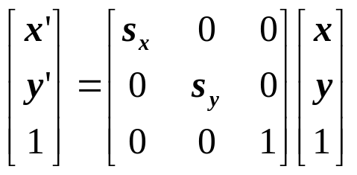
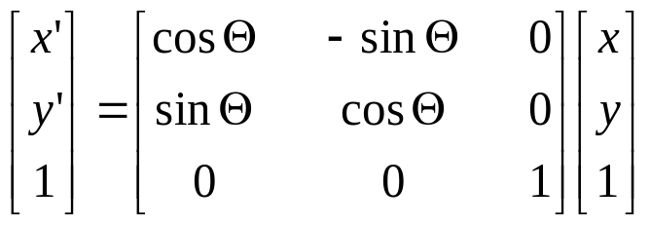
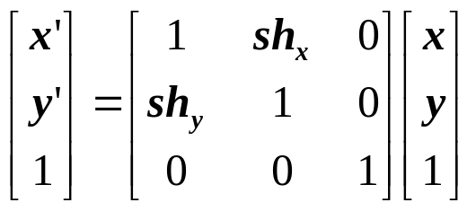
Basic 2D Transformations
Basic 2D transformations as 3x3 matrices
Translate
Scale
Rotate
Shear

Slide 28
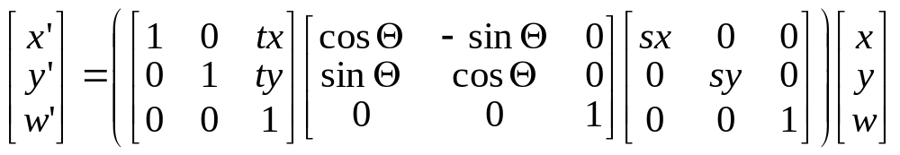
Matrix Composition
Transformations can be combined by
matrix multiplication
p’ = T(t_{x},t_{y}) R(Θ) S(s_{x},s_{y}) p
Does the order of multiplication matter?

Slide 29
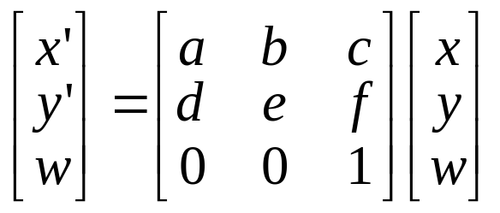
Affine Transformations
Affine transformations are combinations of …
  Linear transformations, and
  Translations
Properties of affine transformations:
  Origin does not necessarily map to origin
  Lines map to lines
  Parallel lines remain parallel
  Ratios are preserved
  Closed under composition
  Models change of basis
Will the last coordinate w always be 1?

Slide 30
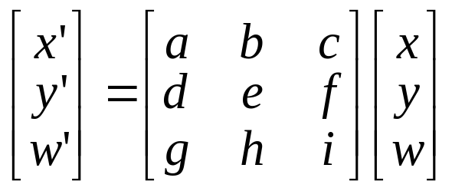
Projective Transformations
Projective transformations …
  Affine transformations, and
  Projective warps
Properties of projective transformations:
  Origin does not necessarily map to origin
  Lines map to lines
  Parallel lines do not necessarily remain parallel
  Ratios are not preserved
  Closed under composition
  Models change of basis

Slide 31
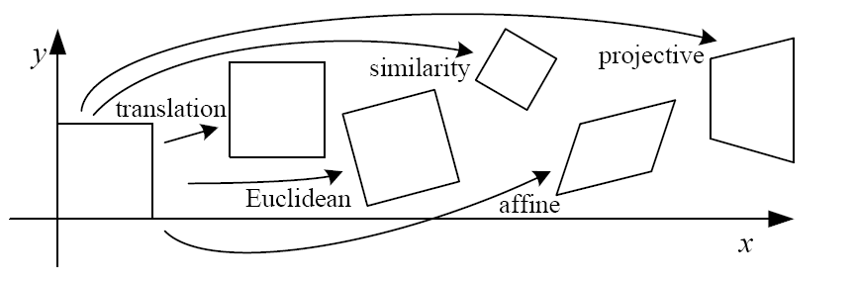
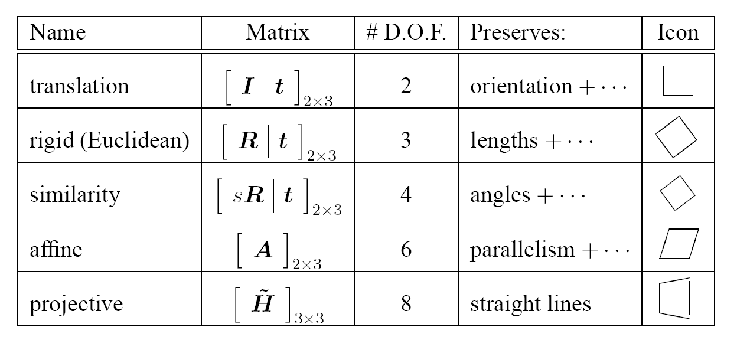
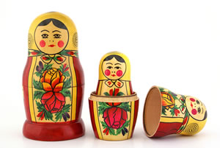
2D image transformations
These transformations are a nested set of groups
  Closed under composition and inverse is a member

Slide 32
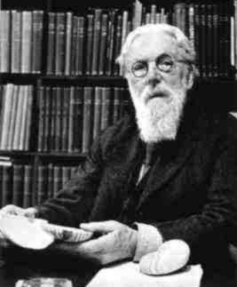
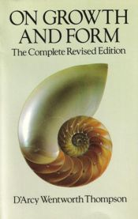
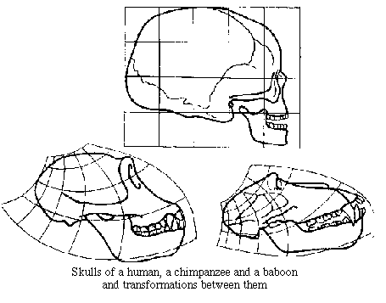
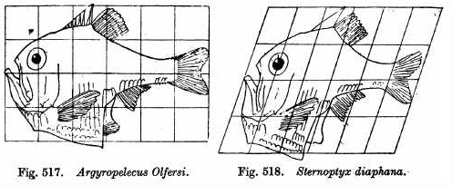
Image Transforms in Biology
D'Arcy Thompson
http://www-groups.dcs.st-and.ac.uk/~history/Miscellaneous/darcy.html
http://en.wikipedia.org/wiki/D'Arcy_Thompson
Importance of shape and structure in evolution
Slide by Durand and Freeman

Slide 33
Pop-up Quiz time!

