Slide 1
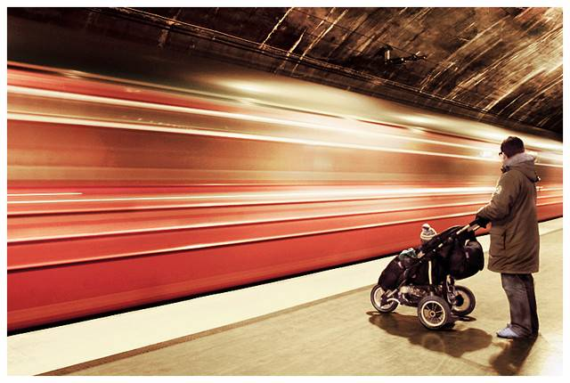
Automatic Image Alignment, Part 2
© Mike Nese
CS180: Intro to Comp. Vision and Comp. Photo
Efros & Kanazawa, UC Berkeley, Fall 2025
with a lot of slides stolen from
Steve Seitz and Rick Szeliski

Slide 2
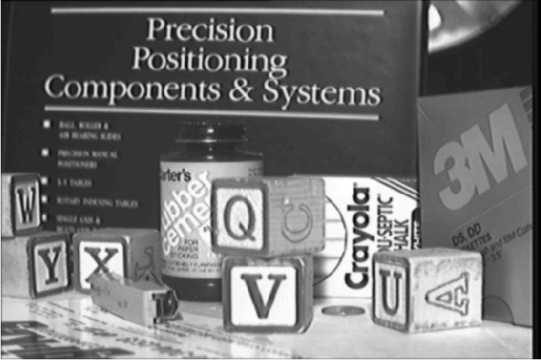
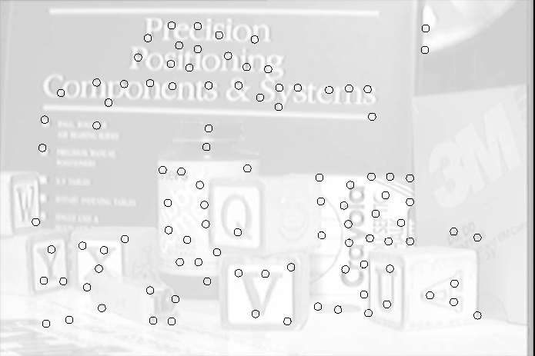
Feature Detectors

Slide 3




Feature Decriptors
Schmid & Mohr 1997, Lowe 1999, Baumberg 2000, Tuytelaars & Van Gool 2000, Mikolajczyk & Schmid 2001, Brown & Lowe 2002, Matas et. al. 2002, Schaffalitzky & Zisserman 2002

Slide 4
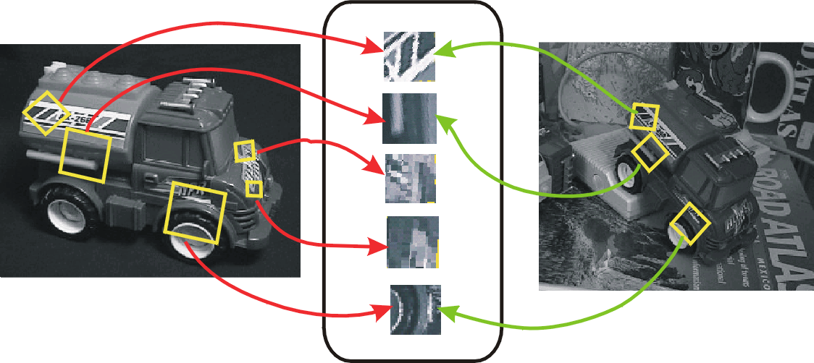
Invariant Local Features
Image content is transformed into local feature coordinates that are invariant to translation, rotation, scale, and other imaging parameters
Features Descriptors

Slide 5
Applications
Feature points are used for:
  Image alignment (homography, fundamental matrix)
  3D reconstruction
  Motion tracking
  Object recognition
  Indexing and database retrieval
  Robot navigation
  … other

Slide 6
Today’s lecture
1 Feature detector
  scale invariant Harris corners
1 Feature descriptor
  patches, oriented patches
Reading:
Multi-image Matching using Multi-scale image patches, CVPR 2005

Slide 7
Feature Detector – Harris Corner

Slide 8
Harris corner detector
C.Harris, M.Stephens. “A Combined Corner and Edge Detector”. 1988

Slide 9
The Basic Idea
We should easily recognize the point by looking through a small window
Shifting a window in any direction should give a large change in intensity

Slide 10
Harris Detector: Basic Idea
“flat” region:
no change in all directions
“edge”:
no change along the edge direction
“corner”:
significant change in all directions

Slide 11
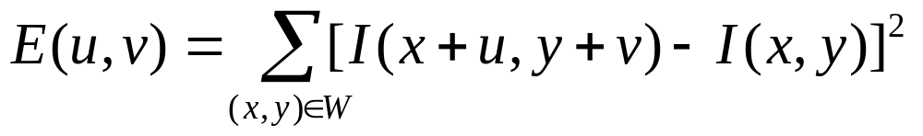
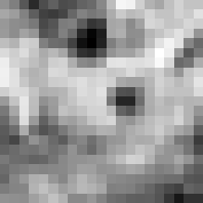

Corner Detection: Mathematics
Change in appearance of window W for the shift [u,v]:
I(x, y)
E(u, v)
E(3,2)

Slide 12
Corner Detection: Mathematics
Change in appearance of window W for the shift [u,v]:
I(x, y)
E(u, v)
E(0,0)

Slide 13
Corner Detection: Mathematics
Change in appearance of window W for the shift [u,v]:
We want to find out how this function behaves for small shifts
E(u, v)
Notes:
Specifically, E has to have a unique minimum at (0,0)

Slide 14
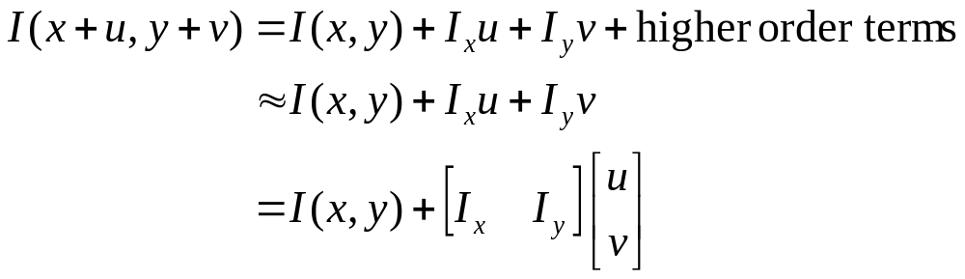
Corner Detection: Mathematics
First-order Taylor approximation for small motions [u, v]:
Let’s plug this into

Slide 15
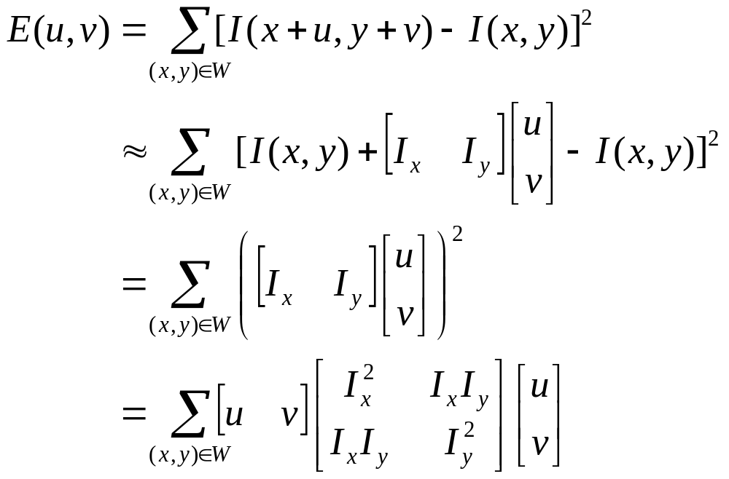
Corner Detection: Mathematics

Slide 16
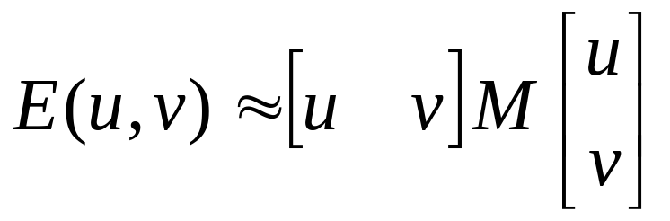
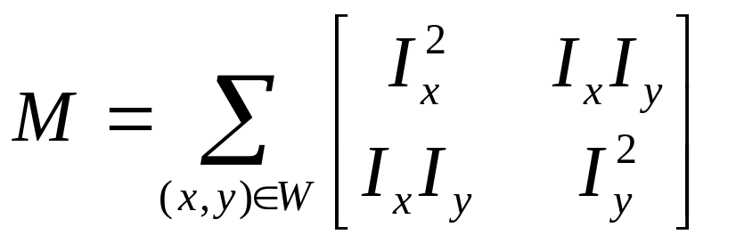
Corner Detection: Mathematics
The quadratic approximation simplifies to
where M is a second moment matrix computed from image derivatives:

Slide 17
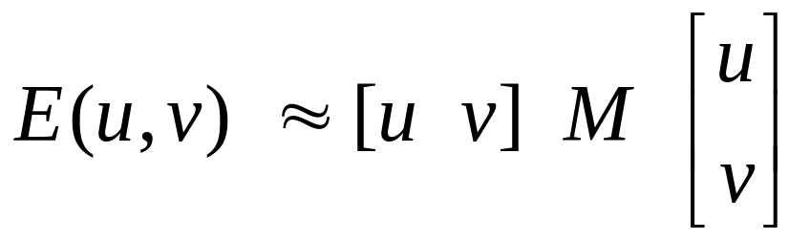
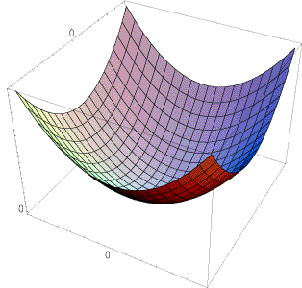
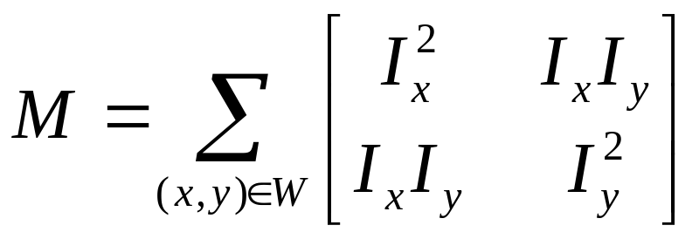
Interpreting the second moment matrix
The surface E(u,v) is locally approximated by a quadratic form. Let’s try to understand its shape.
  Specifically, in which directions
  does it have the smallest/greatest
  change?
E(u, v)

Slide 18

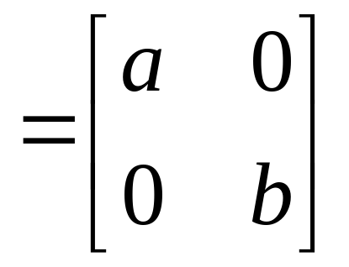
Interpreting the second moment matrix
First, consider the axis-aligned case (gradients are either horizontal or vertical)
If either a or b is close to 0, then this is not a corner, so look for locations where both are large.

Slide 19
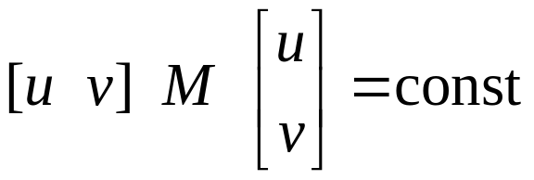
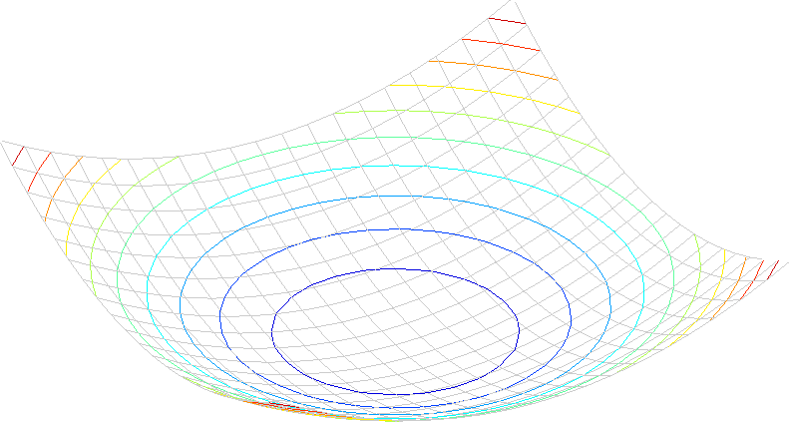
Interpreting the second moment matrix
Consider a horizontal “slice” of E(u, v):
This is the equation of an ellipse.

Slide 20
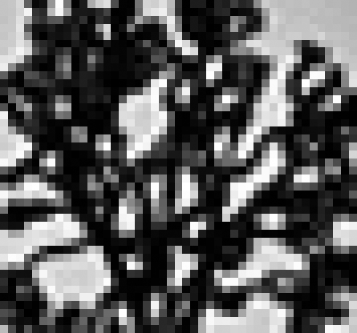
Visualization of second moment matrices

Slide 21
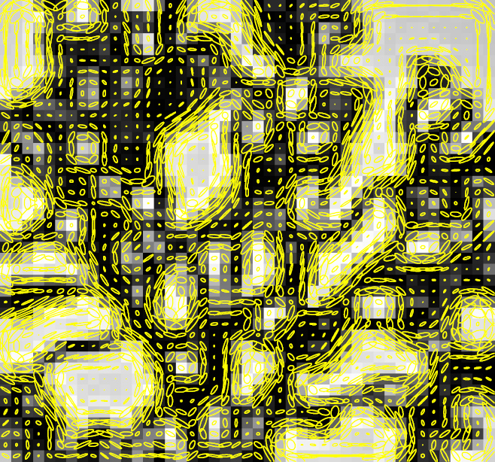
Visualization of second moment matrices

Slide 22
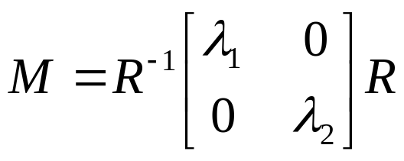
Interpreting the second moment matrix
Consider a horizontal “slice” of E(u, v):
This is the equation of an ellipse.
Diagonalization of M:
The axis lengths of the ellipse are determined by the eigenvalues and the orientation is determined by R
direction of the fastest change
direction of the slowest change
(λ_{max})^{-1/2}
(λ_{min})^{-1/2}

Slide 23
Interpreting the eigenvalues
Classification of image points using eigenvalues of M:
λ₂
“Edge”
λ₂ >> λ₁
“Corner”
λ₁ and λ₂ are large,
λ₁ ~ λ₂;
E increases in all directions
λ₁ and λ₂ are small;
E is almost constant in all directions
“Flat” region
“Edge”
λ₁ >> λ₂
λ₁

Slide 24
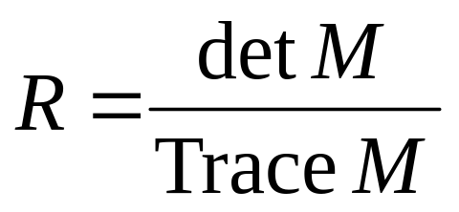
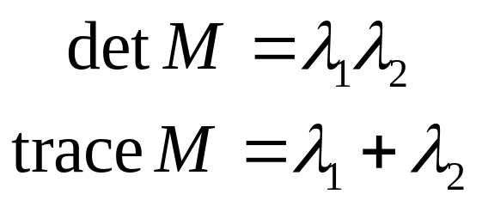
Harris Detector: Mathematics
Measure of corner response:

Slide 25
Harris detector: Steps
Compute Gaussian derivatives at each pixel
For each sliding window in image, compute second moment matrix M in a Gaussian window around each pixel
Compute corner response function R
Threshold R
Find local maxima of response function (nonmaximum suppression)
C.Harris and M.Stephens. “A Combined Corner and Edge Detector.” Proceedings of the 4th Alvey Vision Conference: pages 147—151, 1988.

Slide 26
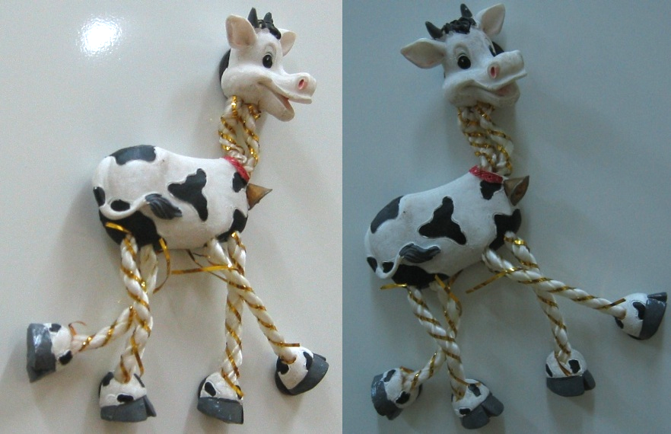
Harris Detector: Workflow

Slide 27
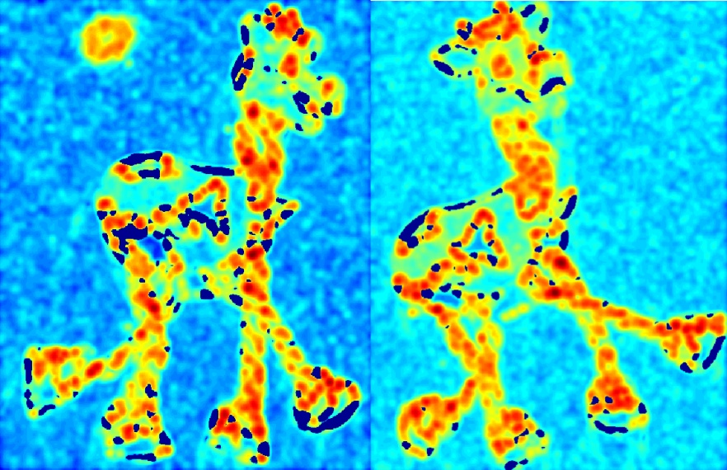
Harris Detector: Workflow
Compute corner response R

Slide 28
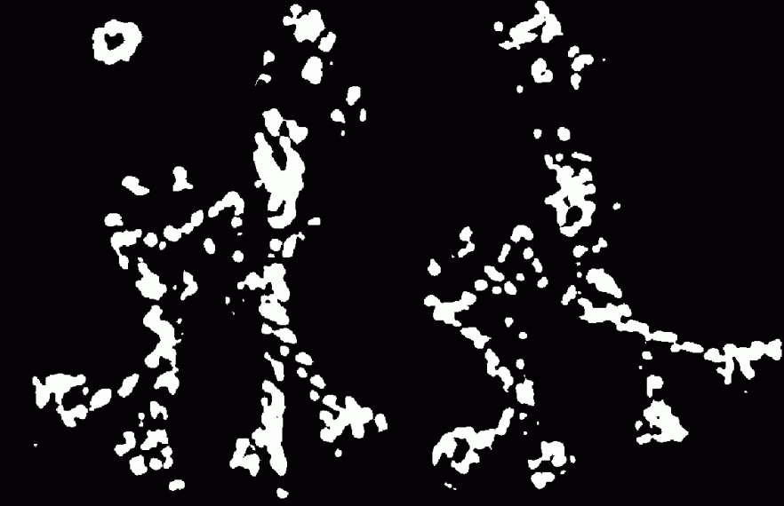
Harris Detector: Workflow
Find points with large corner response: R>threshold

Slide 29
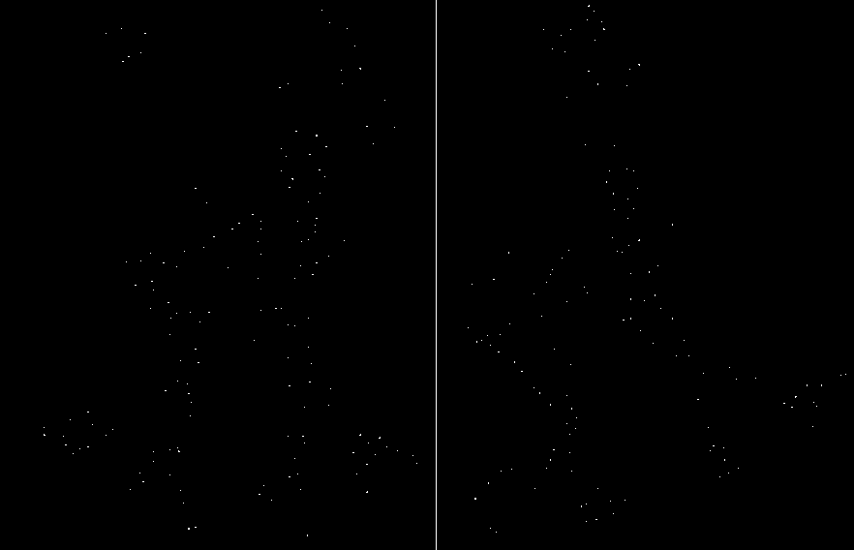
Harris Detector: Workflow
Take only the points of local maxima of R

Slide 30
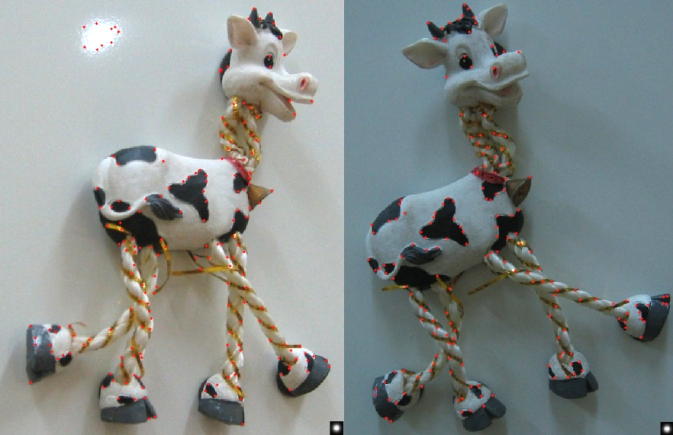
Harris Detector: Workflow

Slide 31
Harris Detector: Some Properties
Rotation invariance
Ellipse rotates but its shape (i.e. eigenvalues) remains the same
Corner response R is invariant to image rotation

Slide 32
Harris Detector: Some Properties
Partial invariance to affine intensity change
Only derivatives are used => invariance to intensity shift I → I + b
Intensity scale: I → a I
R
R
threshold
x (image coordinate)
x (image coordinate)

Slide 33
Harris Detector: Some Properties
But: non-invariant to image scale!
All points will be classified as edges
Corner !

Slide 34
Scale Invariant Detection
Consider regions (e.g. circles) of different sizes around a point
Regions of corresponding sizes will look the same in both images

Slide 35
Scale Invariant Detection
The problem: how do we choose corresponding circles independently in each image?
Choose the scale of the “best” corner

Slide 36
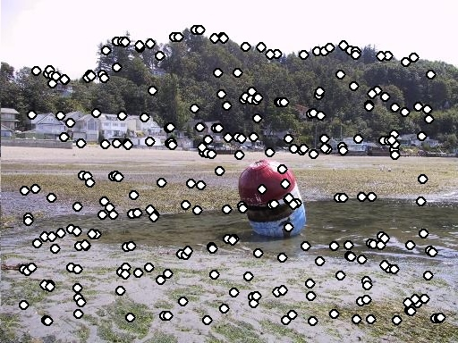
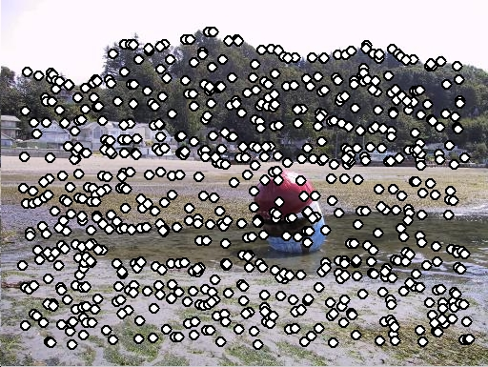
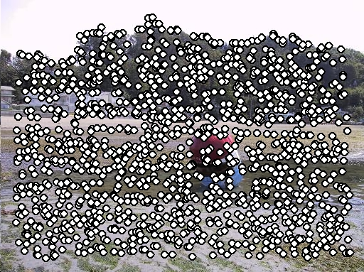
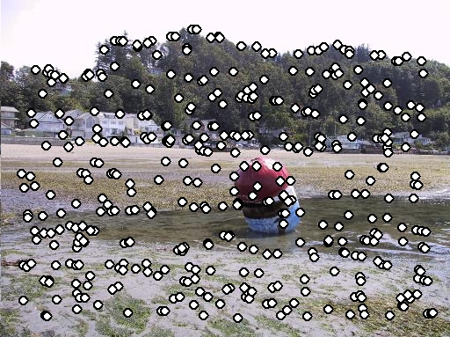
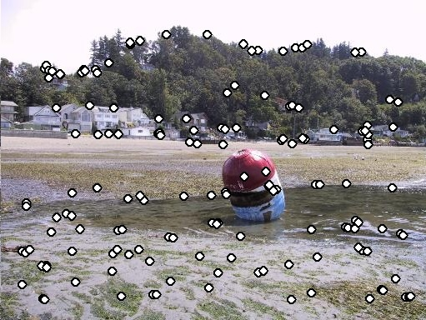
Feature selection
Distribute points evenly over the image

Slide 37
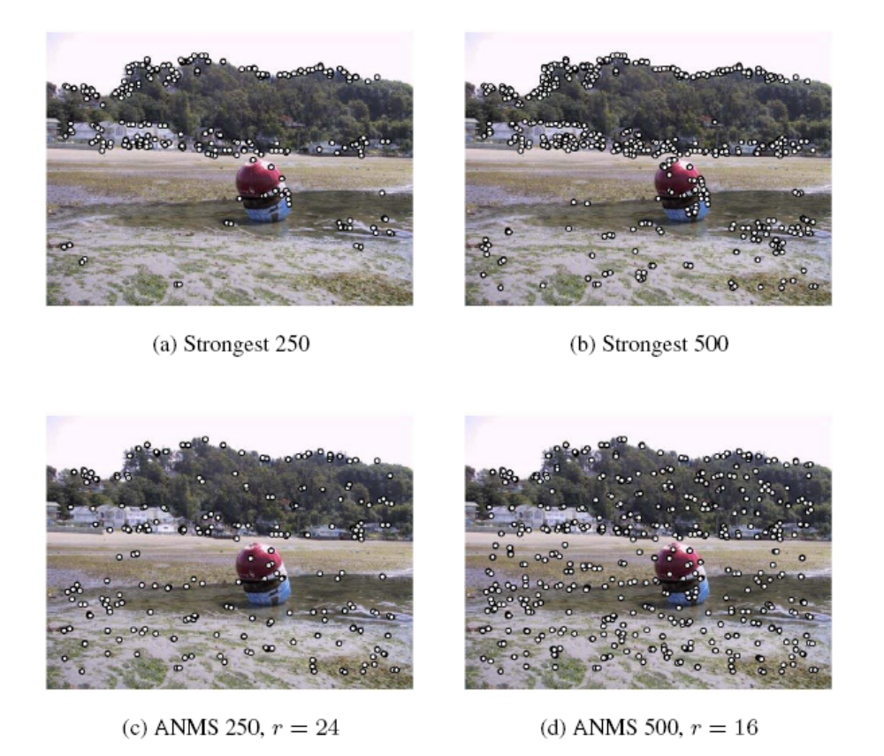
Adaptive Non-maximal Suppression
Desired: Fixed # of features per image
  Want evenly distributed spatially…
  Sort points by non-maximal suppression radius
  [Brown, Szeliski, Winder, CVPR’05]

Slide 38
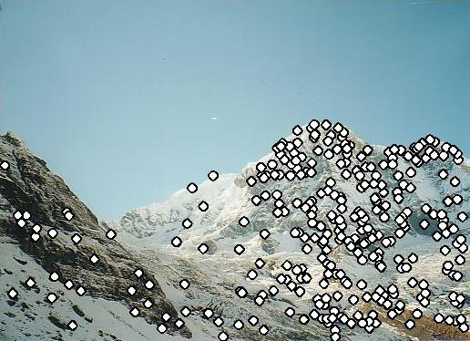
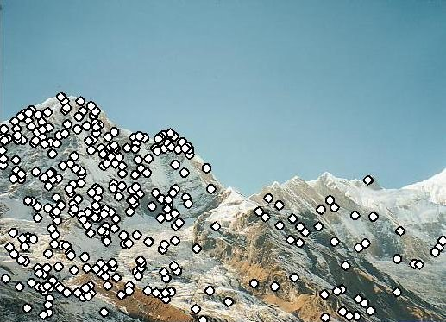
Feature descriptors
We know how to detect points
Next question: How to match them?
?
Point descriptor should be:
  Invariant 2. Distinctive

Slide 39
Feature Descriptor – MOPS

Slide 40
Descriptors Invariant to Rotation
Find local orientation
Dominant direction of gradient
Extract image patches relative to this orientation

Slide 41
Multi-Scale Oriented Patches
Interest points
  Multi-scale Harris corners
  Orientation from blurred gradient
  Geometrically invariant to rotation
Descriptor vector
  Bias/gain normalized sampling of local patch (8x8)
  Photometrically invariant to affine changes in intensity
[Brown, Szeliski, Winder, CVPR’2005]

Slide 42
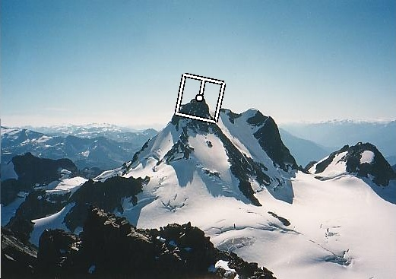
Detect Features, setup Frame
Orientation = blurred gradient
Rotation Invariant Frame
  Scale-space position (x, y, s) + orientation (θ)

Slide 43
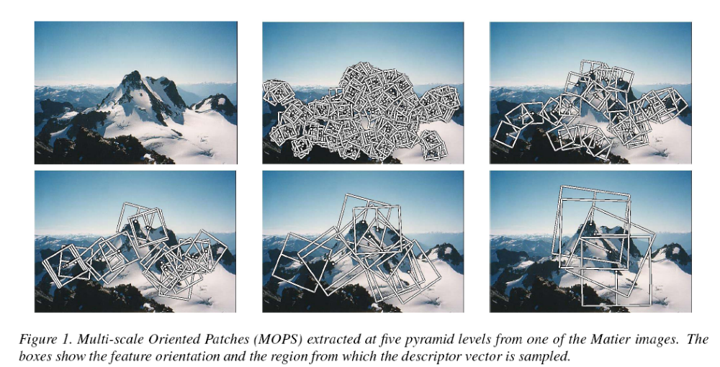
Detections at multiple scales

Slide 44
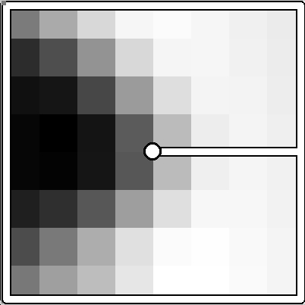
MOPS descriptor vector
8x8 oriented patch
  Sampled at 5 x scale
Bias/gain normalisation: I’ = (I – μ)/σ
40 pixels
8 pixels

Slide 45
Automatic Feature Matching

Slide 46
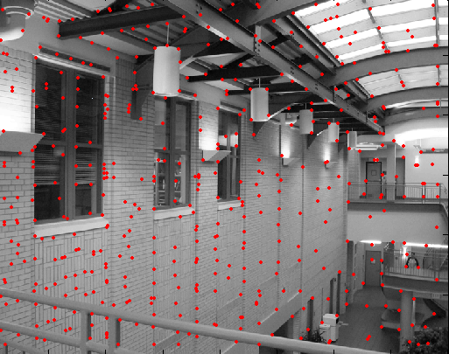
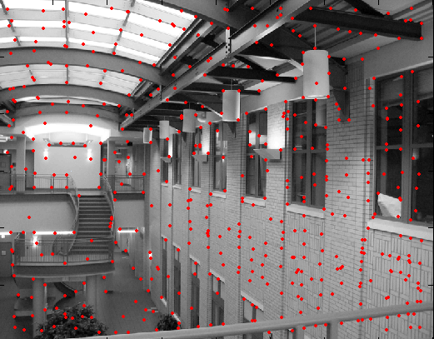
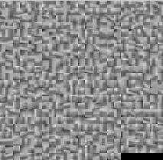
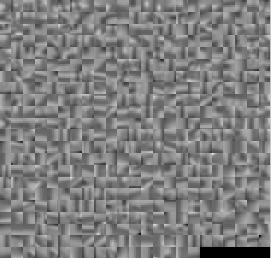
Feature matching
?

Slide 47
Feature matching
Pick best match!
  For every patch in image 1, find the most similar patch (e.g. by L2 distance).
  Called “nearest neighbor” in machine learning
Can do various speed ups:
  Hashing
    compute a short descriptor from each feature vector, or hash longer descriptors (randomly)
  Fast Nearest neighbor techniques
    kd-trees and their variants
  Clustering / Vector quantization
    So called “visual words”

Slide 48
What about outliers?
?

Slide 49
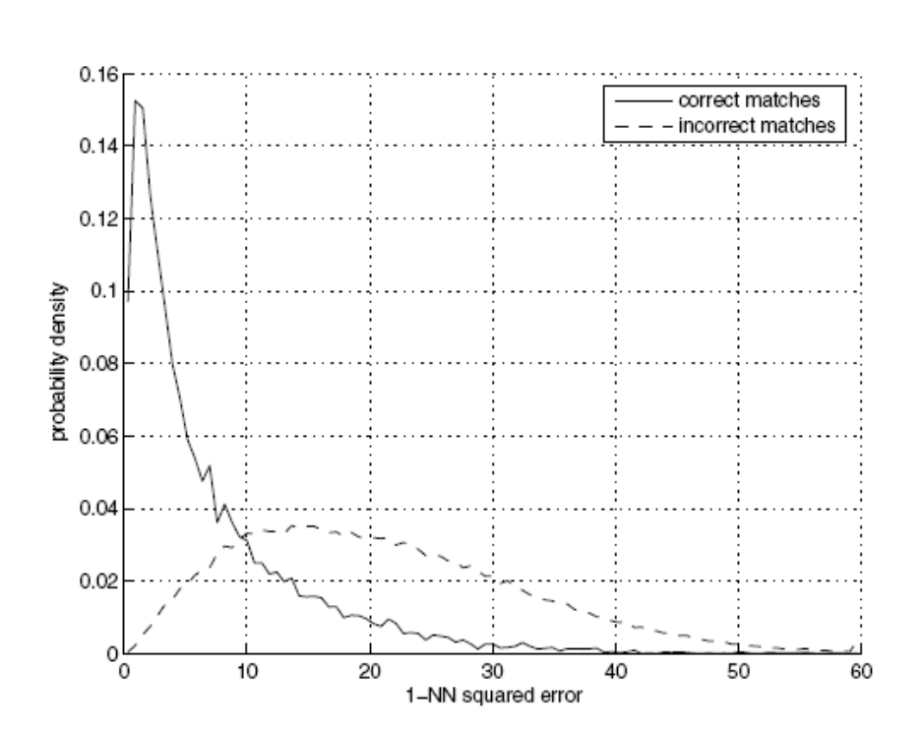
Feature-space outlier rejection
Let’s not match all features, but only these that have “similar enough” matches?
How can we do it?
  SSD(patch1,patch2) < threshold
  How to set threshold?

Slide 50
Feature-space outlier rejection: symmetry
Let’s not match all features, but only these that have “similar enough” matches?
How can we do it?
  Symmetry: x’s NN is y, and y’s NN is x

Slide 51
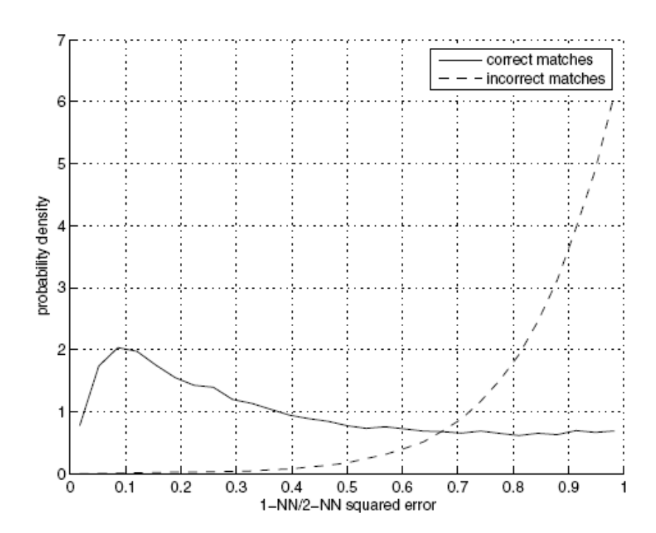
Feature-space outlier rejection: Lowe’s trick
A better way [Lowe, 1999]:
  1-NN: L2 of the closest match
  2-NN: L2 of the second-closest match
  Look at how much better 1-NN is than 2-NN, e.g. 1-NN/2-NN
  That is, is our best match so much better than the rest?

Slide 52
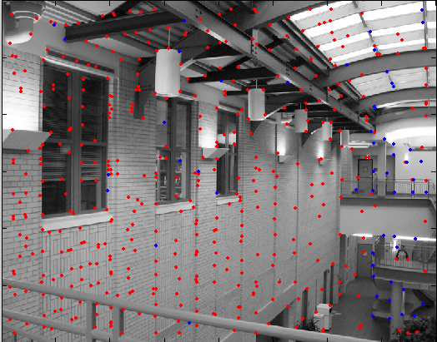
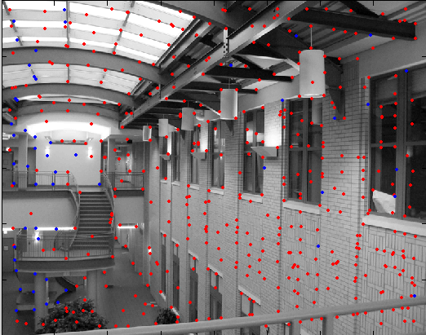
Feature-space outliner rejection
Can we now compute H from the blue points?
  No! Still too many outliers…
  What can we do?

Slide 53
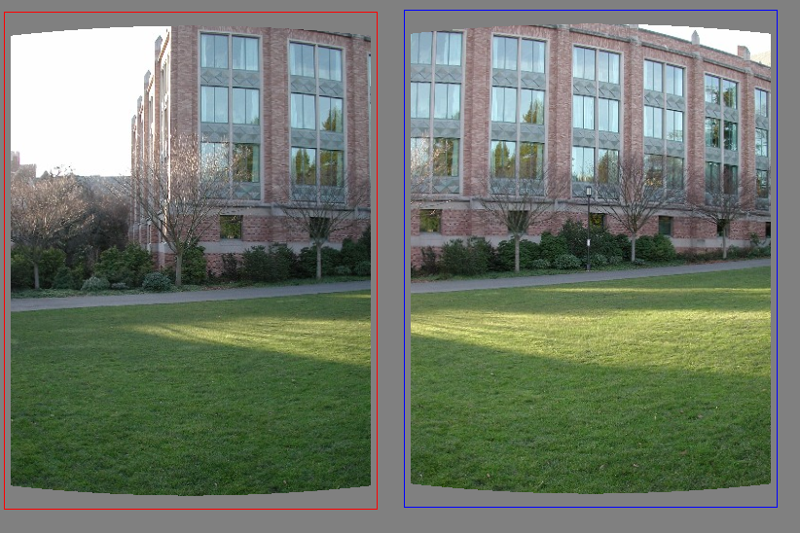
Matching features
What do we do about the “bad” matches?

Slide 54
RAndom SAmple Consensus
Select one match, count inliers

Slide 55
RAndom SAmple Consensus
Select one match, count inliers

Slide 56
Least squares fit
Find “average” translation vector

Slide 57
RANSAC for estimating homography
RANSAC loop:
Select four feature pairs (at random)
Compute homography H (exact)
Compute inliers where dist(p_{i}’, H p_{i} ) < ε
Keep largest set of inliers
Re-compute least-squares H estimate on all of the inliers

Slide 58
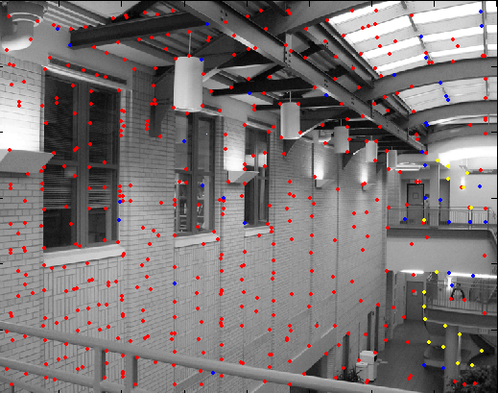
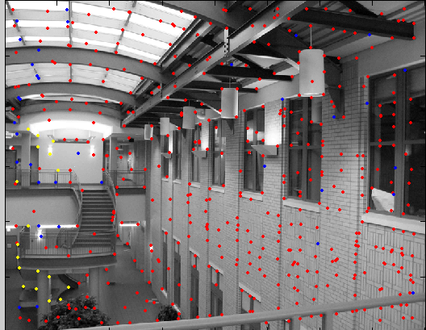
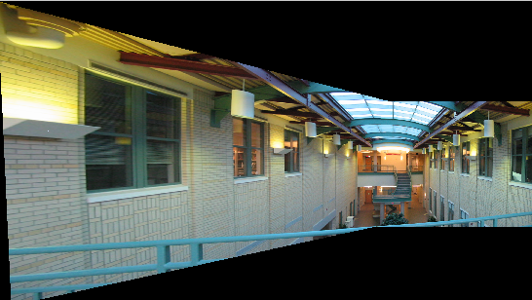
RANSAC

