Slide 1
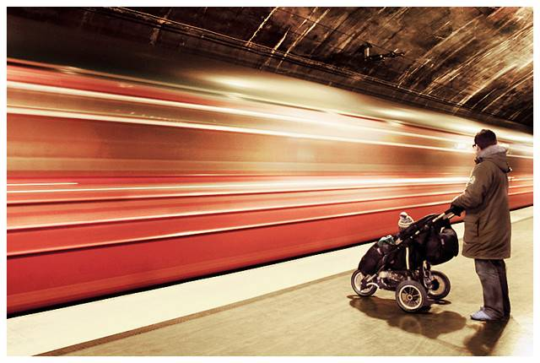
Automatic Image Alignment
© Mike Nese
CS180: Intro to Comp. Vision and Comp. Photo
Alexei Efros, UC Berkeley, Fall 2025
with a lot of slides stolen from
Steve Seitz and Rick Szeliski

Slide 2
From last lecture…

Slide 3
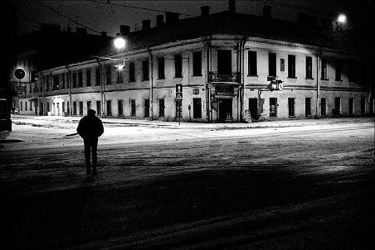
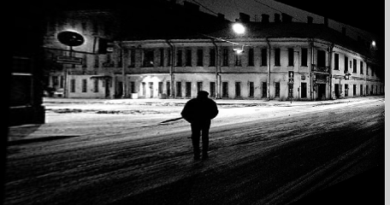
Image rectification
Original image
St.Petersburg
photo by A. Tikhonov
Virtual camera rotations

Slide 4
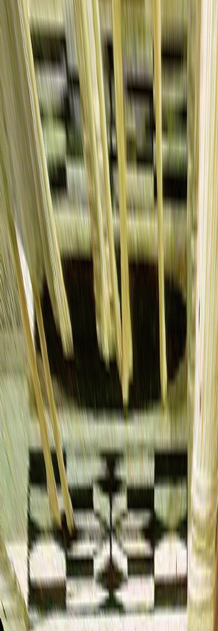
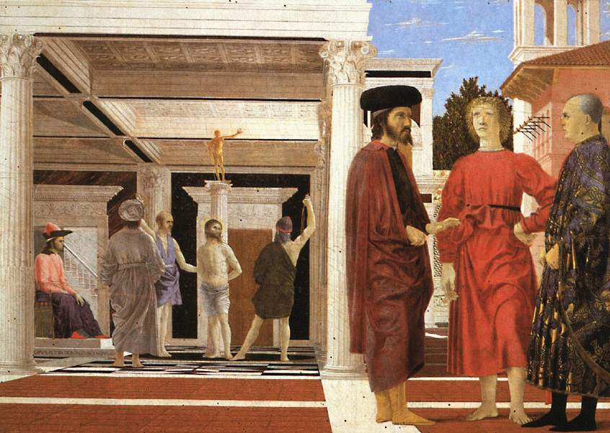

Analysing patterns and shapes
What is the shape of the b/w floor pattern?
Homography
The floor (enlarged)
Automatically
rectified floor
Slide from Criminisi

Slide 5
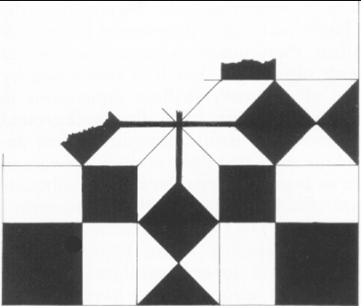
Analysing patterns and shapes
Automatic rectification
From Martin Kemp The Science of Art
(manual reconstruction)
2 patterns have been discovered !
Slide from Criminisi

Slide 6
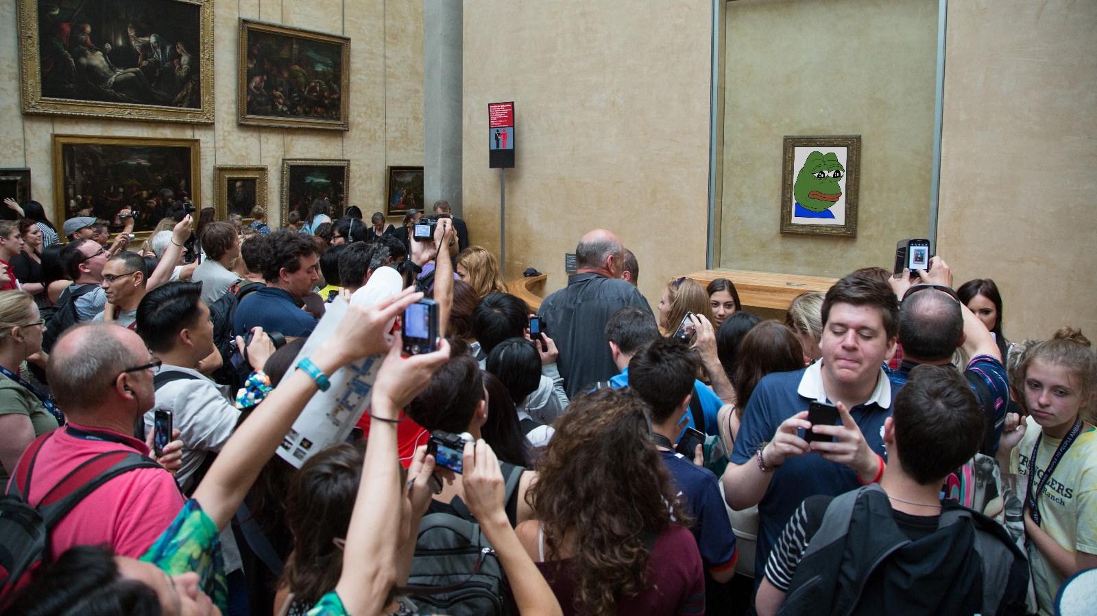
Inverse Rectification
Andrew Campbell

Slide 7
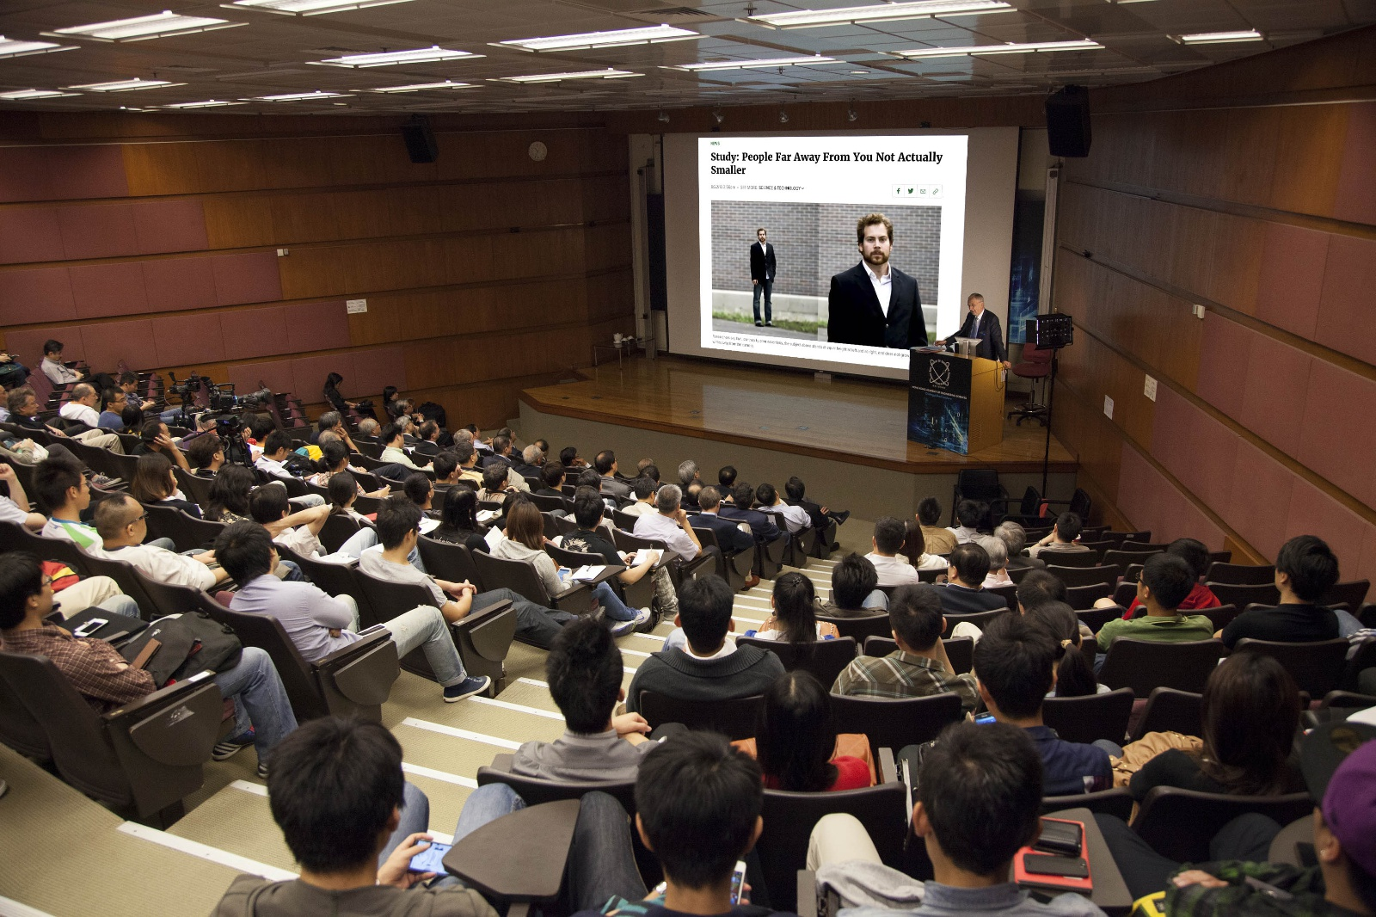
Meanwhile in Stanford…
Andrew Campbell

Slide 8

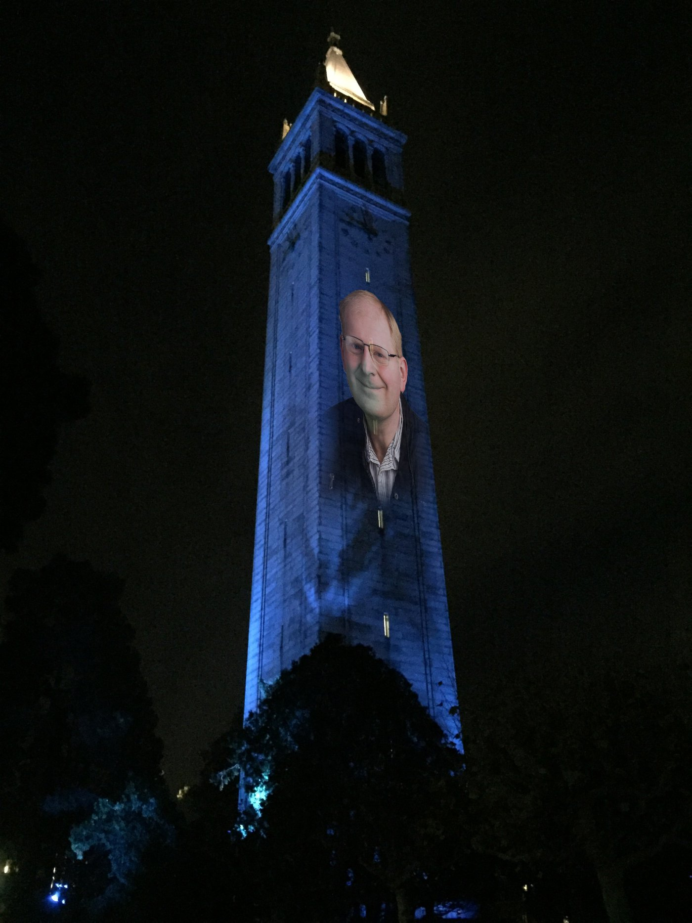
One way to get an A… ☺
Andrew Campbell

Slide 9
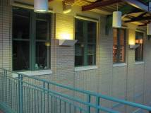
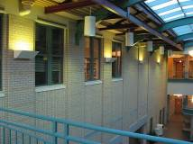
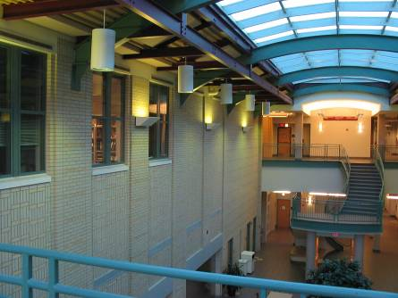
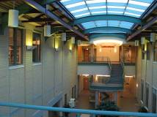
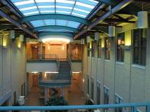
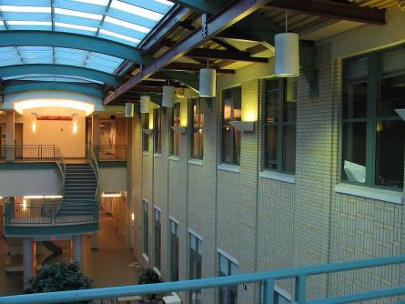
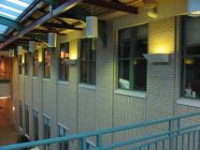
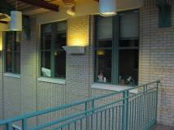
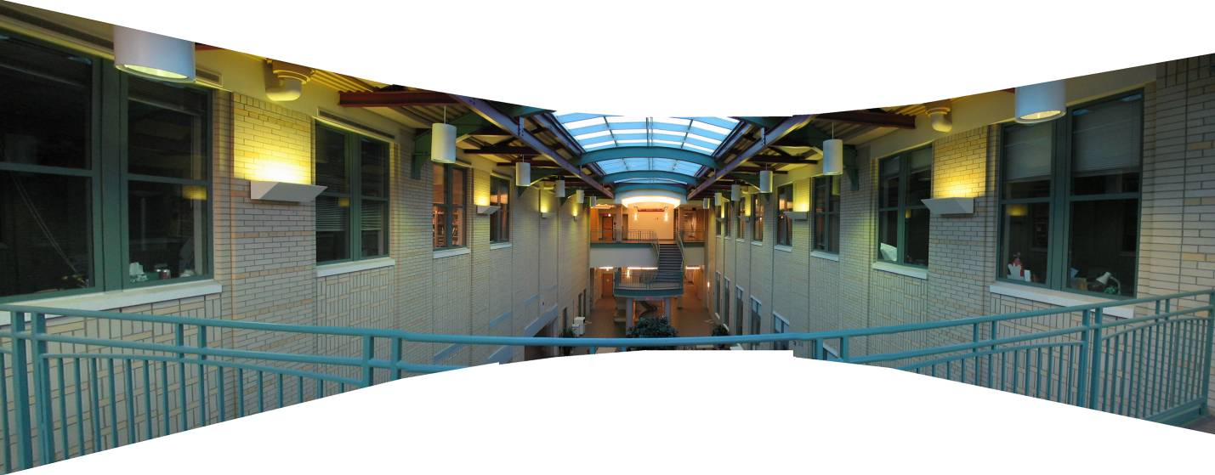
Mosaics: stitching images together
virtual wide-angle camera

Slide 10

Why Mosaic?
Are you getting the whole picture?
  Compact Camera FOV = 50 x 35°
Slide from Brown & Lowe

Slide 11
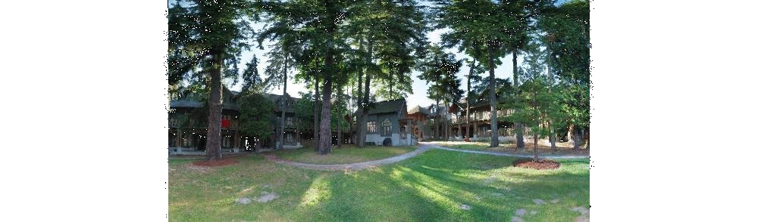
Why Mosaic?
Are you getting the whole picture?
  Compact Camera FOV = 50 x 35°
  Human FOV = 200 x 135°
Slide from Brown & Lowe

Slide 12
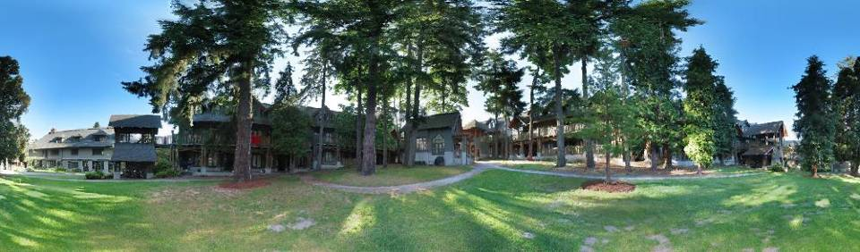
Why Mosaic?
Are you getting the whole picture?
  Compact Camera FOV = 50 x 35°
  Human FOV = 200 x 135°
  Panoramic Mosaic = 360 x 180°
Slide from Brown & Lowe

Slide 13
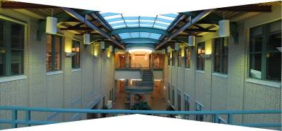
Naïve Stitching
left on top
right on top
  Translations are not enough to align the images

Slide 14
Image reprojection
mosaic PP
The mosaic has a natural interpretation in 3D
  The images are reprojected onto a common plane
  The mosaic is formed on this plane
  Mosaic is a synthetic wide-angle camera

Slide 15
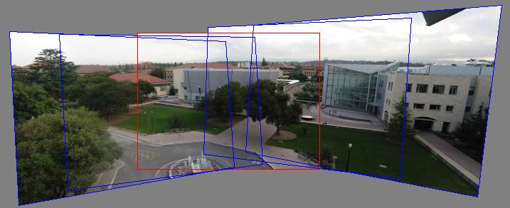
Panoramas
Pick one image (red)
Warp the other images towards it (usually, one by one)
blend

Slide 16
Tricky question…
We can generate any synthetic camera view
as long as it has the same center of projection!
real camera
synthetic camera
What happens if we move the center of projection?

Slide 17
changing camera center
Does it still work?
synthetic PP
PP1
PP2

Slide 18
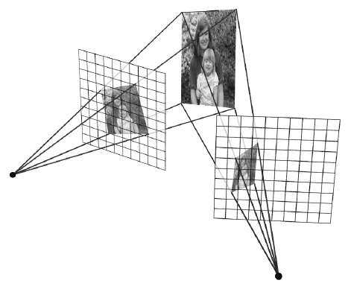
Planar scene (or far away)
PP3
PP1
PP2
PP3 is a projection plane of both centers of projection, so we are OK!
This is how big aerial photographs are made

Slide 19
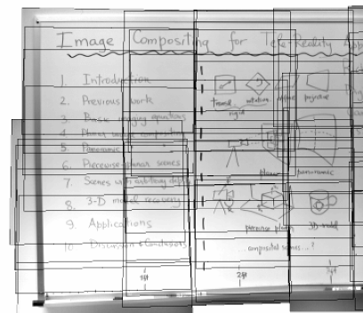
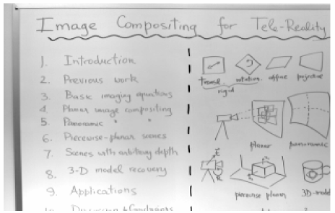
Planar mosaic

Slide 20
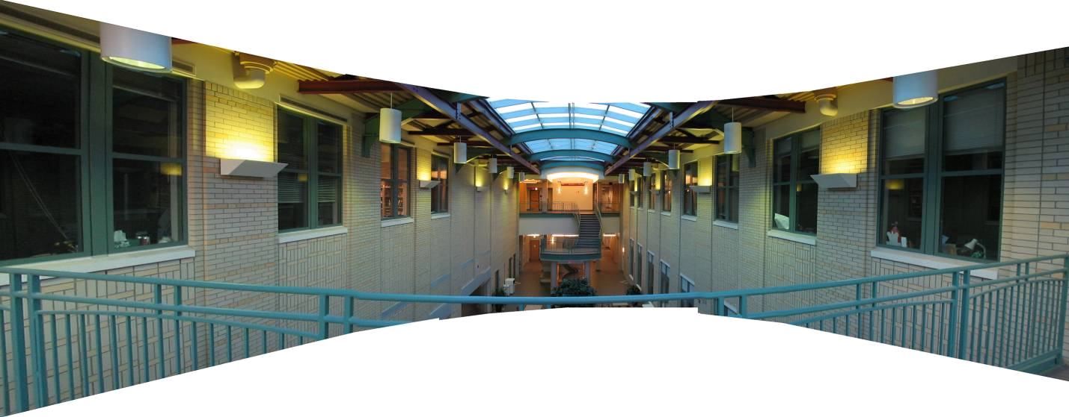
Programming Project #4 (part 1)
Homographies and Panoramic Mosaics
Capture photographs
  Might want to use tripod
Compute homographies (define correspondences)
  will need to figure out how to setup system of eqs.
(un)warp an image (undo perspective distortion)
Produce panoramic mosaics (with blending)

Slide 21
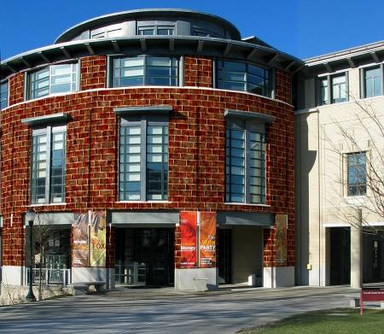
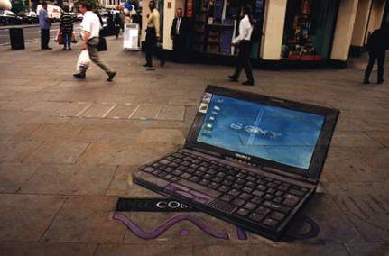
Bells and Whistles
Blending and Compositing
  use homographies to combine images or video and images together in an interesting (fun) way. E.g.
    put fake graffiti on buildings or chalk drawings on the ground
    replace a road sign with your own poster
    project a movie onto a building wall
    etc.

Slide 22
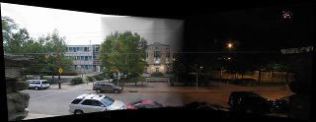
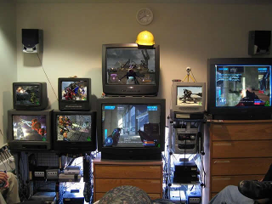

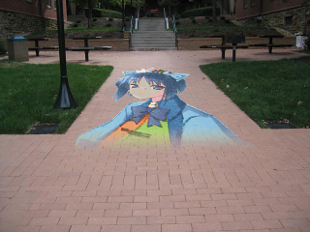
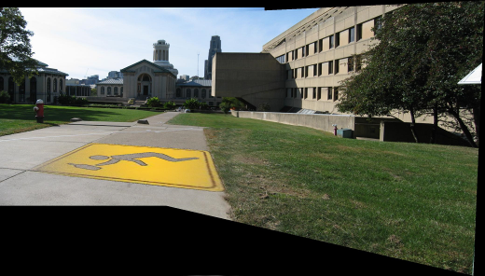
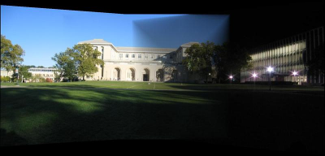
From previous year’s classes
Ben Hollis, 2004
Ben Hollis, 2004
Eunjeong Ryu (E.J), 2004
Matt Pucevich , 2004

Slide 23
Bells and Whistles
Capture creative/cool/bizzare panoramas
  Example from UW (by Brett Allen):
  Ever wondered what is happening inside your fridge while you are not looking?
Capture a 360 panorama (quite tricky…)

Slide 24

Example homography final project

Slide 25
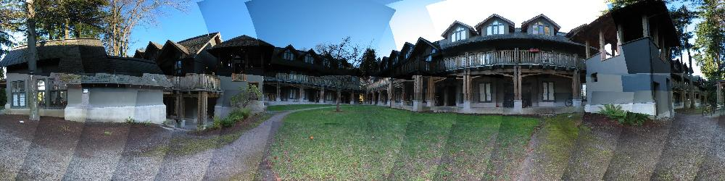
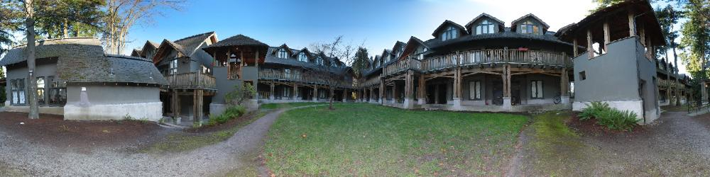
Simplification: Two-band Blending
Brown & Lowe, 2003
  Only use two bands: high freq. and low freq.
  Blends low freq. smoothly
  Blend high freq. with no smoothing: use binary alpha

Slide 26
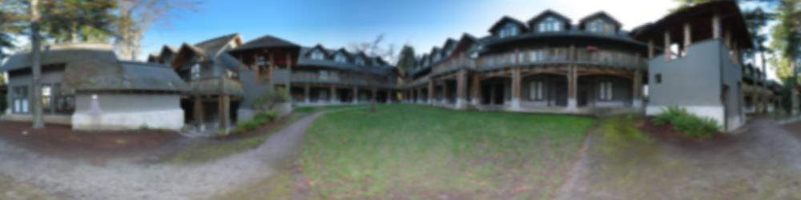
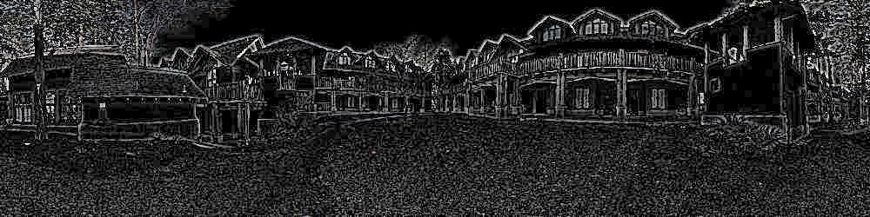
2-band “Laplacian Stack” Blending
Low frequency (λ > 2 pixels)
High frequency (λ < 2 pixels)

Slide 27
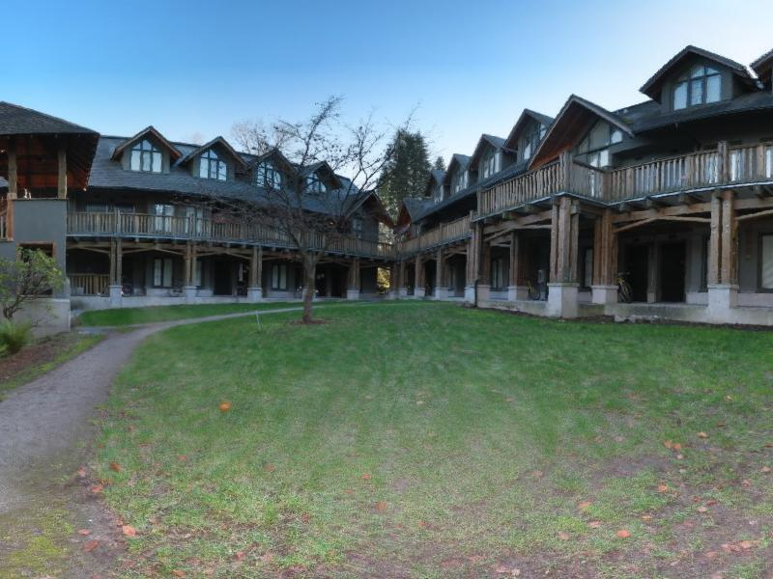
Linear Blending

Slide 28

2-band Blending

Slide 29
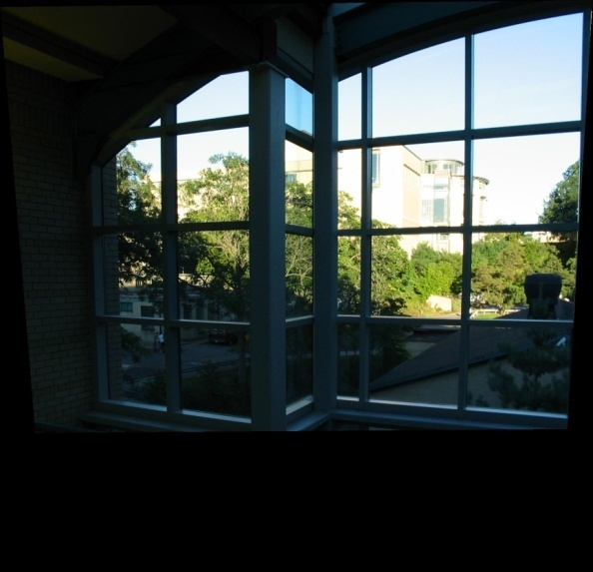
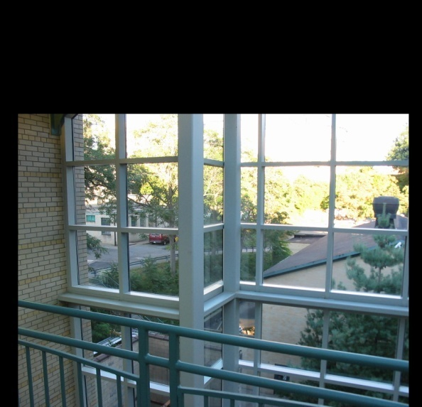

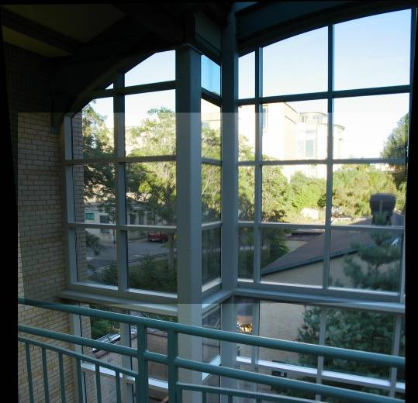
Setting alpha: simple averaging
Alpha = .5 in overlap region

Slide 30



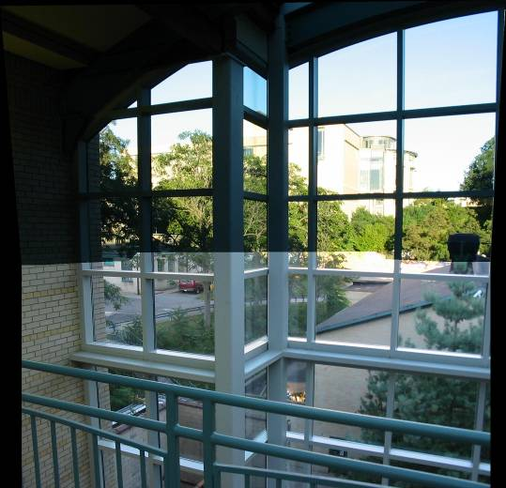
Setting alpha: center seam
Distance
Transform
bwdist
Alpha = logical(dtrans1>dtrans2)

Slide 31

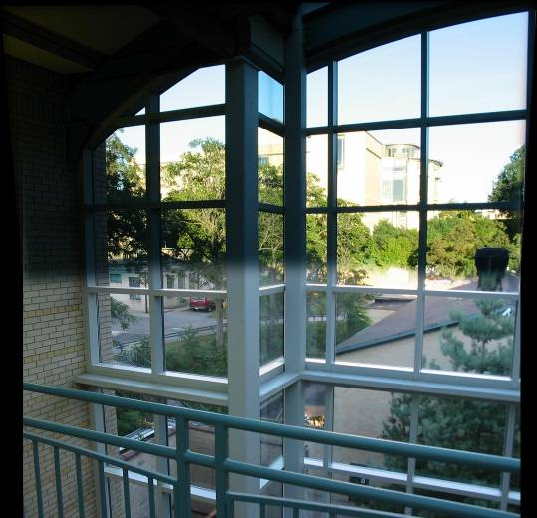
Setting alpha: blurred seam
Distance
transform
Alpha = blurred

Slide 32
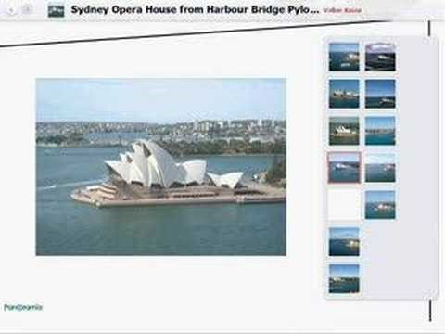
Live Homography…

Slide 33
Image Alignment
How do we align two images automatically?
Two broad approaches:
  Feature-based alignment
    Find a few matching features in both images
    compute alignment
  Direct (pixel-based) alignment
    Search for alignment where most pixels agree

Slide 34
Direct Alignment
The simplest approach is a brute force search (hw1)
  Need to define image matching function
    L2, Normalized Correlation, edge matching, etc.
  Search over all parameters within a reasonable range:
e.g. for translation:
for tx=x0:step:x1,
for ty=y0:step:y1,
compare image1(x,y) to image2(x+tx,y+ty)
end;
end;
Need to pick correct x0,x1 and step
  What happens if step is too large?

Slide 35
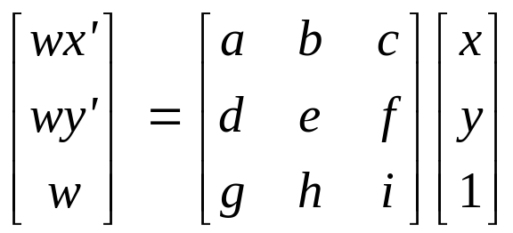
Direct Alignment (brute force)
What if we want to search for more complicated transformation, e.g. homography?
for a=a0:astep:a1,
for b=b0:bstep:b1,
for c=c0:cstep:c1,
for d=d0:dstep:d1,
for e=e0:estep:e1,
for f=f0:fstep:f1,
for g=g0:gstep:g1,
for h=h0:hstep:h1,
compare image1 to H(image2)
end; end; end; end; end; end; end; end;

Slide 36
Problems with brute force
Not realistic
  Search in O(N⁸) is problematic
  Not clear how to set starting/stopping value and step
What can we do?
  Use pyramid search to limit starting/stopping/step values
Alternative: gradient decent on the error function
  i.e. how do I tweak my current estimate to make the SSD error go down?
  Can do sub-pixel accuracy
  BIG assumption?
    Images are already almost aligned (<2 pixels difference!)
    Can improve with pyramid
  Same tool as in motion estimation

Slide 37
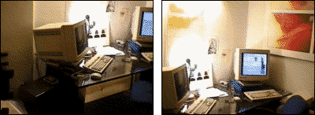
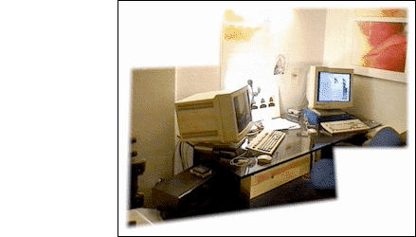
Image alignment

Slide 38
Feature-based alignment
Feature Detection: find a few important features (aka Interest Points) in each image separately
Feature Matching: match them across two images
Compute image transformation: as per Project 4, Part I
How do we choose good features automatically?
  They must be prominent in both images
  Easy to localize
  Think how you did that by hand in Project #4 Part I
  Corners!

Slide 39
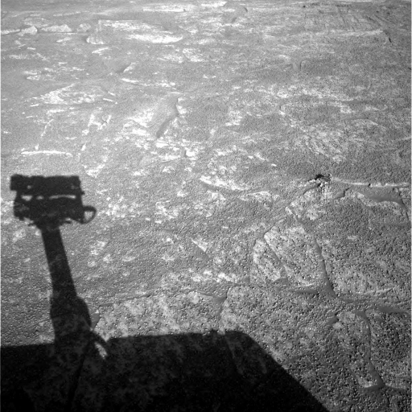
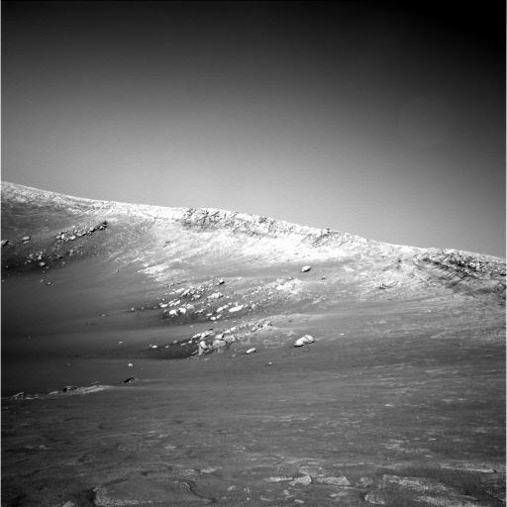
A hard feature matching problem
NASA Mars Rover images

Slide 40
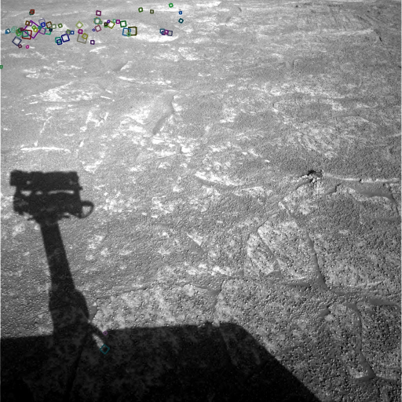

Answer below (look for tiny colored squares…)
NASA Mars Rover images
with SIFT feature matches
Figure by Noah Snavely

Slide 41


Feature Detection

Slide 42
Feature Matching
How do we match the features between the images?
  Need a way to describe a region around each feature
    e.g. image patch around each feature
  Use successful matches to estimate homography
    Need to do something to get rid of outliers
Issues:
  What if the image patches for several interest points look similar?
    Make patch size bigger
  What if the image patches for the same feature look different due to scale, rotation, etc.
    Need an invariant descriptor

Slide 43




Invariant Feature Descriptors
Schmid & Mohr 1997, Lowe 1999, Baumberg 2000, Tuytelaars & Van Gool 2000, Mikolajczyk & Schmid 2001, Brown & Lowe 2002, Matas et. al. 2002, Schaffalitzky & Zisserman 2002

Slide 44

Invariant Local Features
Image content is transformed into local feature coordinates that are invariant to translation, rotation, scale, and other imaging parameters
Features Descriptors

Slide 45
Applications
Feature points are used for:
  Image alignment (homography, fundamental matrix)
  3D reconstruction
  Motion tracking
  Object recognition
  Indexing and database retrieval
  Robot navigation
  … other

Slide 46
Today’s lecture
1 Feature detector
  scale invariant Harris corners
1 Feature descriptor
  patches, oriented patches
Reading:
Multi-image Matching using Multi-scale image patches, CVPR 2005

Slide 47
Feature Detector – Harris Corner

Slide 48
Harris corner detector
C.Harris, M.Stephens. “A Combined Corner and Edge Detector”. 1988

Slide 49
The Basic Idea
We should easily recognize the point by looking through a small window
Shifting a window in any direction should give a large change in intensity

Slide 50
Harris Detector: Basic Idea
“flat” region:
no change in all directions
“edge”:
no change along the edge direction
“corner”:
significant change in all directions

Slide 51



Corner Detection: Mathematics
Change in appearance of window W for the shift [u,v]:
I(x, y)
E(u, v)
E(3,2)

Slide 52
Corner Detection: Mathematics
Change in appearance of window W for the shift [u,v]:
I(x, y)
E(u, v)
E(0,0)

Slide 53
Corner Detection: Mathematics
Change in appearance of window W for the shift [u,v]:
We want to find out how this function behaves for small shifts
E(u, v)
Notes:
Specifically, E has to have a unique minimum at (0,0)

Slide 54

Corner Detection: Mathematics
First-order Taylor approximation for small motions [u, v]:
Let’s plug this into

Slide 55

Corner Detection: Mathematics

Slide 56


Corner Detection: Mathematics
The quadratic approximation simplifies to
where M is a second moment matrix computed from image derivatives:

Slide 57



Interpreting the second moment matrix
The surface E(u,v) is locally approximated by a quadratic form. Let’s try to understand its shape.
  Specifically, in which directions
  does it have the smallest/greatest
  change?
E(u, v)

Slide 58


Interpreting the second moment matrix
First, consider the axis-aligned case (gradients are either horizontal or vertical)
If either a or b is close to 0, then this is not a corner, so look for locations where both are large.

Slide 59


Interpreting the second moment matrix
Consider a horizontal “slice” of E(u, v):
This is the equation of an ellipse.

Slide 60

Visualization of second moment matrices

Slide 61

Visualization of second moment matrices

Slide 62

Interpreting the second moment matrix
Consider a horizontal “slice” of E(u, v):
This is the equation of an ellipse.
Diagonalization of M:
The axis lengths of the ellipse are determined by the eigenvalues and the orientation is determined by R
direction of the fastest change
direction of the slowest change
(λ_{max})^{-1/2}
(λ_{min})^{-1/2}

Slide 63
Interpreting the eigenvalues
Classification of image points using eigenvalues of M:
λ₂
“Edge”
λ₂ >> λ₁
“Corner”
λ₁ and λ₂ are large,
λ₁ ~ λ₂;
E increases in all directions
λ₁ and λ₂ are small;
E is almost constant in all directions
“Flat” region
“Edge”
λ₁ >> λ₂
λ₁

Slide 64


Harris Detector: Mathematics
Measure of corner response:

Slide 65
Harris detector: Steps
Compute Gaussian derivatives at each pixel
Compute second moment matrix M in a Gaussian window around each pixel
Compute corner response function R
Threshold R
Find local maxima of response function (nonmaximum suppression)
C.Harris and M.Stephens. “A Combined Corner and Edge Detector.” Proceedings of the 4th Alvey Vision Conference: pages 147—151, 1988.

Slide 66

Harris Detector: Workflow

Slide 67

Harris Detector: Workflow
Compute corner response R

Slide 68

Harris Detector: Workflow
Find points with large corner response: R>threshold

Slide 69

Harris Detector: Workflow
Take only the points of local maxima of R

Slide 70

Harris Detector: Workflow

Slide 71
Harris Detector: Some Properties
Rotation invariance
Ellipse rotates but its shape (i.e. eigenvalues) remains the same
Corner response R is invariant to image rotation

Slide 72
Harris Detector: Some Properties
Partial invariance to affine intensity change
Only derivatives are used => invariance to intensity shift I → I + b
Intensity scale: I → a I
R
R
threshold
x (image coordinate)
x (image coordinate)

Slide 73
Harris Detector: Some Properties
But: non-invariant to image scale!
All points will be classified as edges
Corner !

Slide 74
Scale Invariant Detection
Consider regions (e.g. circles) of different sizes around a point
Regions of corresponding sizes will look the same in both images

Slide 75
Scale Invariant Detection
The problem: how do we choose corresponding circles independently in each image?
Choose the scale of the “best” corner

Slide 76





Feature selection
Distribute points evenly over the image

Slide 77

Adaptive Non-maximal Suppression
Desired: Fixed # of features per image
  Want evenly distributed spatially…
  Sort points by non-maximal suppression radius
  [Brown, Szeliski, Winder, CVPR’05]

