Slide 1
Data Access and Mentor Selection Check-In
Notes:
Healthier Intelligence. Week 4 of data access. Calder Morton-Ferguson.

Slide 2
Finding our cancer patients
About 3.5 million people are in the Mayo data; roughly 267,000 have a confirmed cancer.
Even when first diagnosed elsewhere, tens of thousands came to Mayo for their treatment - about 76,000 with treatment we can track.
That gives us what a treatment study needs: what the patient looked like before treatment, and what happened after.
Notes:
We found the cancer patients, and the key point is that most come to Mayo FOR TREATMENT. So we have the before-and-after treatment data - which is what the next slide builds on.

Slide 3
Which question fits the data?
Predicting cancer BEFORE diagnosis needs the run-up data - and for most Mayo patients that lives at the outside hospital that diagnosed them. So early detection doesn't fit here.
Treatment response DOES fit - treatment and follow-up both happen at Mayo.
About 20,000 patients already have a clear outcome we can measure: whether the cancer came back within two years.
We're leaning this way, and finalizing the exact question with our mentors.
Notes:
The key decision. NOT early detection (pre-diagnosis data isn't here). Treatment response is the honest fit, with ~20,000 patients who have a clear did-it-come-back outcome. Still finalizing exact question with mentors.

Slide 4
What data we can draw on
As we scope the study, here is the range of data available to us.
Lab results & vitals
Doctors' notes
Medical images
Genetic / molecular
Billions of results going back years. Our main ingredient.
Hundreds of millions of notes with rich clinical detail.
Billions of scans (CT, MRI, X-ray) if we add imaging later.
Limited in what we have today; Mayo has more we could request.
Notes:
Shows range, and quietly explains why we're NOT doing a genetics study - that data is thin. Imaging is huge and kept as an option. This supports the 'still scoping' theme.

Slide 5
Mayo is already proving this works
Our mentor Jeffrey Fetzer (Mayo GI AI Lab) built a foundation model on 50,000+ Mayo endoscopy videos.
It learns from Mayo's own clinical data with self-supervised learning - exactly the approach we want to take.
His is imaging (endoscopy video); ours would be lab and vital-sign history. Same playbook, different data.
Proof that a foundation model can be built and validated inside this environment.
Notes:
Cite Fetzer FIRST as a Mayo-local proof point. Everything here is from his own advisor profile and public work - do NOT add a formal paper citation we haven't verified, since he'll be in the room. The point: this approach already works at Mayo, one modality over.

Slide 6
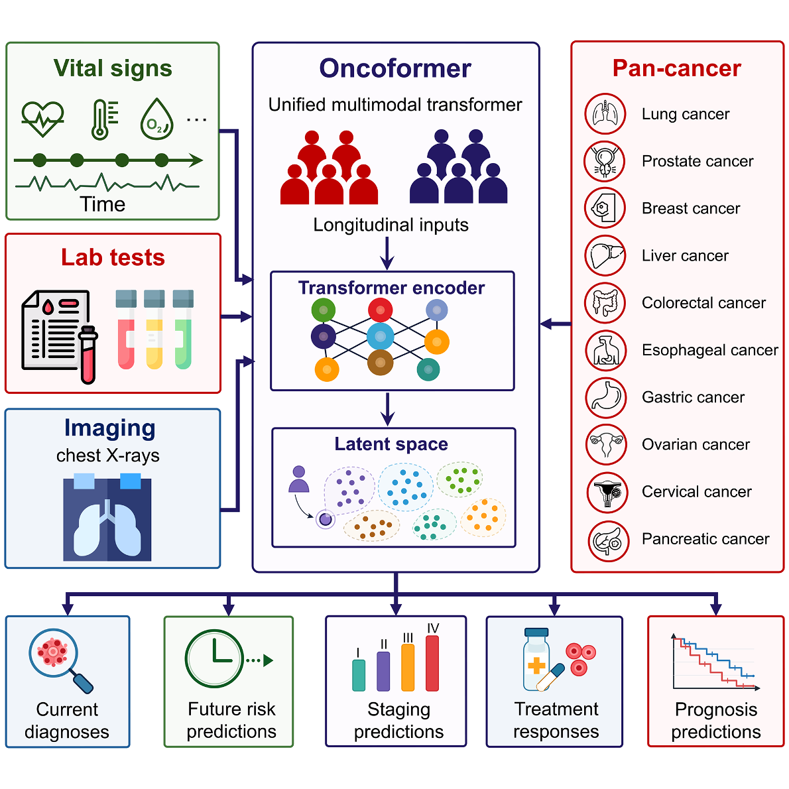
Our inspiration: the Oncoformer study
A 2026 Cell paper: one AI model reads routine clinical data over time to predict cancer outcomes.
What excites us is the approach - not the specific task.
We'd adapt it to a question that fits Mayo: treatment response.
It kicks off our dive into the related research.
Figure: Liu et al., Cell (2026), the Oncoformer paper
Notes:
IMPORTANT bridge: Oncoformer is technically an early-detection model, but we said no to early detection. So be explicit: it inspires our METHOD, not our TASK. We adapt the approach to treatment response. The figure is the authors' own - cite it.

Slide 7
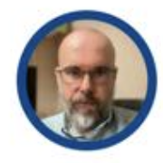
Mentor 1 - Jeffrey Fetzer, PhD (Mayo Clinic)
Who: a Mayo AI scientist who built a large medical-AI model on Mayo's own data.
Why we value him: he has already done what we're attempting - building and validating an AI model inside Mayo's environment - and cares about doing it rigorously.
How we'll engage: guidance on model design, on proving the results hold up, and on working within the data environment's limits.
Notes:
The bullseye technical mentor. He literally built a foundation model on Mayo data and knows the compute and validation constraints we're hitting.

Slide 8
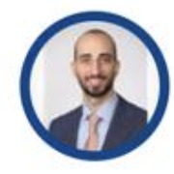
Mentor 2 - Tarek Souaid, MD MPH (Mayo Clinic)
Who: a Mayo physician focused on evaluating AI in real clinical workflows.
Why we value him: a doctor who can tell us whether our patient groups and outcomes make clinical sense - and who works on how to judge whether an AI model is any good.
How we'll engage: clinical sanity-checks on the study, and advice on how we measure success.
Notes:
Our clinical grounding + evaluation expertise. Keeps the study clinically honest.

Slide 9
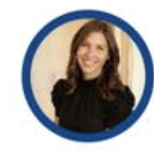
Mentor 3 - Elizabeth Rice (Mayo Clinic)
Who: a healthcare commercial strategist - payers, employers, and market access.
Why we value her: as we think about how this eventually reaches patients, she knows employer-sponsored and payer go-to-market.
How we'll engage: guidance on our commercial strategy, especially employer-sponsored go-to-market.
Notes:
Our business/commercial mentor (vs. the two technical ones). Parth specifically wants employer-sponsored go-to-market support. Frame honestly - she's the commercial pick.

Slide 10
How it's going
The environment is working well and we're genuinely enjoying digging into the data.
We understand the data far better than when we started.
Still scoping: the exact model, the specifics around trials and treatments, and the final study design.
Next: lock the study question with our mentors, then start building.
Notes:
Warm, honest close. It's going well, we're having fun, still scoping, will continue. Hands into the discussion.

Slide 11
Thank you - calder@healthier.inc
Notes:
Leave time for the 20-minute discussion.

