Slide 1
Matchify
Matt Jordan, Blake dobbins, xuanwei li, Jeron duhart-rodriguez

Slide 2

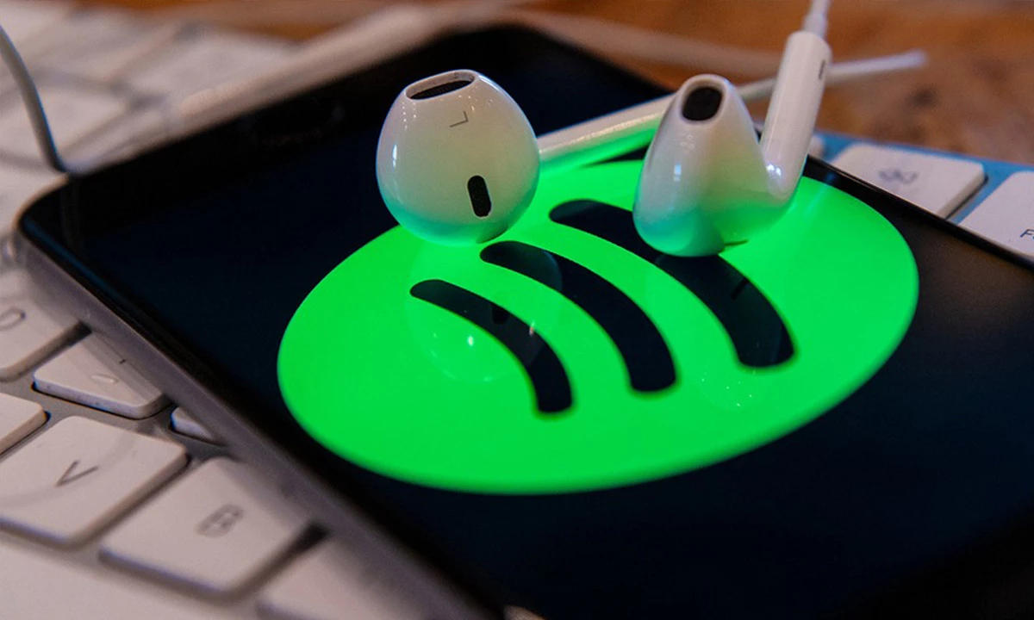
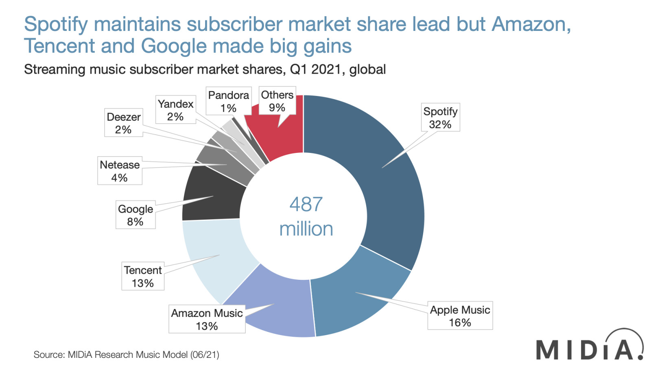
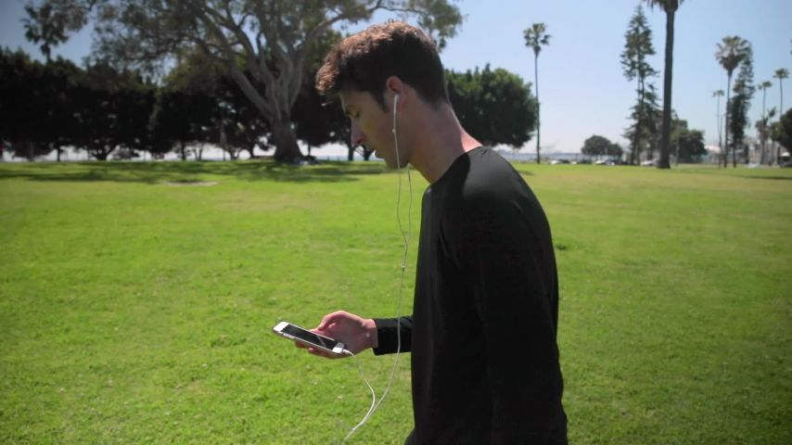

Slide 3
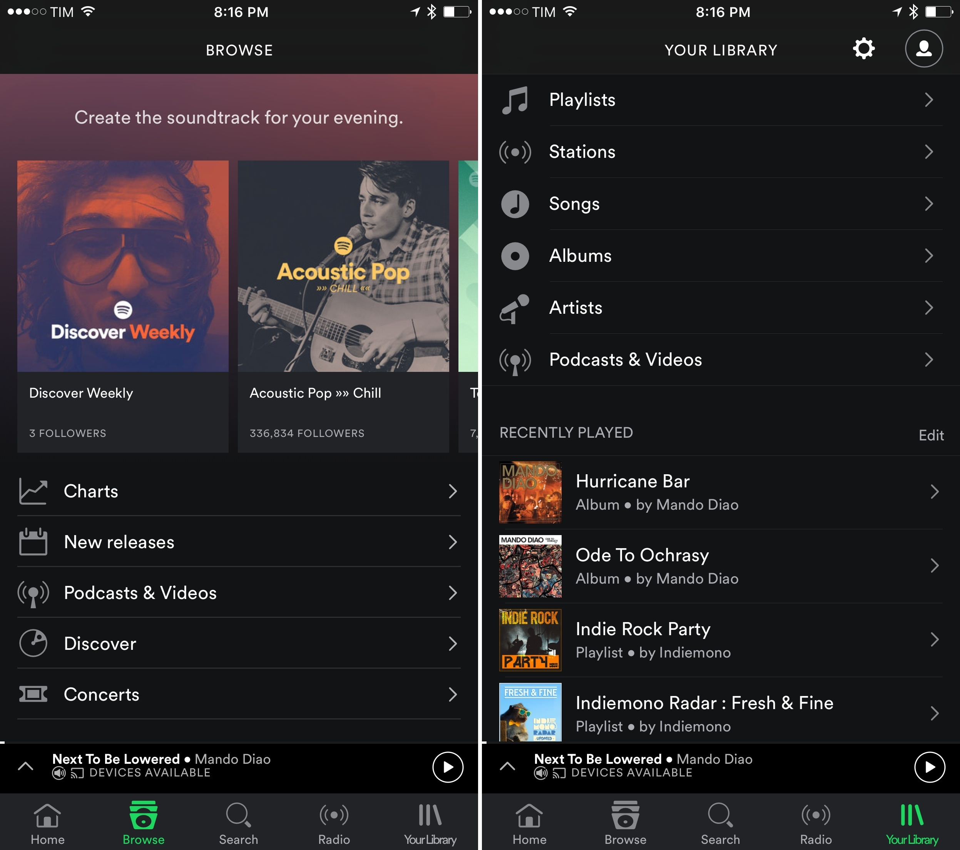
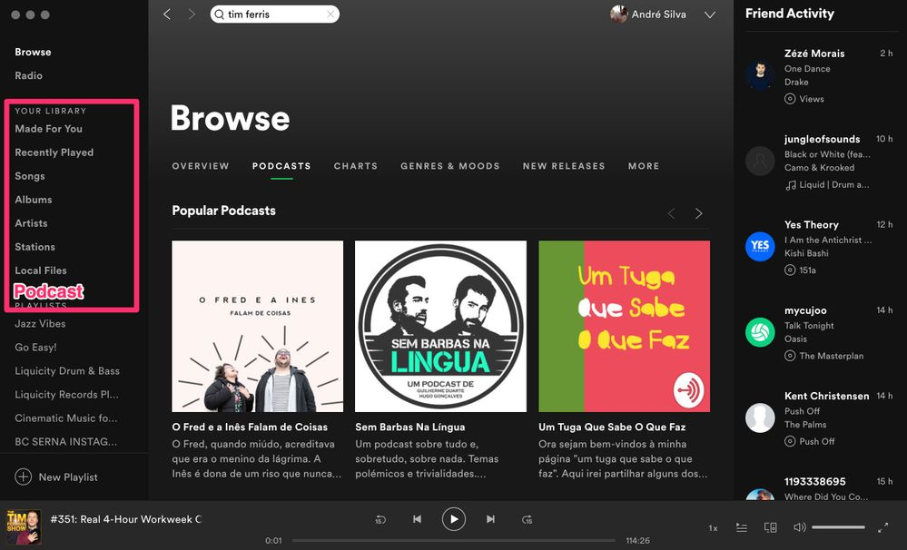

Slide 4
[OuR app PIctures]

Slide 5








Slide 6
Demo

