Slide 1
ACAT Java Training
Session 3

Slide 2
Exceptions
Errors that happens while running the program.
  Network problem
  Coding problem
  User invalid input
Checked vs Unchecked Exceptions

Slide 3

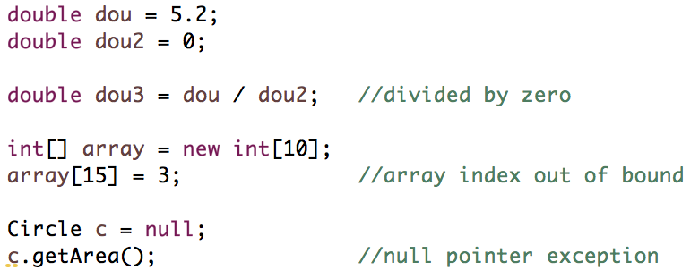
Exceptions
Checked Exceptions
  Something can be checked at compilation time. Eclipse will let you know about it
Unchecked Exceptions
  Something unpredictable, only noticed during run-time

Slide 4
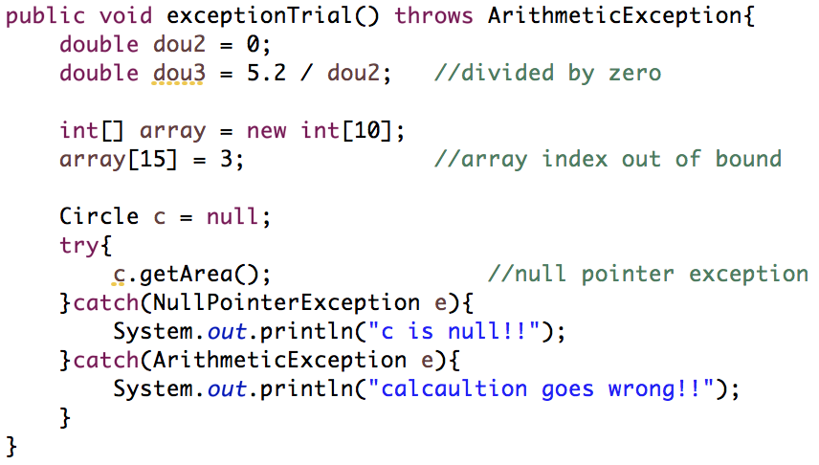
Exceptions
Do nothing
  System just crash -> user feel scared
Try-catch
Throw outside the method

Slide 5
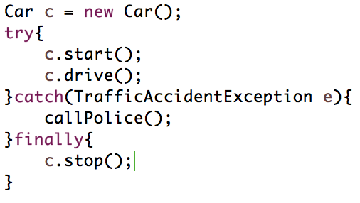
Exception
finally – something that always must do at the end whenever exception is encountered or not

Slide 6
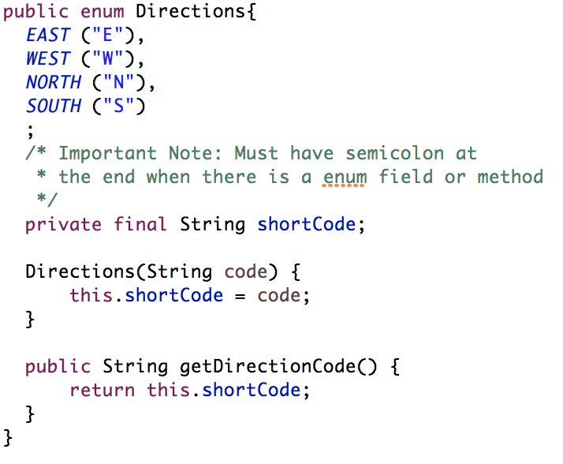
Enum
Enumeration
For a limited countable set of options

Slide 7
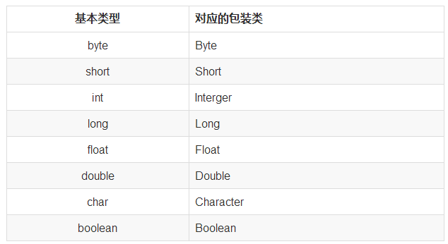
Primitive Data Type vs Package Class
Usage:
  Parse to the particular type from String
  Conversion
  As a class object

Slide 8
Set
A Collection that cannot contain duplicate elements. It models the mathematical set abstraction.
The Set interface contains only methods inherited from Collection and adds the restriction that duplicate elements are prohibited.
Set also adds a stronger contract on the behavior of the equals and hashCode operations, allowing Set instances to be compared meaningfully even if their implementation types differ.

Slide 9
Set
Method & Description
add( ) Adds an object to the collection.
clear( ) Removes all objects from the collection.
contains( ) Returns true if a specified object is an element within the collection.
isEmpty( ) Returns true if the collection has no elements.
iterator( ) Returns an Iterator object for the collection, which may be used to retrieve an object.
remove( ) Removes a specified object from the collection.
size( ) Returns the number of elements in the collection.

Slide 10
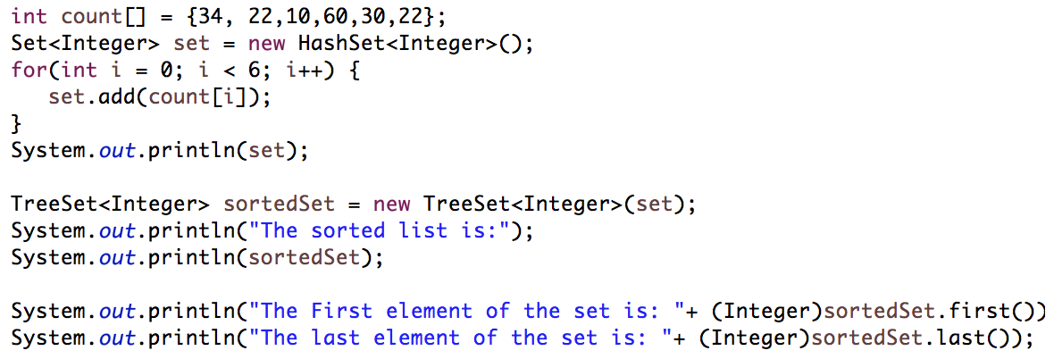
Set – Hash Set

Slide 11
List
Elements can be inserted or accessed by their position in the list, using a zero-based index.
A list may contain duplicate elements.
In addition to the methods defined by Collection, List defines some of its own, which are summarized in the following table.
Better structure than Array.

Slide 12
List
Method & Description
void add(int index, Object obj) Inserts obj into the invoking list at the index passed in the index. Any pre-existing elements at or beyond the point of insertion are shifted up. Thus, no elements are overwritten.
boolean addAll(int index, Collection c) Inserts all elements of c into the invoking list at the index passed in the index. Any pre-existing elements at or beyond the point of insertion are shifted up. Thus, no elements are overwritten. Returns true if the invoking list changes and returns false otherwise.
Object get(int index) Returns the object stored at the specified index within the invoking collection.
int indexOf(Object obj) Returns the index of the first instance of obj in the invoking list. If obj is not an element of the list, .1 is returned.
int lastIndexOf(Object obj) Returns the index of the last instance of obj in the invoking list. If obj is not an element of the list, .1 is returned.

Slide 13
List
Method & Description
ListIterator listIterator( ) Returns an iterator to the start of the invoking list.
ListIterator listIterator(int index) Returns an iterator to the invoking list that begins at the specified index.
Object remove(int index) Removes the element at position index from the invoking list and returns the deleted element. The resulting list is compacted. That is, the indexes of subsequent elements are decremented by one.
Object set(int index, Object obj) Assigns obj to the location specified by index within the invoking list.
List subList(int start, int end) Returns a list that includes elements from start to end.1 in the invoking list. Elements in the returned list are also referenced by the invoking object.

Slide 14
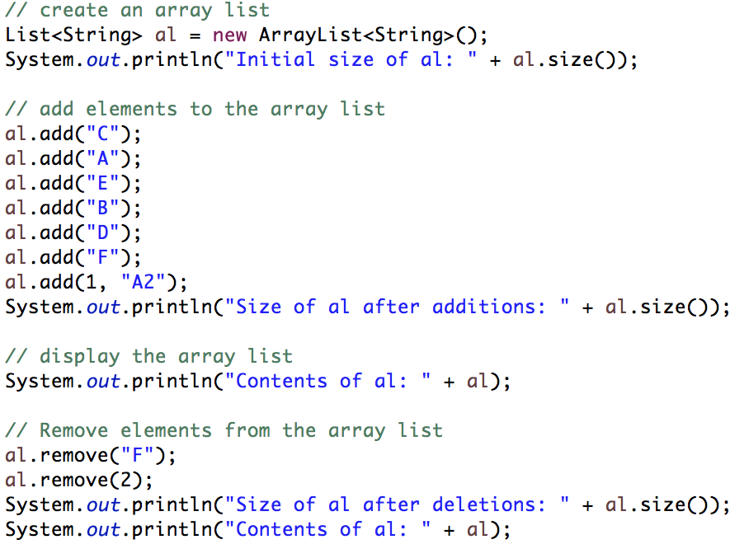
List – Array List

Slide 15
Map
The Map interface maps unique keys to values. A key is an object that you use to retrieve a value at a later date.
Given a key and a value, you can store the value in a Map object. After the value is stored, you can retrieve it by using its key.

Slide 16
Map
Method & Description
void clear( ) Removes all key/value pairs from the invoking map.
boolean containsKey(Object k) Returns true if the invoking map contains k as a key. Otherwise, returns false.
boolean containsValue(Object v) Returns true if the map contains v as a value. Otherwise, returns false.
Set entrySet( ) Returns a Set that contains the entries in the map. The set contains objects of type Map.Entry. This method provides a set-view of the invoking map.
boolean equals(Object obj) Returns true if obj is a Map and contains the same entries. Otherwise, returns false.
Object get(Object k) Returns the value associated with the key k.
int hashCode( ) Returns the hash code for the invoking map.

Slide 17
Map
Method & Description
boolean isEmpty( ) Returns true if the invoking map is empty. Otherwise, returns false.
Set keySet( ) Returns a Set that contains the keys in the invoking map. This method provides a set-view of the keys in the invoking map.
Object put(Object k, Object v) Puts an entry in the invoking map, overwriting any previous value associated with the key. The key and value are k and v, respectively. Returns null if the key did not already exist. Otherwise, the previous value linked to the key is returned.
void putAll(Map m) Puts all the entries from m into this map.
Object remove(Object k) Removes the entry whose key equals k.
int size( ) Returns the number of key/value pairs in the map.
Collection values( ) Returns a collection containing the values in the map. This method provides a collection-view of the values in the map.

Slide 18
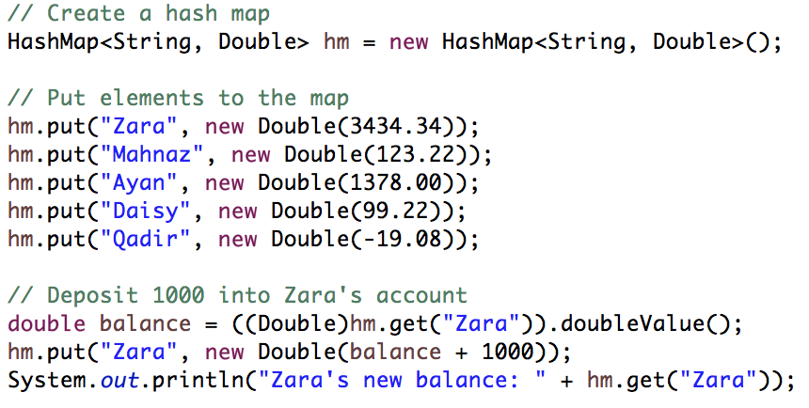
Map – Hash Map

Slide 19
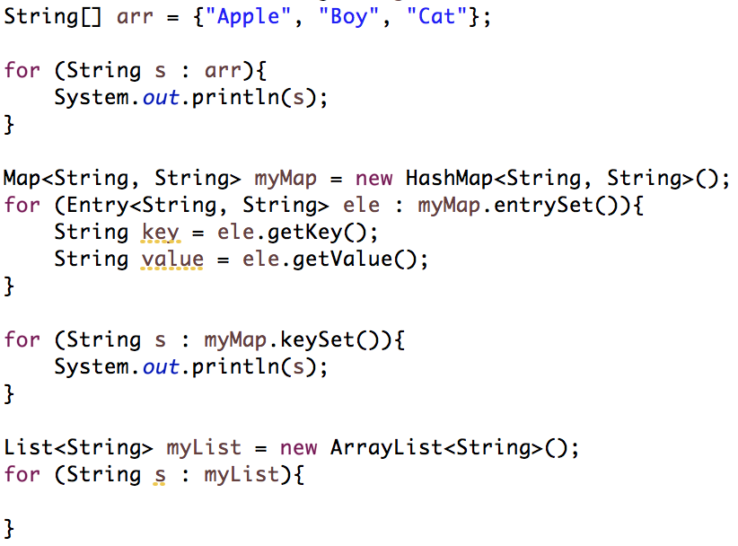
For loop – another way

Slide 20
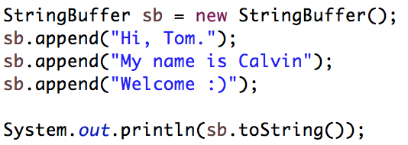
StringBuffer
A string buffer is like a String, but can be modified.
It contains some particular sequence of characters, but the length and content of the sequence can be changed through certain method calls.
They are safe for use by multiple threads.
Every string buffer has a capacity.

Slide 21
Date
Storing date-time
Method & Description
boolean after(Date date) Returns true if the invoking Date object contains a date that is later than the one specified by date, otherwise, it returns false.
boolean before(Date date) Returns true if the invoking Date object contains a date that is earlier than the one specified by date, otherwise, it returns false.
Object clone( ) Duplicates the invoking Date object.
int compareTo(Date date) Compares the value of the invoking object with that of date. Returns 0 if the values are equal. Returns a negative value if the invoking object is earlier than date. Returns a positive value if the invoking object is later than date.

Slide 22

Date
Method & Description
boolean equals(Object date) Returns true if the invoking Date object contains the same time and date as the one specified by date, otherwise, it returns false.
long getTime( ) Returns the number of milliseconds that have elapsed since January 1, 1970.
int hashCode( ) Returns a hash code for the invoking object.
void setTime(long time) Sets the time and date as specified by time, which represents an elapsed time in milliseconds from midnight, January 1, 1970.
String toString( ) Converts the invoking Date object into a string and returns the result.

Slide 23
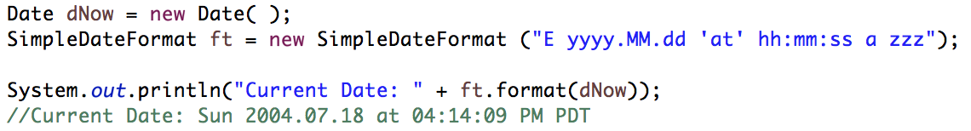
Date – Simple Date Format
SimpleDateFormat is a concrete class for formatting and parsing dates in a locale-sensitive manner.
SimpleDateFormat allows you to start by choosing any user-defined patterns for date-time formatting.

Slide 24
Date – Simple Date Format
Character | Description | Example | Character | Description | Example
G | Era designator | AD | D | Day in year | 360
y | Year in four digits | 2001 | F | Day of week in month | 2 (second Wed. in July)
M | Month in year | July or 07 | w | Week in year | 40
d | Day in month | 10 | W | Week in month | 1
h | Hour in A.M./P.M. (1~12) | 12 | a | A.M./P.M. marker | PM
H | Hour in day (0~23) | 22 | k | Hour in day (1~24) | 24
m | Minute in hour | 30 | K | Hour in A.M./P.M. (0~11) | 10
s | Second in minute | 55 | z | Time zone | Eastern Standard Time
S | Millisecond | 234 | ' | Escape for text | Delimiter
E | Day in week | Tuesday | " | Single quote | `

Slide 25
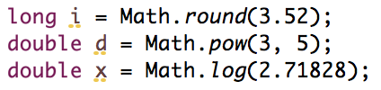
Math
The java.lang.Math class contains methods for performing basic numeric operations such as the elementary exponential, logarithm, square root, and trigonometric functions.

