Slide 1
ACAT Java Training
Session 3

Slide 2
Object-oriented programming (OOP)
Object-oriented programming (OOP) involves programming using objects.
An object represents an entity in the real world that can be distinctly identified. For example, a student, a desk, a circle, a button, and even a loan can all be viewed as objects.
An object has a unique identity, state, and behaviors. The state of an object consists of a set of data fields (also known as properties) with their current values. The behavior of an object is defined by a set of methods.

Slide 3
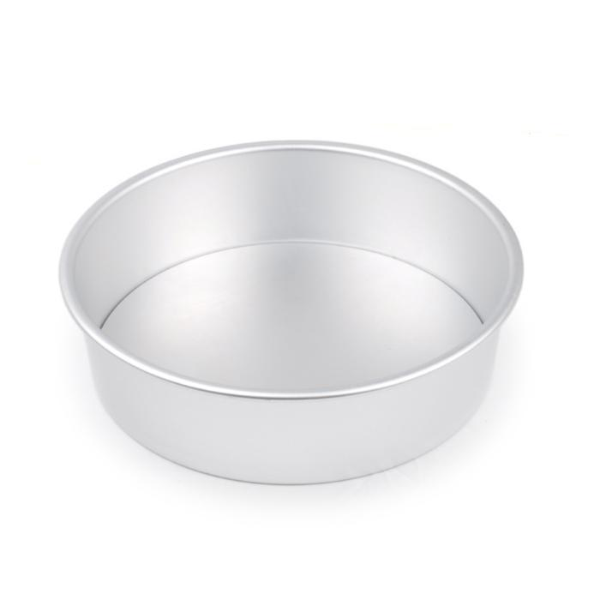
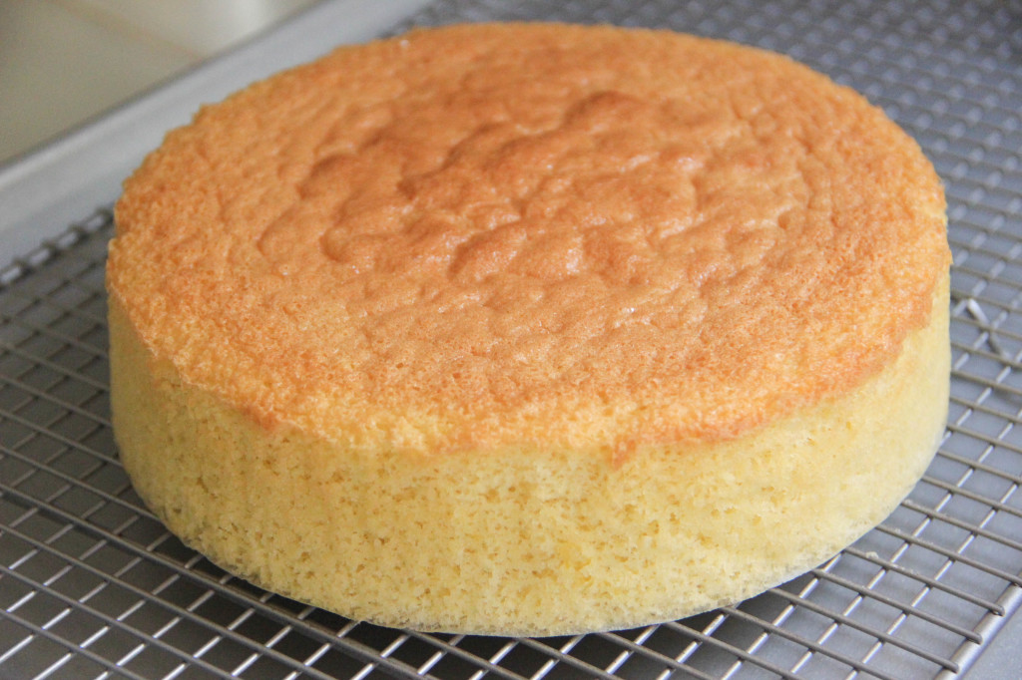


Object-oriented programming (OOP)
Compared to molds, class can make object of arbitrary sizes, flavor, etc

Slide 4
Class
Classes are constructs that define objects of the same type.
A Java class uses variables to define data fields and methods to define behaviors.
A class provides a special type of methods, known as constructors, which are invoked to construct objects from the class.

Slide 5
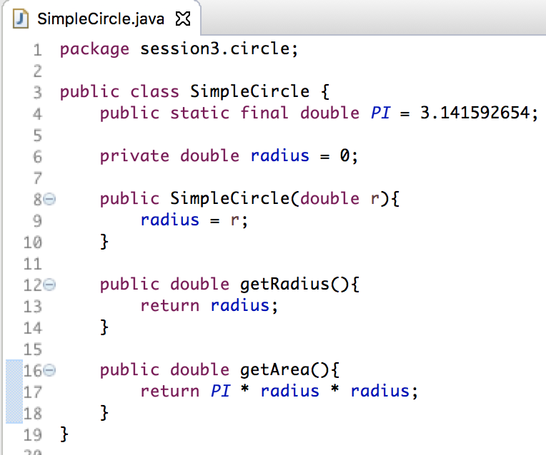
Class - Circle
2
State/ Variables
3
Constructor
Behavior/ Functions
5

Slide 6
Constructor
A special kind of methods that are invoked to construct objects.
Constructors must have the same name as the class itself.
Constructors do not have a return type—not even void.
Constructors are invoked using the new operator when an object is created. Constructors play the role of initializing objects.

Slide 7
Default Constructor
A class may be declared without constructors. In this case, a no-arg constructor with an empty body is implicitly declared in the class. This constructor, called a default constructor, is provided automatically only if no constructors are explicitly declared in the class.

Slide 8
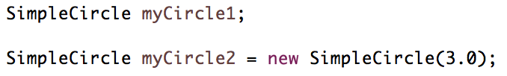

Declare and define object
Same as declare/ define a variable of primitive type
Can access the public variables/ methods of the object.
null

Slide 9
Visibility of Variables/ Methods
Public
  Everyone can freely read/modify
Protect
  Only within class and class who extend from it
Private
  Only within class

Slide 10
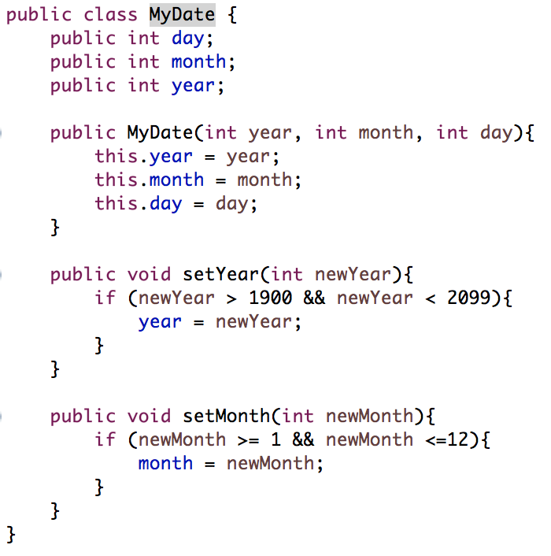
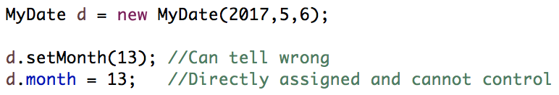
Visibility of Variables/ Method
Advantages
  Protect the data
  Avoid unpredictable modification

Slide 11
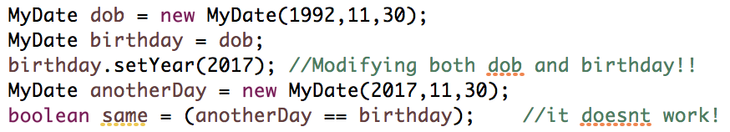
Object Creation/ Comparison
Object is only created when new keyword is used;
Otherwise they are actually referring to the same object.

Slide 12
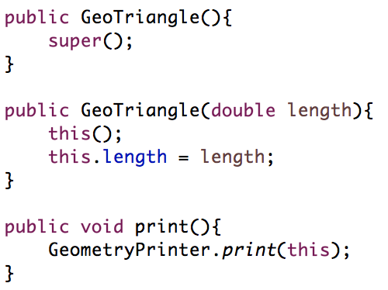
Object - this
Mean the object itself
Usage
  Call another constructor of the same class (only in constructor)
  Identify between the class’s global variable and local variable
  Passing self to another
  function

Slide 13
Inheritance
Suppose you will define classes to model circles, rectangles, and triangles. These classes have many common features. What is the best way to design these classes so to avoid redundancy? The answer is to use inheritance.

Slide 14
Inheritance – Geometry Object
Circle
  Color
  Radius
  Introduce
Rectangle
  Color
  Width
  Height
  Introduce

Slide 15
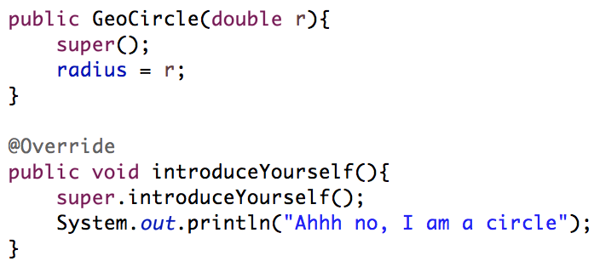
Inheritance
Imply inheritance from a super class
  Define extend XXX in the first line
Call super class’s constructor/ methods
  Using the keyword super()

Slide 16
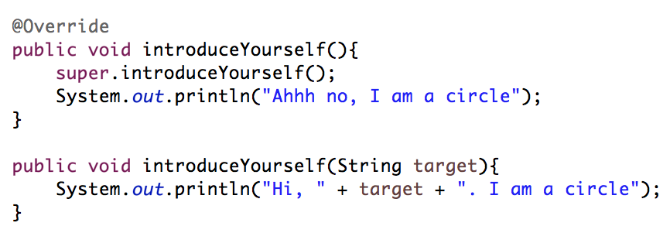
Inheritance – Override and Overload
Override
  Overwrite the method defined in super class
Overload
  Create another method of same name but different types/ number of input parameters

Slide 17
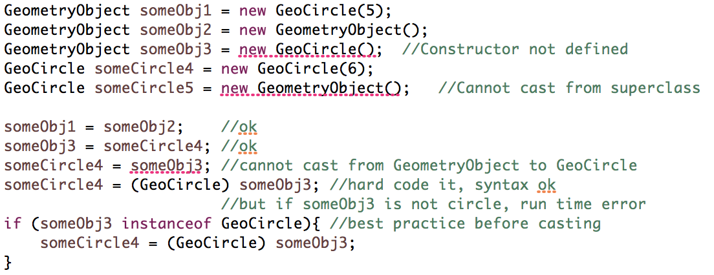
Inheritance - Casting

Slide 18
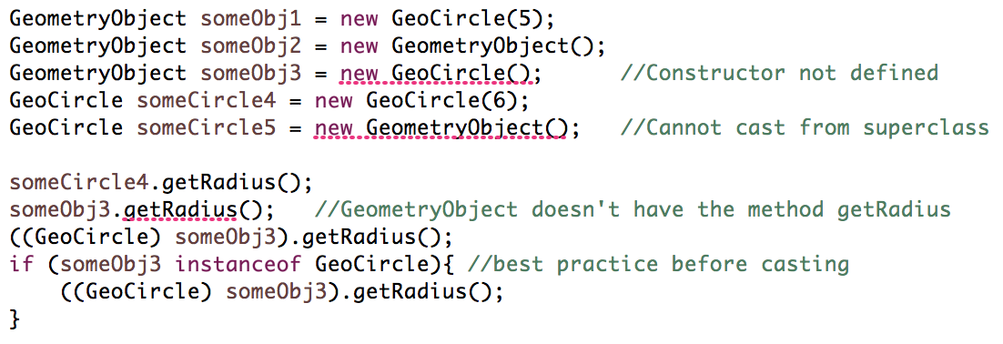
Inheritance - Casting

Slide 19
Interface
To define some special characteristics that is share among different objects
  i.e. common methods
  E.g. Birds and Plane can fly…but they definitely different kinds of things.
One class can only inherit from another superclass but can inherit from any number of interface

Slide 20
Interface
Define any constant stored inside
Declare the methods
Can use instanceof and casting like inheritance of class

Slide 21
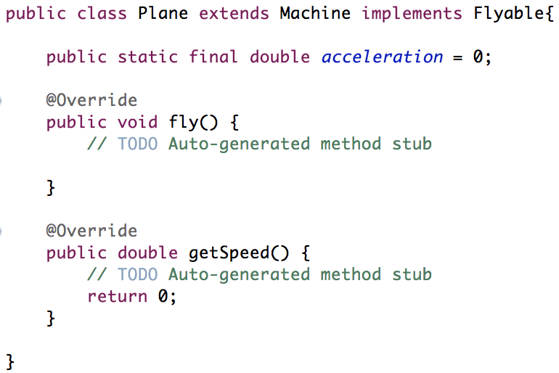


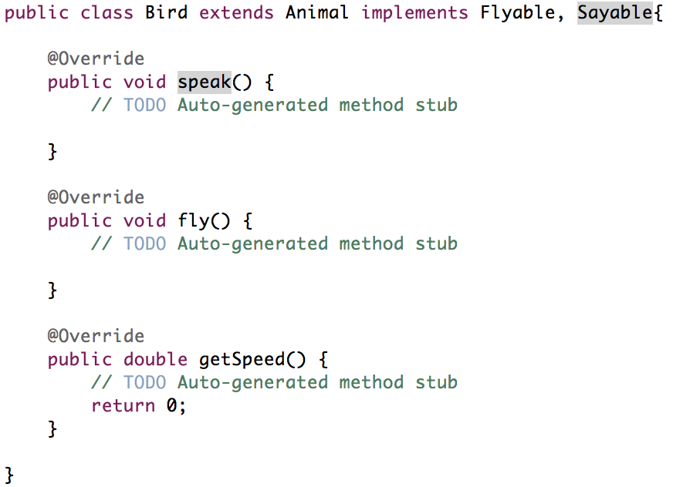
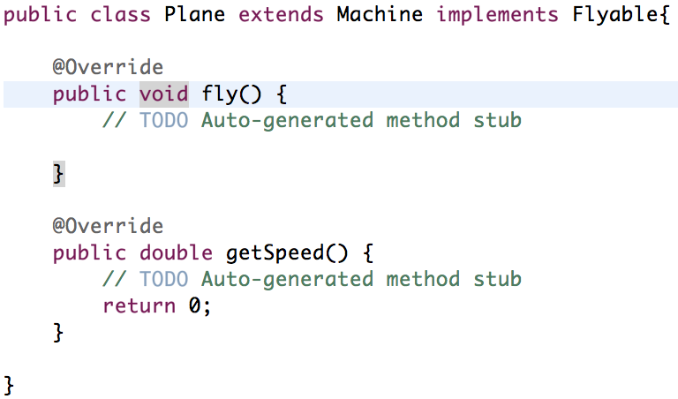
Interface

Slide 22
Exceptions
Errors that happens while running the program.
  Network problem
  Coding problem
  User invalid input
Checked vs Unchecked Exceptions

Slide 23

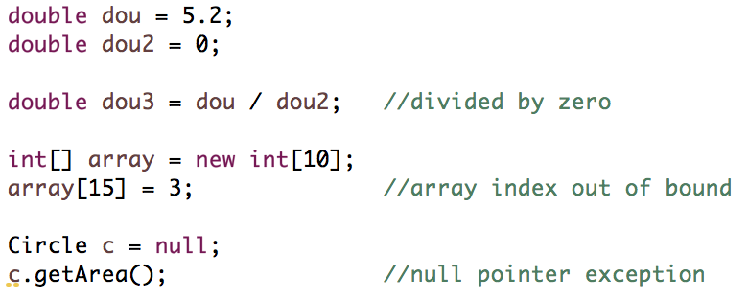
Exceptions
Checked Exceptions
  Something can be checked at compilation time. Eclipse will let you know about it
Unchecked Exceptions
  Something unpredictable, only noticed during run-time

Slide 24
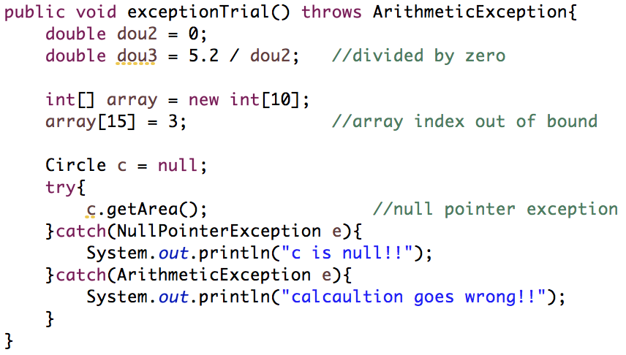
Exceptions
Do nothing
  System just crash -> user feel scared
Try-catch
Throw outside the method

Slide 25
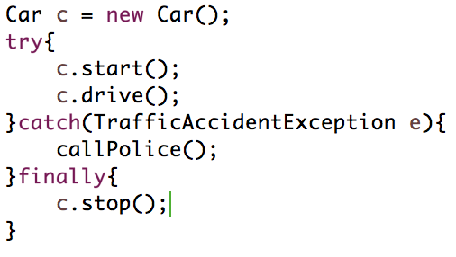
Exception
finally – something that always must do at the end whenever exception is encountered or not

