Slide 1
ACAT Java Training
Session 2

Slide 2
Control Flow
Inside main() is a sequence of statements, and all statements are executed once and exactly once.
Such sequential computation can be a big limitation on what can be computed. Therefore, we have
  selection
  iteration

Slide 3
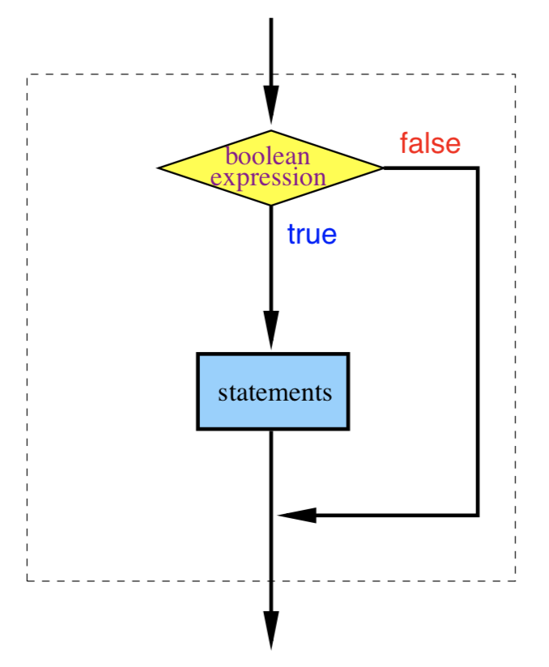
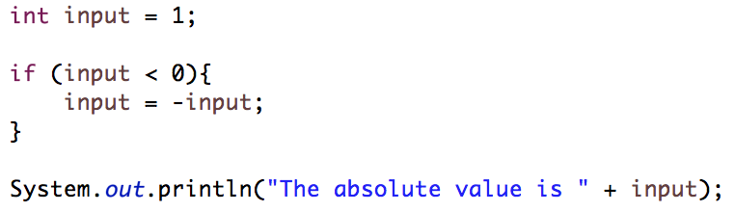
If Statement
If <Condition> { <Sequence> }

Slide 4
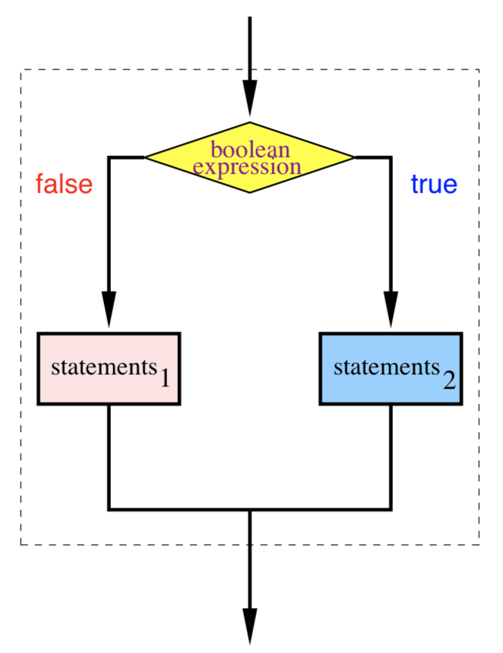
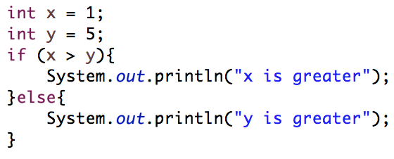
If-else Statement
If <Condition> { <Sequence> }
else { <Sequence> }

Slide 5
If-else-if Statement
If <Condition> { <Sequence> }
else if <Condition> { <Sequence> }
…
else {<Sequence>}

Slide 6
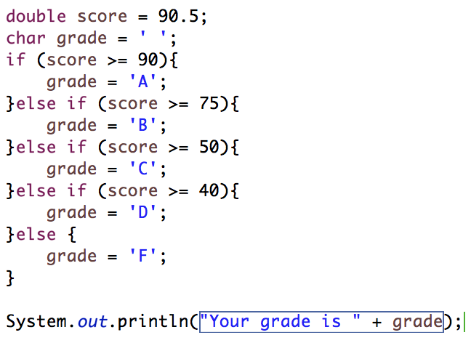
If-else-if Statement

Slide 7

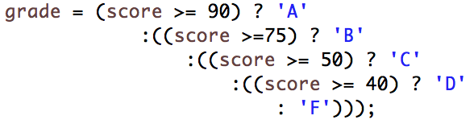
Recall – Ternary Expression
BooleanExpression ? ValueWhenTrue : ValueWhenFalse

Slide 8
switch statement
switch (<variable>){
case <Case1Val>: <Case1Stmts>;
case <Case2Val>: <Case2Stmts>;
…
default:<DefaultStmts>;
}

Slide 9
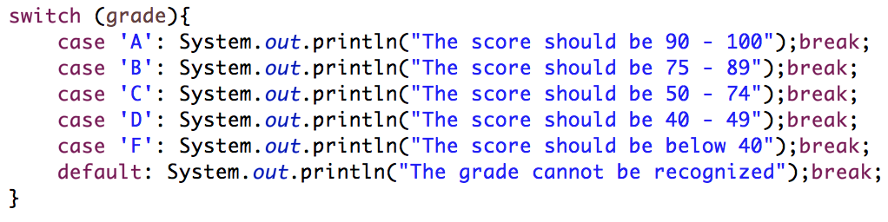
switch statement

Slide 10
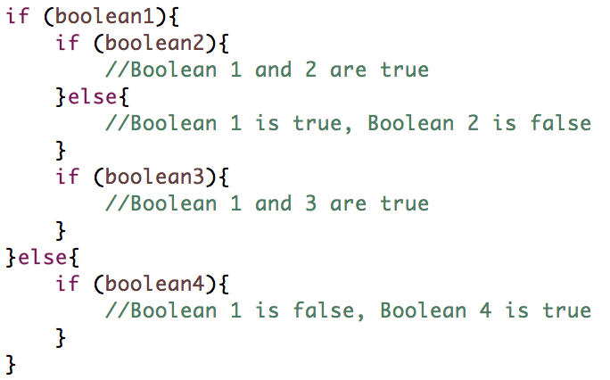
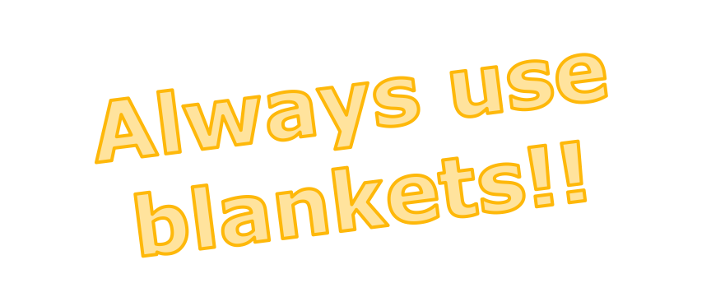
Nested If Statement

Slide 11
Looping
Repeat certain sequence for multiple times until a certain condition is reached

Slide 12
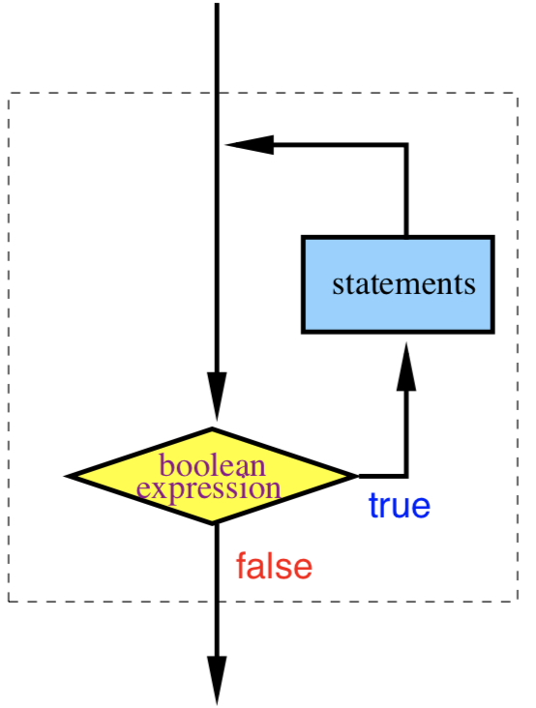
while loop
While(<bool exp>){
<stmts>
}
< stmts > will be repeated as long as the value of < bool exp > is true.
As usual, < stmts > can be a single statement, or a sequence of statements (including another while statement), or even no statement!

Slide 13

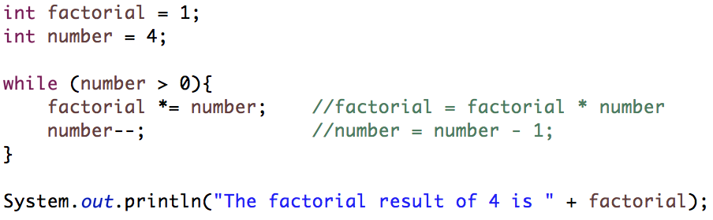
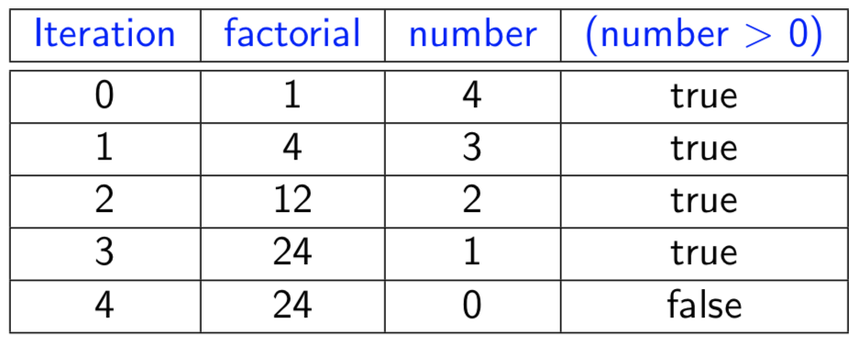
while loop

Slide 14
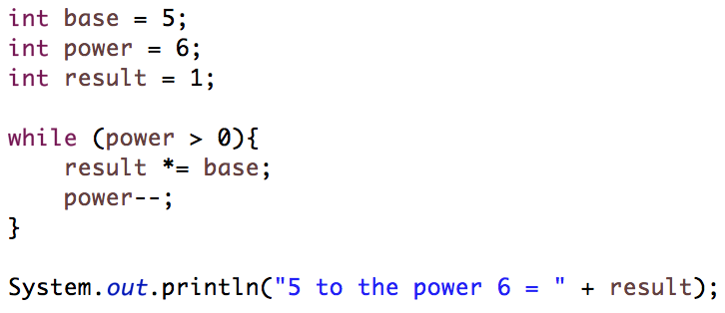
while loop

Slide 15
while loop
Verify your loop with the followings
The first iteration.
The second iteration.
The last iteration.
Do you know exactly how many iterations will be performed?
How can the loop terminate? Otherwise, the program runs forever!

Slide 16
do-while loop
do{
<stms>
}while(<bool exp>)
Similar to while loop except
  The loop body (<stmts>) will run at least once

Slide 17
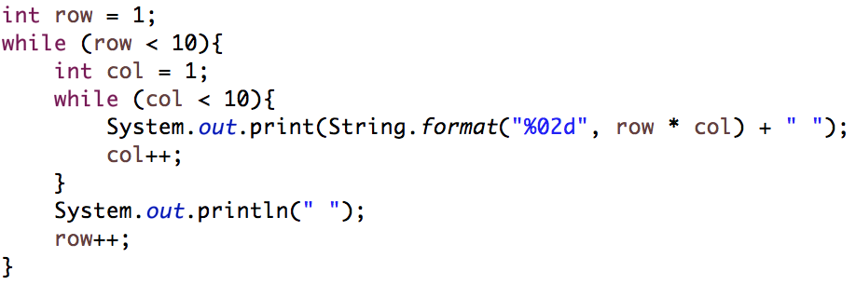
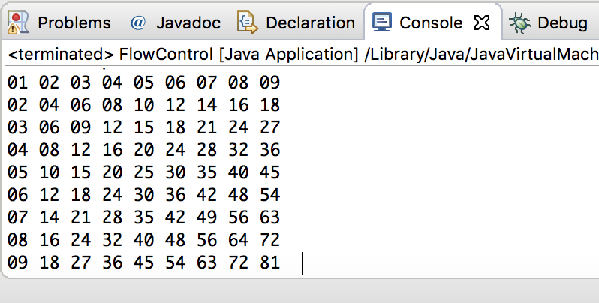
Nested Loops

Slide 18
break and continue
A break causes the innermost enclosing loop to exit immediately.
A continue causes the next iteration of the enclosing loop to begin.
That is, in the while loop, control passes to test the boolean expression again immediately.

Slide 19
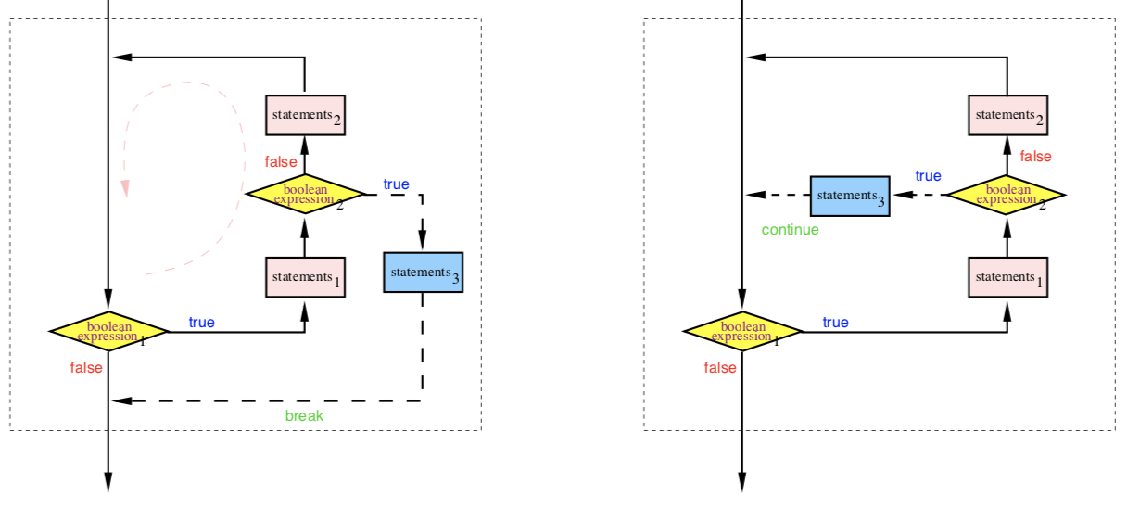
break and continue

Slide 20
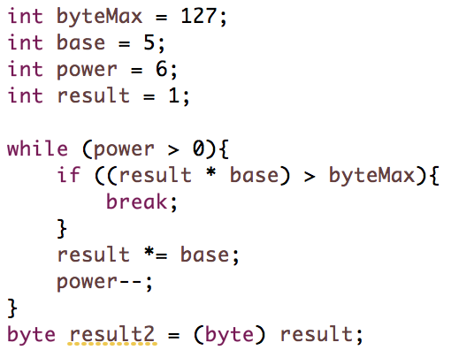
break and continue

Slide 21
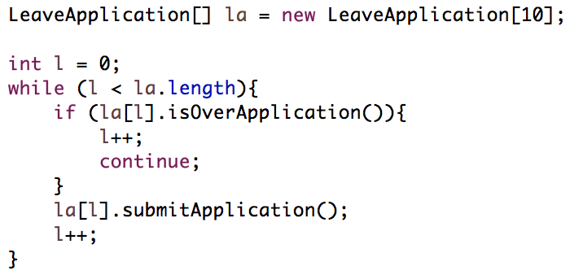
break and continue

Slide 22
for-loop
For(<initializeStaement>;<EndingCond>;<IncrementStatement>){
<loopBody>
}
Use when there is a counter storing the “progress” of the loop

Slide 23
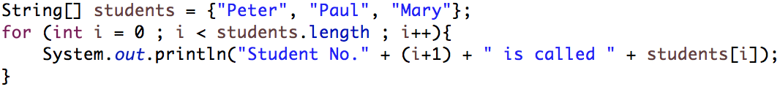
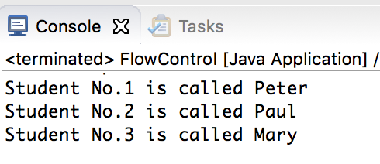
for-loop
Recall – Array
  A collection of similar data of same data type

Slide 24
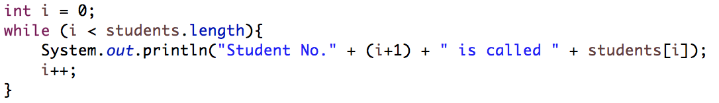
for-loop
Recall – Array
  A collection of similar data of same data type

Slide 25
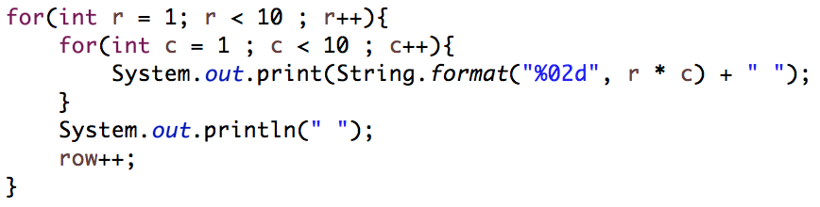
for-loop

