Slide 1


Formative Feedback
Valerie Shute and Umit Tokac
Florida State University
Teacher Training Workshop, July 29, 2011
Project funded by Institute of Education Sciences

Slide 2
Acknowledgments
The work reported in this paper is supported through a grant from Education Research Programs at the Institute of Education Sciences (IES), award number R305A110121, administered by the U.S. Department of Education. Faranak Rohani is the principal investigator for this research. Related information is available at http://cala.fsu.edu/ies/. Findings and opinions do not reflect the positions or policies of IES or the U.S. Department of Education.
Copyright © 2011 by the Center for Advancement of Learning and Assessment, Florida State University. All rights reserved.
Notes:
2

Slide 3
Outline
General Feedback
Principles of Good Feedback
Feedback Focus
Formative Feedback
Type of Feedback
Timing of Feedback
Interactions: Student, Instruction, and Feedback
Activities

Slide 4
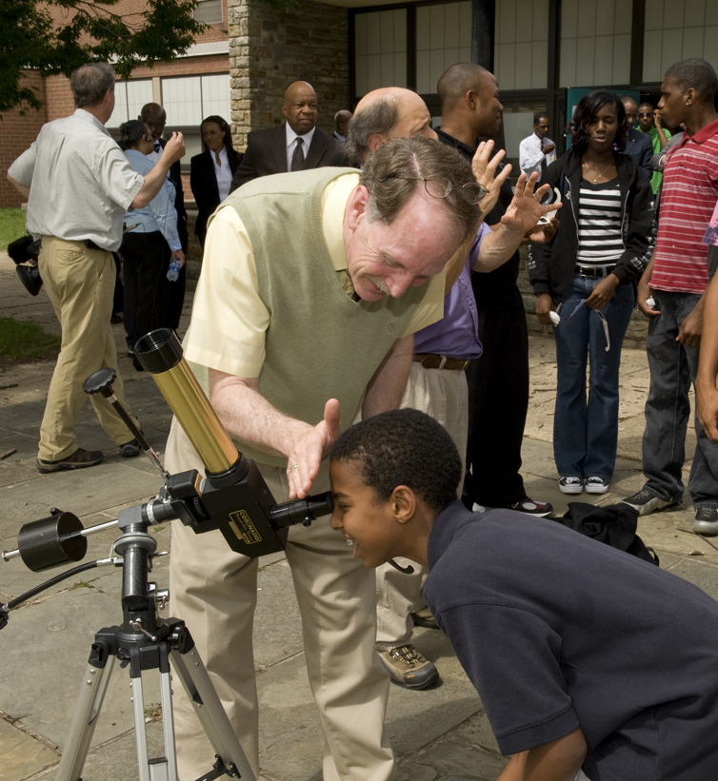
Photo by the NASA Goddard Space Center
What kind of feedback are you using in your class?

Slide 5
General Feedback
Feedback is “one of the more instructionally powerful and least understood features in instructional design” (Cohen, 1985).
Dating back to the early 1900s, there have been 1000s of research studies published on the topic of feedback and its relation to learning and performance.
Within this vast body of research, there are many conflicting findings and no consistent pattern of results.
Notes:
5

Slide 6
Benefits of Feedback
According to Black and Wiliam's (1998) classic meta-analysis of 250 studies, feedback positively influences learning and achievement across all content areas, knowledge and skill types, and levels of education.

Slide 7
Principles of Good Feedback
1. Facilitates development of self-assessment (reflection) in learning.
2. Encourages teacher and peer dialogue around learning.
3. Helps to clarify good performance (i.e., expected goals, criteria, and standards).
4. Provides opportunities to close the gap between current and desired performance.
5. Encourages positive motivational beliefs and self-esteem.
Juwah, C., Macfarlane-Dick, D., Matthew, B., Nicol, D., Ross, D., & Smith, B. (2004). Enhancing student learning through effective formative feedback. York: The Higher Education Academy.

Slide 8
Principle 1
Foster self-
assessment
If students are directly involved in assessing their own work and given frequent opportunities to reflect on their goals, then learning and achievement can be enhanced (McDonald & Boud, 2003).

Slide 9
Principle 2
Promote
dialogue
Conceptual feedback should be a dialogue rather than simply information transmission.
Peer dialogue is beneficial for student learning because
Dialogue with peers is more accessible than with teachers.
Peer discussion provides alternative perspectives, tactics, and strategies on problems.
Peer discussion may be motivational.
It is usually easier for students to accept peers’ critiques than teachers’ critiques.

Slide 10
Principle 2
Teacher or Student
Student
Dialogue
Feedback = Dialogue. Feedback should not only communicate information to the student(s), but also provide opportunities to engage the teacher (or peers) in discussion about the feedback.

Slide 11
Principle 3
Clarify
standards
If students don’t share their teachers’ conceptions of assessment goals, then the feedback information they receive is unlikely to connect (Hounsell, 1997). In this case, it would be difficult for students to evaluate gaps between desired and actual performance.

Slide 12
Principle 4
Close gap
Feedback leads to changes in student behavior as it provides an opportunity to close the gap in the learning process. If the feedback provided is not quickly turned into an action by the student, then the opportunity to close the gap has been missed.

Slide 13
Strategies for Principle 4
Increase number of opportunities (to close the gap) for resubmission.
For teachers, model the strategies that might be applied to close a performance gap in class.
Write down some “action points” alongside the normal feedback to identify what students should do next time to improve their performance.
Involve students actively in the use of feedback to identify their own action points in class.

Slide 14
Principle 5
Improve motivation
High-stakes assessment can lower students’ motivation to learn (Harlen & Crick, 2003), thus encouraging them to focus on performance goals (passing the test) rather than learning goals (Elliott & Dweck, 1988).
Feedback comments without scores improve students’ subsequent interest in learning and performance. Again, students tend to ignore comments when given scores.

Slide 15
Feedback Focus
Task-level formative feedback
Provides specific and timely information to the student about a particular response to a task/problem.
Takes into account the student’s current understanding and ability level.
Notes:
15

Slide 16
Feedback Focus
Features of formative feedback
Signals a gap between current and desired level of performance or goal
Reduces cognitive load of a learner, especially a novice or struggling student
Provides useful information that can help correct errors
Notes:
16

Slide 17
Formative Feedback
Your brain
Your brain on formative feedback
“…Information communicated to the learner intended to modify the learner’s thinking or behavior for the purpose of improving learning.”
Notes:
17

Slide 18
Formative Feedback
Comes in a variety of types (e.g., verification of response accuracy, explanation of correct answer, hints, etc.).
Can be provided at various times during the learning process (e.g., immediately after an answer, after some delay).
May interact with other variables to differentially affect learning (e.g., learner characteristics, aspects of the task).
Notes:
18

Slide 19
Types
Notes:
19

Slide 20
Taxonomy of Feedback Types
(arrayed by complexity)
No Feedback
“Incorrect.”
Verification
“The correct answer is …”
Correct Response
“Incorrect. Try again.”
Try Again
The dogs was barking.
Error Flagging
“That’s wrong because …”
Elaborated
Notes:
20
20

Slide 21
Taxonomy of Feedback Types
Types of Elaborated Feedback
Attribute Isolation
Topic Contingent
Response Contingent
Hints/Prompts
Bugs/Misconceptions
Informative Tutoring
Notes:
21

Slide 22
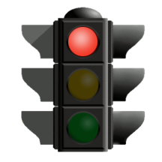
Not So Fast …
It may seem reasonable to assume that richer, more informative feedback—with detailed information about task performance—will enhance student learning. But, that’s not the case!
Notes:
22

Slide 23
Hypothesis/Findings
Feedback that contains detailed information about
task performance will enhance student learning.
Positive Effect
Swan (1983) found that a “bugs and misconceptions” approach was more effective in enhancing student learning compared to simply reteaching (topic contingent).
No Effect
Sleeman et al. (1989) conducted 3 studies comparing “bugs and misconceptions” vs. topic contingent and found (a) they were both better than no tutoring, but (b) not different from each other.
Negative Effect
Kulhavy et al. (1985) tested 4 types of feedback (increasing complexity) and found complexity was inversely related to (a) ability to learn effectively and (b) ability to correct own errors.

Slide 24
Examples
Notes:
24

Slide 25


Example
Steve, which organelle is responsible for producing energy in a cell?
Um, lysosome?
No, that’s not right. The correct answer is mitochondrion.

Slide 26


Example
Ryan, can you list all of the plant cell organelles?
Let’s see …there’s the cell wall, cell membrane, nucleus, nuclear membrane, cytoplasm, endoplasmic reticulum, ribosome, mitochondrion, and vacuole.
You’re missing one organelle. Think of an organelle that plays a big role in the photosynthesis process.

Slide 27
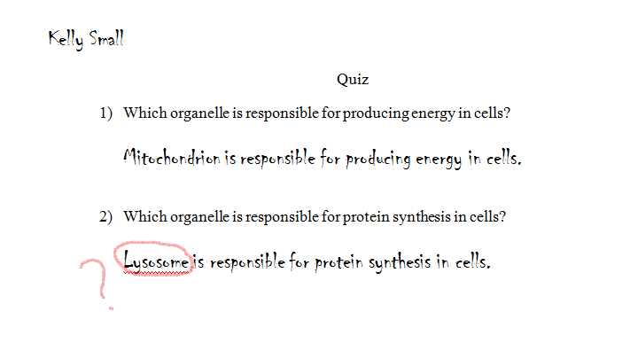

Example
Oh, yeah.
The ribosome is responsible for protein synthesis in cells.

Slide 28

Example
Mary, can you tell me which organelle is responsible for storing nutrients and waste products in cells?
Nucleus?
That is not correct. The nucleus is responsible for controlling cell activities.

Slide 29

Example
Ryan, can you tell me the name of an organelle that is unique to plant cells?
Chloroplast is a unique organelle in plant cells.
That’s correct!!

Slide 30
Example
Kelly, can you tell me which organelle is responsible for producing energy in animal cells?
Golgi apparatus?
The Golgi apparatus is responsible for packing macromolecules for transport elsewhere in the cell. Give it another try!

Slide 31
Example
Steve, can you
tell me how many different kinds of cells you know?
Two kinds, plant and animal cells?
That’s a common—but incorrect—belief. There are actually a lot of different kinds of cells in the world, like bacterial and fungal cells.

Slide 32
Timing
Notes:
32

Slide 33
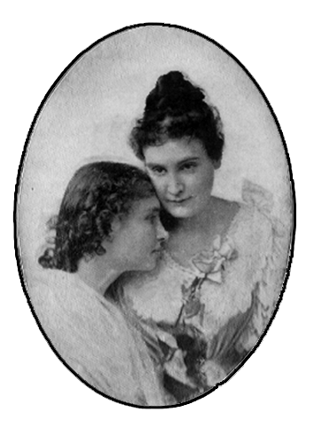
Timing
“It was my teacher's
genius, her quick sympathy,
her loving tact which made
the first years of my education
so beautiful.
It was because she seized
the right moment to impart
knowledge that made
it so pleasant and
acceptable
to me.”
—Helen Keller
Notes:
33

Slide 34
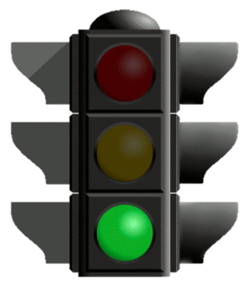
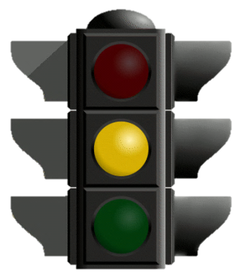
Immediate & Delayed Feedback
Immediate Feedback
Provides feedback right after a student has responded to an item or problem.
Prevents errors being encoded into memory.
Delayed Feedback
Provides feedback minutes, hours, weeks, or longer after the completion of a task or test.
Is more appropriate to promote transfer of learning.

Slide 35
Example
Immediate Feedback
Kelly, do animal cells have cell walls?
Yes, they have cell walls.
No, animal cells have cell membranes like plant cells, but they do not have any cell walls.

Slide 36

Example
Delayed Feedback
Steve, can you describe the function of the Golgi apparatus in an animal cell?
Its function is to produce energy.
Note that the teacher did not say whether Steve’s answer was correct or not, and did not give any feedback on Steve’s answer. He waited to give feedback until after he talked about the function of the lysosome and its relationship with the Golgi apparatus in an animal cell.

Slide 37
Interactions
Notes:
37

Slide 38
Interactions
Feedback
Instruction
Student
(e.g., motivation and prior knowledge)
(e.g., objectives and tasks)
(e.g., type and timing)
Notes:
38
38

Slide 39
Kluger and DeNisi (1996)
“To understand the world, one must not be worrying about one’s self.”—Einstein
Learning/
Performance
Positive
(enhance)
Negative
(reduce)
Positive
(enhance)
Negative
(reduce)
Goal
setting
Correct
solution
Oral
delivery
Memory
tasks
Following-
rules tasks
Praise
Frequent
messages
Computer
delivery
Threats to
self-esteem
Nonphysical
tasks
Physical
tasks
No goal
setting
Personal
growth
Discouraging
feedback
Simple
tasks
Complex
tasks
Feedback Features
Task Features
Notes:
39

Slide 40
Mason and Bruning (2001)
Student
Achievement
Low
High
Task
Level
Lower
level
Higher
level
Lower
level
Higher
level
Timing of
Feedback
Immediate
Immediate
Delayed
Prior Knowledge
Low
High
Low
High
Low
High
Correct Response + Response Contingent
Correct Response +
Topic
Contingent
Verification +
Delayed Response
+ Response Contingent
Try Again
+
Delayed Response
+
Topic
Contingent
Type of
Feedback
Correct Response + Response Contingent
Correct Response +
Topic
Contingent

Slide 41
Intermediate Summary
Feedback
Student
Instruction
Studies find that feedback generally improves learning compared to control conditions but major gaps remain, especially in relation to interactions among instructional/task contexts and student characteristics that mediate feedback effects.
Notes:
41
41

Slide 42
Things to Do
Focus feedback on the task not the learner.
Provide elaborated feedback in manageable units to enhance learning.
Be specific and clear with feedback message.
Keep feedback as simple as possible (based on learner needs and instructional constraints).
Reduce uncertainty between performance and goals.
Give unbiased, objective feedback, written or via computer.
Promote a “learning” goal orientation via feedback.
Provide feedback after learners have attempted a solution.
Notes:
42

Slide 43
Things to Avoid
Do not give normative comparisons.
Minimize use of extensive error analyses and diagnoses.
Do not present feedback that discourages the learner or threatens self-esteem.
Use “praise” sparingly, if at all.
Try to avoid delivering feedback orally.
Do not interrupt the learner with feedback if the learner is actively engaged.
Avoid progressive hints that always end with the correct answer.
Do not limit the mode of feedback presentation to text.
Be cautious about providing overall grades.
Notes:
43

Slide 44
Things to Avoid
Be cautious about providing overall grades.
Wiliam (2007) summarized the following findings:
Students receiving just grades—no learning gains
Those receiving just comments—large learning gains
Those receiving grades and comments—no learning gains (likely due to focusing on grades and ignoring comments)
Notes:
44
44

Slide 45

What did she do wrong?
Ms. Lee asked a question to the class, and Amy gave the correct answer.
Ms. Lee said, “That’s exactly right, Amy! Your answer is much better than the answers given by Mary and Richard. You’re such a bright student! I’m happy to have you in my class.”

Slide 46
What did he do right?
Mr. Johnson wanted Richard to list all of the plant cell organelles.
Richard listed most of the plant cell organelles, but he omitted chloroplast and chlorophyll.
Mr. Johnson let Richard know that he left out two plant cell organelles and added that he believes if Richard thinks about the process of photosynthesis in the plant cell, he will be able to remember the names of the forgotten organelles.

Slide 47


What did he do wrong?
Mr. Johnson asked Byron to give the name of an organelle that plays a role in photosynthesis.
Byron said, “Ribosome?”
Mr. Johnson replied, “That’s a silly answer! I can’t believe that you still don’t know the correct answer!”

Slide 48


Scenario
Ms. Jackson is a science teacher. She wants to improve her science students’ knowledge and skills. She heard about formative feedback from a formative feedback training workshop.
Tommy is a struggling science student with low motivation to join in class discussions or to answer his science teacher’s questions in class.

Slide 49



Scenario
Marcus is a high-ability science student who joins in class discussions and answers his teacher’s questions. He and Angela compete with each other in relation to science achievement.
Angela is a high-ability science student with high motivation to join in class discussions and answer questions in class. She competes with Marcus in relation to science achievement.
Jenny is a struggling science student with low motivation to join in class discussions or to answer her science teacher’s questions in class.

Slide 50
Scenario 1
Ms. Jackson just taught chemical and physical properties of matter in her class and gave a short quiz to her class.
Tommy and Jenny received very low scores on the quiz.
Marcus and Angela received very high scores on the quiz.

Slide 51
If you were Ms. Jackson …
What type of feedback would you use, and when would you give it to each of the students?

Slide 52
Scenario 2
Ms. Jackson is teaching an easy topic in her class today.
She is worried about losing the attention of her high-ability students (Marcus and Angela) while increasing the understanding of her
low-ability students (Tommy and Jenny).

Slide 53
If you were Ms. Jackson …
What type of feedback would you use, and when would you give it to each of the students?
How can you balance feedback for high- and low-ability students in the class without losing the high-ability students’ attention while increasing the low-ability students’ motivation and understanding?

Slide 54
Role-Playing Activity
Teacher: Needs to teach a topic (it can be either difficult or easy) to students today and wants to evaluate as well as support their understanding.
High-ability student: Has high science achievement in the class and will evaluate the quality of the teacher’s feedback at the end of the activity.

Slide 55
Role-Playing Activity
Low-ability student: Has low science achievement in the class and will evaluate the quality of the teacher’s feedback at the end of the activity.
Observer: Responsible for observing the class and providing feedback to the teacher (at the end of the activity) about the teacher’s use of feedback to students.

Slide 56
Discussion
According to role-playing activity
Were the feedback types in the role-playing activity used appropriately?
Was the timing of feedback appropriate?
Other comments?

Slide 57
Assessment Time

Slide 58
References
Black, P., & Wiliam, D. (1998). Assessment and classroom learning. Assessment in Education 5(1), 7–74.
Boud, D. (2000). Sustainable assessment: Rethinking assessment for the learning society. Studies in Continuing Education, 22(2), 151–167.
Butler, R. (1988). Enhancing and undermining intrinsic motivation: The effects of task-involving and ego-involving evaluation on interest and involvement. British Journal of Educational Psychology, 58, 1–14.
Cohen, V. B. (1985). A reexamination of feedback in computer-based instruction: Implications for instructional design. Educational Technology, 25(1), 33–37.
Elliott, E., & Dweck, C. (1988). Goals: An approach to motivation and achievement. Journal of Personality and Social Psychology, 54, 5–12.
Harlen, W., & Crick, R. D. (2003). Testing and motivation for learning. Assessment in Education, 10(2), 169–207.
Hounsell, D. (1997). Contrasting conceptions of essay-writing. In F. Marton, D. Hounsell, and N. Entwistle (Eds.), The Experience of Learning. Edinburgh: Scottish Academic Press.
Juwah, C., Macfarlane-Dick, D., Matthew, B., Nicol, D., Ross, D., & Smith, B. (2004). Enhancing student learning through effective formative feedback. York: The Higher Education Academy.
Kluger, A. N., & DeNisi, A. (1996). The effects of feedback interventions on performance: A historical review, a meta-analysis, and a preliminary feedback intervention theory. Psychological Bulletin, 119(2), 254–284.
Kulhavy, R. W., White, M. T., Topp, B. W., Chan, A. L., & Adams, J. (1985). Feedback complexity and corrective efficiency. Contemporary Educational Psychology, 10(3), 285–291.
Mason, B. J., & Bruning, R. (2001). Providing feedback in computer-based instruction: What the research tells us. Center for Instructional Innovation, University of Nebraska-Lincoln: 14. Retrieved June 1, 2006, from http://dwb.unl.edu/Edit/MB/MasonBruning.html
McDonald, B., & Boud, D. (2003). The impact of self-assessment on achievement: The effects of self-assessment training on performance in external examinations. Assessment in Education,10(2), 209–220.
Sadler, D. R. (1989). Formative assessment and the design of instructional systems. Instructional Science, 18, 119–144.
Shute, V. J. (2008). Focus on formative feedback. Review of Educational Research, 78(1), 153–189.
Sleeman, D. H., Kelly, A. E., Martinak, R., Ward, R. D., & Moore, J. L. (1989). Studies of diagnosis and remediation with high school algebra students. Cognitive Science, 13, 551–568.
Swan, M. B. (1983). Teaching decimal place value. A comparative study of conflict and positively-only approaches. Research Report No. 31, University of Nottingham, Sheel Center for Mathematical Education.
Wiliam, D. (2007). Keeping learning on track: Classroom assessment and the regulation of learning. In F. K. Lester Jr. (Ed.), Second handbook of mathematics teaching and learning (pp. 1053–1098). Greenwich, CT: Information Age Publishing.
Yorke, M. (2003). Formative assessment in higher education: Moves towards theory and the enhancement of pedagogic practice. Higher Education, 45(4), 477–501.

Slide 59



Questions?

