Slide 1
Keyplayer
Carlos Lawrence
Jake Traut
Josh Rinaldi
Michael Bostwick

Slide 2
Overview
Goal
Methodologies Used
Tools Used
Struggles
Final Product
Demonstration

Slide 3
Goal
Play songs from keyboard
Produce visuals
Record songs

Slide 4
Methodologies
Agile
  Weekly Stand-up meetings
Waterfall
  Overall process
  Sprints

Slide 5


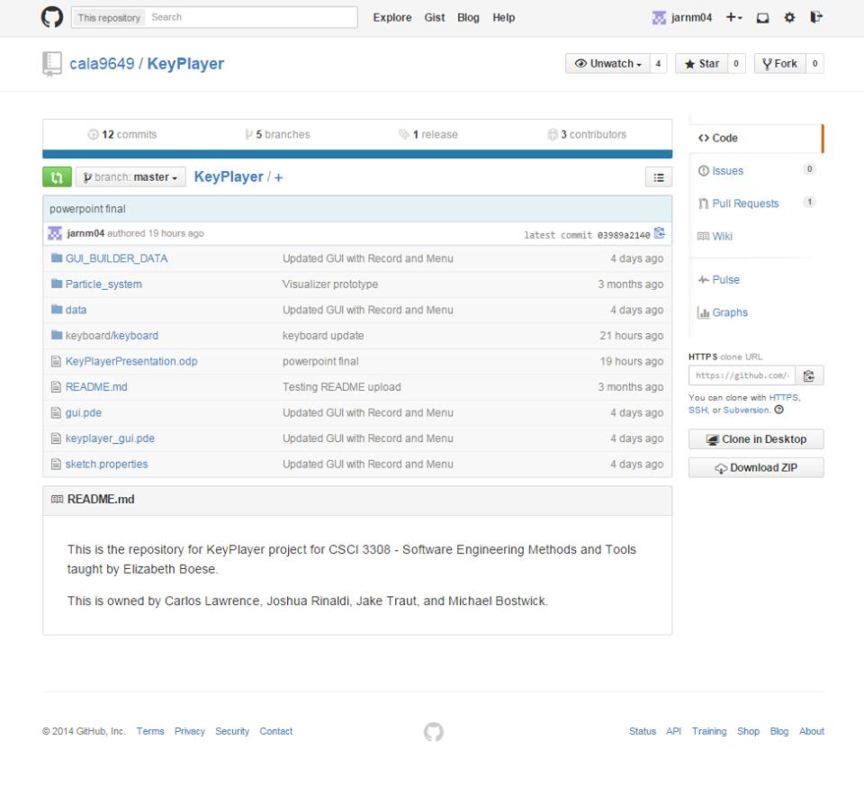
Github

Slide 6

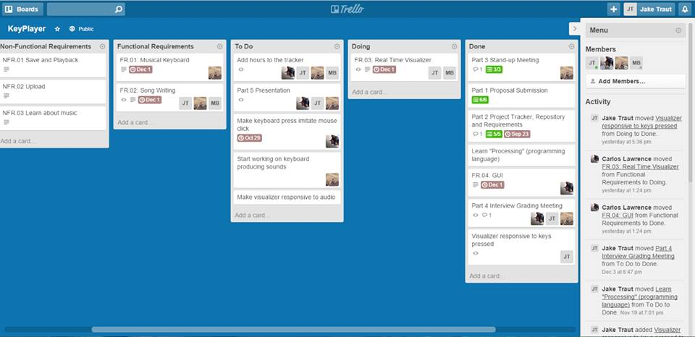
Trello

Slide 7

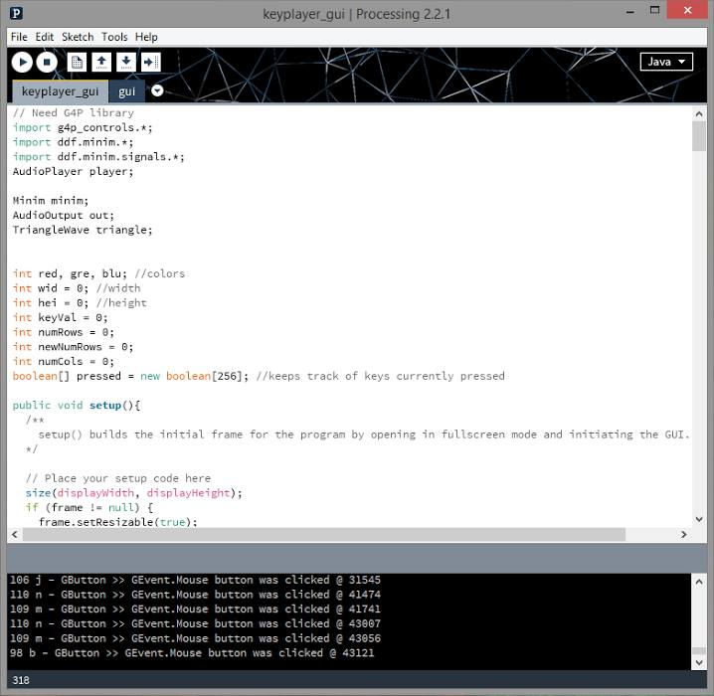
Processing

Slide 8

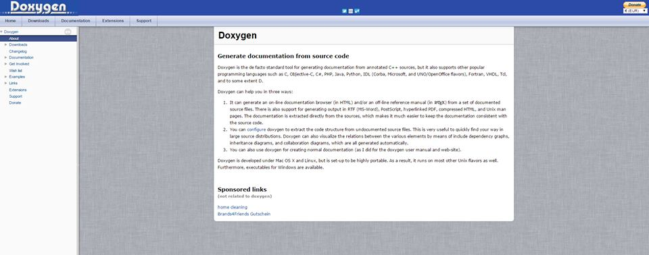
Doxygen

Slide 9
Struggles
Processing language
  Finding tools that support language
  Working around being u
  Test cases
  Learning Language
Finding recordings of sound
  Ended up producing sounds instead
Github
  Very inexperienced

Slide 10
Final Product
Does:
  Play sounds
  Produce visual
Does not:
  Record

Slide 11
Demonstration

Slide 12
Summary
Goal
Methodologies used
Tools used
Struggles
Final Product
Demonstration

