Slide 1
Program Goal; Variables and Functions in main
Program Goal:
Part 1 – Read in stock data
Read in data from user-specified input file, sort it how user wants, print the data to the screen as a list with three labeled columns:
Left – Tickers (official symbols for stock names),
Middle – Share Price (in US dollars, or USD $),
Right – Growth (percent), either positive or negative;
Part 2 – Stock-buying simulation
If the user wishes, run a simulation of buying shares of one stock from the data.
Structures
One structure: struct stock
stock structure fields:
1. char ticker[10] (enough space for 10 characters)
2. double price
3. double growth
Variables (main program)
struct stock stock_list[100]
int num_stocks, sort_choice
char ans1, ans2
double cur_bal, new_bal
Purpose of Variables (main)
stock_list[100]: at each index, store the data for one stock from the given input file
num_stocks: the number of stocks in the data
sort_choice: how the data is to be sorted
ans1: yes/no answer to question in main; is ‘y’ or ‘n’
ans2: same as ans1
cur_bal: if stock-buying simulation is run, the user’s starting balance
new_bal: if stock-buying simulation is run, the user’s ending balance
Functions
Function 1: int read_data(struct stock list[])
Takes stock array, returns integer (num_stocks)
Actions: 1. ask user for input file, 2. have user enter input file name, 3. read in first line of input file (indicates number of stocks in the file), 4. read data from each subsequent line of the file into each index of stock array list[] (each index reads in and stores 1st ticker, 2nd price, and 3rd growth data, in that order, for each stock).

Slide 2
Functions (continued)
Function 2: int user_sort_request()
Returns integer (main variable: sort_choice)
Actions: 1. asks the user to enter an integer indicating how they would like the stocks from the input file to be sorted - 1 for by ticker, 2 for by price, 3 for by percent growth, 2. the user enters the number they want, 3. if the number is invalid, keep asking the user to enter a valid response until they do, 4. return this number.
Function 3: void sort_data(struct stock list[], int num1, int num2)
Takes stock array, integer (main: sort_choice), integer (main: num_stocks)
Actions: 1. checks sort_choice to know how to sort data, 2. if sorting by ticker, ask user if they want stocks sorted A-Z or Z-A; if sorting by price or growth, ask user if they want them sorted greatest to least or least to greatest, 3. have user enter response; while their response is invalid, keep asking them to re-enter response, 4. loop through stock array, check each stock index to make sure it fits sort criteria; if it does not, swap stock positions in list[] accordingly.
Function 4: void print_data(struct stock list[], int len)
Takes stock array, integer (main: num_stocks)
Actions: 1. prints headings for the data (to help display it as a table), separates them from data using line below them comprised of ‘=‘ signs, 2. prints and numbers (starting at 1, not 0) the data for each stock stored at each index of list[], number at left, ticker 2nd from left under “Ticker” heading, price in USD 2nd from right under “Price” heading, percent growth far right under “Growth” heading.
Function 5: double random_bal()
Returns a double (main: cur_bal)
Actions: 1. seeds the random number generator with the time function, 2. assigns a random # between 0 and 10000 to a double variable, 3. returns this as the user’s initial balance in USD
Note: Functions 5 and 6 are only called if user wants
Function 6: double buy(struct stock list[], double bal, int len)
Takes stock array, double (main: cur_bal), integer (main: num_stocks), returns double (main: new_bal)
Actions: 1. Asks user for number on left of table next to ticker of one stock they would like to buy, … (→)

Slide 3
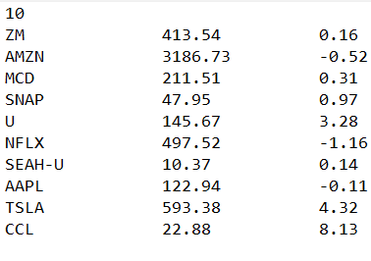
Functions (continued) and Overall Logic
(→)2. user enters number; while response is invalid, ask user to re-enter response; since number refers to index in list[], decrement it by 1, 3. now that a stock is picked, ask user how many shares of it they would like to buy; while total cost of the shares exceeds their current balance, ask them if they want to try to make another purchase - if they do not, return their current balance (which thus remains unchanged from the start of the function), but if they do, repeat the process of steps 1-3 until all responses result in a valid outcome, 4. print to the screen a report of the user’s purchase showing the ticker of the stock they bought, how many shares of it they bought, and the total cost of their transaction, 5. subtract the total cost of the transaction from the user’s current balance, 6. return this difference; this is the user’s final balance.
← Sample Input File
(Number of stocks indicated on 1st
line; in lines below, ticker on left,
price ($) in middle, growth % on right
Logic
Note: this program requires the header files stdio.h, stdlib.h, string.h, time.h
In the program, the only actions the user must take are entering an input file name, then two integers for sorting the data from the input file, then a character to indicate whether they want to run the stock purchase simulation. Each time the user is asked a polar (yes/no) question, a response of y indicates “yes” and a response of n indicates “no.”
In addition, except for the input file name, any time the user is asked to enter a value, a while loop runs after they enter their response if their answer is invalid until a valid one is given. This is done to ensure the program runs optimally.
The program uses integer loop counters i and j, incrementing or decrementing them by 1, to iterate through for loops throughout the program and its functions. The fopen and fscanf functions and a for loop are used to read in the data, starting at index 0 (i=0) of the stock_list[] array and filling in the fields of each next index’s structure until the index number is equal to the number of stocks in the list (counting from 1, not 0). The print_data function uses a for loop of the same format to print each stock’s data. The sort_data function nests a for loop starting at j=i and incrementing each one by 1 (→)

Slide 4
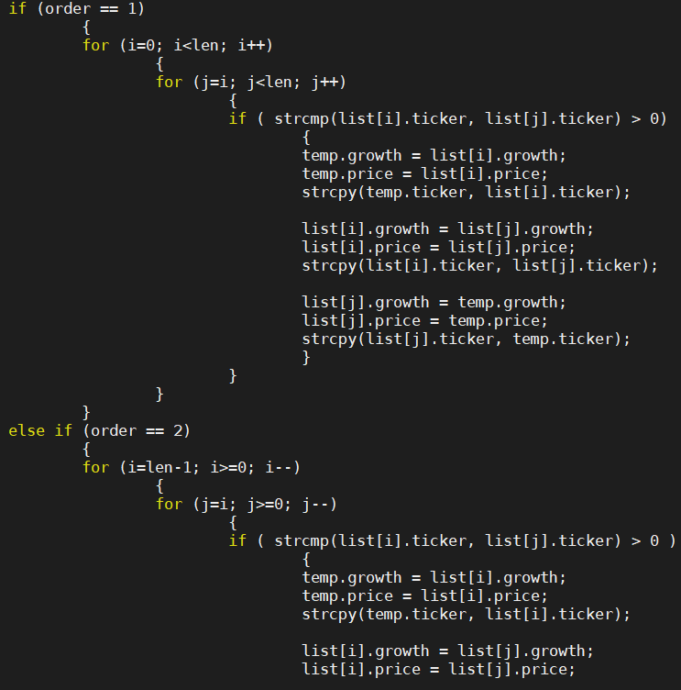
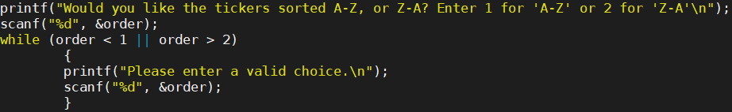
Functions (continued) and Overall Logic
(→) at the end of each loop iteration for data being sorted A-Z or greatest to least. For data being sorted Z-A or least to greatest, a nested for loop where: 1) the outer loop has i=num_stocks-1, and 2) the inner loop has j=i, where each decrements by 1 after each iteration, and runs while each is greater than or equal to 0 (the 0th index). For both these sort orders, the if statement is the same; based on the sort method, it checks if the field at index j of stock_list[] comes first alphabetically or is greater numerically than the one at index i, and if it is, it swaps the two structures (stocks), storing the values at index i in a temporary stock structure and setting the fields at index i equal to those of index j (using the strcpy(char *s1, const char *s2) function for strings) and then replacing the values at index j with those from index i, stored in the temporary stock structure.
As for the remainder of the functions in the program, the bulk of their logic is similar to what has already been described. However, in buy, when the user indicates the specific number of the stock they would like to purchase, no for loop is used to locate this index; their response is stored in a variable stock_choice used to denote the appropriate index for the stock in stock_list[].
An example of the nested for loop used in sort_data; this one sorts the stocks alphabetically; top one A-Z, bottom one Z-A
An example of a while loop used to ensure valid responses throughout the program.

