Slide 1

RFID Technology
Vincent Daniau
GEII Le 18/01/2012

Slide 2
Table of Contents
Introduction to RFID
  Auto-ID
How RFID works
  Systems
  Tags
  Readers
  Communication
Standardization
Applications
  Industry
  Services
  Security
  Examples of integration
Conclusion
References

Slide 3
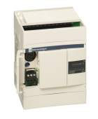
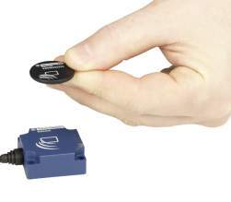
Introduction to RFID
RFiD (Radio Frequency iDentification) is the most promising technology for automatic identification.
RFiD is based on Radio Frequency communications to exchange data between a remote memory device (tag) and a PLC or a computer.
PLC
tag

Slide 4
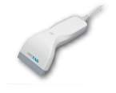
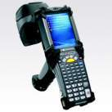
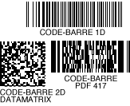
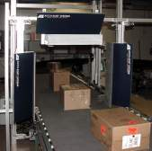

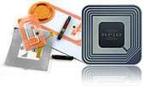
Auto-ID Technologies
Barcode
RFID
Bubble codes
Vision
Wifi
Zigbee
Magnet Strip
Biometric
Notes:
Toutes les technologies d'identification et de Collecte des données sont souvent regroupées sous l’acronyme AIDC ou Auto-ID (auto identification et data capture)
Deux grandes catégories de technologies de traçabilité – les code-barres et le le RFID, et d’autres nouvelles, à prendre en compte également même si nous n’aurons pas le temps aujourd’hui.
A voir sur le salon
Code à bulle – Prooftag
Traçabilité par l’image – Image ID
Traçabilité temps réel sur réseau Wifi – Ekahau, Aeroscout, Cisco, Minesite

Slide 5
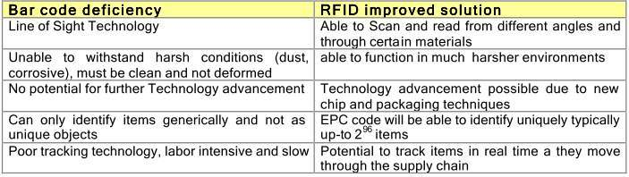
Comparison of Bar Codes and RFID
Bar codes are predominately used today for identifying and tracking products throughout the supply chain. Even though they can achieve efficiencies in the order of 90%, there are still a number of deficiencies in the technology, for which RFID, is able to provide a better solution and further optimization.

Slide 6
RFiD : reliability and robustness
RFiD provides a high level of reliability and robustness of data, compared to optical (bar code ) magnetic (badges) or contact (credit cards) auto ID technologies :
  Non-metal materials such as paper, wood, plastic, etc. do not obstruct communications between antenna and tags, even though these materials are not transparent
  The tag and the reader are environment resistants, including water, oils, chemicals and reflected lights
  The tag has an extremely long span of life. It can be read and written at any time and re used many times.

Slide 7

The origin of RFID Technology
RFiD is a 40 years old technology
One of the first uses was automatic feeding by reading an RFID tag attached to cows. Because of harsh environment, optical bar code is badly adapted to such applications.

Slide 8
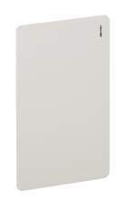
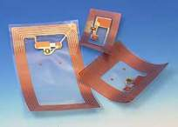
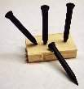
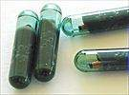
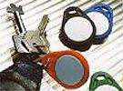
RFID = Evolutive Technology
Today, RFiD has gone out of exclusive industrial applications with a very large range of tags adapted to each need :
  Access control badges for skiing, subway,..
  Paper tags for tracking of books, luggages,..
  Active tags for cars identification (car parks).
  Glass tags for pets identification (injected under the skin)
  ...

Slide 9


How RFID works

Slide 10
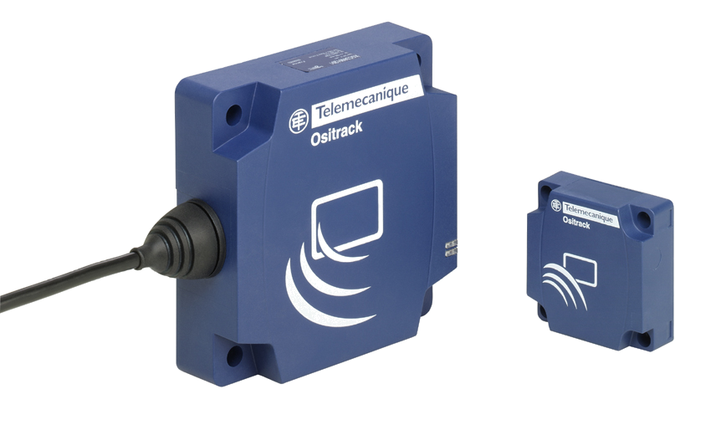
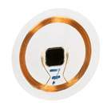
RFID Technology : basics
An RFID system consists of an electronic tag containing data and a reader to communicate with the tag.
The tag provides a remote database, that travels with the product itself. It contains an antenna and a silicon chip including a memory. The tag can be powered by the electromagnetic or electrical field generated by the reader (passive tag) or by an internal battery (active tag)
The reader (or station) consists of an antenna and a controller for communication on serial link or network.
reader
tag
coil (antenna)
chip

Slide 11
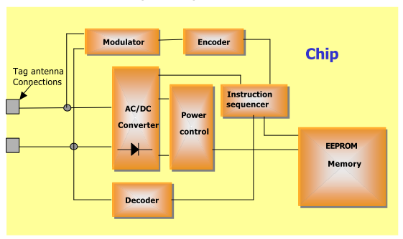
RFiD building blocks : Tags

Slide 12
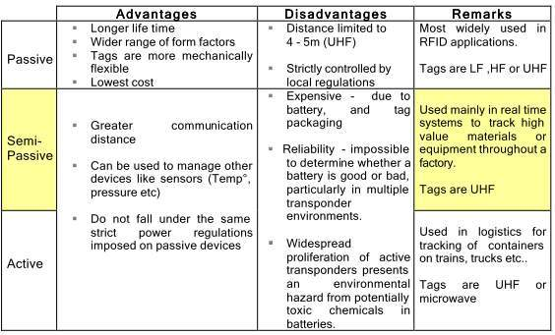
Active and Passive Tags

Slide 13
Tag Classes
One of the main ways of categorizing RFID tags is by their capability to read and write
  CLASS 0 – READ ONLY. – Factory programmed
    These are the simplest type of tags, where the data, which is usually a simple ID number (EPC) is written only once into the tag during manufacture. The memory is then disabled from any further updates. Class 0 is also used to define a category of tags called EAS (electronic article surveillance) or anti-theft devices, which have no ID, and only announce their presence when passing through an antenna field.
  CLASS 1 – WRITE ONCE READ ONLY (WORM) – Factory or User programmed
    In this case the tag is manufactured with no data written into the memory . Data can then either be written by the tag manufacturer or by the user – one time. Following this no further writes are allowed and the tag can only be read. Tags of this type usually act as simple Identifiers
  CLASS 2 – READ WRITE
    This is the most flexible type of tag, where users have access to read and write data into the tags memory. They are typically used as data loggers, and therefore contain more memory space than what is needed for just a simple ID number.
  CLASS 3 – READ WRITE – with on board sensors
    These tags contain on-board sensors for recording parameters like temperature, pressure, and motion, which can be recorded by writing into the tags memory. As sensor readings must be taken in the absence of a reader, the tags are either semi-passive or active.

Slide 14
Memory of the RFID tags
Type | Advantages | Disadvantages
ROM | - Good resistance to high temperatures - Low cost | - Read only
EEPROM | - No battery or backup battery | - Relatively long read/write access time - Number of write operations limited to 100000 cycles per byte
RAM | Rapid access to data High capacity Unlimited number of read/write operations | - Back up battery needed in tag
FeRAM (ferroelectric) | - Rapid access to data - No battery or backup battery - High capacity | - Number of read/write operations limited to 10¹² cycles per byte

Slide 15



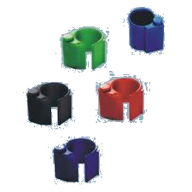
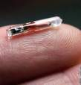

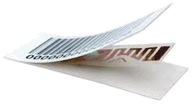

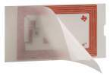


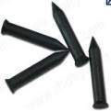

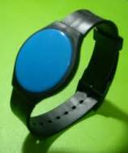
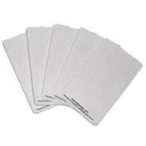
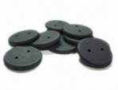

Tags adapted to each application

Slide 16
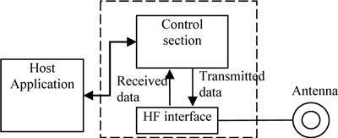
RFID building blocks : Readers
The main role of a RFiD reader is to transmit and to encode a radio signal to interrogate a tag

Slide 17
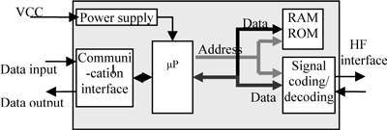
RFID building blocks : Readers
The control section of the RFID reader performs digital signal processing and procedures over the received data from the RFID transponder.
Also, the control section enables the reader to communicate with the transponders wirelessly by performing modulation, anti-collision procedures and decoding the received data from the transponders.
This section usually consists of a microprocessor, a memory block, a few analog-to digital converters and a communication block for the software application.

Slide 18
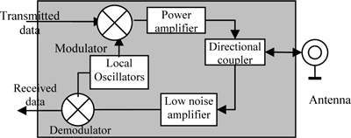
RFID building blocks : Readers
The high frequency interface of the reader is used for RF signal transmission and reception.
HF interfaces are consisted of two separate signal paths to correspond with the two directional data flows from and to the tag.

Slide 19
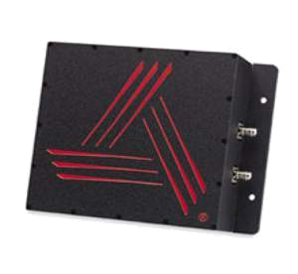
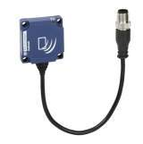
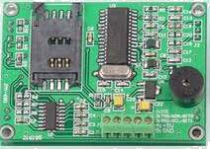
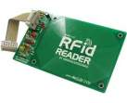
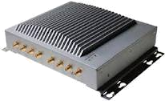
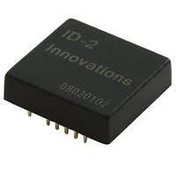
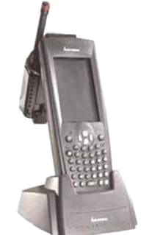
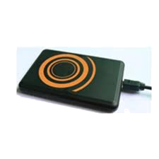

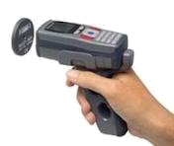
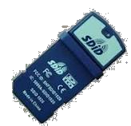

RFID building blocks : Readers
Industrial readers
Portable readers
OEM readers
Office readers

Slide 20
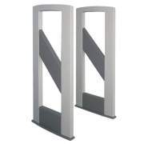
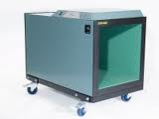
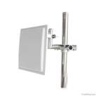
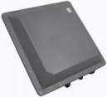
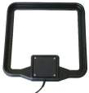

RFID building blocks : antennas
Access control (gate)
Tunnel
Oem antenna

Slide 21
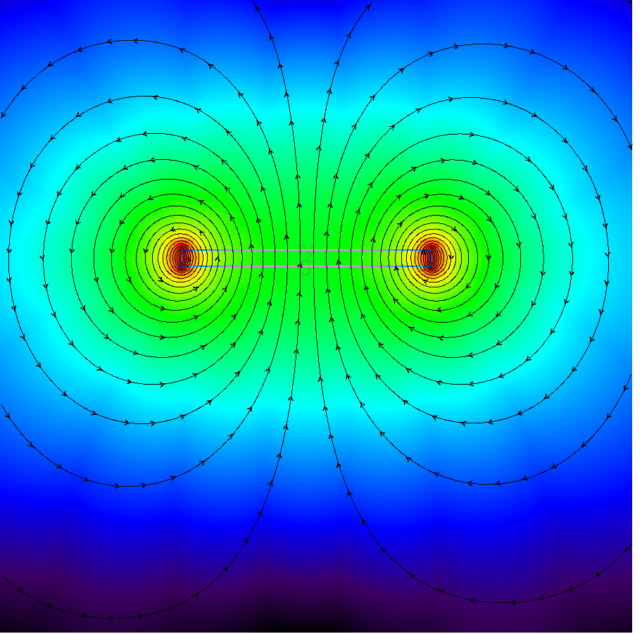
LF and HF antennas : coupling conditions
Air solenoid configuration of LF and HF antennas
The dialog area is defined from several parameters :
Shape of each antennas
Sensitivity of the reader
Sensitivity of the tag (power consumption)
Influence of metal presence in the RF field (metal is considered as a short circuit)
Additional ferrite pieces in the RF field
Small field strength
Positive and negative field lines. Energy in the coil is null → no dialog with the tag
Maximum field strength

Slide 22
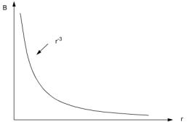
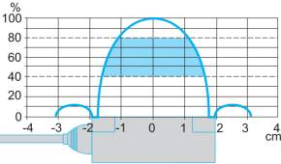
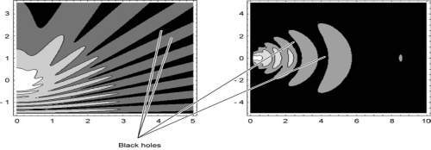
Communication fields
Environment around RFID systems creates multiple effects which disturb the electrical behaviors of devices. The electromagnetic waves can be reflected, refracted, diffracted and absorbed by materials.
HF systems
The magnetic field produced by a loop antenna drops off with r⁻³
UHF systems

Slide 23
Communication protocols
Three main layers
Application → user's data
Communication → 'Language' between tags and readers
(read and write commands, Id of the tag, data integrity management,..)
Transport→ air interface between tag and reader
(Frequency, Modulation, Waveform,Baudrate)

Slide 24
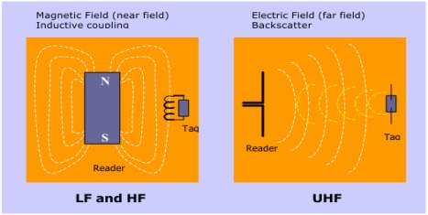
Wireless energization
In order to receive energy and communicate with a reader, passive tags use one of the two following methods shown bellow.
near field communication which employs inductive coupling of the tag to the magnetic field circulating around the reader antenna (like a transformer)
Far field communication which uses similar techniques to radar (backscatter reflection) by coupling with the electric field.
The near field is generally used by RFID systems operating in the LF and HF frequency bands, and the far field for longer read range UHF and microwave RFID systems.

Slide 25
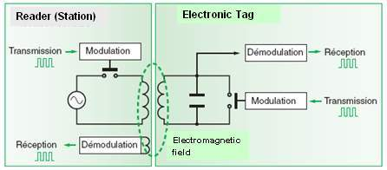
Wireless communication
Reader to tag
  The RF signal amplitude is modulated by the reader. The tags receiver circuit is able to detect the modulated field, and decode the original information from it
Tag to Reader
  The principle is similar to a transformer where the secondary coil (tag antenna) changes the load and the result is seen in the Primary (reader antenna).
  The tag chip accomplishes this same effect by modulating its antenna impedance via an internal circuit. The reader receiver is able to detect this modulation, and decode the orginal information from it

Slide 26
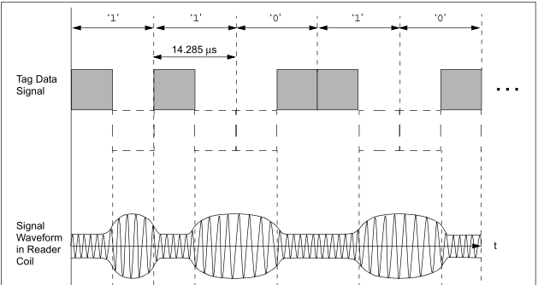

Data signal waveforms

Slide 27

Data coding waveforms

Slide 28

Standardization

Slide 29
Standardization
A very important aspect of RFID technology are the associated standards and regulations.They are designed to ensure safe operation with respect to other electrical and radio equipment, and guarantee interoperability between different manufacturers readers and tags.
Regulations are mainly concerned with reader power emissions and allocation of frequency bands, whilst standards like the ISO (International Standards Organization) define the Air interface communication between Reader->Tag and Tag->Reader, and include parameters such as;
  Communication protocol
  Signal Modulation types
  Data coding and frames
  Data Transmission rates
  Anti-collision (detection and sorting of many tags in the Reader field at the same time)

Slide 30

RFiD Frequencies

Slide 31
RFiD Frequencies
Operating frequency | Most common applications | Advantages | Disadvantages
100 KHz – 2MHz (low frequency) | - Animal identification - Car security - Automotive industry | Low impact of water and metal on read/write distances | Low speed access to data. Short read/write range (< 500 mm) Closed systems (no standard)
13.56 MHz (high frequency) | -Access control Payment (smart card) | Standardization of data transfer protocols (ISO 15693 – ISO 14443 A/B) | Short read/write range (<500 mm)
850 – 950 MHz (UHF) | - Warehousing -Supply Chain | Very low cost of tags Medium read/write range ( < 5 m) | Highly sensitive to metal and liquids Frequency reserved for mobile phones (Europe and Asia) Low memory size
2.45 GHz (micro-wave) | - Car monitoring (toll motorway, car park) | High data transfer speed Long read/write range (<30 m) | Active tags (needs battery replacement)

Slide 32
RFID standards
Communication layer | Air interface layer | Applications | Frequency
ISO 11784/85 | ISO 18000-2 | Animals | LF
ISO 14443A/B | ISO 18000-3 | Badges | HF
ISO 15693 | ISO 18000-3 | Items | HF
NFC | ISO 18000-3 | Items | HF
EPC | ISO 18000-6 | Retail / logistic | UHF / HF
ISO 18185 | ISO 18000-4 ISO 18000-7 | Freight Containers | UHF - Microwave

Slide 33

RFID in applications
The choice of the RFID elements (tags, antennas, frequencies) is linked to the environment of each application

Slide 34






Applications : Industry
Chemical treatment process
Batch process
Assembly process
Tag
Tag
Tool identification
Positionning
Conveying / sorting

Slide 35





Applications :Security
Electronic Passport
Access control
Container tracking
Car immobilizer

Slide 36






Applications : Traceability
Animals
Patient tracking
Anti theft detection
Books in libraries
Cold Chain tracking
Equipments

Slide 37




Applications : Services
Access control of vehicules in pedestrian streets / areas
Rent of bicycles
Access to public facilities /services
  Battery charging spots for electric vehicules
  Services (pre-payment) for trucks / camper-van on parks (electricity / water / network)

Slide 38


Applications : EPC
Electronic Product Code
Based on UHF frequencies (850-950 MHz) and passive tags
Low cost tags (<10 cents) – High-Tech readers (ERP interfaces,…)
Long range (up to 10 meters)
Promoted by retail market (Walmart, Metro, Carrefour, Gillette,..) and majors in software (SAP, IBM, Microsoft, HP,..)
Lack of harmonization in frequencies and radio power around the world
Still some technical issues with sensitivity to water and metal environment
Today : used for packaging ID in logistic applications
Tomorrow : will replace barcodes in retail segment

Slide 39

Applications : NFC (Near Field Communication)

Slide 40
Integration of RFID technology
RFID is based on communication. The readers are always connected to something…

Slide 41


Integration examples
Application
Functions
Position control of a mobile crane for coke loading :
Identification of the position of the crane on the rail
Position ID :
The positions of tags mounted on the rail are used as references for the position of the crane..
Benefits
Reliable position control whatever environment conditions
Unexpensive position control for long distances

Slide 42





Integration examples
PLC (TSX micro)
Tag
24V
RFiD station XGCS4901201
Field expander XGFE2525
Tag XGHB320345
Field-expander

Slide 43

Integration examples
Application
Functions
Access control to pump stations (water distribution) :
Management of maintenance operations:
- Each operator has a RFiD badge
A RFiD reader is fixed near the door of the pump station
When a badge is passed in front of the reader, the UID is sended to a central system which remotely opened the door if the access to this pump station is scheduled.
The history is stored in a central database
Benefits
To reduce risks of terrorist action
Better management of the maintenance operations

Slide 44



Integration examples
The RFID station is connected on existing Modbus communication.
ID data are managed as automation data.
The reader is mounted in a hole in the wall near the door.
Read/write of the badges through the concrete (protection against external action)

Slide 45


Integration examples
Application
Functions
Traceability in a batch process (jam manufacturing) – Link between the loading and the cooking workshops.
ID of the trolleys / containers:
- A RFiD badge is fixed on each trolley – A code (ID of each trolley) is stored in each badge
RFiD readers are mounted on each loading and cooking points
Data transmission :
All RFID readers are connected to a centralized system and transmits the ID of each trolley
Benefits
Adapted to harsch environment (high pressure hot cleaning)
Easy integration

Slide 46



Integration examples
There is no automation in this application :
-All the splitter boxes are connected to the Ethernet network of the plant (intranet) by Ethernet switches
-All the exchanges of RFID data are managed by the computers.
-RFID data are stored in a central database dedicated to traceability
Ethernet
Loading workshop
Cooking workshop

Slide 47

Conclusion
RFiD is promised to become a major technology, with a wide impact on our daily life, similar to mobile phoning.
A future ’totally tagged’ world ?

Slide 48
References
"RFID Laran white paper" 2004
"Généralités RFID" Thomas Huault 2006
"RFiD Training" Schneider-Electric 2009
"RFID Coil Design" Microchip AN678
"RFiD Made easy" µEM AppNote 411

