Slide 1
LITHIUM PLAY
Algorithmic Trading on a lithium portfolio
Presented by: Avangelina Cazares, Mr. Stallworth, Carlos A. Guerra

Slide 2
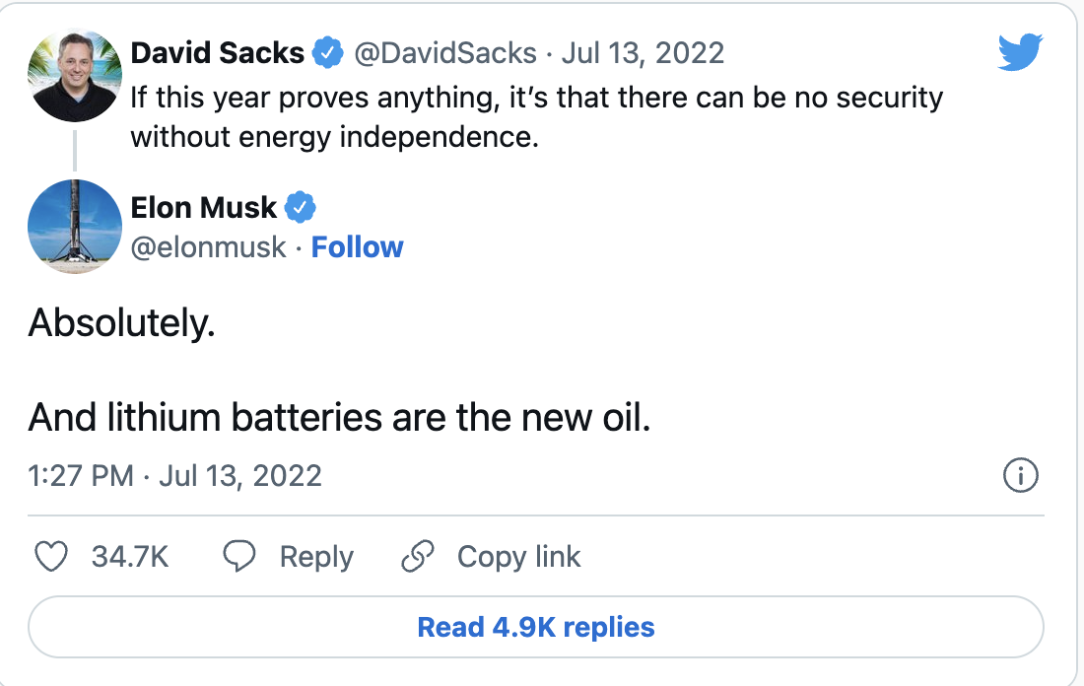
Executive Summary
Lithium Play offers an edge for investors with no prior industry experience with Lithium. By using a tested SMA algorithm
“As electric car makers race to increase the rate and capacity of their cars Lithium will be a key component. This presents an opportunity to invest in a sector with low risk in the short term
Elon Musk:
WSJ: “Demand for lithium is expected to outpace global supply”
https://www.wsj.com/articles/elon-musks-appeals-for-lithium-are-no-substitute-for-better-price-signals-11655889078

Slide 3
User Story
This program is a tool for stock market investors to have an edge in the Lithium public market without prior knowledge of the industry or trading by investing with the help of our Algorithm. It will signal when to buy and sale the top 10 lithium companies for 2022 according to several sources, trained with a strategy that would have worked in the past during the last 12 months
Users can purchase the code directly for use in their own endeavors. Following a period of testing in a paper account we will consider other ways of raising capital and/or improving features

Slide 4

Portfolio & Data
Stock (Ticker)
(LAC) Lithium Americas Corp
(SLI) Standard Lithium
(LTHM) Livent
(LIT) Global X Lithium & Battery Tech ETF
(BATT) Amplify Lithium & Battery Technology
(PLL) Piedmont Lithium
(ALB) Albemarle Corporation
(SQM) Sociedad Quimica y Minera de Chile
(OROCF) Allkem
(RCKTF) Rock Tech Lithium
https://pypi.org/project/yfinance/
yfinance 0.1.72
Yahoo Finance API

Slide 5


Improvements: Trading Bot
Libraries:
Pandas
NumPy
hvPlot
Matplotlib
scikit-learn
The trading algorithm will go live on Alpaca buying and selling stocks in the Lithium portfolio without further human input
https://alpaca.markets/

