Slide 1
01
DVCS

Slide 2
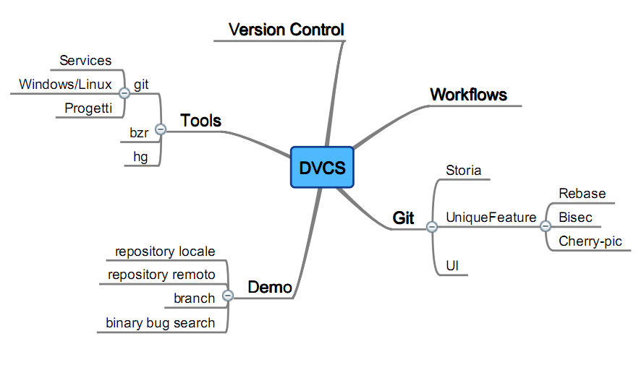
Agenda

Slide 3
02
VCS?
Notes:
Perchè sono qui? Tutta colpa di Simone …

Slide 4
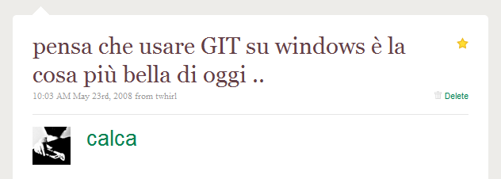

Twitting
Notes:
Perche sono qui a parlare .. Chi già usa GIT? E quali sistemi Operativi?

Slide 5


Twitting
Notes:
Lavorare senza sistema di controllo? Esperienze? Chi ci riesce?

Slide 6
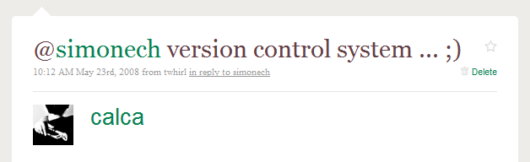

Twitting
Notes:
Quali VCS usate? dVCS o mneo?

Slide 7
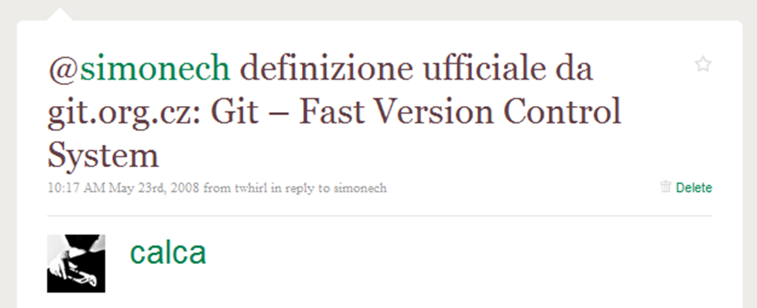
Twitting
Notes:
Parliamo del re dei dCVS ;)

Slide 8
03
Workflows
Notes:
Perchè sono qui? Tutta colpa di Simone …

Slide 9
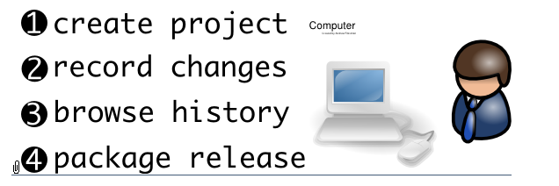
Solo

Slide 10
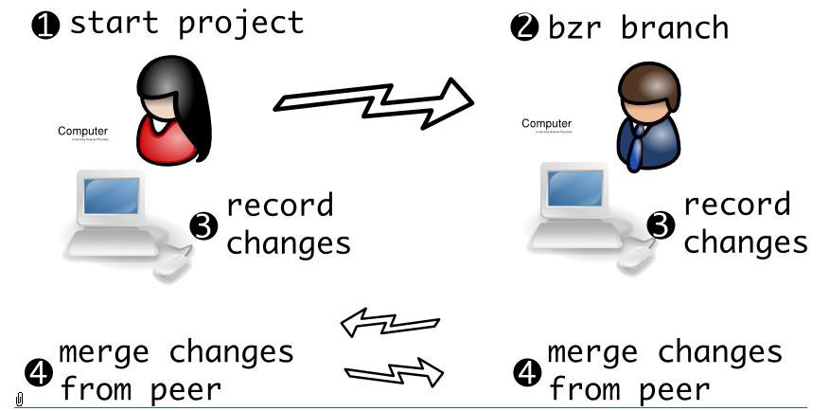
Partner

Slide 11
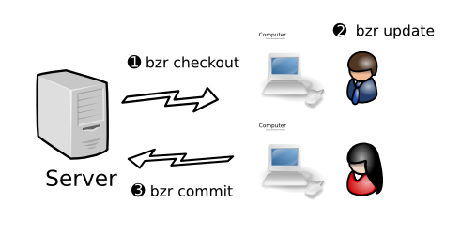
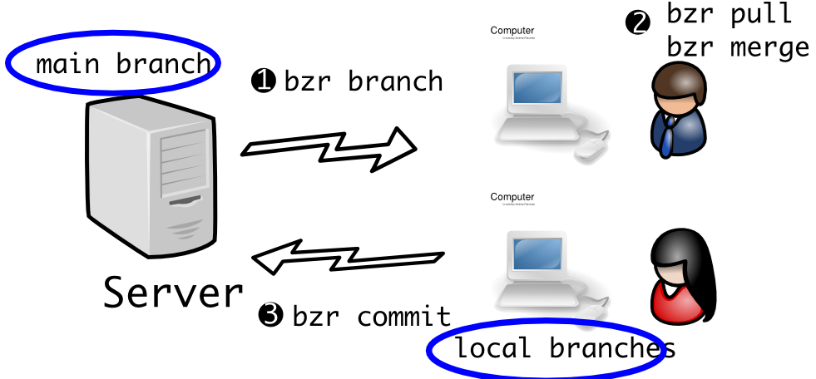
Centralized/Shared Mainline

Slide 12
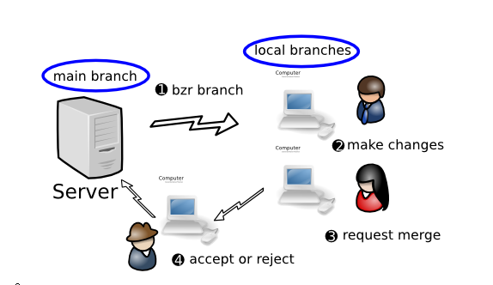
Human gatekeepr

Slide 13
04
Quali?
Notes:
Perchè sono qui? Tutta colpa di Simone …

Slide 14
Bazaar (bzr)
Canonical (Ubuntu)
Multipiattaforma (python)
Launchpad.net
Prestazioni Inferiori
Direcotry/Branches

Slide 15
Mercurial (hg)
Multipiattaforma (python)
Bitbucket.org (1 private)
Fast ( jdk, netbeans)
Mozilla/Python/OpenSolaris
Code.google.com
Notes:
http://code.google.com/p/support/wiki/DVCSAnalysis

Slide 16
GIT
Multipiattaforma (c)
Rebase, Bisec
Github.com
http://gitorious.org/ (AGPL)
Git/Linux/Android/RoR
Notes:
http://code.google.com/p/support/wiki/DVCSAnalysis
Git,Linux Kernel,Perl,Gnome,Qt,Ruby on Rails, Android, Wine, Fedora, Debian, X.org, VLC

Slide 17
05
GIT

Slide 18
Storia
Git è nato il April 6, 2005
1244 rige di codice
Stupido o Spiacevole persona: GIT
A misura di Linus Torvalds
Da Bitkeeper
No Monotone/CVS (lento)
Notes:
http://git-scm.com/about
http://en.wikipedia.org/wiki/Git_(software)

Slide 19




Rebase
git checkout topic
git rebase master.
git checkout topic
git rebase master.
Notes:
git-rebase - Forward-port local commits to the updated upstream head
http://www.kernel.org/pub/software/scm/git/docs/git-rebase.html
http://learn.github.com/p/rebasing.html
Ahh, but the bliss of rebasing is not without its drawbacks. It can be summed up in a single line:
“do not rebase commits that you have pushed to a public repository”
If you follow that, you’ll be cool. If you do not, people will hate you and you will be scorned by friends and family.
When you rebase stuff, you are abandoning existing commits and creating new ones that are similar but still different. That means that if you push commits somewhere that others can pull them down and base work off of them, then you rewrite those commits and push them up again, you collaborators will have to re-merge their work again and things will get messy when you try to pull thier work back into yours.

Slide 20
Bisec
git bisect start
git bisect good tagGoodRelease
git bisect bad tagError
git bisect good
git bisect bad
git bisect visualize.
git bisect reset
Notes:
git-bisect - Find by binary search the change that introduced a bug

Slide 21
One
Rebase, Cherry-pick
Robustezza
Unicità
Merge
Facile
Immediato
Singole Patch
Histroy Pasticciata
No rebase codice condiviso
Notes:
Both rebase (and cherry-pick) and merge have their advantages and disadvantages. I argue formerge here, but it's worth understanding both. (Look here for an alternate, well-argued answerenumerating cases where rebase is preferred.)
merge is preferred over cherry-pick and rebase for a couple of reasons.
Robustness. The SHA1 identifier of a commit identifies it not just in and of itself but also in relation toall other commits that precede it. This offers you a guarantee that the state of the repository at a given SHA1 is identical across all clones. There is (in theory) no chance that someone has done what looks like the same change but is actually corrupting or hijacking your repository. You can cherry-pick in individual changes and they are likely the same, but you have no guarantee. (As a minor secondary issue the new cherry-picked commits will take up extra space if someone else cherry-picks in the same commit again, as they will both be present in the history even if your working copies end up being identical.)
Ease of use. People tend to understand the merge workflow fairly easily. rebase tends to be considered more advanced. It's best to understand both, but people who do not want to be experts in version control (which in my experience has included many colleagues who are damn good at what they do, but don't want to spend the extra time) have an easier time just merging.
Even with a merge-heavy workflow rebase and cherry-pick are still useful for particular cases:
One downside to merge is cluttered history. rebase prevents a long series of commits from being scattered about in your history, as they would be if you periodically merged in others' changes. That is in fact its main purpose as I use it. What you want to be very careful of, is never to rebase code that you have shared with other repositories. Once a commit is pushed someone else might have committed on top of it, and rebasing will at best cause the kind of duplication discussed above. At worst you can end up with a very confused repository and subtle errors it will take you a long time to ferret out.
cherry-pick is useful for sampling out a small subset of changes from a topic branch you've basically decided to discard, but realized there are a couple of useful pieces on.
http://stackoverflow.com/questions/1241720/git-cherry-pick-vs-merge-workflow
http://technosophos.com/content/git-cherry-picking-move-small-code-patches-across-branches

Slide 22
UI
TortoiseGit (windows)
GitX (MacOS X)
SmartGit
CommandLine

Slide 23
06
DEMO

Slide 24









˜ /calca
gianluigi.calcaterra@gmail.com
blog.duea.info
/in/calcaterra

