Slide 1
Advanced Controls Using WPILib
Tyler Veness
Notes:
We'll be going into what that means

Slide 2
Target zone 6 ball autonomous

Slide 3
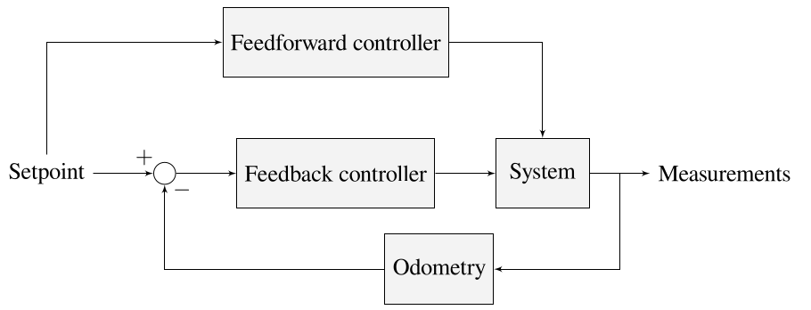
System overview
Notes:
4 levels of autonomous driving I typically see in FRC
Not moving, time-based, and spline-based trajectory tracking
Programming basics notwithstanding, we want to facilitate the spline-based option

Slide 4
Controls engineering in FRC
Modeling - equations representing how the robot behaves
Localization - where the robot is in 2D
Motion planning - planning how to get from here to there consistently
Control - actually getting there
WPILib has features to make these easier!
Notes:
4 levels of autonomous driving I typically see in FRC
Not moving, time-based, and spline-based trajectory tracking
Programming basics notwithstanding, we want to facilitate the spline-based option

Slide 5
Modeling
What?
  Equations that take in voltage and output sensor measurements over time
Why?
  More accurate drivetrain simulations
  Controller autotuning with minimal trial and error
Notes:
4 levels of autonomous driving I typically see in FRC
Not moving, time-based, and spline-based trajectory tracking
Programming basics notwithstanding, we want to facilitate the spline-based option

Slide 6
Modeling
System identification
  Use measured data from encoders and gyroscope to make a model that fits
frc-characterization
  Gathers data to make a feedforward model
  https://docs.wpilib.org/en/stable/docs/software/wpilib-tools/robot-characterization/
LinearSystemId functions
  Makes a more general dynamical model for control later
Notes:
4 levels of autonomous driving I typically see in FRC
Not moving, time-based, and spline-based trajectory tracking
Programming basics notwithstanding, we want to facilitate the spline-based option

Slide 7
Localization
Use external measurements to obtain robot's position and heading on the field
Why?
  Dead reckoning with encoders alone accumulates error
  If you can measure it, you can compensate for it with a controller
Notes:
4 levels of autonomous driving I typically see in FRC
Not moving, time-based, and spline-based trajectory tracking
Programming basics notwithstanding, we want to facilitate the spline-based option

Slide 8
Localization
DifferentialDriveOdometry class
  Inputs: wheel encoders, gyroscope heading
  Outputs: Robot position and heading
  https://docs.wpilib.org/en/stable/docs/software/kinematics-and-odometry/differential-drive-odometry.html
DifferentialDrivePoseEstimator class
  Drop-in replacement for odometry class that incorporates vision measurements
  Compensates for CV pipeline delays!
  https://docs.wpilib.org/en/latest/docs/software/advanced-controls/state-space/state-space-pose_state-estimators.html
Notes:
4 levels of autonomous driving I typically see in FRC
Not moving, time-based, and spline-based trajectory tracking
Programming basics notwithstanding, we want to facilitate the spline-based option

Slide 9
Motion planning
Why?
  Smooth, predictable motion over time
  Only change the setpoint as fast as the system is able to physically move
  Allows better open-loop control

Slide 10
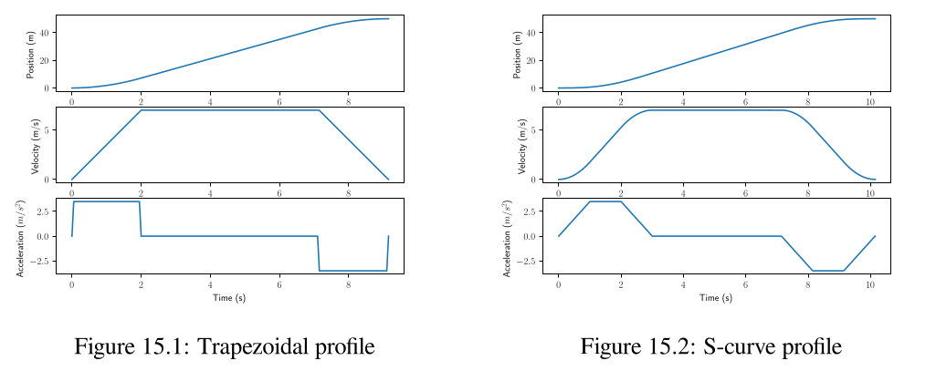
1 DOF motion profiles

Slide 11
1 DOF motion profiles
TrapezoidProfile class
  https://docs.wpilib.org/en/stable/docs/software/advanced-control/controllers/trapezoidal-profiles.html
ProfiledPIDController class
  https://docs.wpilib.org/en/stable/docs/software/advanced-control/controllers/profiled-pidcontroller.html

Slide 12
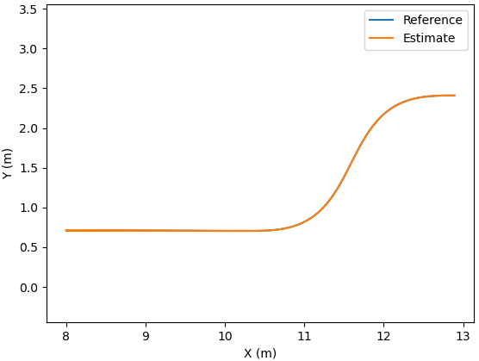
2 DOF motion profiles
Degrees of freedom for drivetrain are x and y axes
Trajectory includes:
  X-Y path
  Wheel velocities

Slide 13
2 DOF motion profiles
TrajectoryGenerator class
  https://docs.wpilib.org/en/latest/docs/software/examples-tutorials/trajectory-tutorial/index.html
  https://docs.wpilib.org/en/latest/docs/software/advanced-controls/trajectories/troubleshooting.html

Slide 14
Control
Why?
  Make robot respond how we want it to
  Automate robot maneuvers
  Make robot robust to disturbances and uncertainty
Notes:
4 levels of autonomous driving I typically see in FRC
Not moving, time-based, and spline-based trajectory tracking
Programming basics notwithstanding, we want to facilitate the spline-based option

Slide 15
Feedforward controllers
Plant inversion
  We know how the system behaves and how we want it to behave, so find a voltage that makes it behave that way
  SimpleMotorFeedforward, ElevatorFeedforward, etc.
  https://docs.wpilib.org/en/stable/docs/software/advanced-control/controllers/feedforward.html
Unmodeled dynamics
  Gravity compensation, gearbox friction

Slide 16
Feedback controllers
Ramsete
  Nonlinear control law for field position
  RamseteController class or RamseteCommand class
PID controller
  Commanded by Ramsete to go to wheel velocities
  PIDController class or PIDSubsystem/PIDCommand
Linear-quadratic regulator
  P controller, but with gains chosen by math
  LinearQuadraticRegulator class
  Can use the model we got from frc-characterization!

Slide 17
More resources
WPILib projects
  https://github.com/wpilibsuite/allwpilib
WPILib documentation
  https://docs.wpilib.org/en/stable/
My book on controls engineering in FRC
  https://controls-in-frc.link/

