Slide 1
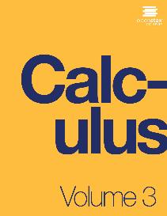

CALCULUS volUME 3
Chapter 1 PARAMETRIC EQUATIONS AND POLAR COORDINATES
PowerPoint Image Slideshow

Slide 2

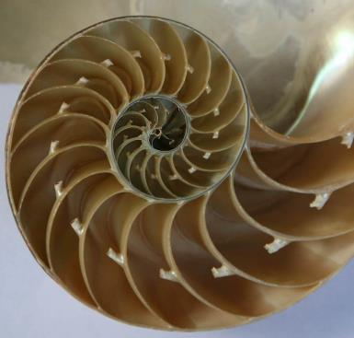
Figure 1.1
The chambered nautilus is a marine animal that lives in the tropical Pacific Ocean. Scientists think they have existed mostly unchanged for about 500 million years.(credit: modification of work by Jitze Couperus, Flickr)

Slide 3
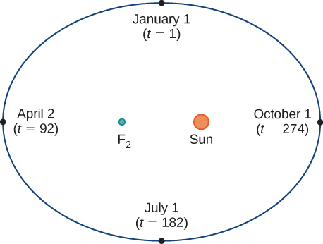
Figure 1.2
Earth’s orbit around the Sun in one year.

Slide 4
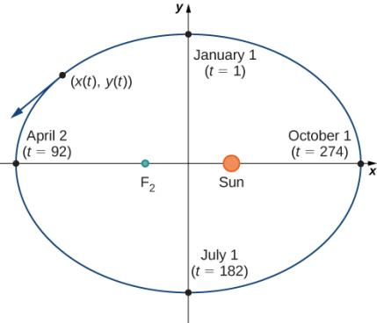
Figure 1.3
Coordinate axes superimposed on the orbit of Earth.

Slide 5
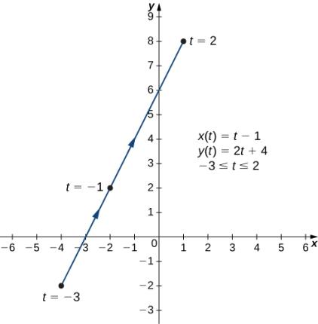
Figure 1.4
Graph of the plane curve described by the parametric equations in part a.

Slide 6
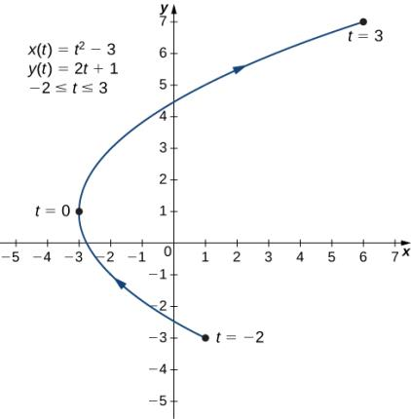
Figure 1.5
Graph of the plane curve described by the parametric equations in part b.

Slide 7
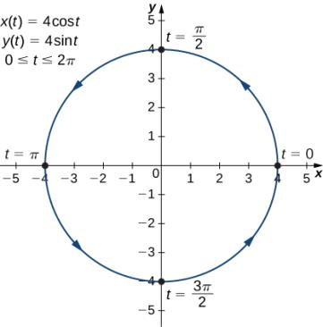
Figure 1.6
Graph of the plane curve described by the parametric equations in part c.

Slide 8
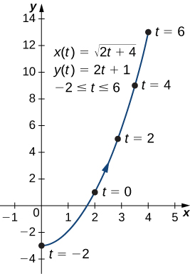
Figure 1.7
Graph of the plane curve described by the parametric equations in part a.

Slide 9
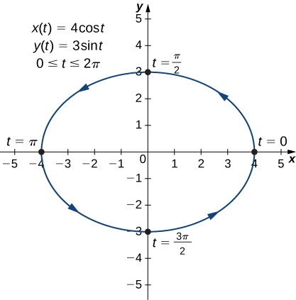
Figure 1.8
Graph of the plane curve described by the parametric equations in part b.

Slide 10
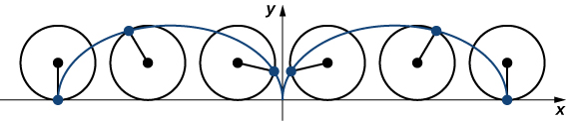
Figure 1.9
A wheel traveling along a road without slipping; the point on the edge of the wheel traces out a cycloid.

Slide 11
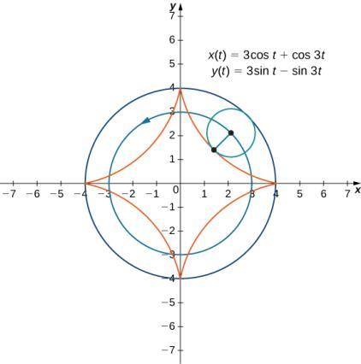
Figure 1.10
Graph of the hypocycloid described by the parametric equations shown.

Slide 12
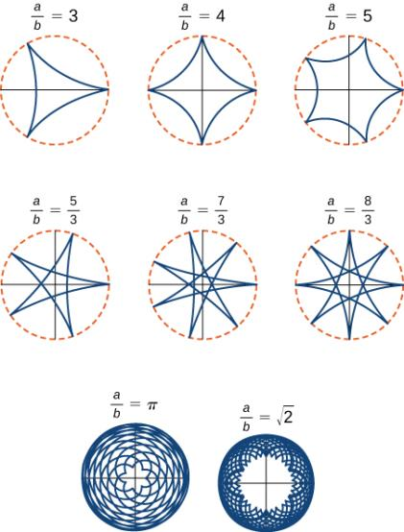
Figure 1.11
Graph of various hypocycloids corresponding to different values of a/b.

Slide 13
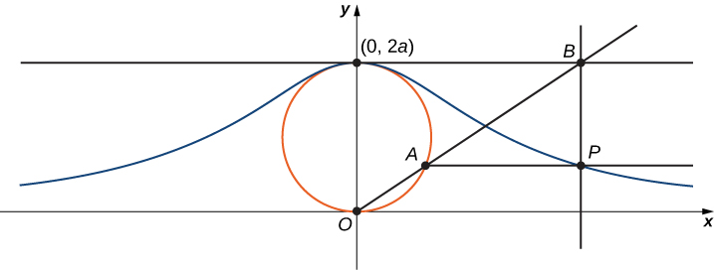
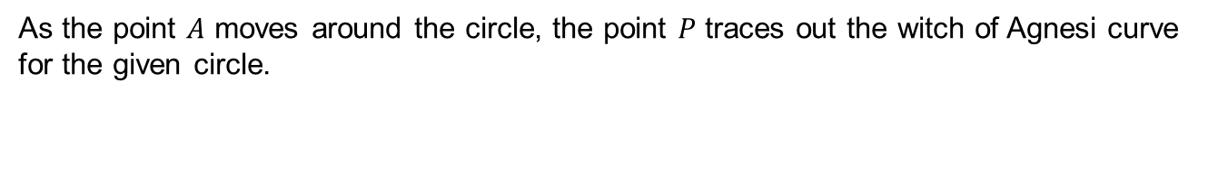
Figure 1.12
As the point $A$ moves around the circle, the point $P$ traces out the witch of Agnesi curve for the given circle.

Slide 14
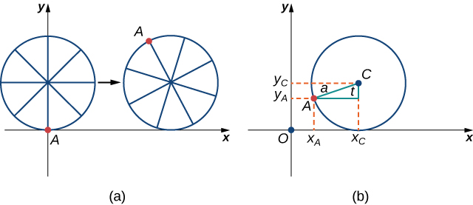
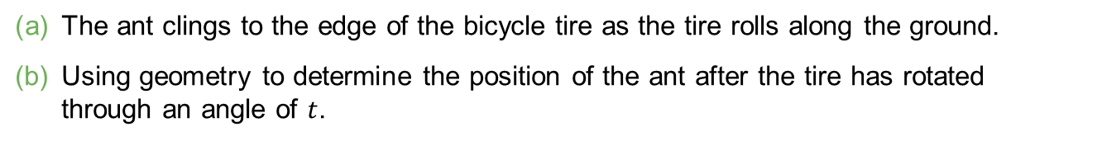
Figure 1.13
The ant clings to the edge of the bicycle tire as the tire rolls along the ground.
Using geometry to determine the position of the ant after the tire has rotated through an angle of $t$.

Slide 15
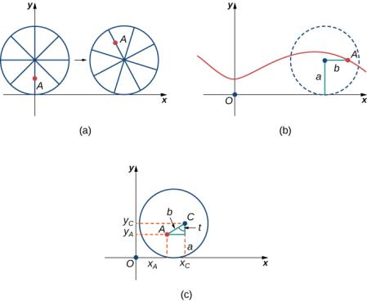
Figure 1.14
The ant climbs up one of the spokes toward the center of the wheel.
The ant’s path of motion after he climbs closer to the center of the wheel. This is called a curtate cycloid.
The new setup, now that the ant has moved closer to the center of the wheel.

Slide 16
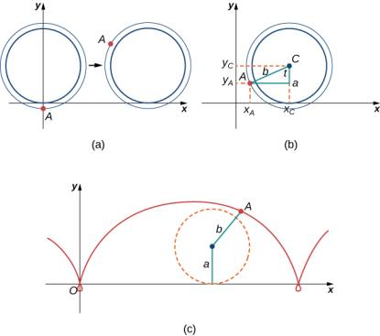
Figure 1.15
The ant is hanging onto the flange of the train wheel.
The new setup, now that the ant has jumped onto the train wheel.
The ant travels along a prolate cycloid.

Slide 17
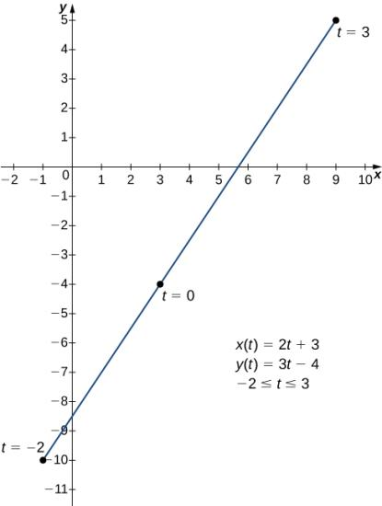
Figure 1.16
Graph of the line segment described by the given parametric equations.

Slide 18
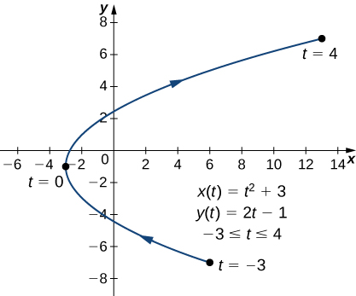
Figure 1.17
Graph of the parabola described by parametric equations in part a.

Slide 19
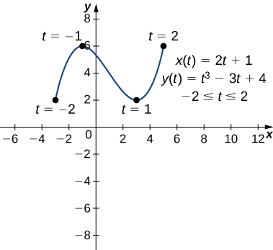
Figure 1.18
Graph of the curve described by parametric equations in part b.

Slide 20
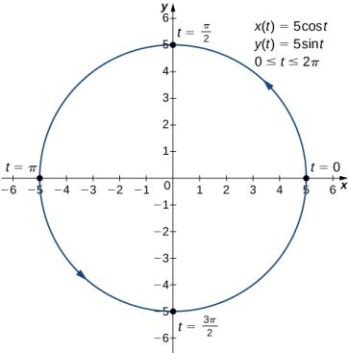
Figure 1.19
Graph of the curve described by parametric equations in part c.

Slide 21
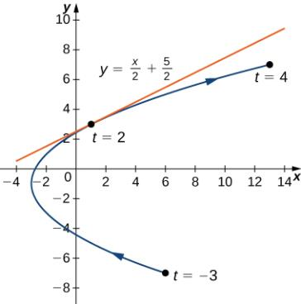
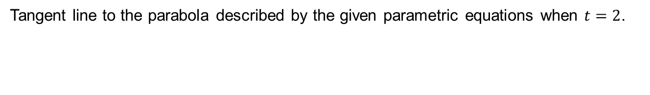
Figure 1.20
Tangent line to the parabola described by the given parametric equations when $t=2$.

Slide 22
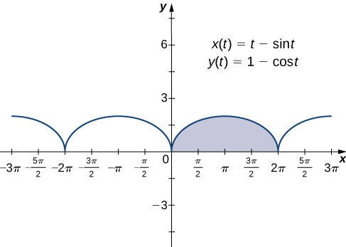

Figure 1.21
Graph of a cycloid with the arch over $[0, 2π]$ highlighted.

Slide 23
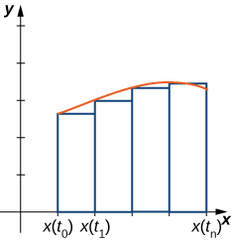
Figure 1.22
Approximating the area under a parametrically defined curve.

Slide 24
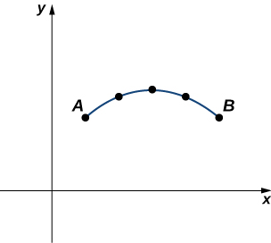
Figure 1.23
Approximation of a curve by line segments.

Slide 25
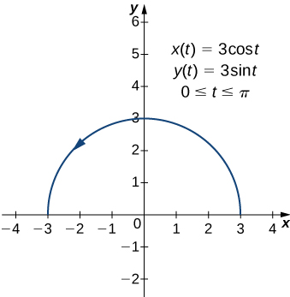
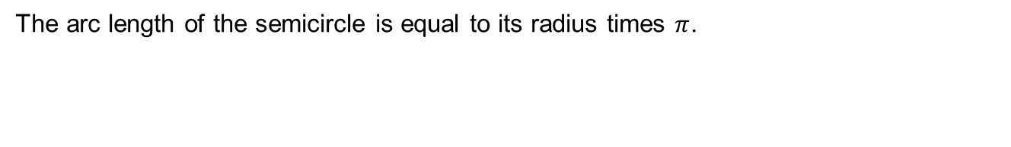
Figure 1.24
The arc length of the semicircle is equal to its radius times $π$.

Slide 26
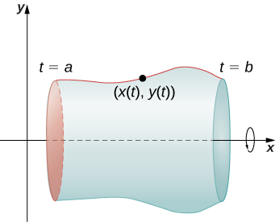
Figure 1.25
A surface of revolution generated by a parametrically defined curve.

Slide 27
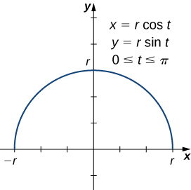
Figure 1.26
A semicircle generated by parametric equations.

Slide 28
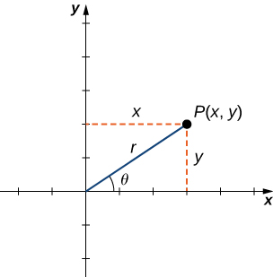
Figure 1.27
An arbitrary point in the Cartesian plane.

Slide 29

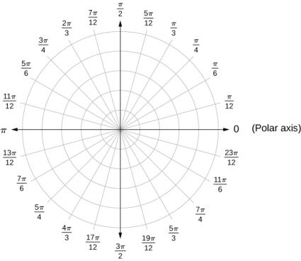
Figure 1.28
The polar coordinate system.

Slide 30
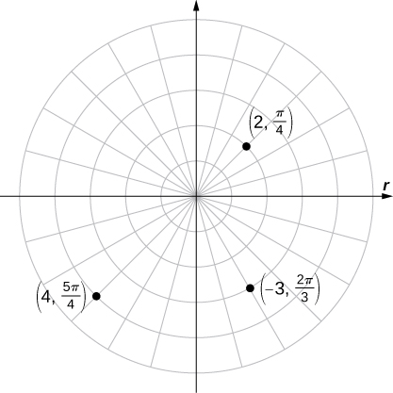
Figure 1.29
Three points plotted in the polar coordinate system.

Slide 31
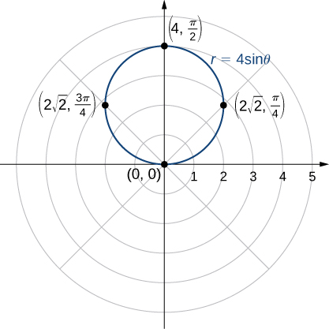

Figure 1.30
The graph of the function $r=4$ sin $θ$ is a circle.

Slide 32
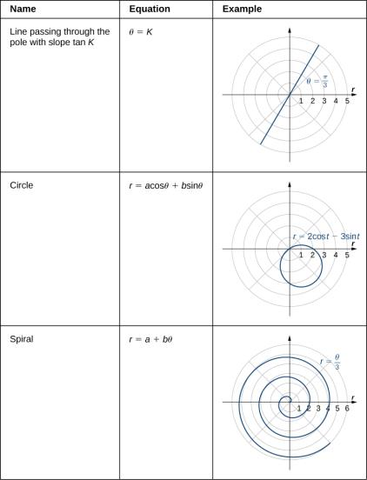
Figure 1.31

Slide 33
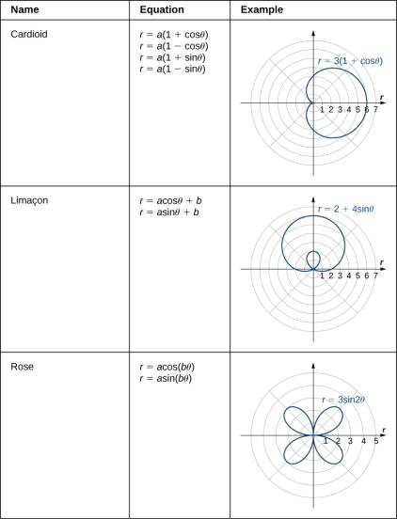
Figure 1.32

Slide 34
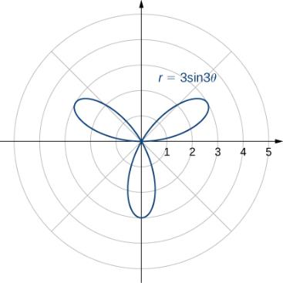
Figure 1.33
Graph of r = 3 sin 3θ.

Slide 35
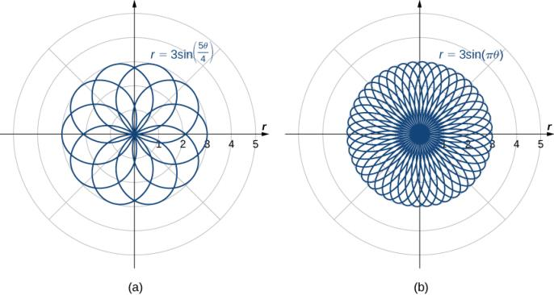
Figure 1.34
Polar rose graphs of functions with (a) rational coefficient and (b) irrational coefficient. Note that the rose in part (b) would actually fill the entire circle if plotted in full.

Slide 36
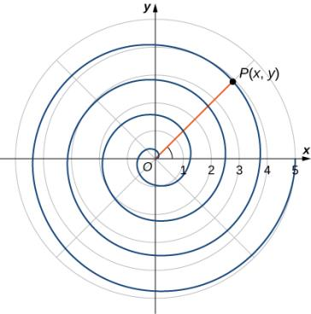
Figure 1.35
How can we describe a spiral graph mathematically?

Slide 37
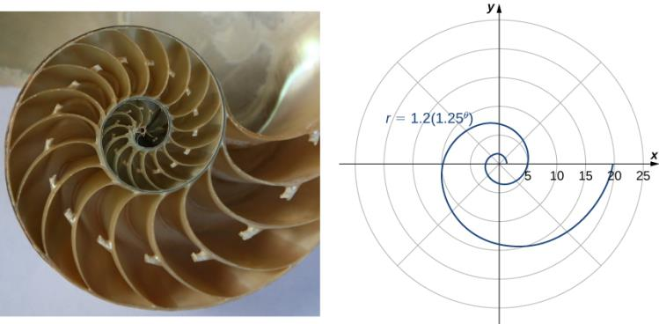
Figure 1.36
A logarithmic spiral is similar to the shape of the chambered nautilus shell. (credit: modification of work by Jitze Couperus, Flickr)

Slide 38
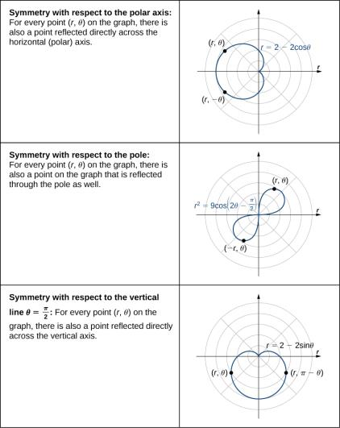

Slide 39
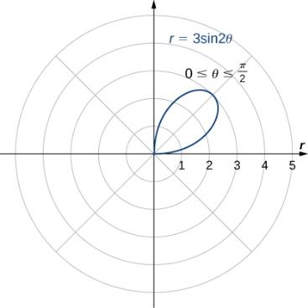
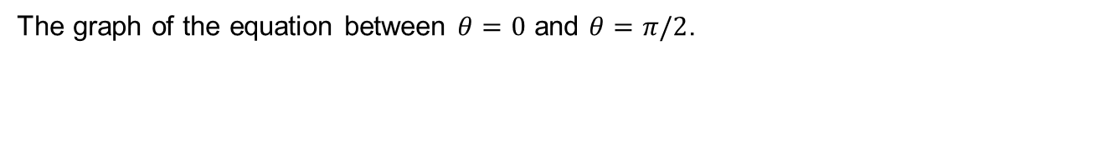
Figure 1.37
The graph of the equation between $θ=0$ and $θ=π/2$.

Slide 40
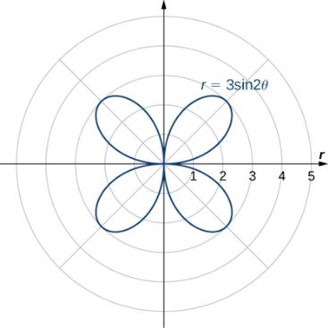
Figure 1.38
The entire graph of the equation is called a four-petaled rose.

Slide 41
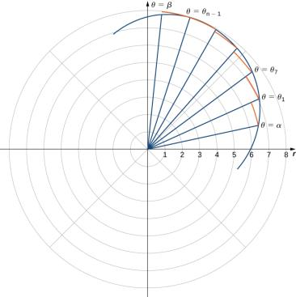
Figure 1.39
A partition of a typical curve in polar coordinates.

Slide 42
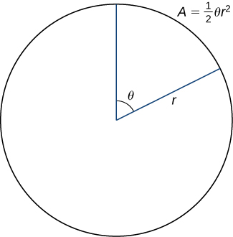
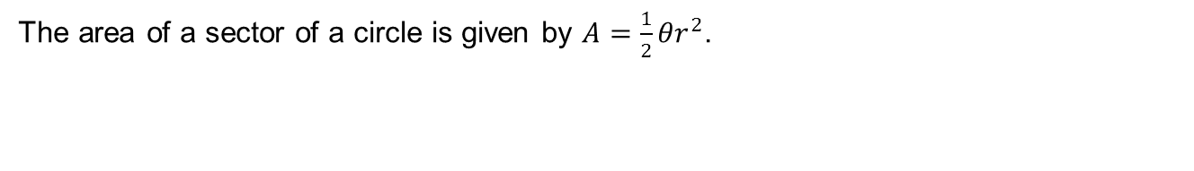
Figure 1.40
The area of a sector of a circle is given by $A=\frac{1}{2}{θr}^{2}$.

Slide 43
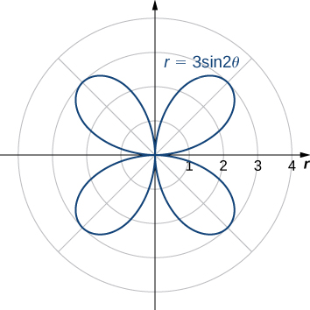

Figure 1.41
The graph of $r=3 sin⁡(2θ)$.

Slide 44


Figure 1.42
The region between the curves $r=2+2 sin⁡θ$ and $r=6 sin⁡θ$.

Slide 45


Figure 1.43
A cone generated by revolving the line $y=3x$ around the $y$-axis.

Slide 46

Figure 1.44
The four conic sections. Each conic is determined by the angle the plane makes with the axis of the cone.

Slide 47


Figure 1.45
A typical parabola in which the distance from the focus to the vertex is represented by the variable $p$.

Slide 48

Figure 1.46
Four parabolas, opening in various directions, along with their equations in standard form.

Slide 49

Figure 1.47
The parabola in Example 1.19.

Slide 50


Slide 51

Figure 1.48
A typical ellipse in which the sum of the distances from any point on the ellipse to the foci is constant.

Slide 52

Figure 1.49
The ellipse in Example 1.20.

Slide 53

Figure 1.50
Earth’s orbit around the Sun is an ellipse with the Sun at one focus.
Statuary Hall in the U.S. Capitol is a whispering gallery with an elliptical cross section.

Slide 54

Figure 1.51
A typical hyperbola in which the difference of the distances from any point on the ellipse to the foci is constant. The transverse axis is also called the major axis, and the conjugate axis is also called the minor axis.

Slide 55

Figure 1.52
Graph of the hyperbola in Example 1.21.

Slide 56

Figure 1.53
A hyperbolic mirror used to collect light from distant stars.

Slide 57

Figure 1.54
The three conic sections with their foci and directrices.

Slide 58

Figure 1.55
Graph of the hyperbola described in Example 1.23.

Slide 59


Figure 1.56
Graph of the equation $xy=1$; The red lines indicate the rotated axes.

Slide 60


Figure 1.57
Graph of the ellipse described by the equation ${13x}^{2}−6\sqrt{3}xy+7y^{2}−256=0$. The axes are rotated 60°. The red dashed lines indicate the rotated axes.

Slide 61
This OpenStax ancillary resource is © Rice University under a CC BY-NC-SA 4.0 International license; it may be reproduced or modified for noncommercial purposes only but must be attributed to OpenStax, Rice University and any changes must be noted. Any adaptation must be shared under the same type of license.

