Slide 1


CALCULUS volUME 3
Chapter 3 VECTOR-VALUED FUNCTIONS
PowerPoint Image Slideshow

Slide 2

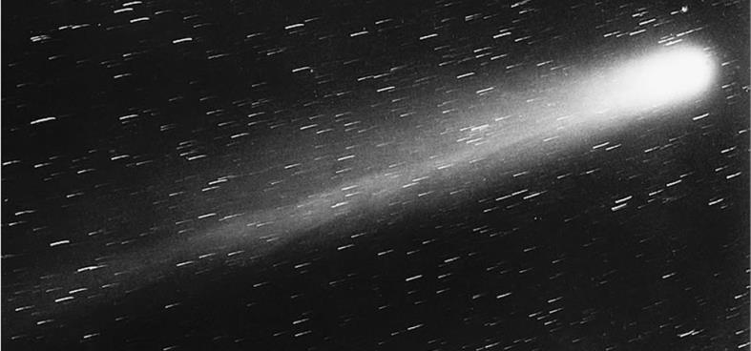
Figure 3.1
Halley’s Comet appeared in view of Earth in 1986 and will appear again in 2061.

Slide 3
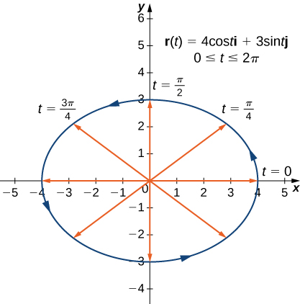
Figure 3.2
The graph of the first vector-valued function is an ellipse.

Slide 4
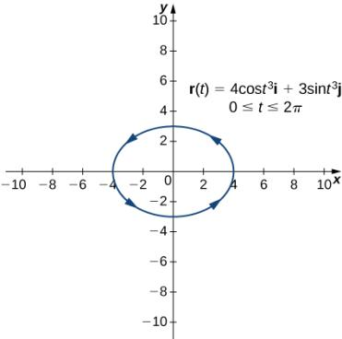
Figure 3.3
The graph of the second vector-valued function is also an ellipse.

Slide 5
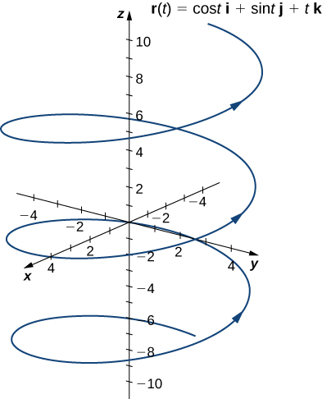
Figure 3.4
The graph of the third vector-valued function is a helix.

Slide 6
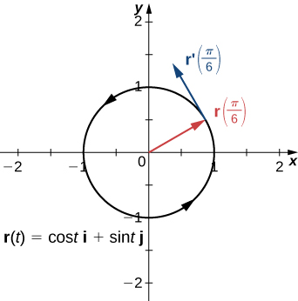
Figure 3.5
The tangent line at a point is calculated from the derivative of the vector-valued function r(t).

Slide 7
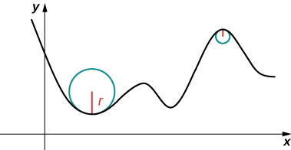
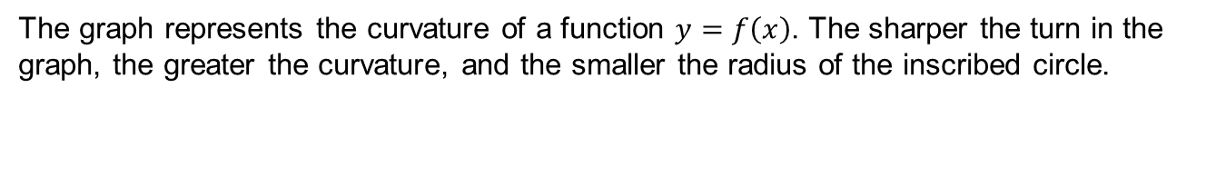
Figure 3.6
The graph represents the curvature of a function $y=f\left(x\right)$. The sharper the turn in the graph, the greater the curvature, and the smaller the radius of the inscribed circle.

Slide 8
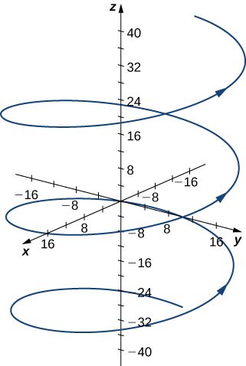

Slide 9
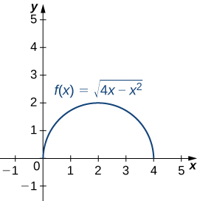

Slide 10
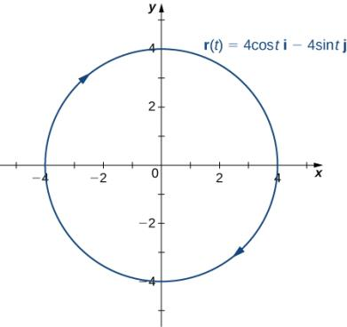

Slide 11
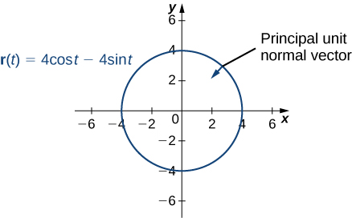

Slide 12
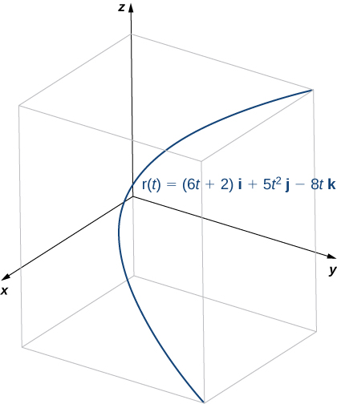

Slide 13
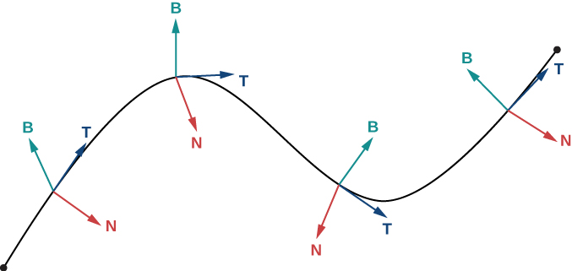
Figure 3.7
This figure depicts a Frenet frame of reference. At every point P on a three-dimensional curve, the unit tangent, unit normal, and binormal vectors form a three-dimensional frame of reference.

Slide 14
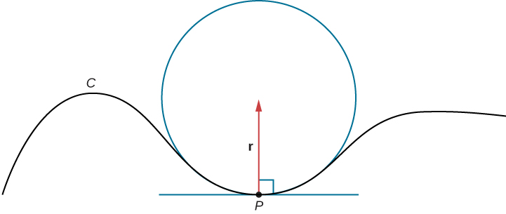
Figure 3.8
In this osculating circle, the circle is tangent to curve C at point P and shares the same curvature.

Slide 15
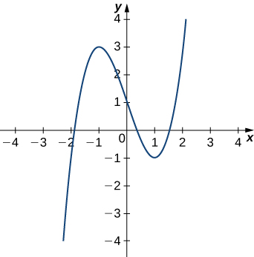

Figure 3.9
We want to find the osculating circle of this graph at the point where $t=1$.

Slide 16
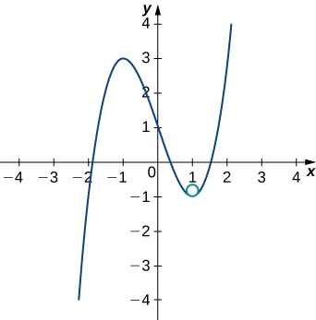
Figure 3.10
The osculating circle has radius R = 1/6.

Slide 17
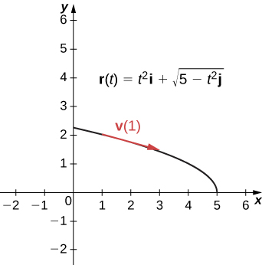
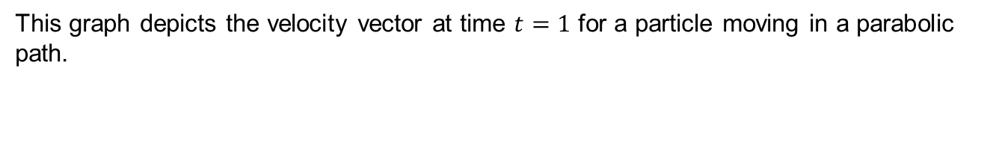
Figure 3.11
This graph depicts the velocity vector at time $t=1$ for a particle moving in a parabolic path.

Slide 18
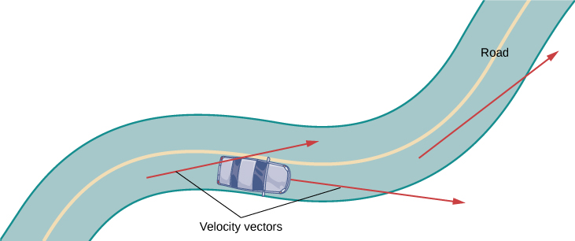
Figure 3.12
At each point along a road traveled by a car, the velocity vector of the car is tangent to the path traveled by the car.

Slide 19
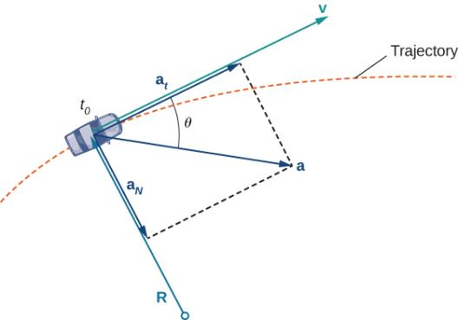
Figure 3.13
The dashed line represents the trajectory of an object (a car, for example). The acceleration vector points toward the inside of the turn at all times.

Slide 20
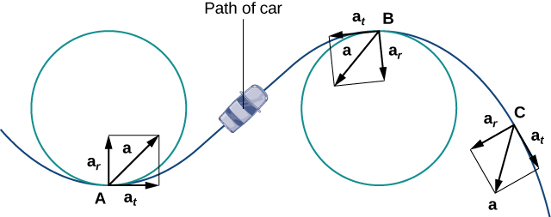
Figure 3.14
The tangential and normal components of acceleration can be used to describe the acceleration vector.

Slide 21
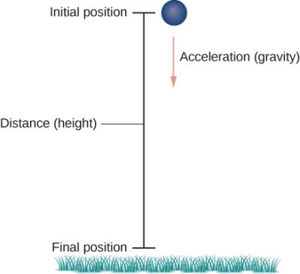
Figure 3.15
An object is falling under the influence of gravity.

Slide 22
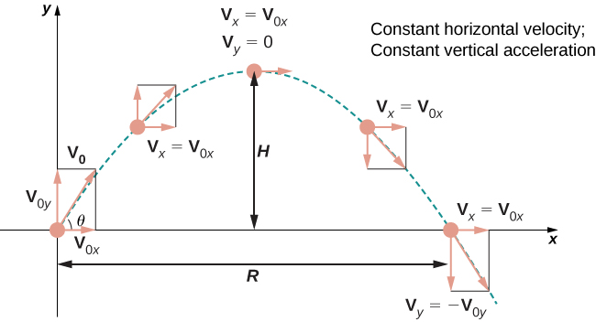
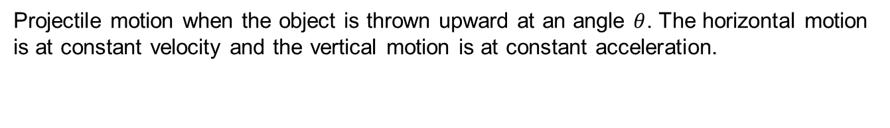
Figure 3.16
Projectile motion when the object is thrown upward at an angle $θ$. The horizontal motion is at constant velocity and the vertical motion is at constant acceleration.

Slide 23
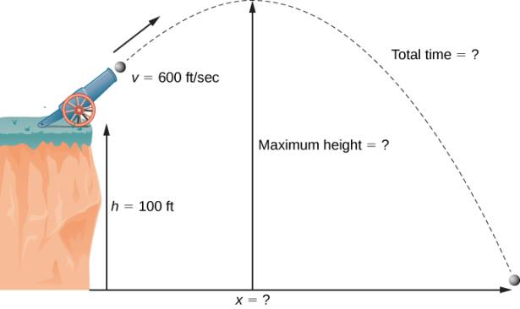
Figure 3.17
The flight of a cannonball (ignoring air resistance) is projectile motion.

Slide 24
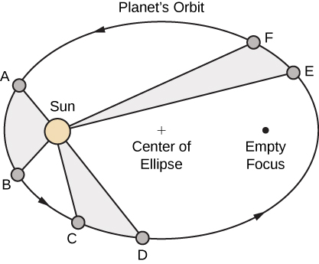
Figure 3.18
Kepler’s first and second laws are pictured here. The Sun is located at a focus of the elliptical orbit of any planet. Furthermore, the shaded areas are all equal, assuming that the amount of time measured as the planet moves is the same for each region.

Slide 25
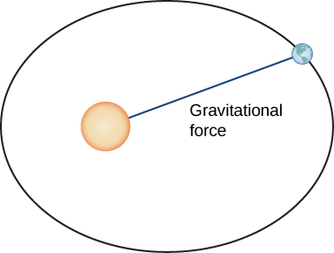
Figure 3.19
The gravitational force between Earth and the Sun is equal to the mass of the earth times its acceleration.

Slide 26
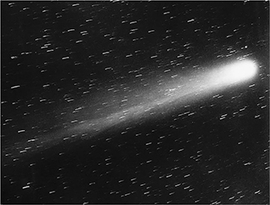

Slide 27
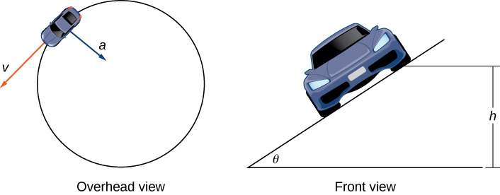
Figure 3.20
Views of a race car moving around a track.

Slide 28
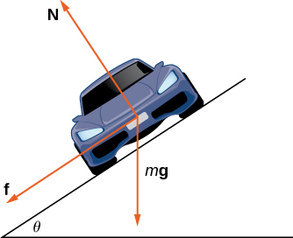
Figure 3.21
The car has three forces acting on it: gravity (denoted by mg), the friction force f, and the force exerted by the road N.

Slide 29
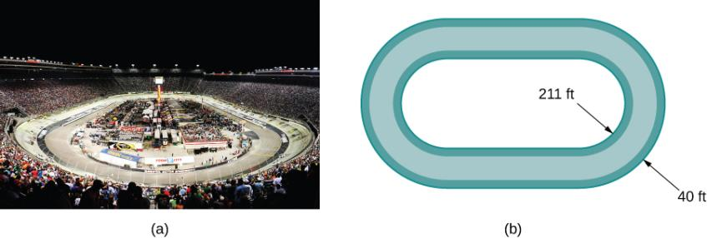
Figure 3.22
At the Bristol Motor Speedway, Bristol, Tennessee (a), the turns have an inner radius of about 211 ft and a width of 40 ft (b). (credit: part (a) photo by Raniel Diaz, Flickr)

Slide 30
This OpenStax ancillary resource is © Rice University under a CC BY-NC-SA 4.0 International license; it may be reproduced or modified for noncommercial purposes only but must be attributed to OpenStax, Rice University and any changes must be noted. Any adaptation must be shared under the same type of license.

