Slide 1


CALCULUS volUME 3
Chapter 4 DIFFERENTIATION OF FUNCTIONS OF SEVERAL VARIABLES
PowerPoint Image Slideshow

Slide 2

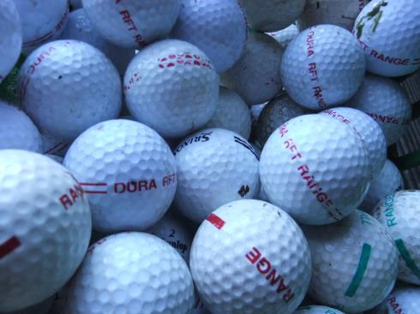
Figure 4.1
Americans use (and lose) millions of golf balls a year, which keeps golf ball manufacturers in business. In this chapter, we study a profit model and learn methods for calculating optimal production levels for a typical golf ball manufacturing company. (credit: modification of work by oatsy40, Flickr)

Slide 3
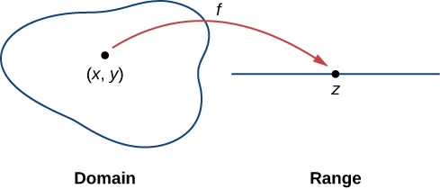

Figure 4.2
The domain of a function of two variables consists of ordered pairs $(x, y)$.

Slide 4
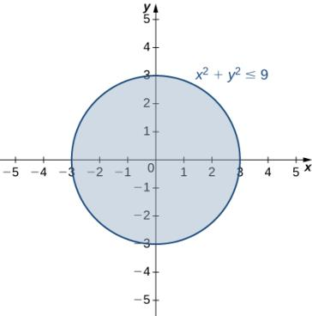
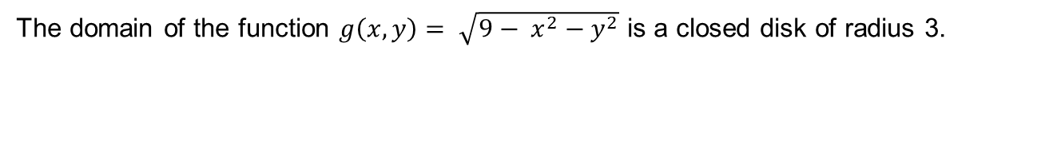
Figure 4.3
The domain of the function $g\left(x, y\right)= \sqrt{9− x^{2}−y^{2}}$ is a closed disk of radius 3.

Slide 5
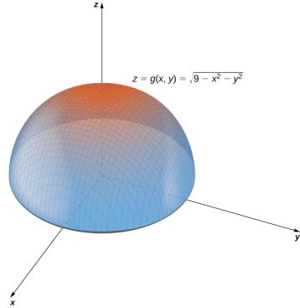
Figure 4.4
Graph of the hemisphere represented by the given function of two variables.

Slide 6
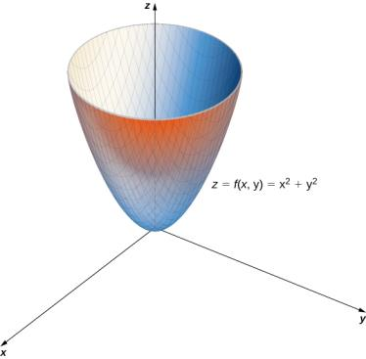
Figure 4.5
A paraboloid is the graph of the given function of two variables.

Slide 7
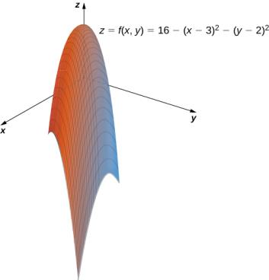
Figure 4.6
The graph of the given function of two variables is also a paraboloid.

Slide 8
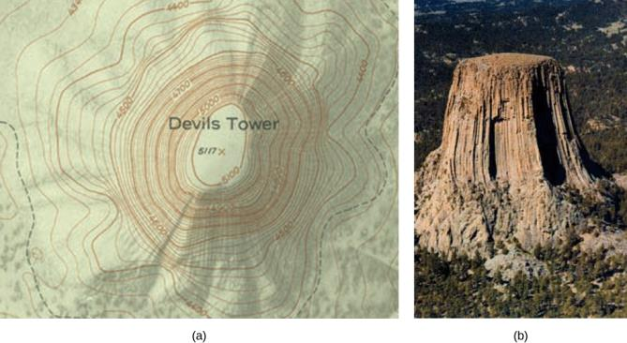
Figure 4.7
A topographical map of Devil’s Tower, Wyoming. Lines that are close together indicate very steep terrain.
A perspective photo of Devil’s Tower shows just how steep its sides are. Notice the top of the tower has the same shape as the center of the topographical map.

Slide 9
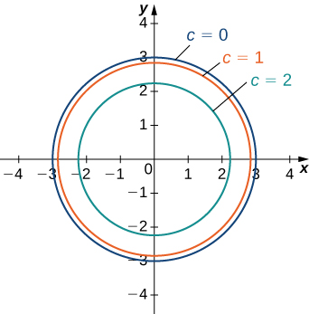
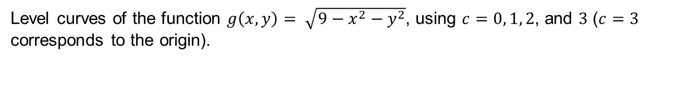
Figure 4.8
Level curves of the function $g\left(x, y\right)= \sqrt{9−x^{2}−y^{2}}$, using $c=0, 1, 2$, and $3$ ($c=3$ corresponds to the origin).

Slide 10
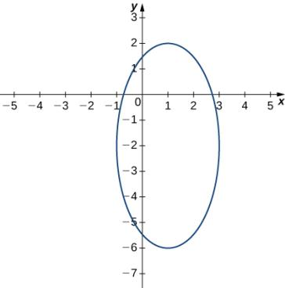
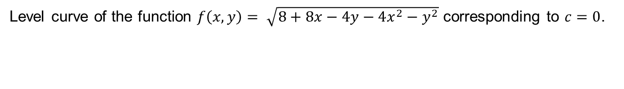
Figure 4.9
Level curve of the function $f\left(x, y\right)= \sqrt{8+8x−4y−4x^{2}−y^{2}}$ corresponding to $c=0$.

Slide 11
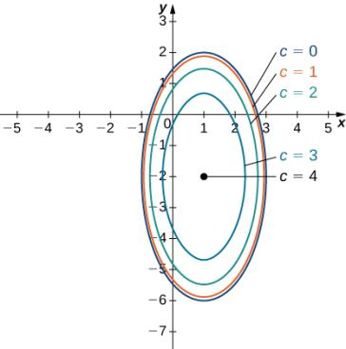
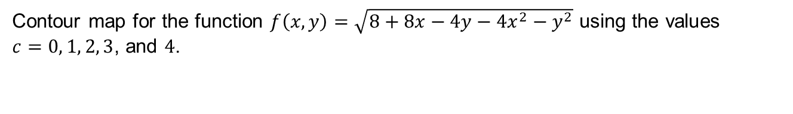
Figure 4.10
Contour map for the function $f\left(x, y\right)=\sqrt{8+8x−4y−4x^{2}−y^{2}}$ using the values $c=0, 1, 2, 3$, and $4$.

Slide 12
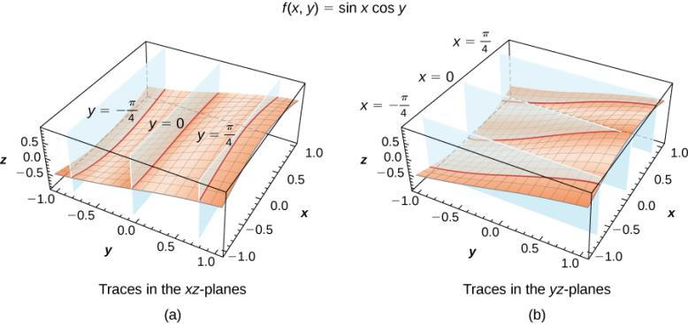
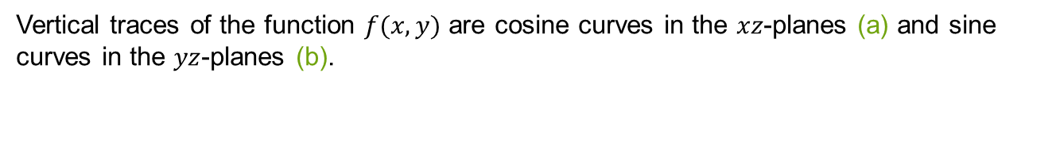
Figure 4.11
Vertical traces of the function $f(x, y)$ are cosine curves in the $xz$-planes (a) and sine curves in the $yz$-planes (b).

Slide 13
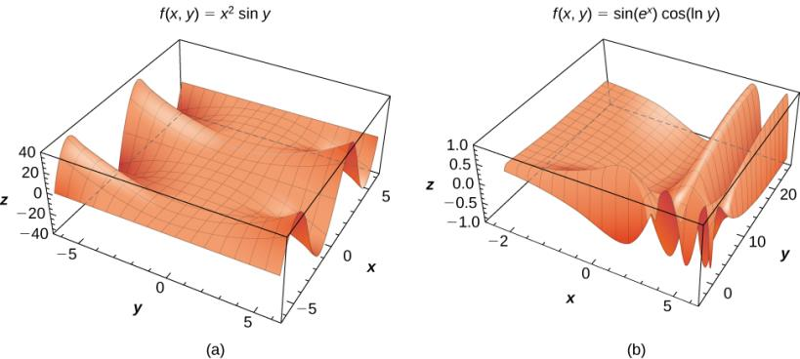
Figure 4.12
Examples of surfaces representing functions of two variables: (a) a combination of a power function and a sine function and (b) a combination of trigonometric, exponential, and logarithmic functions.

Slide 14
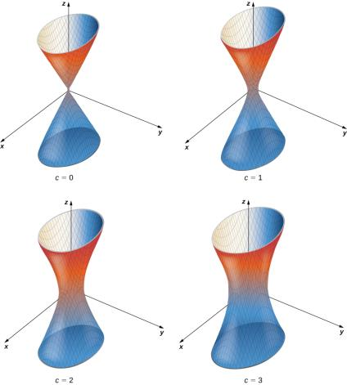
Figure 4.13
A hyperboloid of one sheet with some of its level surfaces.

Slide 15
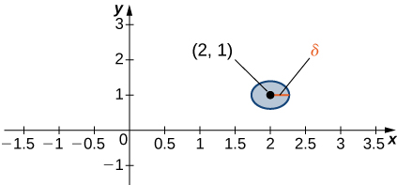

Figure 4.14
A $δ$ disk centered around the point (2, 1).

Slide 16
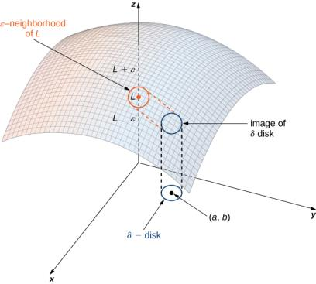
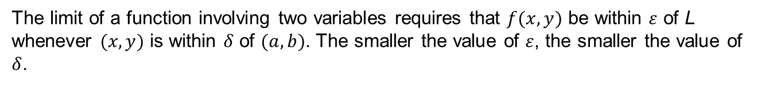
Figure 4.15
The limit of a function involving two variables requires that $f(x, y)$ be within $ε$ of L whenever $(x, y)$ is within $δ$ of $(a, b)$. The smaller the value of $ε$, the smaller the value of $δ$.

Slide 17
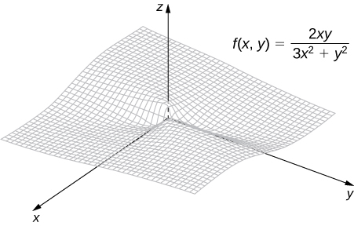
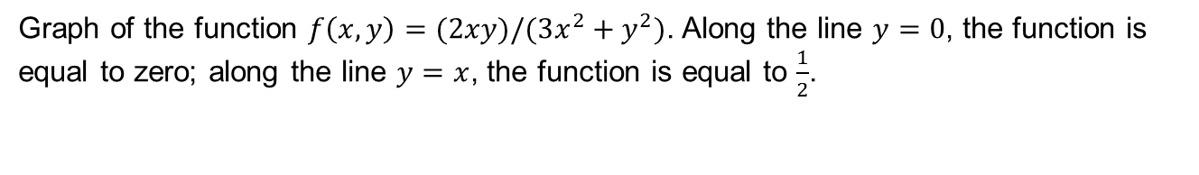
Figure 4.16
Graph of the function $f\left(x, y\right)=(2xy)/(3x^{2}+y^{2})$. Along the line $y=0$, the function is equal to zero; along the line $y=x$, the function is equal to $\frac{1}{2}$.

Slide 18
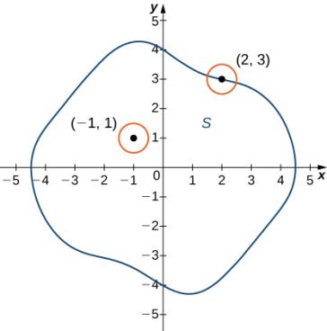
Figure 4.17
In the set S shown, (−1, 1) is an interior point and (2, 3) is a boundary point.

Slide 19
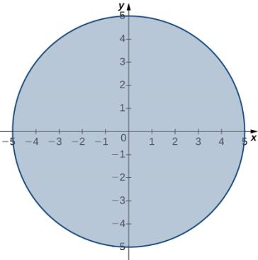

Figure 4.18
Domain of the function $f\left(x, y\right)=\sqrt{25−x^{2}−y^{2}}$.

Slide 20
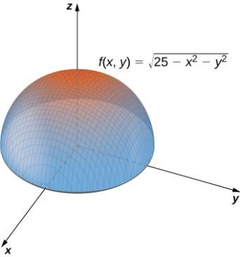

Figure 4.19
Graph of the function $f\left(x, y\right)=\sqrt{25−x^{2}−y^{2}}$.

Slide 21
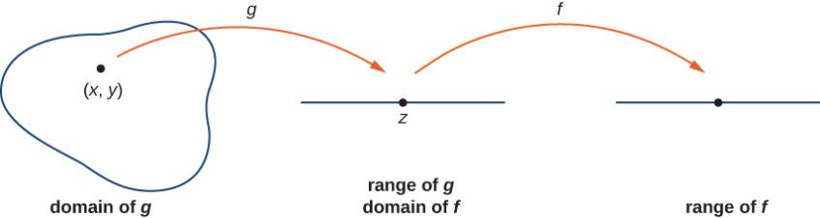
Figure 4.20
The composition of two continuous functions is continuous.

Slide 22
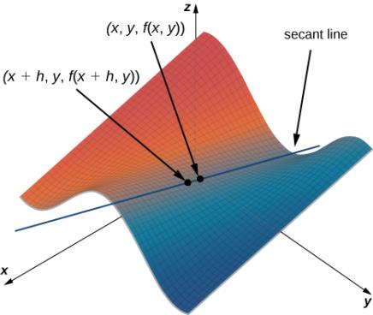
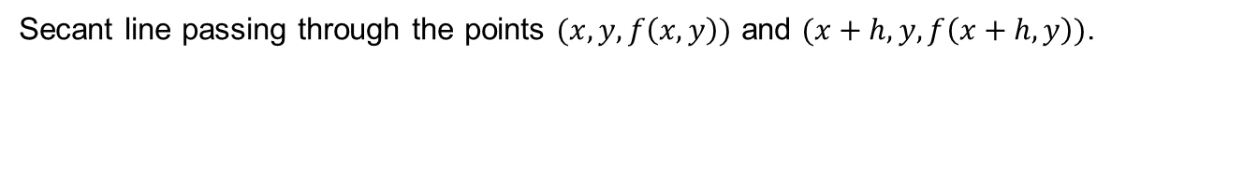
Figure 4.21
Secant line passing through the points $(x, y, f\left(x, y\right))$ and $(x+h, y, f\left(x+h, y\right))$.

Slide 23
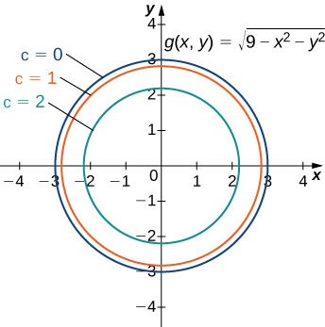
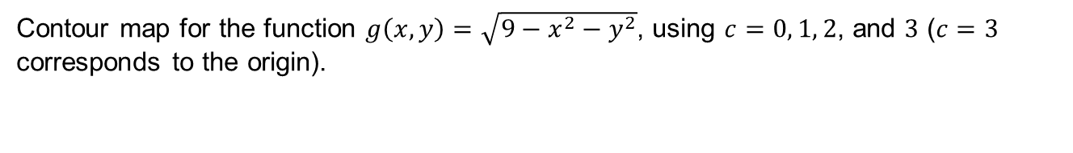
Figure 4.22
Contour map for the function $g\left(x, y\right)=\sqrt{{9−x}^{2}−y^{2}}$, using $c=0, 1, 2$, and $3$ ($c=3$ corresponds to the origin).

Slide 24
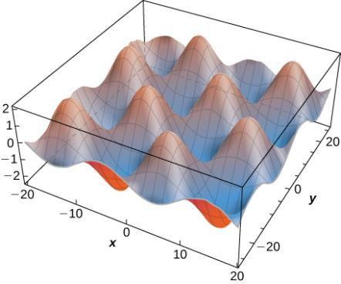
Figure 4.23

Slide 25
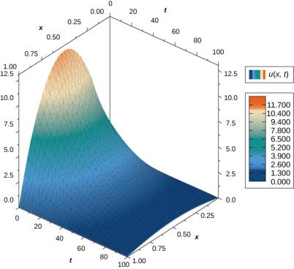
Figure 4.24
Graph of a solution of the heat equation in one dimension over time.

Slide 26
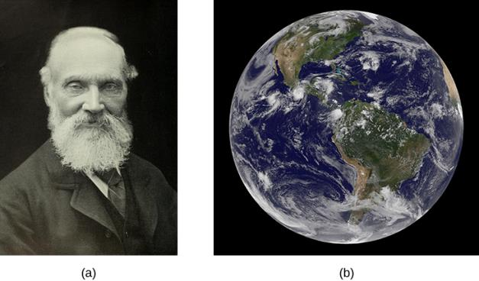
Figure 4.25
William Thomson (Lord Kelvin), 1824-1907, was a British physicist and electrical engineer;
Kelvin used the heat diffusion equation to estimate the age of Earth (credit: modification of work by NASA).

Slide 27
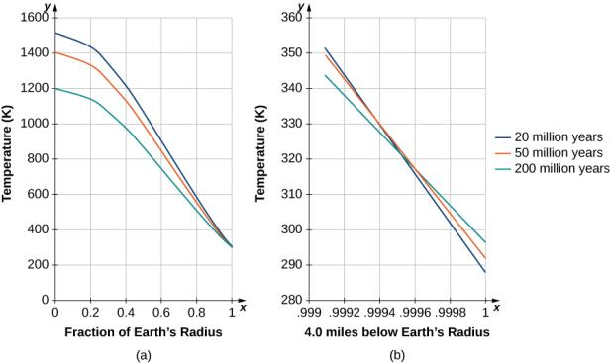
Figure 4.26
Temperature versus radial distance from the center of Earth. (a) Kelvin’s results, plotted to scale. (b) A close-up of the results at a depth of 4.0 mi below Earth’s surface.

Slide 28
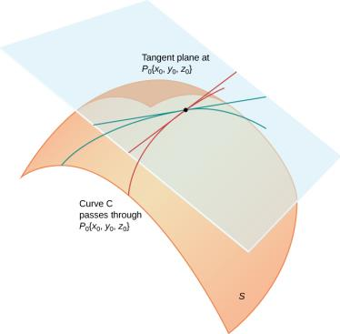
Figure 4.27
The tangent plane to a surface S at a point P₀ contains all the tangent lines to curves in S that pass through P₀.

Slide 29
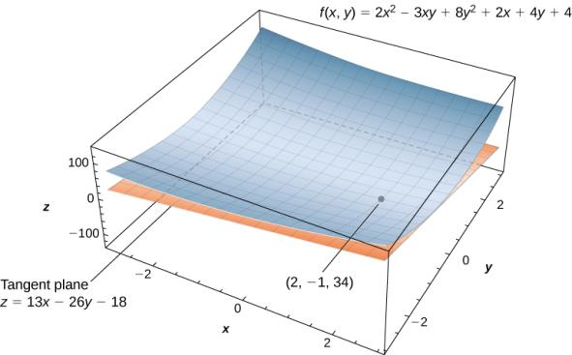
Figure 4.28
Calculating the equation of a tangent plane to a given surface at a given point.

Slide 30
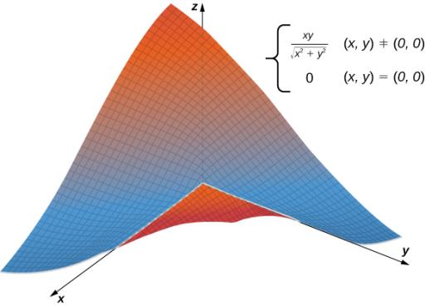
Figure 4.29
Graph of a function that does not have a tangent plane at the origin.

Slide 31
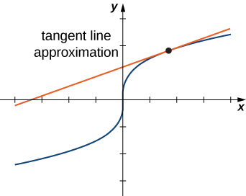
Figure 4.30
Linear approximation of a function in one variable.

Slide 32
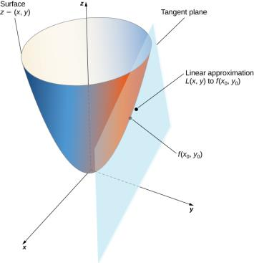
Figure 4.31
Using a tangent plane for linear approximation at a point.

Slide 33
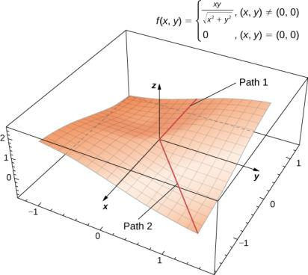

Figure 4.32
This function $f(x, y)$ is not differentiable at the origin.

Slide 34
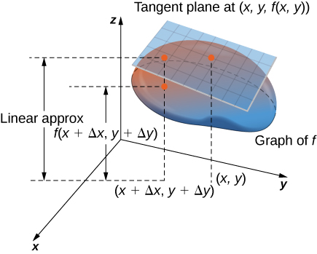
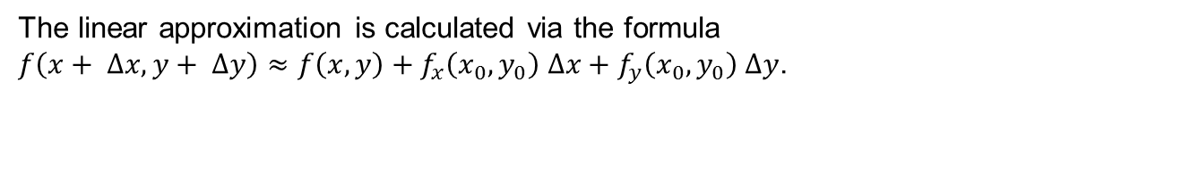
Figure 4.33
The linear approximation is calculated via the formula $f\left(x+ ∆x, y+ ∆y\right)≈f\left(x, y\right)+f_{x}\left(x_{0}, y_{0}\right) ∆x+f_{y}\left(x_{0}, y_{0}\right) ∆y$.

Slide 35
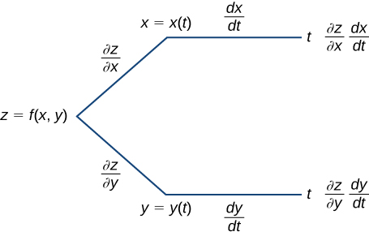
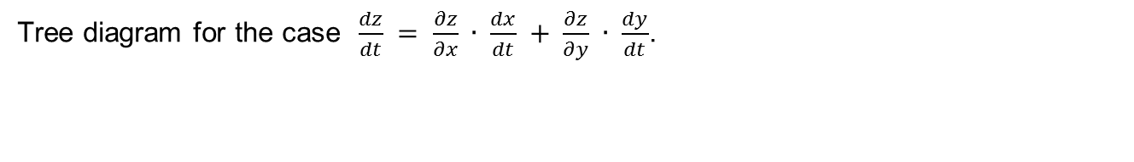
Figure 4.34
Tree diagram for the case $\frac{dz}{dt} = \frac{∂z}{∂x} ∙ \frac{dx}{dt} + \frac{∂z}{∂y} ∙ \frac{dy}{dt}$.

Slide 36
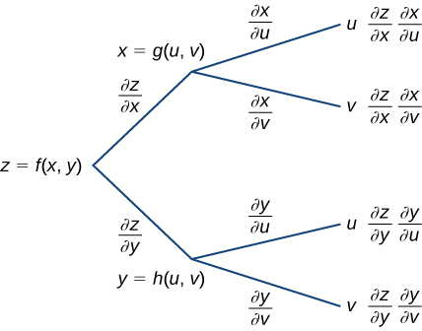
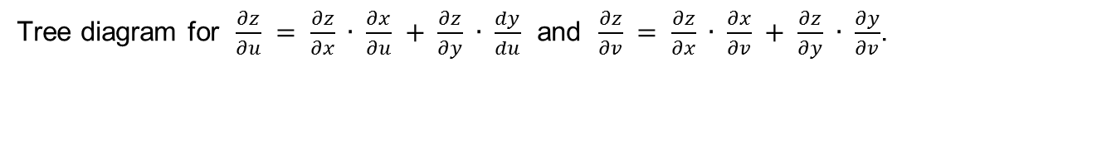
Figure 4.35
Tree diagram for $\frac{∂z}{∂u} = \frac{∂z}{∂x} ∙ \frac{∂x}{∂u} + \frac{∂z}{∂y} ∙ \frac{dy}{du}$ and $\frac{∂z}{∂v} = \frac{∂z}{∂x} ∙ \frac{∂x}{∂v} + \frac{∂z}{∂y} ∙ \frac{∂y}{∂v}$.

Slide 37
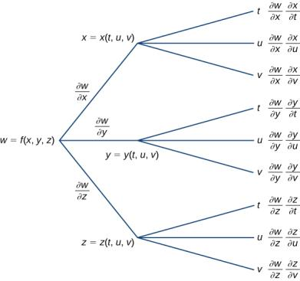
Figure 4.36
Tree diagram for a function of three variables, each of which is a function of three independent variables.

Slide 38
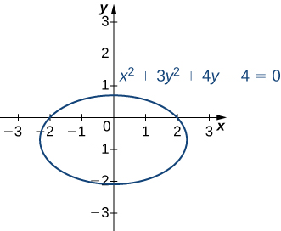

Figure 4.37
Graph of the ellipse defined by $x^{2}+3y^{2}+4y −4=0$.

Slide 39
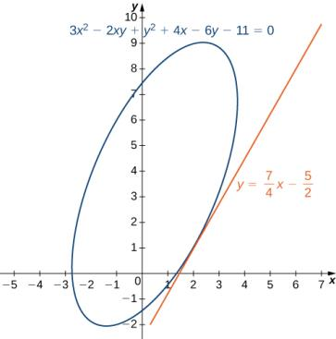

Figure 4.38
Graph of the rotated ellipse defined by $3x^{2} −2xy+ y^{2}+4x −6y −11=0$.

Slide 40


Figure 4.39
Finding the directional derivative at a point on the graph of $z=f(x, y)$. The slope of the black arrow on the graph indicates the value of the directional derivative at that point.

Slide 41

Figure 4.40
Finding the directional derivative in a given direction u at a given point on a surface. The plane is tangent to the surface at the given point (−1, 2, 15).

Slide 42

Figure 4.41
The gradient indicates the maximum and minimum values of the directional derivative at a point.

Slide 43

Figure 4.42
The maximum value of the directional derivative at (−2, 3) is in the direction of the gradient.

Slide 44

Figure 4.43
A typical surface in ℝ ³. Given a point on the surface, the directional derivative can be calculated using the gradient.

Slide 45


Figure 4.44
Contour map for the function ${f\left(x, y\right)=x^{2} −y}^{2}$ using level values between −5 and 5.

Slide 46


Figure 4.45
Tangent and normal vectors to $2x^{2}−3xy+8y^{2}+2x −4y+4=18$ at point (−2, 1).

Slide 47


Figure 4.46
The function $g(x, y)$ has a critical point at (−1, −1, 6).

Slide 48


Figure 4.47
The graph of $z=\sqrt{{16−x}^{2}−y^{2}}$ has a maximum value when $\left(x, y\right)=(0, 0)$. It attains its minimum value at the boundary of its domain, which is the circle $x^{2}+ y^{2}=16.$

Slide 49


Figure 4.48
Graph of the function $z= x^{2} − y^{2}$. This graph has a saddle point at the origin.

Slide 50

Figure 4.49
The second derivative test can often determine whether a function of two variables has a local minima (a), a local maxima (b), or a saddle point (c).

Slide 51


Figure 4.50
The function $f(x, y)$ has a local minimum at (−1, 2, −16).

Slide 52


Figure 4.51
The function $g(x, y)$ has a local minimum and a saddle point.

Slide 53


Figure 4.52
Graph of the domain of the function $f\left(x, y\right)= x^{2} −2xy+4y^{2} −4x −2y+24$.

Slide 54

Figure 4.53
The function $f(x, y)$ has one global minimum and one global maximum over its domain.

Slide 55


Figure 4.54
Graph of the domain of the function $g\left(x, y\right)= x^{2}+ y^{2}+4x −6y$.

Slide 56


Figure 4.55
The function $f(x, y)$ has a local minimum and a local maximum.

Slide 57

Figure 4.56
(credit: modification of work by oatsy40, Flickr)

Slide 58


Figure 4.57
Graph of the domain of the function $f\left(x, y\right)=48x+96y − x^{2} −2xy −9y^{2}$.

Slide 59


Figure 4.58
The profit function $f(x, y)$ has a maximum at (21, 3, 648).

Slide 60


Figure 4.59
Graph of level curves of the function $f\left(x, y\right)=48x+96y −x^{2} −2xy −9y^{2}$ corresponding to $c=150, 250, 350$, and $400$.

Slide 61


Figure 4.60
Graph of level curves of the function $f\left(x, y\right)=48x+96y −x^{2} −2xy −9y^{2}$ corresponding to $c=150, 250, 350$, and $395$. The red graph is the constraint function.

Slide 62


Figure 4.61
Graph of level curves of the function $f\left(x, y\right)=x^{2}+4y^{2}−2x+8y$ corresponding to $c=10$ and $26$. The red graph is the constraint function.

Slide 63
This OpenStax ancillary resource is © Rice University under a CC BY-NC-SA 4.0 International license; it may be reproduced or modified for noncommercial purposes only but must be attributed to OpenStax, Rice University and any changes must be noted. Any adaptation must be shared under the same type of license.

