Slide 1


CALCULUS volUME 3
Chapter 7 SECOND-ORDER DIFFERENTIAL EQUATIONS
PowerPoint Image Slideshow

Slide 2

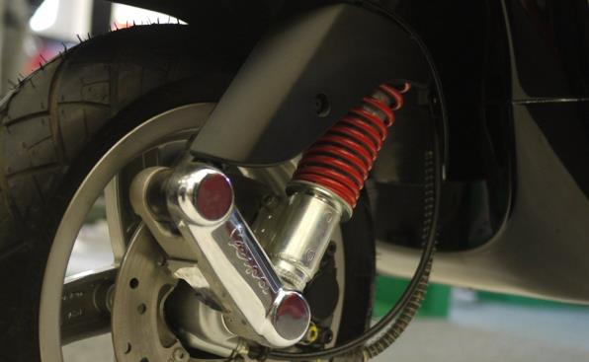
Figure 7.1
A motorcycle suspension system is an example of a damped spring-mass system. The spring absorbs bumps and keeps the tire in contact with the road. The shock absorber damps the motion so the motorcycle does not continue to bounce after going over each bump. (credit: nSeika, Flickr)

Slide 3
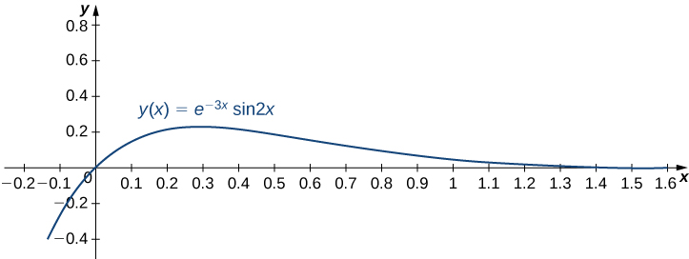

Slide 4
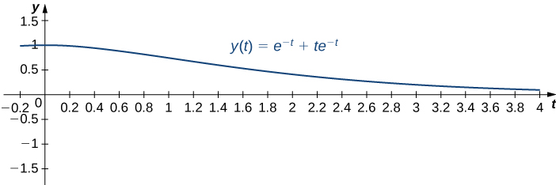

Slide 5
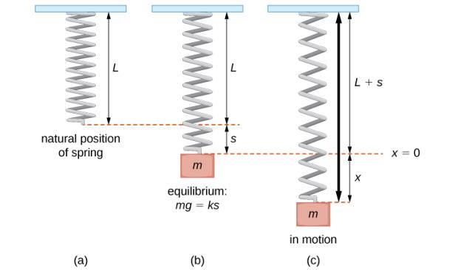
Figure 7.2
A spring in its natural position (a), at equilibrium with a mass m attached (b), and in oscillatory motion (c).

Slide 6
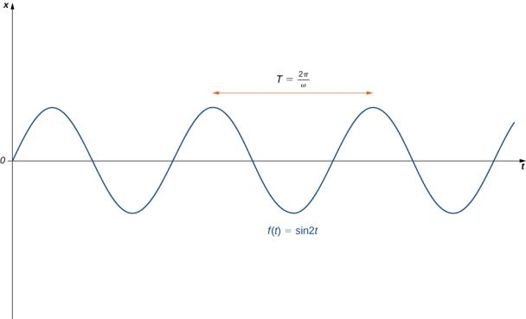
Figure 7.3
A graph of vertical displacement versus time for simple harmonic motion.

Slide 7
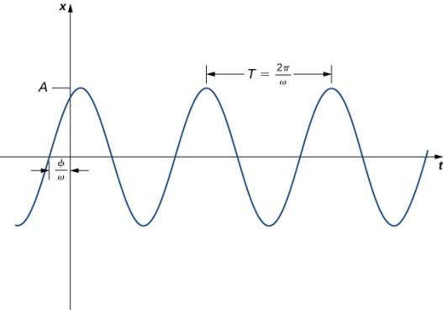
Figure 7.4
A graph of vertical displacement versus time for simple harmonic motion with a phase change.

Slide 8
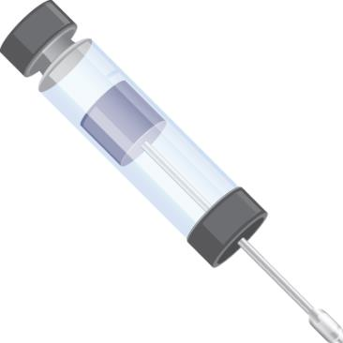
Figure 7.5
A dashpot is a pneumatic cylinder that dampens the motion of an oscillating system.

Slide 9
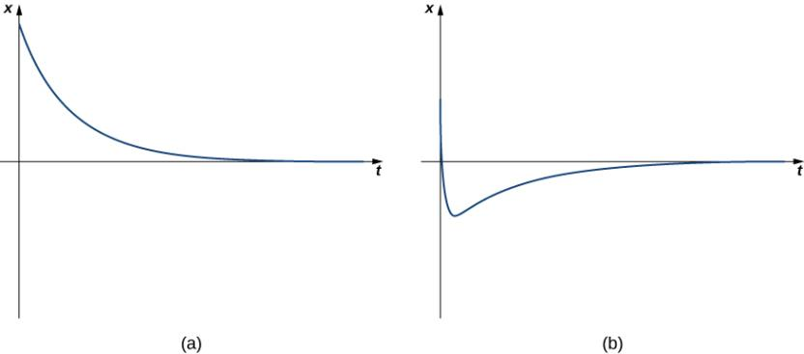
Figure 7.6
Behavior of an overdamped spring-mass system, with no change in direction (a) and only one change in direction (b).

Slide 10
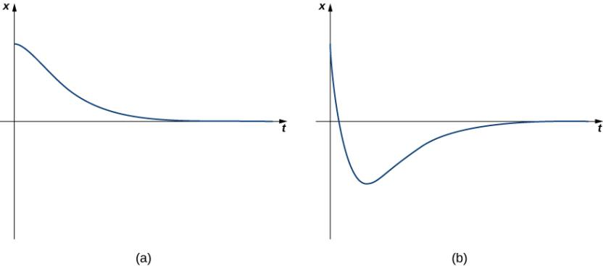
Figure 7.7
Behavior of a critically damped spring-mass system. The system graphed in part (a) has more damping than the system graphed in part (b).

Slide 11
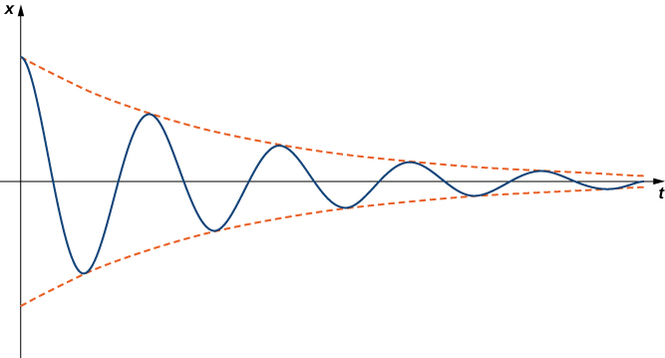
Figure 7.8
Behavior of an underdamped spring-mass system.

Slide 12
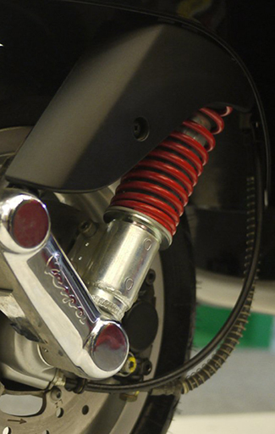
Figure 7.9
(credit: modification of work by nSeika, Flickr)

Slide 13
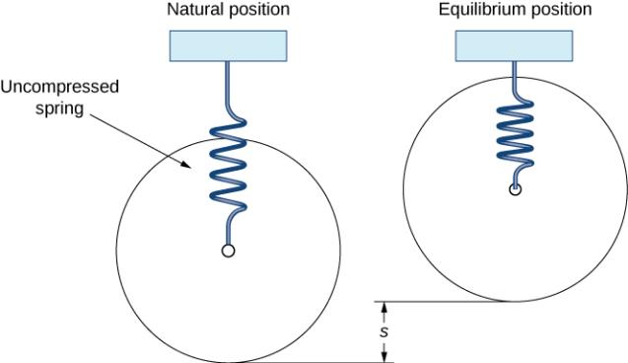
Figure 7.10
We can use a spring-mass system to model a motorcycle suspension.

Slide 14
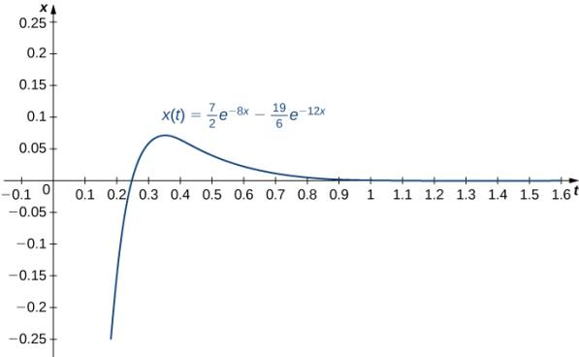
Figure 7.11
Graph of the equation of motion over a time of one second.

Slide 15
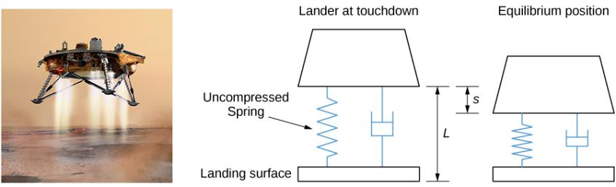
Figure 7.12
The landing craft suspension can be represented as a damped spring-mass system. (credit “lander”: NASA)

Slide 16
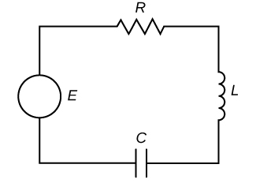
Figure 7.13
An RLC series circuit can be modeled by the same differential equation as a mass-spring system.

Slide 17
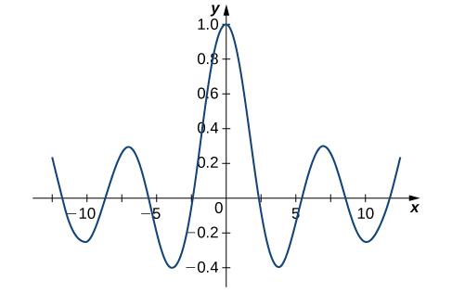

Slide 18
This OpenStax ancillary resource is © Rice University under a CC BY-NC-SA 4.0 International license; it may be reproduced or modified for noncommercial purposes only but must be attributed to OpenStax, Rice University and any changes must be noted. Any adaptation must be shared under the same type of license.

