Slide 1



OLIST_data_analysis
View in Power BI

Slide 2
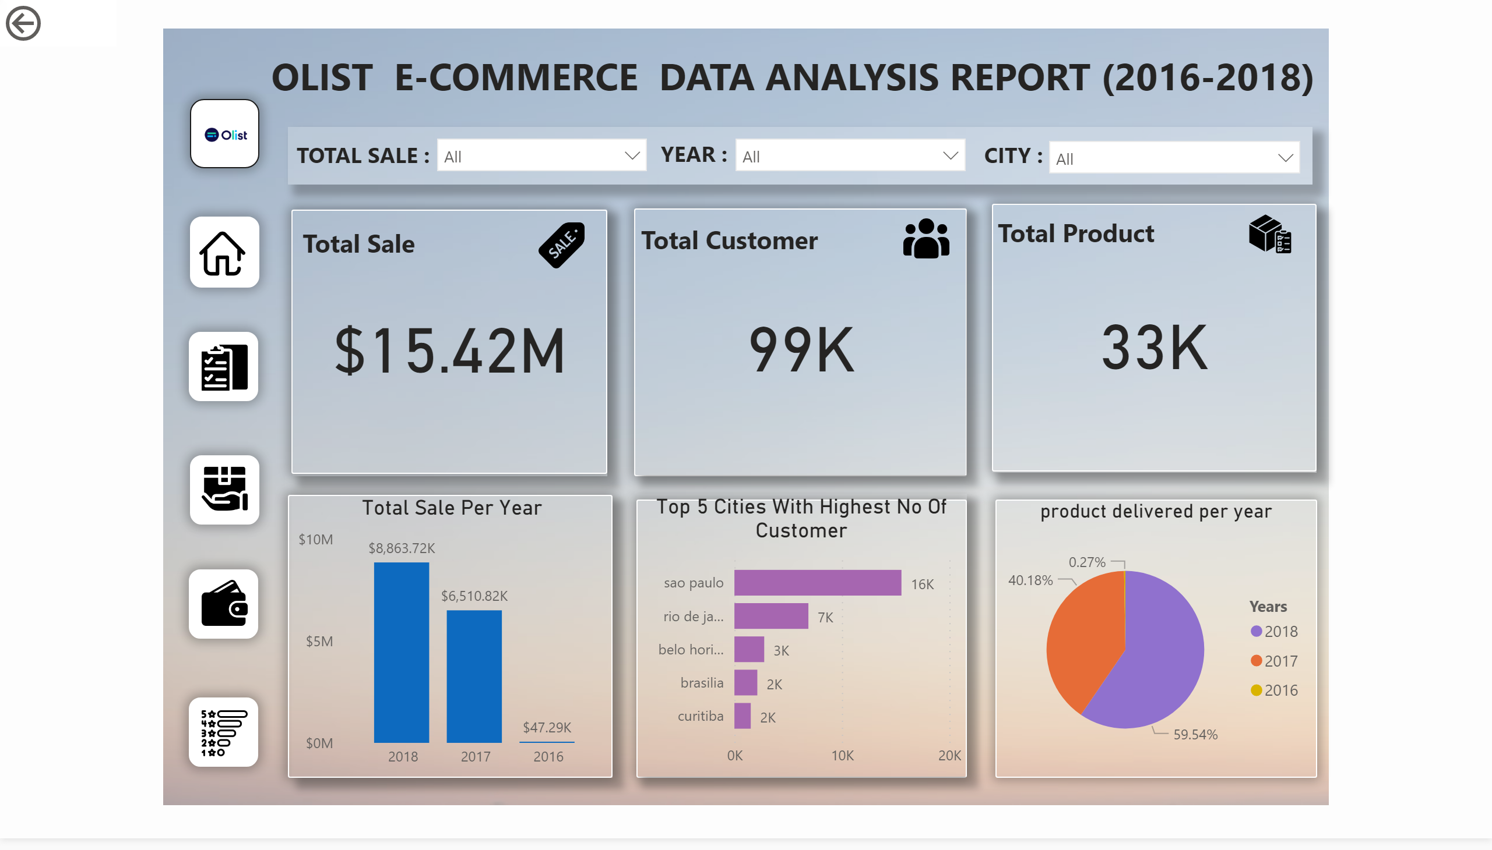
Home

Slide 3
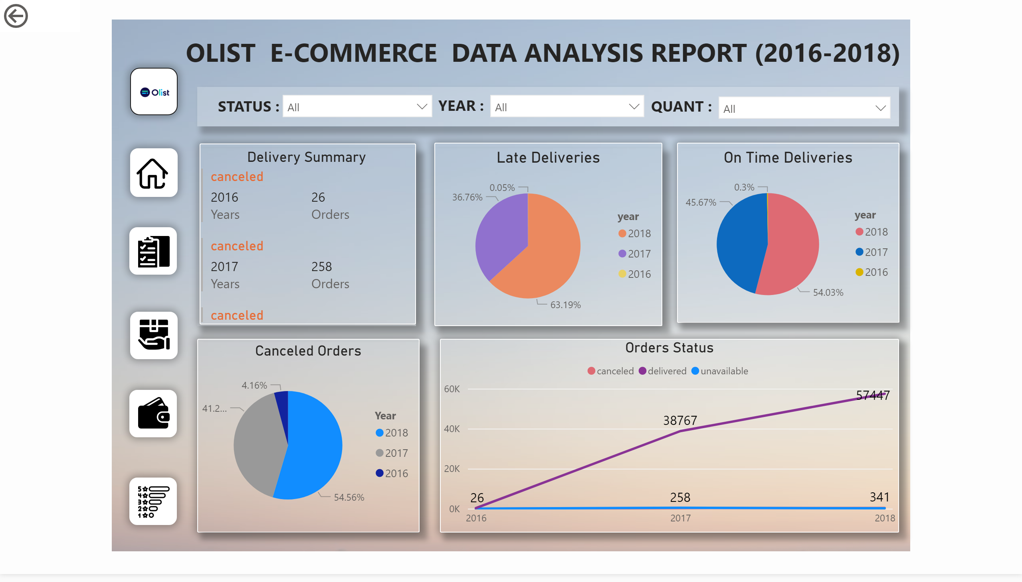
Orders

Slide 4
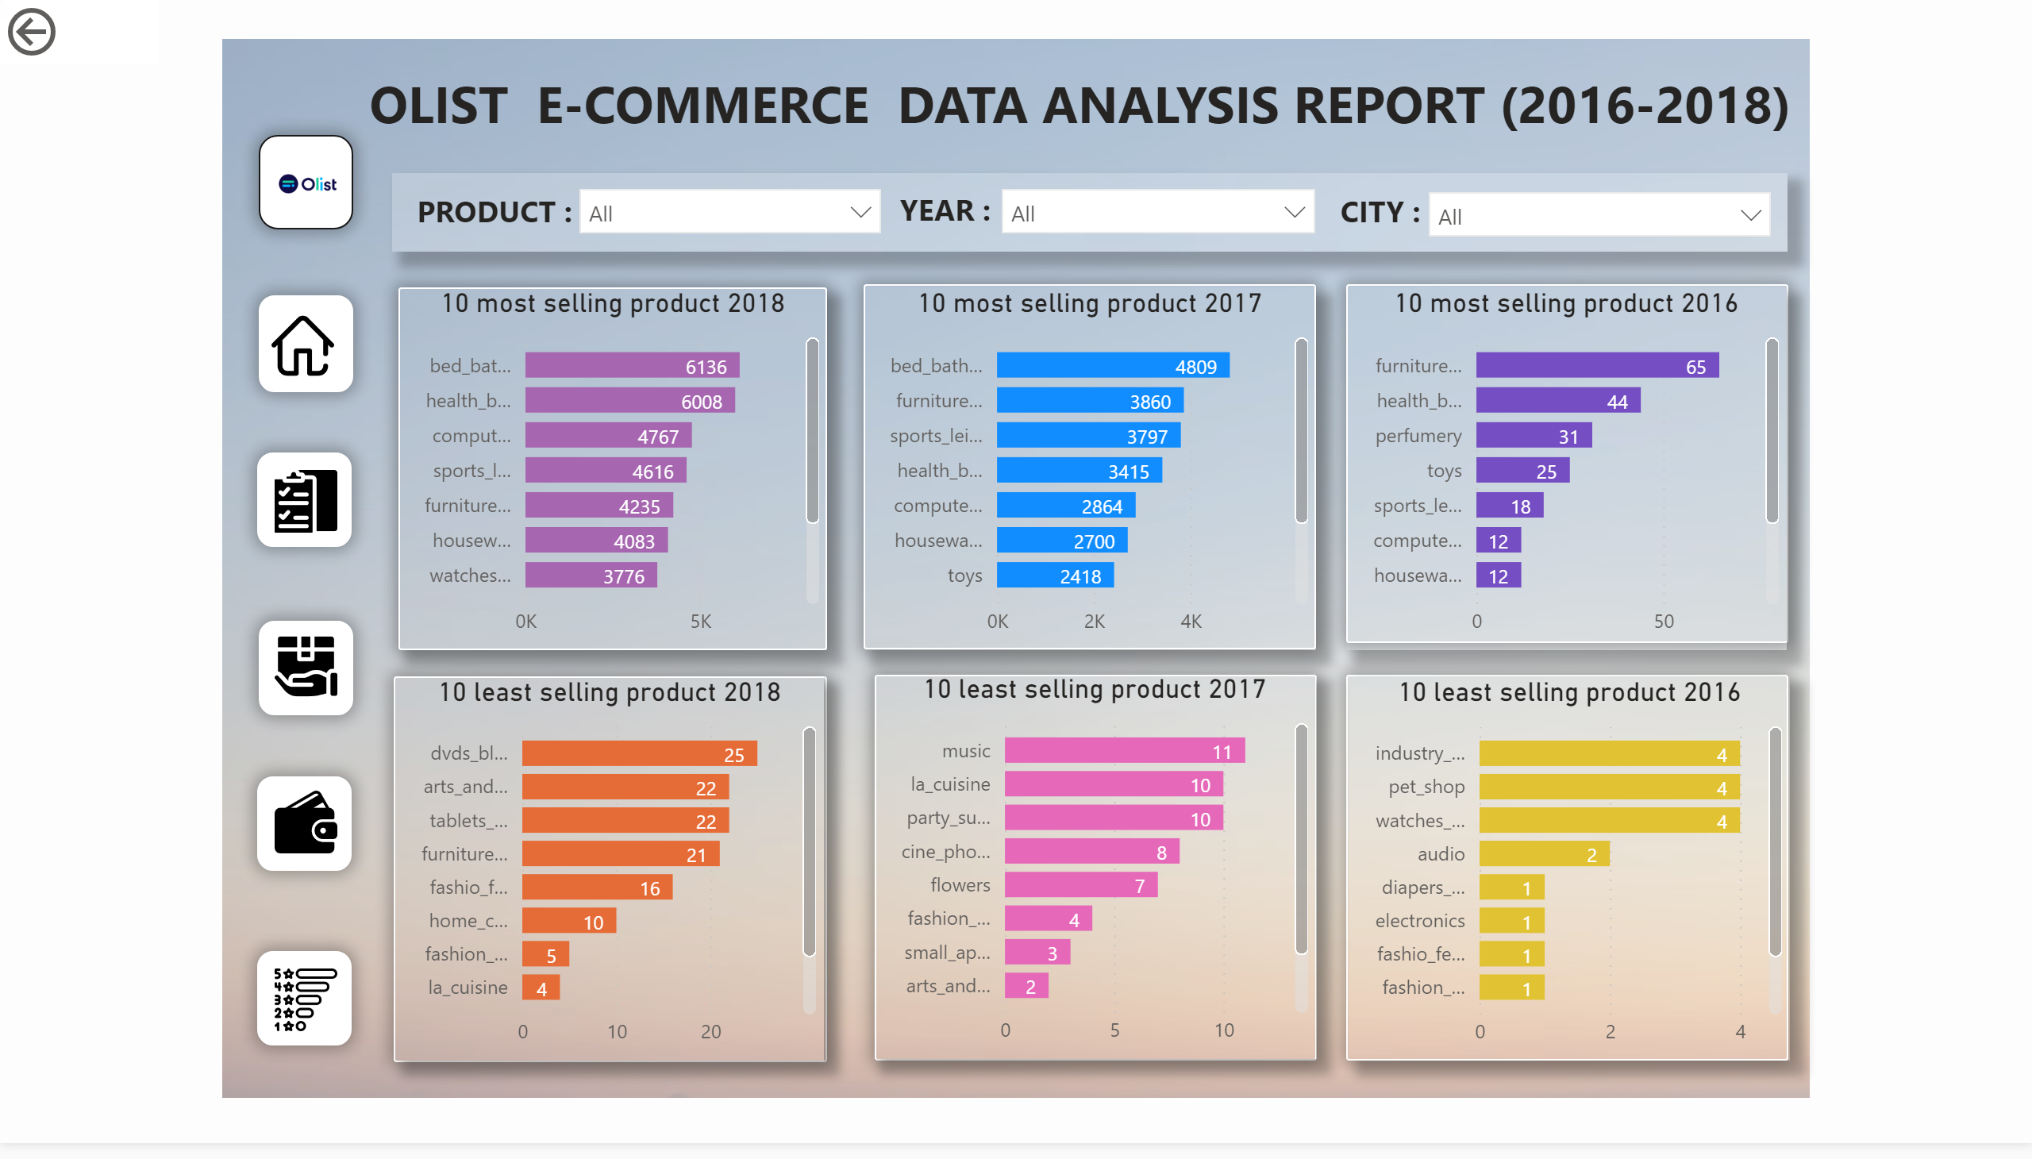
Products

Slide 5
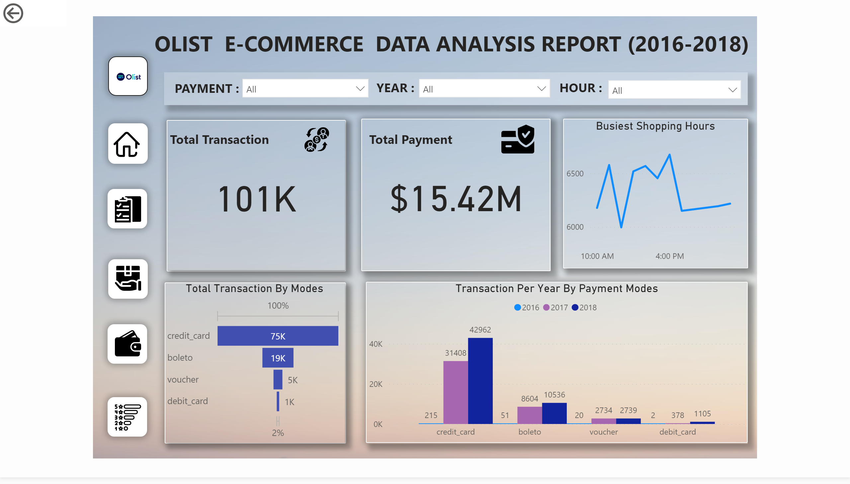
Payment

Slide 6
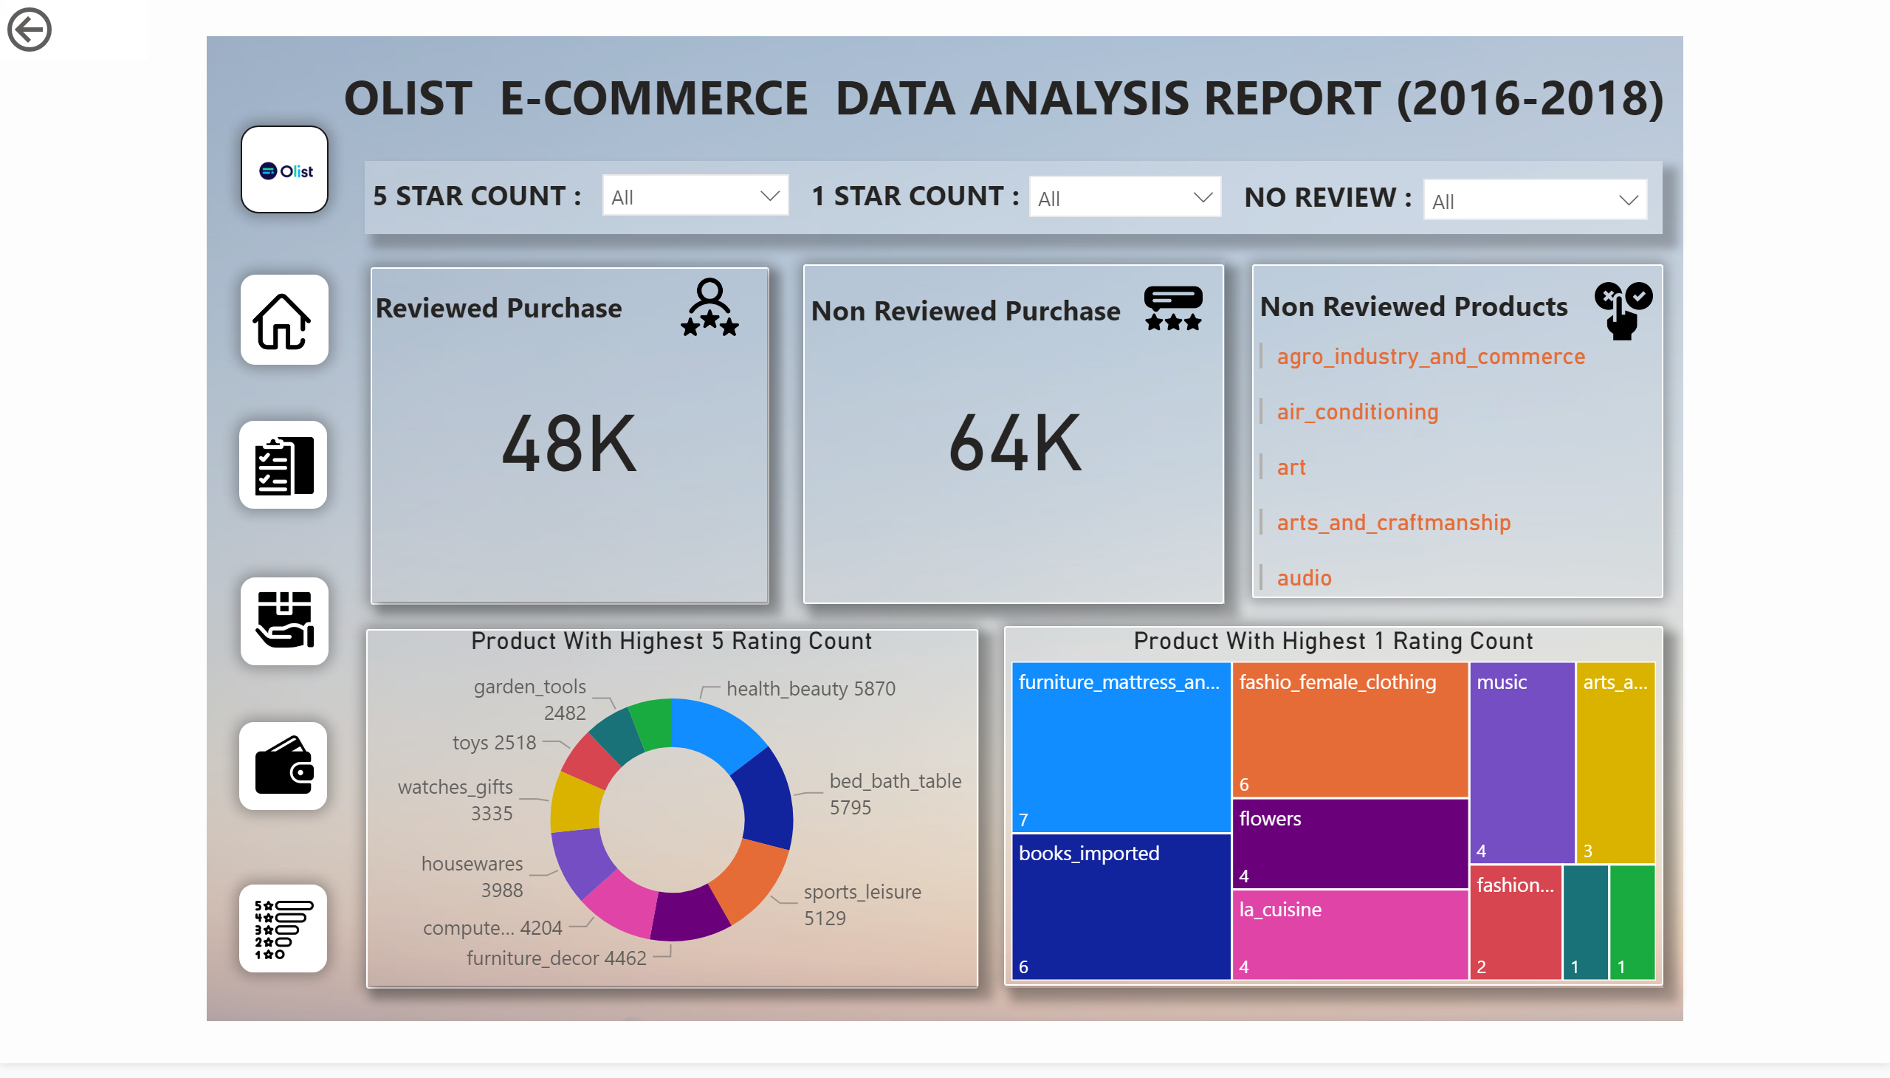
Reviews & Rating

