Slide 1


Putting Power BI to Work: An in-depth look from end-to-end

Slide 2
“
The only thing that gives an organization a competitive edge...is what it knows, how it uses what it knows and how fast it can know something.
- Larry Prusak (1996)
”
Notes:
Larry Prusak: researcher and consultant, founder and Executive Director of the Institute for Knowledge Management (IKM).
IKM: a global consortium of member organizations engaged in advancing the practice of knowledge management through action research.
Larry has had extensive experience, within the U.S. and internationally, in helping organizations work with their information and knowledge resources. He has also consulted with many U.S. and overseas government agencies and international organizations (NGO's). He is currently on the faculty of Columbia University teaching in their Information and Knowledge Strategy Program

Slide 3

Agenda
Microsoft Power BI: What is it?
A deeper look at the parts of Power BI:
Power BI Service
Power BI Desktop
Power BI Mobile
Power BI Embedded
Creating and publishing a dashboard
My Workspace
Groups
Roles of an Organization
Flow: Discover to Deploy
Q & A

Slide 4
Agenda
Microsoft Power BI: What is it?
A deeper look at the parts of Power BI:
Power BI Service
Power BI Desktop
Power BI Mobile
Power BI Embedded
Creating and publishing a dashboard
My Workspace
Groups
Roles of an Organization
Flow: Discover to Deploy
Q & A

Slide 5
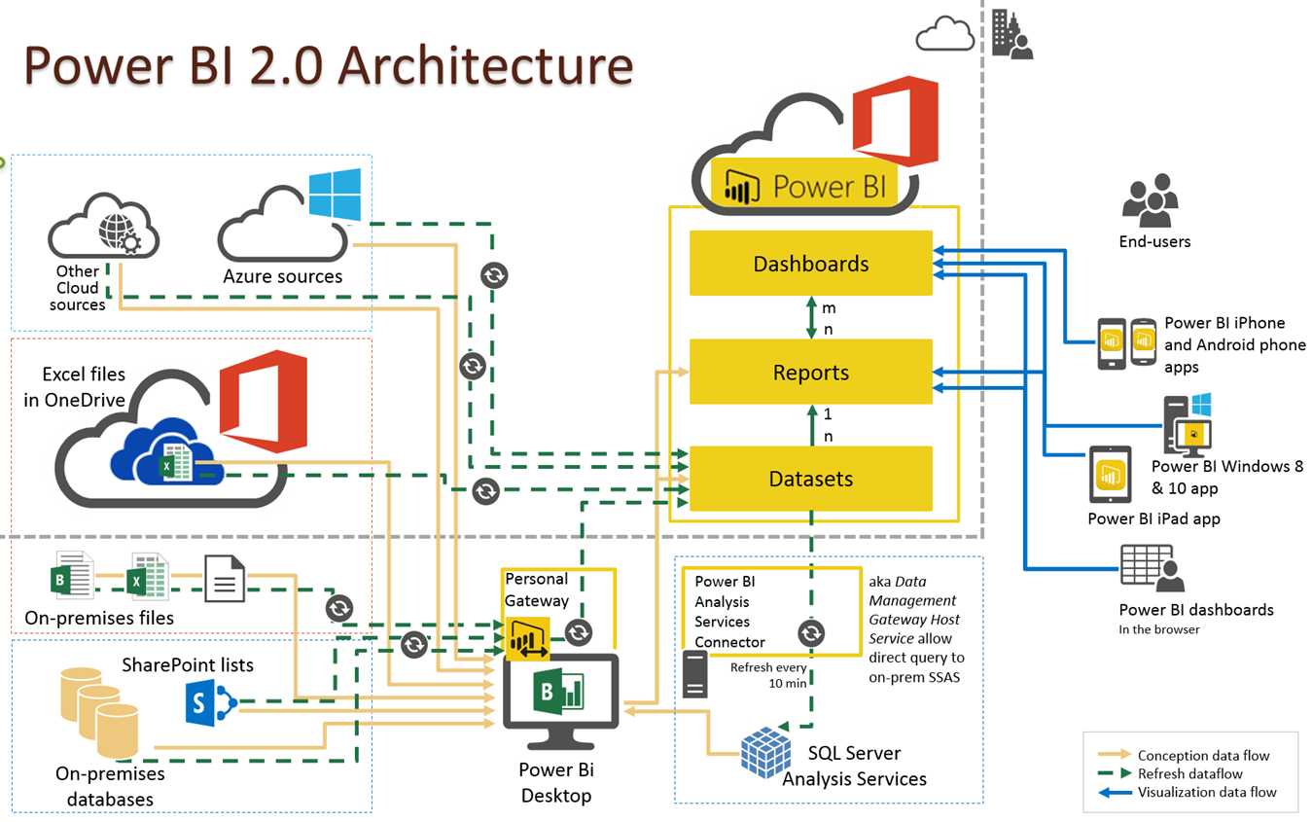

Slide 6

Power BI: What is it?
Power BI is *NOT* business intelligence.
Business Intelligence is an on-going strategy for a company.
You can not buy business intelligence.
You can buy tools and technology but BI is about people and data.
Power BI is a set of tools and technologies.

Slide 7
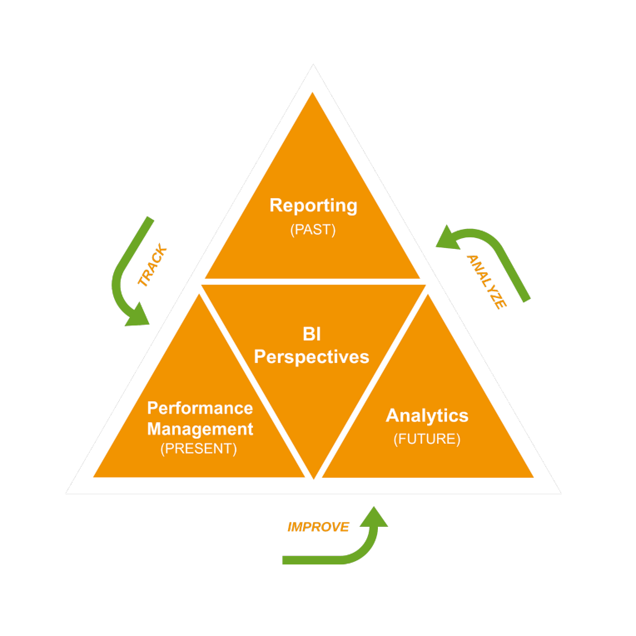
Three perspectives of data
PAST: What Happened?
Reactive reporting
Common among most companies
PRESENT: What is Happening?
KPI’s and CPM Concepts
Streaming analytics
FUTURE: What will Happen?
Predict based on trends and external data
Understand impact and what-if analysis

Slide 8
Agenda
Microsoft Power BI: What is it?
A deeper look at the parts of Power BI:
Power BI Service
Power BI Desktop
Power BI Mobile
Power BI Embedded
Creating and publishing a dashboard
My Workspace
Groups
Roles of an Organization
Flow: Discover to Deploy
Q & A

Slide 9

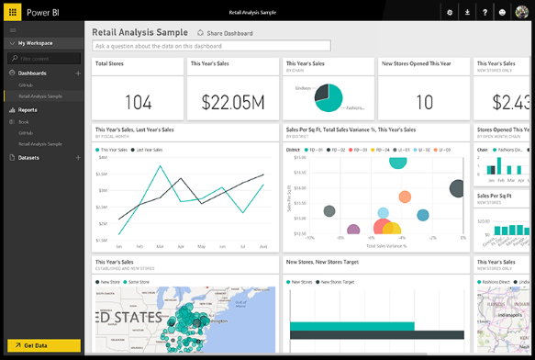
Power BI Service
Microsoft Power BI
Cloud based service (Part of Office 365)
Access to all data, wherver it may live
Ask questions, integrate with cortana analytics and more
Create curated content based on your company needs
Share insights across web, mobile and embedded within your own applications.
“Any data, anywhere, any time”

Slide 10
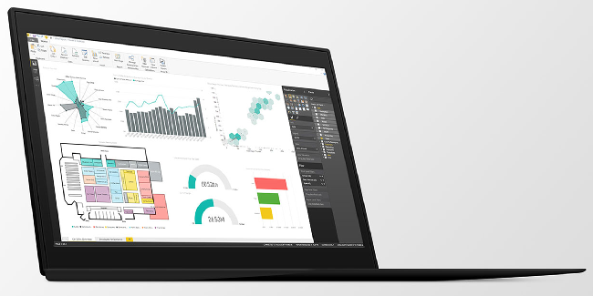
Power BI Desktop
Free download that starts your Power BI experience.
Not an end user tool, but a power user and designer tool.
Can be used to mash, model and design engaging experiences.
Transform and clean data
Design once and view anywhere
“Any data, anywhere, any time”

Slide 11
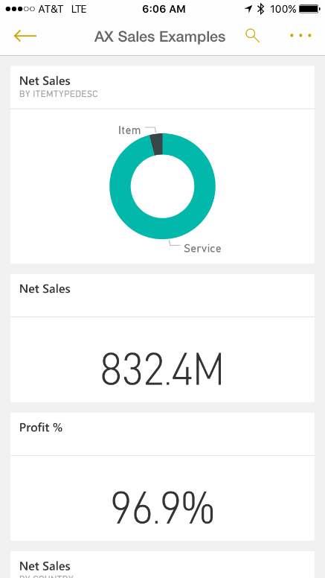
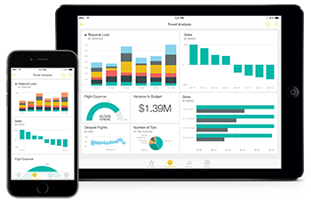
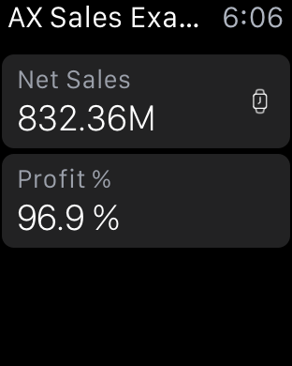
Power BI mobile
Consume from almost any device
Microsoft
Android
Apple – Including Apple Watch
Set alerts that allow for proactive engagement
Offline cache for dashboard consumption without an internet connection.
“Any data, anywhere, any time”

Slide 12

Power BI embedded
Microsoft Power BI
Ability to embed within any application or website.
Includes Dynamics ERP and CRM
Ability to deploy quickly with the scale of the Microsoft cloud.
Showcase Dashboard example: Northwind Traders.
“Any data, anywhere, any time”

Slide 13
Agenda
Microsoft Power BI: What is it?
A deeper look at the parts of Power BI:
Power BI Service
Power BI Desktop
Power BI Mobile
Power BI Embedded
Creating and publishing a dashboard
My Workspace
Groups
Roles of an Organization
Flow: Discover to Deploy
Q & A

Slide 14
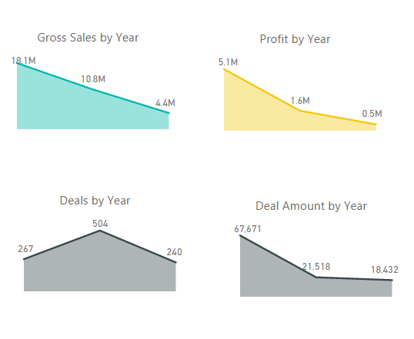
Create and publish
Create an example Power BI Report
Publish to PowerBI.com
Groups vs. My workspace
Pin to create a new dashboard.
Review Question and Answer option (Importance of Semantics)
Security Modeling with “View As” and assigning to user.
“Any data, anywhere, any time”

Slide 15
Agenda
Microsoft Power BI: What is it?
A deeper look at the parts of Power BI:
Power BI Service
Power BI Desktop
Power BI Mobile
Power BI Embedded
Creating and publishing a dashboard
My Workspace
Groups
Roles of an Organization
Flow: Discover to Deploy
Q & A

Slide 16

Roles of an Organization
Data Layer:
DBA
Creates and Assist with Company’s enterprise data.
IT Administration
Task with sever administration, including Power BI Enterprise Gateway.
Semantic Layer:
Data Modeler
Organize, clean and contribute to transform data into business semantics.
BI Architect
Task with understanding the business, the data and the questions – oversee and maps
Presentation Layer:
BI Designer
Advanced Power BI Report creation
Power User
Department focused Power BI Report creation
Consumer
End user that consumes Power BI Reports and Dashboards
“Any data, anywhere, any time”

Slide 17
Agenda
Microsoft Power BI: What is it?
A deeper look at the parts of Power BI:
Power BI Desktop
Power BI Service
Power BI Mobile
Power BI Embedded
Creating and publishing a dashboard
My Workspace
Groups
Roles of an Organization
Flow: Discover to Deploy
Q & A

Slide 18
Flow: Discover to Deploy
Discover
What questions are to be answered and for what role?
Develop
Develop the data model within Power BI Desktop.
Design
Deploy
What is the natural workflow of the role?
What is the nature of the data and where does it live?
Design the dimensional model from the questions to be answered.
Design the flow of the data to answer the desired questions.
Develop the Power BI Report
Review and iterate with the user for: Data Validation & Report design.
Repeat into satisfied version 1.0
Create any needed groups on PowerBI.com
Assign appropriate rights to users to consume and manage.
Publish to PowerBI.com desired group.
Create any content packs including starting Dashboard.
Design and mock the Power BI Report.

Slide 19
Q & A

