Slide 1

Transform, Pivot

Slide 2

Microsoft’s approach delivers data dividends
An end-to-end platform for any data and everyone
Business questions
and problems
Actionable
results
Transform
+ analyze
Visualize
+ decide
Data
Collect + manage
Microsoft data platform

Slide 3




Microsoft Data Platform
BI & ANALYTICS
Self-service
Corporate
Collaboration
Mobile
Predictive
DATA ENRICHMENT & FEDERATED QUERY
Single query model
Extract, transform, load
Data quality
Master data management
DATA MANAGEMENT & PROCESSING
✓
Relational
Non-relational
Analytical
Streaming
Internal & External
INFRASTRUCTURE
Scalability
Virtualization
Security and Identity
Quality of service

Slide 4

Visualize & decide
Transform
+ analyze
Discover, explore, and combine any data type or size, regardless of location
Ask questions of data to visualize, analyze, and forecast
Visualize
+ decide
Data
Make faster decisions, share broadly,
and access insights on any device
Collect + manage

Slide 5
Visualize & decide
Analyze in Excel
Collaborate in Office 365
Discover
Search, access, and transform public and internal data sources with Power Query
Share
Share data views and workbooks refreshable from on-premises and cloud based data sources, with Power BI Sites
Analyze
Easy data modeling and lightning fast in-memory analytics with Power Pivot
Question
Ask questions and get immediate answers with natural language query
Q&A
Visualize
Bold new interactive data visualizations with Power View and Power Map
Mobility
Mobile access through HTML5 and touch optimized apps
Scalable | Manageable | Trusted

Slide 6




Slide 7
How can I improve my sales?

Slide 8
How can I better enable my sales staff?

Slide 9
How can I better target my customers?
Speaker Name

Slide 10
How does IT have insight?

Slide 11

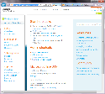
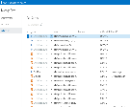
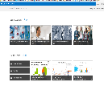


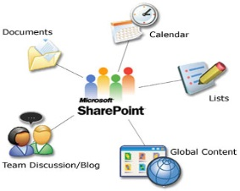
Component Diagram for Power BI Hybrid Architecture
Collaborate in Office 365 1 in 4 enterprise customers on Office 365
Share
O365 Power BI
Data Management Portal
Find
O365 Power BI
Corporate
Data Catalog
Power BI Admin Center
SPO team sites, BI Sites, Q&A
Q&A
Mobile
Data Management Gateway
Excel,
Tablet/Mobile,
Browser – Silverlight, HTML5
Insights in Excel 1 Billion Office Users
Discover
Source 1
Source 2
On-Premises
Analyze
Source 3
Datamart
Power Query
Power Pivot
Power View
Power Map
Visualize
Source 4
Reference Data
IW (Author)

Slide 12
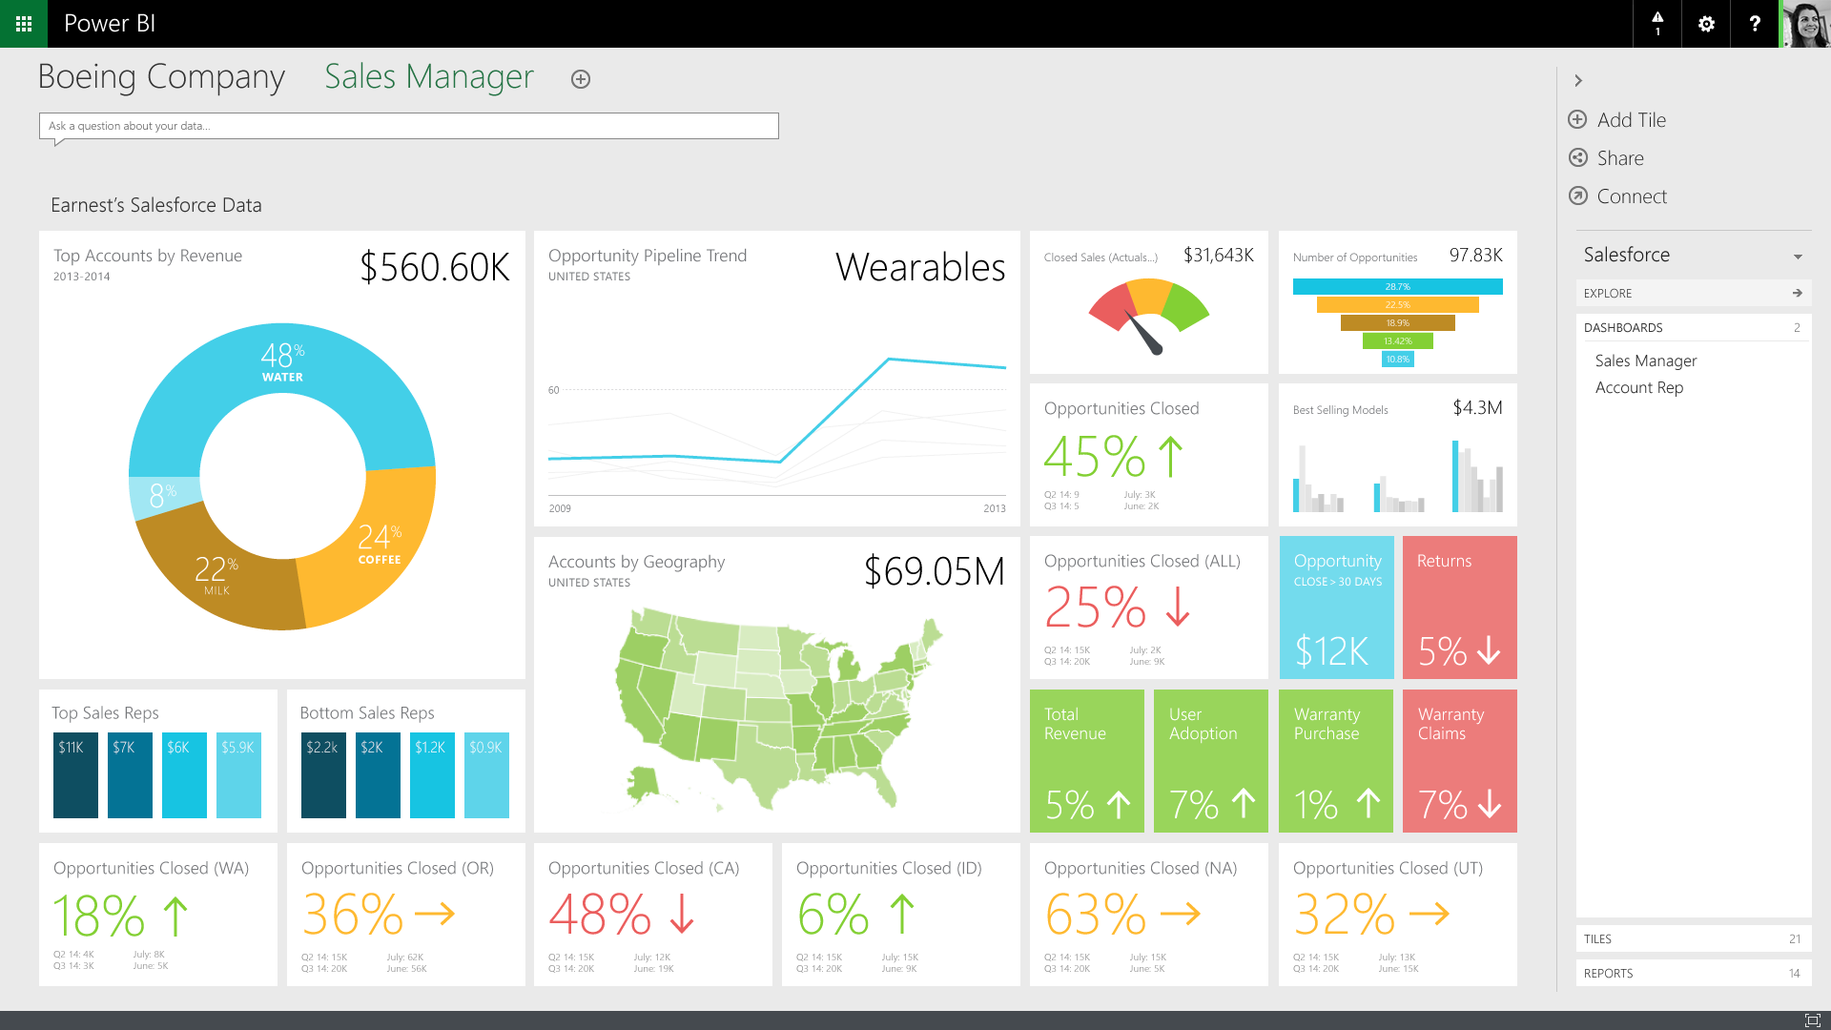
Next …

Slide 13
Power BI Readiness
FREE training
Learn how to leverage your existing investment in Excel to gain better insight
Contact: info@sipbharat.com

Slide 14
Thank You

