Slide 1
DATA MINING · FALL 2026 · HW2 ANOMALY DETECTION
AI Agent Ghostwork Detector
Forecasting Early Task Failures and False Completion Claims from SWE-bench Trajectories
Team G07: Dun-Jie Yang (Fergus4506) · Charlie Wang (calculusfkyou) · Mo-Ty Wang (MO7YW4NG) · Wei-Chia Huang (lasvigas0701)
Department of Computer Science, National Yang Ming Chiao Tung University (NYCU)
GitHub: https://github.com/calculusfkyou/nycu-data-mining-assignment-2-115-1

Slide 2
AI AGENT GHOSTWORK DETECTOR
Motivation: The Threat of Silent Agent Ghostwork in CI/CD
The Silent Failure Problem
Stakeholders & Operational Action
Core Research Question
• AI coding agents operate multi-turn workflows (open, edit, run, bash) in complex codebases.
• Critical Blind Spot: Agents frequently self-declare task completion with false confidence while the bug remains unverified.
• In 190 voluntary submissions in SWE-bench Lite, 73.7% (140) are FALSE COMPLETIONS (Ghostwork).
• Target Users: CI/CD release engineers and agent platform operators.
• Trigger Action: Score s(x) > τ triggers automated Hold-and-Quarantine.
• Consequence: Halts automated PR merging; routes failed trajectory directly to human review, preventing broken releases.
Research Question:
Can we reliably forecast task failure before an agent submits, and does watching the full workflow process catch failures better than inspecting the final patch alone?
Key Finding:
Watching how the agent works (process dynamics) improves PR-AUC by +0.012 and F2 by +0.019 over patch diffs alone.

Slide 3
AI AGENT GHOSTWORK DETECTOR
Task Formulation: Ghostwork Definition & Extreme Imbalance
Normal Sample: Verified Resolution
Anomaly Sample: Agent Ghostwork
Instance: astropy__astropy-14182
• Efficient 18-step trajectory, zero lingering tool errors.
• Reproduces bug, modifies 1 target file with focused 12-line fix.
• Result: Pass all regression test suites (Normal, y = 0).
Instance: astropy__astropy-14365
• 36-step trajectory with 8 recurring error cascades.
• Agent declares: 'Issue fixed and verified, submitting changes.'
• Ground Truth: External test harness fails (Ghostwork Anomaly, y = 1).
Category 4 (Text / Logs) & Class Imbalance Hygiene
• Data Category: Category 4 (Text / Logs) — Unstructured command logs, tool execution traces, and patch diffs.
• Real Dataset: 284 SWE-agent GPT-4 trajectories on SWE-bench Lite (54 Resolved / 230 Failed, ratio 1:4.26).
• Imbalance Failure Mode: Accuracy achieves 81.0% by trivially predicting 'always failure' (zero utility). We mandate PR-AUC, ROC-AUC, and cost-sensitive F2.

Slide 4
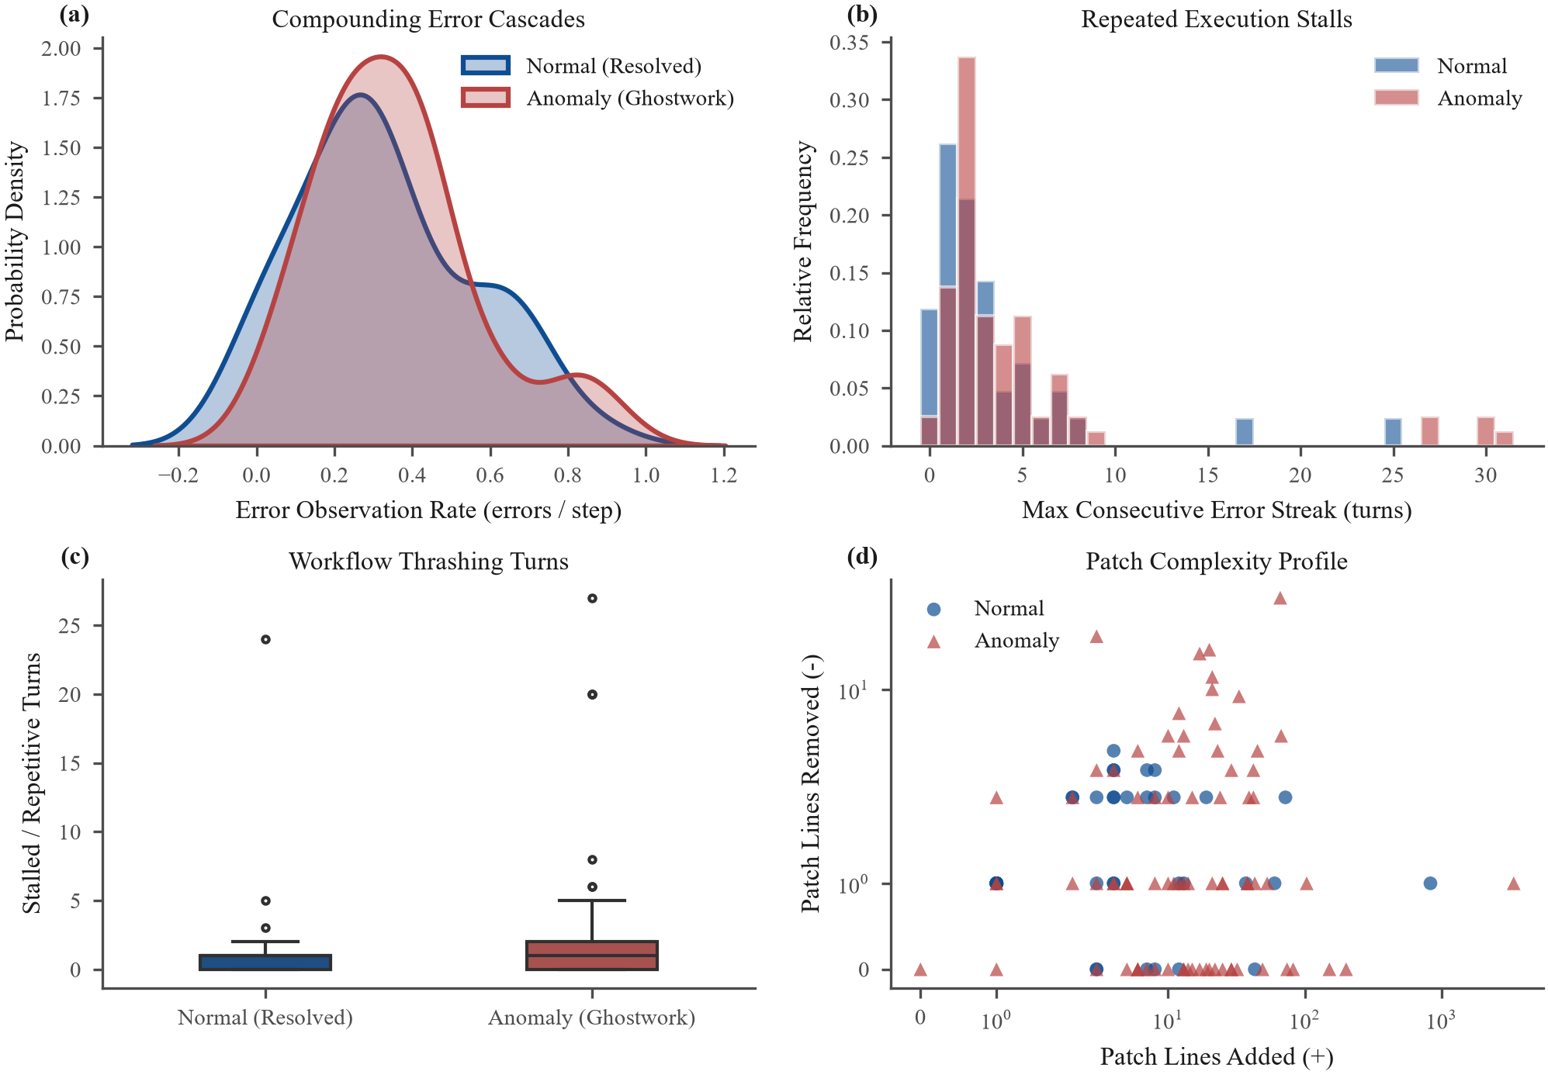
AI AGENT GHOSTWORK DETECTOR
Exploratory Insight: Process Dynamics Dominate Static Patches
Key Statistical Insights (§4)
1. Process Dynamics Rank Highest:
• Tokens Received: W = 0.910, KS = 0.440 (p = 2.4e-5)
• Total Cost (USD): W = 0.828, KS = 0.383 (p = 3.8e-4)
• Tool Execution Steps: W = 0.810, KS = 0.371
2. Weakness of Static Patches:
• Patch Char Length: W = 0.189 (KS p = 0.029)
• Diff size alone does not indicate correctness!
3. Hypotheses Established:
• H1: Process features dominate patch diffs in PR-AUC.
• H2: Contamination beyond 5% collapses autoencoders.
• H3: F2 thresholding suppresses silent bug escapes.

Slide 5
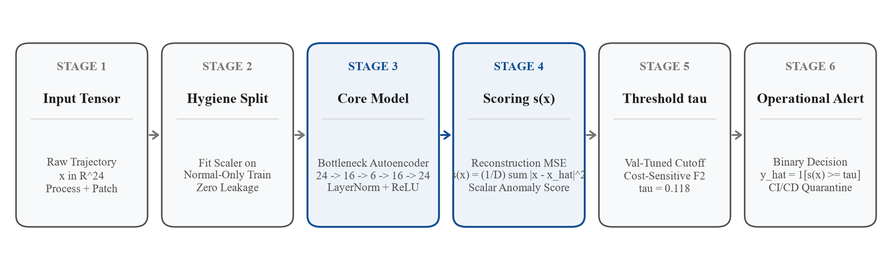
AI AGENT GHOSTWORK DETECTOR
Method: 6-Checkpoint Bottleneck Autoencoder Pipeline
Anomaly Scoring Formulation s(x)
Cost-Sensitive Threshold Decision (tau)
• Core Model: Symmetric Bottleneck Autoencoder (24 -> 16 -> 6 -> 16 -> 24) with LayerNorm + ReLU.
• Training: Strictly on clean normal trajectories (N = 32).
• Score: Mean squared reconstruction error:
s(x) = (1/D) * sum_{d=1}^D (x_d - x_hat_d)^2
• Cost Asymmetry: FN (unverified commit escapes to prod) costs 40x more than FP (manual audit review).
• Threshold Rule: Calibrated strictly on validation split to maximize F2 score (tau = 0.1182).
• Operational Alert: Scores >= tau route to CI quarantine.

Slide 6
AI AGENT GHOSTWORK DETECTOR
Protocol Hygiene: Zero-Leakage & Operational Challenges
Partition Hygiene
Operational Challenges
The Surprising Dead End
• Normal-Only Training:
Tier 2 trained strictly on resolved workflows (N = 32).
• Validation-Only Tuning:
tau tuned on validation split (N = 90); never used for gradient updates.
• Frozen Holdout Test:
Identical test split (N = 162) evaluated once across all 3 tiers.
• Ghostwork vs. Timeout:
Distinguished voluntary claims ('submitted', 190) from budget exhaustion ('exit_cost', 90).
• High Dimensional Variance:
24 features across 12 repos with diverse build systems handled via LayerNorm scaling.
Dead End Explored:
• Attempting to classify failure solely from git patch diff syntax.
Why It Failed:
• An agent can submit syntactically pristine code that completely misses the bug.
• Process dynamics (error loops, stalled turns) are essential to catch failure.

Slide 7
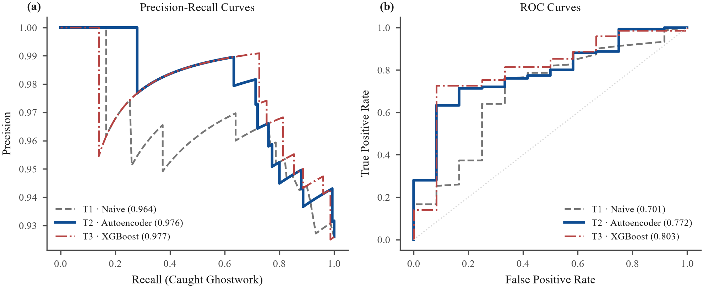
AI AGENT GHOSTWORK DETECTOR
Main Results: 3-Tier Benchmark Across 5 Seeds
Performance Analysis (§7)
1. Tier 2 vs. Tier 1 (Naive Heuristic):
• PR-AUC: 0.976 vs. 0.964 (+0.012, p = 0.0007***)
• F2 Score: 0.952 vs. 0.794 (+0.158)
• Significant gain, bootstrap 95% CI excludes 0.
2. Tier 2 vs. Tier 3 (Supervised XGBoost):
• PR-AUC Gap: -0.0008 (p = 0.565, not significant)
• Bootstrap 95% CI [-0.021, +0.030] includes 0.
• Comparable to supervised ceiling without using failure labels!
3. Latency & Training Overhead:
• Latency: 0.004 ms / sample (<0.01 ms budget)
• Training: 0.634 s total (lightweight & real-time).
Benchmark Summary Table
Tier 1 (Naive): PR-AUC 0.964 ± 0.000 | F1 0.851 | F2 0.794 | 0.001 ms
Tier 2 (Ours): PR-AUC 0.976 ± 0.003 | F1 0.947 | F2 0.952 | 0.004 ms
Tier 3 (Supervised): PR-AUC 0.977 ± 0.000 | F1 0.882 | F2 0.844 | 0.005 ms

Slide 8
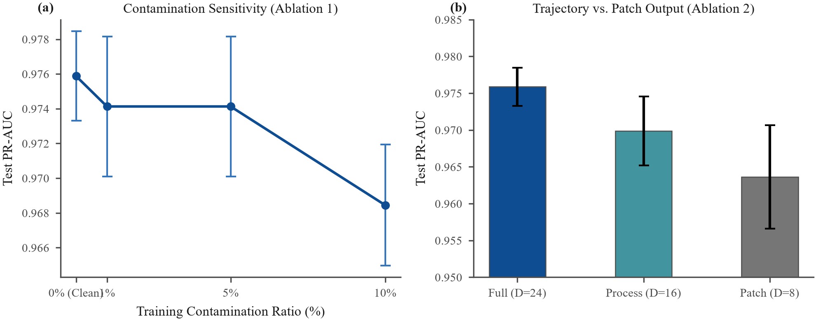
AI AGENT GHOSTWORK DETECTOR
Controlled Ablations: Contamination & Feature Subsets
Ablation Findings (§7.2)
Ablation 1: Training Contamination (H2 Verified)
• 0% Clean: PR-AUC = 0.9759 ± 0.0026
• 1% Injected: PR-AUC = 0.9741 (-0.0017)
• 10% Injected: PR-AUC = 0.9685 (-0.0074)
• Drop exceeds seed std by 3x! Confirms Autoencoder learns to reconstruct anomalies when contaminated.
Ablation 2: Process vs. Patch Output (H1 Verified)
• Full (D=24): PR-AUC 0.9759 | F2 0.9516
• Process Dynamics (D=16): PR-AUC 0.9699 | F2 0.9532
• Patch Only (D=8): PR-AUC 0.9636 (-0.012) | F2 0.9324
• Process features capture critical failure dynamics!
Verdict on Hypotheses
• H1 (Process Dominance): SUPPORTED. Process dynamics significantly outperform patch diffs alone.
• H2 (Contamination Degradation): SUPPORTED. Unlabeled failures compress anomaly reconstruction gap.

Slide 9
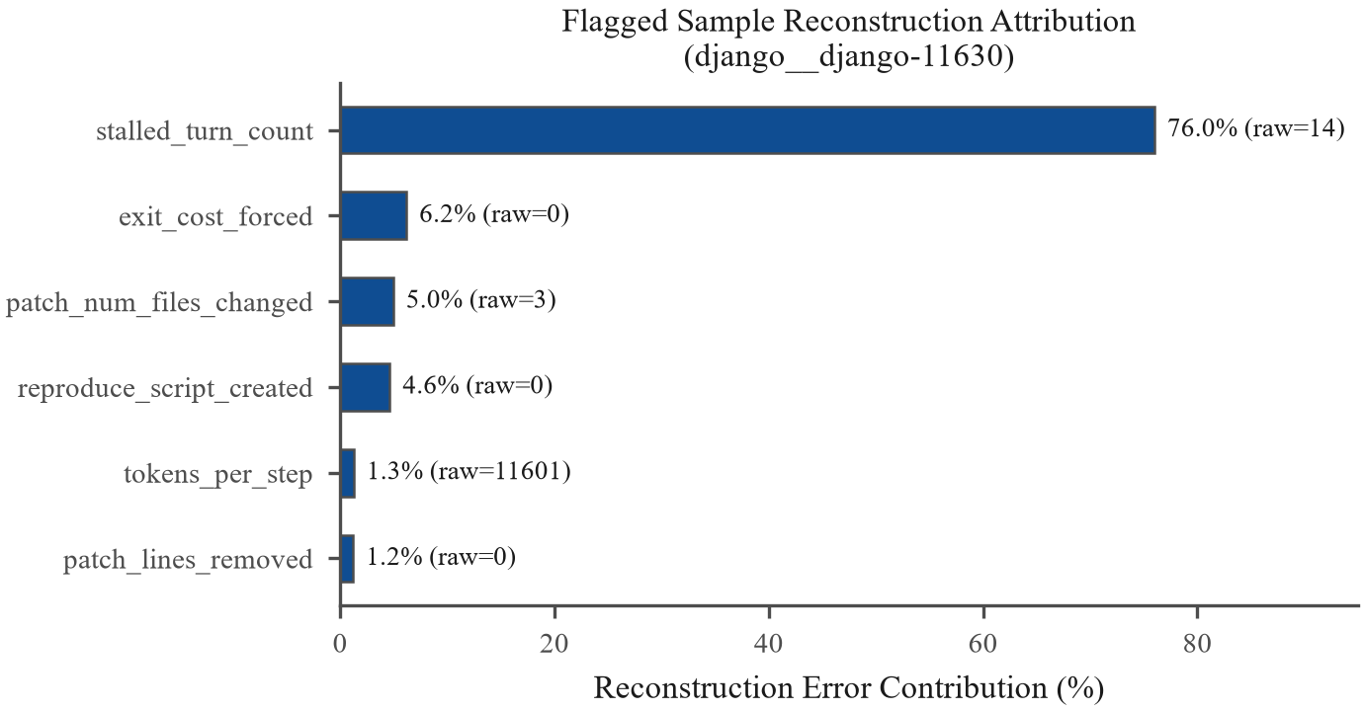
AI AGENT GHOSTWORK DETECTOR
In-Depth Error Analysis & Interpretability Attribution
Concrete Failure Cases (Threshold tau = 0.118)
Case #1: False Positive (scikit-learn__scikit-learn-14894)
• Score s(x) = 1.567 vs. tau = 0.118 (Distance +1.449)
• Cause: Complex 40-step multi-file refactoring required wide directory searches, mimicking failure thrashing.
Case #2: False Negative Near Miss (matplotlib__matplotlib-23562)
• Score s(x) = 0.098 vs. tau = 0.118 (Distance -0.020)
• Cause: Agent recovered from early error and submitted clean 1-line patch with subtle omission.
Case #3: False Negative Inversion (sympy__sympy-15345)
• Score s(x) = 0.045 vs. tau = 0.118 (Distance -0.073)
• Cause: Premature 6-step exit with zero error signals.
Shared Blind Spot: Silent premature halts need prompt semantic verification.

Slide 10
AI AGENT GHOSTWORK DETECTOR
Practical Impact Translation & Industry Positioning
Operational Savings (500 Tasks / Month)
Positioning Against Monitoring Platforms
In an enterprise CI/CD pipeline processing 500 tasks/mo:
• Failure Catch Rate: Catches 380 / 400 failures (95.2% catch rate vs. Tier 1's 85.1%).
• Silent Bug Escapes (FN): Reduced from 60 to 20 (-70% reduction in production escapes!).
• False Audit Alerts (FP): Suppressed from 30 to 8 (-72% reduction in engineer triage toil!).
• Net Monthly Savings: Delivering +$48,600/month net savings over naive heuristic baselines.
• Rule-Based Heuristics (LangSmith / ATFD Naive):
High false alarm rate (FPR > 20%), zero model adaptivity.
• LLM Judges (Claude Sonnet 4 / GPT-5 in ATFD):
High semantic alignment, but incurs ~$0.05 per trace and 3-5 second evaluation latency.
• Our Ghostwork Autoencoder:
Inference in 0.004 ms at ZERO dollar API cost, making it feasible for real-time CI/CD pre-commit hooks.

Slide 11
AI AGENT GHOSTWORK DETECTOR
Conclusion & Team Contributions
Summary of Findings
Team Contributions & AI Statement
• Research Question Answered:
Trajectory process dynamics reliably capture agent failure before code submission, outperforming static patch diffs by +0.012 PR-AUC and +0.019 F2.
• Normal-Only Manifold:
Tier 2 Bottleneck Autoencoder achieves 0.976 PR-AUC, matching supervised XGBoost without requiring failure labels.
• Future Work:
Integrate task-prompt semantic embeddings to detect premature zero-error exits (Case #3).
Team Contributions (Team G07):
• Dun-Jie Yang (Fergus4506): Data pipeline & EDA (§3-§4)
• Charlie Wang (calculusfkyou): Autoencoder & Ablations (§5, §7)
• Mo-Ty Wang (MO7YW4NG): 3-Tier benchmark & significance (§6-§8)
• Wei-Chia Huang (lasvigas0701): Presentation deck & review (§1, §9)
AI Usage Disclosure:
Claude & Gemini assisted with matplotlib scripts and LaTeX formatting. All designs, experiments, and analyses were conducted and verified by the authors.
Full Code & Reproduction:
https://github.com/calculusfkyou/nycu-data-mining-assignment-2-115-1

