Slide 1
Screening coding-agent task failures
Normal-only reconstruction on real SWE-bench Lite trajectories
Team G04 | Data Mining, NYCU | Fall 2026
Tun-Chieh Yang · Jia-Cheng Wu · Min-Quan Wang
Wei-Chia Chang · Chun-Ting Hou
G04 | 1 / 11
Notes:
Rehearsal budget: 25 seconds.
Open with the release engineer deciding which completed patch needs extra inspection. This is task-end screening, not early prediction. Repository: https://github.com/calculusfkyou/nycu-data-mining-assignment-2-115-1

Slide 2
Which completed patches need extra review?
User: release engineer reviewing coding-agent patches
Alert: open the execution trace and run targeted tests
Normal = officially resolved; failure = not resolved
A low score does not authorize an automatic release
G04 | 2 / 11
Notes:
Rehearsal budget: 40 seconds.
The detector is an experimental triage signal. Failure labels do not establish deceptive intent or an explicit false completion claim. Source: SWE-bench ICLR 2024, https://proceedings.iclr.cc/paper_files/paper/2024/hash/edac78c3e300629acfe6cbe9ca88fb84-Abstract-Conference.html

Slide 3
Failures are common in this dataset
284 real runs: 54 resolved / 230 unresolved
Category 4: Text / Logs → 24 aggregate features
Test: 150 failures / 162 runs (92.6%)
High AP needs a prevalence baseline (0.926)
No false-completion intent is inferred from the label
G04 | 3 / 11
Notes:
Rehearsal budget: 40 seconds.
Of 300 Lite tasks, 16 have no generation; 284 generated trajectories are retained. 190 voluntary submissions include 140 failures; 94 budget-terminated submissions include 90 failures. Source: Dataset/evaluation_results.json and provenance.json. The application deviates from classical rare-event AD and this is a limitation.

Slide 4
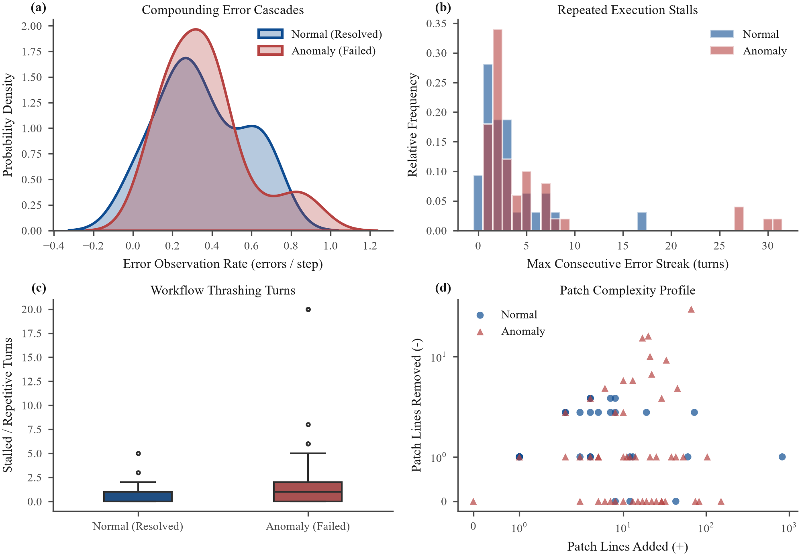
Training logs suggest workflow signals
EDA: training rows only (32 successes + 50 failures)
Tokens received: W = 0.957; KS = 0.505
Costs, steps and tokens overlap and correlate
Hypothesis: workflow features improve ranking
G04 | 4 / 11
Notes:
Rehearsal budget: 40 seconds.
W is standardized Wasserstein distance. Error patterns can be expected reproduction attempts; do not equate observed tracebacks with final failure. Summary statistics and Spearman matrix are computed only on training rows. Source: EDA/tables/feature_separability.csv.

Slide 5
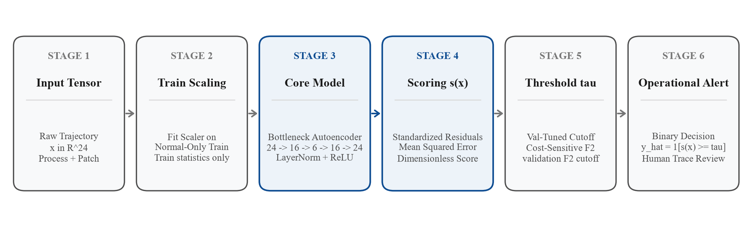
Normal-only reconstruction gives an alert score
Fit scaler and network on 32 successful training runs
24 → 16 → 6 → 16 → 24; LayerNorm + ReLU
Score = mean standardized squared reconstruction error
Validation F2 cutoff: τ = 0.1758 for seed 42
s ≥ τ requests human review
G04 | 5 / 11
Notes:
Rehearsal budget: 50 seconds.
Explain the six stages. AdamW lr .005, weight decay 1e-4, 150 epochs, batch 16. F2 weights false negatives more but is not the dollar-optimal objective. All features require the completed trajectory and final patch. Source: Model/models.py and Model/tables/all_seed_runs.csv.

Slide 6
Three tiers share disjoint fitting and calibration data
Train 82 (32 normal / 50 failures) | Val 40 (10 / 30)
Test 162 (12 / 150), same IDs for every tier
T1: fixed error/repetition heuristic
T2: normal-only autoencoder | T3: supervised XGBoost
Five seeds; CPU; test was inspected in an earlier draft
G04 | 6 / 11
Notes:
Rehearsal budget: 40 seconds.
The original test IDs were preserved during repairs. Fifty development failures moved to training. Validation never enters weight fitting. Test reuse is disclosed; these results require new runs for confirmation. No architecture search was performed. XGBoost defaults are deterministic across seeds. Sources: split_ids.json, environment.json. XGBoost: https://doi.org/10.1145/2939672.2939785

Slide 7
High AP does not establish a useful release gate
Method | AP | ROC-AUC | F2 | ms/sample
T1 heuristic | 0.962 ± 0.000 | 0.691 | 0.751 ± 0.000 | 0.0001
T2 autoencoder | 0.978 ± 0.004 | 0.782 | 0.948 ± 0.006 | 0.0018
T3 XGBoost | 0.980 ± 0.000 | 0.794 | 0.940 ± 0.000 | 0.0034
Always alert | 0.926 | 0.500 | 0.984 | —
T2 vs T3: paired seed p = 0.449; no equivalence claim
Mean T2: 142.4 TP / 7.6 FN / 9 FP / 3 TN
75% false-alarm rate on only 12 successful test runs
Always alert has higher F2; T2 spares some reviews
G04 | 7 / 11
Notes:
Rehearsal budget: 55 seconds.
Timing is median warmed batch scoring divided by 162, not single-request end-to-end latency. Train seconds: T1 essentially zero, T2 .641 ± .866, T3 .013 ± .001. Paired row bootstrap AP gap T2 minus T3: [-.0147,.0206], seed 42 model, 1000 resamples. Seeds characterize optimization variation on one split. Source: main_results_table.csv, significance_tests.csv, practical_impact.csv.

Slide 8
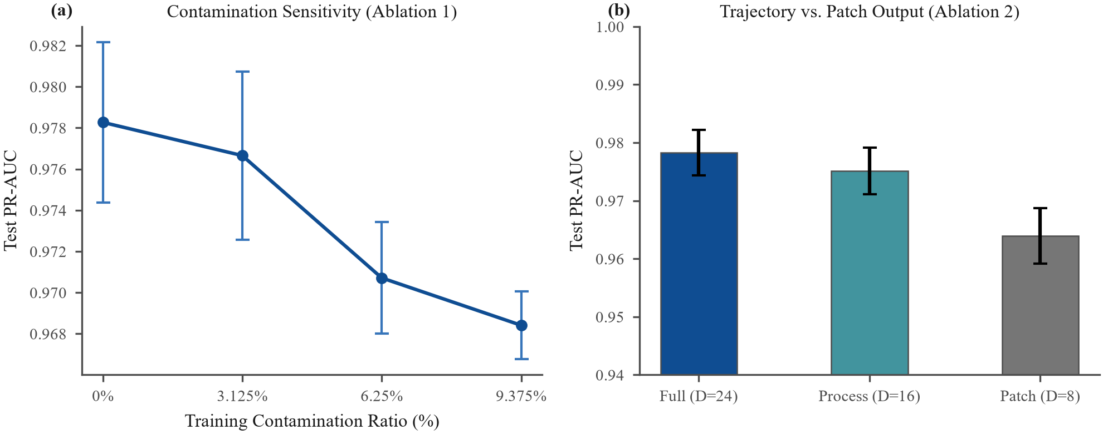
Ablations isolate three different decisions
H1: full AP 0.9783 vs patch-only 0.9639 (+0.0143)
Patch-only F2 is slightly higher: no universal dominance
H2: 3/32 contaminated rows lower AP by 0.0099
H3: F1 and F2 choose identical cutoffs in every seed
G04 | 8 / 11
Notes:
Rehearsal budget: 55 seconds.
Feature masks preserve all 24 coordinates and network shape. Contamination replaces 0,1,2,3 rows for 0,3.125,6.25,9.375%, holding sample size and clean scaler fixed. The 9.375% AP drop exceeds baseline seed SD .0039 by 2.5x. A Normal95 validation threshold misses 144 of 150 failures with zero false alarms. Sources: ablation_runs.csv and summary tables. H1 ranking supported; H2 supported here; H3 not supported.

Slide 9
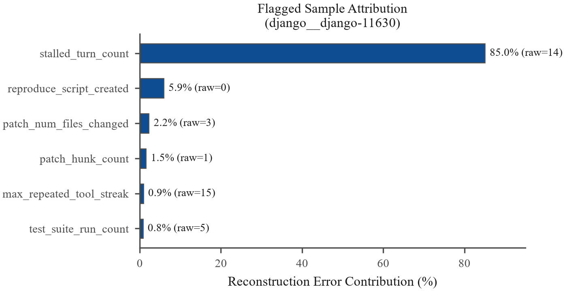
Noisy successes and quiet failures overlap
FP: scikit-learn-14894 | 25 steps, 19 errors | s=1.5674
FN: django-14155 | 9 steps, 0 errors | s=0.1694
FN: sympy-15345 | 11 steps, 0 errors | s=0.0630
τ=0.1758; semantic correctness is missing from counts
G04 | 9 / 11
Notes:
Rehearsal budget: 50 seconds.
Full IDs: scikit-learn__scikit-learn-14894, django__django-14155, sympy__sympy-15345. Scores minus tau: +1.3916,-.0065,-.1128. Patches add 8,15,2 lines respectively and all end in submit; do not claim aborts or empty patches. The separate flagged django__django-11630 has s=3.8673 and 14 stalled observations contributing 85.04% of reconstruction error; this supports trace inspection, not a causal verdict. Sources: failure_cases.csv, case_excerpts.json, feature_attribution_flagged_sample.csv.

Slide 10
Under these assumed costs, reviewing all wins
Illustration: 500 tasks; 80% fail; $1,200 per escape
Every alert costs 0.5 h × $60/h (including true alerts)
T1: 114.7 escapes, 327.0 reviews → $147,410
T2: 20.3 escapes, 454.7 reviews → $37,962
Review all: $15,000, assuming perfect review
G04 | 10 / 11
Notes:
Rehearsal budget: 45 seconds.
These are conditional projections, not measured production savings. T2 consumes 227.4 review hours vs T1 163.5. Perfect review is a strong scenario assumption; real reviewer sensitivity and capacity are unknown. At low deployment prevalence, precision changes. Source: practical_impact.csv. Contrast with prior work: SWE-agent solves issues; Deep SVDD uses one-class compactness; our work audits task-end trace screening. Sources: https://proceedings.neurips.cc/paper_files/paper/2024/hash/5a7c947568c1b1328ccc5230172e1e7c-Abstract-Conference.html and https://proceedings.mlr.press/v80/ruff18a.html

Slide 11
Workflow signals help ranking; deployment remains unproven
Next: expected-error recovery and task-semantic checks
Fresh agents/repos and more successes are needed
No prefix prediction, live gate or production validation
Member contributions: pending confirmation (all five)
Codex audited code, experiments, references and artifacts
G04 | 11 / 11
Notes:
Rehearsal budget: 40 seconds.
Team G04: Tun-Chieh Yang (315553010), Jia-Cheng Wu (314554059), Min-Quan Wang (315553008), Wei-Chia Chang (315553011), Chun-Ting Hou (315554022). Each member contribution is pending confirmation at the user’s request. Earlier materials mention Claude/Gemini but versions and scope remain unconfirmed. Do not imply team verification has already occurred. Full reproduction and source links are in README. Close with the research question: full workflow features improve AP over patch-only, but the alert trade-off is not a proven operational win.

