Slide 1
Newton’s Fall
Reinforcement Learning Agent
Training Process

Slide 2
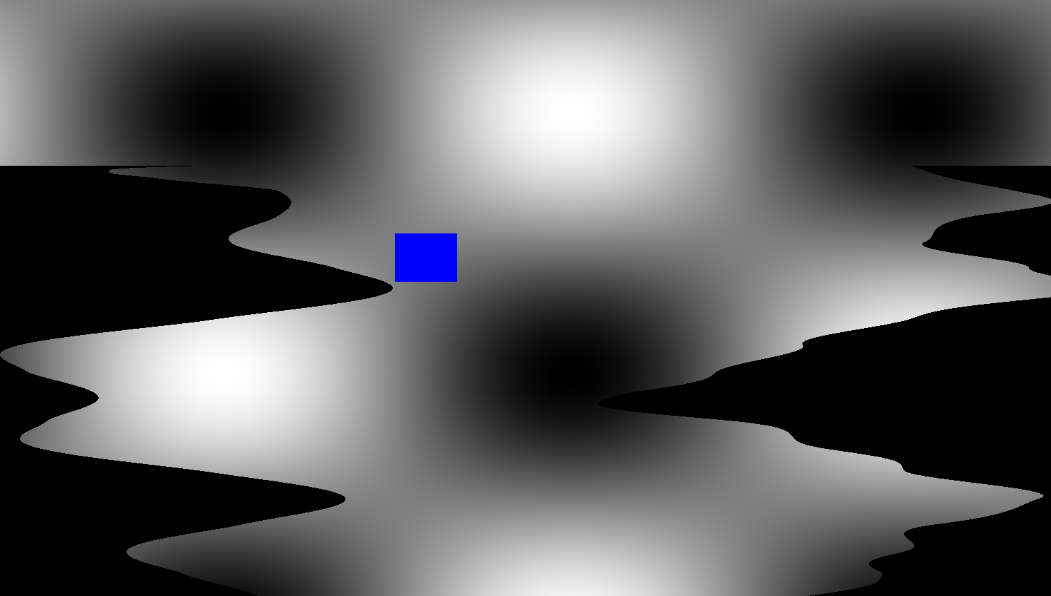
Newton’s Fall Game
Goal: reach the bottom with as much health remained as possible by not touching the walls. Move left, right or stay.

Slide 3
Newton’s Fall Game
Game mechanics: Box2D(Physics library)
Some physics mechanics implemented by hand
Graphics: SFML
Future improvements to graphics using OpenGL

Slide 4
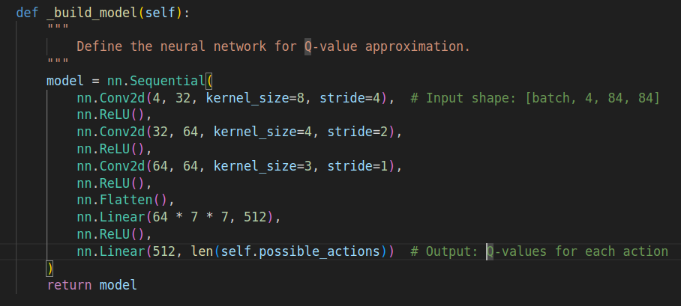
Deep Q Network

Slide 5
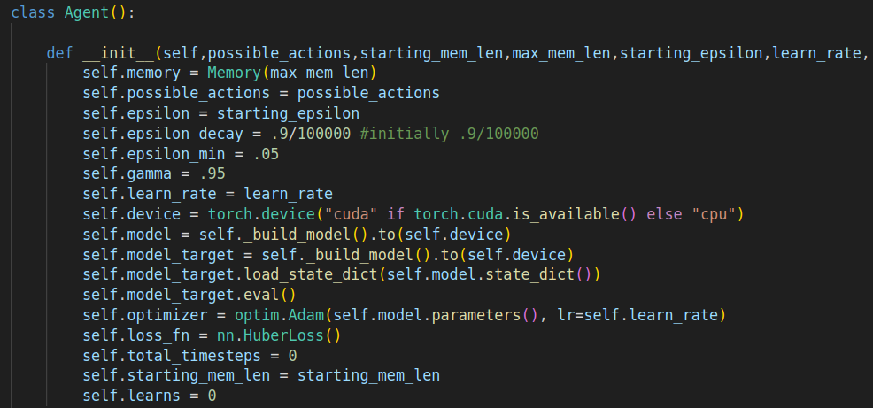
Deep Q Network

Slide 6
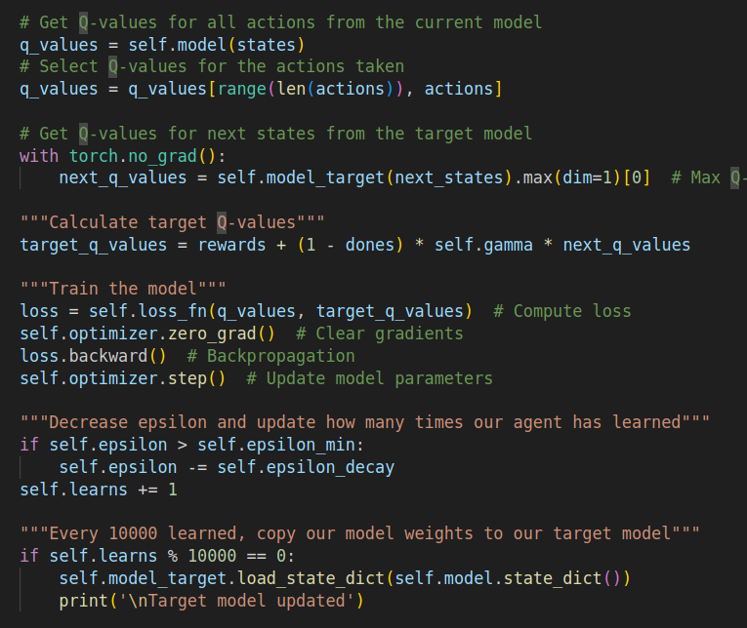
Deep Q Network

Slide 7
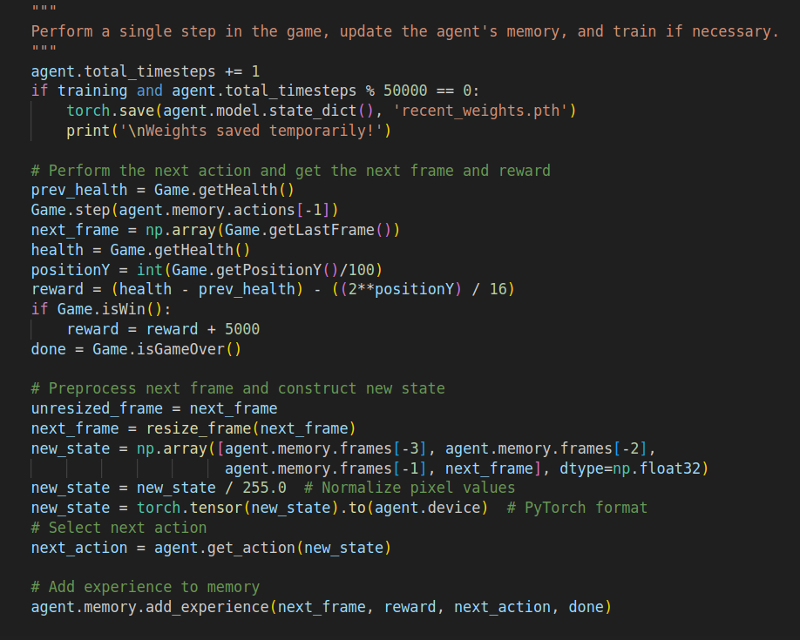
Deep Q Network

Slide 8
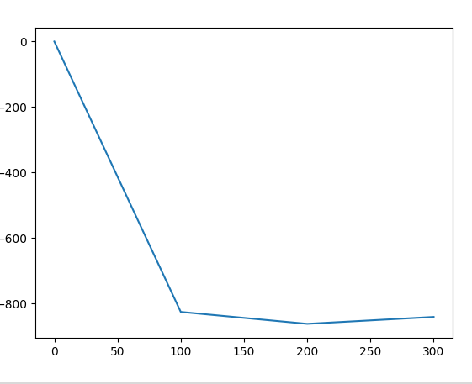
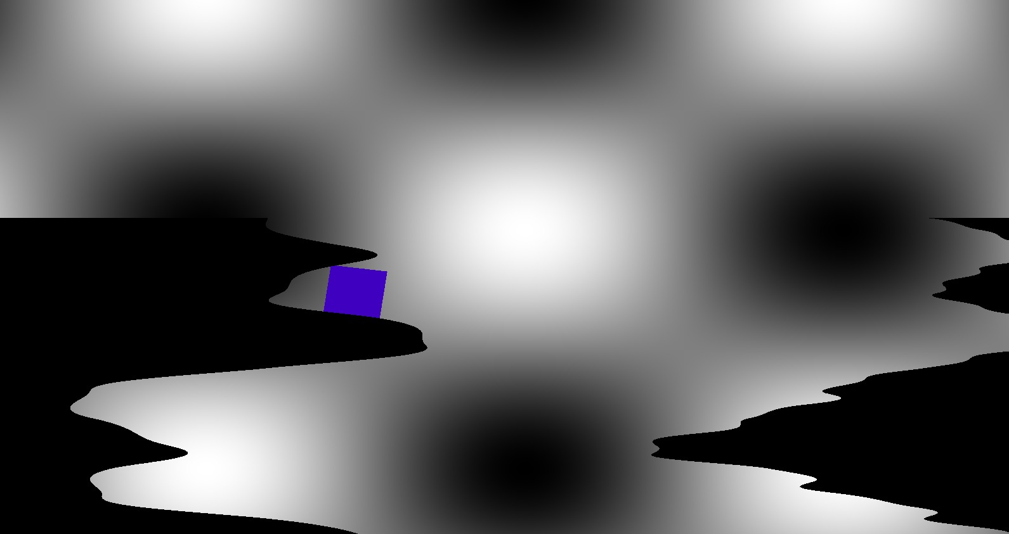
First Serious Attempt – Fail
Reward: every step: -1 - damage(if any). If Win, reward = 5000
Episodes trained: 300
Duration: 4.5 hours (cpu)
Strategy learned: stay in the corner :(

Slide 9
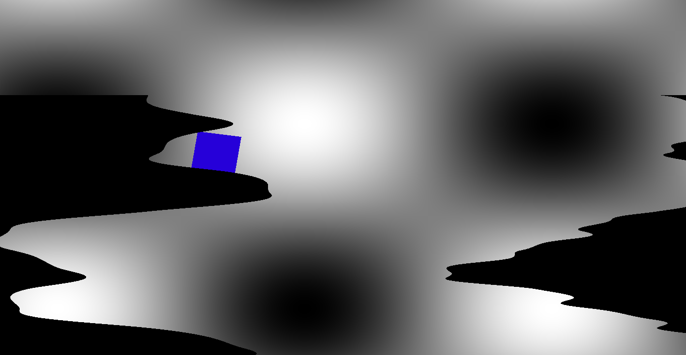
Second Attempt
Reward: every step: - damage(if any) – (2^PositionY / 16).
If Win, reward = 5000
Episodes trained: 200
Duration: 3 hours
Same results

Slide 10
Observations
Epsilon decay: Tried 0.9/10^4, but learns little because it doesn’t try many things. Kept 0.9/10^5
Decreased height of game, since it only won once or twice, and that was during exploration
Maximum 75 seconds per episode

Slide 11
Thank you!

