Slide 1
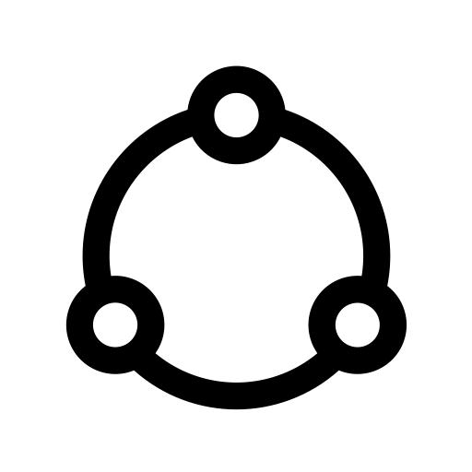
Sky-chain design
Architectural & Detail
Notes:
NOTE:
To change the image on this slide, select the picture and delete it. Then click the Pictures icon in the placeholder to insert your own image.

Slide 2
Node Runtime
MyApp
sky-chain
Kestrel & Npgsql

Slide 3
Hierarchy of Environments
DbEnviron
ChainEnviron
ServerEnviron
MyApp

Slide 4
Chain Environment
Connectivity to federated peers, keep data sync
ChainEnviron
ChainWebConnect
ChainValidator

Slide 5
Data Storage
Chain Transaction
1..n
_Ent
Queuel
Archival

Slide 6
Entries of Transaction
txn | typ | acct | remark | amt | stamp | rpeerid
01000001 | 1 | 00034 |  | -3
01000001 | 1 | 23412341243 |  | 1
01000001 | 1 | 23412341773 |  | 1
01000001 | 1 | 23419987987 |  | 1
peerid | seq | txn | typ | acct | remark | amt | stamp | rpeerid
1 |  | 01000001 | 1 | 00034 |  | -3
1 |  | 01000001 | 1 | 23412341243 |  | 1
1 |  | 01000001 | 1 | 23412341773 |  | 1
1 |  | 01000001 | 1 | 23419987987 |  | 1

Slide 7
Process
App submission
Submitted by the last activity of a workflow
Check queue status (failure or success)
Archiver
Transaction validate
Commit the successful to archive
submit
archive
App Data
Queuel
Archival
validate

Slide 8
合作社
商户

