Slide 1
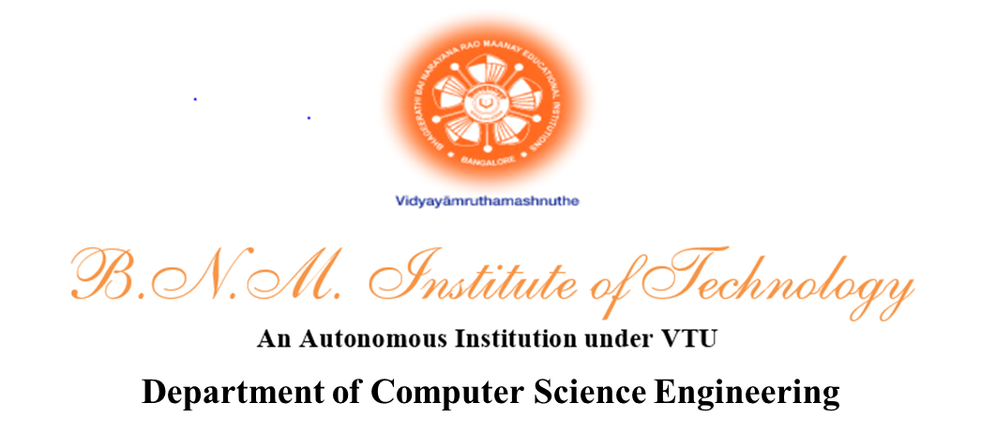
AgriSync
A Blockchain Based Application for Agricultural Supply Chain Management
Guide:
Mrs. Manikantha K
Asst. Professor
Department of CSE
Course Code: 18CSS84
Abhay Nataraj 1BG19CS004
Mohammed Affan 1BG19CS133
Calden M D’Souza 1BG19CS027
Charan Kannati 1BG19CS030

Slide 2
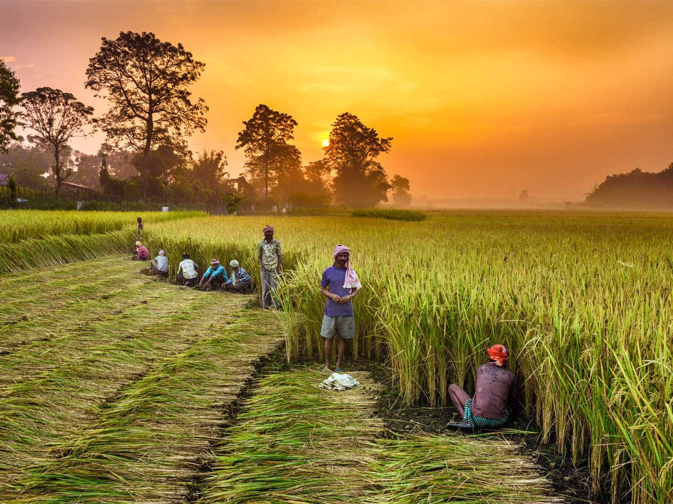
Introduction
Improved supply chain management system
Using blockchain technology
Decentralized and Transparent
System helping the Farmers to track the status of their goods
In accordance with IoT
This Photo by Unknown Author is licensed under CC BY

Slide 3
Literature Survey

Slide 4
[1] Dr. V. Sudha, Dr. P.Shanmugasundaram & Dr.R. Kalaiselvi “The Blockchain-based solution to improve the Supply Chain Management in Indian agriculture”- (2021)
Methodology:
Author proposes a blockchain-based solution to keep track of the goods.
details of goods/quality such as size, colour, defect-free, natural/manure free/organic, time of cultivation, humidity, current market price, etc., are measured and stored in the Blockchain
Details about the goods can also be collected via a form.
information obtained through this form is validated using the rules specified in the smart contract.
Benefits:
Integrity and authenticity of data are maintained by combining Blockchain with IoT.
Health of the crops can be tracked.
Drawbacks:
Higher investment in IoT devices
Farmers may need assistance if they are not tech-friendly

Slide 5
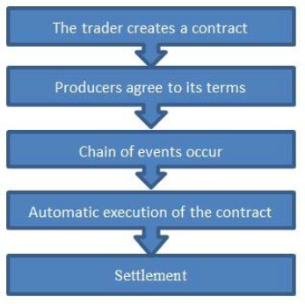
Dr. B Ravishankar, Mayur Appaiah & Bhagya Hegde “Agricultural Supply Chain Management Using Blockchain Technology”- (2020)
Benefits :
The producer will have security. They will be able to receive a
reasonable percentage of profit.
Traders can eliminate competition.
Traceability: Players in different tiers can be held responsible for any
damages.
Increase in multidirectional information transfer.
Drawbacks:
For the product to be international it will have to
succumb to various international laws.
Blockchain applications are very complex to design.
Blockchain relies on a network effect.

Slide 6
[2] N.Nasurudeen Ahamed, Karthikeyan P, SP Anandaraj, Vignesh R “ Sea Food Supply Chain Management Using Blockchain”-(2020)
Methodology:
The NFC Tag tracks and traces the product. Each product uses NFC Tag, Securing, and storing the product.
The purpose of the QR code generated from the warehouse to reach the appropriate consumer means it is for consumer satisfaction. After reaching the product to the consumer. He/she checks out the product via mobile to check the good's origin and date of the particular food.
Benefits :
The unique tag ensures all people from the producer to the consumer side get all details of the product. This creates trust in the proposed system.
Drawbacks:
For the product to be international it will have to succumb to various international laws.
Blockchain applications are very complex to design.
Blockchain relies on a network effect.

Slide 7
[3] Affaf Shahid, Ahmad Almogren, Nadeem Javaid, Fahad Ahmad Al-zaharani, Mansour Zuair ,MasoomAlam “Blockchain-Based Agri-Food Supply Chain: A Complete Solution”-(2020)
Methodology:
Traceability
Trading and Delivery
Reputation System
Advantages:
Accountability
Credibility
Autonomy
Authenticity
Disadvantages:
Blockchain doesn’t eliminate the need to trust human institutions. There will always be a big gap that can’t be addressed by technology alone.

Slide 8
[4] B. M. A L. Basnayake, C. Rajapakse “A Blockchain-based decentralized system to ensure the transparency of organic food supply chain”-(2019)
Methodology:
DApp based on Token model, Solidity-based smart transaction model and QR code generation model.
For each deployment of the “product” contract, it will return an address which was used to generate the QR code to identify the physical product.
Consumers could scan the QR code using a mobile application that enables access to the Blockchain system.
Benefits :
A public Blockchain concept was selected instead of a private Blockchain in this study to ensure transparency by allowing any person to access the network.’
Farmers could place a certification request regarding their products and, they can gain reputation tokens for each certification done by peers.
Drawbacks:
Certification can be misused to sell products from third parties or low-quality products because only the farmers are certified, not products because only the farmers are certified, not the products.

Slide 9
[5] Technology-S. Madumidha, P. Siva Ranjani, U.Vandhana, B.Venmuhilan “A Theoretical Implementation: Agriculture-Food Supply Chain Management using Blockchain Technology”-(2019)
Methodology:
The supplier uploads the data about the food product like its harvested date, and price. The Food product is then tagged with an RFID chip. The tags are placed on any items, ranging from individual parts to delivery labels. Inside the RFID tag, it consists of a microchip and antennae. Identifying information from the Special printers are used to print the tags which wirelessly load the identifying information to the tags. The information on the tags can be used for various tasks. When RFID scanners scan the item, information is read from the tag which could include some necessary information that could be very effective in maintaining the Supply chain.
Benefits :
Increase Transparency
Reduce Error
Prevents product delays
Eliminate unethical and illegal activities
Better management
Increase the trust between consumers and supplier
Drawbacks:
Lengthy Process
Market Revolves around retailers
.

Slide 10
Problem Statement
To Design a Application using blockchain technology and IoT to attain transparency about the goods’ status, leading to a healthy relationship between Farmer and Customer.

Slide 11
System Architecture

Slide 12
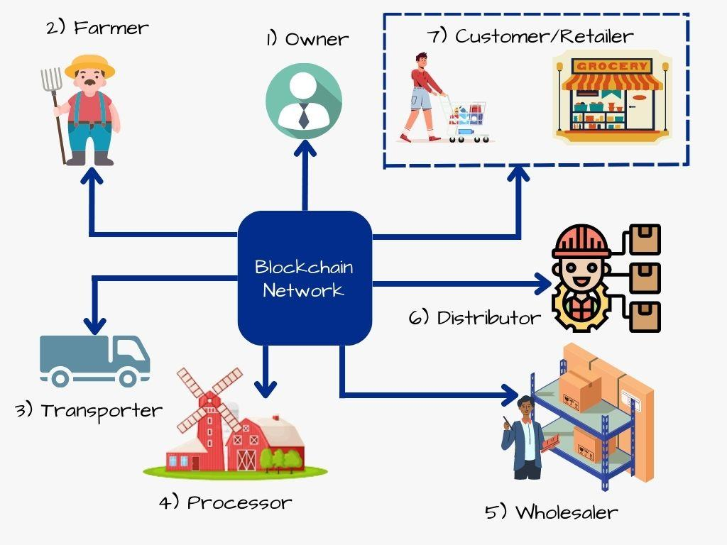

Slide 13
Module Design

Slide 14
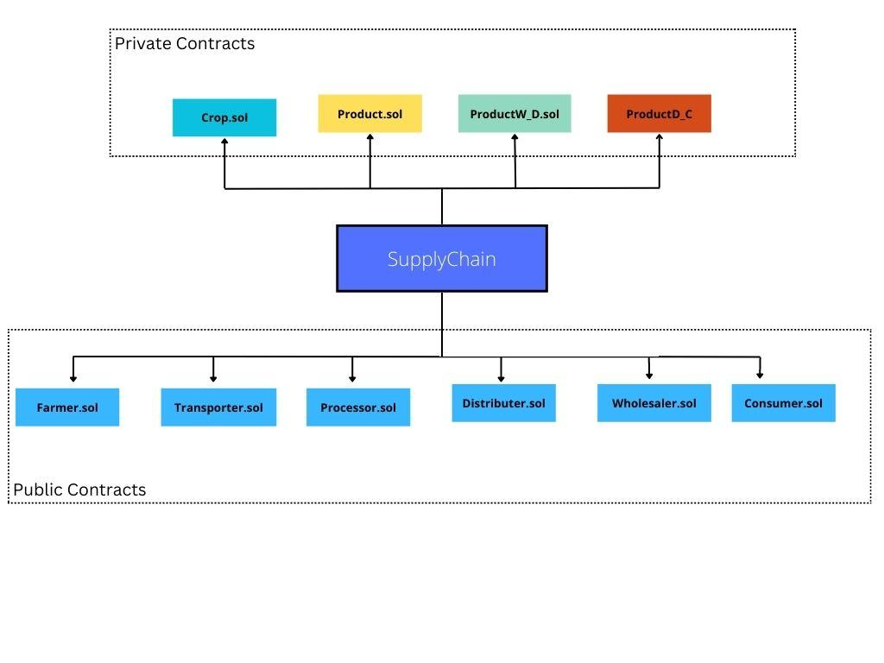

Slide 15
Data Flow Diagram

Slide 16
Level 0
Agricultural Supply Chain System
Users Created
Owner
Users
Owner creates users
Users Interact with the Chain

Slide 17
Level 1
Crop Creation
Blockchain
Farmer
Crop Details
Crop name and quantity used to create new contract
Agricultural Supply Chain System
Product name and crops used to create new contract
Product Creation
Owner
Processor
Product Details
Pick and Deliver Package
From and to addresses of Crop and Product contract are changed
Transporter
Package Details

Slide 18
Crop Creation
Level 2
Farmer
Crop Address
Blockchain
Find and verify crop address and processor address
Buy Crop
Farmer Address
Product Creation
processor
Find and verify product address and wholesaler/distributor address
Product Address
Buy Product
Owner
Agricultural Supply Chain System
Processor Address
Wholesaler
ProductW_D Address
Buy ProductW_D
Change From and to Address of package
Distributor
Wholesaler Address
ProductD_C Address
Buy ProductD_C
Pick and Deliver Package
Transporter
Customer
Distributor Address
Package Details

Slide 19
Use Case Diagram

Slide 20
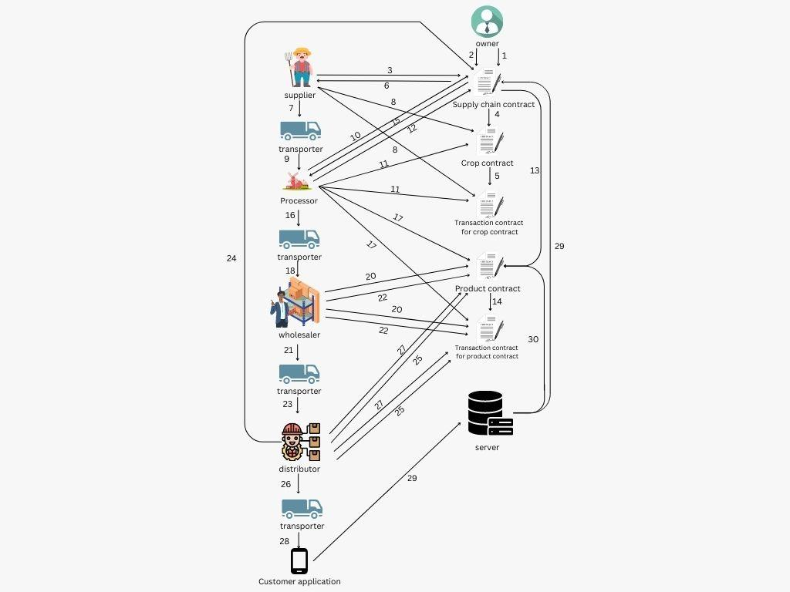

Slide 21
Module Implementation

Slide 22
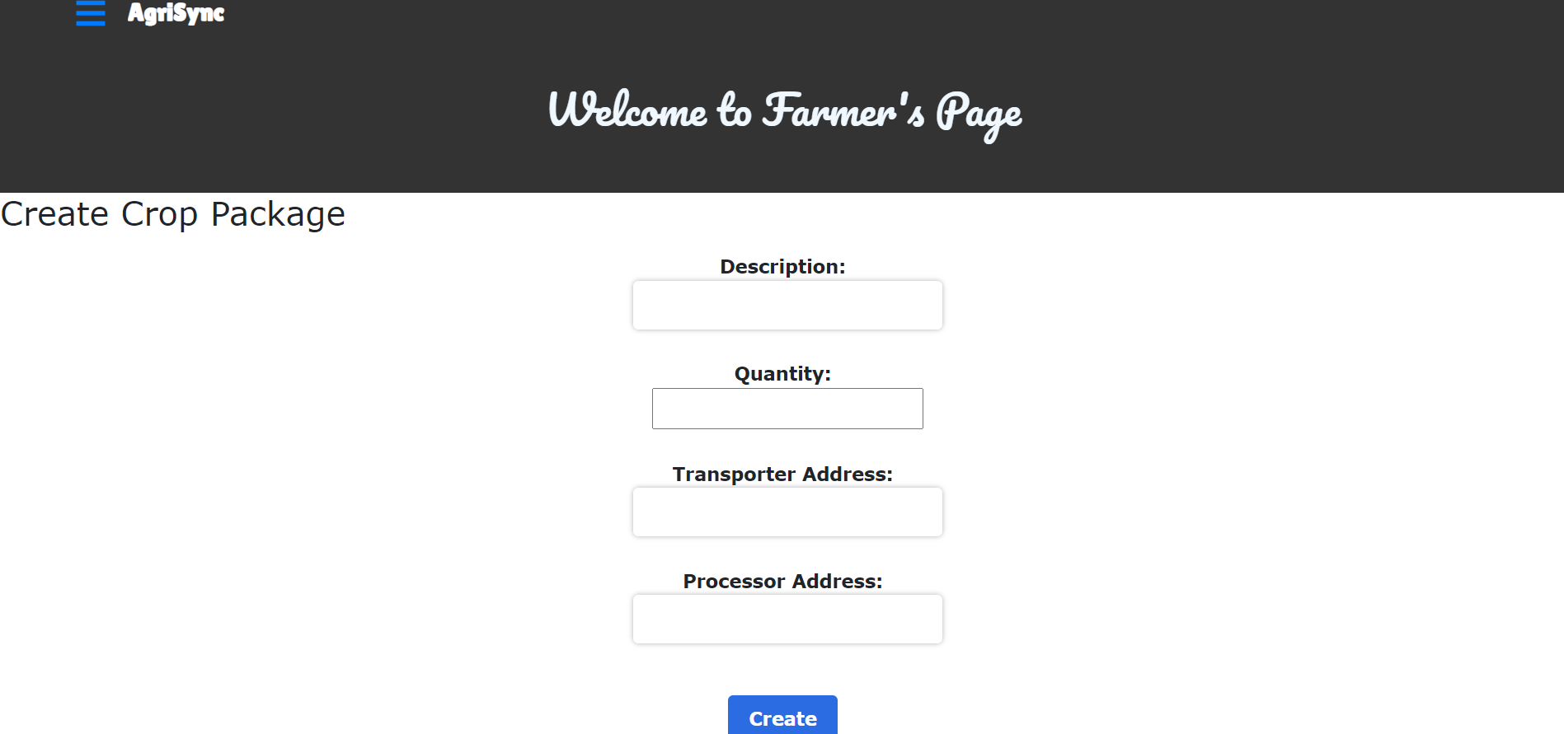

Slide 23
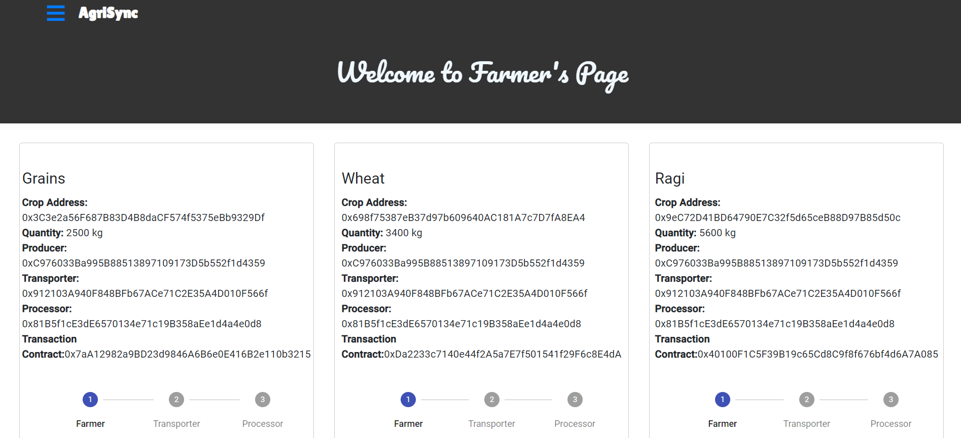

Slide 24
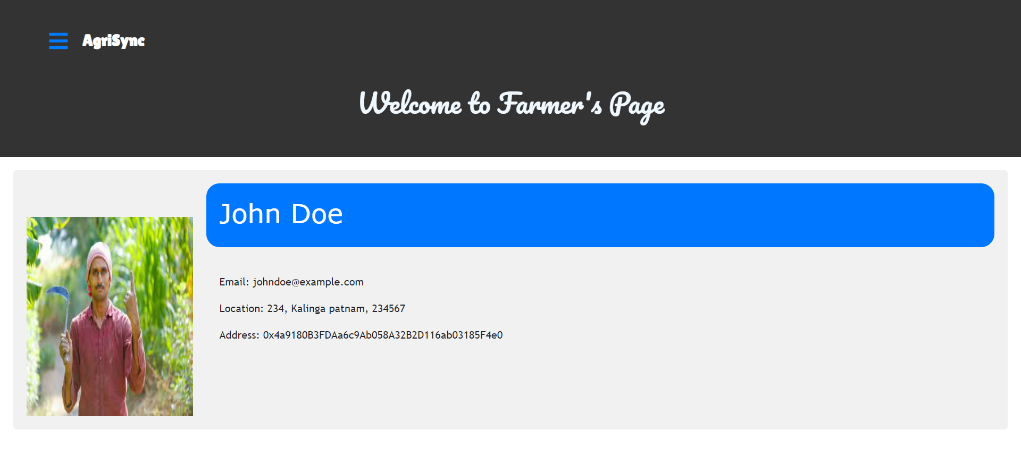

Slide 25
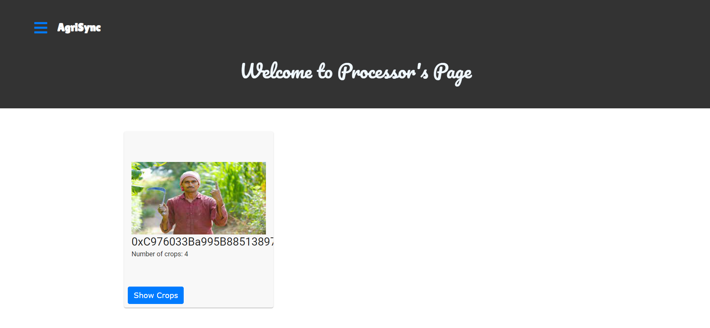

Slide 26
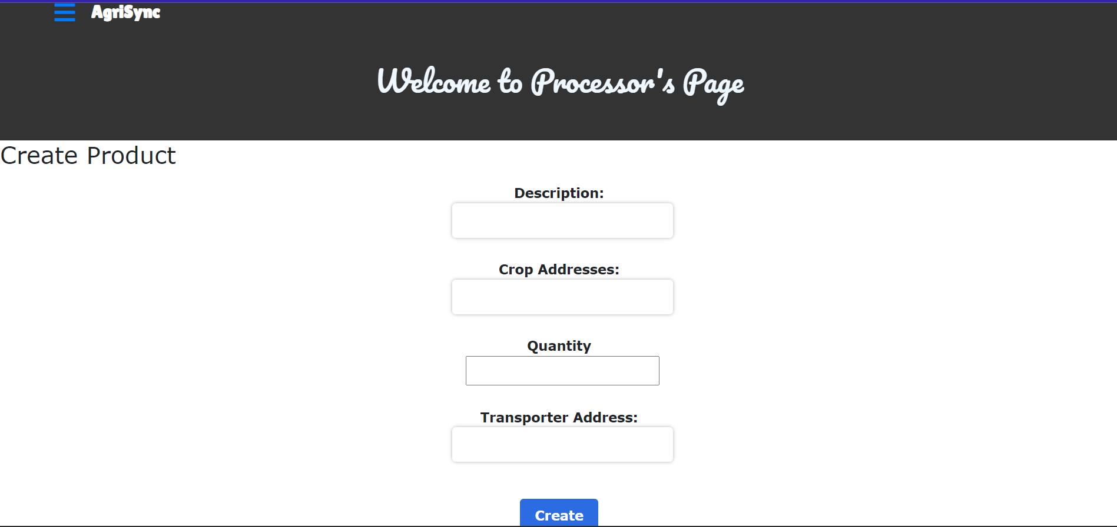

Slide 27
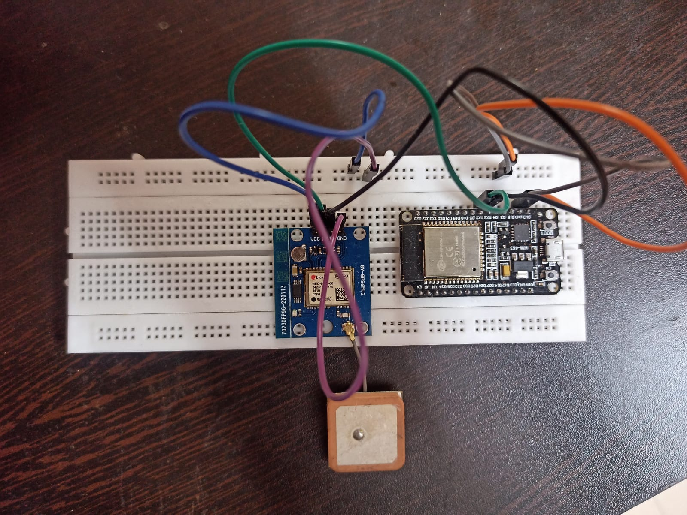
IOT Implementation

Slide 28
Conclusion
The use of blockchain technology and IoT devices in the agricultural supply chain management system can increase transparency, accountability, and efficiency.
The system provides a secure and tamper-proof record of transactions and data, improving traceability and compliance with regulations.
The inclusion of smart contracts eliminates the need for intermediaries and reduces transaction costs, leading to increased efficiency and cost savings.
The implementation of a blockchain-based supply chain management system poses challenges such as initial investment, scalability, and interoperability.

Slide 29
Future Scope
IOT devices to monitor the health and conditions of crops.
Integration of payment portal.
Prediction and Real-Time package tracking.
Nearest transporter assignment

Slide 30
Thank You

