Slide 1
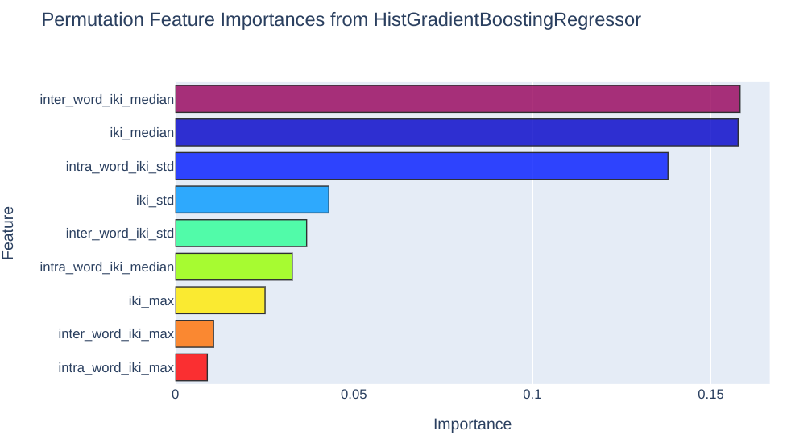
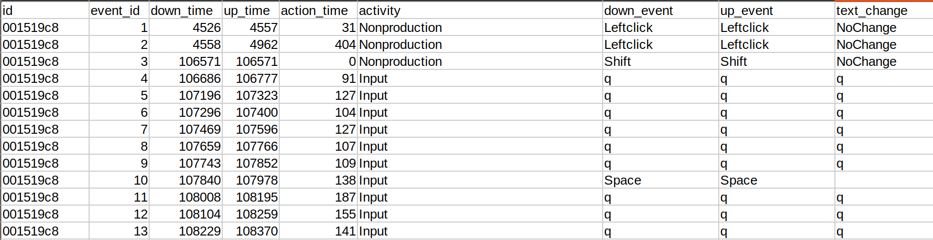
Linking Writing Processes to Essay Quality
Calder Lenhart
–
COLLEGE OF ARTS AND SCIENCES / DEPARTMENT OF PHYSICS / PHYSICS 5680 / FINAL PROJECT
Background
The "Linking Writing Processes to Writing Quality" Kaggle competition hosts a dataset comprised of keystroke logs from mock SAT essays collected from more than 5000 participants on Amazon’s Mechanical Turk platform. Similar datasets have previously been published, but this one is unprecedented in size. Successfully identifying the relationships between people’s writing behaviors and the quality of their work during the writing process has the potential to improve writers’ metacognitive regulation.
Model Design
Selection: I initially treated this as a classification problem,
Tuning:
Performance:
Results
Feature Importance:
Using scikit-learn’s built-in permutation feature importance model inspection technique, I
Mean Square Error on Training Set:
Mean Square Error on Hidden Test Set:
Efficiency:
Future Improvements
Data
The data consists of three CSV files. Shown below are the training logs consisting of a user ID, event ID, timestamps for the downstroke and upstroke of the key, the type of activity, the key pressed, and the change in text. Note that all alphanumeric characters are masked with the letter “q” to ensure that the models are trained on the writing behaviors rather than content. Additionally, there is a CSV file with essay scores for each participant, human-graded on a half-integer scale from 0.5 to 6.
Feature Engineering
I derived 9 features from this data based on two studies [1][2] of real-time prediction of writing quality using keystrokes.
Interkeystroke interval (IKI)
The time between the downstroke of a keypress and the downstroke of the subsequent keypress
Inter-word IKI
IKI between the end of a word and the beginning of the following word
Intra-word IKI
IKI between the beginning and end of a word
References
[1] Conijn, R., Cook, C., van Zaanen, M. et al. Early prediction of writing quality using keystroke logging. Int J Artif Intell Educ 32, 835–866 (2022). https://doi.org/10.1007/s40593-021-00268-w
[2] Malekian, Donia, et al. "Characterising Students' Writing Processes Using Temporal Keystroke Analysis." International Educational Data Mining Society (2019).
https://github.com/calderlen/kaggle-competition.git

