Slide 1
FRONTEND (Top Layer)
APPLICATION LOGIC
(Middle Layer)
PERSISTENCE (Bottom Layer)

Slide 2




FRONTEND
(Top Layer)
Web - Browser
APPLICATION LOGIC
(Middle Layer)
Server
PERSISTENCE
(Bottom Layer)
Server

Slide 3





FRONTEND
(Top Layer)
HTML, CSS, JavaScript
APPLICATION LOGIC
(Middle Layer)
JAVA
PERSISTENCE (Bottom Layer)
SQL

Slide 4

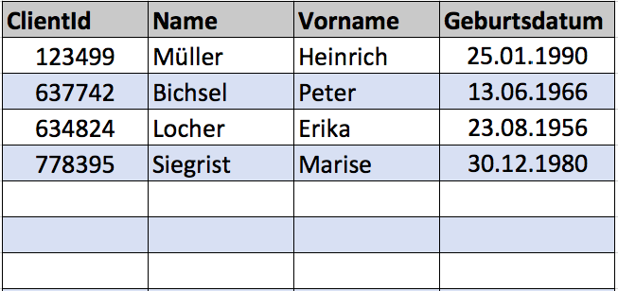
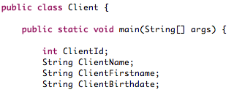

FRONTEND
(Top Layer)
Presentation Layer
APPLICATION LOGIC
(Middle Layer)
Domain Layer
PERSISTENCE
(Bottom Layer)
Data Access Layer

Slide 5
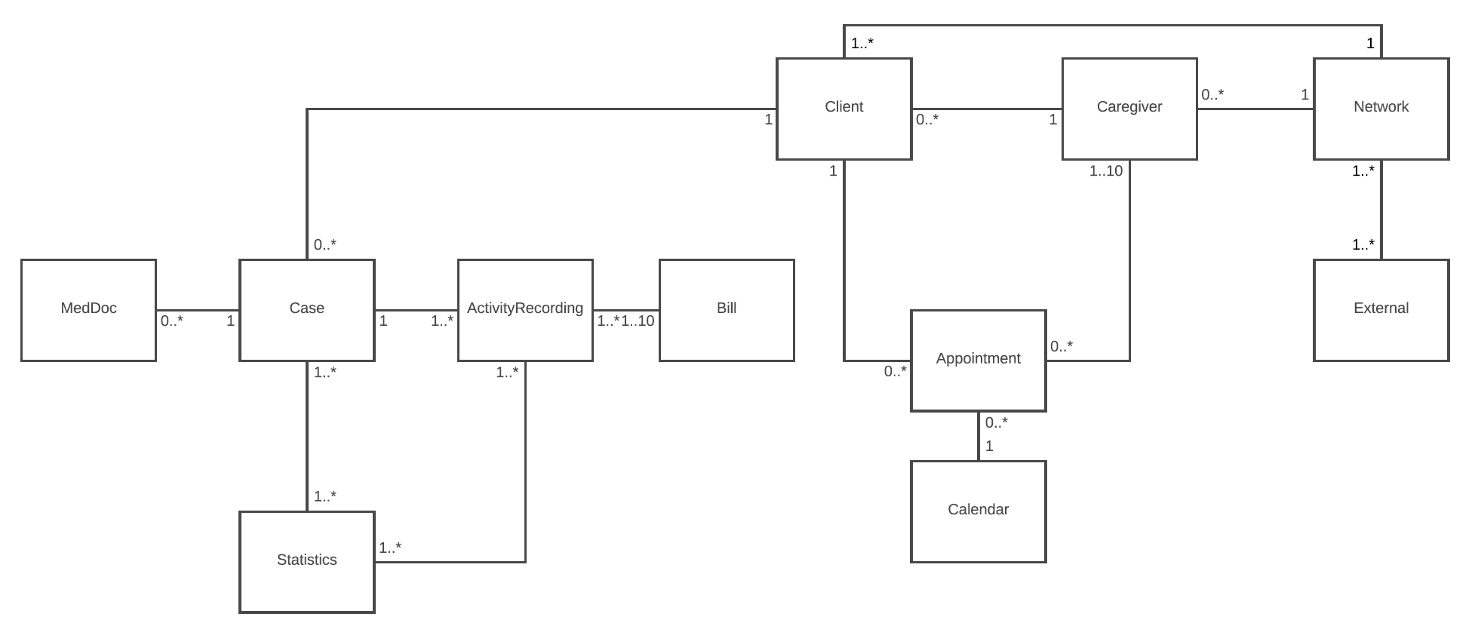

FRONTEND
(Top Layer)
- Login Screen
- Main Screen
- Clients View/Screen
- Case View/Screen
- Calendar Subwindow
- Patient List Subwindow
- Statistic Screen
- Network Subwindow
APPLICATION LOGIC
(Middle Layer)
PERSISTENCE
(Bottom Layer)
- Clients – DB
- Case – DB
- User – DB
- Partner (Network) - DB

