Slide 1

CUBO+ BUILD SPRINT 2026 · MICROPAYMENTS FOR CONTENT
Pay for the lesson you need, in sats.
A learning platform where each lesson, chapter or course can be bought over Lightning, and access stays with the version you bought.
By Caleb Ortiz and Ivania Martinez
DEMO DAY · NOV 8, 2026
LIGHTNING · DJANGO · LNBITS
Notes:
Good morning. We are BTC.EDU. Our project started with one question: how can someone buy exactly the educational content they need, without paying for a full course or a monthly subscription?

Slide 2
What people need isn't what platforms sell
THE PROBLEM
WHAT PEOPLE NEED
WHAT PLATFORMS SELL
One topic for tomorrow's exam
A full course
Automate one report at work
≠
A monthly subscription
Try a subject before committing
Fees that eat small payments
Notes:
Think of a student who only needs one topic for tomorrow's exam, or someone at work who needs to automate one report. Most platforms sell the whole course or a subscription. The unit they sell doesn't match the need. These are hypotheses we still have to test with users.

Slide 3



BTC.EDU: buy exactly what you need
THE IDEA
Explore
Pay in sats
Keep it
Free lessons, objectives and a sample before paying.
A lesson, a chapter or the whole course, over Lightning.
Access stays tied to the version you bought, even if the course changes.
SIX CATEGORIES
BITCOIN & LIGHTNING
SOFTWARE
DATA & AI
CYBERSECURITY
INFRA & CLOUD
DESIGN
Notes:
BTC.EDU is a learning platform where you can buy a single lesson, a chapter, or the full course, and pay with sats over Lightning. You can read free content and a sample before you pay, and after you pay you keep access to the version you bought. Our first audience is students, working people and self-learners in El Salvador. Bitcoin is the payment method; the content goes beyond Bitcoin.

Slide 4
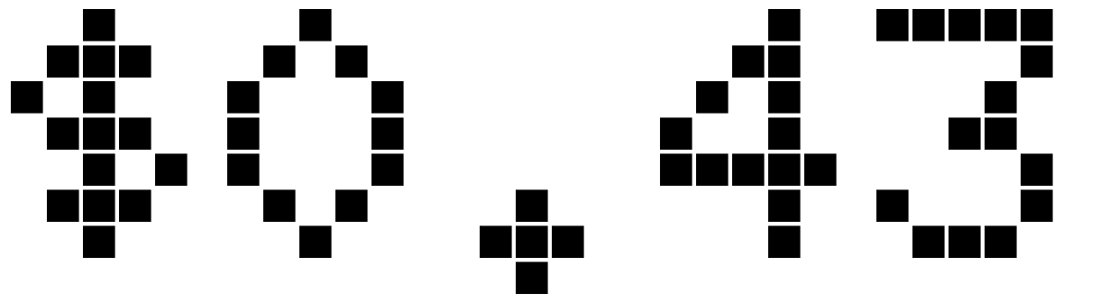
Why Lightning makes small purchases work
RESEARCH
Pay the difference
Tips
Finish a course paying only what's missing.
10 to 100,000 sats straight to an educator.
lost in card fees on a $1 purchase
Refunds
Gifts
Illustration with Patreon's published card rates, USD settlement. Not our cost.
8 days, paid back over Lightning.
Buy for someone with a one-time link.
Notes:
We compared subscription, advertising, freemium and micropayments, and reviewed Udemy, Domestika, Coursera Plus, Gumroad, Patreon, Teachable and Thinkific. Individual purchases already exist; we don't claim to invent them. Card fees have a fixed part: with Patreon's published card fees, a 1-dollar purchase loses about 43 cents. Lightning makes very small payments viable, and also tips, refunds and partial payments.

Slide 5
Three models, side by side
BUSINESS MODEL
01
02
03
Paid
Freemium
Membership
Buy any lesson, any chapter or the full course.
Three lessons free, the other nine for sale.
Every included course, for 30 days. Renewed by hand.
3,000 sats
2,100 sats
5,000 sats
TYPICAL FULL COURSE
TYPICAL FULL COURSE
PER 30 DAYS
A lesson costs 1.5× its share, so the full course is the better deal. All prices are test values, not yet validated.
Notes:
We show that the models can live together. Each of the six categories has a paid course, a freemium course with three free lessons, and a course included in a 30-day membership of 5,000 sats. Lessons cost 1.5 times their share of the course, so the full course is the better deal. All prices are test values; we have not validated them with buyers yet.

Slide 6
From locked lesson to permanent access
LIVE DEMO
1
2
3
4
5
Locked
Invoice
Pending
Paid
Unlocked
Sample and objectives; protected text stays on the server
Lightning QR from LNbits, valid for 15 minutes
The page checks the status silently
Server verifies hash, amount and expiry
Access is saved and persists
Late payment: logged as an incident for admin, never automatic access.
INVOICE STATES
PENDING
PAID
EXPIRED
FAILED
Notes:
Demo, about 4 and a half minutes. Terminal: dev.ps1 running Django and LNbits with FakeWallet. Catalog, then a paid lesson: the sample shows, the protected text never reaches the browser. Buy now, prepare payment, QR invoice with 15 minutes. Pay with FakeWallet: the lesson opens. Reload: access persists. Back to the course: the price subtracts what was paid. Then the metrics page and admin invoices. Mention the ZEUS payment of 3,600 sats on regtest on November 3.

Slide 7
Trust lives on the server
ARCHITECTURE
The server sets the price
Browser
It calculates and signs the quote. The browser never decides how much to pay.
3 account types
Payment is verified before access
Django 5.2
LNbits
settle checks hash, amount in msat, expiry and order, all in one transaction. A repeat never duplicates.
accounts content creators commerce learning media
invoices
Publishing freezes a version
Wallet
Later edits don't change what someone bought or their progress.
FakeWallet or LND regtest
Notes:
Django 5.2 with SQLite for this stage, split into apps: accounts, content, creators, commerce, learning and media. Three rules: the server calculates and signs the price; settle checks the payment hash, the amount in millisats, the expiry and the order, then creates purchase, access rights and enrollment in one transaction, or stores an incident; publishing freezes a version. A repeated confirmation never creates two purchases. reconcile_payments checks pending invoices in the background.

Slide 8






What we built and verified
EVIDENCE
COURSES, ORIGINAL TEXTS
LESSONS
CATEGORIES
AUTOMATED TESTS
COMMITS SINCE OCT 1
SATS PAID FROM ZEUS ON REGTEST
Notes:
25 courses and 252 lessons across six categories, original texts. 629 automated tests plus concurrency checks, Ruff and migration checks. 94 commits since October 1, with a daily log. And on November 3 we paid 3,600 sats from the ZEUS wallet on a phone, on a regtest network with Polar, and the course unlocked. No real funds.

Slide 9
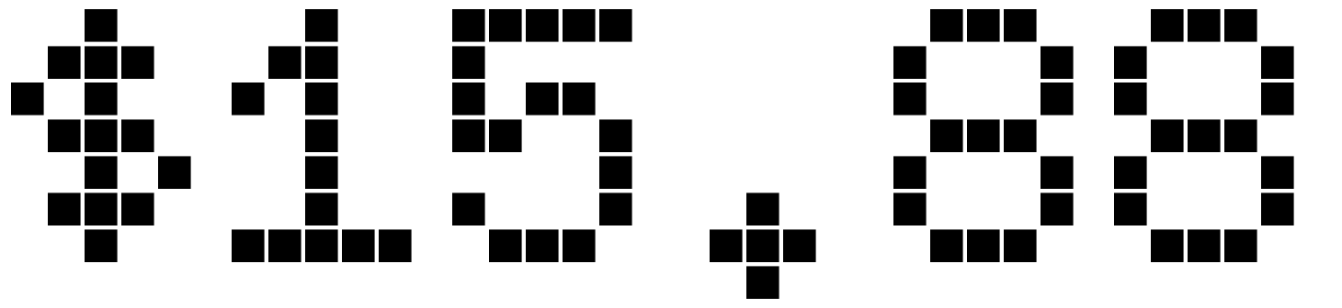


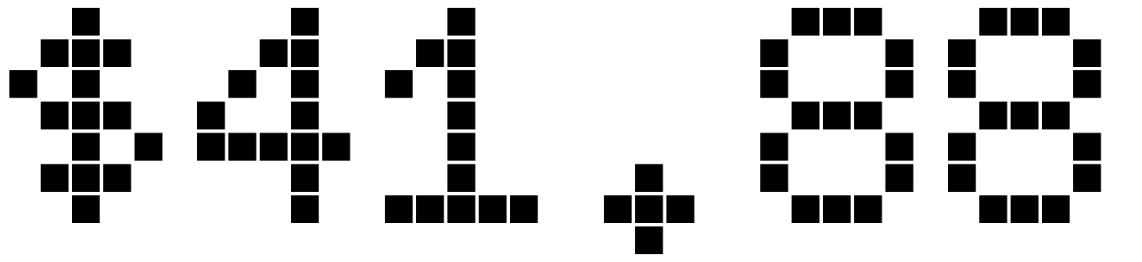

What it costs to run
OPERATIONAL MODEL
MONTHLY BREAK-EVEN · BTC AT $80K
memberships
PER MONTH · MINIMAL PILOT
our own content
Server, backups, offsite copy
average courses
our own content
courses
PER MONTH · INITIAL OPERATION
20% commission on other educators
Adds email and own video hosting
Without node or people's time. Proposal: 80% educator / 20% platform, weekly Lightning payouts. A hypothesis, not yet in the MVP.
Notes:
A minimal pilot would cost about 16 dollars a month in infrastructure, about 42 with email and video, without the Lightning node or people's time. At 80,000 dollars per bitcoin, that's about 11 memberships or 46 average courses a month if the content is ours; with a 20 percent commission on other educators, about 230 courses. Proposal: 80 percent for the educator, 20 for the platform, weekly Lightning payouts. It's a hypothesis; the MVP doesn't calculate payouts yet.

Slide 10
What we proved, and what we haven't
STATUS
PROVEN · TECHNICAL
NOT YET
Publish, pay and unlock, end to end
Interviews and usability sessions
Protected text stays on the server
Validated prices and demand
Access persists by version
Real funds and a public pilot
Real wallet payment on regtest
Specialist review of the courses
629 automated tests pass
Educator payouts
Notes:
We want to be clear. We proved the technical flow: publish, pay, unlock, keep access. We have not yet run interviews or usability sessions, prices are not validated, and no real money has moved. The interview guides and tasks are ready; that's the next step.

Slide 11
Next, test it with people in El Salvador
NEXT STEPS
01
02
03
Validate
Pilot
Pay educators
Interviews and usability tasks with students and educators.
HTTPS, email, backups and a node with inbound liquidity.
Commission, weekly payouts and a legal review of refunds.
Thank you. Questions?
Notes:
BTC.EDU shows that Lightning can change the unit of purchase in education: you pay for the lesson you need, in sats, and keep it. Next we will test it with students and educators in El Salvador. Thank you; we're happy to take questions.

