Slide 1
Reroute
Building an AI-verdict Tube-disruption app in one working session
Caleb Lim · 2026-09-23

Slide 2
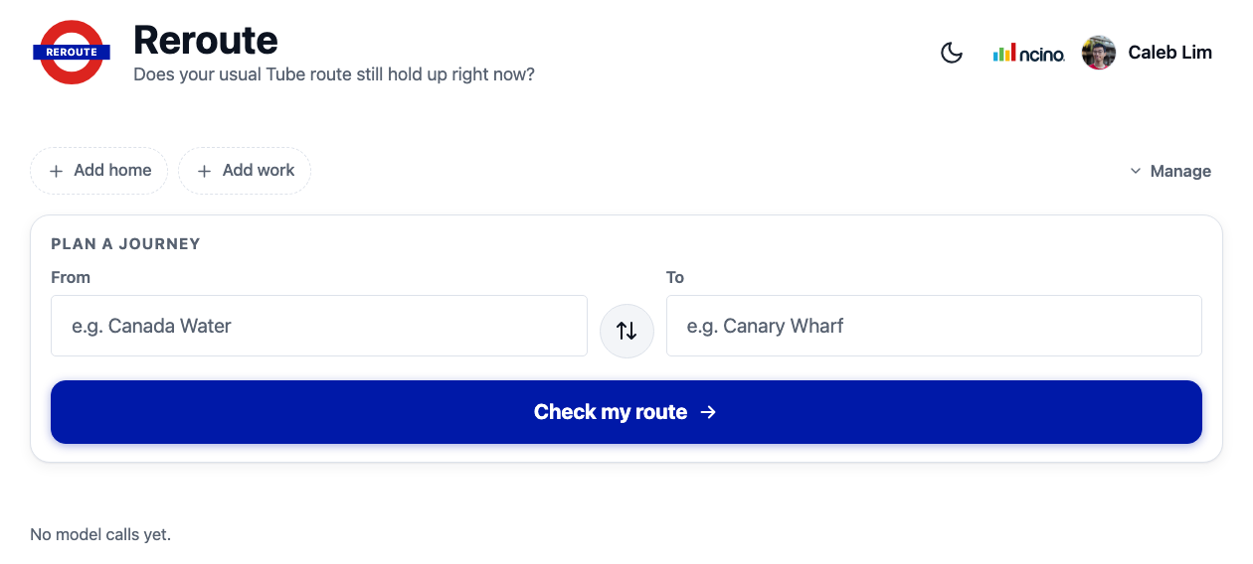
What is Reroute?
The problem: your usual Tube route might be disrupted right now, and checking line status yourself takes several taps.
The approach: Bun + Hono backend calls the TfL Unified API for live journeys, crowding and line status, then hands that data to a Claude agent (via Bedrock) that returns a plain-English verdict.
The output: "Your usual route still holds" or "Take this route instead" — with the live journey, timing, and confidence shown.

Slide 3
How it evolved
Six checkpoints, ~09:00–13:00 today — reconstructed from git history
• 10:41 — TfL tools + Agent SDK verdict
• 10:51 — Autocomplete & saved stations
• 11:16 — Expanded TfL tooling
• 11:43 — Branding pass
• 12:07 — Resilience + polish
• 13:00 — Final UI pass

Slide 4
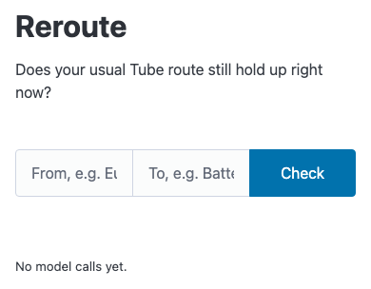
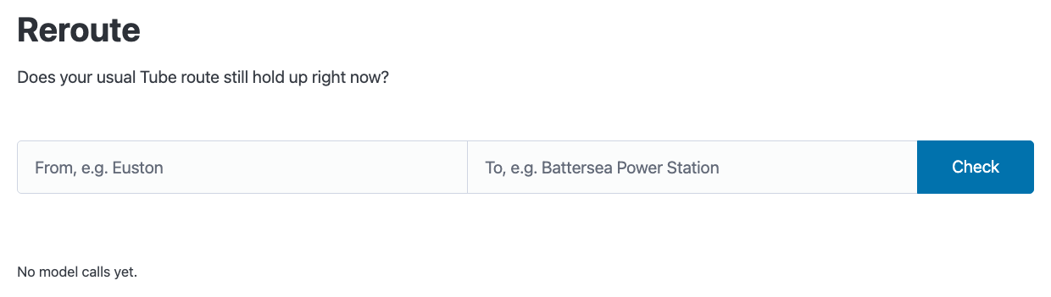
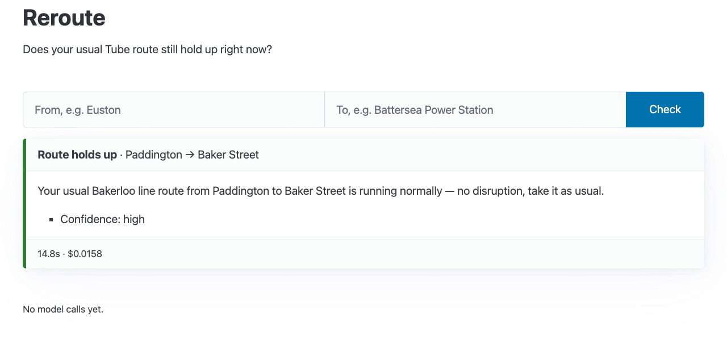
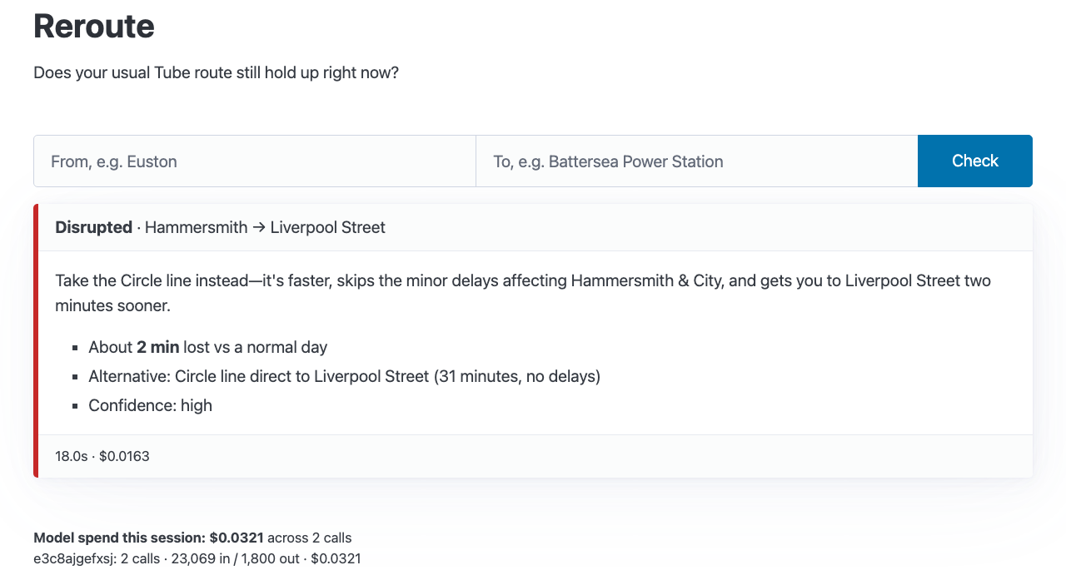
TfL tools + Agent SDK verdict
Checkpoint 10:41 today
Core loop: htmx page, usage ledger, first working verdict card.
Desktop — home
Mobile — home
Live test: Paddington → Baker Street
Judge test: Hammersmith → Liverpool Street

Slide 5
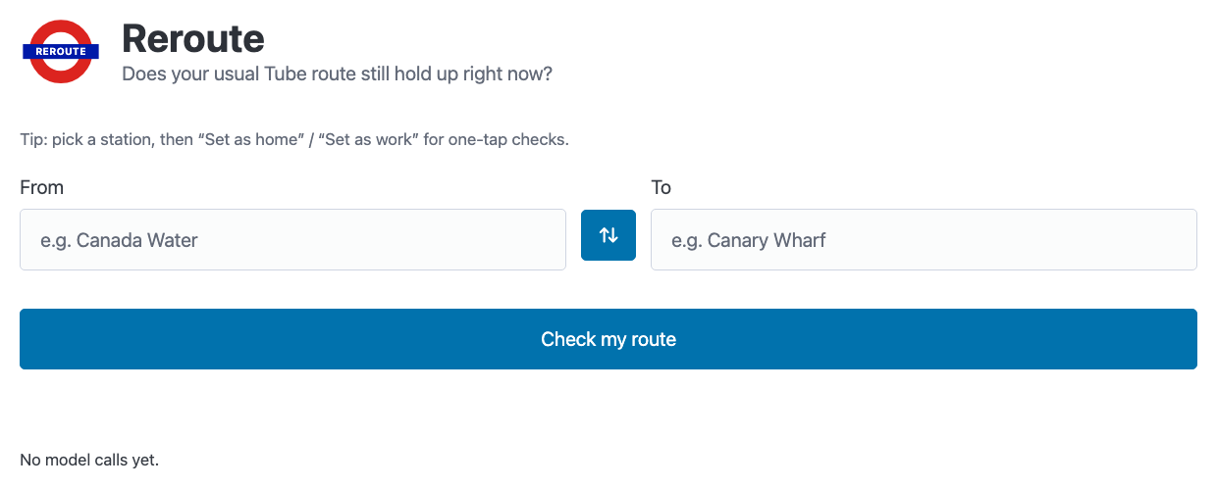
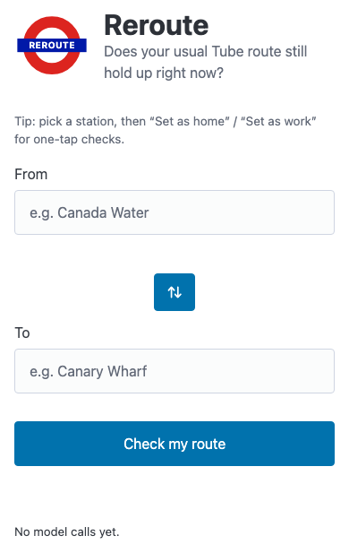
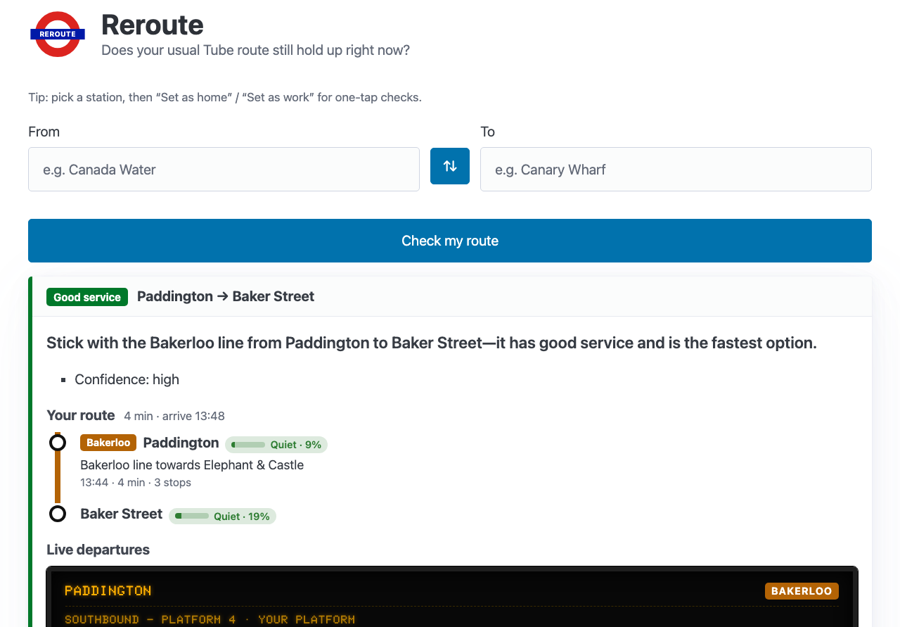
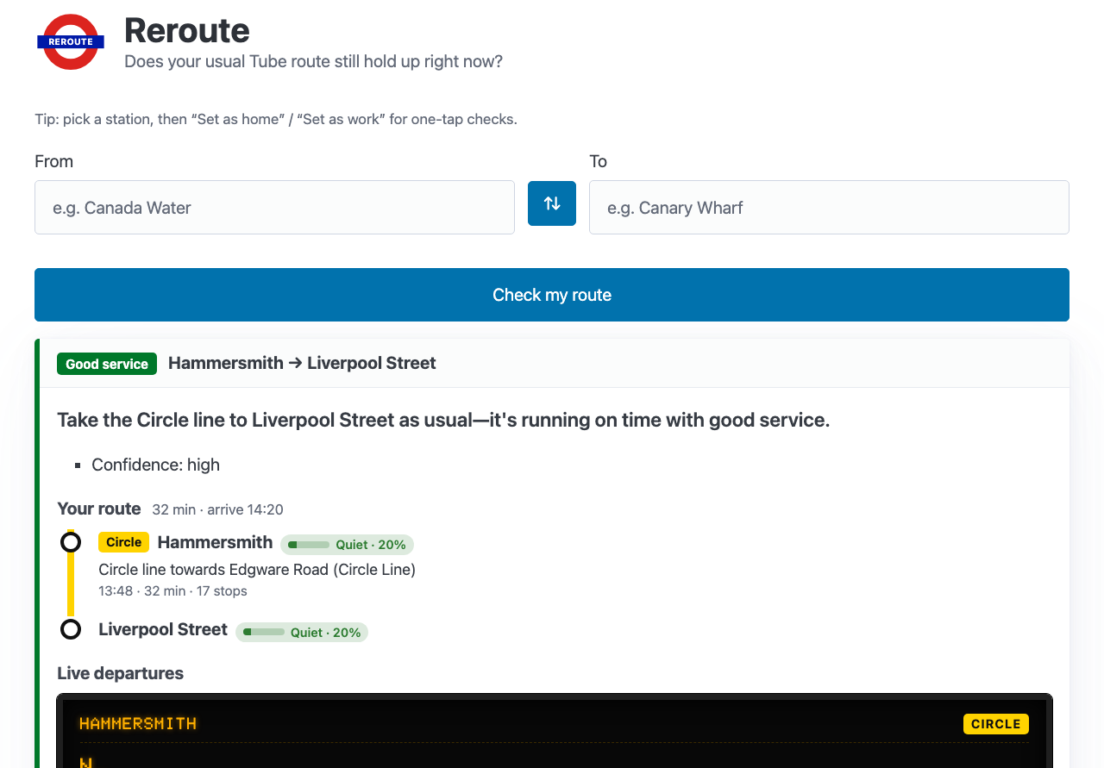
Autocomplete & saved stations
Checkpoint 10:51 today
Home/work stations, exact-route matching, departure board, crowding, live gauge.
Desktop — home
Mobile — home
Live test: Paddington → Baker Street
Judge test: Hammersmith → Liverpool Street

Slide 6
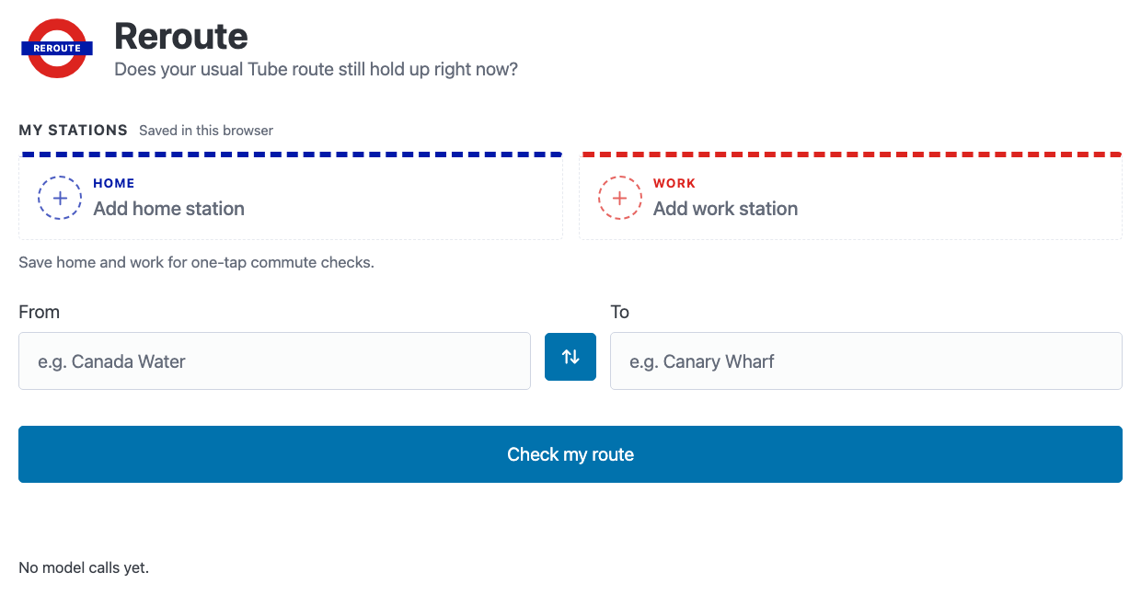
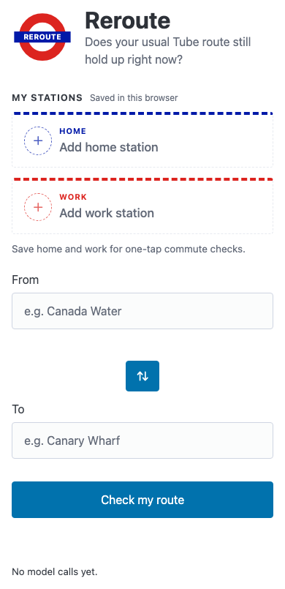
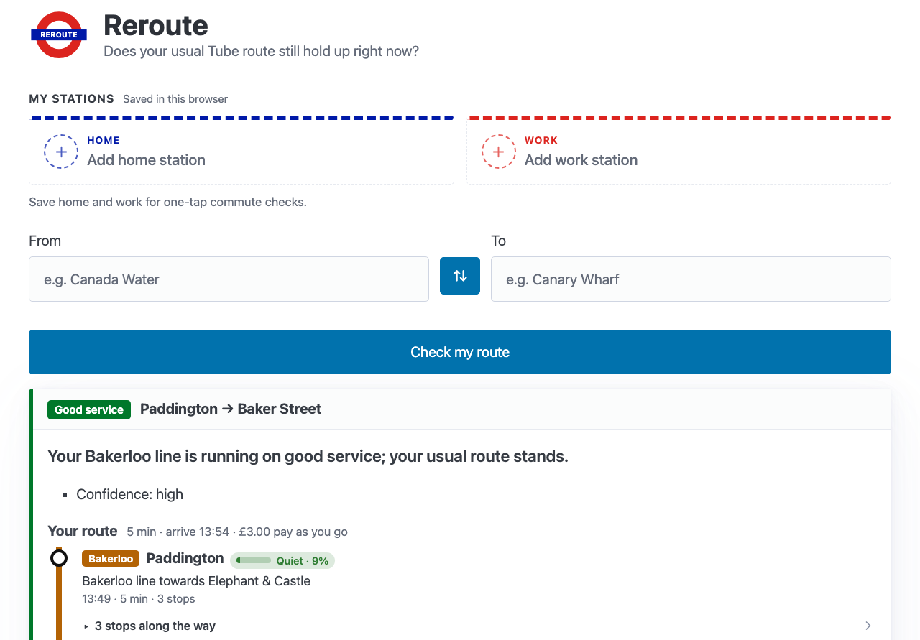
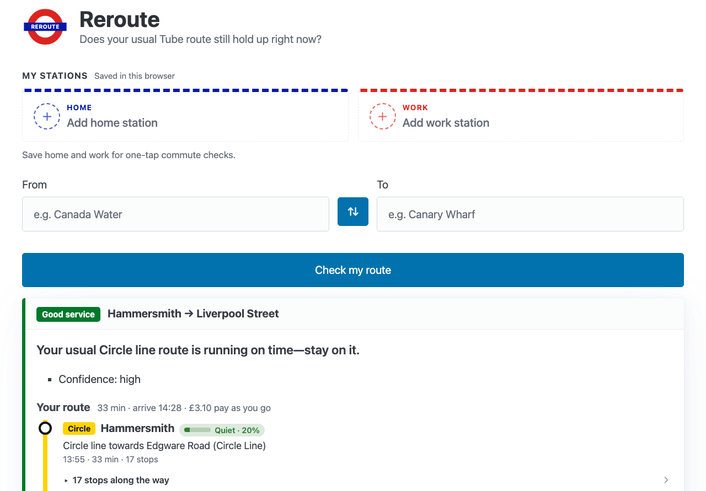
Expanded TfL tooling
Checkpoint 11:16 today
More agent tools, dedicated views, first UI pass — home/work chips as dashed slots.
Desktop — home
Mobile — home
Live test: Paddington → Baker Street
Judge test: Hammersmith → Liverpool Street

Slide 7
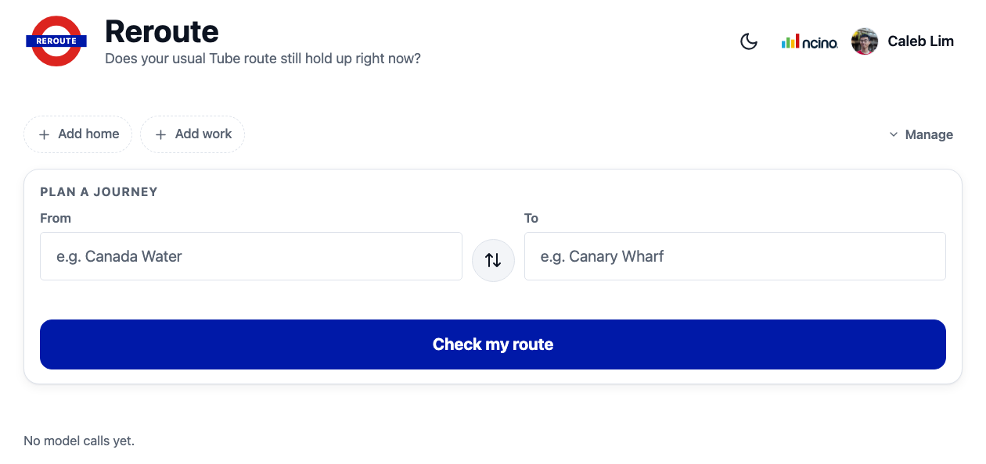
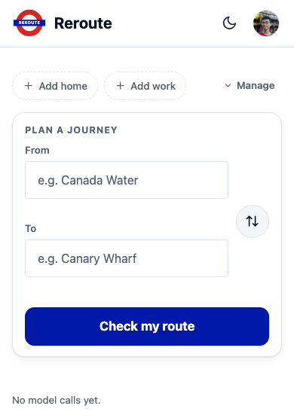
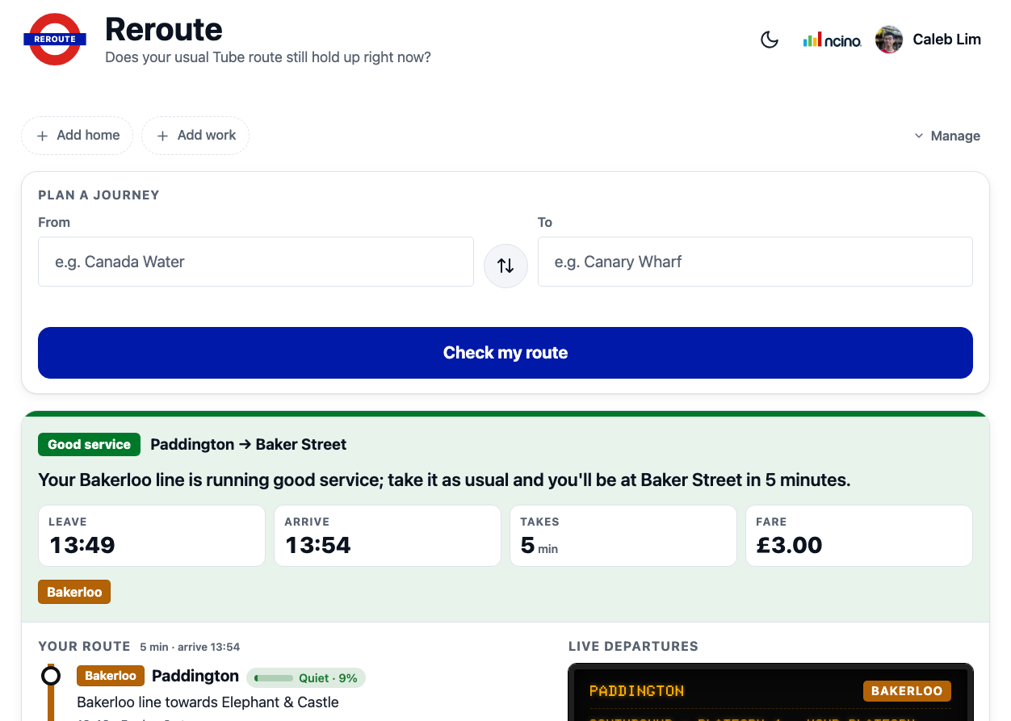
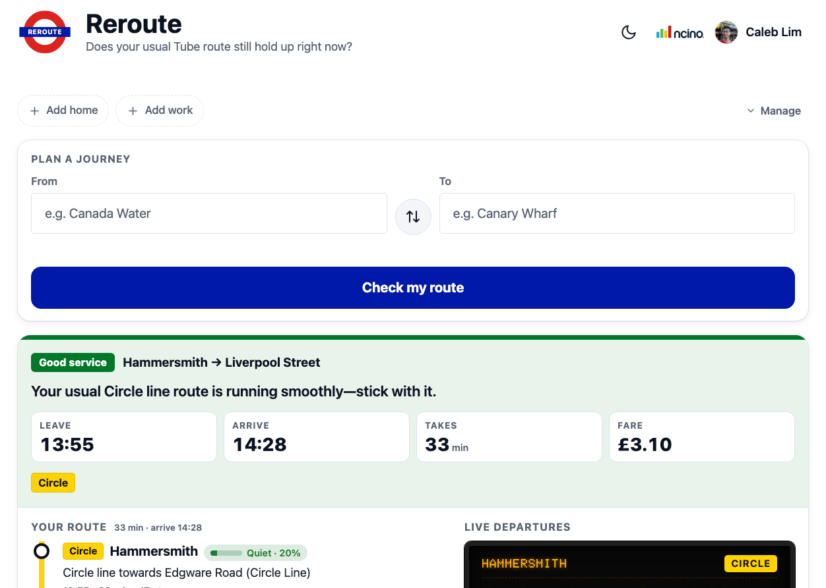
Branding pass
Checkpoint 11:43 today
Reroute logo, brand colors, further TfL tooling refinements.
Desktop — home
Mobile — home
Live test: Paddington → Baker Street
Judge test: Hammersmith → Liverpool Street

Slide 8

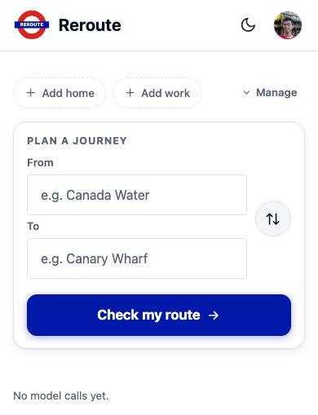
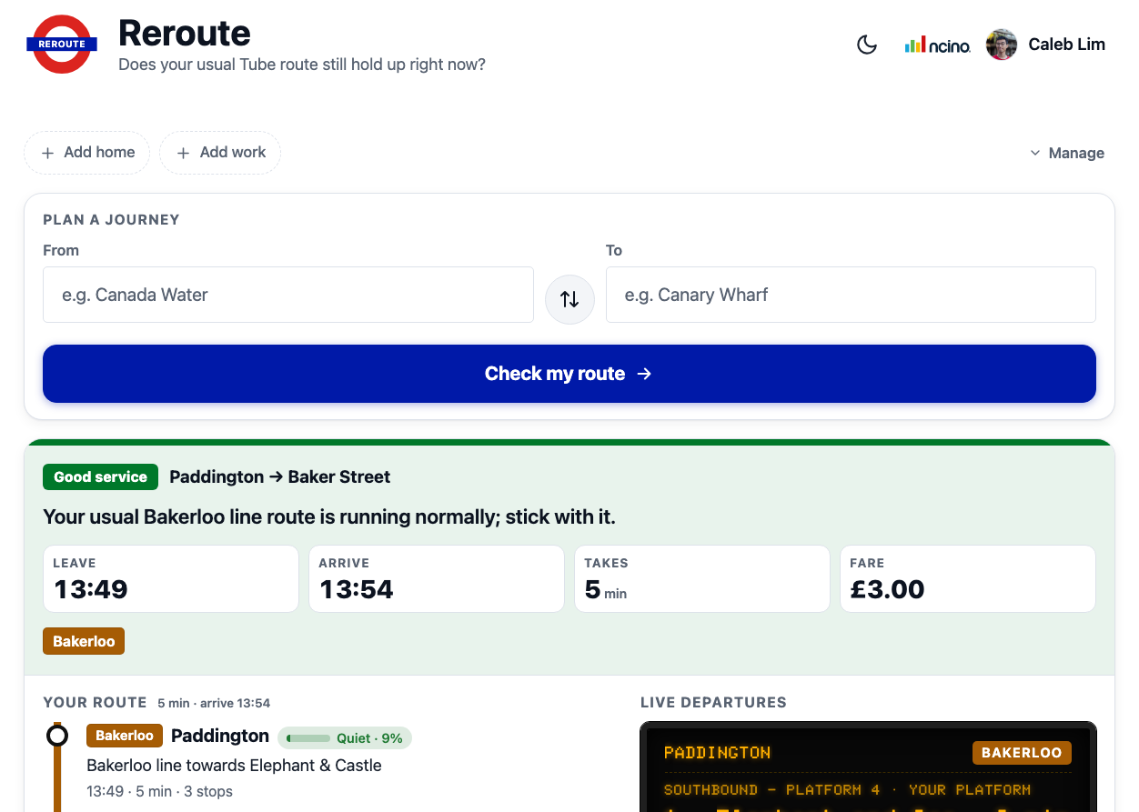
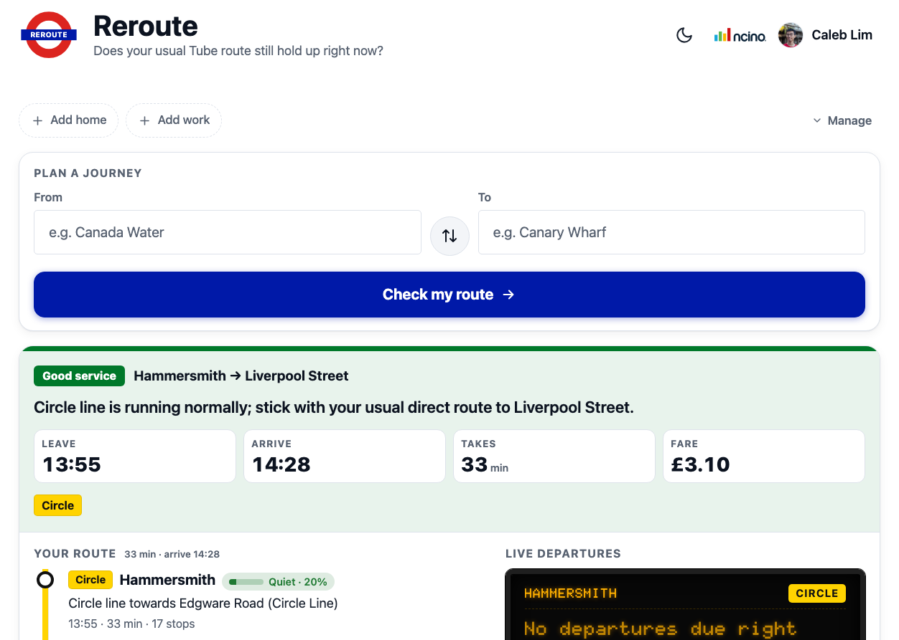
Resilience + polish
Checkpoint 12:07 today
Cancel-in-flight checks, dark-mode logo, confidence gauge.
Desktop — home
Mobile — home
Live test: Paddington → Baker Street
Judge test: Hammersmith → Liverpool Street

Slide 9

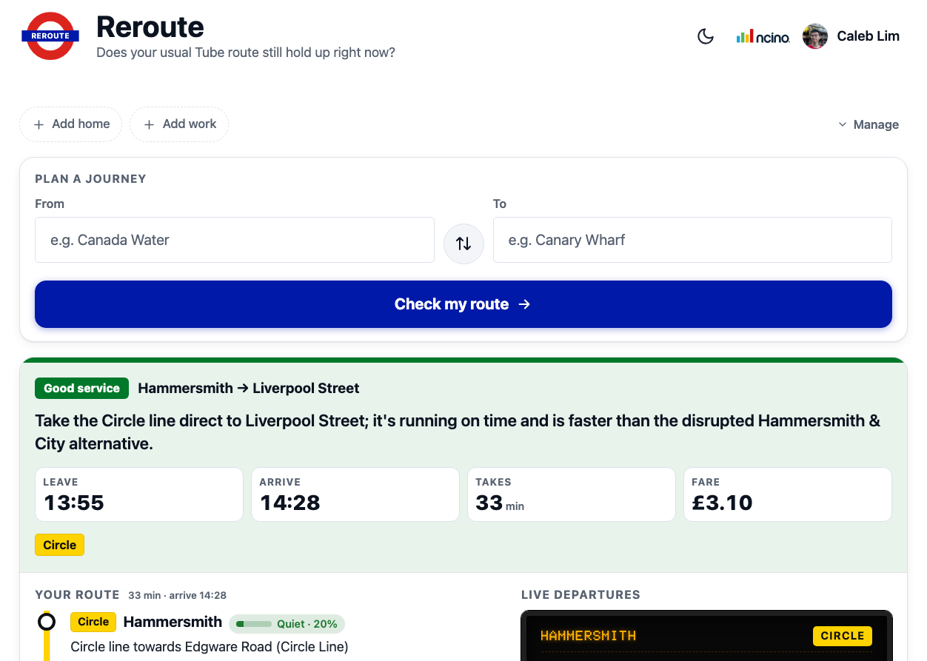
Final UI pass
Checkpoint 13:00 today
Combined line pills, saved-station badge cleanup, ncino branding, user avatar.
Desktop — home
Mobile — home
Live test: Paddington → Baker Street
Judge test: Hammersmith → Liverpool Street

Slide 10
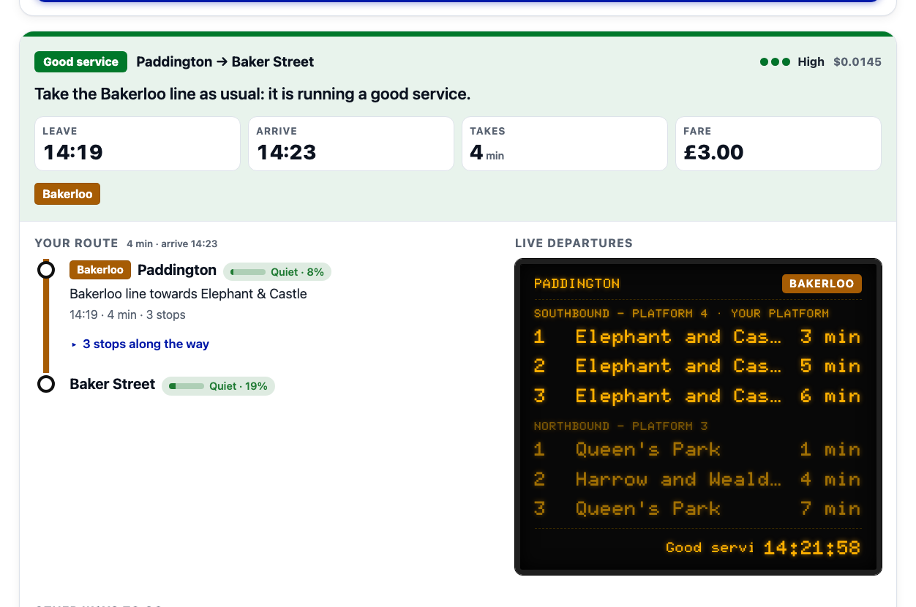
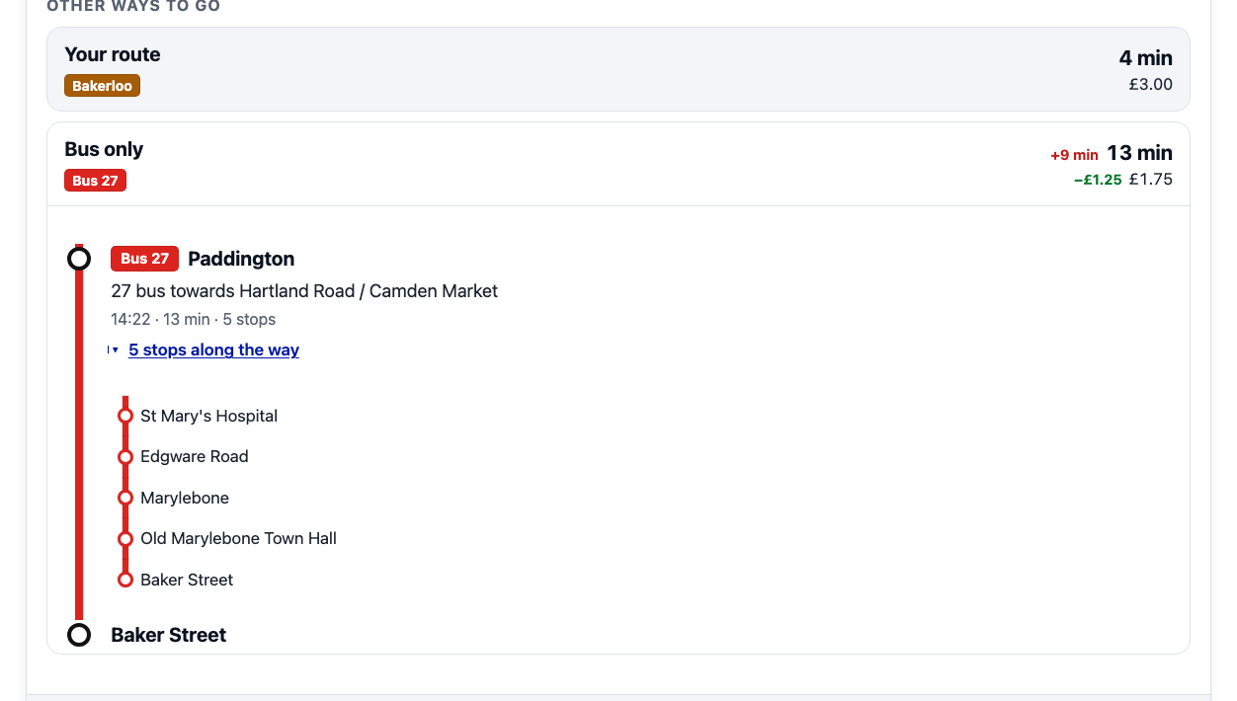
Rerouting, live departures & alternatives
Three things the verdict card always carries alongside the plain-English line.
Live departure board — real-time arrivals for your platform, both directions
Rerouting: a genuine live disruption, recommending the Circle line instead
Rerouting: when the model sets recommended_live_option, the page swaps in that live TfL journey — a real alternative, not a guess.
Alternatives: every card also carries tube-only and bus-only options, priced and timed against the recommended route, each expandable to its own stop-by-stop itinerary.
"Other ways to go" — bus-only alternative, expanded to its full itinerary

Slide 11
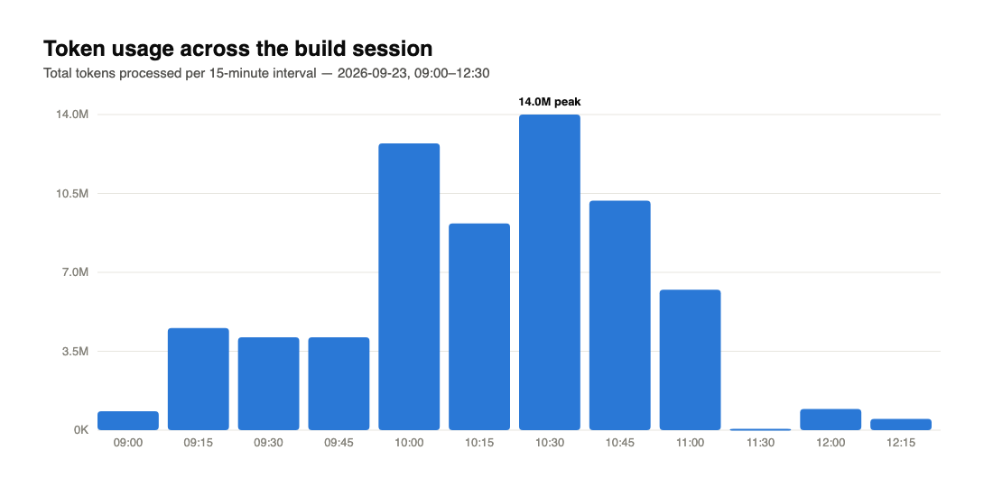
Token usage across the build
Pulled from local Claude Code session transcripts for today (all assistant turns, deduped by message id).
824
model turns
501K
output tokens
67.5M
total tokens processed
~$12.51
estimated Bedrock spend

Slide 12
The judge test: real TfL data is noisy
What it is: the same Hammersmith → Liverpool Street query run against every checkpoint, live, against whatever TfL's network was actually doing at that moment.
What it showed: the Hammersmith & City line was genuinely running Minor Delays all session — but TfL's own journey planner quietly routes around it, and the agent doesn't always pick the same alternative twice. One run recommended the Circle line as a detour; another found the usual route was already Circle, so nothing needed to change.
Why that matters: it's real evidence the agent is reasoning over live data rather than following a script — but it also means a live disruption can't be relied on to reliably reproduce for a demo.
The fix: exactly the motivation for demo mode, on the next slide.

Slide 13
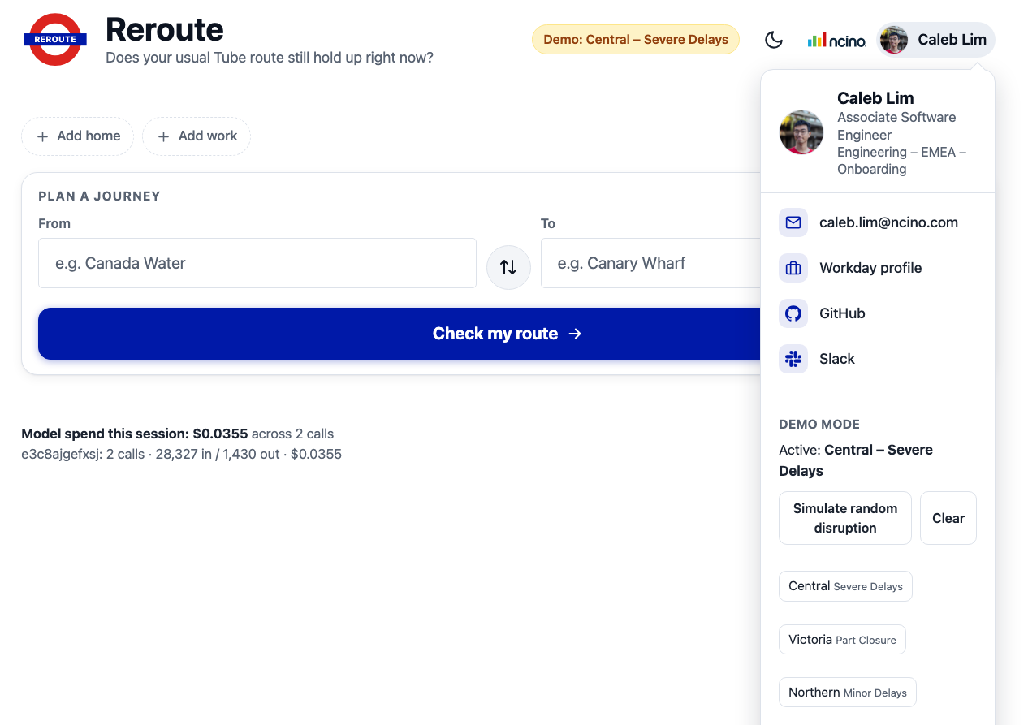
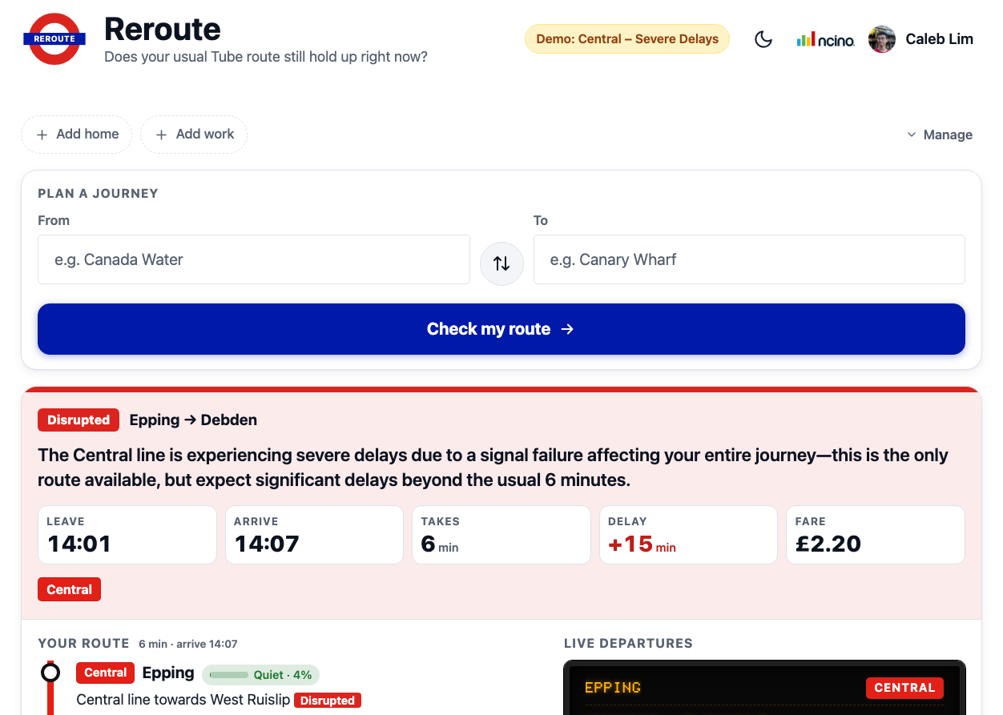
New: Demo mode
A dev panel (profile menu → Demo mode) that injects a synthetic disruption so a live demo doesn't depend on TfL actually having a bad day.
Preset picker, under the profile avatar
Resulting verdict: Central line, Severe Delays
How it stays honest: the fake status is only injected at the get_line_status / get_line_disruption_detail tools the agent calls — the model still reasons genuinely over it, it just isn't real TfL data.
Full-page consistency: the departure board ticker and the itinerary's per-leg "Disrupted" tag are overridden too, so the whole page agrees with the verdict instead of the text alone claiming a delay nothing else shows.

Slide 14
Under the hood: changes you can't screenshot
Warm subprocess pre-spawning: one Claude Code subprocess is kept ready ahead of the next request, cutting the ~4s cold-spawn cost off most checks.
Schema-constrained model output: the agent's final answer is forced through a JSON schema, so the server always gets a parseable verdict instead of occasionally-malformed prose.
Restricted tool surface: the agent gets exactly 4 read-only TfL tools and nothing else — no built-in tools, no filesystem, no ~/.claude settings leaking into a server process.
Live-vs-usual signature matching: today's live journey is matched to the normal-day baseline by line/mode sequence, not by guesswork, so "your route" is provably the same route.
Server-side cancel-in-flight: starting a new check interrupts any still-running previous one on the server, not just hiding it in the browser.
Disruption timestamps: get_line_disruption_detail now carries reportedAt / expectedEnd, so the model can say "unknown" instead of guessing how long an incident will last.

Slide 15
Tasks tackled & how
Runtime constraint: spec called for Cloudflare Workers, but the Claude Agent SDK spawns a subprocess — no spawning on Workers. Resolved by moving to a long-lived Bun process instead.
Model access: verified which Bedrock routes were actually invokable (application inference profiles only, direct model IDs blocked by SCP) before writing the agent code, avoiding a dead end later.
Live-vs-usual routing logic: matched today's live journey to the user's usual route by mode/line signature, so "your route" only shows real, live TfL data — not a guess.
Iterative UI polish: six checkpoints in one session — autocomplete, saved home/work stations, crowding chips, cancel-in-flight requests, dark mode, and a confidence gauge, each shipped and screenshotted as it landed.
Demo reliability: when the judge test showed real disruptions can't be counted on to reproduce, added a demo mode instead of chasing live TfL weather.

Slide 16
Further improvements added
• Combined line pills — multiple lines on one leg render as a single grouped chip instead of repeating.
• Saved-station badge cleanup — home/work chips simplified from dashed placeholder slots to compact pill buttons.
• Cancel-in-flight checks — a new route check now cancels any still-running previous check server-side, not just in the browser.
• Dark-mode logo + theme toggle, and a live confidence gauge on the verdict card.
• nCino branding + user identity in the header for the internal-facing build.
• Demo mode — simulate a common disruption on demand, consistently reflected in the verdict, departure board, and itinerary.
Next up: persistent usage logging (this deck's chart had to be reconstructed from session transcripts — worth writing straight to disk).

