Slide 1


AI DAY · INTERNAL SHOWCASE
Reroute.
Your London commute, reasoned about — not just routed.
An AI agent that checks TfL live, then tells you the truth in one line.
Caleb Lim · 2026-09-23

Slide 2

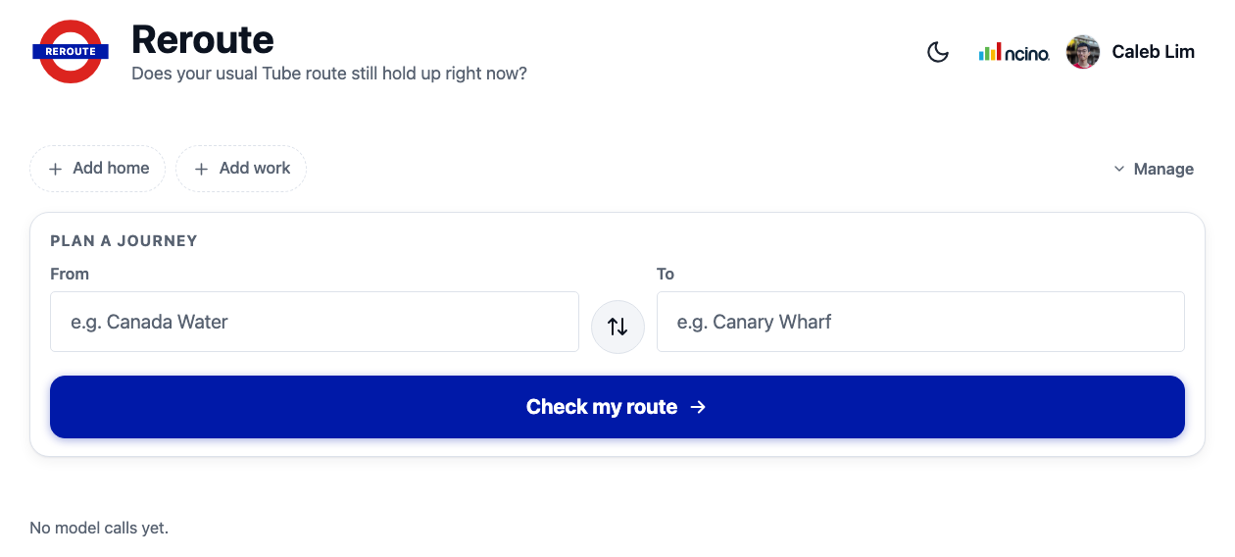
OVERVIEW
What is Reroute?
The problem
Your usual Tube route might be disrupted right now, and checking line status yourself takes several taps.
!
The approach
Bun + Hono backend calls the TfL Unified API for live journeys, crowding and line status, then hands that data to a Claude agent (via Bedrock) that returns a plain-English verdict.
⚙
The actual app — plan a journey, get a live, plain-English verdict.
The output
“Your usual route still holds” or “Take this route instead” — with the live journey, timing, and confidence shown.
✓

Slide 3
TIMELINE
How it evolved
Six checkpoints, ~09:00–13:00 today — reconstructed from git history.
1
10:41
2
10:51
3
11:16
TfL tools + Agent SDK verdict
$2.11 · 10.7M tokens
Autocomplete & saved stations
$0.55 · 2.2M tokens
Expanded TfL tooling
$2.64 · 15.5M tokens
4
11:43
5
12:07
6
13:00
Branding pass
$4.45 · 21.8M tokens
Resilience + polish
$2.45 · 15.9M tokens
Final UI pass
$0.67 · 3.2M tokens

Slide 4
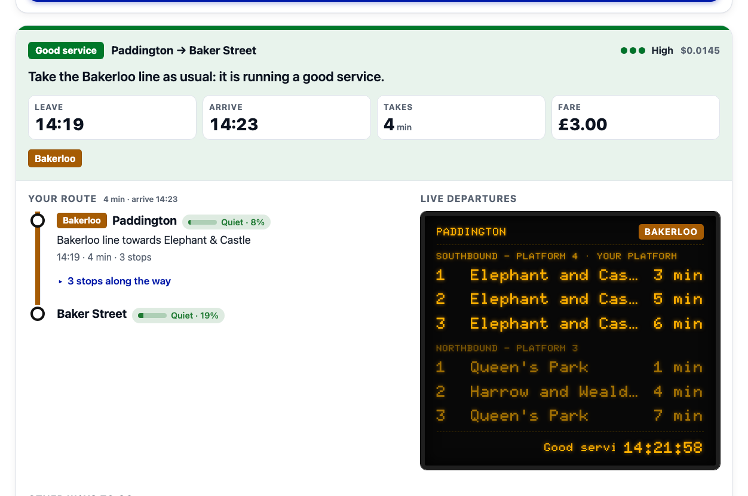
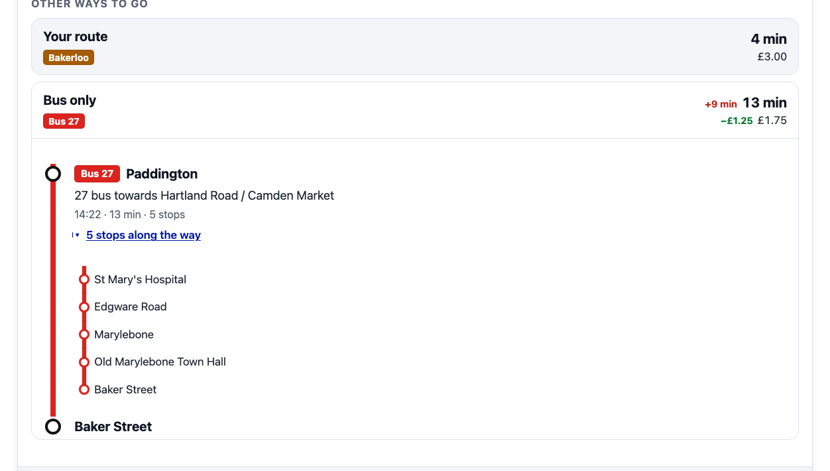
CORE FEATURES
Rerouting, live departures & alternatives
Three things the verdict card always carries alongside the plain-English line.
Rerouting: live journey swap-in
Alternatives: tube-only & bus-only options
Rerouting
When the model sets recommended_live_option, the page swaps in that live TfL journey — a real alternative, not a guess.
Alternatives
Every card also carries tube-only and bus-only options, priced and timed against the recommended route, each expandable to its own stop-by-stop itinerary.
↻
≡

Slide 5
KEY FINDING
The judge test: real TfL data is noisy
FINDING
The agent reasons over live TfL data — which means it can't be relied on to reproduce a demo exactly.
What it is: The same Hammersmith → Liverpool Street query run against every checkpoint, live, against whatever TfL's network was actually doing at that moment.
What it showed: The Hammersmith & City line was genuinely running Minor Delays all session — but TfL's own journey planner quietly routes around it, and the agent doesn't always pick the same alternative twice. One run recommended the Circle line as a detour; another found the usual route was already Circle, so nothing needed to change.
Why that matters: It's real evidence the agent is reasoning over live data rather than following a script — but it also means a live disruption can't be relied on to reliably reproduce for a demo.
The fix: Exactly the motivation for demo mode, on the next slide.

Slide 6
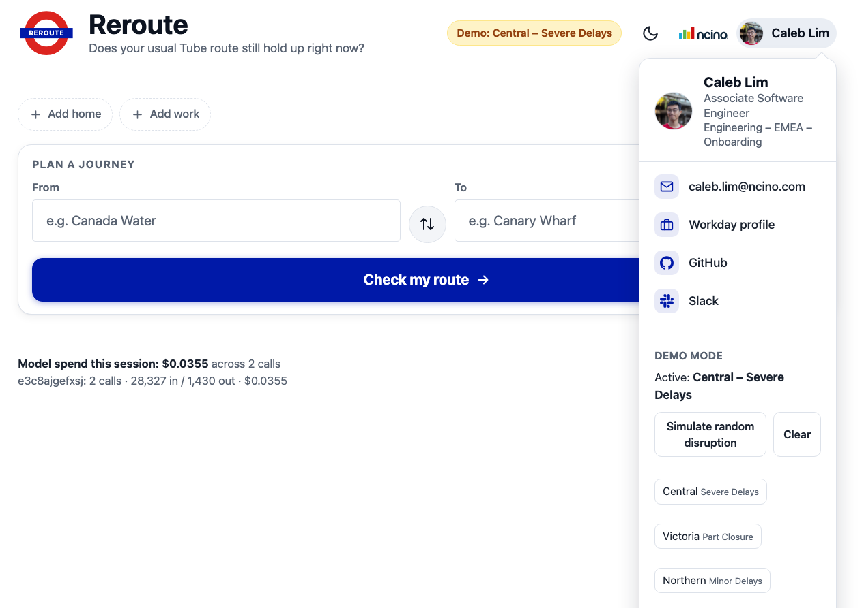
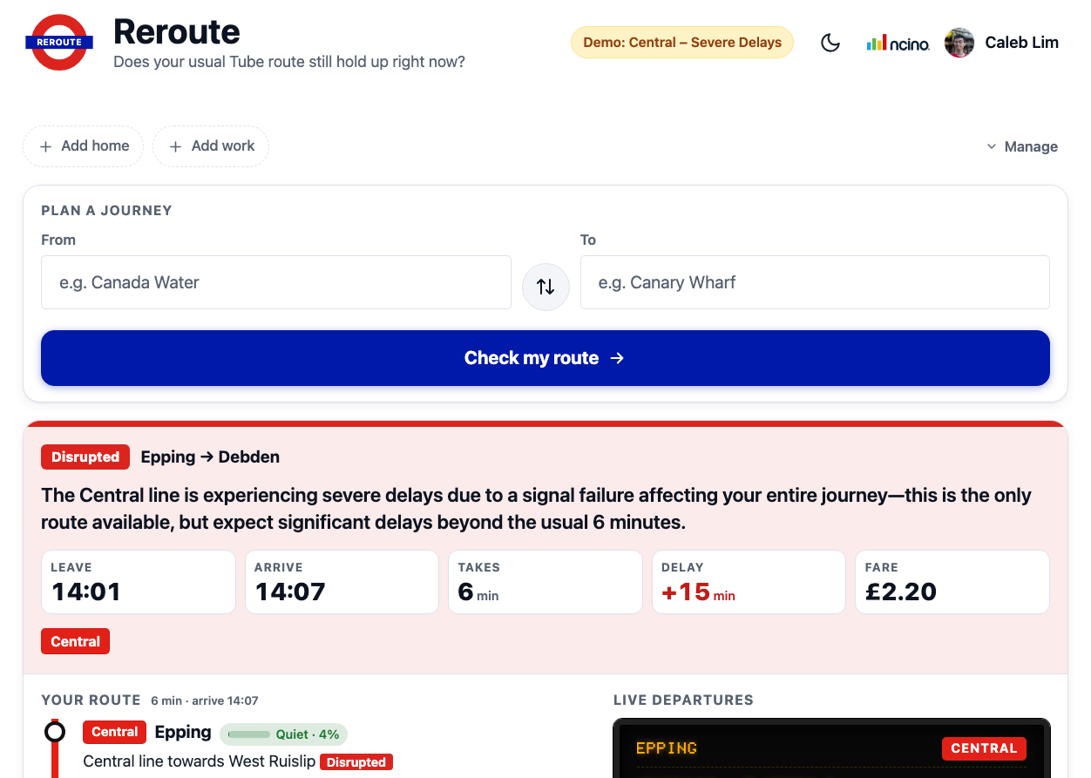
NEW
New: Demo mode
A dev panel (profile menu → Demo mode) that injects a synthetic disruption so a live demo doesn't depend on TfL actually having a bad day.
How it stays honest
The fake status is only injected at the get_line_status / get_line_disruption_detail tools the agent calls — the model still reasons genuinely over it, it just isn't real TfL data.
◉
Full-page consistency
The departure board ticker and the itinerary's per-leg 'Disrupted' tag are overridden too, so the whole page agrees with the verdict instead of the text alone claiming a delay nothing else shows.
≡
Preset picker, under the profile avatar
Resulting verdict: Central line, Severe Delays

Slide 7
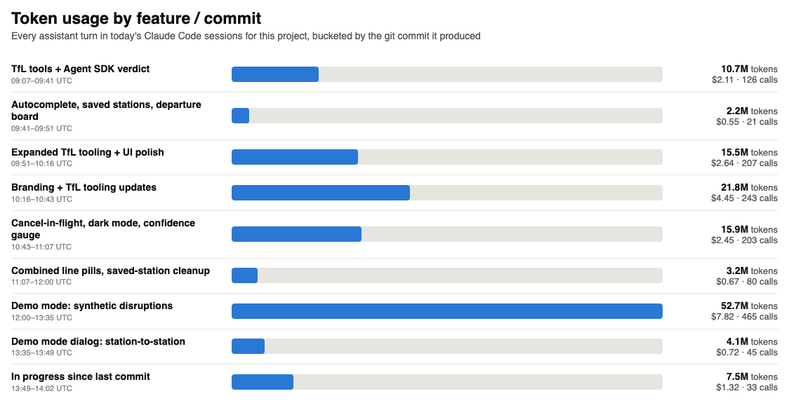
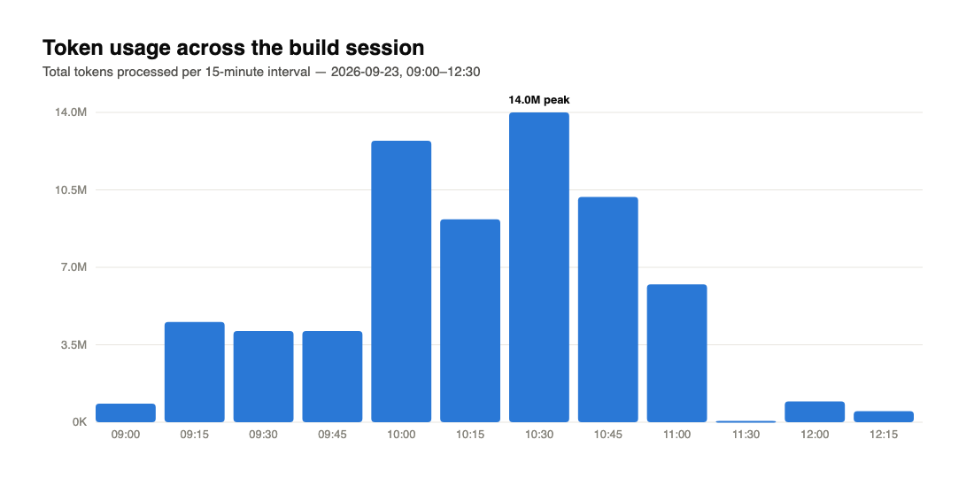
BY THE NUMBERS
Token usage across the build
Every assistant turn in today's Claude Code sessions, bucketed by the commit/feature it produced.
1,503
840K
MODEL TURNS
OUTPUT TOKENS
147.9M
~$24.90
TOTAL TOKENS PROCESSED
ESTIMATED BEDROCK SPEND

Slide 8
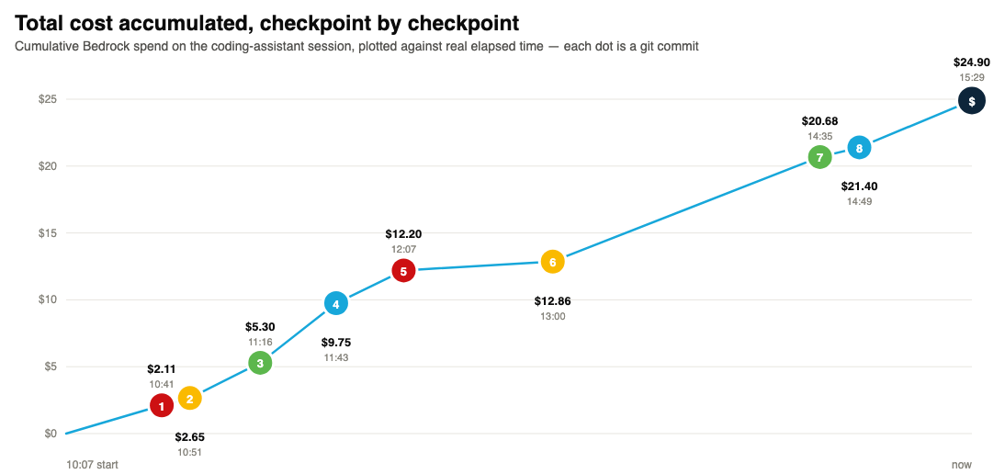
BY THE NUMBERS
Total cost, checkpoint by checkpoint
Cumulative Bedrock spend on the coding-assistant session — every dot is a git commit.
$24.90
TOTAL SPEND TODAY
147.9M tokens
1503 calls

Slide 9
EFFICIENCY
Model breakdown & efficiency
Which Claude models did the building, and what prompt caching saved along the way.
96%
CACHE HIT RATE
$126
SAVED BY CACHING
claude-sonnet-5 $19.31 · 1228 calls · 81.1%
claude-opus-5-5 $5.18 · 261 calls · 18.3%
$0.017
AVG COST / CALL
98K
claude-opus-5 $0.41 · 14 calls · 0.6%
AVG TOKENS / CALL
This is build-time (coding assistant) usage. The deployed app's own live verdicts run on a separate, much smaller Haiku 4.5 call — tracked in-app, not here.

Slide 10
ENGINEERING
Under the hood: technical highlights
Warm subprocess pre-spawning
One Claude Code subprocess is kept ready ahead of the next request, cutting the ~4s cold-spawn cost off most checks.
⚡
Schema-constrained model output
The agent's final answer is forced through a JSON schema, so the server always gets a parseable verdict instead of occasionally-malformed prose.
{ }
Restricted tool surface
The agent gets exactly 4 read-only TfL tools and nothing else — no built-in tools, no filesystem, no ~/.claude settings leaking into a server process.
⚑
Server-side cancel-in-flight
Starting a new check interrupts any still-running previous one on the server, not just hiding it in the browser.
✕
Disruption timestamps
get_line_disruption_detail now carries reportedAt / expectedEnd, so the model can say 'unknown' instead of guessing how long an incident will last.
○

Slide 11
PROBLEM SOLVING
Tasks tackled & how
Runtime constraint
Spec called for Cloudflare Workers, but the Claude Agent SDK spawns a subprocess — no spawning on Workers. Resolved by moving to a long-lived Bun process instead.
⚙
Model access
Verified which Bedrock routes were actually invokable (application inference profiles only, direct model IDs blocked by SCP) before writing the agent code, avoiding a dead end later.
✓
Live-vs-usual routing logic
Matched today's live journey to the user's usual route by mode/line signature, so 'your route' only shows real, live TfL data — not a guess.
↻

Slide 12
ROADMAP
Further improvements & what's next
Combined line pills
Multiple lines on one leg render as a single grouped chip instead of repeating.
Saved-station badge cleanup
Home/work chips simplified from dashed placeholder slots to compact pill buttons.
≡
⌂
Dark-mode + confidence gauge
Dark-mode logo + theme toggle, and a live confidence gauge on the verdict card.
nCino branding & identity
nCino branding + user identity in the header for the internal-facing build.
◑
▤
Persistent usage logging — this deck's chart had to be reconstructed from session transcripts, worth writing straight to disk.
NEXT UP

