Slide 1









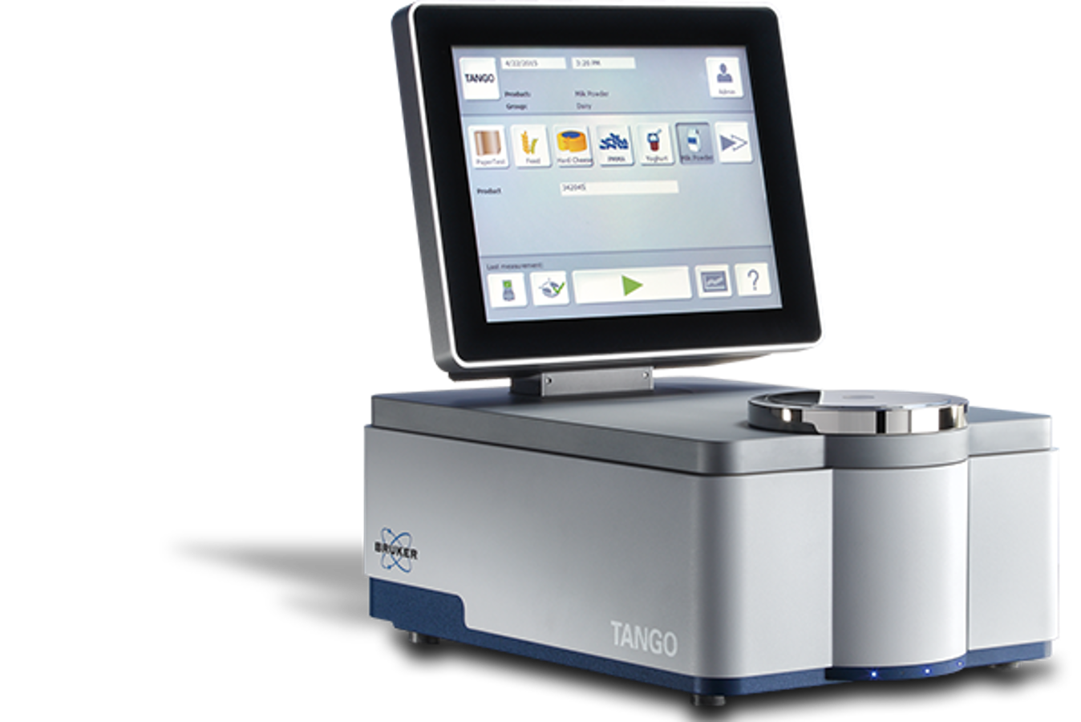








Figure 2. Comparing average diet cost for each formulation strategy and phase.
P < 0.001
P < 0.001
P < 0.001
c
a
a
b
a
a
b
c
a
a
b
Diet Cost ($USD/MT)
c
Starter
Grower
Finisher
LP
LP-SD
LP-Approx.
SP
Clustering of nutrient composition to identify patterns in nutrient and antinutrient variability in corn, wheat, and soybean meal of three countries
Scan for abstract, contact, & more
Caleb M. Marshall¹, Virginie Blanvillain², and Edgar O. Oviedo-Rondón¹
¹North Carolina State University, Raleigh, NC, United States; ²AB Vista, Plantation, Fl, United States
Introduction
Results
Feedstuff variability undermines precision nutrition & profitability
Sources of real-world nutrient variation:
season & harvest
storage & transport
origin
manufacturing processes
“Antinutrient” content similarly varies, and unaccounted for can reduce nutrient utilization and intake
Figure 1. Cluster proportions and counts, for each ingredient and source
(Moss et al., 2021)
Clusters:
C1
C2
C3
ARG
BRA
USA
(Weiss and St-Pierre, 2024)
Corn
n C1 – 1,580 C2 – 3,328
C3 – 316
n C1 – 23,260 C2 – 4,376
C3 – 15,464
n C1 – 4,151 C2 – 3,625
C3 – 9,372
n C1 – 92 C2 – 179
C3 – 202
n C1 – 385 C2 – 494
C3 – 253
USA
n C1 – 224 C2 – 123
C3 – 177
(Gaviley et al., 2025)
Wheat
Objective: To characterize the nutrient and “antinutrient” composition of corn, wheat, and soybean meal (SBM) from three origins
USA
SBM
n C1 – 3,664 C2 – 4,394
C3 – 4,988
n C1 – 18,165 C2 – 16,799
C3 – 18,139
n C1 – 6,834 C2 – 4,305
C3 – 5,399
Materials and Methods
Figure 2. Within source cluster comparison of Phytic P for corn, wheat, and SBM
Figure 3. Within source cluster comparison of Total NSP for corn, wheat, and SBM
Data:
Commercial NIRS readings
Proximate Composition
Energy
Fiber Composition
SID AMINO Acids
3
Quality parameters
Years: 2019 to 2024
Ingredients:
Sources:
Argentina (ARG)
Brazil (BRA)
United States (USA)
Cluster Analysis:
Composition standardized to 88% DM
K-means: K = 3 per ingredient and source
Based on proximate values
Statistical Analysis
One-way ANOVA – α = 0.05
Multiple Comparison – Tukey’s HSD
Between K-mean clusters
Variables:
Phytic P
Lignin-ADL
Non-starch polysaccharides (NSP)
Total (tNSP)
Insoluble (iNSP)
P < 0.001
P < 0.001
P < 0.001
P < 0.001
P < 0.001
P < 0.001
b
a
a
c
a
b
b
c
a
c
b
a
a
b
c
c
a
b
P < 0.001
P < 0.001
P < 0.001
P < 0.001
P < 0.001
P < 0.001
b
a
b
b
c
a
b
a
c
a
c
b
b
c
a
b
a
c
Corn (N = 65,472)
Wheat (N = 2,129)
SBM (N = 82,687)
P < 0.001
P < 0.001
P < 0.001
P < 0.001
P < 0.001
a
P < 0.001
b
a
a
a
b
b
c
a
b
b
a
c
c
b
c
a
b
Discussion & Conclusions
Differences in Proximate, Fiber, and NSP content between clusters for each ingredient and source
Clustering readings with similar proximate profiles identifies sub-populations, even within localized regions
Nutrient and anti-nutrient values agree with published values, however:
Averaged published values ignore smooth over variation
Potentially impacting the accurate delivery of nutrients
Clusters can be useful in understanding variation in nutrient and anti-nutrient, with opportunities for:
Optimized enzyme delivery
Dynamic feed formulation and matrix updating
Conclusions
(Roush et al., 1996 and Sriperm et al., 2010)
*All available nutrients and anti-nutrient were evaluated, but due to space limitations only the above are covered at present*
(Bedford and Cowieson, 2020)
Prestage Department of Poultry Science
(Kidd et al., 2023)

