Slide 1






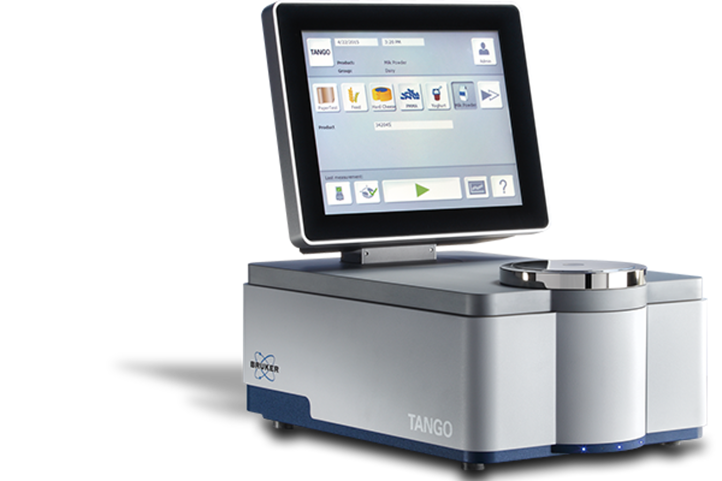

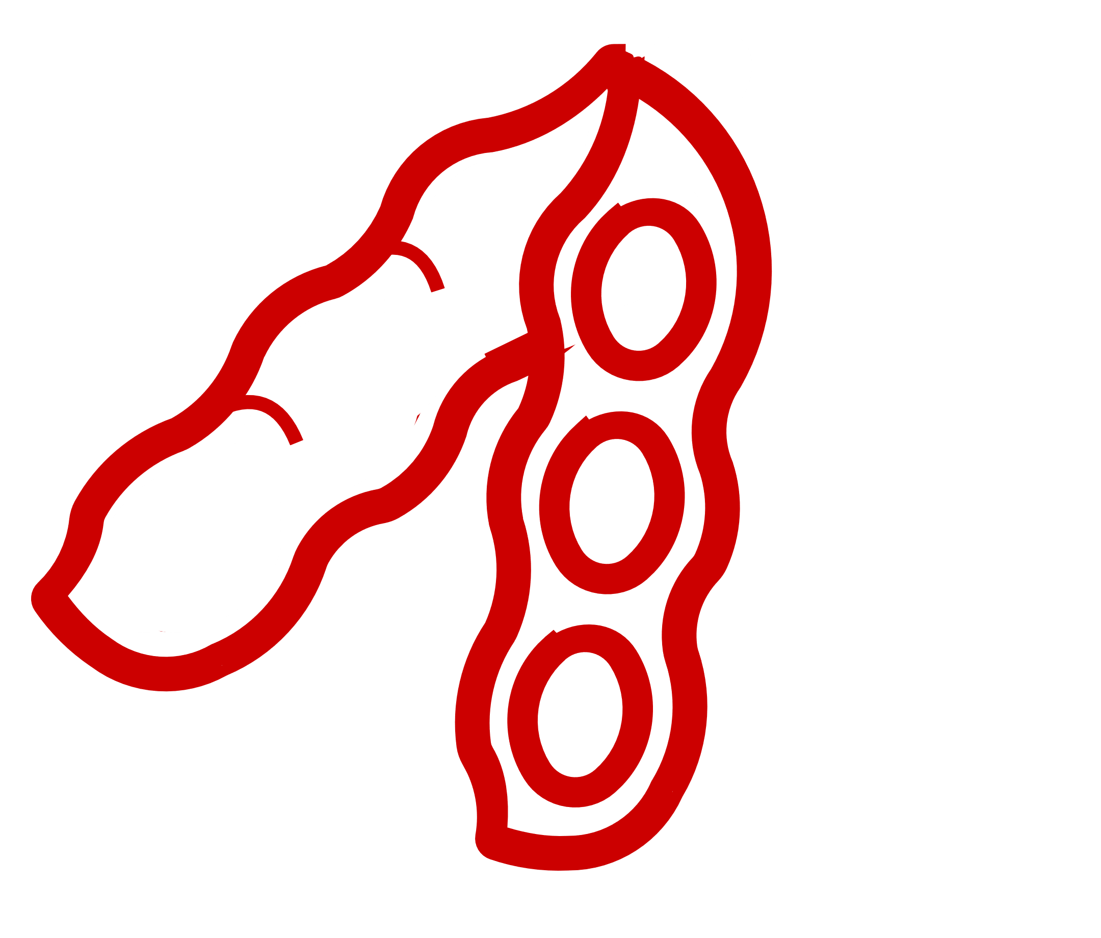



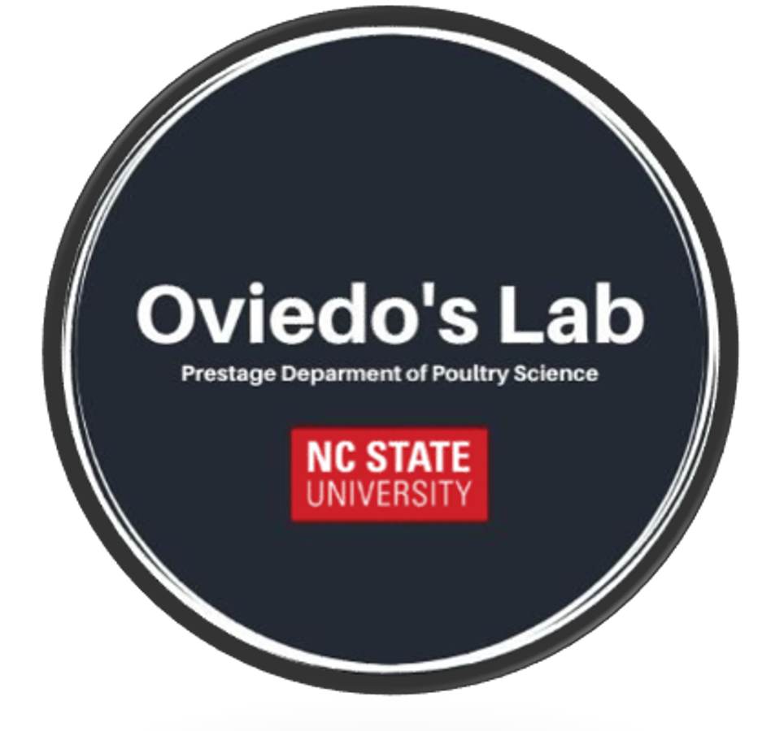





Feed formulation outcomes on antinutrient contents using cluster-based nutrient variability in corn, wheat, and soybean meal from three countries
Scan for abstract, contact, & more
Caleb M. Marshall¹, Virginie Blanvillain², and Edgar O. Oviedo-Rondón¹
¹North Carolina State University, Raleigh, NC, United States;²AB Vista, Plantation, Fl, United States
Introduction
Results
Precision nutrition necessitates accurate:
Ingredient characterization
Nutrient requirement determination
Management of 1 & 2
Sources of real-world nutrient variation:
season & harvest
storage & transport
origin
manufacturing processes
“Antinutrient” content similarly varies, and unaccounted for can reduce nutrient utilization and intake
Figure 1. Average composition value by source and high cluster by source, for corn, wheat, and SBM, used for diet formulation
(Moss et al., 2021)
Ingredient | Ingredient Source |  | Phytic P (%) |  |  | Lignin (%) |  |  | Total NSP (%)
 |  |  | Source Mean | High Cluster |  | Source Mean | High Cluster |  | Source Mean | High Cluster
Corn | ARG |  | 0.20 | 0.20 |  | 0.49 | 0.56 |  | 6.17 | 6.56
 | BRA |  | 0.17 | 0.19 |  | 0.58 | 0.65 |  | 6.47 | 6.60
 | USA |  | 0.19 | 0.20 |  | 0.38 | 0.56 |  | 6.31 | 7.05
Wheat | ARG |  | 0.22 | 0.23 |  | 1.35 | 1.67 |  | 9.91 | 10.81
 | BRA |  | 0.25 | 0.28 |  | 1.75 | 2.00 |  | 9.75 | 10.37
 | USA |  | 0.24 | 0.27 |  | 1.32 | 1.53 |  | 9.17 | 10.19
SBM | ARG |  | 0.44 | 0.44 |  | 1.62 | 1.80 |  | 14.69 | 15.12
 | BRA |  | 0.43 | 0.43 |  | 2.07 | 2.50 |  | 16.04 | 16.53
 | USA |  | 0.42 | 0.43 |  | 1.38 | 1.53 |  | 14.35 | 15.37
(Weiss and St-Pierre, 2024)
(Gaviley, et al., 2025)
Objective: Evaluate the impact of using average nutrient composition values in formulation under conditions where ingredients antinutrient content are elevated
Figure 1. Average antinutrient content across each dietary phase, when formulating with source mean and high cluster matrix values.
Figure 1. Average antinutrient content across each dietary phase, when formulating with source mean and high cluster matrix values.
Materials and Methods
Total NSP
Total NSP
Data:
Commercial NIRS readings
Proximate Composition
Energy
Fiber Composition
SID AMINO Acids
3
Quality parameters
Years: 2019 to 2024
Ingredients:
Sources:
Argentina (ARG)
Brazil (BRA)
United States (USA)
Cluster Analysis:
Composition standardized to 88% DM
K-means: K = 3 per ingredient and source
Based on proximate values
+5.63
+5.25
+6.49
+7.84
-3.43
-3.20
Phytic P
Phytic P
+0.12
+0.22
+0.14
-1.65
-5.84
-2.95
Corn (N = 65,472)
Wheat (N = 2,129)
SBM (N = 82,687)
Lignin-ADL
Lignin-ADL
+1.95
+2.34
+1.63
+3.97
+3.34
-4.80
Discussion & Conclusions
These worst-case antinutrient profiles reflect plausible compositions, which were observed from user submitted NIRS readings from ARG, BRA, and USA
Considering only averages or published values, could lead to poor estimation of true anti-nutrient content, increasing variability
These formulation outcomes, highlighted the need to evaluate feedstuff antinutrient content for strategic:
Exogenous enzyme delivery
Matrix value updating
Cluster Feed Formulaiton:
Worst case scenario diets with high antinutrient content (Phytic P, Total NSP, and Lignin) for each source
Conclusions
(Roush et al., 1996)
Nutrient Matrix
Nutrient Matrix
(Bedford and Cowieson, 2020)
Source Average Value
- vs -
High Antinutrient Cluster
(Kidd et al., 2023)
To more precisely formulate diets, it will be necessary to fully understand the antinutrient content ingredients and their potential variability. Ensuring nutritionist can minimize gut health and digestibility issues, which can negatively impact productivity.
*Broiler diets meet the “All Plant Protein-Based” Ross 708 Recommendation (Aviagen, 2022) – for all starter, grower, and finisher diets*
Prestage Department of Poultry Science

