Slide 1



Zach Cross
Stephen Mardin
Corey Nolan
John Schwarz
Caleb Vincent

Slide 2

http://nolanc3.myrpi.org/sdd/
Find teacher: “Magellan”
If you win, speak up! (you get a free shirt ☺)

Slide 3

Web application to facilitate learning using word games (bingo, wordsearch, crosswords)
Goals:
  Help students pay attention
  Repetition of keywords
  Quick to create and play
  Fun!

Slide 4

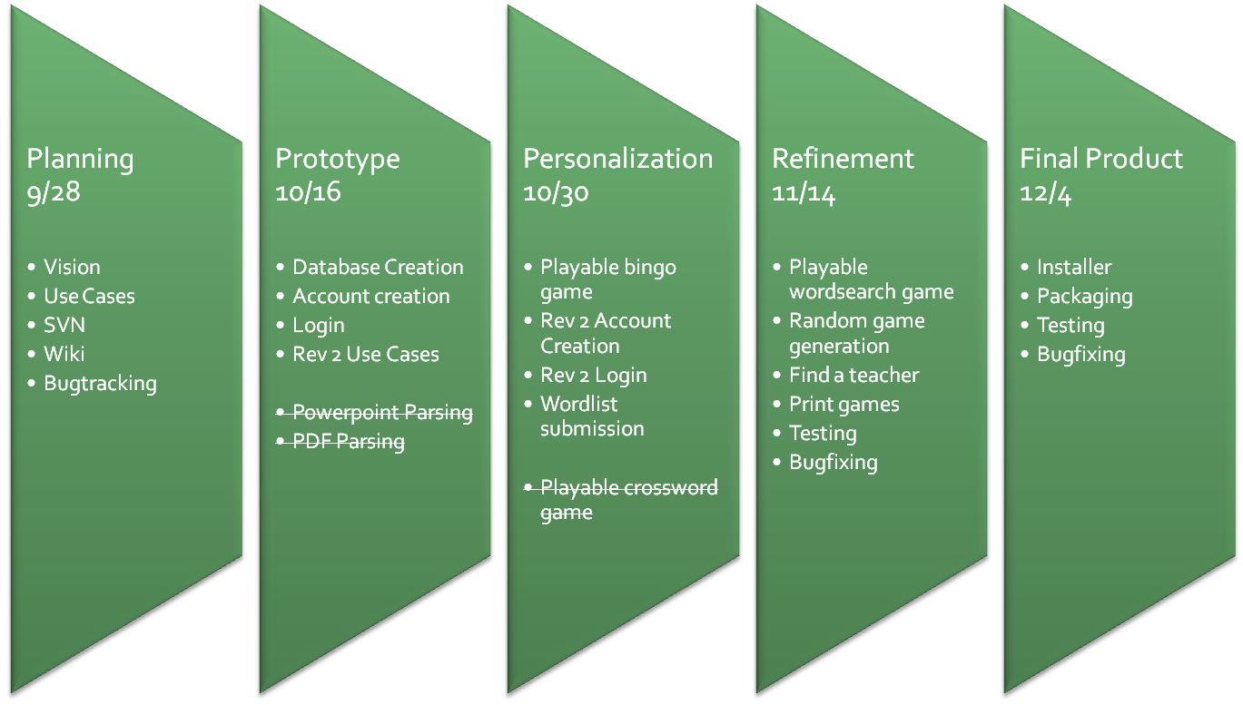

Slide 5

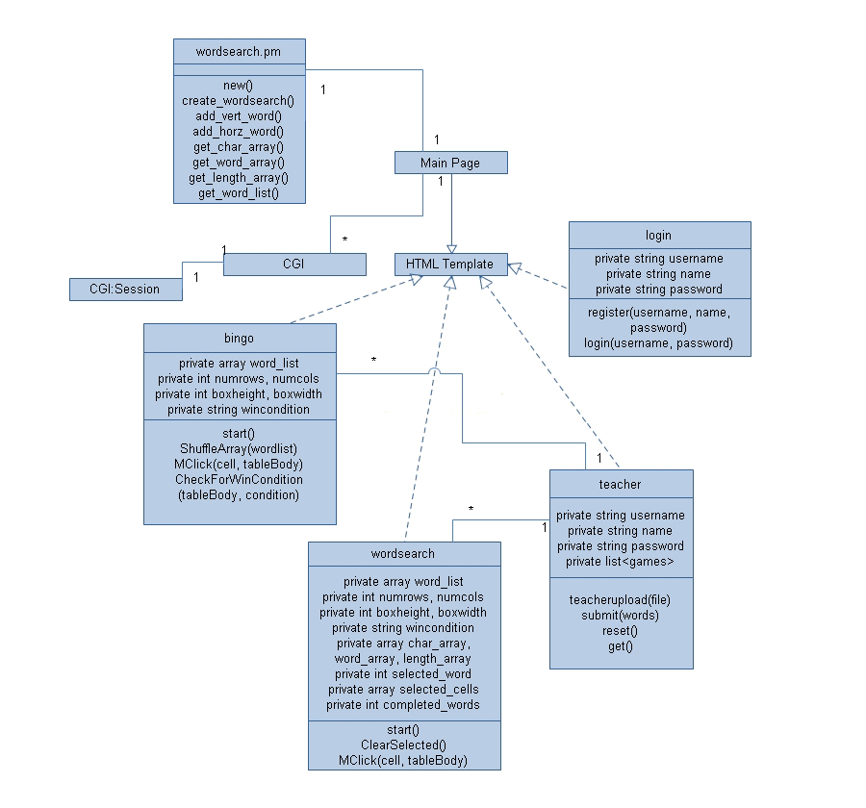

Slide 6

Wiki:
  http://magellan.wikidot.com/
Repository and Bugtracking:
  http://code.google.com/p/magellantools/
Revision Updates:
  magellanAdmin@gmail.com

Slide 7

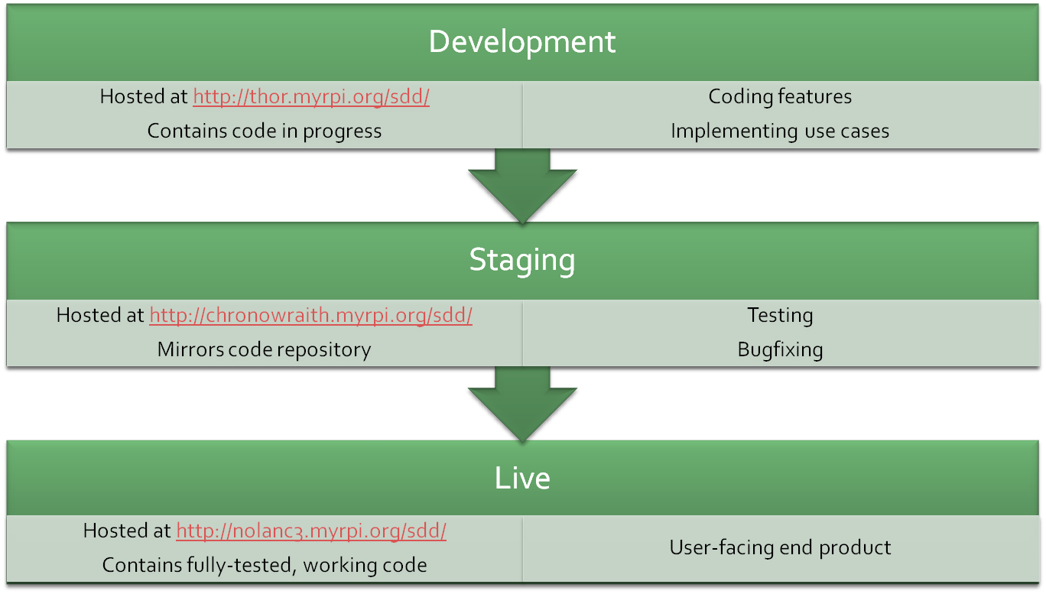

Slide 8

BETTER MANAGEMENT
  -Finer lecture control
  -Administrator interface
USER SKINNABLE
  -CSS picker
MORE CONTENT
  -Implement crosswords
  -Study sheet generation
  -Improved wordsearch
  -.pdf/.ppt parsing
  Winner notification sent to teacher (bingo)

Slide 9

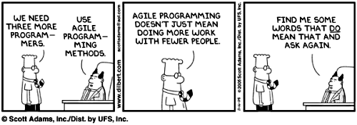

Slide 10
Questions?
Winner?

