Slide 1
Weekly Production Performance Analysis
A detailed report highlighting key metrics and trends

Slide 2
Introduction
This report provides an analysis of weekly production performance, covering metrics such as production output, quality rates, costs, and efficiency. Key insights and recommendations are provided to help improve overall operational performance.

Slide 3
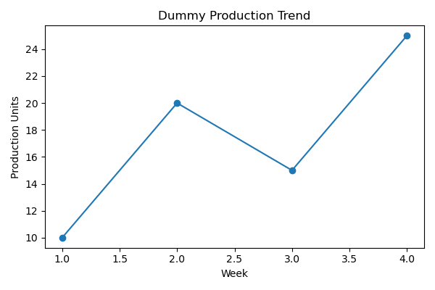
Weekly Production Metrics
The chart below highlights weekly production trends, showing fluctuations in output over the analyzed period.

Slide 4
Quality Control Analysis
Quality control metrics were analyzed to identify trends in defect rates and correlations with training hours. Insights include areas where quality assurance can be enhanced to reduce errors.

Slide 5
Cost Analysis
Production costs and cost per unit were analyzed to evaluate operational efficiency. The analysis highlights opportunities to optimize resource allocation and reduce waste.

Slide 6
Summary and Recommendations
Key Findings:
- High production weeks contribute significantly to overall efficiency.
- Training hours have a positive correlation with quality rates.
- Cost optimization can improve profitability.
Recommendations:
- Increase training hours to enhance quality rates.
- Focus on reducing costs in low-performing weeks.
- Optimize processes in high-cost locations.

