Slide 1

Iteration Three
Matt Giles
Hunter Michalk
Jameson Axton
Caleb DeHaan

Slide 2
Design Patterns
Requirement: Use 7 Design Patterns
Implemented 3
Factory, Visitor, & Singleton
Used 6 other design patterns, which were implemented in Java classes.
Builder, Iterator, Command, Decorator, Composite, & Flyweight
Notes:
Name the four we implemented and where

Slide 3
Design Patterns Examples
Visitor: ActionVisitor
Builder: StringBuilder
Singleton: User
Decorators: BufferedReader
Command: Runnable
Iterator: List
Composite: java.awt.Component
Flyweight: Integer, Long, etc.
Specifically, the valueOf() function

Slide 4
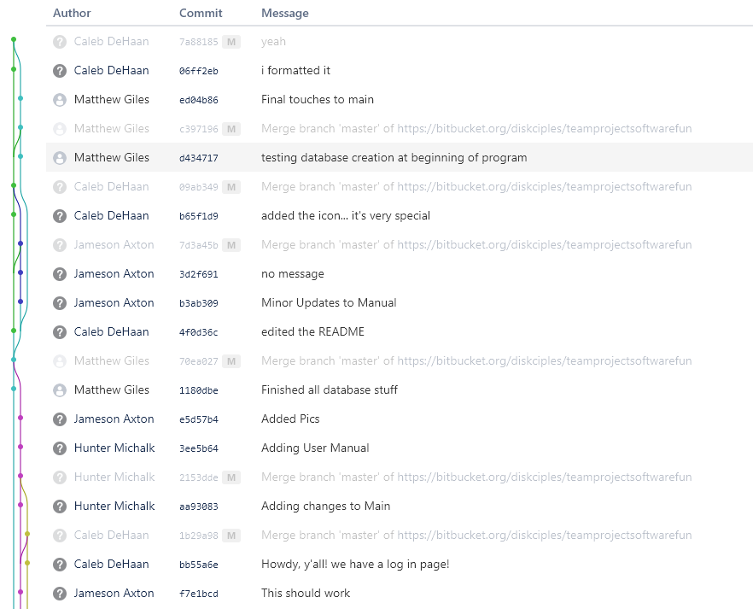
Git commits

Slide 5
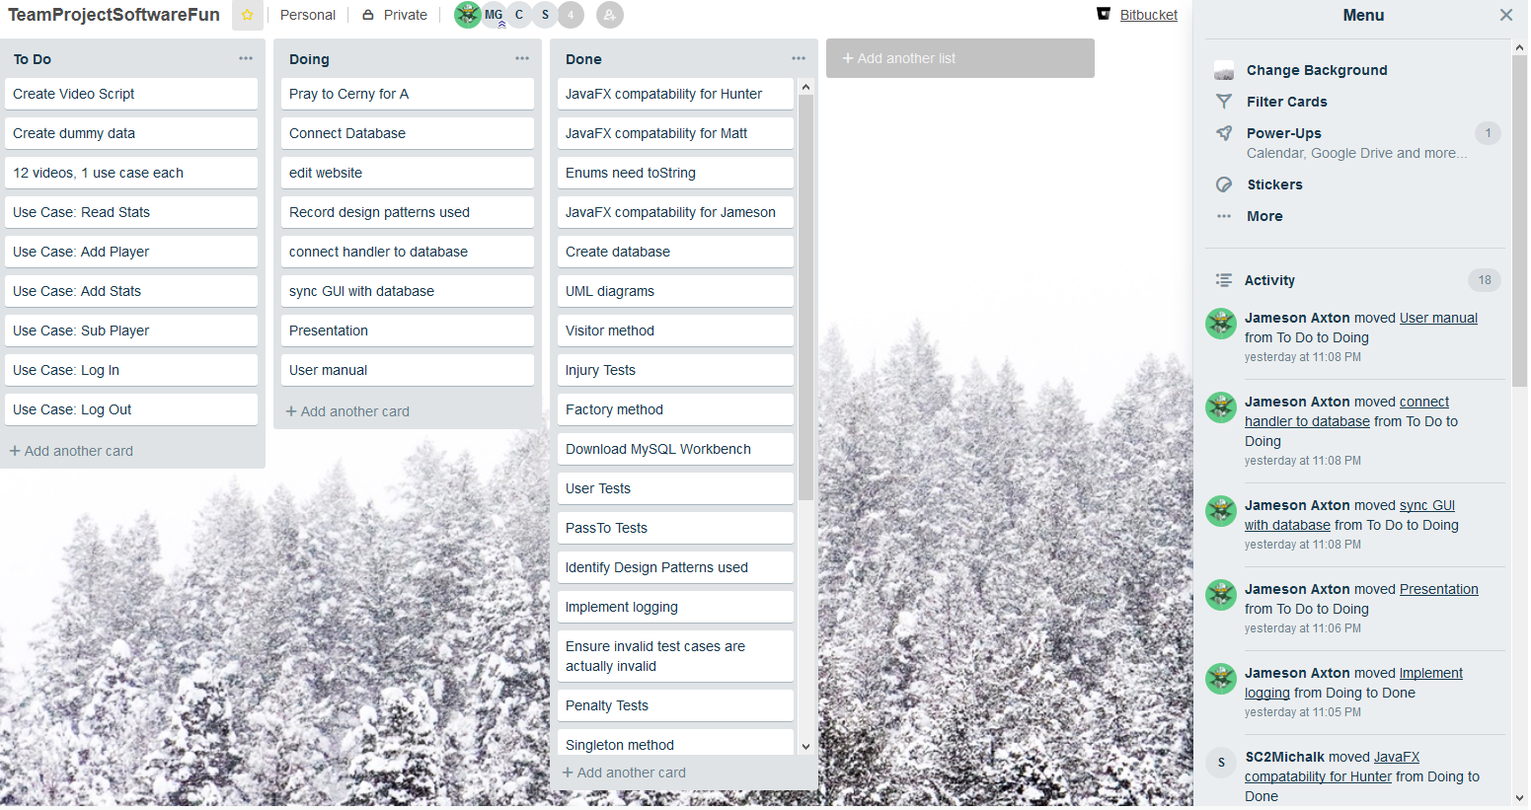
Issue Tracking
Notes:
Note: Pray to Cerny for A

Slide 6
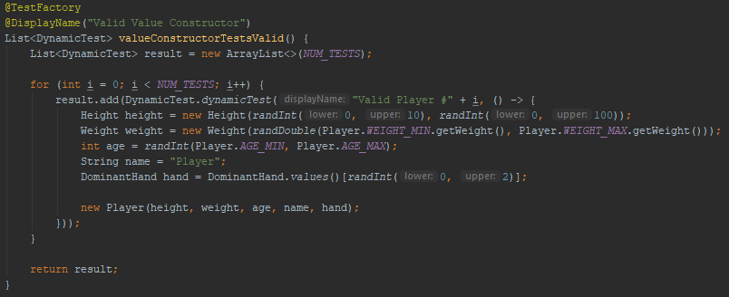
“Awesome Code Pieces”
Notes:
Generates Valid Input Test Cases for Player.

Slide 7
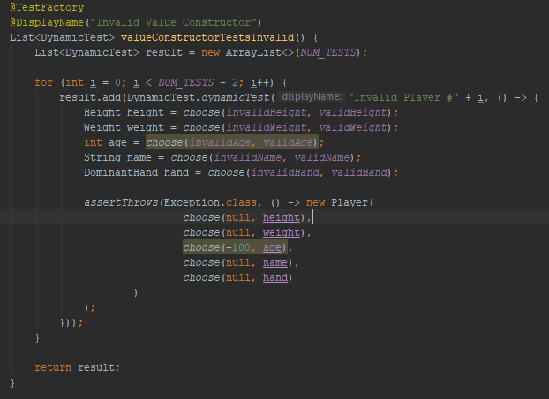
Notes:
25% chance to generate valid input.

Slide 8
Database
We have SQL database functionality working.
Tracks information about each team member
Personal info (height, age, weight, etc.)
Ultimate Frisbee stats (passes, injured, etc.)

Slide 9
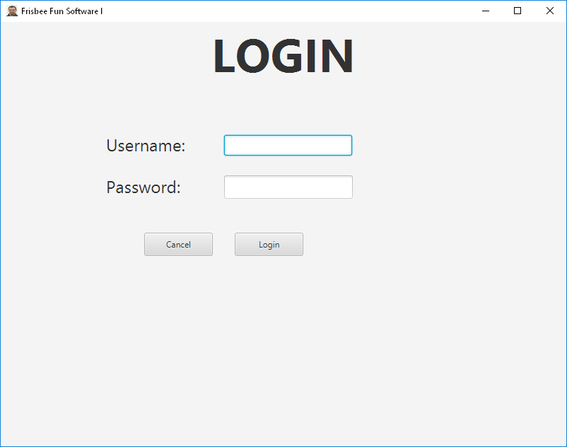
Login screen

Slide 10
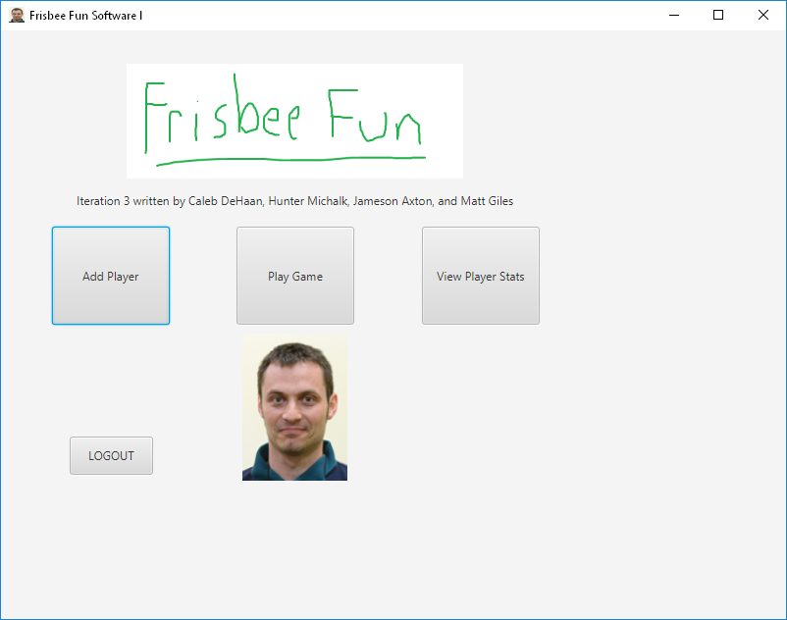
Home screen

Slide 11
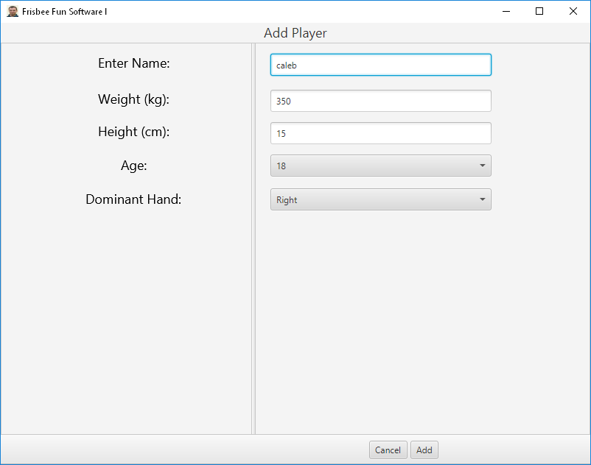
Add players

Slide 12
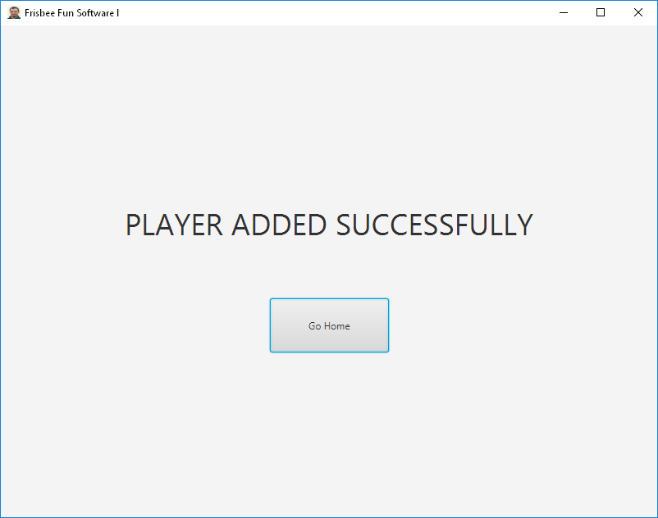
Add players (confirmation)

Slide 13
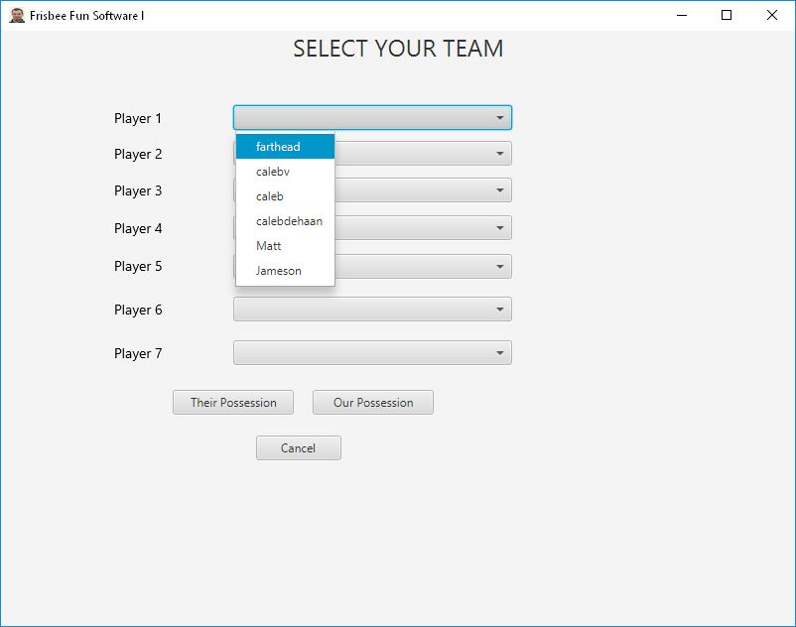
Pre-game screen

Slide 14
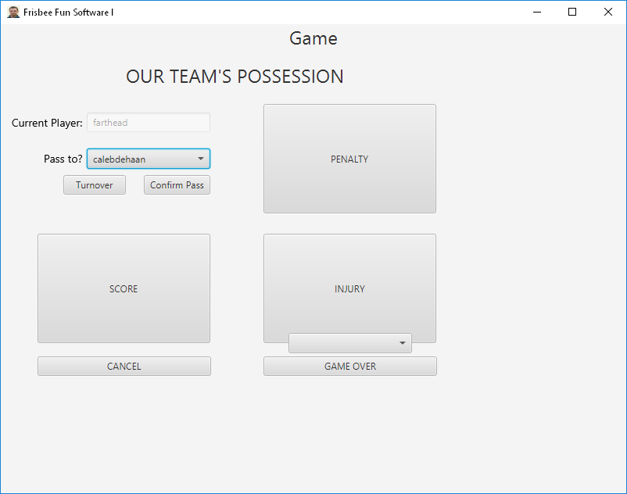
Our team's possession

Slide 15
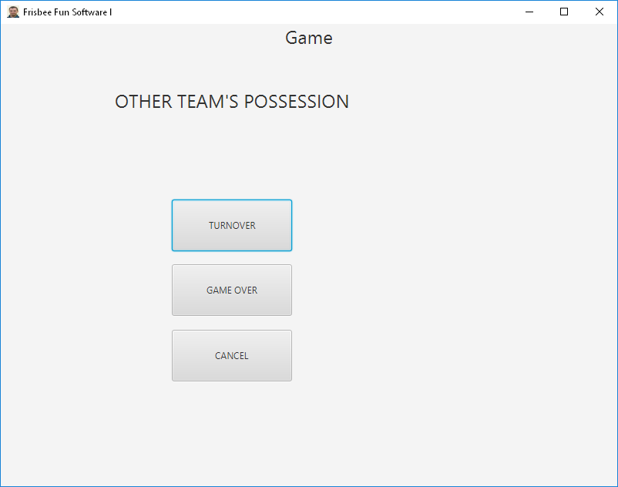
Their team's possession

Slide 16
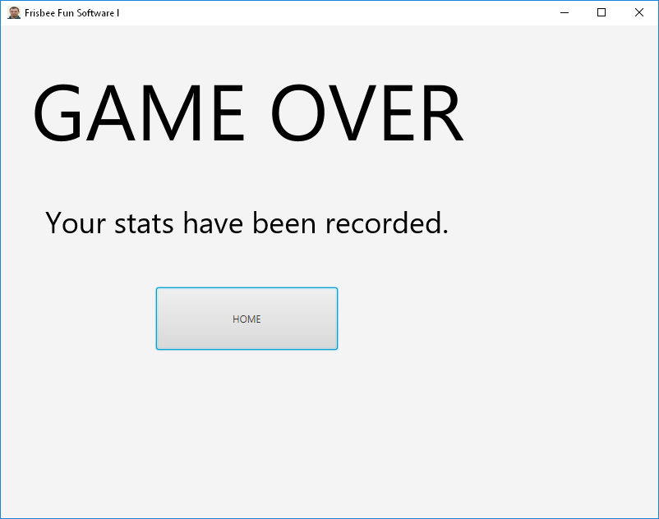
Game over screen

Slide 17
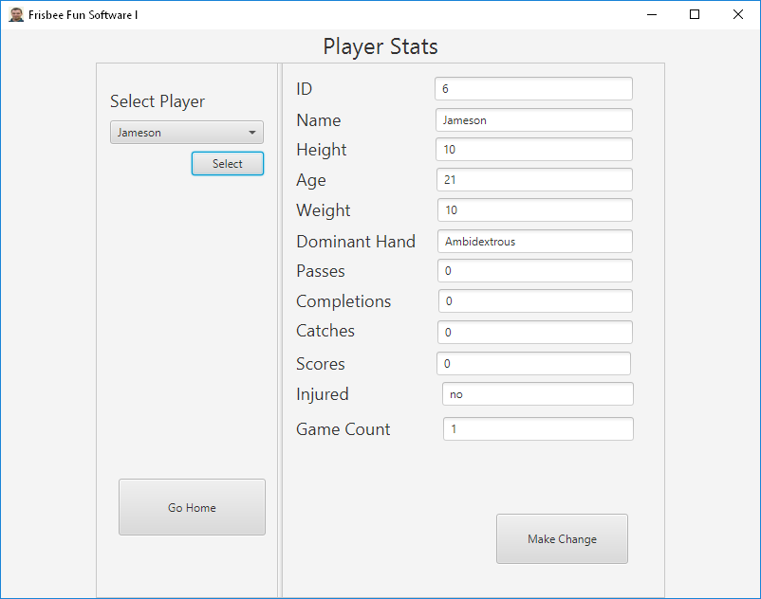
Player stats

Slide 18
Time spent Per Person
Jameson: 32 hours
Hunter: 30 hours
Matt: 41 hours
Caleb: 40 hours

