Slide 1
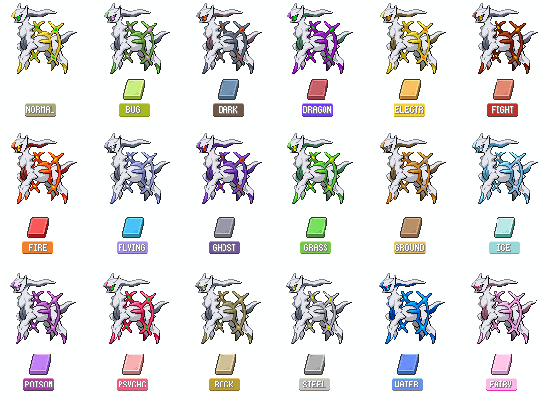

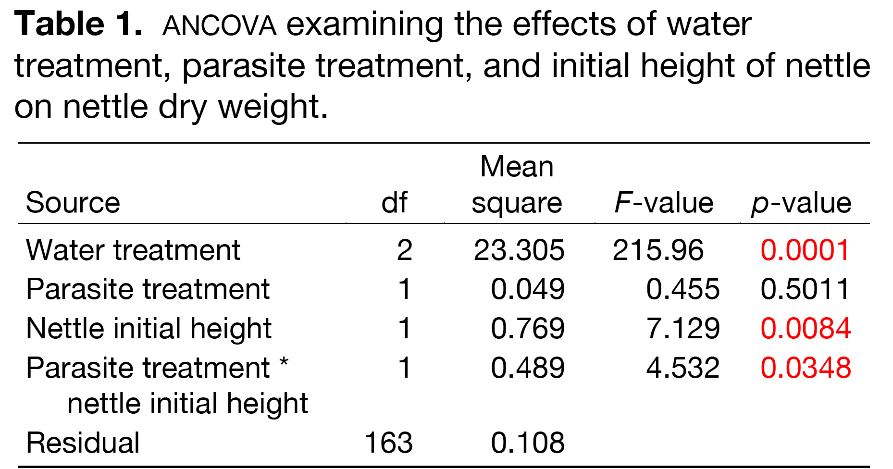
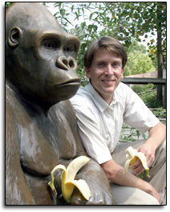
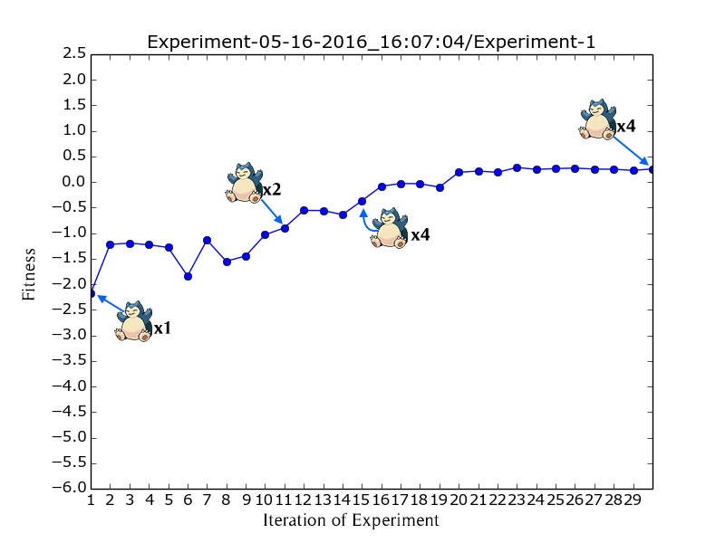
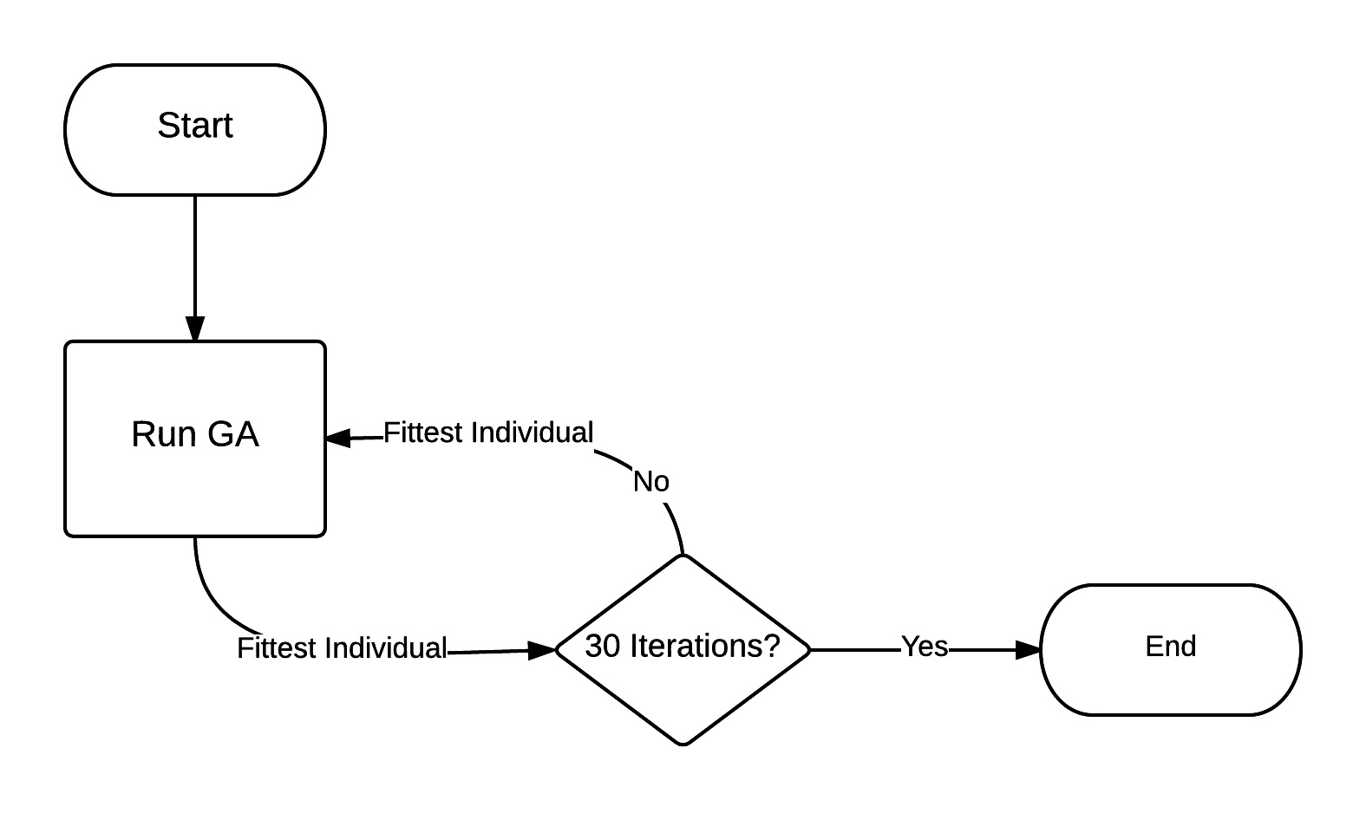

Format in “sentence case.” This means only the “t” in “title” gets capitalized.
Maintain a good amount of space between your columns. Although you could squeeze them right up against each other, the poster’s aesthetics would suffer. So when your mentor says to do it, just nod your head as if you’re listening, but roll your eyes as soon as she’s not looking.
Using a Genetic Algorithm to Find the Best Pokémon Team
Caleb Dinsmore and Adam Pogwizd Department of Computer Science and Engineering, Taylor University, Upland, IN 46989
The first sentence of the first paragraph does not need to be indented.
Make sure the edges of your columns are aligned with adjacent columns. Don’t trust your eyes: select the columns, then “Align” with the Align tool.
Introduction
Pokémon is a video game (and television) series wherein players (referred to as “trainers”) capture and use creatures (called “Pokémon”) and train them to challenge other trainers and their respective teams in turn-based battles.
Smogon University, an online authority on competitive Pokémon battling, has divided Pokémon into tier lists based on perceived power and usage (“An Introduction to Smogon’s Tier System”). The tier list of interest for our system is the “Uber” list. This tier contains Pokémon that are perceived as too powerful for competitive play, making this list effectively the ban list for Pokémon.
Our system aims to create a team of Pokémon sourced from tiers below Uber that can suitably compete against (and defeat) teams composed solely from the Uber tier.
Our fitness criteria was the difference between the percentage of health remaining in our team minus the percentage remaining of the opposing team.
We doubled negative results to encourage winning
Due to time and resource limitations, we had to cut functionality out of our Pokémon battle simulator.
We cut the following:
Items
Status-affecting moves/abilities
The teams we decided to optimize against were teams that we decided were the most balanced and most difficult to defeat: 3 teams, each containing 6 Arceus—one for each type in the game.
Conclusions
You can, of course, start your conclusions in column #3 if your results section is “data light.”
Conclusions should not be mere reminders of your results. Instead, you want to guide the reader through what you have concluded from the results. What is the broader significance? Would anyone be mildly surprised? Why should anyone care? This section should refer back, explicitly, to the “burning issue” mentioned in the introduction. If you didn’t mention a burning issue in the introduction, go back and fix that -- your poster should have made a good case for why this experiment was worthwhile. A good conclusion will also refer to the literature on the topic -- how does your research add to what is already published on the topic?
Blah, blah, blah. Blah, blah, blah. Blah, blah, blah. Blah, blah, blah. Blah, blah, blah. Blah, blah, blah. Blah, blah, blah. Blah, blah, blah. Blah, blah, blah. Blah, blah, blah. Blah, blah, blah. Blah, blah, blah. Blah, blah, blah. Blah, blah, blah. Blah, blah, blah. Blah, blah, blah. Blah, blah, blah. Blah, blah, blah. Blah, blah, blah. Blah, blah, blah.
Blah, blah, blah. Blah, blah, blah. Blah, blah, blah. Blah, blah, blah. Blah, blah, blah. Blah, blah, blah. Blah, blah, blah. Blah, blah, blah.
This result was not isolated to that experiment. Experiment after experiment converged to teams containing an unexpected number of Snorlax.
Figure 4. Avoid keys that force readers to labor through complicated graphs: just label all the lines (as above) and then delete the silly key provided by your charting software altogether. The above figure would also be greatly improved if I had the ability to draw mini rats with and without brains. I would then put these really cute little illustrations next to the lines they represent.
Figure 3. These are all 16 Arceus that compose the opposition to our GA’s solution.
Figure 1. One of the most powerful Pokémon, Arceus. The teams we use to test our population are composed entirely of this Pokémon in its different type variations.
Be sure to separate figures from other figures by generous use of white space. When figures are too cramped, viewers get confused about which figures to read first and which legend goes with which figure.
Figures are preferred but tables are sometimes unavoidable. A table looks best when it is first composed within Microsoft Word, then “Inserted” as an “Object.” If you can add small drawings or icons to your tables, do so!
Experimental Design
Since this is an optimization problem, we decided to use a genetic algorithm to derive our solution.
Here are the parameters we used for our algorithm:
Results
The results we got were very unexpected. Our experiments repeatedly converged on teams containing an excess of Snorlax.
This was very unusual, because comparatively, Arceus has much higher base stats than Snorlax (720 vs. 540 total).
Hi. If you’ve found this poster helpful, please consider sending me a postcard from wherever you are presenting your poster. It makes me feel like a have friends. Colin Purrington, Dept of Biology, Swarthmore College, Swarthmore, PA 19081, USA.
Literature cited
"An Introduction to Smogon's Tier System." Smogon University. N.p., n.d. Web. 16 May 2016.
Pokemon Mutation Rate | 0.05 | Rate at which a Pokémon within a chromosome mutated
Move Mutation Rate | 0.005 | Rate at which a Pokémon’s move mutated
Crossover Rate | 0.65 | Rate at which crossover occurred
Population Size | 500 | Number of individuals in a population
Abutting these last sections can save you a little space, and subtly indicates to viewers that the contents are not as important to read.
Acknowledgments
We thank I. Güor for laboratory assistance, Mary Juana for seeds, Herb Isside for greenhouse care, and M.I. Menter for questionable statistical advice. Funding for this project was provided by the Swarthmore College Department of Biology, a Merck summer stipend, and my mom. [Note that people’s titles are omitted.]
Put a figure here that explores a statistical result
This is the gene of interest!
Figure 5. You can use connector lines and arrows to visually guide viewers through your results. Adding emphasis this way is much, much better than making the point with words in the text section. These lines can help viewers read your poster even when you’re not present.
For further information
Please contact email@blahcollege.edu. More information on this and related projects can be obtained at www.swarthmore… (give the URL for general laboratory web site). A link to an online, PDF-version of the poster is nice, too. If you just must include a pretentious logo, hide it down here rather than up near where it would compete with your title.
Figure 2. Diagram illustrating the flow of our experimental design. We ran the GA thirty times, seeding each run with the fittest individual that our experiment had produced thus far.
Blah, blah, blah. Blah, blah, blah. However, blah, blah, blah.
Figure 3. While not containing solely Snorlax, the number present in the final team (which defeated all three teams of Arceus) was quite alarming.
Notes:
This poster template is from http://www.swarthmore.edu/NatSci/cpurrin1/posteradvice.htm. It is free, free, free for non-commercial use. But if you really like it, I’m always thrilled to get postcards from wherever you happen to be presenting your poster. Have fun. Sincerely, Colin Purrington, Department of Biology, Swarthmore College, Swarthmore, PA 19081, USA. Email: cpurrin1@swarthmore.edu

