Slide 1

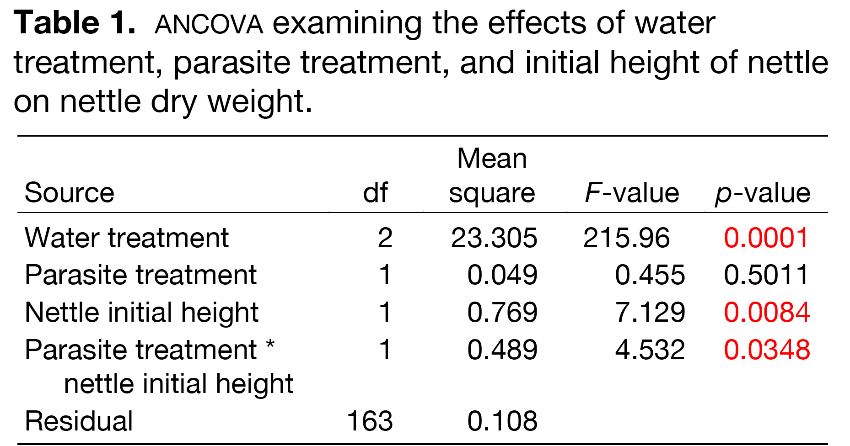
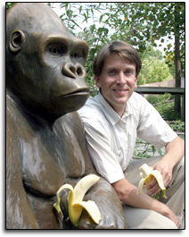
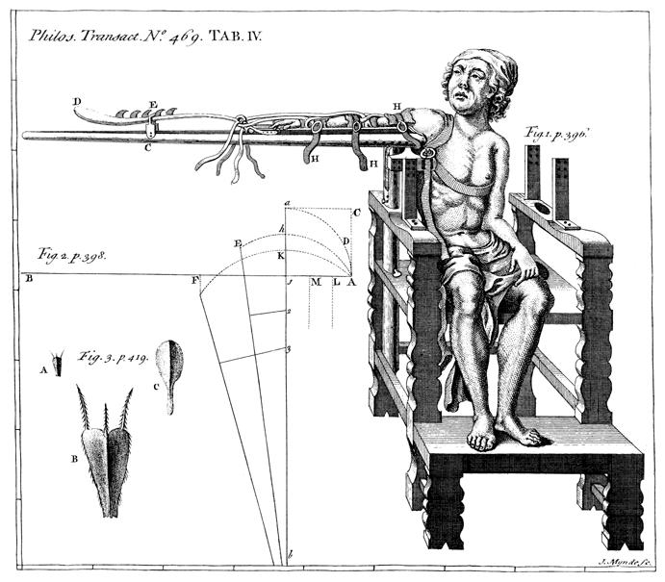
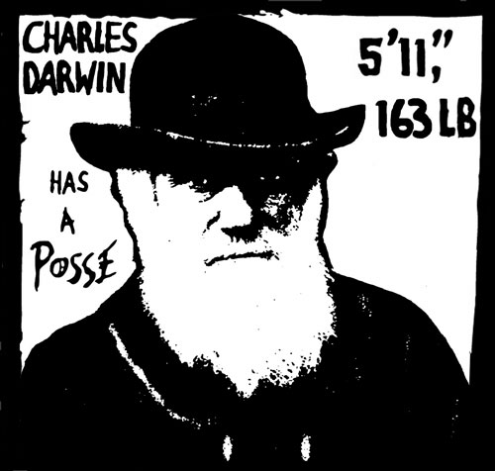

Format in “sentence case.” This means only the “t” in “title” gets capitalized.
Maintain a good amount of space between your columns. Although you could squeeze them right up against each other, the poster’s aesthetics would suffer. So when your mentor says to do it, just nod your head as if you’re listening, but roll your eyes as soon as she’s not looking.
Using a Genetic Algorithm to Find the Best Pokémon Team
Your name(s) here Department of Biology, Swarthmore College, Swarthmore, Pennsylvania 19081
The first sentence of the first paragraph does not need to be indented.
Make sure the edges of your columns are aligned with adjacent columns. Don’t trust your eyes: select the columns, then “Align” with the Align tool.
This is a header. If you make the font size large and then add bolding and/or color, there is no need to also [sic] apply underlining or italicization or numbers.
If you can orient your label horizontally (like this one), do it! Viewers with fused neck musculature are more likely to read it.
Introduction
Pokémon is a video game (and television) series wherein players (referred to as “trainers”) capture and use creatures (called “Pokémon”) and train them to challenge other trainers and their respective teams in turn-based battles.
Smogon University, an online authority on competitive Pokémon battling, has divided Pokémon into tier lists based on perceived power and usage (“An Introduction to Smogon’s Tier System”). The tier list of interest for our system is the “Uber” list. This tier contains Pokémon that are perceived as too powerful for competitive play, making this list effectively the ban list for Pokémon.
Our system aims to create a team of Pokémon sourced from tiers below Uber that can suitably compete against (and defeat) teams composed solely from the Uber tier.
Results
The overall layout for this section should be modified from this template to best show off your graphs and other result-related illustrations. You might want a single, large column to accommodate a big map, or perhaps you could arrange 6 figures in a circle in the center of the poster: do whatever it takes to make your results graphically clear. And, for the love of God (or whoever), make your graphs big enough to read from 6’ away.
Paragraph format is fine, but sometimes a simple list of “bullet” points can communicate results more effectively:
data were so non-normal, they were bizarre
9 out of 12 brainectomized rats survived
1 brainectomized rat escaped, killing 12 undergraduates
Control rats completed maze faster, on average, than rats without brains (Fig. 3b) (t = 9.84, df = 21, p = 0.032)
Conclusions
You can, of course, start your conclusions in column #3 if your results section is “data light.”
Conclusions should not be mere reminders of your results. Instead, you want to guide the reader through what you have concluded from the results. What is the broader significance? Would anyone be mildly surprised? Why should anyone care? This section should refer back, explicitly, to the “burning issue” mentioned in the introduction. If you didn’t mention a burning issue in the introduction, go back and fix that -- your poster should have made a good case for why this experiment was worthwhile. A good conclusion will also refer to the literature on the topic -- how does your research add to what is already published on the topic?
Blah, blah, blah. Blah, blah, blah. Blah, blah, blah. Blah, blah, blah. Blah, blah, blah. Blah, blah, blah. Blah, blah, blah. Blah, blah, blah. Blah, blah, blah. Blah, blah, blah. Blah, blah, blah. Blah, blah, blah. Blah, blah, blah. Blah, blah, blah. Blah, blah, blah. Blah, blah, blah. Blah, blah, blah. Blah, blah, blah. Blah, blah, blah. Blah, blah, blah.
Blah, blah, blah. Blah, blah, blah. Blah, blah, blah. Blah, blah, blah. Blah, blah, blah. Blah, blah, blah. Blah, blah, blah. Blah, blah, blah.
Rats with brains navigated mazes faster
Time (s)
Brainectomized
Putting titles on graphs is a huge no-no for manuscripts, but for a poster it really makes your graph instantly understandable to your viewers. E.g., just TELL your viewer what’s so cool or important about the graph…don’t make them hunt for it.
Control (brain intact)
Maze difficulty index
Figure 4. Avoid keys that force readers to labor through complicated graphs: just label all the lines (as above) and then delete the silly key provided by your charting software altogether. The above figure would also be greatly improved if I had the ability to draw mini rats with and without brains. I would then put these really cute little illustrations next to the lines they represent.
Figure 1. One of the most powerful Pokémon, Arceus. The teams we use to test our population are composed entirely of this Pokémon in its different type variations.
(a)
(b)
(c)
Be sure to separate figures from other figures by generous use of white space. When figures are too cramped, viewers get confused about which figures to read first and which legend goes with which figure.
Figures are preferred but tables are sometimes unavoidable. A table looks best when it is first composed within Microsoft Word, then “Inserted” as an “Object.” If you can add small drawings or icons to your tables, do so!
Materials and Methods
Figure 3. Make sure legends have enough detail to explain to the viewer what the results are, but don’t go on and on. Note that for posters it is good to put some “Materials and methods” information within the figure legends or onto the figures themselves—it allows the M&m section to be shorter, and gives viewer a sense of the experiment(s) even if they have skipped directly to figures. Don’t be tempted to reduce font size in figure legends, axes labels, etc.—your viewers are probably most interested in reading your figures and legends!
Hi. If you’ve found this poster helpful, please consider sending me a postcard from wherever you are presenting your poster. It makes me feel like a have friends. Colin Purrington, Dept of Biology, Swarthmore College, Swarthmore, PA 19081, USA.
Literature cited
"An Introduction to Smogon's Tier System." Smogon University. N.p., n.d. Web. 16 May 2016.
Often you will have some more text-based results between your figures. This text should explicitly guide the reader through the figures.
Blah, blah, blah (Figs. 3a,b). Blah, blah, blah. Blah, blah, blah. Blah, blah, blah. Blah, blah, blah. Blah, blah, blah. Blah, blah, blah. Blah, blah, blah.
Blah, blah, blah. Blah, blah, blah. Blah, blah, blah. Blah, blah, blah. Blah, blah, blah. Blah, blah, blah. Blah, blah, blah. Blah, blah, blah (Fig. 3c). Blah, blah, blah. Blah, blah, blah. Blah, blah, blah. Blah, blah, blah. Blah, blah, blah. Blah, blah, blah (data not shown).
Blah, blah, blah. Blah, blah, blah. Blah, blah, blah. Blah, blah, blah. Blah, blah, blah. Blah, blah, blah. Blah, blah, blah. Blah, blah, blah. Blah, blah, blah. Blah, blah, blah (God, personal communication).
Abutting these last sections can save you a little space, and subtly indicates to viewers that the contents are not as important to read.
Acknowledgments
We thank I. Güor for laboratory assistance, Mary Juana for seeds, Herb Isside for greenhouse care, and M.I. Menter for questionable statistical advice. Funding for this project was provided by the Swarthmore College Department of Biology, a Merck summer stipend, and my mom. [Note that people’s titles are omitted.]
I sure wish I’d presented my theory with a poster before I wrote my book.
Put a figure here that explores a statistical result
This is the gene of interest!
Figure 5. You can use connector lines and arrows to visually guide viewers through your results. Adding emphasis this way is much, much better than making the point with words in the text section. These lines can help viewers read your poster even when you’re not present.
For further information
Please contact email@blahcollege.edu. More information on this and related projects can be obtained at www.swarthmore… (give the URL for general laboratory web site). A link to an online, PDF-version of the poster is nice, too. If you just must include a pretentious logo, hide it down here rather than up near where it would compete with your title.
Figure 2. Illustration of important piece of equipment, or perhaps a flow chart summarizing experimental design. Scanned, hand-drawn illustrations are usually preferable to computer-generated ones. Just bribe (cookies, whatever) an artist to help you out.
Blah, blah, blah. Blah, blah, blah. However, blah, blah, blah.
Notes:
This poster template is from http://www.swarthmore.edu/NatSci/cpurrin1/posteradvice.htm. It is free, free, free for non-commercial use. But if you really like it, I’m always thrilled to get postcards from wherever you happen to be presenting your poster. Have fun. Sincerely, Colin Purrington, Department of Biology, Swarthmore College, Swarthmore, PA 19081, USA. Email: cpurrin1@swarthmore.edu

