Slide 1
The Digital Downconverter
Caleb Distel, SES 598 Student
Prof. Tracee Jamison-Hooks
Arizona State University

Slide 2
Description
The Digital Downconverter isolates a specific discrete frequency band, which allows scientists to use a lower sampling rate without losing any data. In other words, the DDC increases the ratio of scientific-insight : data-quantity
DDC moves a desired band from some center signal​ to baseband (around 0 Hz), filters to keep only that band, then reduces the sample rate so you process fewer samples

Slide 3
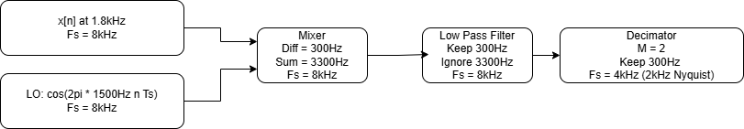
System Block Diagram

Slide 4
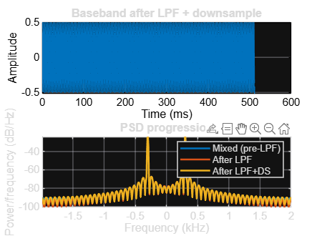
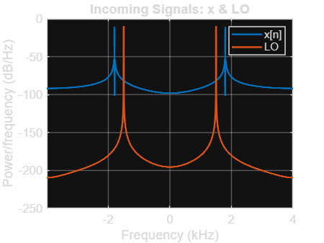
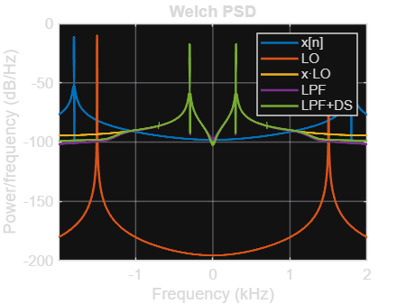
Incoming Frequencies

Slide 5
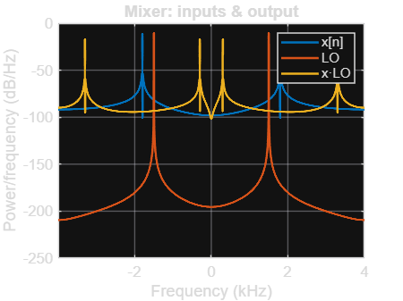
Mixing
Mathematical Explanation
Magic frequency: |f_sig − f_LO| → shows up at ±|f_sig − f_LO| after mixing.
Example: f_sig = 1900 Hz, f_LO = 1600 Hz → magic = 300 Hz.
Real-LO mixing (trig):
x[n] = A·cos(2π f_sig n T_s), LO[n] = cos(2π f_LO n T_s)
x[n]·LO[n] = ½ cos(2π(f_sig − f_LO)nT_s) + ½ cos(2π(f_sig + f_LO)nT_s)
New frequencies created (sum & difference):
Difference (magic): |f_sig − f_LO| (kept at baseband).
Sum (image): f_sig + f_LO (removed by LPF).
Example: sum = 3500 Hz.
Complex LO view (spectrum shift):
x[n]·e^(−j2π f_LO n T_s) ↔ X(f + f_LO): shifts spectrum by −f_LO (no image).
Real LO ≈ combination of +/− complex shifts → creates both sum & difference.

Slide 6
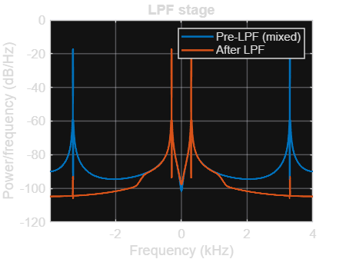
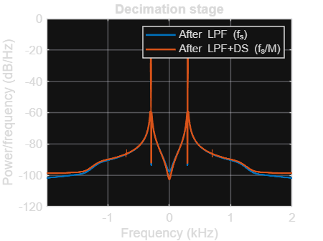
LPF & Down Sampling
LPF - What & Why
Low-pass filter the mixer output to keep the difference (|f_sig−f_LO|) band and reject the sum (f_sig+f_LO) and out-of-band energy to prevent aliasing.
Function used: FIR low-pass (windowed-sinc) via convolution.
Cutoff frequency: 1000 Hz (passes ~300 Hz; attenuates ~3500 Hz).
Downsample - Factor
Decimation factor M = 2 ⇒ new rate f_s = 4000 Hz (Nyquist 2000 Hz).
LPF occurs before decimation so the kept band fits within the new Nyquist

Slide 7
What did you learn?
Choosing LO near IF(x) shifts the desired tone near baseband, enabling easier signal manipulation for cases like the DDC.
LPF removes the sum and out-of-band noise before decimation. Filtering first is important.
Decimating appropriately slows the sample rate while preserving information.
Modelling noise (or any real-world variables) introduces new challenges, requiring well-engineered solutions.
MATLAB practice + modelling proficiencies

