Slide 1

CST499: Week 5 Final Software Project
Caleb Drehmer
University of Arizona Global Campus
CST 499: Capstone for Computer Software Technology
Professor Elchouemi
March 30, 2023

Slide 2

Objectives
Showcase Elements of the SRS Document
Display the UML models utilized for this project
Web Page Screenshots
Features of the Software System
PHP Source Code

Slide 3
SRS Document
The purpose of this SRS is to compile the requirements for a enrollment system for online courses. The SRS will outline the scope of the project, the external requirements, system features, and any additional non-functional requirements.
The software being created will be a web page capable of databasing students and assigning them manually to online courses. The benefit will be enabling students to be independent from resource advisors and set courses that are best for them. The goal will be to have a student create an account, log in, view a catalog of courses, and enroll into a class. This is in line with the schools business plan to enable students to take control of their own education.
Requirements:
[REQ-1] User registration with unique ID and password
[REQ-2] User will have information associated with the account in the database
[REQ-3] User will be able to login to the webpage at any time
[REQ-4] User will be able to filter courses as spring / summer / fall
[REQ-5] Courses will have a maximum number of students able to register
[REQ-6] Waiting lists for full courses
[REQ-7] Users will be able to de-enroll from a course

Slide 4
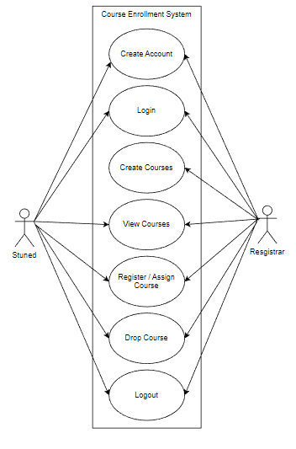
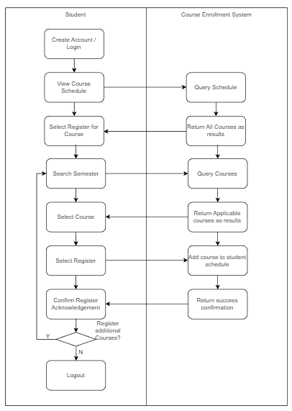
UML Diagrams
Use Case Diagram
Activity Diagram

Slide 5
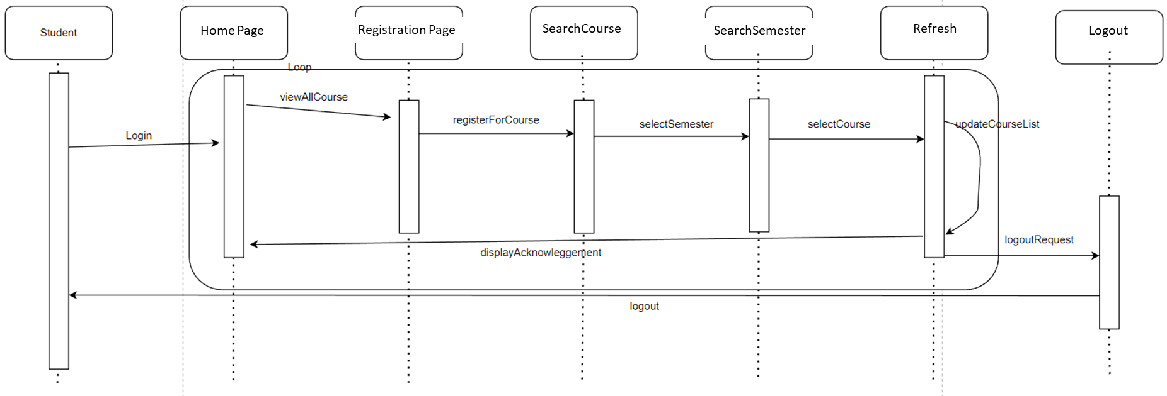
UML Diagrams
Sequence Diagram

Slide 6
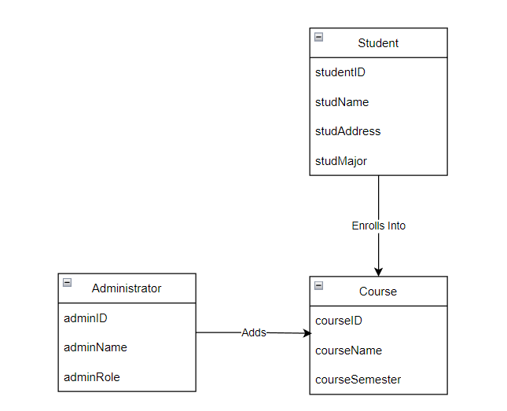
UML Diagrams
Class Diagram

Slide 7
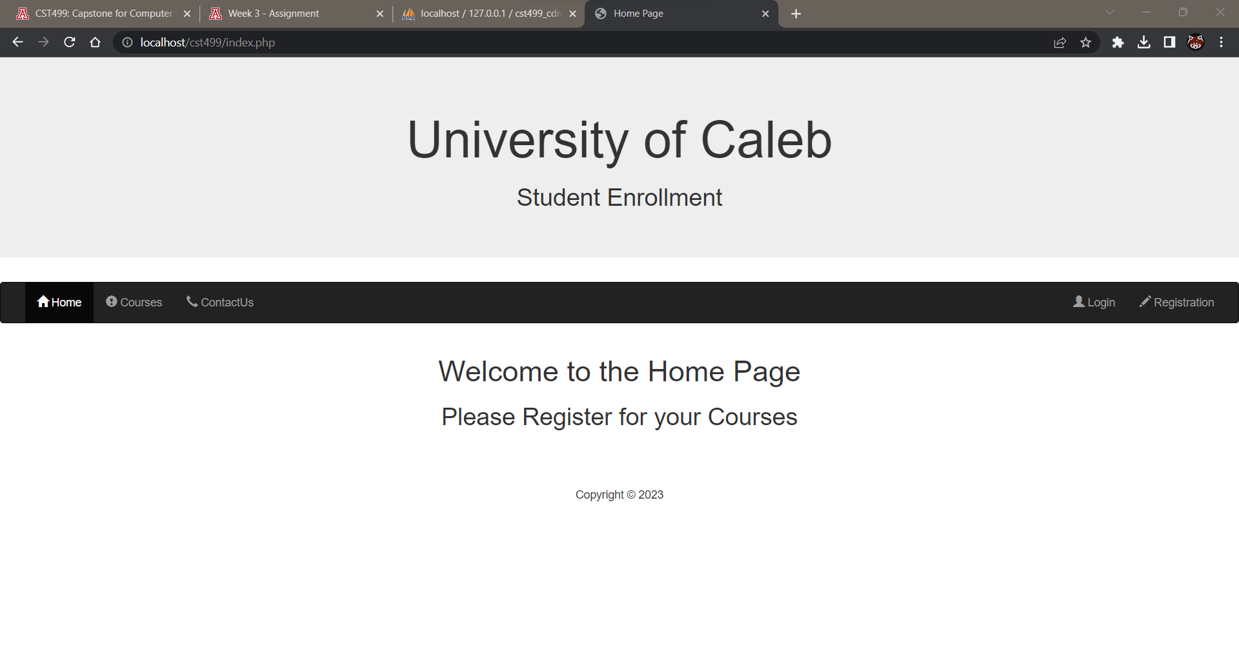
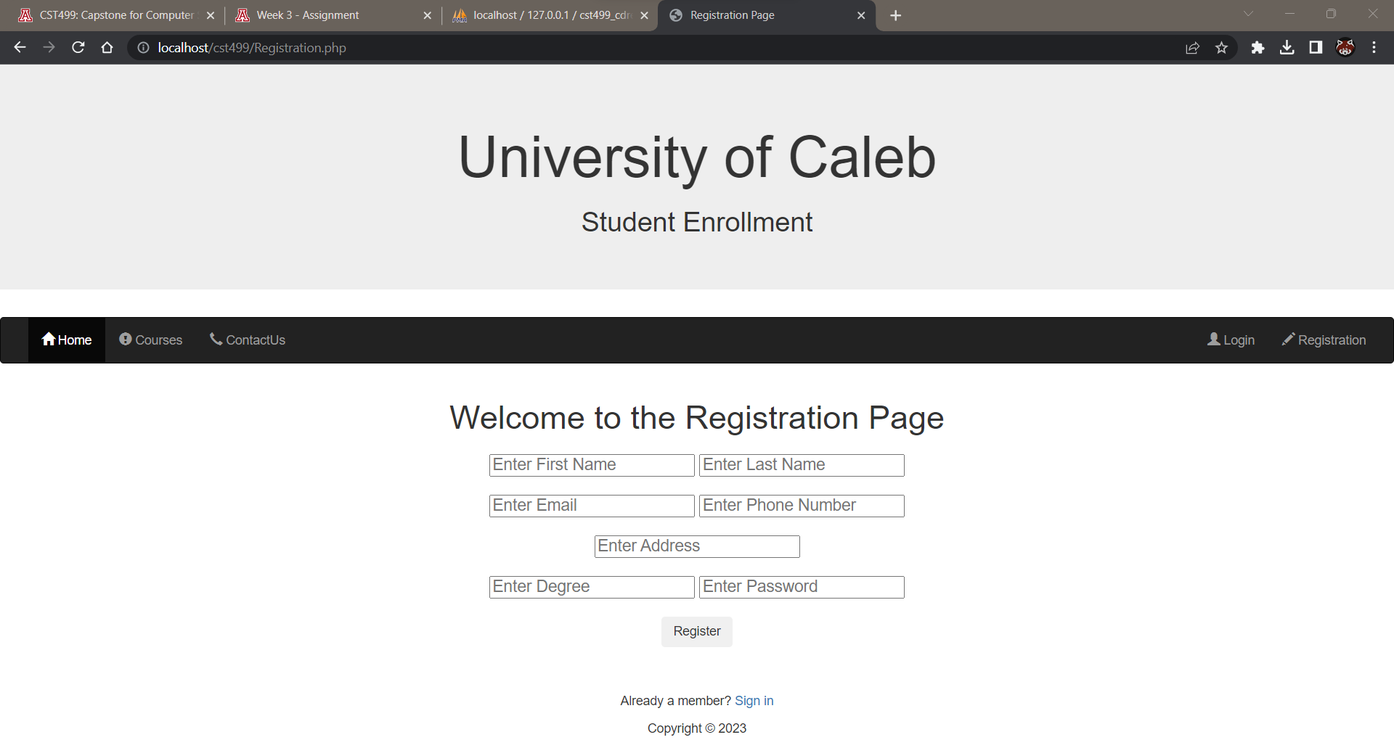
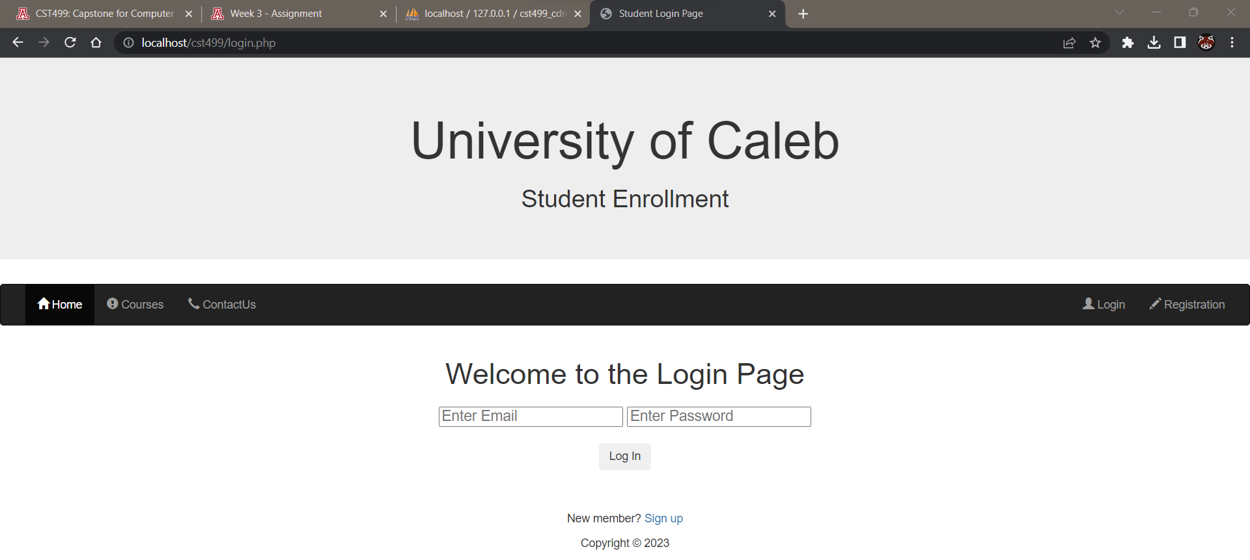
Web Page
Home Page
Registration Page
Login Page

Slide 8
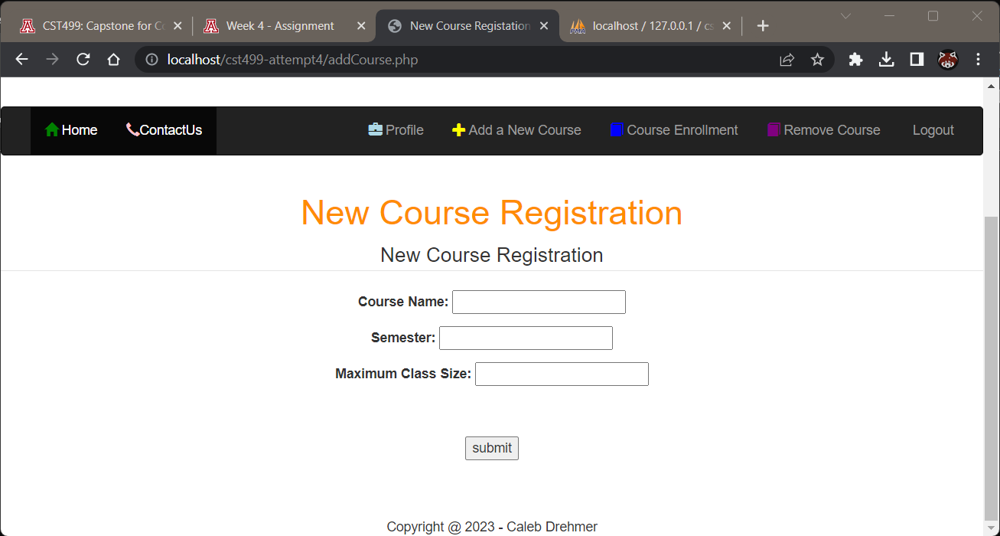
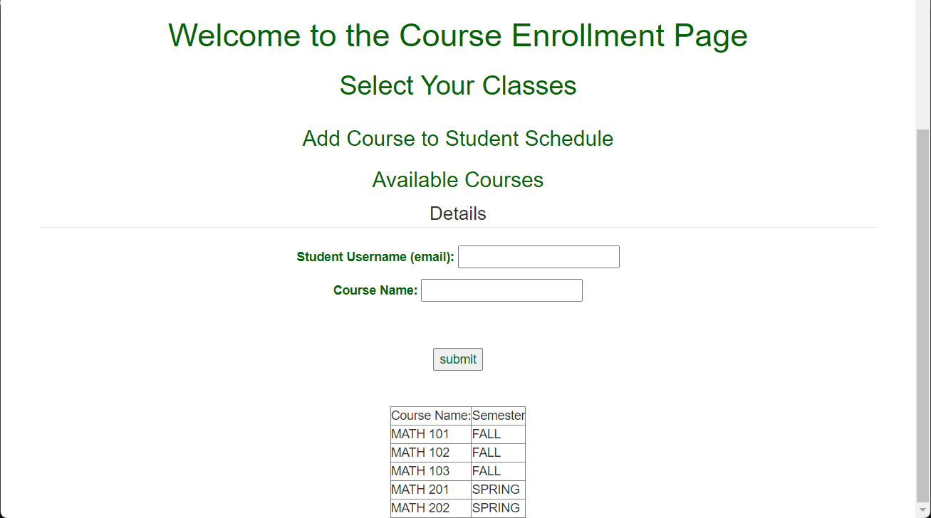
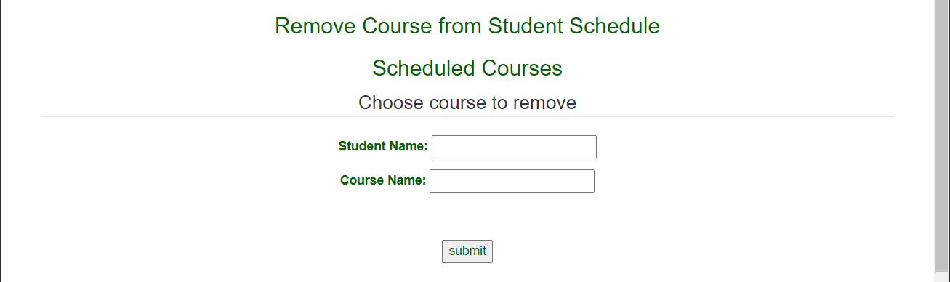
Web Page
Add Course
Enroll Course Page
Disenrollment Page

Slide 9
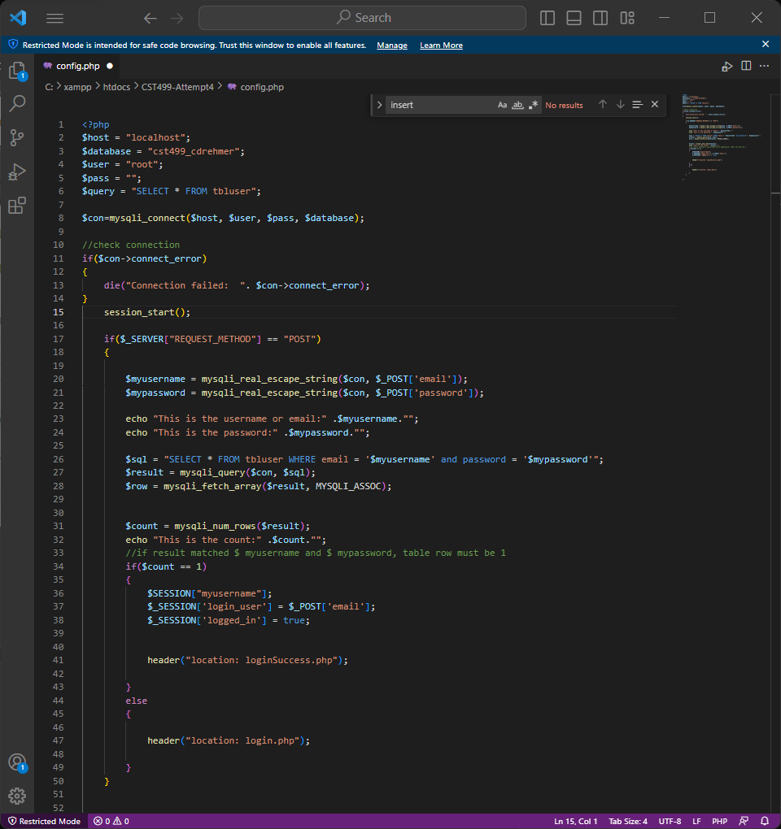
PHP Source Code

Slide 10
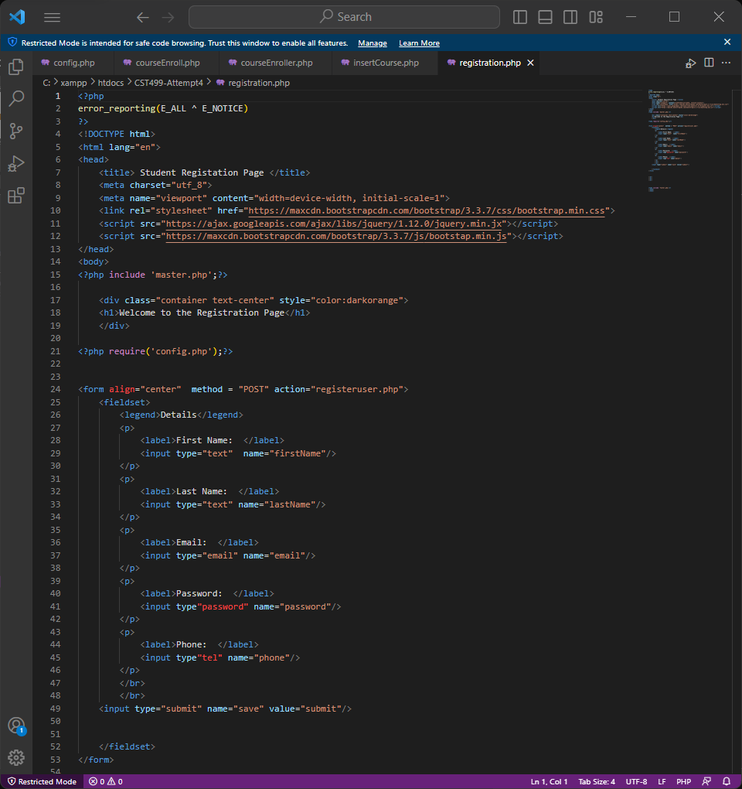
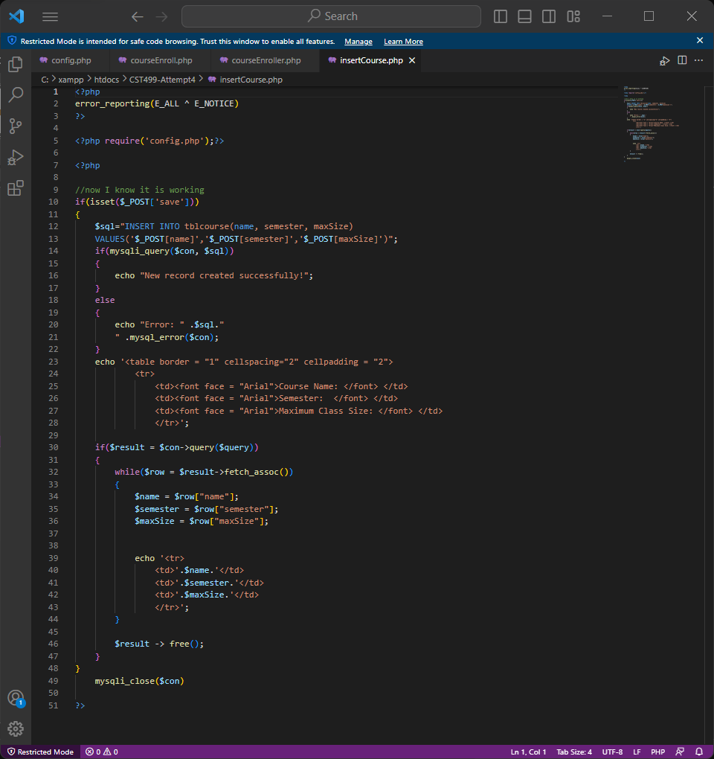
PHP Source Code

Slide 11
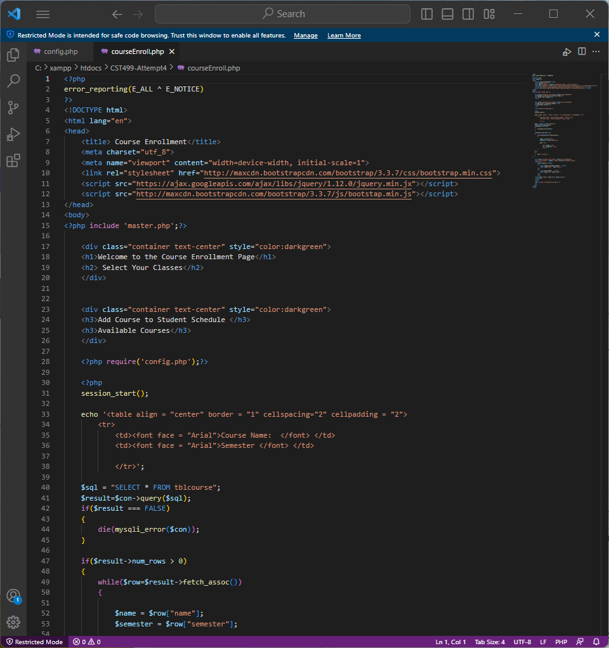
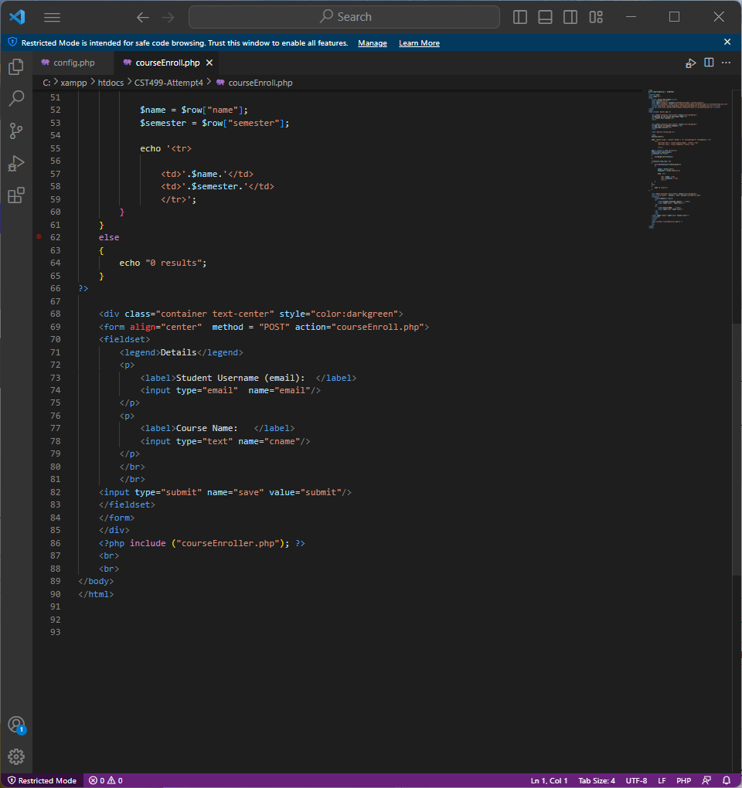
PHP Source Code

Slide 12
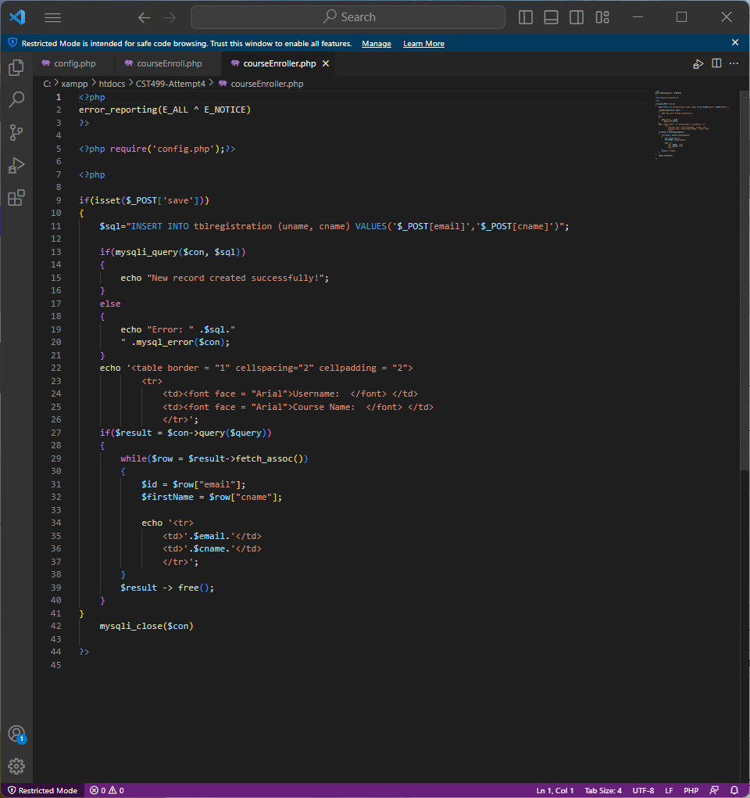
PHP Source Code

Slide 13
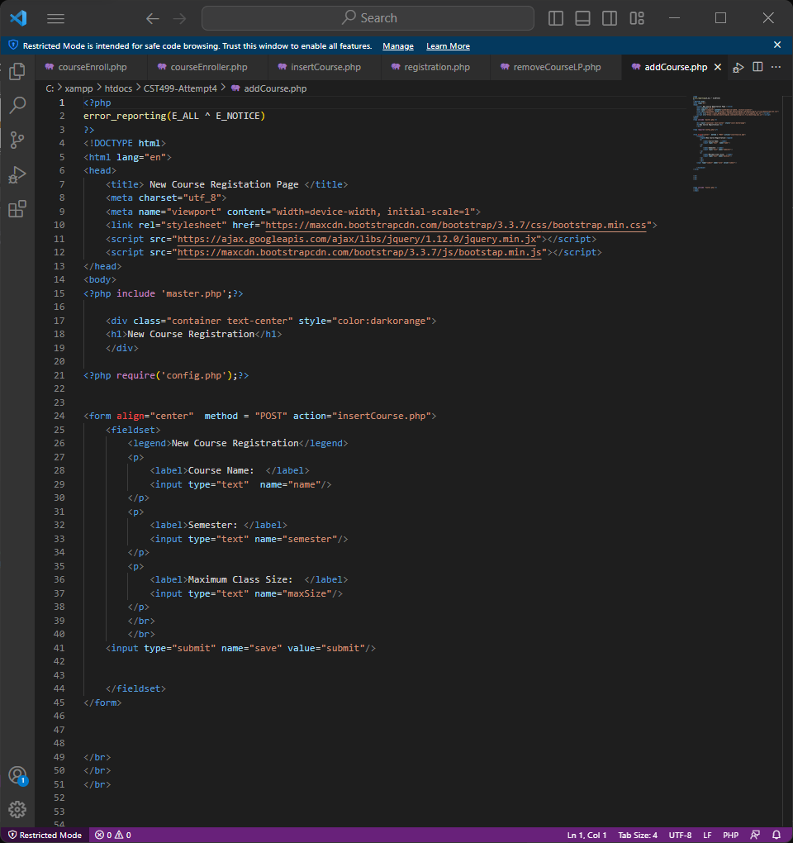
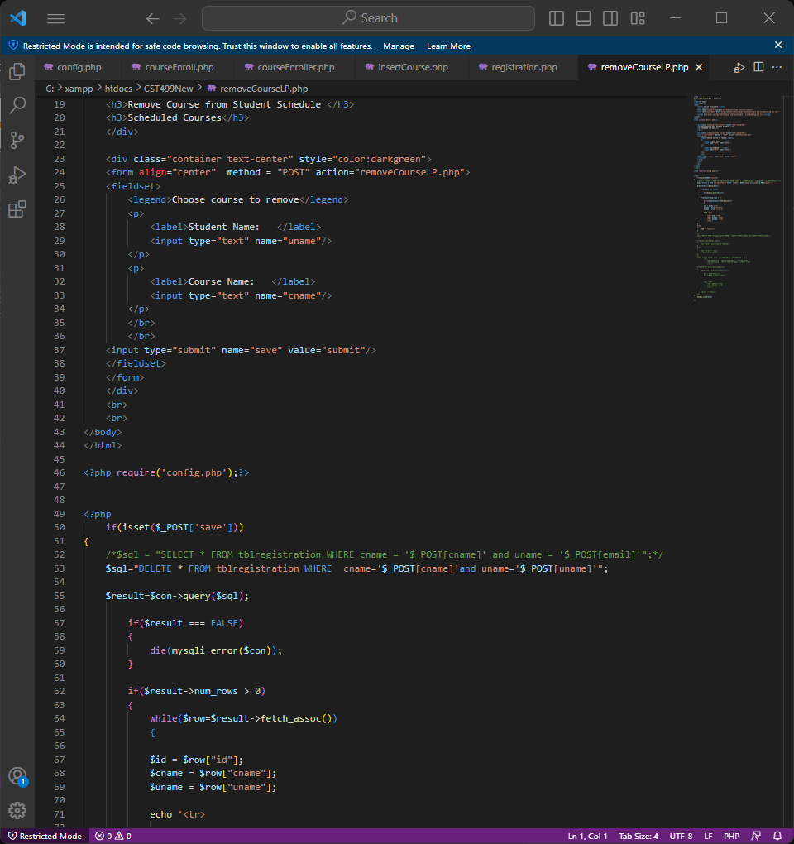
PHP Source Code

Slide 14
Conclusion
The SRS Document was used to plan the over all software system
UML Diagrams were created to visually depict characteristics and actions
Web pages were built with buttons to enable the functions
PHP files were created to build the web pages and the actions to connect to the database

