Slide 1
Unit 5 SQL: Data Manipulation Language For Relational Databases

Slide 2
SQL
We study key features of ANSI SQL standard for relational query/schema languages (more about schemas, that is specifying the structure of the database in the next unit)
History:
SEQUEL by IBM
Implemented in a product (DB2)
Many standards
SQL 86
…
SQL 2008
Many commercial implementations “close” to one of the standards
With some parts missing and some parts added
Very powerful
At its core relational algebra with many additions
Notes:
90

Slide 3
Our Focus
We will focus on
As precise as feasible (here) description of the semantics of various operations: some of them are somewhat surprising
Construction of simple and complex queries, to show the full power of SQL
More than you can get from any manual
We will not focus on
Any specific system
What you can get from a manual
But, I have run most of the queries on Microsoft Access, which allowed easy production of “snapshots”
I have run some of them on Oracle too

Slide 4
Key Differences Between Relational Algebra And SQL
SQL data model is a multiset not a set; still rows in tables (we sometimes continue calling relations)
Still no order among rows: no such thing as 1st row
We can count the number of times a particular row appears in the table (if we want to)
We can remove/not remove duplicates as we specify (most of the time)
There are some operators that specifically pay attention to duplicates
We must know whether duplicates are removed (and how) for each SQL operation; luckily, easy

Slide 5
Key Differences Between Relational Algebra And SQL
SQL contains all the power of relational algebra and more
Many redundant operators (relational algebra had only one: intersection, which can be computed using difference)
SQL provides statistical operators, such as AVG (average)
Can be performed on subsets of rows; e.g. average salary per company branch

Slide 6
Key Differences Between Relational Algebra And SQL
Every domain is “enhanced” with a special element: NULL
Very strange semantics for handling these elements
“Pretty printing” of output: sorting, and similar
Operations for
Inserting
Deleting
Changing/updating (sometimes not easily reducible to deleting and inserting)

Slide 7
More About Multisets
In a relational algebra, the basic object was a set
Order of elements cannot be specified
The multiplicity (how many times an element appearing in the set appears in it) cannot be specified; i.e., cannot say that “a” appears 3 times
In SQL the basic element is a multiset
Order of elements cannot be specified
The multiplicity (how many times an element appearing in the set appears in it) can be specified; i.e., can say that “a” appears 3 times

Slide 8
More About Multisets
The following two tables are equal, because:
They contain the same rows with the same multiplicity
The order of rows does not matter
The order of columns does not matter, as they are labeled
R | A | B
 | 1 | 10
 | 2 | 20
 | 2 | 20
 | 2 | 20
S | B | A
 | 20 | 2
 | 20 | 2
 | 10 | 1
 | 20 | 2

Slide 9
More About Multisets
The following two tables are not equal, because:
There is a row that appears with different multiplicities in the two tables
But as sets they would be equal
R | A | B
 | 1 | 10
 | 2 | 20
 | 2 | 20
 | 2 | 20
S | A | B
 | 1 | 10
 | 2 | 20
 | 2 | 20

Slide 10
Relational Algebra vs. SQL
We did not say that sets contain each element only once
We said that we cannot specify (and do not care) how many times an element appears in a set
It only matters whether it appears (at least once) or not (at all)
Therefore, all that we have learned about relational algebra operations immediately applies to corresponding operations in SQL, which does care about duplicates
That’s why it was important not to say that an element in a set appears exactly once
This was a subtle, but important, point

Slide 11
The Most Common Query Format (We Have Seen This Before)
As we have seen, a very common expression in SQL is:
SELECT A1, A2, ... FROM R1, R2, ... WHERE F;
In order of execution
FROM: Single table or Cartesian product
WHERE (optional): choose rows by condition (predicate)
SELECT: choose columns by listing
All three operations keep (do not remove) duplicates at any stage (unless specifically requested; more later)
We proceed to progressively more and more complicated examples, starting with what we know from relational algebra
A SELECT statement is also called a join: tables R1, R2, … are “joined” when condition F holds
Notes:
92

Slide 12
Set Operations (Not All Of Them Always Implemented)
UNION, duplicates are removed: SELECT * FROM R UNION SELECT * FROM S;
R | A
 | 1
 | 1
 | 2
 | 3
 | 2
S | A
 | 1
 | 2
 | 2
 | 4
 | 2
Result | A
 | 1
 | 2
 | 3
 | 4
Notes:
93

Slide 13
Set Operations (Not All Of Them Always Implemented)
MINUS, duplicates are removed: SELECT * FROM R MINUS SELECT * FROM S;
R | A
 | 1
 | 1
 | 2
 | 3
 | 2
S | A
 | 1
 | 2
 | 2
 | 4
 | 2
Result | A
 | 3
Notes:
93

Slide 14
Set Operations (Not All Of Them Always Implemented)
INTERSECT, duplicates are removed: SELECT * FROM R INTERSECT SELECT * FROM S;
R | A
 | 1
 | 1
 | 2
 | 3
 | 2
S | A
 | 1
 | 2
 | 2
 | 4
 | 2
Result | A
 | 1
 | 2
Notes:
93

Slide 15
Set Operations (Not All Of Them Always Implemented)
UNION ALL, duplicates are not removed: SELECT * FROM R UNION ALL SELECT * FROM S;
An element appears with the cardinality that is the sum of its cardinalities in R and S
R | A
 | 1
 | 1
 | 2
 | 3
 | 2
S | A
 | 1
 | 2
 | 2
 | 4
 | 2
Result | A
 | 1
 | 1
 | 2
 | 3
 | 2
 | 1
 | 2
 | 2
 | 4
 | 2
Notes:
93

Slide 16
Set Operations (Not All Of Them Always Implemented)
MINUS ALL, duplicates are not removed: SELECT * FROM R MINUS ALL SELECT * FROM S;
An element appears with the cardinality that is max(0, cardinality in R − cardinality in S)
R | A
 | 1
 | 1
 | 2
 | 3
 | 2
S | A
 | 1
 | 2
 | 2
 | 4
 | 2
Result | A
 | 1
 | 3
Notes:
93

Slide 17
Set Operations (Not All Of Them Always Implemented)
INTERSECT ALL, duplicates are not removed: SELECT * FROM R INTERSECT ALL SELECT * FROM S;
An element appears with the cardinality that is min(cardinality in R, cardinality in S)
R | A
 | 1
 | 1
 | 2
 | 3
 | 2
S | A
 | 1
 | 2
 | 2
 | 4
 | 2
Result | A
 | 1
 | 2
 | 2
Notes:
93

Slide 18
Our Sample Database
We will describe the language by means of a toy database dealing with orders for a single product that are supplied to customers by plants
It is chosen so that
It is small
Sufficiently rich to show to learn SQL
Therefore, a little artificial, but this does not matter
Sample database: PlantCustomerInvoice.mdb in Microsoft Access Database Examples for this unit
Notes:
91

Slide 19
The Tables of Our Database
Plant(P,Pname,Pcity,Profit)
This table describes the plants, identified by P. Each plant has a Pname, is in a Pcity, and makes certain Profit
Customer(C,Cname,Ccity,P)
This table describes the customers, identified by C. Each customer has a Cname and lives in a Ccity. Note that each customer is assigned to a specific P, where the orders for the customers are fulfilled. This P is a foreign key referencing Plant
Invoice(I,Amt,Idate,C)
This table describes the orders, identified by I. Each order is for some Amt (amount), is on a specific Idate, and placed by some C. This C is a foreign key referencing Customer. C must not be NULL
I could not use attribute “Date,” as it is a reserved keyword

Slide 20
The Tables of Our Database

Slide 21
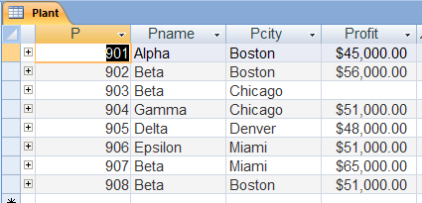
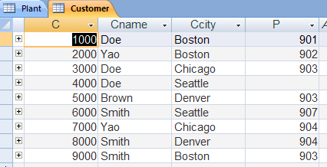
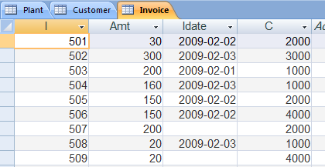
Our Instance

Slide 22
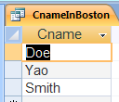
Queries On A Single Table
Find Cname for all customers who are located in Boston:
SELECT Cname FROM Customer WHERE Ccity = 'Boston';
Notes:
94

Slide 23
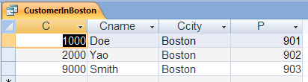
Queries On A Single Table
Find full data on every customer located in Boston:
SELECT * FROM Customer WHERE Ccity = 'Boston';
The asterisk, *, stands for the sequence of all the columns, in this case, C, Cname, Ccity, P
Notes:
94

Slide 24
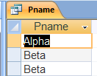
Queries On A Single Table
Find Pname for all plants that are located in Boston:
SELECT Pname FROM Plant WHERE Pcity = 'Boston';
Note that duplicates were not removed

Slide 25

Queries on a Single Table (Continued)
Find every C who is supplied from a plant in the same city they it is in and the plant’s profit is at least 50000
SELECT C FROM Plant, Customer WHERE Plant.Pcity = Customer.Ccity AND Plant.P = Customer.P AND Profit >= 50000;
Note that we need to “consult” two tables even though the answer is taken from a single table
Notes:
95

Slide 26
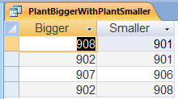
Queries On Two Tables And Renaming Columns and Tables
We want to produce a table with the schema (Bigger,Smaller), where bigger and smaller are two P located in the same city and the Profit of the Bigger is bigger than that of the Smaller
Two (logical) copies of Plant were produced, the first one is First and the second one is Second .
The attributes of the result were renamed, so the columns of the answer are Bigger and Smaller
SELECT First.P AS Bigger, Second.P AS Smaller FROM Plant AS First, Plant AS Second WHERE First.City = Second.City AND First.Profit > Second.Profit;
In some implementations AS cannot be used for renaming of tables, and only space can be used (see next)
Notes:
102

Slide 27
Queries On Two Tables And Renaming Columns and Tables
We want to produce a table with the schema (Bigger,Smaller), where bigger and smaller are two P located in the same city and the Profit of the Bigger is bigger than that of the Smaller
SELECT First.P Bigger, Second.P Smaller FROM Plant First, Plant Second WHERE First.City = Second.City AND First.Profit > Second.Profit;
This example shows how the space character is used as a renaming operator (does not work in Access)
Notes:
102

Slide 28
A Note About NULLs
We will discuss NULLs later, but we can note something now
There are two plants in Chicago, one of them has profit of NULL
When the comparison for these two plants is attempted, the following need to be compared:
$51,000.00
NULL
This comparison “cannot be done”

Slide 29
Division
We next introduce a new important type of query, which could have been done using relational algebra (as everything so far)
This is probably the most complex query we will discuss, so we deferred it until here
It is very important, but due to its complexity frequently not covered in textbooks
Its building blocks (and concepts behind them) are important too
So I will go over it very carefully

Slide 30
Asking About Some Versus Asking About All
We first compute two tables
CnameInCcity(Ccity,Cname)
This table lists all the “valid” tuples of Ccity,Cname; it is convenient for us to list the city first
CnameInChicago(Cname)
This table lists the names of the customers located in Chicago.
We then produce two queries
The first one is expressible by the existential quantifier (more about it later, if there is time)
The second one is expressible by the universal quantifier (more about it later, if there is time)
Notes:
Doe07

Slide 31
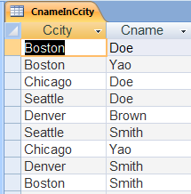
CnameInCcity
SELECT Ccity, Cname INTO CnameInCcity FROM Customer;
This variant of the SELECT statement uses INTO, creates a new table, here CnameInCcity and populates it with the result of the query

Slide 32

CnameInChicago
SELECT Customer.Cname INTO CnameInChicago FROM Customer WHERE Ccity='Chicago';

Slide 33
Our Tables
I have reproduced them, so they are larger and we can see them clearly
CnameInCcity | Ccity | Cname
 | Boston | Doe
 | Boston | Yao
 | Boston | Smith
 | Chicago | Doe
 | Chicago | Yao
 | Seattle | Doe
 | Seattle | Smith
 | Denver | Smith
 | Denver | Brown
CnameInChicago | Cname
 | Doe
 | Yao

Slide 34
Asking About Some Vs. Asking About All
In the following examples, I removed duplicates to save space
In SQL duplicates will not be removed, but it will not change the meaning of the result—still the right answers will be obtained
We will see this in Access snapshots

Slide 35
Asking About Some And About All
List all cities, the set of whose Cnames, contains at least one Cname that is (also) in Chicago
This will be easy
List all cities, the set of whose Cnames contains at least all the Cnames that are (also) in Chicago
This will be harder
Notes:
Doe08

Slide 36
Another Example
I will state a more natural example, which has exactly the same issues
I did not want to introduce a new database, do this is just to show that the problem is not artificial
Has | Person | Tool
 | Marsha | Fork
 | Marsha | Knife
 | Marsha | Spoon
 | Vijay | Fork
 | Vijay | Knife
 | Dong | Fork
 | Dong | Spoon
 | Chris | Spoon
 | Chris | Cup
Needed | Tool
 | Fork
 | Knife

Slide 37
Asking About Some And About All
List all Persons, whose set of Tools contains at least one Tool that is (also) in Needed
This will be easy
List all Persons, whose set of Tools contains at least all the Tools that are (also) in Needed
This will be harder
Notes:
Doe08

Slide 38
Asking About Some
List all cities, the set of whose Cnames, contains at least one Cname that is (also) in Chicago
SELECT Ccity INTO AnswerSome FROM CnameInCcity, CnameInChicago WHERE CnameInCcity.Cname = CnameInChicago.Cname;
AnswerSome | Ccity
 | Boston
 | Chicago
 | Seattle
Notes:
Doe08

Slide 39
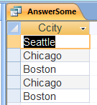
In Microsoft Access

Slide 40
Asking About All
We will proceed in stages, producing temporary tables, to understand how to do it
It is possible to do it using one query, which we will see later
We will start with the roadmap of what we will actually do
We will produce some intermediate tables

Slide 41
Roadmap
TempA = (all cities)
TempB = (all cities, all customers); for every city all the customers in the database, not only the customers in this city
TempC = TempB − CnameInCcity = (all cities, customers that should be in the cities to make them good but are not there); in other words, for each Ccity a Cname that it does not have but needs to have to be a “good” City
TempD = (all bad cities)
AnswerAll = TempA − TempD = (all good cities)

Slide 42
Asking About All
SELECT Ccity INTO TempA FROM CnameInCcity;
Set of all cities in which there could be customers
TempA | Ccity
 | Boston
 | Chicago
 | Seattle
 | Denver
Notes:
Doe09

Slide 43
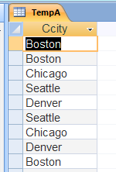
In Microsoft Access
Note duplicates: nothing surprising about this, as duplicates are not removed

Slide 44
Asking About All
SELECT Ccity, Cname INTO tempB FROM TempA, CnameInChicago;
Set of all pairs of the form (Ccity,Cname); in fact a Cartesian product of all cities with all desired Cnames (not only cities that have all desired Cnames)
tempB | Ccity | Cname
 | Boston | Doe
 | Boston | Yao
 | Chicago | Doe
 | Chicago | Yao
 | Seattle | Doe
 | Seattle | Yao
 | Denver | Doe
 | Denver | Yao
Notes:
Doe09

Slide 45
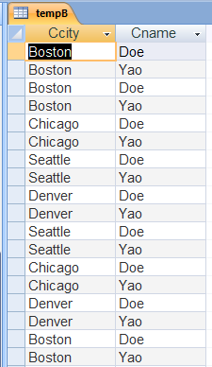
In Microsoft Access

Slide 46
Asking About All (Not Real Microsoft Access SQL Syntax)
SELECT * INTO tempC FROM (SELECT * FROM tempB ) MINUS (SELECT * FROM CnameInCcity);
Set of all pairs of the form (Ccity,Cname), such that the Ccity does not have the Cname; this is a “bad” Ccity with a proof why it is bad
tempC | Ccity | Cname
 | Seattle | Yao
 | Denver | Doe
 | Denver | Yao
Notes:
Doe09

Slide 47
Microsoft Access Has To Do This Differently We Will Understand This Later
SELECT * INTO tempC FROM tempB WHERE NOT EXISTS (SELECT * FROM CnameInCcity WHERE tempB.Ccity = CnameInCcity.Ccity AND tempB.Cname = CnameInCcity.Cname);
Set of all pairs of the form (Ccity,Cname), such that the Ccity does not have the Cname; this is a “bad” Ccity with a proof why it is bad
tempC | Ccity | Cname
 | Seattle | Yao
 | Denver | Doe
 | Denver | Yao
Notes:
Doe09

Slide 48
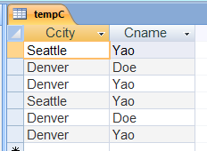
In Microsoft Access

Slide 49
Asking About All
SELECT Ccity FROM tempC INTO tempD;
Set of all “bad” Cities, that is cities that lack at least one Cname in CnameInChicago
tempD | Ccity
 | Seattle
 | Denver
 | Denver
Notes:
DoeDoe0

Slide 50
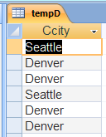
In Microsoft Access

Slide 51
Asking About All (Not Real Microsoft Access SQL Syntax)
SELECT * INTO AnswerAll FROM (SELECT * FROM tempA) MINUS (SELECT * FROM tempD);
Set of all “good” cities, that is cities that are not “bad”
AnswerAll | Ccity
 | Boston
 | Chicago
Notes:
DoeDoe0

Slide 52
Microsoft Access Has To Do This Differently We Will Understand This Later
SELECT * INTO AnswerAll FROM tempA WHERE NOT EXISTS (SELECT * FROM tempD WHERE tempD.Ccity = tempA.Ccity);
Set of all “good” cities, that is cities that are not “bad”
AnswerAll | Ccity
 | Boston
 | Chicago
Notes:
DoeDoe0

Slide 53
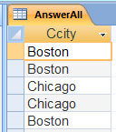
In Microsoft Access

Slide 54
Why Was Division So Difficult
We review our other example
Has | Person | Tool
 | Marsha | Fork
 | Marsha | Knife
 | Marsha | Spoon
 | Vijay | Fork
 | Vijay | Knife
 | Dong | Fork
 | Dong | Spoon
 | Chris | Spoon
 | Chris | Cup
Needed | Tool
 | Fork
 | Knife

Slide 55
Venn Diagram To Explain Division Query

Slide 56
NULLS And Duplicates
We now move to look at some aspects of SQL, which are not applicable to our relational algebra model
We will use, for this purposes simpler example databases and then will return to our PlantCustomerInvoice.mdb database

Slide 57
NULLs
Each domain is augmented with a NULL
NULL, intuitively stands for one of the following
Value unknown
Value not permitted to be known (to some of us)
Value not applicable
Semantics of NULLs is very complicated, I will touch on the most important aspects
There are two variants
For SQL DML
For SQL DDL
But the core is common

Slide 58
NULLs
We start with a SELECT statement
SELECT … FROM … WHERE condition
As we know:
Each tuple is tested against the condition
If the condition on the tuple is TRUE, then it is passed to SELECT
What happens if the condition is, say “x = 5”, with x being a column name?
It may happen that some current value in column x is NULL, what do we do?
What happens if the condition is, say “x = 5 OR x <> 5”, with x being a column name?
No matter what the value of x is, even if x is NULL, this should evaluate to TRUE? Or should it?
We use a new logic

Slide 59
NULLs
We abbreviate:
T for TRUE
F for FALSE
U for UNKNOWN
Standard 2-valued logic
New 3-valued logic
U is “between” F and T, “metathink” as being “maybe T or maybe F”
 | NOT
F | T
T | F
OR | F | T
F | F | T
T | T | T
AND | F | T
F | F | F
T | F | T
 | NOT
F | T
U | U
T | F
OR | F | U | T
F | F | U | T
U | U | U | T
T | T | T | T
AND | F | U | T
F | F | F | F
U | F | U | U
T | F | U | T

Slide 60
NULLs
Something to aid intuition
Think
NOT(x) as 1 − x
x OR y as max(x,y)
x AND y as min(x,y)
Then for 2-valued logic
FALSE is 0
TRUE is 1
Then for 3-valued logic
FALSE is 0
UNKNOWN is 0.5
TRUE is 1

Slide 61
NULLs
Back to a SELECT statement
SELECT … FROM … WHERE condition
As we know, each tuple is tested against the condition. Then, these are the rules
If the condition on the tuple is TRUE, then it is passed to SELECT
If the condition on the tuple is UNKNOWN, then it is not passed to SELECT
If the condition on the tuple is FALSE, then it is not passed to SELECT
In this context, of SQL DML queries, UNKNOWN behaves exactly the same as FALSE
So why introduce it? Because it will behave differently in the context of SQL DDL, as we will see later

Slide 62
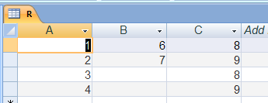
NULLs
We will use a simple Microsoft Access database: Nulls.mdb in Extras
It has only one table

Slide 63
NULLs
Any comparison in which one side is NULL is UNKNOWN
SELECT A FROM R WHERE B = 6 OR C = 8;
We get:
R | A | B | C
 | 1 | 6 | 8
 | 2 | 7 | 9
 | 3 | NULL | 8
 | 4 | NULL | 9
 | A
 | 1
 | 3

Slide 64

In Microsoft Access

Slide 65
NULLs
Any comparison in which one side is NULL is UNKNOWN
SELECT A FROM R WHERE B = 6 AND C = 8;
We get:
R | A | B | C
 | 1 | 6 | 8
 | 2 | 7 | 9
 | 3 | NULL | 8
 | 4 | NULL | 9
 | A
 | 1

Slide 66

In Microsoft Access

Slide 67
NULLs
Any comparison in which one side is NULL is UNKNOWN
SELECT A FROM R WHERE B = NULL;
We get:
which is an empty table
R | A | B | C
 | 1 | 6 | 8
 | 2 | 7 | 9
 | 3 | NULL | 8
 | 4 | NULL | 9
 | A

Slide 68

In Microsoft Access

Slide 69
NULLs
Any comparison in which one side is NULL is UNKNOWN
SELECT A FROM R WHERE B <> NULL;
We get:
which is an empty table
R | A | B | C
 | 1 | 6 | 8
 | 2 | 7 | 9
 | 3 | NULL | 8
 | 4 | NULL | 9
 | A

Slide 70
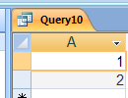
In Microsoft Access
But note what Access did, which is wrong:

Slide 71
In Oracle
Oracle did it right
Script | Trace
drop table R; create table R ( A number, B number, C number ); insert into R values(1,6,8); insert into R values(2,7,9); insert into R values(3,null,8); insert into R values(4,null,9); select * from R; select A from R where B <> null; | Table dropped. Table created. 1 row created. 1 row created. 1 row created. 1 row created. A B C ---------- ---------- ---------- 1 6 8 2 7 9 3 8 4 9 no rows selected

Slide 72
NULLs
Any comparison in which one side is NULL is UNKNOWN
SELECT A FROM R WHERE B = B;
We get:
Because, going row by row:
6 = 6 is TRUE
7 = 7 is TRUE
NULL = NULL is UKNOWN
NULL = NULL is UNKNOWN
R | A | B | C
 | 1 | 6 | 8
 | 2 | 7 | 9
 | 3 | NULL | 8
 | 4 | NULL | 9
 | A
 | 1
 | 2

Slide 73

In Microsoft Access

Slide 74
NULLs
A new keyword made of three words: IS NOT NULL
SELECT A FROM R WHERE B IS NOT NULL;
We get:
R | A | B | C
 | 1 | 6 | 8
 | 2 | 7 | 9
 | 3 | NULL | 8
 | 4 | NULL | 9
 | A
 | 1
 | 2

Slide 75

In Microsoft Access

Slide 76
NULLs
A new keyword made of two words: IS NULL
SELECT A FROM R WHERE B IS NULL;
We get:
R | A | B | C
 | 1 | 6 | 8
 | 2 | 7 | 9
 | 3 | NULL | 8
 | 4 | NULL | 9
 | A
 | 3
 | 4

Slide 77
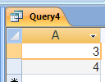
In Microsoft Access

Slide 78
NULLs
We have not discussed arithmetic operations yet, but will later
If one of the operands is NULL, the result is NULL (some minor exceptions), so:
5 + NULL = NULL
0 * NULL = NULL
NULL / 0 = NULL

Slide 79
NULLs
All NULLs are duplicates of each other (even though it is UNKNOWN whether they are equal to each other)*
We will understand what the implications of this are once we look a little closer at duplicates and aggregates soon
* This is not my fault!

Slide 80
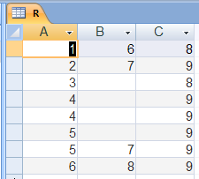
Duplicates
Standard SELECT FROM WHERE statement does not remove duplicates at any stage of its execution
Standard UNION, EXCEPT, INTERSECT remove duplicates
UNION ALL, EXCEPT ALL, INTERSECT ALL do not remove duplicates with rather interesting semantics
We will just go over some of these here, using database Nulls+Duplicates.mdb in Extras
It has one table

Slide 81
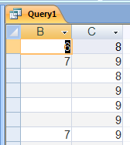
Duplicates
SELECT B, C FROM R WHERE A < 6;

Slide 82
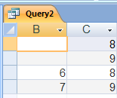
Duplicates
SELECT DISTINCT B, C FROM R WHERE A < 6;
New keyword DISTINCT removes duplicates from the result (all NULLs are duplicates of each other)

Slide 83
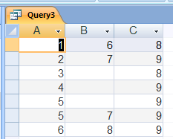
Removing Duplicate Rows From A Table
SELECT DISTINCT * FROM R;
This can be used to remove duplicate rows (later need to rename the result so it is called R; minor syntax issue)

Slide 84
Aggregation
It is possible to perform aggregate functions on tables
The standard aggregate operators are:
SUM; computes the sum; NULLs are ignored
AVG; computes the average; NULLs are ignored
MAX; computes the maximum; NULLs are ignored
MIN; computes the minimum; NULLs are ignored
COUNT; computes the count (the number of); NULLs are ignored, but exception below
Notes:
99

Slide 85
Aggregation
It is sometimes important to specify whether duplicates should or should not be removed before the appropriate aggregate operator is applied
Modifiers to aggregate operators
ALL (default, do not remove duplicates)
DISTINCT (remove duplicates)
COUNT can also have * specified, to count the number of tuples, without removing duplicates, here NULLs are not ignored, example of this later
Microsoft Access does not support DISTINCT
Notes:
99

Slide 86
Queries With Aggregates
Find the average Amt in Invoice, taking into account only orders from February 2, 2009
SELECT AVG(Amt) FROM Invoice WHERE Idate = #2009-02-02#;
Note that we must not remove duplicates before computing the average of all the values of Amt, to get the right answer
Note that we had to assume that there are no duplicate rows in Invoice; we know how to clean up a table
Note syntax for date
Notes:
100

Slide 87

In Microsoft Access

Slide 88
Queries With Aggregates
Find the average Amt in Invoice, taking into account only orders from February 2, 2009
SELECT AVG(DISTINCT Amt) FROM Invoice WHERE Idate = #2009-02-02#;
Cannot run this on Microsoft Access
Should return: 60
Notes:
100

Slide 89
Queries With Aggregates
Find the average Amt in Invoice, taking into account only orders from February 2, 2008
SELECT AVG(Amt) FROM Invoice WHERE Idate = #2008-02-02#;
Notes:
100

Slide 90

In Microsoft Access

Slide 91
Queries With Aggregates
Find the number of different values of Amt in Invoice, taking into account only orders from February 2, 2009
SELECT COUNT(DISTINCT Amt) FROM Invoice WHERE Idate = #2009-02-02#;
Here we had to remove duplicates, to get the right answer
Cannot run on Microsoft Access
Notes:
100

Slide 92
Queries With Aggregates
Find the largest Amt in Invoice, taking into account only orders from February 2, 2009
SELECT MAX(Amt) FROM Invoice WHERE Idate = #2009-02-02#;
Does not matter if we remove duplicates or not
Notes:
100

Slide 93

In Microsoft Access

Slide 94
Queries With Aggregates
Find the smallest Amt in Invoice, taking into account only orders from February 2, 2009
SELECT MIN(Amt) FROM Invoice WHERE Idate = #2009-02-02#;
Does not matter if we remove duplicates or not
Notes:
100

Slide 95
Queries With Aggregates
Find the number of tuples in Invoice, taking into account only orders from February 2, 2009
SELECT COUNT(*) FROM Invoice WHERE Idate = #2009-02-02#;
Notes:
100

Slide 96

In Microsoft Access

Slide 97
Queries With Aggregates
Find the number of tuples in Invoice, taking into account only orders from February 2, 2008
SELECT COUNT(*) FROM Invoice WHERE Idate = #2008-02-02#;
Notes:
100

Slide 98

In Microsoft Access

Slide 99
Queries With Aggregates
If the FROM … WHERE … part produces an empty table then:
SELECT COUNT (*) returns 0
SELECT COUNT returns 0
SELECT MAX returns NULL
SELECT MIN returns NULL
SELECT AVG returns NULL
SELECT SUM returns NULL

Slide 100
Queries With Aggregates
If the FROM … WHERE … part produces an empty table then:
SELECT SUM…. returns NULL
This violates laws of mathematics, for instance
and not undefined or NULL

Slide 101
Queries With Aggregates
Assume I own all the plants
How much money I made (or actually invoiced) on February 2, 2009?
Let’s use a nice title for the column (just to practice)
SELECT SUM(Amt) AS Billed20090202 FROM Invoice WHERE Idate = #2009-02-02#;
Logically, it makes sense that we get 330

Slide 102

In Microsoft Access

Slide 103
Queries With Aggregates
Assume I own all the plants
How much money I made (or actually invoiced) on February 2, 2008?
Let’s use a nice title for the column (just to practice)
SELECT SUM(Amt) AS Billed20080202 FROM Invoice WHERE Idate = #2008-02-02#;
Logically (and mathematically, following standard laws of mathematics), it makes sense that we get 0
But we get NULL

Slide 104

In Microsoft Access

Slide 105
Queries With Aggregates
In some applications it may sense
For example, if a student has not taken any classes, perhaps the right GPA is NULL
Even in Mathematics, we would be computing number of points divided by number of courses, 0/0, which is undefined

Slide 106
Queries With Aggregates
It is possible to have quite a sophisticated query:
(Completely) ignoring all orders placed by C = 3000, list for each Idate the sum of all orders placed, if the average order placed was larger than 100
SELECT Idate, SUM(Amt) FROM Invoice WHERE C <> 3000 GROUP BY Idate HAVING AVG(Amt) > 100;
The order of execution is:
FROM
WHERE
GROUP
HAVING
SELECT
We will trace this example to see how this works
Notes:
101

Slide 107
Queries With Aggregates
To make a smaller table, I only put the day (one digit) instead of the full date, which the database actually has
So, instead of 2009-02-02 I just write 2
No problem, as everything in the table is in the range 2009-02-01 to 2009-02-03

Slide 108
Queries With Aggregates
Invoice I Amt Idate C 501 30 2 2000 502 300 3 3000 503 200 1 1000 504 160 3 1000 505 150 2 2000 506 150 2 4000 507 200 NULL 2000 508 20 3 1000 509 20 NULL 4000
After FROM, no change, we do not have Cartesian product in the example
I Amt Idate C 501 30 2 2000 502 300 3 3000 503 200 1 1000 504 160 3 1000 505 150 2 2000 506 150 2 4000 507 200 NULL 2000 508 20 3 1000 509 20 NULL 4000

Slide 109
Queries With Aggregates
I Amt Idate C 501 30 2 2000 502 300 3 3000 503 200 1 1000 504 160 3 1000 505 150 2 2000 506 150 2 4000 507 200 NULL 2000 508 20 3 1000 509 20 NULL 4000
After WHERE C <> 3000
I Amt Idate C 501 30 2 2000 503 200 1 1000 504 160 3 1000 505 150 2 2000 506 150 2 4000 507 200 NULL 2000 508 20 3 1000 509 20 NULL 4000

Slide 110
Queries With Aggregates
I Amt Idate C 501 30 2 2000 503 200 1 1000 504 160 3 1000 505 150 2 2000 506 150 2 4000 507 200 NULL 2000 508 20 3 1000 509 20 NULL 4000
After GROUP BY Idate
I Amt Idate C 501 30 2 2000 505 150 2 2000 506 150 2 4000 503 200 1 1000 504 160 3 1000 508 20 3 1000 507 200 NULL 2000 509 20 NULL 4000

Slide 111
Queries With Aggregates
I Amt Idate C 501 30 2 2000 505 150 2 2000 506 150 2 4000 503 200 1 1000 504 160 3 1000 508 20 3 1000 507 200 NULL 2000 509 20 NULL 4000
We have 4 groups, corresponding to the dates: 2, 1, 3, NULL
We compute for ourselves the average order for each group, the group condition
Idate AVG(Amt) 2 110 1 200 3 90 NULL 110
Groups for dates 2, 1, NULL satisfy the “group” condition

Slide 112
Queries With Aggregates
I Amt Idate C 501 30 2 2000 505 150 2 2000 506 150 2 4000 503 200 1 1000 504 160 3 1000 508 20 3 1000 507 200 NULL 2000 509 20 NULL 4000
Groups for dates 2, 1, NULL satisfy the “group” condition, so after HAVING AVG(Amt) > 100
I Amt Idate C 501 30 2 2000 505 150 2 2000 506 150 2 4000 503 200 1 1000 507 200 NULL 2000 509 20 NULL 4000

Slide 113
Queries With Aggregates
I Amt Idate C 501 30 2 2000 505 150 2 2000 506 150 2 4000 503 200 1 1000 507 200 NULL 2000 509 20 NULL 4000
The SELECT statement “understands” that it must work on group, not tuple level
Idate SUM(Amt) 2 330 1 200 NULL 220

Slide 114
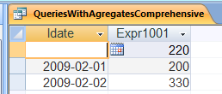
In Microsoft Access

Slide 115
Queries With Aggregates
Not necessary to have the WHERE clause, if all tuples should be considered for the GROUP BY operation
Not necessary to have the HAVING clause, if all groups are good

Slide 116
Queries With Aggregates
In the SELECT line only a group property can be listed, so, the following is OK, as each of the items listed is a group property
SELECT SUM(Amt), MIN(Amt) FROM Invoice WHERE C <> 3000 GROUP BY Idate HAVING AVG(Amt) > 100;
We could list Idate too, as it is a group property too
SELECT Idate, SUM(Amt), MIN(Amt) FROM Invoice WHERE C <> 3000 GROUP BY Idate HAVING AVG(Amt) > 100;

Slide 117
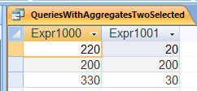
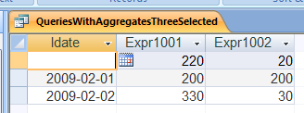
In Microsoft Access

Slide 118
Queries With Aggregates
But, the following is not OK, as C is not a group property, because on a specific Idate different C’s can place an order
SELECT C FROM Invoice WHERE C <> 3000 GROUP BY Idate HAVING AVG(Amt) > 100;

Slide 119
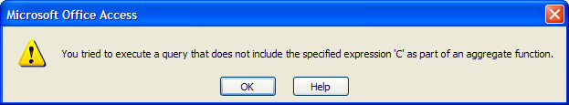
In Microsoft Access
Got it right!

Slide 120
Queries With Aggregates
One can aggregate on more than one attribute, so that the following query (shown schematically) is possible
SELECT Amt, Idate, MIN(C) FROM Invoice WHERE … GROUP BY Amt, Idate HAVING …;
This will put in a single group all orders for some specific Amt placed on some specific Idate

Slide 121
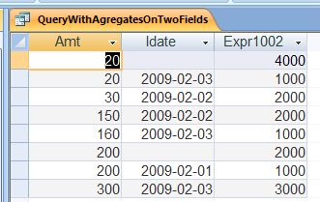
In Microsoft Access

Slide 122
Queries With Aggregates
The following is permitted also
SELECT MIN(C) FROM Invoice WHERE … GROUP BY Amt, Idate HAVING …;

Slide 123
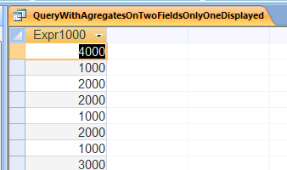
In Microsoft Access

Slide 124
Subqueries
In a SELECT statement, the WHERE clause can refer to a result of another query, thought of as an “inner loop,” referred to as a subquery
Consider two relations R(A,B) and S(A,B)
SELECT A FROM R WHERE B > (SELECT MIN(C) FROM S)
This will pick up all values of column A of R if the corresponding B is larger than the smallest element in the C column of S
Generally, a result of a subquery is either one element (perhaps with duplicates) as in the above example or more than one element
We start with one element subquery results

Slide 125
Subqueries
Find a list of all I for orders that are bigger than the smallest order placed on the same date.
SELECT I FROM Invoice AS Invoice1 WHERE Amt > (SELECT MIN(Amt) FROM Invoice WHERE Idate = Invoice1.Idate);
For each tuple of Invoice1 the value of Amt is compared to the result of the execution of the subquery.
The subquery is executed (logically) for each tuple of Invoice
This looks very much like an inner loop, executed logically once each time the outer loop “makes a step forward”
Note that we needed to rename Invoice to be Invoice1 so that we can refer to it appropriately in the subquery.
In the subquery unqualified Idate refers to the nearest encompassing Invoice

Slide 126
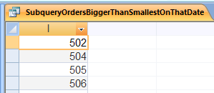
Subqueries

Slide 127
Subqueries
In addition to the > operator, we could also use other standard comparison operators between two tuple values, such as >=, <>, etc.,
For such comparison operators, we need to be sure that the subquery is syntactically (i.e., by its syntax) guaranteed to return only one value
Subqueries do not add any expressive power but one needs to be careful in tracking duplicates
We will not do it here
Benefits of subqueries
Some people find them more readable
Perhaps easier for the system to implement efficiently
Perhaps by realizing that the inner loop is independent of the outer loop and can be executed only once

Slide 128
Subqueries
Find a list of all I for orders that are bigger than the smallest order placed on the same date
The following will give the same result, but more clumsily than using subqueries
SELECT Idate, MIN(Amt) AS MinAmt INTO InvoiceTemp01 FROM Invoice GROUP BY Idate;
SELECT Invoice.I FROM Invoice, InvoiceTemp01 WHERE Invoice.Idate = InvoiceTemp01.Idate AND Amt > MinAmt;

Slide 129
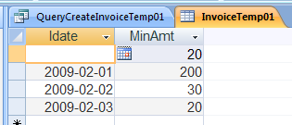
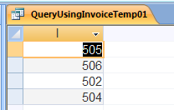
Subqueries

Slide 130
Subqueries Returning a Set of Values
In general, a subquery could return a set of values, that is relations with more than one row in general
In this case, we use operators that can compare a single value with a set of values.
The two keywords are ANY and ALL
Let v be a value, r a set of values, and op a comparison operator
Then
“v op ANY r” is true if and only if v op x is true for at least one x in r
“v op ALL r” is true if an only if v op x is true for each x in r
Notes:
104

Slide 131
Subqueries With ALL and ANY
Find every I for which Amt is larger than the largest Amt on February 2, 2009
SELECT I FROM Invoice WHERE Amt > ALL (SELECT Amt FROM Invoice WHERE Idate = #2009-02-02#);
Note, loosely speaking: > ALL X means that for every x in X, > x holds
Notes:
105

Slide 132
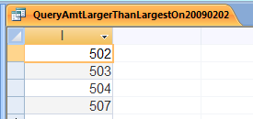
Subqueries With ALL and ANY

Slide 133
Subqueries With ALL and ANY
Find every I for which Amt is larger than the smallest Amt on February 2, 2009
SELECT I FROM Invoice WHERE Amt > ANY (SELECT Amt FROM Invoice WHERE Idate = #2009-02-02#);
Note, loosely speaking: > ANY X means that for at least one x in X, > x holds
Notes:
105

Slide 134
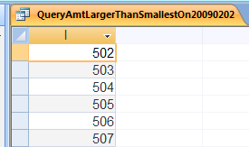
Subqueries With ALL and ANY

Slide 135
= ALL and = ANY
What does = ANY mean?
Equal to at least one element in the result of the subquery
It is possible to write “IN” instead of “= ANY”
But better check what happens with NULLs (we do not do it here)
What does <> ALL mean?
Different from every element in the subquery
It is possible to write “NOT IN” instead of “= ANY”
But better check what happens with NULLs (we do not do it here)
What does <> ANY mean?
Not equal to at least one element in the result of the subquery
But better check what happens with NULLs (we do not do it here)
What does = ALL mean?
Equal to every element in the result of the subquery (so if the subquery has two distinct elements in the output this will be false)
But better check what happens with NULLs (we do not do it here)

Slide 136
Subqueries With ALL and ANY
Assume we have R(A,B,C) and S(A,B,C,D)
Some systems permit comparison of tuples, such as
SELECT A FROM R WHERE (B,C) = ANY (SELECT B, C FROM S);
But some do not; then EXISTS, which we will see next, can be used

Slide 137
Testing for Emptiness
It is possible to test whether the result of a subquery is an empty relation by means of the operator EXISTS
“EXISTS R” is true if and only if R is not empty
So read this: “there exists a tuple in R”
“NOT EXISTS R” is true if and only if R is empty
So read this: “there does not exist a tuple in R”
These are very important, as they are frequently used to implement difference (MINUS or EXCEPT) and intersection (INTERSECT)
First, a little practice, then how to do the set operations
Notes:
106

Slide 138
Testing for Emptiness
Find all Cnames who do not have an entry in Invoice
SELECT Cname FROM Customer WHERE NOT EXISTS (SELECT * FROM Invoice WHERE Customer.C = Invoice.C);
Notes:
106

Slide 139
Testing for Non-Emptiness
Find all Cnames who have an entry in Invoice
SELECT Cname FROM Customer WHERE EXISTS (SELECT * FROM Invoice WHERE Customer.C = Invoice.C);
Notes:
106

Slide 140
Implementing Intersection And Difference If They Are Not Directly Available
See SetOperationsInSql.mdb in Extras
In general, use EXISTS and NOT EXISTS
If the tables have only one column, you may see advice to use IN and NOT IN: don’t do this: problems with NULLs

Slide 141
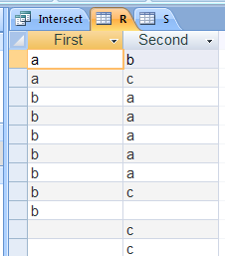
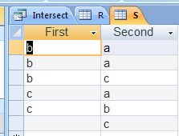

Set Intersection (INTERSECT) Use EXISTS
SELECT DISTINCT * FROM R WHERE EXISTS (SELECT * FROM S WHERE R.First = S.First AND R.Second = S.Second);
Note that a tuple containing nulls, (NULL,c), is not in the result, and it should not be there

Slide 142
Set Intersection (INTERSECT) Can Also Be Done Using Cartesian Product
SELECT DISTINCT * FROM R WHERE R.First = S.First AND R.Second = S.Second)

Slide 143
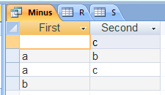
Set Difference (MINUS/EXCEPT) Use NOT EXISTS
SELECT DISTINCT * FROM R WHERE NOT EXISTS (SELECT * FROM S WHERE R.First = S.First AND R.Second = S.Second);
Note that tuples containing nulls, (b,NULL) and (NULL,c), are in the result, and they should be there

Slide 144
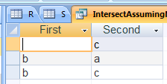
Accounting For NULLs (Perhaps Semantically Incorrectly)
SELECT DISTINCT * FROM R WHERE EXISTS (SELECT * FROM S WHERE (R.First = S.First AND R.Second = S.Second) OR (R.First IS NULL AND S.First IS NULL AND R.Second = S.Second) OR (R.First = S.First AND R.Second IS NULL AND S.Second IS NULL) OR (R.First IS NULL AND S.First IS NULL AND R.Second IS NULL AND S.Second IS NULL));

Slide 145
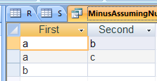
Accounting For NULLs (Perhaps Semantically Incorrectly)
SELECT DISTINCT * FROM R WHERE NOT EXISTS (SELECT * FROM S WHERE (R.First = S.First AND R.Second = S.Second) OR (R.First IS NULL AND S.First IS NULL AND R.Second = S.Second) OR (R.First = S.First AND R.Second IS NULL AND S.Second IS NULL) OR (R.First IS NULL AND S.First IS NULL AND R.Second IS NULL AND S.Second IS NULL));

Slide 146
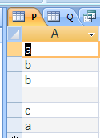
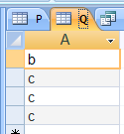

Set Intersection For Tables With One Column
SELECT DISTINCT * FROM P WHERE A IN (SELECT A FROM Q);

Slide 147

Set Difference For Tables With One Column
SELECT DISTINCT * FROM P WHERE A NOT IN (SELECT A FROM Q);
Note (NULL) is not in the result, so our query is not quite correct (as I have warned you earlier)

Slide 148
Using More Than One Column Name
Assume we have R(A,B,C) and S(A,B,C,D)
Some systems do not allow the following (more than one item = ANY)
SELECT A FROM R WHERE (B,C) = ANY (SELECT B, C FROM S);
we can use
SELECT A FROM R WHERE EXISTS (SELECT * FROM S WHERE R.B = S.B AND R.C = S.C);

Slide 149
Back To Division
We want to compute the set of Cnames that have at least all the Cnames that Chicago has
CnameInCcity | Ccity | Cname
 | Boston | Doe
 | Boston | Yao
 | Boston | Smith
 | Chicago | Doe
 | Chicago | Yao
 | Seattle | Doe
 | Seattle | Smith
 | Denver | Smith
 | Denver | Brown
CnameInChicago | Cname
 | Doe
 | Yao

Slide 150
Computing Division Concisely
List all cities, the set of whose profits, contains all the profits that are in Chicago.
SELECT Ccity FROM CnameInCcity AS CnameInCcity1 WHERE NOT EXISTS (SELECT Cname FROM CnameInChicago WHERE Cname NOT IN (SELECT Cname FROM CnameInCcity WHERE CnameInCcity.Ccity = CnameInCcity1.Ccity));
This is really the same as before
I leave it to you to figure this out, if you like
Notes:
112

Slide 151
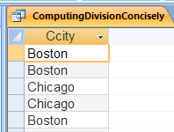
In Microsoft Access

Slide 152
Joins
SQL has a variety of “modified” Cartesian Products, called joins
The interesting ones are outer joins, interesting when there are no matches where the condition is equality
Left outer join
Right outer join
Full outer join
We will use new tables to describe them, see OuterJoins.mdb in Extras
R | A | B
 | a | 1
 | b | 2
 | c | 3
S | C | D
 | 1 | e
 | 2 | f
 | 2 | g
 | 4 | h

Slide 153
LEFT OUTER JOIN
SELECT * FROM R LEFT OUTER JOIN S ON R.B = S.C;
Includes all rows from the first table, matched or not, plus matching “pieces” from the second table, where applicable.
For the rows of the first table that have no matches in the second table, NULLs are added for the columns of the second table
R | A | B
 | a | 1
 | b | 2
 | c | 3
S | C | D
 | 1 | e
 | 2 | f
 | 2 | g
 | 4 | h
 | A | B | C | D
 | a | 1 | 1 | e
 | b | 2 | 2 | f
 | b | 2 | 2 | g
 | c | 3
Notes:
116

Slide 154
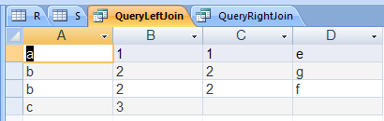
In Microsoft Access

Slide 155
RIGHT OUTER JOIN
SELECT * FROM R RIGHT OUTER JOIN S ON R.B = S.C;
Includes all rows from the second table, matched or not, plus matching “pieces” from the first table, where applicable.
For the rows of the second table that have no matches in the first table, NULLs are added for the columns of the first table
R | A | B
 | a | 1
 | b | 2
 | c | 3
S | C | D
 | 1 | e
 | 2 | f
 | 2 | g
 | 4 | h
 | A | B | C | D
 | a | 1 | 1 | e
 | b | 2 | 2 | f
 | b | 2 | 2 | g
 |  |  | 4 | h
Notes:
116

Slide 156
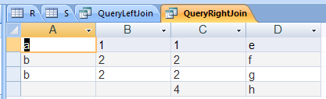
In Microsoft Access

Slide 157
FULL OUTER JOIN
SELECT * FROM R FULL OUTER JOIN S ON R.B = S.C;
Cannot be done in Microsoft Access directly
Can use Left Outer and Right Outer
R | A | B
 | a | 1
 | b | 2
 | c | 3
S | C | D
 | 1 | e
 | 2 | f
 | 2 | g
 | 4 | h
 | A | B | C | D
 | a | 1 | 1 | e
 | b | 2 | 2 | f
 | b | 2 | 2 | g
 | c | 3
 |  |  | 4 | h
Notes:
116

Slide 158
Ranges and Templates
It is possible to specify ranges, or templates:
Find all P and Pcity for plants in cities starting with letters B through D
SELECT P, Pcity FROM Plant WHERE ((City BETWEEN 'B' AND 'I') AND (Pcity <> ‘E'));
Note that we want all city values in the range B through DZZZZZ....; thus the value E is too big, as BETWEEN includes the “end values.”
Notes:
97

Slide 159
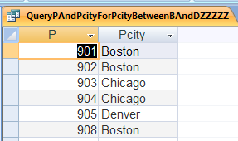
In Microsoft Access

Slide 160
Ranges and Templates
Find Pnames for cities containing the letter X in the second position:
SELECT Pname FROM Plant WHERE (City LIKE '_X%');
% stands for 0 or more characters; _ stands for exactly one character.
Notes:
97

Slide 161
Presenting the Result
It is possible to manipulate the resulting answer to a query. We present the general features by means of examples.
For each P list the profit in thousands, order by profits in decreasing order and for the same profit value, order by increasing P:
SELECT Profit/1000 AS Thousands, P FROM Plant ORDER BY Profit DESC, P ASC;
Notes:
121

Slide 162
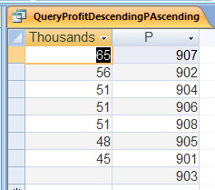
In Microsoft Access

Slide 163
Presenting the Result
Create the relation with attributes Idate, C while removing duplicate rows.
SELECT DISTINCT Idate, C FROM Invoice;
Notes:
121

Slide 164
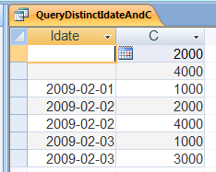
In Microsoft Access

Slide 165
Testing For Duplicates
It is possible to test if a subquery returns any duplicate tuples, with NULLs ignored
Find all Cnames that all of whose orders are for different amounts (including, or course those who have placed no orders)
SELECT Cname FROM Customer WHERE UNIQUE (SELECT Amt FROM Invoice WHERE Customer.C = C);
UNIQUE is true if there are no duplicates in the answer, but there could be several tuples, as long as all are different
If the subquery returns an empty table, UNIQUE is true
Recall, that we assumed that our original relations had no duplicates; that’s why the answer is correct

Slide 166
Testing For Duplicates
It is possible to test if a subquery returns any duplicate tuples, with NULLs being ignored
Find all Cnames that have at least two orders for the same amount
SELECT Cname FROM Customer WHERE NOT UNIQUE (SELECT Amt FROM Invoice WHERE Customer.C = C);
NOT UNIQUE is true if there are duplicates in the answer
Recall, that we assumed that our original relations had no duplicates; that’s why the answer is correct

Slide 167
Digression: Execution Plan Matters
Consider a database consisting of 3 relations
Lives(Person,City) about people in the US, about 300,000,000 tuples
Oscar(Person) about people in the US who have won the Oscar, about 1,000 tuples
Nobel(Person) about people in the US who have won the Nobel, about 100 tuples
How would you answer the question, trying to do it most efficiently “by hand”?
Produce the relation Good_Match(Person1,Person2) where the two Persons live in the same city and the first won the Oscar prize and the second won the Nobel prize
How would you do it using SQL?

Slide 168
Digression: Execution Plan Matters
SELECT Oscar.Person Person1, Nobel.Person Person2 FROM Oscar, Lives Lives1, Nobel, Lives Lives2 WHERE Oscar.Person = Lives1.Person AND Nobel.Person = Lives2.Person AND Lives1.City = Lives2.City; very inefficient
Using various joins (which, we did not cover) or intermediate tables, we can specify easily the “right order,” in effect producing
Oscar_PC(Person,City), listing people with Oscars and their cities
Nobel_PC(Person,City), listing people with Nobels and their cities
Then producing the result from these two small relations
This is much more efficient
But the cleanest way is to use “big cartesian product”

Slide 169
Modifying the Database
Until now, no operations were done that modified the database
We were operating in the realm of algebra, that is, expressions were computed from inputs.
For a real system, we need the ability to modify the relations
The three main constructs for modifying the relations are:
Insert
Delete
Update
This in general is theoretically, especially update, quite tricky; so be careful
Duplicates are not removed
Notes:
123

Slide 170
Insertion of a Tuple
INSERT INTO Plant (P, Pname, Pcity, Profit) VALUES ('909','Gamma',Null,52000);
If it is clear which values go where (values listed in the same order as the columns), the names of the columns may be omitted
INSERT INTO Plant VALUES ('909',‘Gamma',Null,52000);
Notes:
124

Slide 171
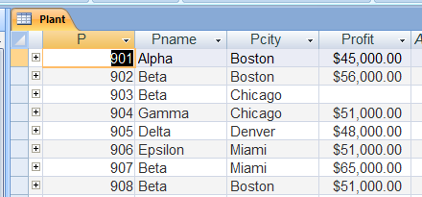
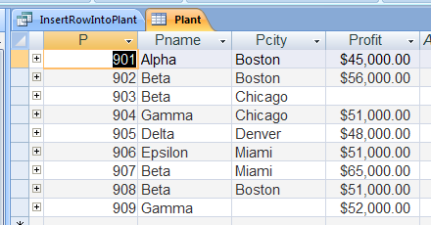
In Microsoft Access

Slide 172
Insertion of a Tuple
If values of some columns are not specified, the default values (if specified in SQL DDL, as we will see later; or perhaps NULL) will be automatically added
INSERT INTO Plant (P, Pname, Pcity) VALUES ('910','Gamma',Null);
Notes:
124

Slide 173
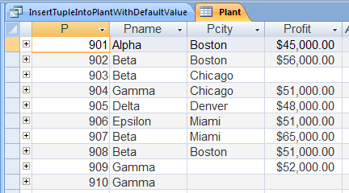
In Microsoft Access

Slide 174
Insertion From A Table
Assume we have a tableCandidate(C,Cname,Ccity,Good) listing potential customers
First, for each potential customer, the value of Good is Null
Later it becomes either Yes or No
We can insert part of this “differential table” into customers:
INSERT INTO Customer (C, Cname, Ccity, P) SELECT C, Cname, Ccity, NULL FROM Candidate WHERE Good = 'YES';
In general, we can insert any result of a query, as long as compatible, into a table
Notes:
125

Slide 175
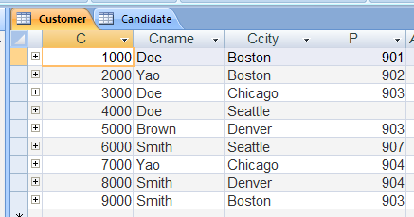
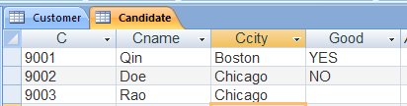

In Microsoft Access

Slide 176
Deletion
DELETE FROM Candidate WHERE Good = 'Yes';
This removes rows satisfying the specified condition
In our example, once some candidates were promoted to customers, they are removed from Candidate
Notes:
126

Slide 177

In Microsoft Access

Slide 178
Deletion
DELETE FROM Candidate;
This removes all the rows of a table, leaving an empty table; but the table remains
Every row satisfied the empty condition, which is equivalent to: “WHERE TRUE”
Notes:
126

Slide 179

In Microsoft Access

Slide 180
Another Way to Compute Difference
Standard SQL operations, such as EXCEPT do not work in all implementations.
To compute R(A,B) − S(A,B), and to keep the result in R(A,B), one can do:
DELETE FROM R WHERE EXISTS (SELECT * FROM S WHERE R.A = S.A AND R.B = S.B);
But duplicates are not removed
Of course no copy of a tuple that appears in both R and S remains in R
But if a tuple appears several times in R and does not appear in S, all these copies remain in R

Slide 181
Update
UPDATE Invoice SET Amt = Amt + 1 WHERE Amt < 200;
Every tuple that satisfied the WHERE condition is changed in the specified manner (which could in general be quite complex)
Notes:
128

Slide 182


In Microsoft Access

Slide 183
Update
But this gets quite “strange,” and incorrect if the same tuple could be updated in different ways if it satisfies a different condition, the system will reject this
Example
A student can have only one major (we will see how to specify this later) and we tell the database to change each student major to X, if the student took a course in department X
If students can take courses in several departments, the above cannot work

Slide 184
SQL Embedded In A Host Language
Scenario
You go to an ATM to withdraw some money
You swipe your card, something (a program, not a relational database) reads it
You punch in your PIN, a program reads it
The program talks to a relational database to see if things match, assume that they do
You ask for a balance, a program reads what you punched and formulates a query to a relational database and understands the answer and shows you on the screen
You want to withdraw money, a program formulates an request to the relational database to update your account
. . .

Slide 185
SQL Embedded in A Host Language
Sometimes, we need to interact with the database from programs written in another host language
The advantage of this is that we are able to use the structure of the database, its layers, indices, etc
The disadvantage is, the host language does not understand the concepts of relations, tuples, etc
We use a version of SQL, called Embedded SQL, for such interactions
We concentrate on static embedded SQL
We just sketch this very briefly
Notes:
129

Slide 186
SQL Commands As Procedure Calls
SQL commands in host languages, could at a gross level be considered procedure calls
ANSI standard specified Embedded SQL for some programming languages only
There are two main types of operations:
Those working on a tuple
Those working on a relation
Notes:
130

Slide 187
Common Variables
Variables in the host language that are used to communicate with the SQL module must be declared as such
Assuming we want to act on the relation plants, we would write in our host program something similar to:
EXEC SQL BEGIN DECLARE SECTION; VAR Plant: INTEGER; Plantname: ...; Plantcity: ...; Plantprofit: ...; EXEC SQL END DECLARE SECTION;
Notes:
131

Slide 188
A Fragment of a Host Program
We could write the following program fragment in our host program (note '':'' before variable name):
EXEC SQL SELECT P FROM Plant INTO :Plant WHERE Profit = :Plantprofit; after Plantprofit is set to a correct value in the host program
We could also write
EXEC SQL INSERT INTO Plant VALUES(:Plant, :Plantname, :Plantcity, :Plantprofit);
after Plant, Plantname, Plantcity, Plantprofit are set to correct values in the host program
Notes:
132

Slide 189
Treatment of NULLS
Sometimes the value inserted or retrieved will be NULL
However host language does not know how the database is coding NULLs.
It is possible to use special indicator variables to indicate that the value is actually NULL
EXEC SQL SELECT profit INTO :Plantprofit INDICATOR :Ind WHERE C = 75;
Here if host language variable Ind is negative, it means that Plantprofit does not contain an actual value, but NULL was returned by the SQL system
Notes:
133

Slide 190
SQL Codes
As part of the declaration section, a variable, generally referred to as SQLCODE, must be declared
It is set by SQL to indicate whether the operation was successful, and if not what kind of problems may have occurred
Notes:
134

Slide 191
Handling Sets Of Tuples (Relations)
To handle a relation in a host language, we need a looping mechanism that would allow us to go through it a tuple at a time
We have seen before how to handle a tuple at a time.
The mechanism for handling relations is referred to as CURSOR
Notes:
135

Slide 192
Usage Of CURSOR
DECLARE a CURSOR, in a way similar to defining a query
As a consequence, the relation is defined, but is not computed
OPEN a CURSOR
The relation is now computed, but is not accessible.
FETCH CURSOR is executed in order to get a tuple
This is repeated, until all tuples are processed
The current tuple is referred to as CURRENT
Of course, some condition must be checked to make sure there are still tuples to be processed. SQLCODE is used for this
CLOSE the CURSOR
Delete the relation
Notes:
136

Slide 193
Example Of Using A CURSOR
Increase the profit of all plants in Miami by 10%, if the profit is less than 0.1. This is what is written in the host, non-SQL, program
Plantcity:='Miami'; EXEC SQL DECLARE CURSOR Todo AS SELECT * FROM Plant WHERE CITY = :Plantcity; EXEC SQL OPEN CURSOR Todo; WHILE SQLCODE = 0 DO BEGIN EXEC SQL FETCH Todo INTO :Plant, :Plantname, :Plantcity, :Plantprofit; IF :Plantprofit < 0.1 THEN EXEC SQL UPDATE Plant SET Profit = Profit*1.1 WHERE CURRENT OF Todo END; EXEC SQL CLOSE CURSOR Todo;
Notes:
137

Slide 194
Dynamic Embedded SQL
Previously described embedded SQL was static
The queries were fully specified (the relations, the columns, etc.), therefore they could be preprocessed before the program started executing
Dynamic embedded SQL allows submission during execution of strings to SQL, which are interpreted and executed
Useful when program execution can “take many different paths”
Useful to allow users to submit spontaneous queries during execution of the program
Notes:
138

Slide 195
Dynamic Embedded SQL
Assume that x is a string variable in your host language
Put in x a string that is an SQL statement
EXEC SQL PREPARE y from :x ;
The string is parsed and compiled and the result put in y, so that the SQL statement is understood and ready to be submitted
EXEC SQL EXECUTE y
Execute this SQL statement
EXEC SQL EXECUTE IMMEDIATE :x ;
This combines both statements above
Good if the statement is executed once only, otherwise, unnecessarily parsing and compiling are repeated for each query execution

Slide 196
Optional Material

Slide 197
Why Was Division So Difficult
Let us return to a previous example
Has | Person | Tool
 | Marsha | Fork
 | Marsha | Knife
 | Marsha | Spoon
 | Vijay | Fork
 | Vijay | Knife
 | Dong | Fork
 | Dong | Spoon
 | Chris | Spoon
 | Chris | Cup
Needed | Tool
 | Fork
 | Knife

Slide 198
Venn Diagram To Explain Division Query

Slide 199
Asking About Some And About All
List all Persons, whose set of Tools contains at least one Tool that is (also) in Needed
This will be easy
List all Persons, whose set of Tools contains at least all the Tools that are (also) in Needed
This will be harder
This is technically called a division: Has divided by Needed
Notes:
Doe08

Slide 200
Asking About Some
List all Persons, whose set of Tools contains at least one Tool that is (also) in Needed
The result can be expressed using a logical formula with an existential quantifier:
The standard SELECT … FROM … WHERE … easily expresses the existential quantifier above
p “is good” if it has at least one needed tool
Notes:
Doe08

Slide 201
Asking About All
List all Persons, whose set of Tools contains at least all the Tools that are (also) in Needed
The result can be expressed using a logical formula with a universal quantifier:
Using, the following four facts in predicate calculus, we can rewrite out formula, using an existential quantifier, and that is what we, in effect, did while using SQL
Notes:
Doe08

Slide 202
Reiteration: Differences Between SQL And “Pure” Relational Algebra
This is for those who want to have concise description
This part of the Unit is optional

Slide 203
Key Differences Between Relational Algebra And SQL
SQL data model is a multiset not a set; still rows in tables (we sometimes continue calling relations)
Still no order among rows: no such thing as 1st row
We can (if we want to) count how many times a particular row appears in the table
We can remove/not remove duplicates as we specify (most of the time)
There are some operators that specifically pay attention to duplicates
We must know whether duplicates are removed (and how) for each SQL operation; luckily, easy
Many redundant operators (relational algebra had only one: intersection)
SQL provides statistical operators, such as AVG (average)
Can be performed on subsets of rows; e.g. average salary per company branch

Slide 204
Key Differences Between Relational Algebra And SQL
Every domain is “enhanced” with a special element: NULL
Very strange semantics for handling these elements
“Pretty printing” of output: sorting, and similar
Operations for
Inserting
Deleting
Changing/updating (sometimes not easily reducible to deleting and inserting)

Slide 205
Basic Syntax Comparison
Relational Algebra | SQL
π _{a, b} | SELECT a, b
σ _{(d > e) ∧ (f =g )} | WHERE d > e AND f = g
p × q | FROM p, q
π _{a, b} σ _{(d > e) ∧ (f =g )} (p × q) | SELECT a, b FROM p, q WHERE d > e AND f = g; {must always have SELECT even if all attributes are kept, can be written as: SELECT *}
renaming | AS {or blank space}
p := result | INSERT INTO p result {assuming p was empty}
π _{a, b} (p) (assume a, b are the only attributes) | SELECT * FROM p;

Slide 206
Basic Syntax Comparison
Relational Algebra | SQL
p ∪ q | SELECT * FROM p UNION SELECT * FROM q
p − q | SELECT * FROM p EXCEPT SELECT * FROM q Sometimes, instead, we have DELETE FROM
p ∩ q | SELECT * FROM p INTERSECT SELECT * FROM q

