Slide 1
Unit 9 Transaction Processing: Recovery

Slide 2
Transaction Processing
Implemented as part of the Database Operating System
Includes:
Recovery (this unit)
Concurrency (next unit)
Relies on services provided by the “standard” operating system running on the hardware
Notes:
261

Slide 3
Example: Money Transfer
Transfer $50 from account a to b (items on the disk) 1. transaction starts 2. read a into xa (local variable in RAM) 3. xa := xa − 50 4. write xa onto a 5. read b into xb (local variable in RAM) 6. xb := xb + 50 7. write xb onto b 8. transaction ends
If initial values are a = 180 and b = 100 then after the execution a = 130 and b = 150
Notes:
266

Slide 4
Example: Money Transfer
Sample values of database variables at various points in a completed execution a b 180 100 1. transaction starts 180 100 2. read a into xa 180 100 3. xa := xa − 50 180 100 4. write xa onto a 130 100 5. read b into xb 130 100 6. xb := xb + 50 130 100 7. write xb onto b 130 150 8. transaction ends 130 150
Notes:
267

Slide 5
Example: Money Transfer
If the state of RAM is lost between instructions 1. and 8., it is not known which was the last instruction executed
Thus in general, neither of the following naive recovery procedures will work:
re-execute the transaction. Wrong, because if the transaction crashed after instruction 4, incorrect values (a = 80,...) will exist in the database.
do not re-execute the transaction Wrong, because if the transaction crashed before instruction 7, incorrect values (..., b = 100) will exist in the database
Notes:
268

Slide 6
Transactions
Transaction is an execution of a user’s program
In the cleanest and most important model it is supposed to satisfy the ACID conditions
Atomic
It is not logically divisible into smaller units of executions
It is either executed to completion (was committed), or not executed at all (was aborted, also called rolled back)
Consistent
It preserves the consistency of the database, when running by itself (without any other transactions executing concurrently)
If started on a “correct” database, and “successfully” finished, it will leave a “correct” database
“Correctness” means: satisfies integrity constraints as specified to the database
This is somewhat weak, as correctness presumably should model real world not just internal consistency
Notes:
262

Slide 7
Transactions
Durable
Once it completed “successfully,” the values it produced will never be forgotten and “in effect” will be installed in the database (on the disk, which is the only thing that counts)
Of course they can be overwritten by transactions that come later
Isolated
It does not interact with other transactions running concurrently
It does not see what they do, they do not see what it does: as if each executed on the database by itself
Notes:
262

Slide 8
Recovery and Concurrency Management
The job of these recovery/concurrency modules of the database operating system is to assure the ACID properties, and handle other related issues
The two modules are quite intertwined and cooperate during their execution
Recovery is more fundamental and also applicable to a single user systems
Recovery management will be “helped” by concurrency management, as we will see in the “Concurrency” unit
Notes:
263

Slide 9
Recovery Management
The job of recovery is to make sure that the transaction satisfies ACD properties
So the job is not to allow partial executions and to make sure that transactions once executed do not “disappear” (i.e., their “effects” remain, unless these “effects” become obsolete)
If a failure occurred while a transaction was executing, we cannot continue, and therefore need to restore the database to the state before the failed transaction started
If a failure occurred after a transaction finished executing (we will be more precise about the meaning of “finished executing”), the state must continue reflecting this transaction
Notes:
264

Slide 10
Storage Model
Again, we need a model
Two level storage
RAM
Disk
RAM (volatile storage)
There will be no errors but all the information on it can disappear
Electricity goes down
Disk (stable storage)
Atomic reads/writes of blocks
No failures
This is ideal but implementable in practice, through RAIDs, offline storage on tapes, DVDs, backing up the disk, etc.
While the hierarchies is much larger (registers, primary caches, secondary caches, RAM, disk, tape, etc.), we only need to be concerned about RAM vs. disk

Slide 11
Failure
RAM failure (the state of the computation is lost and we do not know what are the values of the variables in RAM); this is the most interesting case, and other cases will be solved if we solve it, so we will focus on it (because if we do not know what to do in some case, we can just reboot and our methods will fix everything)
Typical scenario: electricity goes down and the computer shuts down and then reboots forgetting everything, other than whatever has been written to the disk
“Global” problem in execution
E.g., deadlock: a transaction needs to be removed in the middle of an execution to let the system proceed
Transaction failure
Transaction’s execution may result in violating CHECKs and CONSTRAINTs; then the transaction needs to be failed
This is still OK as failed transactions do not have to be correct, because their effects are going to be removed from the execution

Slide 12
Lifecycle Of A Transaction
Start
Run
Finish
Check for deferred consistency requirements, if any
Requirement that can be violated during execution (but not after it), such as during the movement of money from checking account to savings account
Such deferrals can be specified using SQL DDL
Commit if steps 1 – 4 are done successfully: this means the transaction’s effects are “durable”
But a transaction can be aborted for any reason (or no reason) before commit
Of course an aborted transaction can be re-executed, especially if this was not “its fault,” but then this is really another transaction

Slide 13
The Fate Of A Transaction
I either move money from my savings account to my checking account or not

Slide 14
History (Schedule)
This is a trace of execution of transactions in a system
This is somewhat imprecise at this point
We will make it more formal as needed
Example at the beginning of the unit was a trace
At different time we will “trace” different actions
Most commonly which transaction accessed which item in which mode
E.g. T1 R x; meaning transaction T1 Reads item x
E.g. T1

Slide 15
Recoverable Histories
A history is recoverable if for every transaction T that commits, the Commit of T follows the Commit of every transaction from which T read
We do not formally define here what it means “from which T read,” but it is pretty obvious intuitively: T read the result of writing by that transaction
Histories must be recoverable, otherwise transaction may operate based on non-existent past
A history that is not recoverable T1 T2 W x R x W y Commit
Notes:
312

Slide 16
Non-Recoverable Histories
Here is what could happen next T1 T2 W x R x W y Commit Abort
And now what to do about T2?
It operated using a non-existent value of x (here y could have been x + 1)
It cannot be aborted because it has already committed
Notes:
312

Slide 17
More On Non-recoverable Histories
We need to understand what is wrong with the following T1 T2 W x R x Commit
Abort
It may seem that there is no problem because T2 only read
Consider the following case:
Initially x = 0 and y = 0
T1 is: x := 1
T2 is: if x = 0 then y := 1
Then the value of x did matter and depending on whether T1 existed or not the behavior of T2 is different

Slide 18
Cascading Aborts
A history avoids cascading aborts if every transaction reads only values produced by transactions that have already committed
Of course it can read the initial state unless overwritten previously by another transaction
We will assume, to simplify discussion, some transaction T0, running by itself and creating the initial state of the database
T0 is recoverable, automatically
A history that does not avoid cascading aborts T1 T2 W x R x W y

Slide 19
Cascading Aborts
Here is what could happen next T1 T2 W x R x W y Abort
Then we must do: T1 T2 W x R x W y Abort Abort

Slide 20
Strict Histories
History is strict if
Satisfies the condition for avoiding cascading aborts
For every transaction, if it writes an item, all the transactions that previously wrote that item have already committed or aborted
If we need to abort a transaction that wrote a value, the most convenient thing to implement is just to restore the value that existed previously
If a history is not strict, this is not good enough
A history that is not strict T1 T2 W x W x
Notes:
312

Slide 21
Strict Histories
Here is what could happen next T1 T2 Wx Wx Abort
Even though T1 aborted, we must not do anything to x!
Notes:
312

Slide 22
Strict Histories
Here what could happen next T1 T2 Wx Wx Abort Abort
Because T2 aborted, we must restore the value of x that existed before T1 wrote, sometime in the past
Very complicated; need to maintain several values for x
Notes:
312

Slide 23
Relations
Strict implies no cascading aborts
No cascading aborts implies recoverable
So we like strict, which really means:
Every transaction reads only values produced by transactions that have already committed
Every transaction, if it writes an item, all the transactions that previously wrote that item have already committed or aborted
But note: a transaction can read a value that was read by an uncommitted transaction
We will assume that the DB OS will make sure that all histories will be strict
This will be automatically ensured “magically” by concurrency management (next unit)

Slide 24
Reminder On Virtual Memory: Paging In And Out
a
b
c
d
a
b
c
d
a
a
b
c
d
a
b
a
b
c
d
c
b
a
b
c
d
c
a
Disk RAM
Access a
Access b
Access c
Access a
“Access” means read or write
4 blocks on the disk and 2 page slots in the RAM cache

Slide 25
General Setting And “Principles”
A transaction modifies “items” by changing an “old” value into a “new” value
At any time before the commit, the old values must be in stable storage (on the disk)
Because old values must be remembered if the RAM fails
Note: on the disk but not necessarily in the database
At any time after the commit, the new values must be in stable storage (on the disk)
Because the new values must be remembered if the RAM fails
Note: on the disk but not necessarily in the database
The transaction commits exactly when this “fact” is written in stable storage (on the disk)
Because we must remember this if the RAM fails

Slide 26
Simplified Scenario: Immediate Writes To Disk
We will discuss first a simplified scenario, which is the conceptual foundation to what happens in real systems
We ignore virtual memory and assume that writes to the database on the disk happen “immediately” after the values are changed in RAM
We will explain the most common method of managing concurrency: Write Ahead Log
The basic idea
Record how you are going to modify the database before you actually do it
We return to our old money transfer example and consider the situation when
RAM values “disappear” because the system crashes
Disk values “do not disappear”

Slide 27
Example: Money Transfer
Sample values of database variables at various points in a completed execution, to fit more text later we dropped some digits and made small change in values
We move 5 from a to b a b 8 1 1. transaction starts 8 1 2. read a into xa 8 1 3. xa := xa − 5 8 1 4. write xa onto a 3 1 5. read b into xb 3 1 6. xb := xb + 5 3 1 7. write xb onto b 3 6 8. transaction ends 3 6
Notes:
267

Slide 28
RAM and Disk
We will have the following:
Database on disk with two items: a and b
RAM with two items xa and xb
Log: a sequential file on the disk consisting of records of the following types:
[T starts]; abbreviated as [T s]
[T commits]; abbreviated as [T c]
[T item old-value new-value]
We only consider one transaction, but in general there are many so “T” needs to be written in the log

Slide 29
Trace Of Execution: Items And Log
xa xb a b log
0 0 8 1

Slide 30
Trace Of Execution: Items And Log
xa xb a b log
0 0 8 1
0 0 8 1 [T s]

Slide 31
Trace Of Execution: Items And Log
xa xb a b log
0 0 8 1
0 0 8 1 [T s]
8 0 8 1 [T s]

Slide 32
Trace Of Execution: Items And Log
xa xb a b log
0 0 8 1
0 0 8 1 [T s]
8 0 8 1 [T s]
3 0 8 1 [T s]

Slide 33
Trace Of Execution: Items And Log
xa xb a b log
0 0 8 1
0 0 8 1 [T s]
8 0 8 1 [T s]
3 0 8 1 [T s]
3 0 8 1 [T s][T a 8 3]

Slide 34
Trace Of Execution: Items And Log
xa xb a b log
0 0 8 1
0 0 8 1 [T s]
8 0 8 1 [T s]
3 0 8 1 [T s]
3 0 8 1 [T s][T a 8 3]
3 0 3 1 [T s][T a 8 3]

Slide 35
Trace Of Execution: Items And Log
xa xb a b log
0 0 8 1
0 0 8 1 [T s]
8 0 8 1 [T s]
3 0 8 1 [T s]
3 0 8 1 [T s][T a 8 3]
3 0 3 1 [T s][T a 8 3]
3 1 3 1 [T s][T a 8 3]

Slide 36
Trace Of Execution: Items And Log
xa xb a b log
0 0 8 1
0 0 8 1 [T s]
8 0 8 1 [T s]
3 0 8 1 [T s]
3 0 8 1 [T s][T a 8 3]
3 0 3 1 [T s][T a 8 3]
3 1 3 1 [T s][T a 8 3]
3 6 3 1 [T s][T a 8 3]

Slide 37
Trace Of Execution: Items And Log
xa xb a b log
0 0 8 1
0 0 8 1 [T s]
8 0 8 1 [T s]
3 0 8 1 [T s]
3 0 8 1 [T s][T a 8 3]
3 0 3 1 [T s][T a 8 3]
3 1 3 1 [T s][T a 8 3]
3 6 3 1 [T s][T a 8 3]
3 6 3 1 [T s][T a 8 3][T b 1 6]

Slide 38
Trace Of Execution: Items And Log
xa xb a b log
0 0 8 1
0 0 8 1 [T s]
8 0 8 1 [T s]
3 0 8 1 [T s]
3 0 8 1 [T s][T a 8 3]
3 0 3 1 [T s][T a 8 3]
3 1 3 1 [T s][T a 8 3]
3 6 3 1 [T s][T a 8 3]
3 6 3 1 [T s][T a 8 3][T b 1 6]
3 6 3 6 [T s][T a 8 3][T b 1 6]

Slide 39
Trace Of Execution: Items And Log
xa xb a b log
0 0 8 1
0 0 8 1 [T s]
8 0 8 1 [T s]
3 0 8 1 [T s]
3 0 8 1 [T s][T a 8 3]
3 0 3 1 [T s][T a 8 3]
3 1 3 1 [T s][T a 8 3]
3 6 3 1 [T s][T a 8 3]
3 6 3 1 [T s][T a 8 3][T b 1 6]
3 6 3 6 [T s][T a 8 3][T b 1 6]
3 6 3 6 [T s][T a 8 3][T b 1 6][T c]

Slide 40
Recovery Under Various Conditions
a b log
8 1

Slide 41
Recovery Under Various Conditions
a b log
8 1 [T s]
]

Slide 42
Recovery Under Various Conditions
a b log
8 1 [T s][T a 8 3]

Slide 43
Recovery Under Various Conditions
a b log
3 1 [T s][T a 8 3]

Slide 44
Recovery Under Various Conditions
a b log
3 1 [T s][T a 8 3][T b 1 6]

Slide 45
Recovery Under Various Conditions
a b log
3 6 [T s][T a 8 3][T b 1 6]

Slide 46
Recovery Under Various Conditions
a b log
3 6 [T s][T a 8 3][T b 1 6][T c]

Slide 47
Recovery Procedure
The system crashes (RAM “disappears”)
We look at the log.
If there is [T s] but no [T c], we copy the old values of a and b from the log onto the database on the disk
If there is [T c] (and therefore also [T s]) we copy the new values of a and b from the log onto the database on the disk
We then continue with then reboot the database and continue processing
If we restored old values, we re-execute the transaction
Next: Elaborate on the protocol with virtual memory and checkpoints

Slide 48
Write Ahead Log
We will discuss the most common way of handling recovery
The log will be a sequential file, which will be produced by the DB OS
It will describe the history of what has happened (more precisely: what is going to happen)
It will have 4 types of records
T starts; this records that transaction “T” started
T x a b; this records that transaction “T” modified “x” with the old value being “a” and the new value being “b”
T abort; this records that transaction “T” was aborted
T commit; this records that transaction “T” was committed
To simplify discussion, we will assume that no transaction is aborted: the only failure is the failure of the RAM
Once we finish, we will essentially know what to do if transactions are aborted

Slide 49
RAM and Disk
“Real log” is log on disk + unwritten buffers
“Real database” is database on disk + some more up-to-date pages in RAM (in virtual memory)
But of course, after a failure we only see what is on the disk

Slide 50
Assumptions And Remarks
Note that if a write instruction is executed, the appropriate value is generally written in a buffer in the RAM.
At some later point in time it will be written on the disk
If RAM fails between these two points in time, the new value does not exist on disk and therefore is lost
We will use the term actually written to indicate that the value is written on disk (from RAM)
As usual, in virtual memory systems, not every update to a page is written on the disk, only “sometimes” the disk is updated
Only a small part of the database pages can be kept in virtual memory
For pages in virtual memory the current value is always in virtual memory and maybe also on disk
Notes:
272

Slide 51
Additional Assumptions On Execution
The log always runs ahead of the execution in RAM (not strictly necessary, but convenient to assume)
So if x_{old} is replaced by x_{new} in RAM, then in order
The log record “T x x_{old} x_{new}” is written in the log buffer (in RAM)
x_{new} is written in the appropriate virtual page (in RAM)
On the log, values are written in the same sequential order in which the write instructions are issued because it is a sequential file
If the transaction executes a read of an item x, it gets the latest value
It obtains it from the virtual memory pool or if not there, from the database itself
Notes:
273

Slide 52
Additional Assumptions On Execution
The log always runs ahead of the execution on the Disk
So if x_{old} is replaced by x_{new}, then in order
The log record “T x x_{old} x_{new}” is actually written in (actually appended to) the log (but this may not take place if there is a failure before this is done
x_{new} is actually written on the disk (but this may actually never happen even if there are no failures, we will see why later)
On the log, values are actually written in the same sequential order in which the write instructions are issued because the log is a sequential file
Notes:
273

Slide 53
Temporal Ordering Constraints On Execution

Slide 54
“Tracing” Two Writes And Their Temporal Ordering Constraints
Originally, x = 10 and y = 20
In the execution:
x := 11
y := 21
Eight actions
x := 11 in RAM
y := 21 in RAM
x := 11 on Disk
y := 21 on Disk
T x 10 11 in RAM
T y 20 21 in RAM
T x 10 11 on Disk
T y 20 21 on Disk

Slide 55
Two Transactions (Programs)
T1 | T2
read(a); read(b); i: b := a + b; read(c); ii: c := 2c; iii: a := a + b + c + 50; | read(e); iv: e := e − 10; read(a); v: a := a + 10; read(d); read(b); vi: d := d + b;
Transactions T1 and T2
Initial values: a = 100, b = 300, c = 5, d = 80, e = 60, f = 70
The instructions labeled with roman numerals are really writing of values into the database (first RAM then later perhaps on the Disk)

Slide 56
A History Of An Execution In RAM
T1 | T2
read(a); read(b); i: b := a + b; read(c); ii: c := 2c; iii: a := a + b + c + 50; | read(e); iv: e := e − 10; read(a); v: a := a + 10; read(d); read(b); vi: d := d + b;

Slide 57
Write Instructions For The History
Log records
1. T1 starts 2. T1 b 300 400 3. T2 starts 4. T1 c 5 10 5. T2 e 60 50 6. T1 a 100 560 7. T1 commits 8. T2 a 560 570 9. T2 d 80 480 10. T2 commits
Database items
(i) b 400 (ii) c 10 (iv) e 50 (iii) a 560 (v) a 570 (vi) d 480
Notes:
275

Slide 58
Temporal Constraints
There are certain temporal constraints, which we indicate by “<“ If action1 < action2, where the actions are actual writes, this means that necessarily, in any execution, action1 has to come before action2
1 < 2 < 3 < 4 < 5 < 6 < 7 < 8 < 9 < 10
Because actual write to a sequential file (the log), are processed in order of issuing of “non-actual” writes
2 < i, 4 < ii, 5 < iii, 6 < iv, 8 < v, 9 < vi
Because actual writing to the log is ahead of actual writing to the database
Notes:
276

Slide 59
Temporal Constraints
iii < v
Because an “older” value of a could not have existed in RAM after a “newer” value was produced, therefore
If v is actually written, it has been in RAM (for some time) and iii is not longer in RAM.
Note however that iii need not have taken place!
Because, the disk is only “sometimes” updated (when there is no room in virtual memory or maybe when we “force” update of the blocks on the disk)
Notes:
276

Slide 60
A Possible Order of Actions
The order of actual writes might be:
log database 1 2 3 4 ii i
5 6 7 8
9 iv vi v 10
Notes:
277

Slide 61
Possible Situation After “write d” Was Issued
DB | log
a = 100 b = 400 c = 10 d = 80 e = 60 f = 70 | 1. T1 starts 2. T1 b 300 400 3. T2 starts 4. T1 c 5 10 5. T2 e 60 50 6. T1 a 100 560 7. T1 commits 8. T2 a 560 570
DB | log
a = 570 b = 400 d = 80 | 9. T2 d 80 480
Disk RAM
Actual writes processed in order: 1, 2, 3, 4, ii, i, 5, 6, 7, 8
Notes concerning “write d”:
It has already been reflected in the log in RAM
It has not yet been reflected in the DB in RAM
It has not yet been reflected in the log on Disk
It has not yet been reflected in the DB on Disk

Slide 62
Disaster Strikes
Assume a RAM failure occurs (“crash”)
The log on the disk is examined: all of it “from the beginning of time”
Various actions are taken for the variables in the database
There are two possibilities for each transaction in the log
It has a commit record; therefore it has committed
It does not have a commit record; therefore it has not committed
Recall: we assume no transaction was aborted during execution
Notes:
279

Slide 63
Recovery
Transaction that has not committed In this case we make sure that the values it produced are not reflected in the database We perform undo = copy old values from log to database (and later, after recovery ends, rerun the transaction—we need to do it for all “correct” submitted transactions that have not completed as it is not their fault that they have been “undone”)
Transaction has committed In this case, we make sure that the values it produced are reflected in the database We perform redo = copy new values from log to database

Slide 64
Consider Our Example
If the last instruction on the log is 8 (as in our example), then we have to do the following
undo T2
redo T1
Because we know that
T2 has not committed, but the database may be contaminated by some values produced by T2 and we need to restore the state as if T2 never existed (in fact in our example no such contamination took place, but could have)
T1 has committed and the log and the database together contain all the information describing the state after T1 finished
Notes:
280

Slide 65
The Algorithm With Some Details Missing Will Explain Later As Part Of Checkpointing
Undo all transactions for which the log has “start” but no “commit”
Redo all transactions for which the log has both "start" and “commit”
Remarks:
If the system crashes during the recovery stage, recovery needs to be started again; this may have to be done repeatedly
All such “recoveries” together must be equivalent to a single recovery: recovery must be idempotent
In this algorithm, a large number of transactions need to be redone, since we do not know how far behind the log the database updates are
Note: We have to scan the log between (a) the point it was started: i.e., when the system was turned on last, and (b) its end
We assume that before the system is turned on (in the current session), the Disk DB is completely up to date
Notes:
281

Slide 66
Checkpointing
A technique to obviate the need to look at the complete log and thus reduce the work during recovery
During the execution in addition to the activities of the previous algorithm, periodically perform checkpointing in this precise order:
1. Stop processing (suspend transactions)
Force log buffers on Disk log (“force” means “actually write”)
Force database buffers on Disk database
Write on the log the list of transaction currently running (currently suspended)
Write CHECKPOINT DONE on the log
Resume processing
Checkpointing in fact synchronizes the database with the log
The database reflects everything actually written in the log by this time
Notes:
282

Slide 67
Checkpointing
We will simplify and assume that we can write in one block a checkpoint record that both list the transactions and that checkpointing was done
So we combine steps 4 and 5
During the execution in addition to the activities of the previous algorithm, periodically perform checkpointing in this precise order:
1. Stop processing
Force log buffers on Disk log (“force” means “actually write”)
Force database buffers on Disk database
Write and force “checkpoint record” on log
List of transactions running at this time
The fact that we have done checkpointing
Resume processing
Notes:
282

Slide 68
Checkpointing
This is not efficient enough
We should not stop processing for checkpointing because then transactions (which may be interactive) need to be suspended
There are a little more complex checkpointing mechanisms, of incremental nature, that are more efficient
We do not cover them here
Notes:
282

Slide 69
Recovery With Checkpointing
Start scanning the log you see on the disk backwards from the end until you reach the first checkpoint record you see, producing 2, initially empty, lists (sets)
Undo list
Redo list
For every transaction for which you have a commit record, add it to the redo list
For each transaction for which you have a start record but not a commit record, add it to the undo list
For each transaction that is listed in the checkpoint record for which there is no commit record, add it to the undo list
Revised recovery algorithm:
undo all transactions in the undo list
redo all transactions in the redo list (but only from the checkpoint to the end of the log)

Slide 70
Recovery With Checkpointing

Slide 71
Recovery With Checkpointing
Going backwards from the end of the log, for each record belonging to an “undo” transaction perform undo
can stop when all “start” records for transaction in the “undo” list have been seen
Going forwards from the checkpoint record to the end of the log, for each record belonging to a “redo” transaction perform redo
If you do not do checkpointing, use the above procedure, but you have to use the beginning of the log as if it were a checkpoint record
Undo going from end to beginning
Redo going from beginning to end

Slide 72
Example Log On The Disk After A Crash
T1 starts
T1 a 0 10
T1 commits
T2 starts
T2 b 0 10
T3 starts
T3 c 0 10
T3 c 10 20
checkpoint T2 T3
T4 starts
T2 a 10 20
T4 d 0 10
T5 starts
T6 starts
T6 e 0 10
T6 aborts (needs discussing we will ignore it here)
T2 commits
T5 a 20 500
T4 commits

Slide 73
Practice Recovery On This Log
We ignore (for simplicity of discussion): transaction T6 and item e
Possible values on the disk after crash:
a = 10 or 20 or 500
b =10
c = 20
d = 0 or 10
Undo list: T5, T3
Redo list: T4, T2
Actual writes
a := 20
c := 10
c := 0
a := 20
d := 10

Slide 74
Practice Recovery On This Log
Final values
a = 20
b = 10
c = 0
d = 10
Transactions existed (reflected): T1, T2, T4
Transaction not existed (not reflected): T3, T5

Slide 75
Big Recovery Example
Initial values: a = b = c = d = e = f = g = h = i = j = k = 0
On the log after the crash:
T1 STARTS
T1 a, 0, 1
T2 STARTS
T2 b, 0, 1
T3 STARTS
T3 c, 0, 1
T4 STARTS
T4 d, 0, 1
T4 e, 0, 1
T4 COMMITS
T5 STARTS
T5 f, 0, 1
T6 STARTS
T6 g, 0, 1
T2 d, 1, 2
CHECKPOINT T1, T2, T3, T5, T6
T2 h, 0, 1
T2 COMMITS
T5 h, 1, 2

Slide 76
Big Recovery Example
T7 STARTS
T7 i, 0, 1
T5 COMMITS
T8 STARTS
T8 d, 2, 3
T8 j, 0, 1
T8 COMMITS
T3 d, 3, 4
CRASH
We look at the log

Slide 77
Big Recovery Example
undo list: T3, T7, T6, T1
redo list: T8, T5, T2
Values of database items at different points in time
a b c d e f g h i j k
initial 0 0 0 0 0 0 0 0 0 0 0
after checkpoint 1 1 1 2 1 1 1 0 0 0 0
after crash possible 1 1 1 2 1 1 1 0 0 0 0
3 1 1 1
4 2
undo 0 0 3 0 0
redo 1
3 2 1
from checkpoint 1 1 1
unmodified 0
after recovery 0 1 0 3 1 1 0 2 0 1 0
After the recovery: effects of committed transactions
a b c d e f g h i j k
T4 1 1
T2 1 2 1
T5 1 2
T8 3 1

Slide 78
A Few Points
A transaction should be acknowledged, and its definition stored on the log, when accepted by the system
The system must at some point execute it, unless it fails on its own
Thus
A transaction that was aborted due to a RAM failure must be re-executed.
A transaction that was undone during recovery must be re-executed.
Note that even a “completed” transaction maybe need to be redone if the commit record has not been written to the log, which can happen even if all the new values are written both to the log and to the database
Because we do not know that all the new values have been reflected on the disk
Notes:
283

Slide 79
Problem With Interactive Transactions
Interactive transactions are difficult to handle satisfactorily.
How can you rollback a message to the user?
How can you recall $100 an automatic teller has already handed out?
Some workarounds
Forbid interactive transactions, or break them into smaller units of consistency that are transactions on their own
Send all messages after commit
But what if after the crash you do not know if all the messages have been sent (you cannot simultaneously send messages and record that you have done it, so danger of inconsistency); do you “send $100” again?
Notes:
285

Slide 80
SQL Support
Transaction is started implicitly, by executing a “reasonable” SQL statement
Or BEGIN WORK
Transaction is ended explicitly by issuing one of the two instructions
COMMIT, or
ROLLBACK
If the instruction is ROLLBACK, the transaction is aborted (by DB OS)
If the instruction is COMMIT
Every ASSERTION and CHECK that has been declared as DEFERRABLE (in the SQL DDL specification), and therefore was not being checked during the transaction, is now automatically checked
If there is a failure of such a consistency requirement, the COMMIT is automatically converted to ROLLBACK and the transaction is aborted
If everything is OK, the transaction is committed (by DB OS)

Slide 81
SQL Support
DDL statements issue an implicit COMMIT after their execution
This implies that change to data is committed too
We do not discuss this further here
SAVEPOINT can be added to save partial work
This may be useful for implementing subtransactions (smaller units of consistency)
We do not discuss this further here

Slide 82
Advanced Material

Slide 83
Refining The Model
It is interesting and important to consider the efficiency implications of using recovery mechanism
Some systems, such as Microsoft Access do not support recovery
In systems that do not support recovery mechanism, at the very least, all the new data needs to be written to the database before a transaction commits
We will refine the model and study the implications of the recovery mechanism costs
We will still assume our standard write-ahead logging

Slide 84
Refining The Model
As usual, the physical unit of access to the disk is a block, which is the same size as page in the virtual memory pool
The logical unit of access to a file is a record, which is likely to be much smaller than a block
So, what the log could contain is a sequence of tuples of the form
transaction_name, record_identifier, old_value, new_value
Such tuples (together with control tuples, such as commit records) are the records of the sequential log file
Records of the log are buffered in RAM and when a full page/block is assembled, it is written out to the disk and a new page/block of the log is started

Slide 85
Refining The Model
Records of the log are likely to be small compared to the size of the block/page
So many of them fit in a block

Slide 86
Scenario
We will consider a stream of frequent transactions, each of them modifying one tuple of a relation, that is one record of the file storing the relation
These transactions are submitted by interactive users (perhaps bank customers at ATM machines)
So, the transactions have to be acknowledged as successful relatively quickly
So, the transactions have to be committed relatively quickly

Slide 87
Without Recovery
Each transaction modified only one record
But a block of the database (containing this record) must be written before commit
So, to commit a transaction a block must be written

Slide 88
With Recovery
Each transaction modified one record
But a block of the log containing information about the record (transaction_name, record_identifier, old_value, new_value) must be written before commit
So, to commit a transaction this block must be written
But this block contains information for many transactions
So a single block write commits many transactions
So the overhead of recovery may result in much more efficient execution!

Slide 89
Example
We will consider a simple example
Our log, to simplify, will not contain transaction names
The database is a vector of 72 integers
A block contains 18 records, each of one integer
There is room in the RAM for 5 blocks
The whole database can be kept in RAM for processing, but when a transaction commits, “something” must be written to the disk
There will be 6 transactions

Slide 90
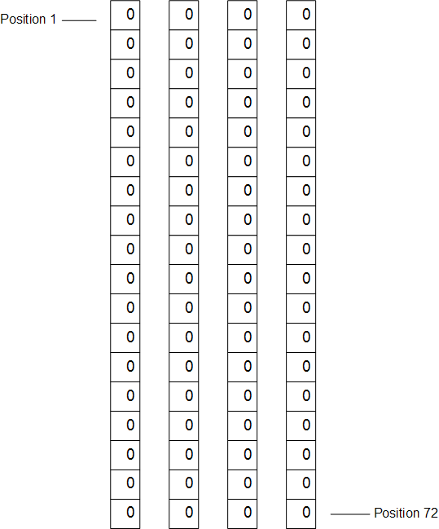
Initial State Of The Memory Pool
The vector needs 4 blocks, of 18 integers in the RAM virtual memory pool

Slide 91
Without Recovery Mechanism
We need to write one block to commit each transaction

Slide 92
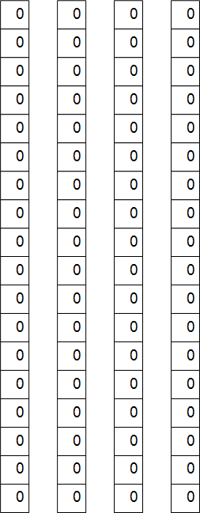
Initial State Of Memory Pool
Initial database in RAM

Slide 93
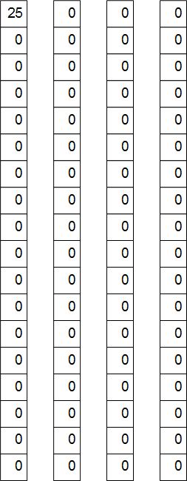
After Transaction 1
We need the new values to be in stable storage before commit
After an update of position 1, block 1 needs to be written out to the database before commit can be done and reported to the user

Slide 94
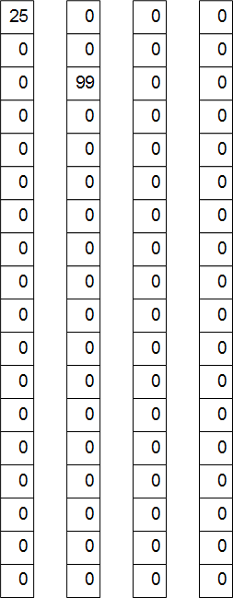
After Transaction 2
We need the new values to be in stable storage before commit
After an update of position 21, block 2 needs to be written out to the database before commit can be done and reported to the user

Slide 95
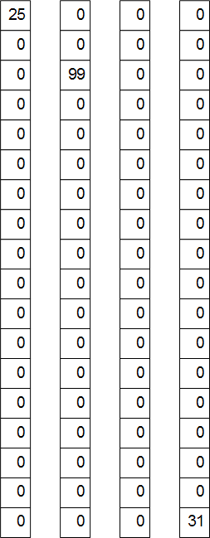
After Transaction 3
We need the new values to be in stable storage before commit
After an update of position 72, block 4 needs to be written out to the database before commit can be done and reported to the user

Slide 96
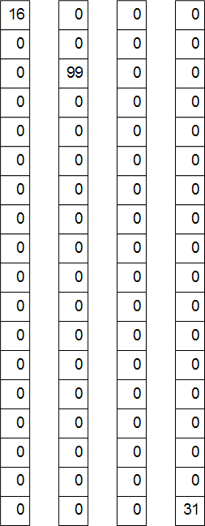
After Transaction 4
We need the new values to be in stable storage before commit
After an update of position 1, block 1 needs to be written out to the database before commit can be done and reported to the user

Slide 97
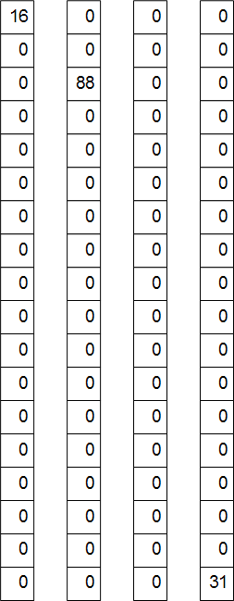
After Transaction 5
We need the new values to be in stable storage before commit
After an update of position 21, block 2 needs to be written out to the database before commit can be done and reported to the user

Slide 98
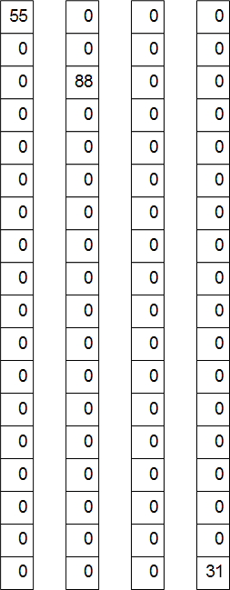
After Transaction 6
We need the new values to be in stable storage before commit
After an update of position 1, block 1 needs to be written out to the database before commit can be done and reported to the user

Slide 99
With Recovery Mechanism
We do not need to write one block to commit each transaction
We write one full log block to commit “many” transactions

Slide 100
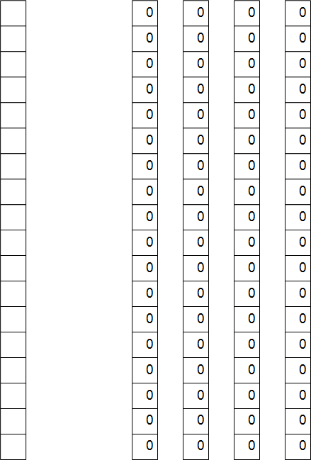
Initial State Of Memory Pool
Empty log block and initial database in RAM

Slide 101
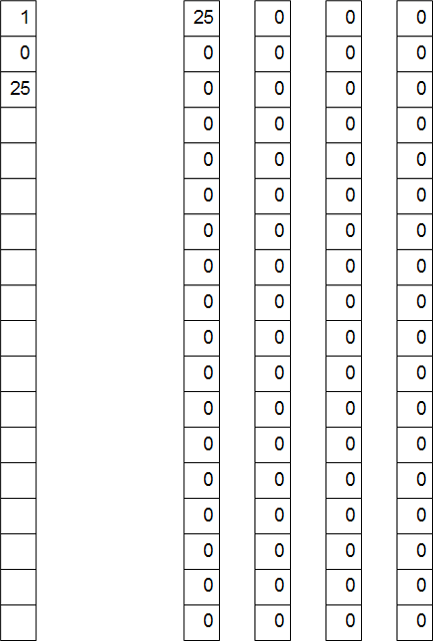
After Transaction 1
We need the new values to be in stable storage before commit
After an update of position 1, log block describing this update needs to be written out to the database before commit can be done and reported to the user
If transactions come frequently, we can wait until log block is full

Slide 102
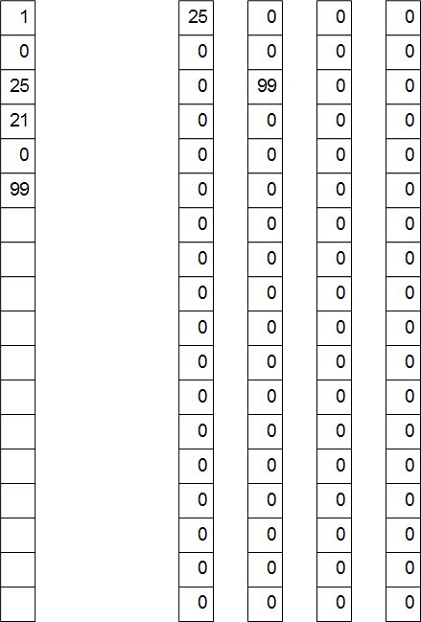
After Transaction 2
We need the new values to be in stable storage before commit
After an update of position 21, log block describing this update needs to be written out to the database before commit can be done and reported to the user
If transactions come frequently, we can wait until log block is full

Slide 103
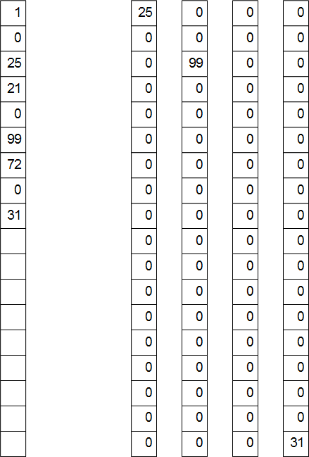
After Transaction 3
We need the new values to be in stable storage before commit
After an update of position 72, log block describing this update needs to be written out to the database before commit can be done and reported to the user
If transactions come frequently, we can wait until log block is full

Slide 104
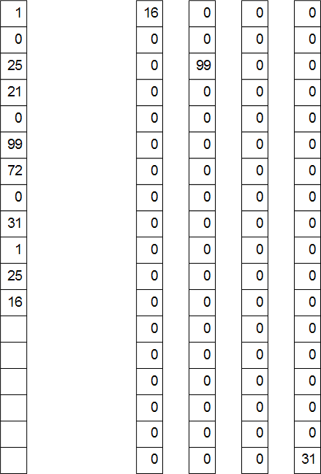
After Transaction 4
We need the new values to be in stable storage before commit
After an update of position 1, log block describing this update needs to be written out to the database before commit can be done and reported to the user
If transactions come frequently, we can wait until log block is full

Slide 105
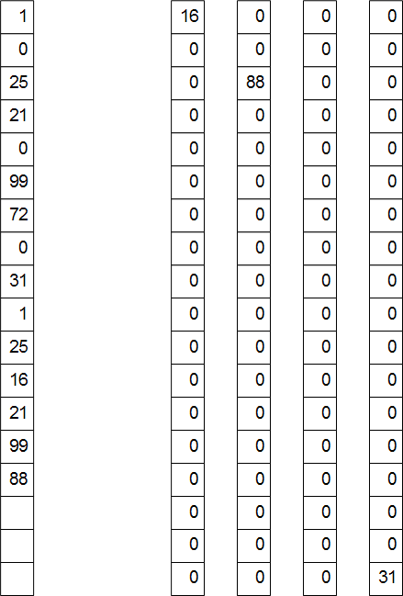
After Transaction 5
We need the new values to be in stable storage before commit
After an update of position 21, log block describing this update needs to be written out to the database before commit can be done and reported to the user
If transactions come frequently, we can wait until log block is full

Slide 106
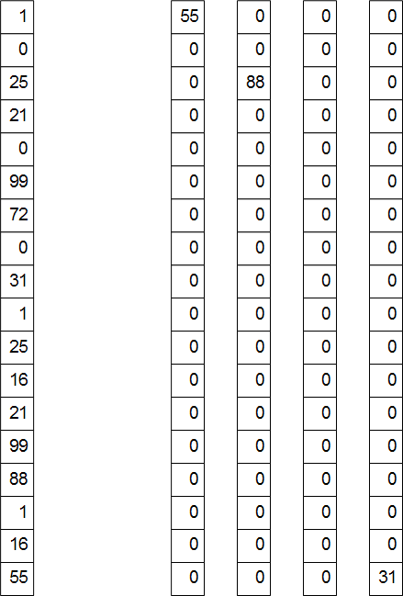
After Transaction 6
We need the new values to be in stable storage before commit
After an update of position 1, log block describing this update needs to be written out to the database before commit can be done and reported to the user
If transactions come frequently, we can wait until log block is full

Slide 107
Committing The Transactions
The block of the log is written out, committing the transactions
Nothing is done to the four blocks of the database residing in RAM (at least for a while)

Slide 108
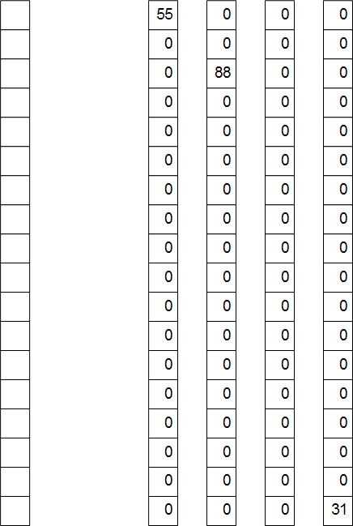
New State Of Memory Pool
Ready for new transactions

Slide 109
Conclusion
Running with recovery resulted in significant reduction of block writes
In addition, of course, to supporting recovery well

Slide 110
Key Ideas
ACID properties
Need for recovery
History (schedule)
Recoverable histories
Cascading aborts
Strict histories
Write ahead log
Algorithm for recovery
Checkpointing
SQL support

