Slide 1

VERTECO
SmartJob
Job card management
for field service
Solution design and implementation
Group 20 (TEAM VANTAGE):
Moegammad Alexander ST10453511 Group 2 (Group Leader/Project Manager and Data Lead)
Caleb Forbes ST10438433 Group 1 (Web Front End Lead)
Alexandro Ornelas ST10437348 Group 1 (Backend Core Lead)
Erin Sarjoo ST10450571 Group 2 (Mobile Lead)
Keeran Perumal ST10367702 Group 3 (Security and Identity Lead)
Isaac Phiri ST10074970 Group 3 (DevOps, Hosting and API Platform Lead)
Notes:
SmartJob brings job creation, site work, review and historical records into one coherent solution. The presentation combines application screens with the full solution specification. The architecture sections explain the documented system design.
Source: Documentation_Group20_VertecoSmartJob (1).pdf, pp. 1, 6–11. Source: supplied implementation plan, Pasted text.txt.

Slide 2
Client context
The job record connects every stage
Verteco’s power, IT and infrastructure work depends on accurate records from customer sites.
1 Capture on site
2 Review in the office
3 Retrieve later
Checklists, equipment serials, photographs, comments and signatures describe the work performed.
Managers need job progress, outstanding issues and a clear basis for approval.
Historical records support maintenance, customer queries and warranty investigations.
2
Notes:
Explain why the record has value beyond the visit itself. Equipment evidence and the history of work help the team answer later maintenance and warranty questions. SmartJob has its own job-card records; the scope does not assume a direct integration with SafetyCulture.
Source: Documentation_Group20_VertecoSmartJob (1).pdf, Introduction and FR-50–60, FR-76–77, pp. 6–11.

Slide 3
Workflow
One job, clear responsibilities
Managers coordinate and approve
Technicians record the work
The site representative signs off
Manager
Technician
Technician + site
Manager
Manager
Create and assign
Carry out work
Submit record
Review and decide
Find the history
→
→
→
→
Customer, site, template and technician
Checklist, equipment, comments and evidence
Required fields, signatures and revision
Approve or return with a reason
Job number, customer, site or serial
3
Notes:
Walk through the responsibility changes rather than each screen. The manager creates the assignment; the technician performs and records the work; the manager makes the final approval decision. Returned work follows the same record through a correction and resubmission.
Source: Documentation_Group20_VertecoSmartJob (1).pdf, functional requirements and roles, pp. 7–14. Source: supplied implementation plan, Pasted text.txt., lifecycle and role decisions.

Slide 4
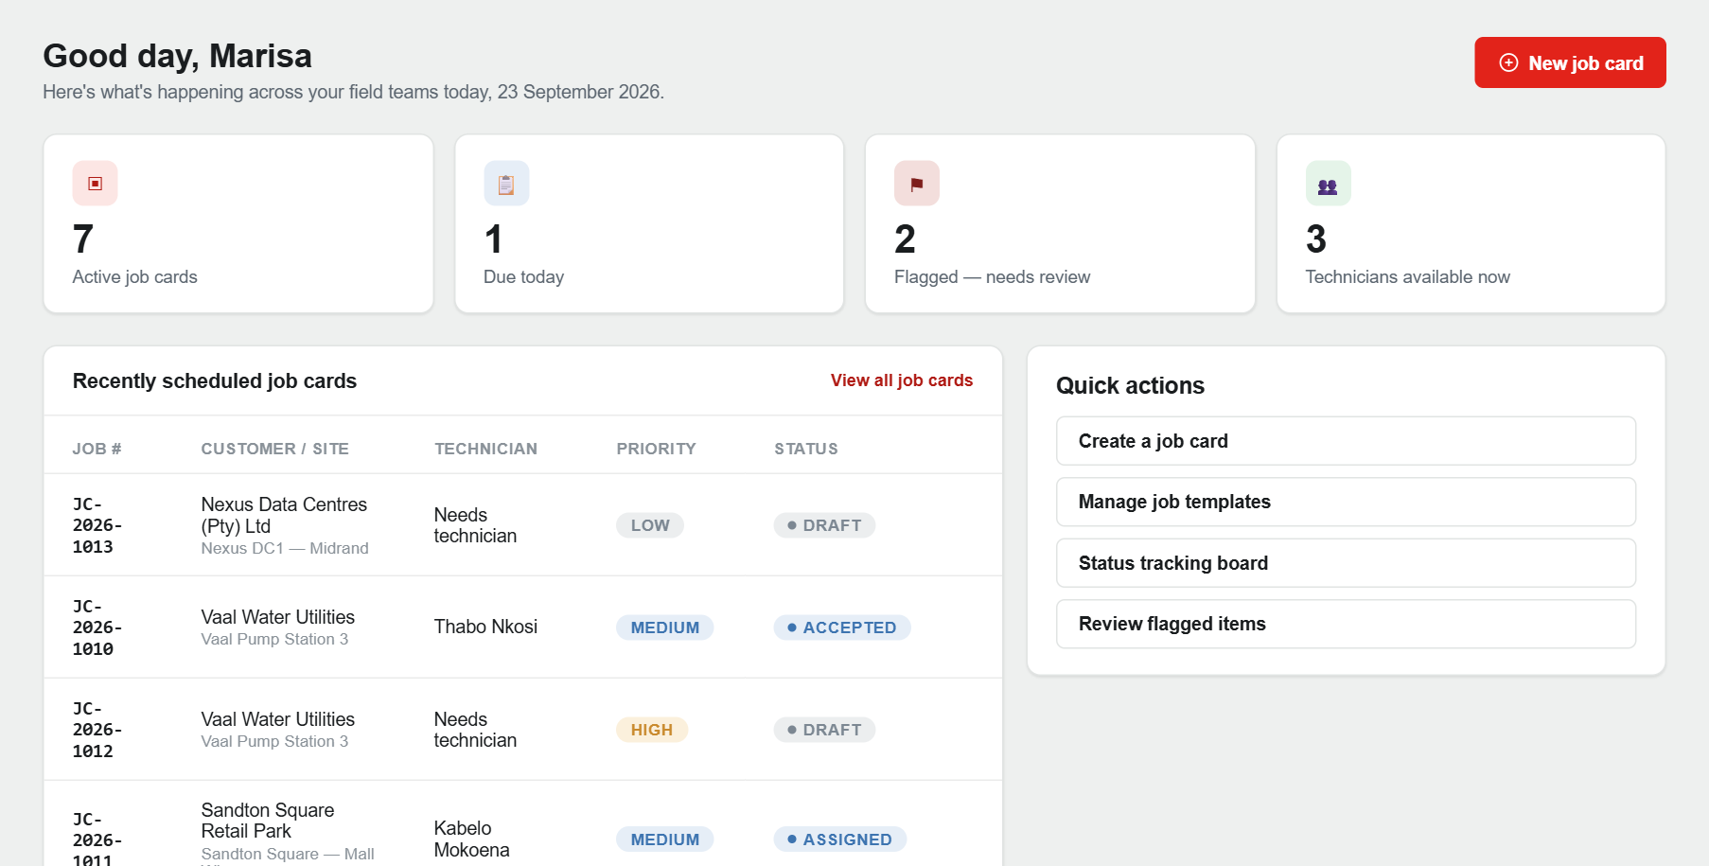
Manager workspace
A clear view of field activity
The dashboard brings job counts, recent assignments and frequent actions together.
Prioritise work
See active jobs, due work and open flags.
Navigate quickly
Open the job list, create a card or inspect the status board.
Use consistent cues
Verteco red highlights actions; named statuses explain progress.
4
Notes:
Use the real dashboard capture to point out the difference between a summary and an individual record. Counts are calculated from the API, and each row links to a job card. The screenshot uses seeded South African customer and technician records.
Source: application capture, 23 September 2026; DashboardController and Dashboard/Index.cshtml; site.css.

Slide 5
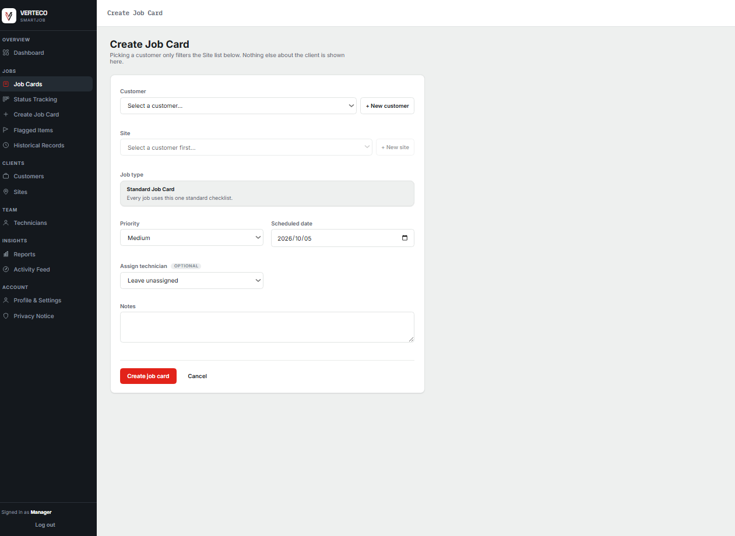
Job setup
Create a complete assignment
The job card links the customer, site, work template, priority, date and technician.
Customer and site
A selected customer determines the available sites.
Work definition
The selected template supplies the checklist for the job type.
Ownership and instructions
Priority, schedule and job notes give the technician the context to begin.
5
Notes:
The captured form has been filled without submitting it. Explain how the linked fields prevent a disconnected record: the job belongs to a customer and site, has a job template, and may be assigned when it is created. Template publishing and versioning are part of the wider solution specification.
Source: application capture, 23 September 2026; JobCards/Create.cshtml; documentation FR-8–25; supplied implementation plan, Persons 1 and 4.

Slide 6
Mobile interaction design
Capture the work where it happens
The .NET MAUI application organises the core technician tasks around assigned jobs.
1 Open the job
2 Complete the record
3 Attach evidence
4 Sign and submit
Assigned work, site details and equipment context
Checklist responses, serial numbers, notes and flags
Before-work, installation and serial-number images
Technician and site sign-off, completeness check and review
MVVM separates the screen state, user actions and API communication.
6
Notes:
Describe the mobile flow as a focused on-site experience. It uses shared API contracts and MVVM view models. The complete field workflow is specified to include equipment entry, evidence, signatures and synchronisation. The supplied application includes job actions, checklists, flags, and local photo and signature capture.
Source: supplied implementation plan, Pasted text.txt., Person 5. Source: Mobile README, Views and ViewModels; documentation FR-26–42.

Slide 7
Evidence handling design
Photos and signatures belong to the job
The upload route passes through the API before evidence enters private storage.
Capture
Send to API
Validate
Store privately
→
→
→
Photo, document
or signature
Authenticated
job reference
Type, signature
and size checks
Blob object +
job/revision link
File controls
Sign-off record
JPEG, PNG and PDF allow-list
Magic-byte checks
Size limits
Generated storage names.
Keep technician and site signatures, their timestamps and the submitted job revision together.
7
Notes:
This diagram explains the evidence design. Files travel through the API, so validation and authorisation happen before storage. A file is linked to the correct record and revision. Private storage prevents a public blob URL from becoming an uncontrolled way to view client information.
Source: supplied implementation plan, Pasted text.txt., week-1 file-upload decision and Persons 2, 3 and 5; Source: Documentation_Group20_VertecoSmartJob (1).pdf, pp. 9, 42, 64–67.

Slide 8
Business logic
A controlled job-card lifecycle
Every status change follows a domain rule, with approval tied to the submitted content.
Draft
→
Assigned
→
Accepted
→
In Progress
→
Awaiting
Approval
→
Completed
Exception paths
Reopened → In Progress
Cancelled
A manager must supply a reason for rework.
Cancellation is blocked once a job is completed.
8
Notes:
The implemented domain model owns these transitions. Incomplete checklists prevent submission, a reopen needs a reason, and a changed submission cannot be approved silently. Invalid transitions return 409; incomplete checklist and missing reason errors return 422. The hash covers checklist state and notes in the supplied implementation.
Source: Domain/Entities/JobCard.cs; Api/Middleware/GlobalExceptionHandler.cs; JobCardLifecycleTests.cs.

Slide 9
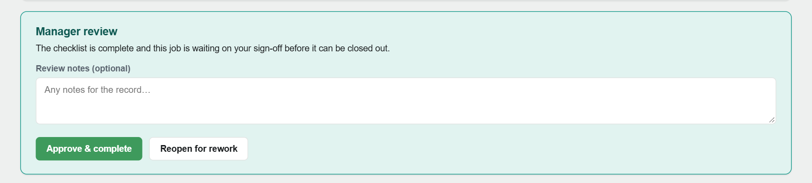
Manager review
Review, approve or return for correction
A single record brings the status, review decision and checklist context together.
Approve and complete
The submitted record moves to Completed after the manager’s decision.
Reopen for rework
A reason explains what must be corrected before resubmission.
Keep issues visible
Flags and corrective actions give exceptions a clear place in the workflow.
9
Notes:
The captured record is awaiting manager approval. Point to the two actions, then explain that the server enforces the state rules. Automated review cues help the manager inspect the record; the manager still makes the approval decision.
Source: application capture of JC-2026-1004, 23 September 2026; JobCards/Details.cshtml; JobCard.cs.

Slide 10
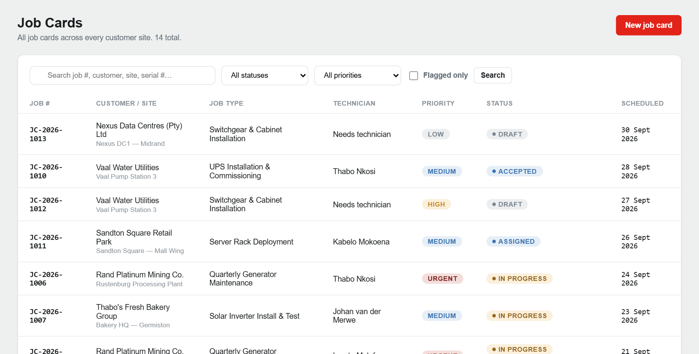
Records and reporting
Searchable history supports warranty work
Job cards remain useful after completion, especially when equipment must be traced by serial number.
Find the record
Search by job number, customer, site, technician or equipment serial.
Control large lists
Filter by status and priority, sort results and page through records.
Reporting specification
Completed-job PDF, warranty PDF and CSV/Excel exports.
10
Notes:
Use the job list to explain how historical lookup supports real business questions. Serial-number search connects equipment to past work. The full reporting specification includes completed-job and warranty PDFs plus tabular exports; the screenshot illustrates the searchable records interface.
Source: Documentation_Group20_VertecoSmartJob (1).pdf, FR-50–60, pp. 10–11; Source: supplied implementation plan, Pasted text.txt., Person 1 reports and search; source: application capture and JobCardRepository.

Slide 11
Engineering
A shared API with clear responsibilities
The two clients share contracts while business rules remain in the domain layer.
Clients
REST API
Application
Domain
ASP.NET MVC
.NET MAUI
→
DTOs, validation
and error handling
→
Use-case services
and repository ports
→
Entities and
lifecycle guards
Infrastructure adapters
Why this structure
EF Core repositories, database migrations, AI review and storage services implement the application boundaries.
Shared contracts reduce drift; isolated rules are easier to test.
11
Notes:
Explain the separation of responsibilities without reading every project name. MVC and MAUI use the API and shared DTOs. Application services coordinate use cases, while the domain defines allowed business behaviour. Infrastructure implements storage and external-service boundaries. This lets an AI provider or database provider change without moving business rules into the client.
Source: repository solution structure, project references and README; documentation architecture and design patterns, pp. 56–59.

Slide 12
Logical data model
Keep the job, its revision and its evidence linked
The full schema separates customer context, assignment, template versions and submitted content.
Customer
Site
JobCard
Integrity controls
→
→
One customer, many sites
Location and equipment
Assignment and status
Foreign keys
Unique job numbers
Indexed serial numbers
Soft deletion
Revision-based review
↓
Template version
Job revision
Evidence
→
→
Published questions
Captured responses
Images and sign-off
12
Notes:
The diagram is a logical summary, not a replacement for the full ERD. Customer and site records establish context. Job cards identify the assignment and lifecycle. Versioned templates and revisions preserve the meaning of captured responses, while evidence and signatures remain linked to the relevant submitted record. Indefinite retention makes controlled deletion and indexed historical search important.
Source: Documentation_Group20_VertecoSmartJob (1).pdf, data model, normalisation and ERD, pp. 35–48; Source: supplied implementation plan, Pasted text.txt., Persons 1 and 2.

Slide 13
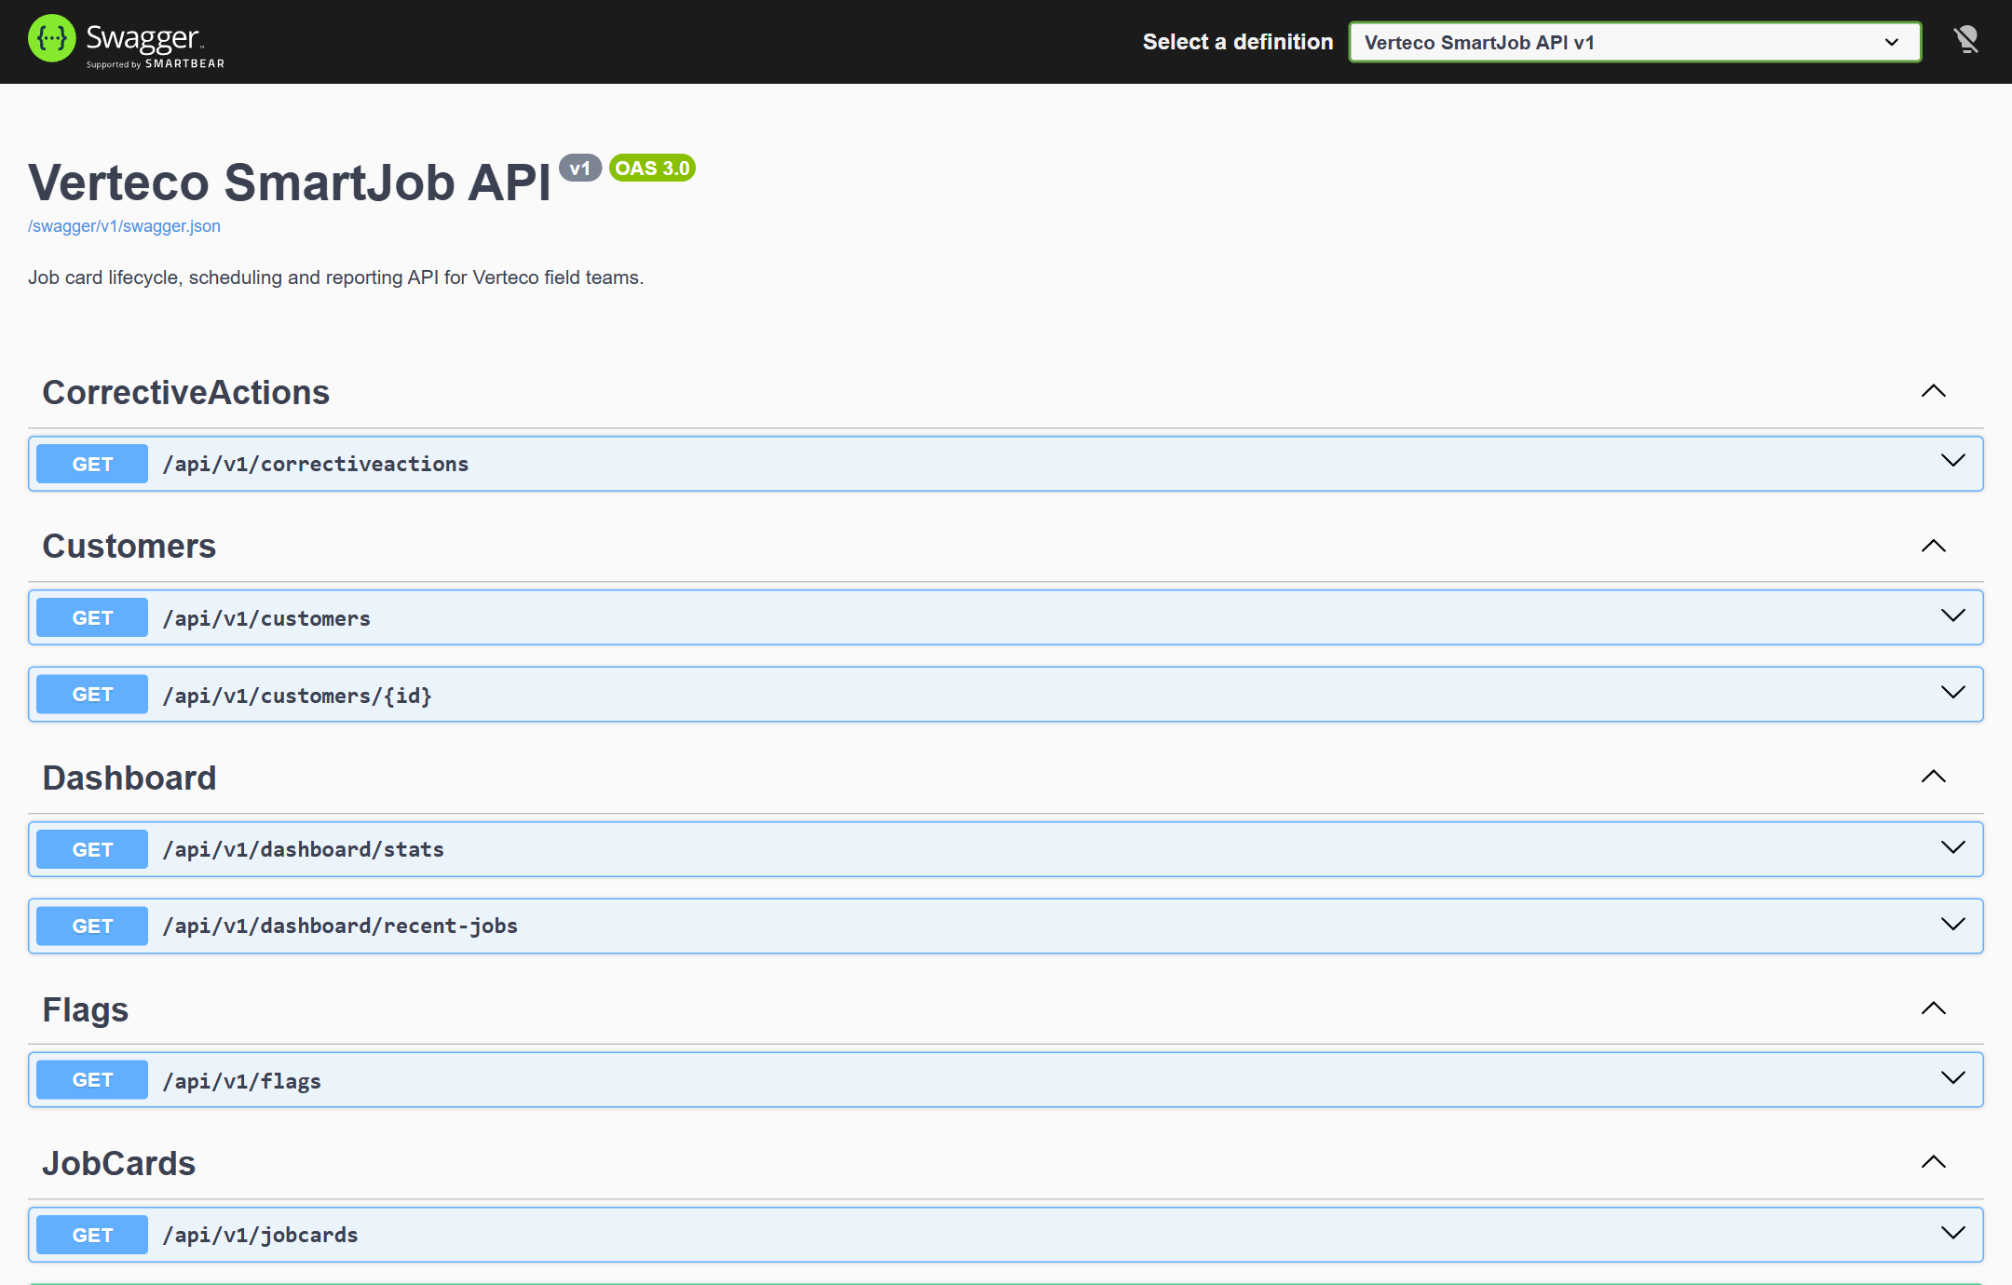
API Contract
Consistent requests and predictable errors
The REST interface is versioned under /api/v1 and documented with OpenAPI.
Resource queries
page · pageSize · sort · q
Filters narrow the result set; DTOs define the JSON returned to each client.
Business commands
assign / accept / start
submit / complete / reopen
409: state conflict 422: business rule violation
13
Notes:
Show the API as the contract between the user interfaces and the business layer. Resource queries return paged data; actions correspond to domain transitions. FluentValidation and the global exception handler give callers useful validation or conflict responses. Unexpected errors are returned generically instead of exposing server stack traces.
Source: running Swagger UI capture; JobCardsController; JobCardValidators; GlobalExceptionHandler; repository README.

Slide 14
Ai review design
Assist the manager without taking the decision
The review contract returns a summary, missing items and warnings for the submitted revision.
Text only
Review adapter
Structured result
→
→
→
Manager decision
Checklist and notes
Remove identifying data
IAiReviewService
provider boundary
Summary, missing
items and warnings
Inspect the record
Approve or reopen
Privacy boundary
Failure handling
Exclude names, addresses, signatures and photographs from the provider request.
Use a rule-based fallback on timeout or rate limit; cache results by revision.
14
Notes:
Describe the purpose before the technology: the review helper reduces the effort of spotting missing information. The manager remains responsible for the result. The shipped adapter runs deterministic rules. The wider design places an external provider behind the same interface, restricts data sent to it and defines a fallback path.
Source: Documentation_Group20_VertecoSmartJob (1).pdf, FR-71–75 and AI review sections; Source: supplied implementation plan, Pasted text.txt., Person 2; source: IAiReviewService and RuleBasedAiReviewService.

Slide 15
Offline synchronisation design
Keep field work safe through disconnection
The queue preserves work until the server acknowledges it, with explicit conflict handling.
Cache
Capture
Replay
Reconcile
→
→
→
Assigned jobs and
templates in SQLite
Responses and media
in private device storage
Ordered operations
with idempotency keys
Compare RowVersion;
confirm or flag conflict
Dependency order
Conflict path
Responses → evidence → submission
409 → Needs Review
16
Notes:
Explain why simply showing an offline banner is insufficient. The specified queue stores each operation, its idempotency key and the base revision. It replays dependencies in order, keeps photos until acknowledged, and brings conflicting work to a person for review rather than overwriting silently.
Source: supplied implementation plan, Pasted text.txt., Persons 1 and 5; Source: Documentation_Group20_VertecoSmartJob (1).pdf, offline requirements and sequence, pp. 28–29, 54.

Slide 16
Security architecture
Identity, access and audit controls
Access checks belong in the API, including ownership checks for a technician’s assigned jobs.
Boundary | Control in the security design | Purpose
Manager web | HttpOnly / SameSite session API token on server | Protect the browser session
Technician mobile | Short-lived JWT Rotating refresh tokens SecureStorage | Limit and revoke access
API and evidence | Role + resource checks Rate limits File validation | Enforce allowed actions
Audit and privacy | Append-only who / what / when Retention notice | Trace changes and explain retention
15
Notes:
Walk through the four boundaries. Browser and mobile sessions have different token handling, but both rely on the same API permissions. Technician ownership checks are as important as the role itself. File validation occurs before private storage. An append-only audit and a clear privacy notice support traceability and retention requirements. These are the specified security controls.
Source: supplied implementation plan, Pasted text.txt., Person 3; Source: Documentation_Group20_VertecoSmartJob (1).pdf, security and privacy, pp. 31–33, 64–67.

Slide 17
Azure deployment architecture
Separate application, records and evidence
Azure is the client’s preferred cloud platform; the deployment design keeps each responsibility clear.
Azure SQL
Users
App Service
→
Cost constraint
→
Structured job records
Manager browser
Technician application
Web application + API
HTTPS entry points
R1,500–R2,000
Client budget per month
Cost must account for retained data and evidence.
↓
Private Blob
Storage
→
Photographs and files
Operations
Logs, health checks
backup and rollback
17
Notes:
Discuss the hosting decisions as a topology. App Service hosts application processes, SQL stores structured records and private Blob storage holds larger evidence files. Configuration and secrets belong outside source control. Logs, health checks, backups and a documented rollback support operations. The budget is the client’s stated constraint, not a measured Azure bill or a pricing quote.
Source: Documentation_Group20_VertecoSmartJob (1).pdf, deployment and Azure architecture, pp. 59–63; Source: supplied implementation plan, Pasted text.txt., Person 6 and hosting decision.

Slide 18
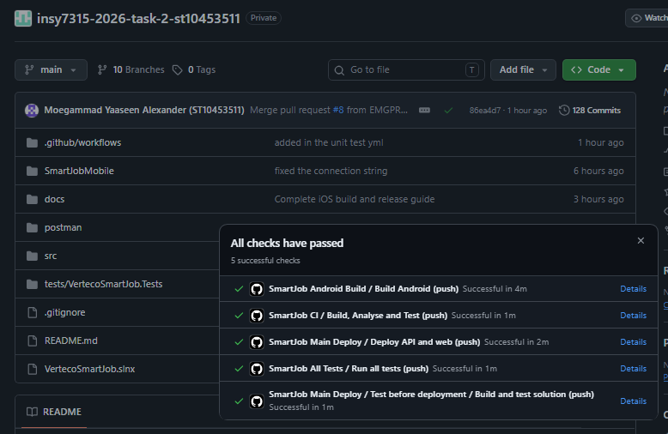
CI/CD workflow design
Review code, validate changes and then release
Branch protection and repeatable checks connect team contributions to controlled deployments.
Pull request
Checks
Build and test
Merge main
Deploy
Verify
Peer review
→
Format, lint,
secrets, dependencies
→
Unit and
integration tests
→
Protected
release branch
→
Web/API +
safe migrations
→
Health and
smoke checks
Mobile release
Build and sign the Android artifact, then publish a durable GitHub Release.
18
Notes:
The pipeline design starts with a reviewed change and finishes with a health check. Package restore, formatting, builds, automated tests and dependency/secret checks run before release. Main drives application deployment and the Android release artifact. Safe migrations and rollback must be handled explicitly. The diagram describes the required delivery workflow.
Source: supplied implementation plan, Pasted text.txt., Person 6; Source: Documentation_Group20_VertecoSmartJob (1).pdf, DevOps, p. 68; rubric 9.4.4.

Slide 19
Quality and verification
Connect requirements to checks
Evidence should show both the business behaviour and the operating conditions expected by Verteco.
Acceptance checks from the specification
52
Area | Acceptance check
Workflow | Valid transitions Required fields Reopen reason Sealed review
Security | Login/reset, lockout, token refresh, 401/403 and ownership
Offline and evidence | Replay order, duplicate requests, conflicts and upload validation
Usability and hosting | Keyboard access Responsive screens; ~3 s requests 99% availability
unit tests passed
Lifecycle and rule-based review
5 October 2026
19
Notes:
The supplied test run passed 14 unit tests covering lifecycle and rule-based review. The matrix gives the broader acceptance checks defined by the plan. It should not be read as a statement that security, synchronisation, accessibility or hosted uptime tests have passed. Tie each area to specific evidence when discussing the implementation.
Source: dotnet test result captured 22 September 2026: 14 passed, 0 failed. Supplied implementation plan, QA and testing responsibilities; documentation NFR-01–04, pp. 28–34.

Slide 20
VERTECO SMARTJOB
One record from assignment to history
The solution brings the work performed, the review decision and the long-term record together.
For technicians
For managers
For Verteco
Clear assignments and a focused path through site capture.
Progress, exceptions and a defined approval process.
Consistent records that support maintenance and warranty lookup.
20
Notes:
Close with the operational value of a consistent job record. Invite questions about the workflow, the information required at each stage, and the security and rollout controls. Group 20: Moegammad Alexander, Caleb Forbes, Alexandro Ornelas, Erin Sarjoo, Keeran Perumal and Isaac Phiri.
Source: Documentation_Group20_VertecoSmartJob (1).pdf, introduction, requirements and cover; supplied implementation plan.

