Slide 1
WikiMood A tool to find Wikipedia articles
Caleb Frye

Slide 2
Overview of the WikiMood Tool
Consists of:
A backend API which fetches articles, performs document processing, and scores documents based on BM25 and mood score
A frontend UI where the user can input a search query and mood, and see articles which match the query and mood
Motivation:
I like browsing random Wikipedia articles when I’m bored
I looked online but surprisingly didn’t find any website like this
I also wanted to add something that made it more advanced than just a simple BM25 search, so I added the mood score

Slide 3
System Flow
Store information about processed articles in the corpus as JSON files
User submits a query and mood in the UI
Fetch and preprocess random Wikipedia articles using the MediaWiki API
Backend API returns the highest ranked documents according to (BM25 score) * (mood score)
UI displays the returned results, and can sort results by overall score, raw BM25 score, or raw mood score
Backend API calculates the BM25 and mood score for each document

Slide 4
Algorithm Choice: BM25
Does a decent job of scoring documents while allowing for fast performance and efficient document storage (with the preprocessing that I’ve done)
See the file ‘bm25.py’ for the functions I use to calculate the BM25 score
But how to combine it with a mood score?

Slide 5
Combining BM25 and Mood Score
First, I defined lists of mood words for each mood in ‘constants.py’
When fetching articles, the system checks each term to see if it is in one of the mood word lists
If so, it adds +1 to that article’s ‘[mood]_frequency’ value
A document’s mood multiplier is then:
([mood]_frequency) ÷ (number of mood words in [mood])
Overall score = (BM25 score) × (mood multiplier)

Slide 6
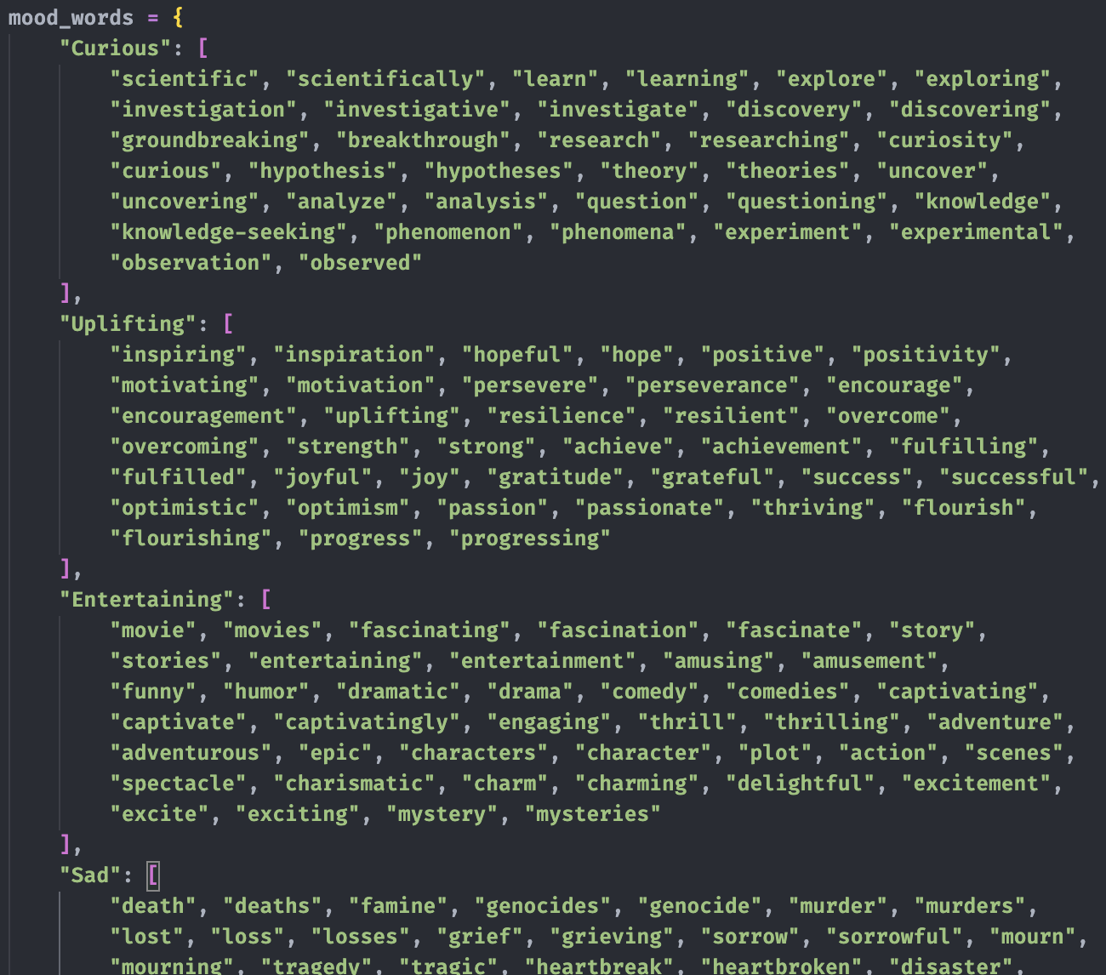
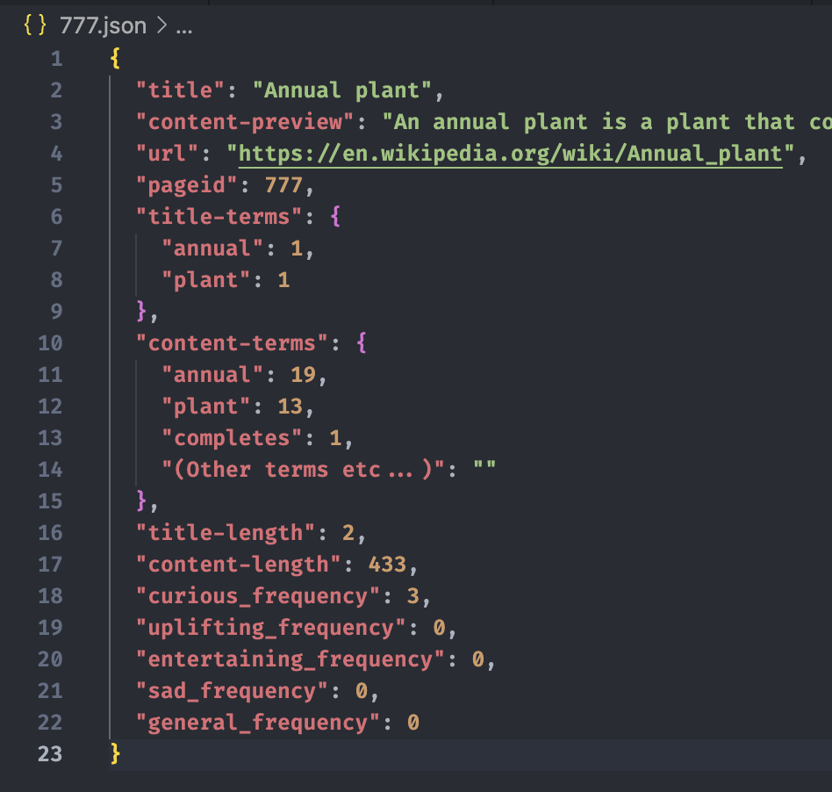
Combining BM25 and Mood Score cont.
Example of mood words:
Mood term frequency information in the JSON:

Slide 7
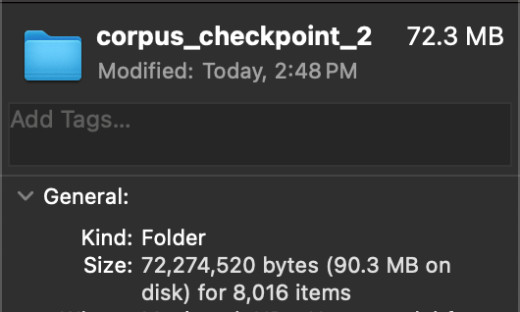
The Corpus
Example document JSON file:
The system stores document information as JSON after stripping out stopwords
This allows for very efficient document storage and fast search performance
At the time of making this, the corpus is 8,000 documents and takes up only 90MB:
Term frequencies

Slide 8
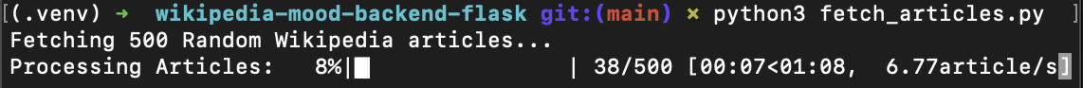
Adding Documents to the Corpus
I wrote a python script which automatically fetches, preprocesses, and adds new articles to the corpus
Parameters are configurable in ‘constants.py’ and explained in the README on Github
Simply use the script as seen below:

Slide 9
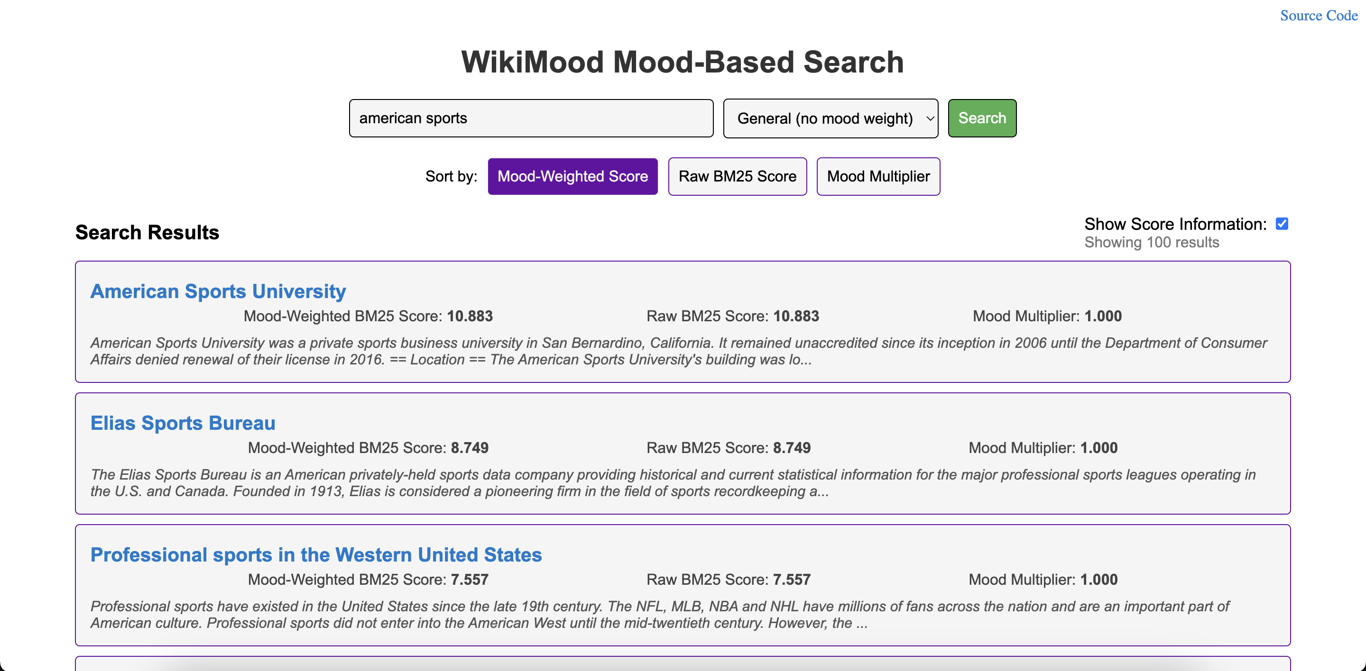
Using the UI
Option to select mood
Search query
Results:

Slide 10
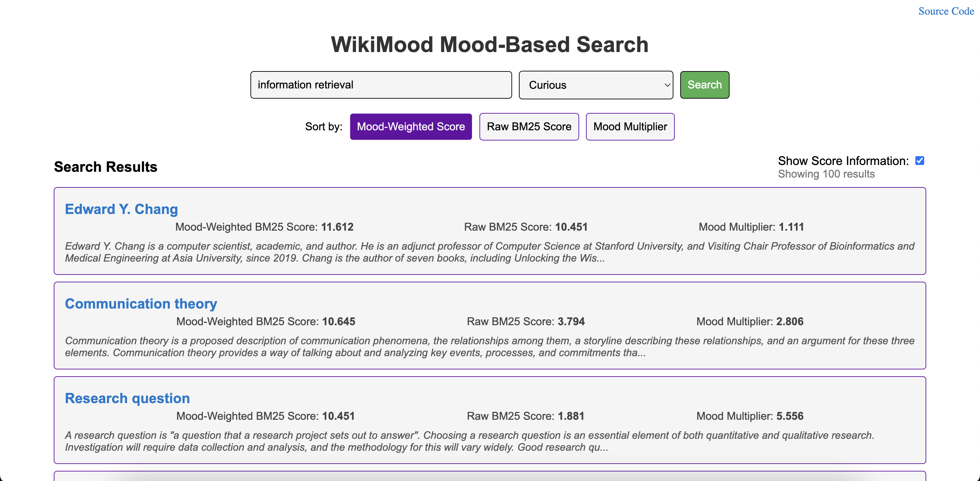
Using the UI cont.
BM25 score is then weighted using the mood multiplier
When a mood is selected, the articles have mood multipliers

Slide 11
Evaluation
The BM25 algorithm returns relevant articles decently well, but…
Since I don’t take term positions into account the results can be slightly unrelated
For example, searching “tennis player” with any mood other than ‘general’ returns a lot of articles about video games, since the word “player” appears in them frequently, and the articles that are actually about tennis players don’t have high mood scores
However, I think this is ok! The goal of the system is to help you find articles to read, so if it exposes you to more topics, you’re more likely to find something interesting to read
That said, if I made the system again I would definitely take term positions into account

Slide 12
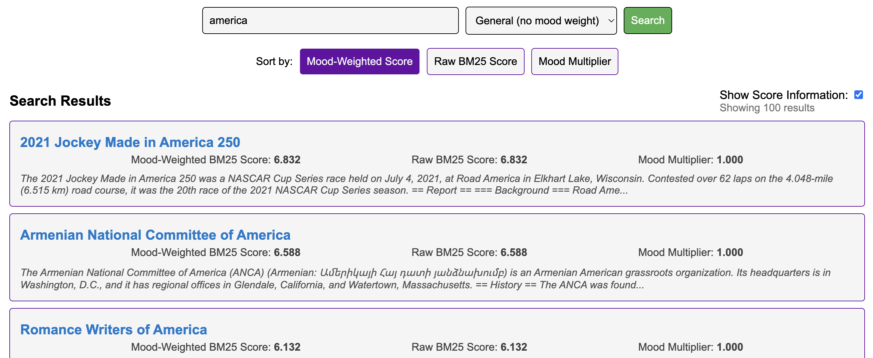
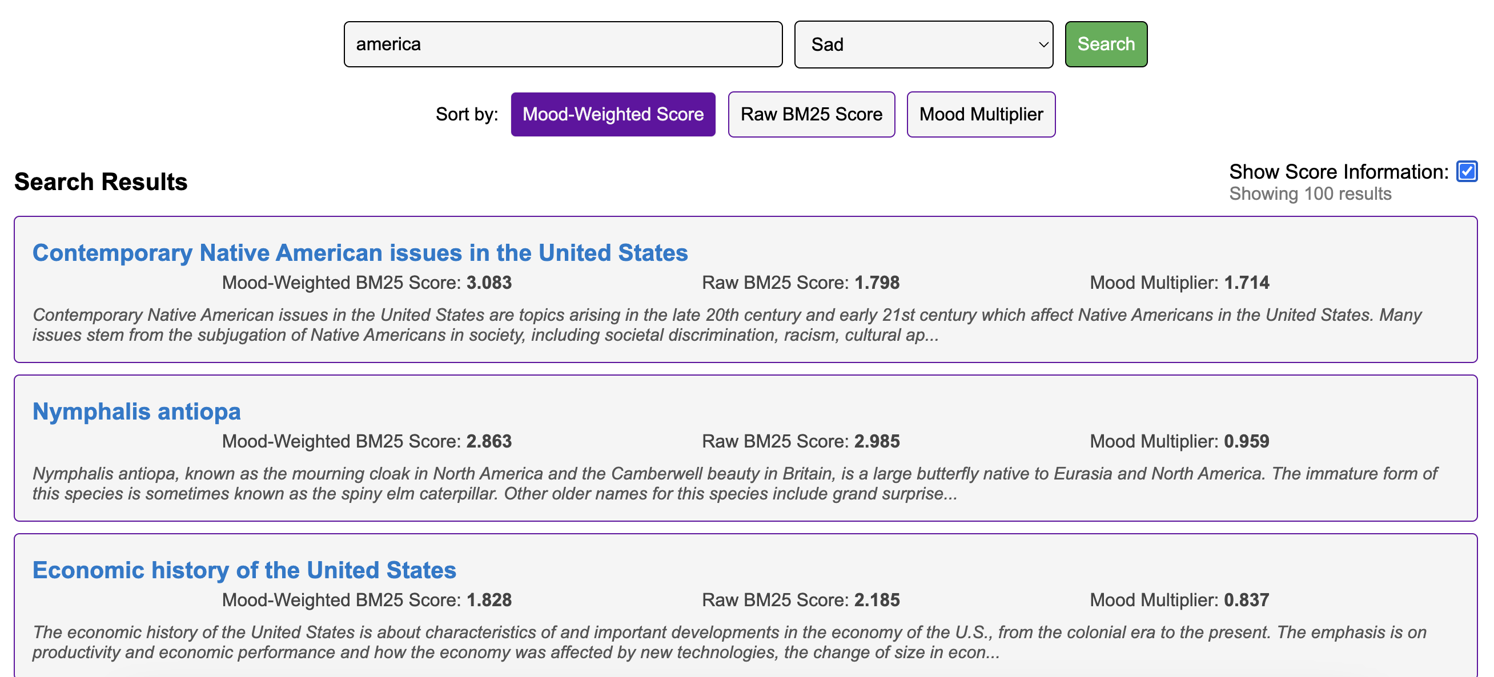
Evaluation cont.
The mood multiplier does affect which documents are ranked higher, especially noticeable for the ‘sad’ and ‘entertaining’ moods
For example, see the top result for searching ‘America’ with no mood vs. ‘sad’ mood:
It’s not perfect, but the mood does make a difference

Slide 13
Conclusion
Even though it’s not perfect, the system does return interesting Wikipedia articles based on your query and mood selection
The considerations I made in document preprocessing allow for fast searches and efficient document storage
I know the tool works, because there were many times while I was working on it that I got distracted and started reading the articles returned by the tool

Slide 14
Thank you!

