Slide 1
Deep Learning in Spatial Transcriptomics Intro to Neural Networks
Caleb Hallinan
09/08/2025
10x Xenium Breast Cancer Data

Slide 2
Announcements
No class next week ☹
I will send an announcement on Canvas as a reminder
The class the following week (9/22) will be on zoom!
I will send zoom link closer to then
Feel free to reach out if you ever have any questions or want to meet!
challin1@jh.edu

Slide 3
Class outline
Brief refresher on Spatial Transcriptomics
What is a neural network? Coding in python
2-3 classes
What is a convolutional neural network? Coding in python
1 class
Pytorch crash course
2 classes
Discussion of Spatial Transcriptomics analyses performed. Reading in ST data to python
1 class
Discussion of DL applications to ST data
1 class
Using what we have learned to do this ^
1 class

Slide 4
Class goals
Truly understand how a neural network functions
Given a modified neural network (visually or code), you can parse out how it works because you understand the basics
Basic understanding of spatial transcriptomics – what it is and how it works
Finally, how DL can be applied to ST

Slide 5
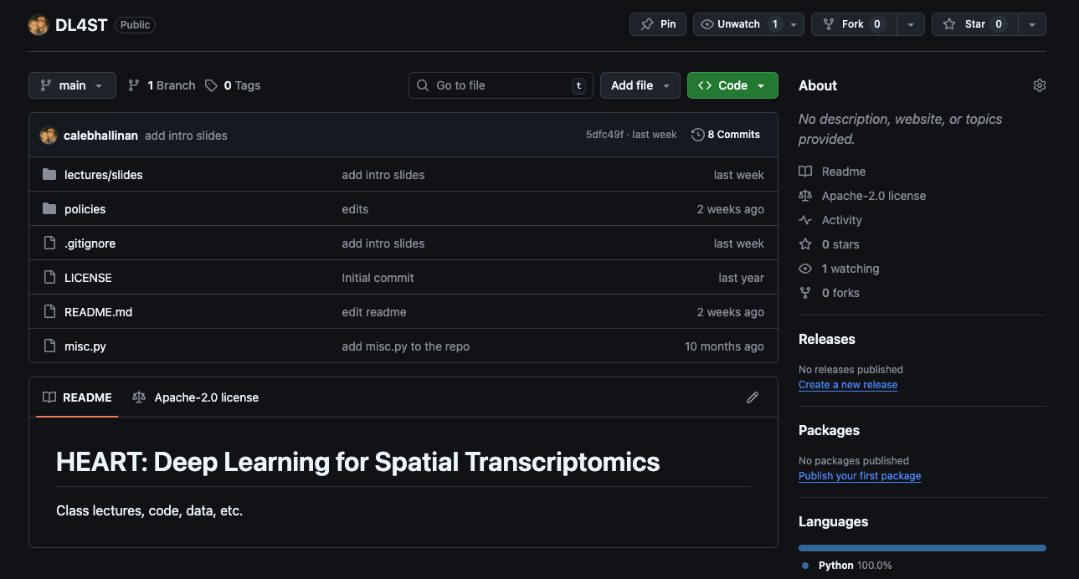
GitHub for class
Now public, recommend connecting to local folder as we will begin using code today

Slide 6
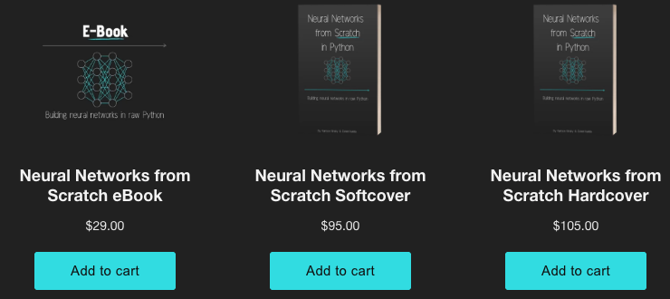
Neural Networks from Scratch in Python
https://nnfs.io/order
https://github.com/Sentdex/nnfs_book/tree/main

Slide 7
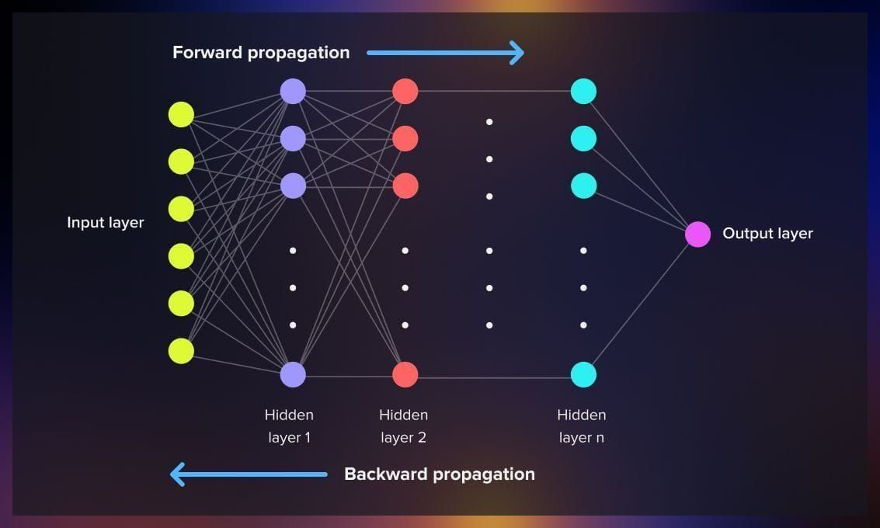
Today’s coding
How do NN do forward propagation?
Next class: How do NN do backward propagation?

Slide 8
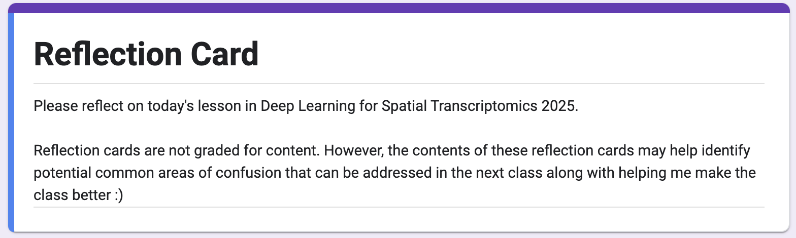
Reflection Cards
Essentially a means to help me make this class better!
What is something that you learned in today's lecture?
What is something that you are still confused about from today's lecture?
Do you have any other comments/feedback/thoughts/suggestions/concerns?
https://forms.gle/QwjjUPFD8YFThhyL9

